Slide 2
Stigma and online sex-seeking among men who have sex with men and transgender women in Tijuana, Mexico: a cross-sectional study
Cristina Espinosa da Silva, Laramie R. Smith, Thomas L. Patterson, Shirley J. Semple,
Alicia Harvey-Vera, Stephanie Nunes, Gudelia Rangel, Heather A. Pines
Funding from National Institute on Drug Abuse grants:
K01DA040543, R01DA037811, T32DA023356, and K01DA039767
Share your thoughts on this presentation with #IAS2019
@cespinosadsilva

Slide 3
Background
~20% HIV prevalence among MSM and TW in Tijuana, 89% unaware of their HIV+ status^{1,2}
Prior HIV testing associated with lower levels of internalized stigma and greater outness³
Due to popularity of online sex-seeking among MSM and TW globally, HIV interventions delivered via online sex-seeking platforms may reach those most affected by stigma towards sexual and gender minorities^{4,5}
Objective
Examine the effect of stigma on online sex-seeking among MSM and TW in Tijuana, Mexico
Methods
MSM and TW recruited via respondent-driven and venue-based sampling (2015-2018)
Participants underwent HIV testing and completed interviewer-administered surveys that collected information on seeking sex partners online in the past 4 months and five factors hypothesized to shape or be influenced by stigma
Logistic regression used to evaluate the effect of each stigma measure on online sex-seeking
¹ Pitpitan et al., J Int AIDS Soc, 2015; ² Salas-Espinoza et al., AIDS Behav, 2017; ³ Pines et al., BMJ Open, 2016; ⁴ Muessig et al., Curr HIV/AIDS Rep, 2015; ⁵ Cao et al., J Med Internet Res, 2017.

Slide 4
Results
29% of sample reported seeking sex partners online in the past 4 months
Associations between factors that shape or are influenced by stigma towards sexual and gender minorities and online sex-seeking
 | AOR^{d} | 95% CI |  | Hypothesis | Findings
Traditional machismoª | 0.37 | 0.19, 0.71
Internalized stigma related to same-sex sexual behavior or gender identity | 0.96 | 0.94, 0.99
Gay-identifying^{b} | 2.04 | 1.30, 3.21
Outness about same-sex sexual behavior or gender identity | 1.17 | 1.06, 1.28
History of discrimination related to same-sex sexual behavior^{c} | 1.85 | 1.10, 3.14
Abbreviations: AOR=adjusted odds ratio; CI=confidence interval. ª Restricted to HIV-negative participants. ^{b} Restricted to MSM participants. ^{c} Restricted to HIV-negative MSM participants. ^{d} Adjusted for recruitment method, gender identity (in models not restricted to MSM), age, education, monthly income, years of residence in Tijuana, and social support.

Slide 5
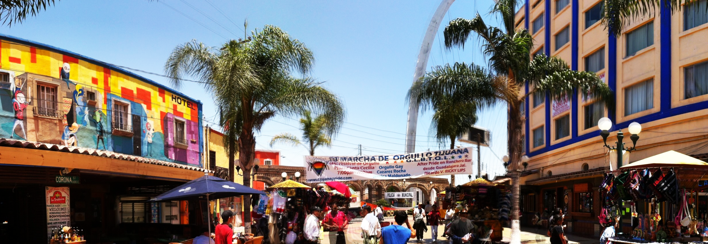
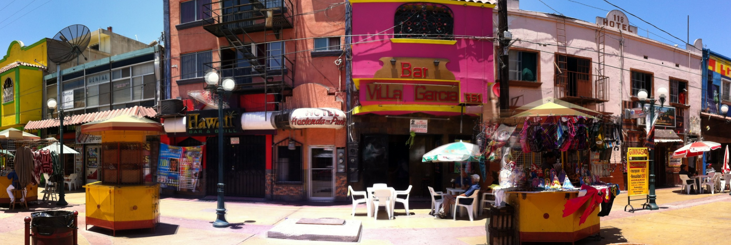
Conclusions
Online sex-seeking is relatively common among MSM and TW in Tijuana
Online sex-seeking platforms may be a feasible way to engage MSM and TW in HIV prevention and care
Contrary to our hypothesis, MSM and TW most affected by stigma were least likely to seek sex online
Research is needed to identify effective and acceptable strategies to engage highly stigmatized MSM and TW in Tijuana in HIV testing, prevention, and care
Future research should monitor changes in use of online sex-seeking platforms among MSM and TW in low- and middle-income countries

