Slide 1
Implementation challenges and strategies in integration of PrEP into maternal and child health and family planning services: Experiences of frontline health care workers in Kenya
Kristin Beima-Sofie, Anjuli Wagner, Jillian Pintye, Felix Abuna, Harrison Lagat, Jared Baeten, John Kinuthia, Grace John-Stewart, Gabrielle O’Malley
@GlobalWACh
Share your thoughts on this presentation with #IAS2019
Notes:
Thank you to the organizers for the opportunity to present on behalf of my co-authors

Slide 2
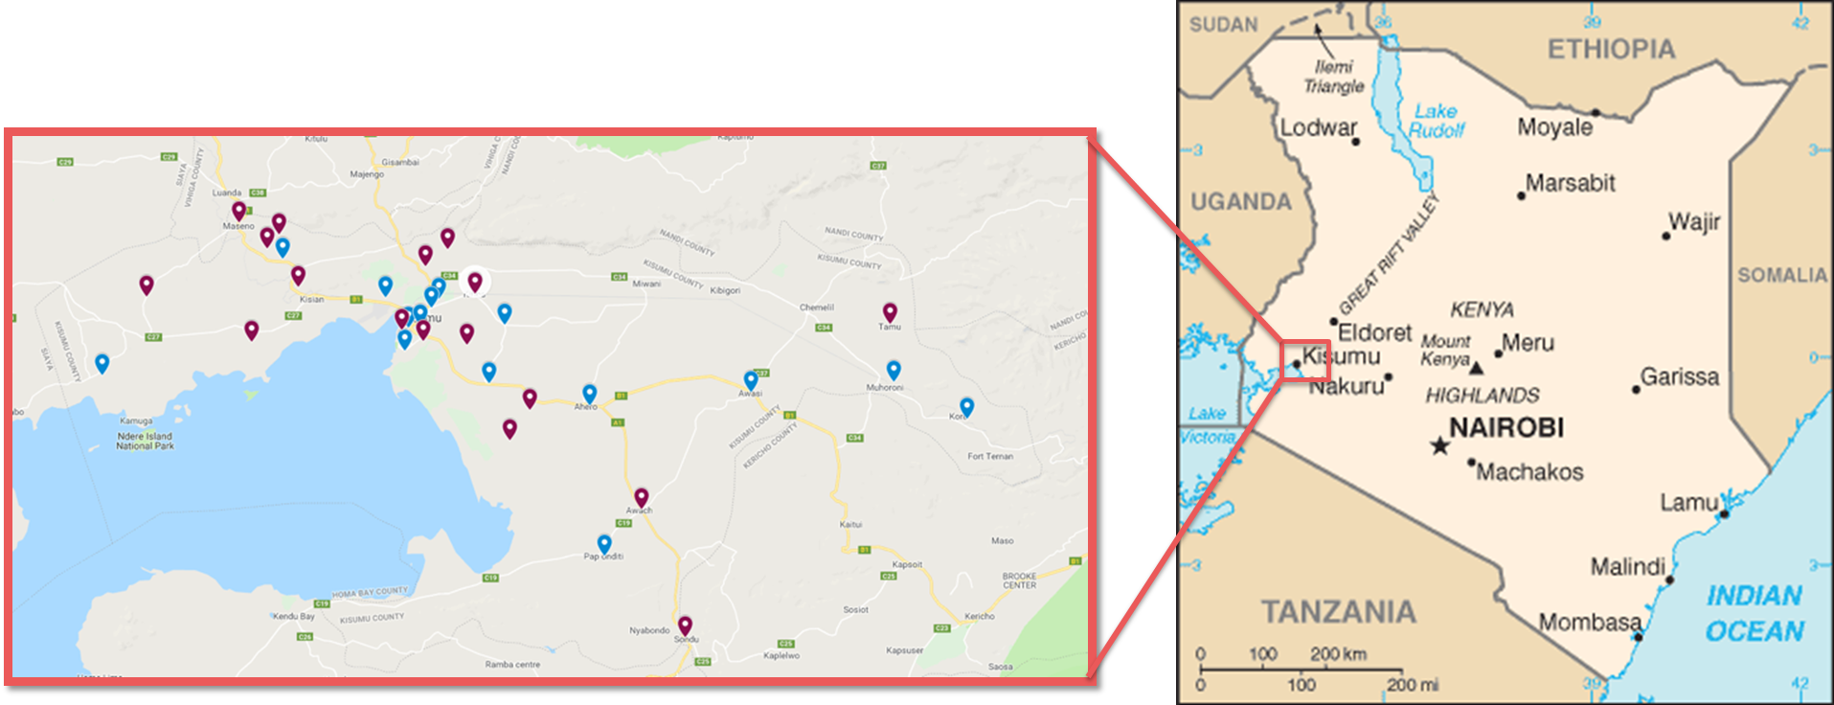
Notes:
The PrEP Implementation for Young Women and Adolescents or “PrIYA” Program aimed to provide real-world evidence on delivering PrEP integrated within routine maternal child health, or MCH, and family planning, or FP clinics in Kisumu, Kenya.
This large-scale program specifically targeted adolescent girls and young women, including pregnant and postpartum women

Slide 3
Study Design
Objective: Identify factors influencing PrEP delivery through MCH and FP clinics
Design: Focus group discussions (FGDs) with healthcare workers (HCWs) offering PrEP through MCH and FP clinics
Notes:
The objective of this study was to identify factors influencing the implementation of PrEP delivery through MCH and FP clinics in order to inform future scale-up
We conducted focus group discussions (FGDs) with healthcare workers (HCWs) offering PrEP as part of the PrIYA Program

Slide 4
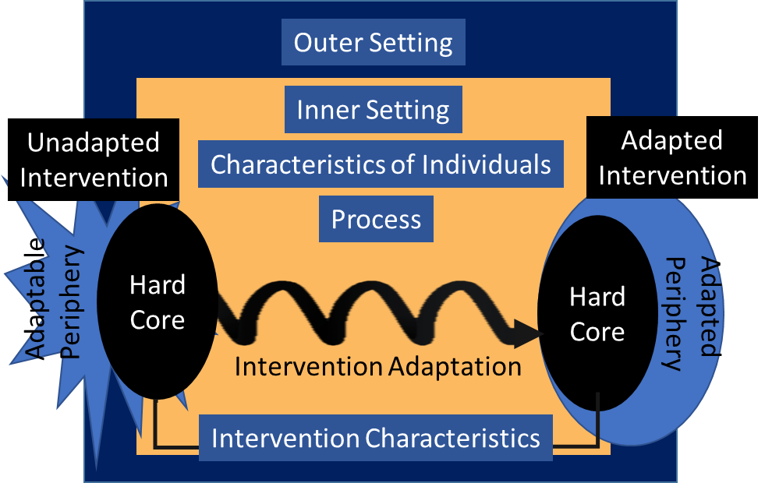
Study Design
CFIR
Data Collection: Semi-structured topic guides based on the Consolidated Framework for Implementation Research (CFIR)
Data Analysis: Directed content analysis to identify CFIR constructs most influential of acceptability, feasibility and sustainability
Figure adapted from Damschroder et al. (2009)
Notes:
Focus groups were conducted using semi-structured topic guides based on the Consolidated framework for implementation research or CFIR
CFIR is a commonly used meta-theoretical framework from the field of implementation science designed to understand why things work or do not work in implementation.
Directed content analysis was used to identify the main CFIR constructs influencing HCW beliefs about acceptability, feasibility, and sustainability of PrEP delivery through MCH and FP clinics

Slide 5
Study Population
50 HCWs from 26 facilities participated in 8 FGDs
HCWs were primarily nurses (64%), clinical officers (16%), and nurse counselors (12%)
Median of 13 months experience providing PrEP (IQR: 10-18)
Notes:
Overall, 50 HCWs from 26 facilities participated in 8 FGDs.
HCWs were primarily nurses, clinical officers, and nurse counselors and reported having a median of 13 months experience providing PrEP

Slide 6
Results
Relative Advantage
Adaptability
Readiness for Implementation
Enabled high coverage
Lowered barriers to access
Notes:
While several CFIR constructs influenced HCW perceptions of the acceptability, feasibility and sustainability, I’m going to highlight constructs that were the most influential
First, HCWs described the construct of relative advantage as positively influencing the acceptability of PrEP delivery. The relative advantage construct captures perceptions of how delivery through MCH or FP clinics is better or worse than delivery through existing programs
In our analysis, HCWs felt PrEP delivery through MCH provided a relative advantage because it enabled high coverage of the adolescent population and lowered PrEP access barriers. Delivery through MCH and FP reduced stigma associated with PrEP uptake when compared to PrEP delivered through HIV care clinics, and facilitated continued use by harmonizing PrEP devliery with routine MCH visit schedules

Slide 7
Results
“What I have seen working best is the fact that PRIYA is incorporating PrEP with other service delivery…..the fact that you are doing [PrEP] with other services makes them want to continue with the drug.”
Notes:
For example, one HCW noted “What I have seen working best is the fact that PRIYA is incorporating PrEP with other service delivery….the fact that you are doing ‘PrEP’ with other services makes them want to continue with the drug“

Slide 8
Results
Relative Advantage
Adaptability
Readiness for Implementation
Increased workload
Logistical barriers
Inaccurate PrEP knowledge
Notes:
A CFIR construct that negatively influenced HCW perceptions of feasibility and early adoption was readiness for implementation, which describes the level of resources dedicated for implementation, including physical space and time
HCWs described early phase implementation challenges that mirror implementation of many new programs, including feeling overburdened by the increased workload and documentation required, logistical barriers including physical space constraints and drug stockouts, and inaccurate PrEP knowledge and lack of PrEP delivery training among HCWs
These initial barriers were overcome through leadership buy-in and HCW engagement, which facilitated improved feasibility and adoption

Slide 9
Results
“The matron helped, and also the nurses, they were very good and they referred clients to us and they are supportive…”
Notes:
For example, one HCW described how “The matron helped, and also the nurses, they were very good and they referred clients to us and they are supportive”

Slide 10
Results
Relative Advantage
Adaptability
Readiness for Implementation
Task shifting
Patient flow modifications
Health talks
Notes:
Finally, the construct of adaptability, which captures the degree to which PrEP delivery can be modified to meet local needs, positively influenced acceptability, feasibility and perceived future sustainability
HCWs found PrEP delivery to be easily adapted within their specific clinic setting and described employing various strategies that optimized delivery, including task shifting from nurses to HIV Testing Service providers, facility-specific patient flow modifications such as fast-tracking PrEP clients to reduce wait times and PrEP demand-generation and myth-busting during group health talks to reduce individual time spent counseling clients

Slide 11
Results
“[W]e, from different facilities, had to find something that would work in wherever we were working, because at the end of the day what will work for this facility might not work for the other, and we had to come up with ways to make PrEP delivery better for the future generation.”
Notes:
For example, one HCW described how “[W]e, from different facilities, had to find something that would work in wherever we were working, because at the end of the day what will work for this facility might not work for the other, and we had to come up with ways to make PrEP delivery better for the future generation.”

Slide 12
Summary and Conclusion
HCWs believed PrEP delivery through MCH and FP clinics was feasible and acceptable
Increased workload and supportive leadership influenced perceptions of sustainability
Notes:
In summary, HCWs believed PrEP delivery through MCH and FP clinics was feasible and acceptable and noted how increased workload and supportive leadership influenced perceptions of scalability and sustainability

Slide 13
Acknowledgements
We gratefully acknowledge PrIYA participants and PrIYA project staff, the Kenyan Ministry of Health, and the Kisumu County Government
Funding provided by: National Institutes of Health (R01HD094630); PrIYA was funded by the United States Department of State as part of the DREAMS Innovation Challenge, managed by JSI Research & Training Institute, Inc.
PrIYA Website:
http://sites.google.com/uw.edu/priya
Notes:
I would like to thank our participants, team members, Ministry of Health collaborators and funders

