Slide 2
Study comparative NASA and budget tracking: Enabling and empowering the local budget and resource allocation in Bandung district
Sis Silvia Dewi
Head of AIDS Secretariat
Bandung District, Indonesia
@sisdewi81
Share your thoughts on this presentation with #IAS2019

Slide 3
HIV in Indonesia
Source : Ministry of Health, 2017

Slide 4
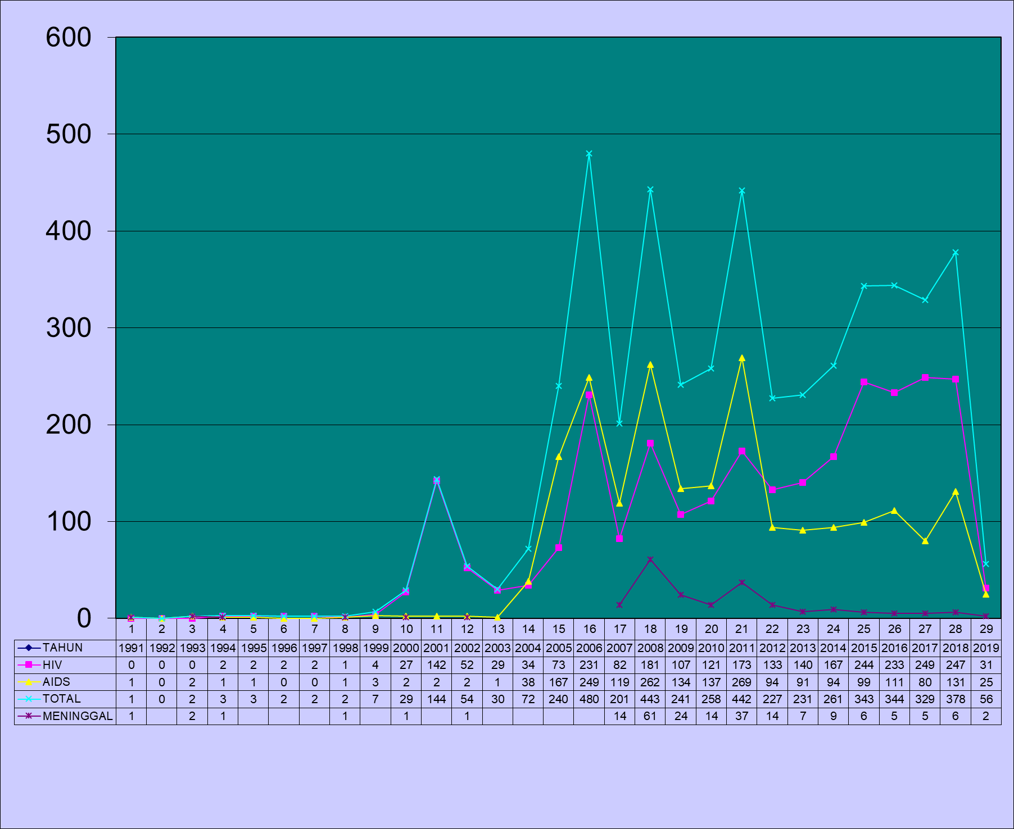
HIV and AIDS trend in Bandung (1991 – 2019)
Source : SIHA, 2019

Slide 5
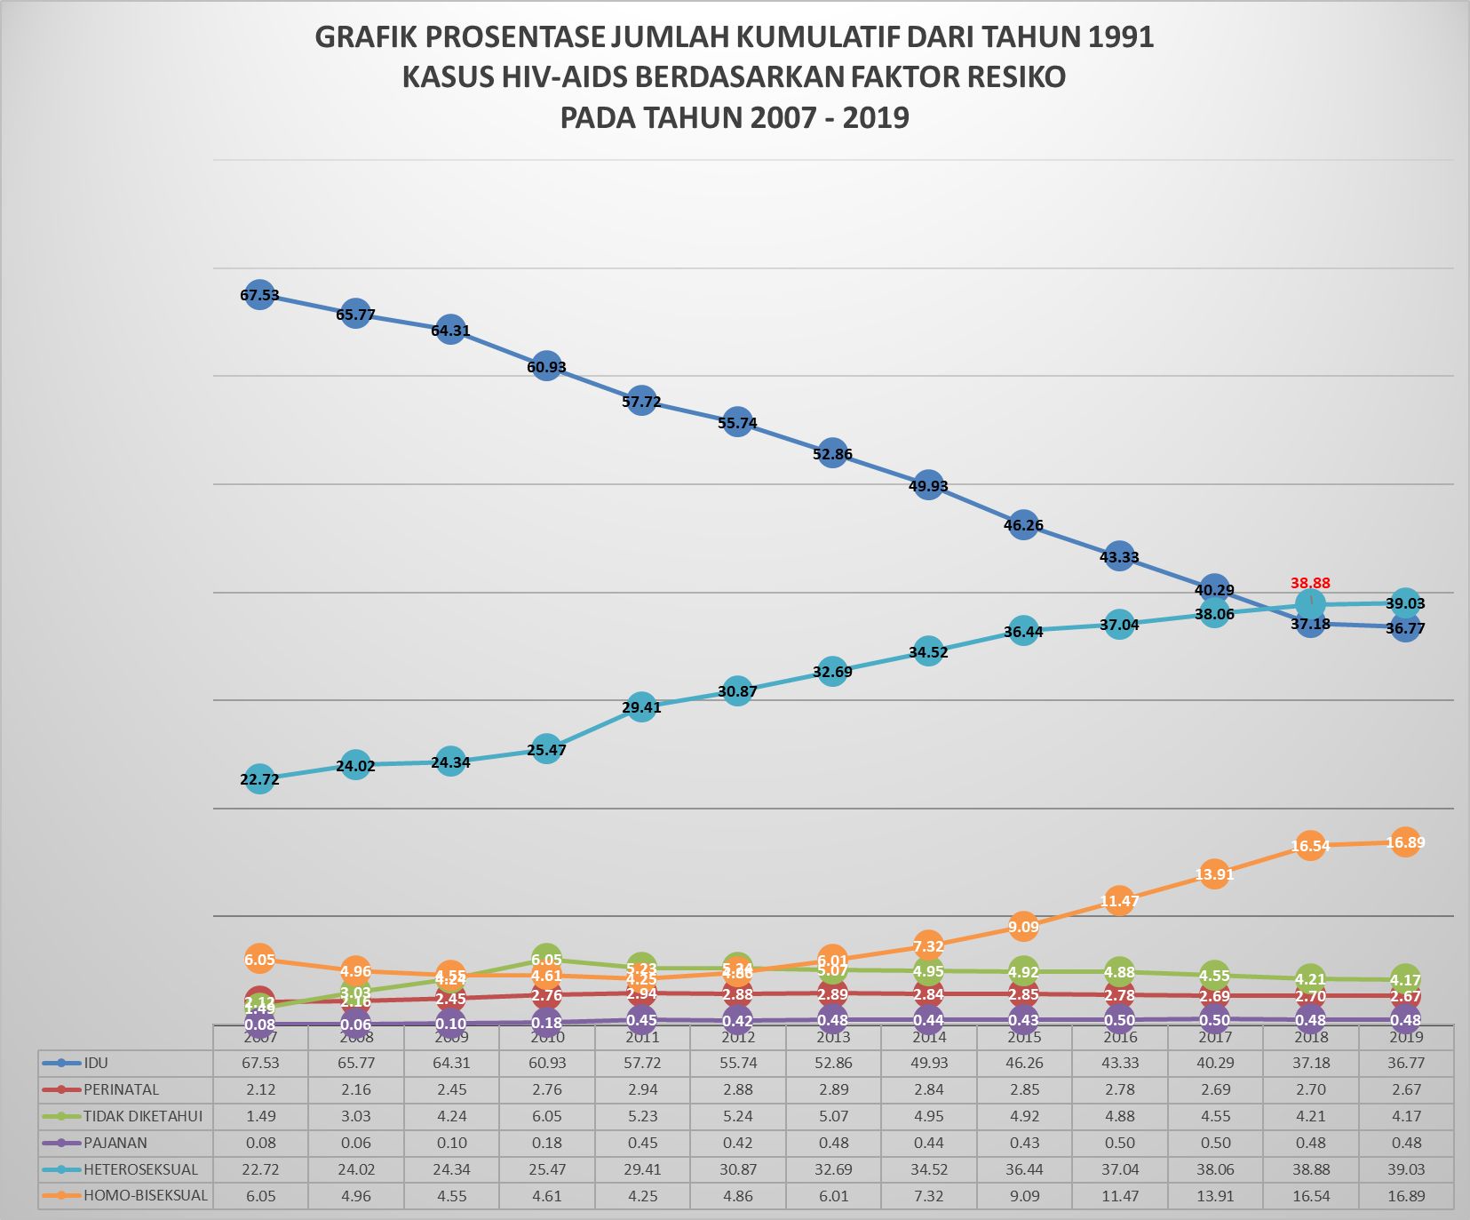
HIV Proportion by Risk Factor (2007 – 2019)
PWID
Heterosexual
MSM
Source : SIHA, 2019
Notes:
Faktor penularan HIV-AIDS di Kota Bandung TERTINGGI adalah Faktor risikomelalui Heteroseksual sebesar 39,03 % → Cenderung meningkat 2-3% pertahun
SEDANGKAN MELALUI jarum suntik (IDU's) yaitu sebesar 36,77 %.→ Cenderung menurun antara 2-3% pertahun
Faktor Penularan HIV melalui Homoseksua1 sebesar 16,89 % dengan kenaikan rata – rata 1% pertahun

Slide 6
Funding resources for HIV in Bandung
 | Promotion | Prevention | Treatment | Rehabilitation
APBD (local government budget) | x | x |  | x
Global Fund | x | x | x | x
IPF (Indonesia Partnership Fund) |  | x
HCPI (AusAID) | x | x | x
ASA-FHI (USAID) | x | x | x
UNFPA |  | x
UNICEF |  | x
Elton John AIDS Foundation (EJAF) | x | x |  | x

Slide 7
Research Question
Most of the HIV resources came from international funds → raise question on SUSTAINABILITY
The distribution of the HIV package funding uneven → most donor focused on Prevention or Promotion
There is an increase in local budget trend since 2017
How is the previous expenditure on HIV program?
How to expand future program when we had sufficient local budget?

Slide 8
Methods
Literature review Peer reviewed and grey literature (2007 – 2017)
Analyse budget expenditure
Search strategy: HIV, financing, budget, Bandung
Found 9 related article
41 article retrieved from electronic sources
(Pubmed, Google scholars)
17 article excluded for not meeting the inclusion criteria
23 were reviewed
9 article excluded for not meeting the inclusion and year publication
12 full text article were reviewed
3 article excluded for not relevant to the topic
9 article were included

Slide 9
Results
 | Proportion | Value (USD) | SD (USD)
Prevention and promotion | 61,73 % | 313,340 | 62,791
Mitigation | 24,20% | 122,844 | 9,517
Management and administration | 13,10% | 66,493 | 18,684
Diagnostic and treatment | 0,89% | 5,889 | 1,601
Conducive environment | 0,59% | 2,985 | 1,488

Slide 10
Conclusion
Most budget allocation goes to prevention and outreach program
Budget allocation for diagnostic and treatment very limited, thus made the new infection continue to increase rapidly
The mitigation budget were sufficient, however the mortality rate still high. An appropriate strategy for mitigation needed

Slide 11
Recommendation
Future budget allocation should stressed more on treatment as prevention to achieve suppressed new infection
Prevention budget mostly came from external donor, the future local budget should balance between prevention (outreach) program and treatment

Slide 12
Acknowledgment
Oded M Danial (Bandung City Mayor)
Yana Mulyana (Bandung Vice City Mayor – Head of AIDS Commision)
Rita Verita (Head of DHO)
Bagus Rahmat Prabowo (Secretary of Bandung AIDS Commission)
Rosye Hadiana (Head of HIV Sub-directorate DHO)
Rozar Prawiranegara (Padjadjaran University)

Slide 13
Thank You!
Terimakasih!
Gracias!

