Slide 1
HIV Prevention Cascades: uses and considerations
Bernadette Hensen
London School of Hygiene and Tropical Medicine

Slide 2
Presentation outline
Why prevention cascades?
A proposed unifying framework (including video)
Criticisms & limitations to consider
“Review” literature of use to date & ongoing work
Summary of key considerations when operationalising HIV prevention cascades

Slide 3
Why HIV prevention cascades?
HIV incidence remains high
Need increased coverage of available prevention methods
Identify of gaps in coverage of prevention methods across three steps
  Understand reasons underlying gaps
  Design interventions to close gaps
  Comparison of coverage over time and place, and populations
Assist in strengthening prevention programming

Slide 4
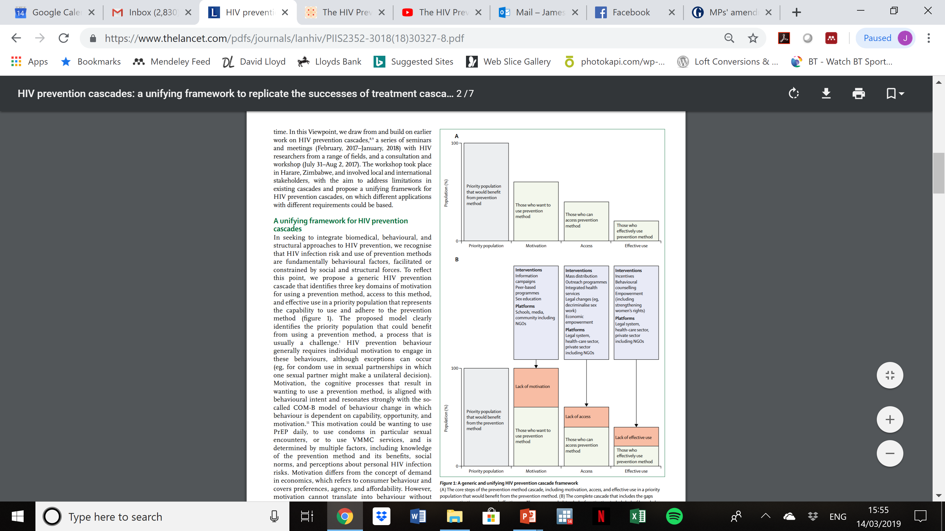
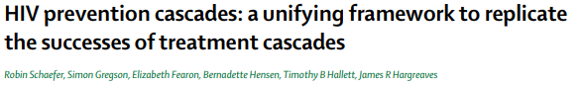
Proposed unifying framework

Slide 5

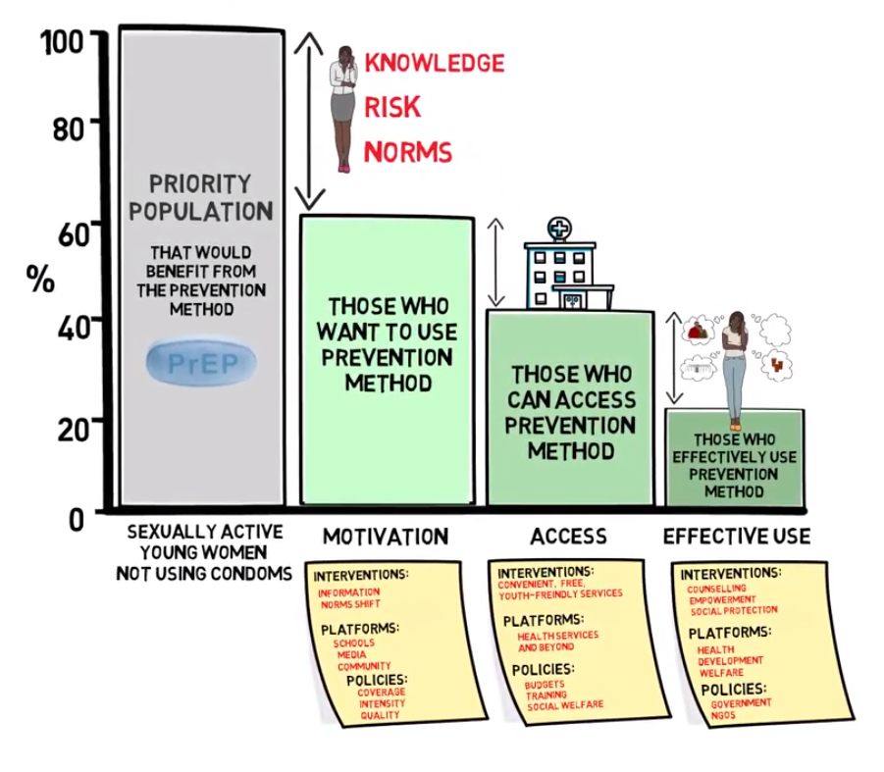
HIV prevention cascade video
https://www.youtube.com/watch?v=Zv-rRq9G9V4

Slide 6
Criticisms & limitations to consider
Prevention not linear like treatment - not really a cascade
Not one prevention method & prevention needs vary
Singular objective – ignores other externalities
Measurement of the cascade: too complex for programmes/overly simple
Important criticisms & limitations
that need to be considered

Slide 7
How have cascades been used to date?

Slide 8
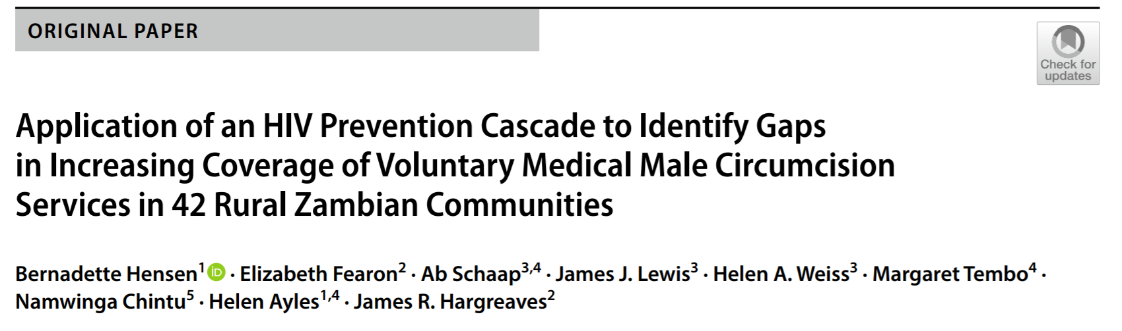
Gaps in increasing coverage of medical male circumcision in Zambia
Population-based cross-sectional surveys (2013 and 2014/15)
Defined measures of demand (motivation) and perceived supply (access)

Slide 9
Gaps in increasing coverage of medical male circumcision in Zambia

Slide 10
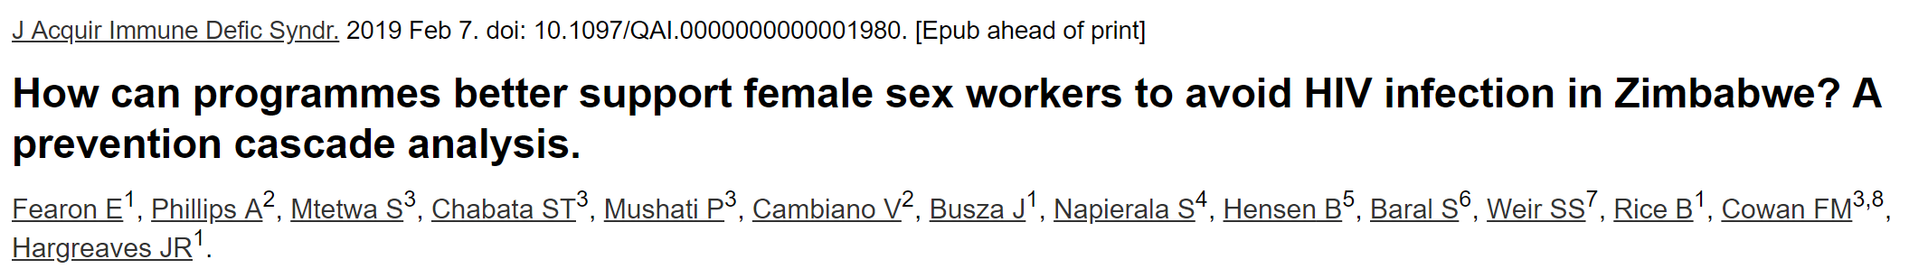
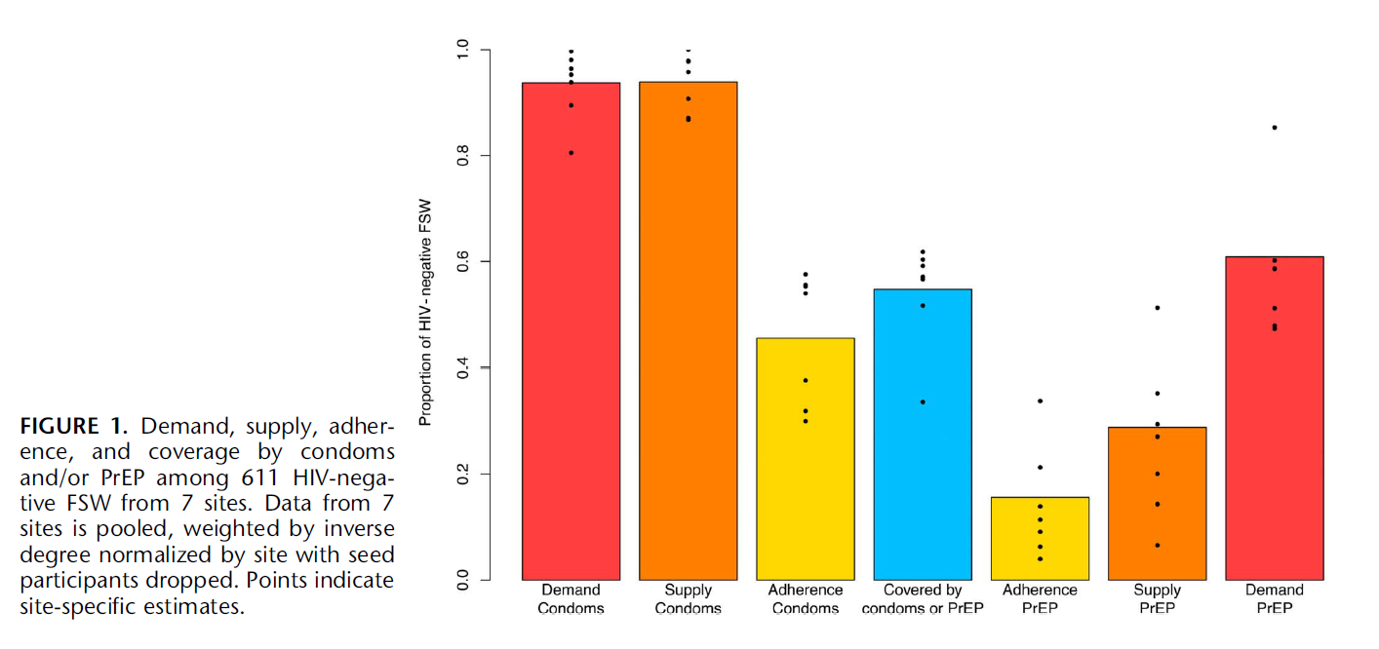
Use of condoms or PrEP by female sex workers in Zimbabwe

Slide 11
Use of condoms or PrEP by female sex workers in Zimbabwe
Supply defined as:
Condoms easily available
Ever offered PrEP
Demand defined as:
Believing condoms can prevent HIV
Having heard of PrEP

Slide 12
Combining data sources: Condom use among female sex workers in India

Slide 13
Programme data: PrEP uptake in South Africa

Slide 14
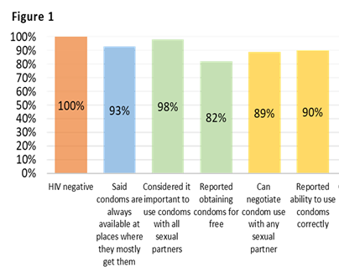
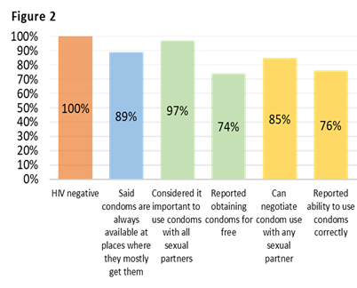
Measuring gaps: condom use among young women who sell sex aged 18 to 24 in Zimbabwe
Measuring gaps in condom use among YWSS who identified as a female sex worker (fig 1, N=1221) and those who did not (fig 2; N=622)
Chabata et al. Condom use among young women who sell sex enrolled in an impact evaluation of DREAMS in Zimbabwe. HIVR4P 2018 Madrid.

Slide 15

Measuring the prevention cascades - Zimbabwe
Developing measure to collect data on prevention cascades for key prevention methods
Population-based survey ~10,000 individuals in Manicaland, Zimbabwe (July 2018-Dec 2019)
Construct cascades using different measures (single vs index measures)
Construct combination cascades, cascades in a ‘backward’ fashion
Measuring reasons for gaps in motivation/demand, access.. Social norms, risk,

Slide 16
Summary of Key Considerations
  Defining the population & prevention method
  Defining & measuring the steps
    Single measures necessary but not sufficient
  Defining & measuring the gaps
    What and how to measure these – draw on existing tools

Slide 17
Summary of Key Considerations
  Data sources: what is available or required
  Combine programmatic data with data from individuals
  Alterative data collection methods – microplanning, mobile phones¹, qualitative data (ranking)
Constructing a cascade just first step: need to understand who isn’t using prevention method & why gaps exist to strengthen programming
1. Weiner et al (2018). Using a cascade approach to assess condom uptake in female sex workers in India: a review of the Avahan data. BMC Public Health

Slide 18
Acknowledgements
James Hargreaves, Brian Rice, Elizabeth Fearon (LSHTM/MeSH Consortium)
Judith Auerbach (UCSF)
Simon Gregson, Robin Schaefer (Imperial)
Zambart and CeSHHAR

