Slide 2
Policing practices and HIV risk among people who inject drugs – a systematic literature review
Pieter Baker, MPH
@PieterBaker
Share your thoughts on this presentation with #IAS2019

Slide 3
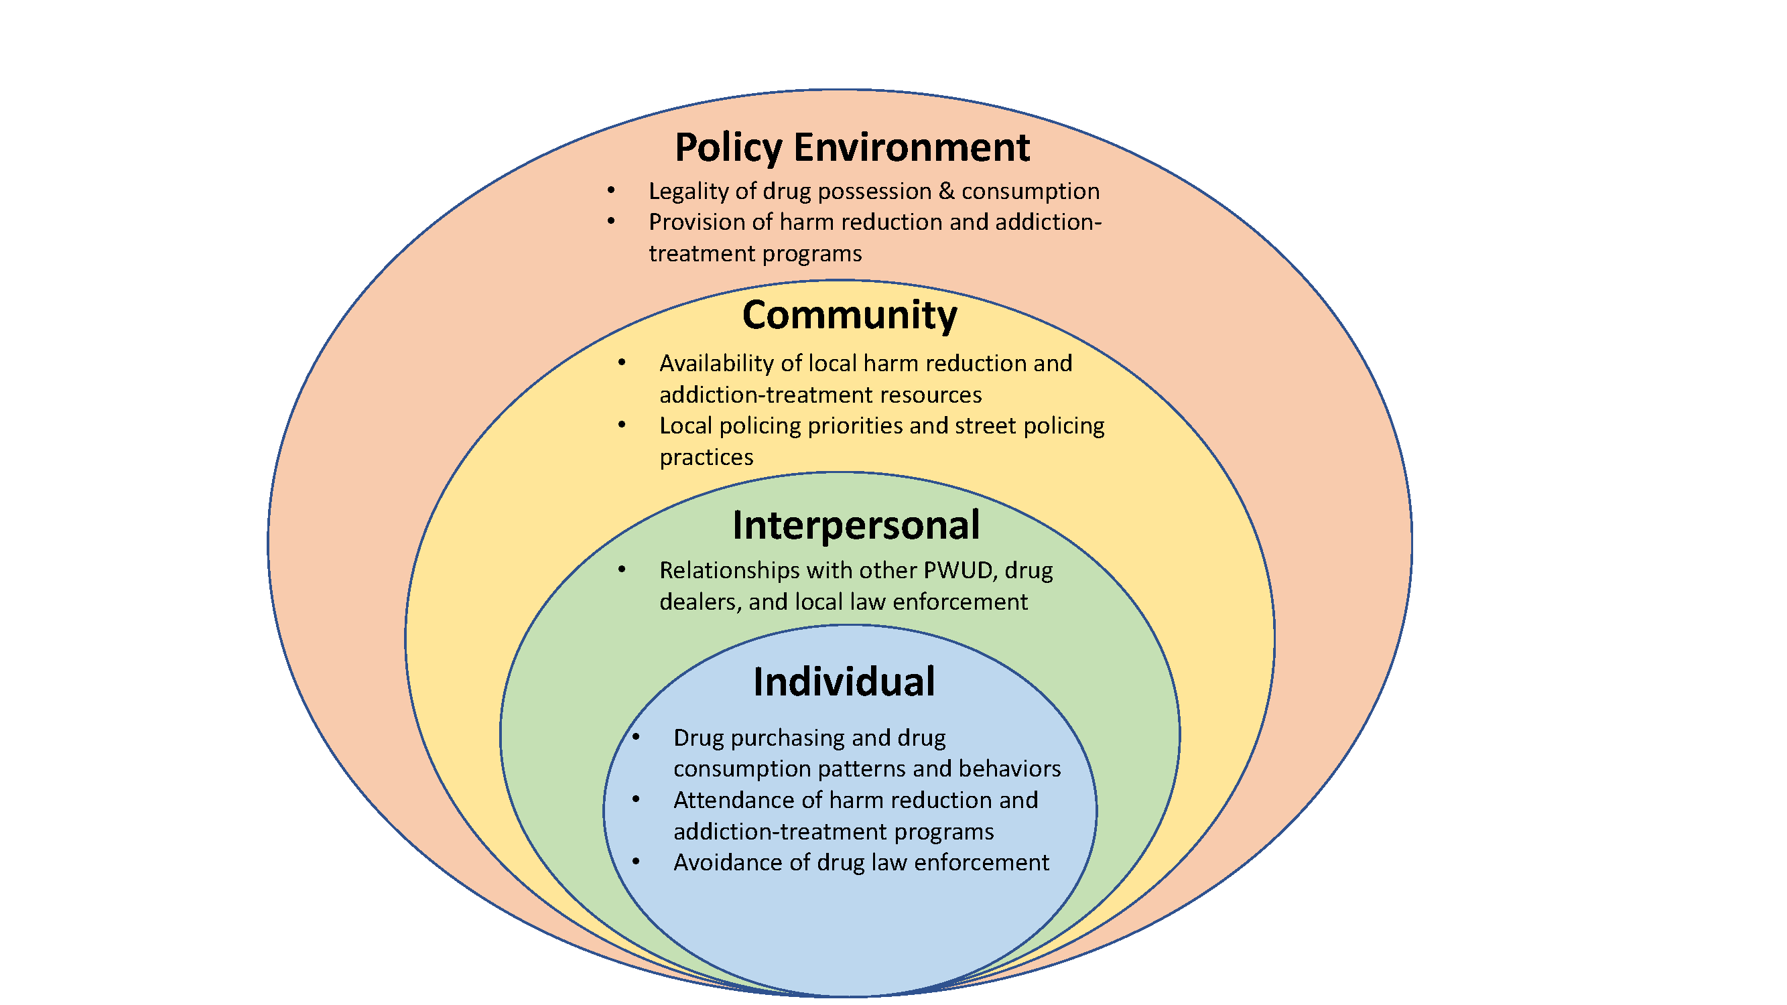
Background
Socio-ecological model of policing, drug policy and drug-related harms among PWID
Policing practices are structural determinants of HIV risk among people who inject drugs (PWID)
Interactions with police affect how PWID consume drugs and access HIV prevention programs
“Law on the streets” may not reflect drug laws “on the books”
Notes:
Drug policy environment determines drug possession/consumption legality – these laws are among the tools that drug law enforcement officers use when interacting with PWID (arrests, confiscations, etc). Policy environment also allows or prohibits the provision of addiction-treatment resources to treat underlying substance use disorders (OAT) and programs to reduce drug-related harms such as HIV infection (syringe exchange, safe consumption sites)
Community level – local community shapes availability and accessibility of harm reduction and HIV prevention resources.
Local municipal strategies and policing priorities affect how police conduct their work.
Interpersonal level –direct interactions with police (Arrest, detainment, confiscation, harassment/intimidation)
Individual level – PWID risk behaviors: syringe sharing, shooting gallery attendance, avoiding SEP/OAT

Slide 4
Previous Research
Drug criminalization has a negative effect on HIV prevention (Debeck et al. 2017)
Incarceration is associated with elevated risk of HIV infection (Stone et al. 2018)
Street policing & HIV risk (sexual) among female sex workers (Footer et al. 2016)
Street policing & HIV risk (injection) among PWID → No systematic review
Purpose
To describe the quantitative associations between policing practices and HIV risk among PWID that have been documented in the literature
Notes:
DeBeck K, Cheng T, Montaner JS, et al. HIV and the criminalisation of drug use among people who inject drugs: a systematic review. The lancet HIV 2017; 4(8): e357-e74.
Stone J, Fraser H, Lim AG, et al. Incarceration history and risk of HIV and hepatitis C virus acquisition among people who inject drugs: a systematic review and meta-analysis. The Lancet Infectious diseases 2018; 18(12): 1397-409.
Footer KH, Silberzahn BE, Tormohlen KN, Sherman SG. Policing practices as a structural determinant for HIV among sex workers: a systematic review of empirical findings. Journal of the International AIDS Society 2016; 19(4 Suppl 3): 20883.

Slide 5
Methods
Abstract Screening
Manuscript Review & Coding
MEDLINE, sociological databases and gray literature (Sep 2017-Nov 2018)
Search terms related to policing/law enforcement and injection drug use/HIV (1981-present)
3 screeners, QA on ~5% of abstracts
Inter-reviewer reliability >95%
EndNote software (version 8.2)
Eligibility: valid quantitative association between exposure (police practices) and outcome (HIV infection or risky behavior among individual PWID)
Standardized assessment of bias form to determine relative validity (good/fair/poor)
In-house coding form to extract study data
4 coders, at least 2 coders per manuscript
Notes:
We excluded studies that 1) only reported qualitative findings; 2) did not disaggregate between PWID and non-PWID; 3) studies where individual PWID were not the unit of analysis (e.g. ecological analyses) 4) consisted of only modeling, cost-effectiveness or analyses where PWID were not empirically investigated; or 5) did not present a valid association between a policing exposure and HIV or an HIV-related injection risk behavior.

Slide 6
Results
8,201 unique abstracts
26 eligible manuscripts
Originating from 9 different countries (Russia, Mexico, USA, Canada, Ukraine, Thailand, Malaysia, China and India)
No longitudinal data (all cross-sectional)
Studies with HIV seroprevalence data (n=6)
Studies with risky injection behavior data (n=21)
Studies with HIV prevention program data (n=9)

Slide 7
Policing & HIV Seroprevalence (n=6 studies, 18 bivariate associations)
Author | Location
Bluthenthal (1999) | USA, San Francisco
Strathdee (2008) | Mexico, Tijuana
Strathdee (2011) | Mexico, Tijuana and Ciudad Juarez
Hayashi (2013) | Thailand, Bangkok
Beletsky (2013) | Mexico, Tijuana and Ciudad Juarez
Booth (2013) | Ukraine, Odessa
Syringes Confiscated (last 6 m) & HIV:
2.38 (1.17,4.81)
Beaten by Police (last 6 m) & HIV:
1.35 (1.08,1.67)
Didn’t buy syringes for fear of police (last 6 m) & HIV: 3.30 (1.47,7.61)

Slide 8
Policing & Risky Injection Behaviors (n=21 studies, 42 bivariate associations)
Author | Location
Bluthenthal (1999) | USA, San Francisco
Rhodes (2004) | Russia, Togliatti City
Flath (2017) | USA, Baltimore
Werb (2008) | Canada, Vancouver
Lunze (2014) | Russia, St. Petersburg
Michalopolous (2016) | Malaysia, Panang State
Armenta (2015) | USA, San Diego
Philbin (2008) | Mexico, Tijuana
Wagner (2013) | USA, Los Angeles
Pollini (2008) | Mexico, Tijuana and Ciudad Juarez
Lunze (2016) | Russia, St. Petersburg
Beletsky (2016) | Mexico, Tijuana
Fear of arrest (ever) & syringe sharing (last 30 days):
4.80 (3.32,6.94)
Stop/search/detained (last 6 m) & distributive syringe sharing (last 6 m):
5.66 (2.23,14.36)
Arrest for used syringe possession (ever) & receptive syringe sharing (last 6 m):
4.31 (2.75,6.73)
Notes:
Highlight issues surrounding lack of variable homogeneity (why we couldn’t do a meta analysis)
Discuss variety of outcomes related in “Risky Injection”: syringe sharing (receptive/distributive), shooting gallery attendance
Note: Not all studies represented on this table, this is an appreviated representation of this set of results

Slide 9
Policing & HIV Prevention Services (n=9 studies, n=14 bivariate associations)
First Author (pub date) | Location
Beletsky (2014) | USA, New York City
Hayashi (2013) [BMC] | Thailand, Bangkok
Heath (2015) | Bangkok, Thailand
Gu (2014) | Guangzhou, China
Fairbairn (2009) | Thailand, Bangkok
Shaw (2015) | Canada, Ottawa
Werb (2015) | Mexico, Tijuana
Kutsa (2016) | Ukraine (5 Cities)
Sarin (2016) | India, Delhi
Stop & Frisk (last 12 m); likely to use SEP (last 12 m): 2.13 (1.47, 3.13)
Fear of Police Arrest (ever) & Methadone nonattendance (recent): 12.0 (1.60, 92.3)
Arrest for syringe possession (ever) & Attend methadone or SEP (last 12 m):
0.51 (0.27,0.95)
Notes:
Highlight issues surrounding lack of variable homogeneity (why we couldn’t do a meta analysis)
Discuss variety of outcomes related in “Risky Injection”: syringe sharing (receptive/distributive), shooting gallery attendance
Note: Not all studies represented on this table, this is an appreviated representation of this set of results

Slide 10
Notes:
Discussion: Over 179 countries have documented injection drug use. <light blue>
We identified specific research on policing and HIV risk in 9 countries representing a variery of socioeconomic and drug policy settings.
despite a lack of published findings in certain regions (south America, Africa), the associations we analyzed in this review are likely relevant to these countries as well.
*Be sure to mention that there is a lot of research on this topic coming from Australia, but were not eligible due to study designconsiderations (PWID as unit of analysis, direct associations between policing exposure/HIV related outcome) (mention labs and PIs).*
Representation in low- and high-income countries and in various drug policy settings

Slide 11
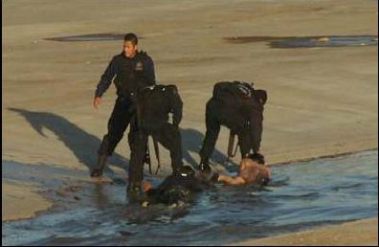
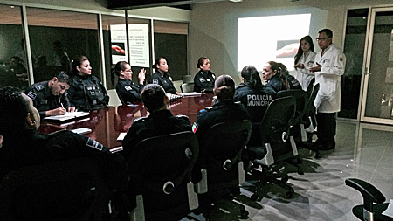
Discussion
Literature indicates policing practices consistently associated with HIV infection/risk behaviors among PWID in many settings
Need for standardized constructs for future meta-analysis
Limitations: lack of data from many regions, lack of longitudinal data,
Consideration of Hep C, HIV/HepC, overdose
Interventions to align policing w/ public health and maximize potential of drug policy reform
Policing and criminal justice reform is an HIV prevention imperative
Photo by A. Cabrera
ESCUDO Police Training Intervention in Tijuana, Mexico. Photo: Jaime Arredondo, 2014
Notes:
-We identified 26 studies that included a total of 74 unique bivariate association between policing practices and either HIV infection of HIV risk behaviors. The most common policing practices identified were arrests, syringe confiscations and XXX while the most common HIV risk behaviors were syringe sharing and avoidance of HIV prevention/harm reduction programs (SEP/OST)
-limitations: selection bias if high risk populations were more likely to be recruited AND have police interactions
-need uniformity both in construction and reporting timeframes for meta analysis. only XXX studies collected transgender demographic data. Most studies are recent (past 6 years or so), so time to standardize
-overdose, booth study found an ass b/w

Slide 12
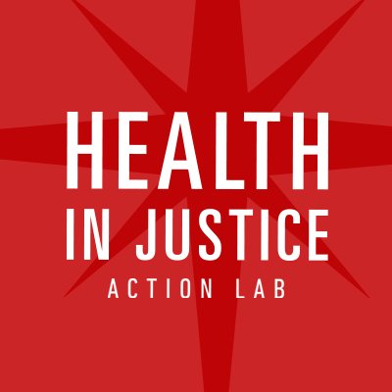
Acknowledgements
Literature review team:
Leo Beletsky, JD, MPH
Liliana Avalos, BS
Christopher Venegas, BS
Carlos Rivera, MSc
Steffanie A. Strathdee, PhD
Javier Cepeda, PhD
All PWID participating in research
Scientists and staff conducting the research
Funding organizations and institutes
IAS for the opportunity to highlight this important line of research
@UCSDHealth
@HiJAction

Slide 13
References
1.Degenhardt L, Charlson F, Mathers B, et al. The global epidemiology and burden of opioid dependence: results from the global burden of disease 2010 study. Addiction (Abingdon, England) 2014; 109(8): 1320-33.
2.Degenhardt L, Peacock A, Colledge S, et al. Global prevalence of injecting drug use and sociodemographic characteristics and prevalence of HIV, HBV, and HCV in people who inject drugs: a multistage systematic review. The Lancet Global health 2017; 5(12): e1192-e207.
3.Degenhardt L, Charlson F, Stanaway J, et al. Estimating the burden of disease attributable to injecting drug use as a risk factor for HIV, hepatitis C, and hepatitis B: findings from the Global Burden of Disease Study 2013. The Lancet Infectious diseases 2016; 16(12): 1385-98.
4.Peters PJ, Pontones P, Hoover KW, et al. HIV Infection Linked to Injection Use of Oxymorphone in Indiana, 2014-2015. The New England journal of medicine 2016; 375(3): 229-39.
5.Strathdee SA, Beyrer C. Threading the Needle--How to Stop the HIV Outbreak in Rural Indiana. The New England journal of medicine 2015; 373(5): 397-9.
6.Mathers BM, Degenhardt L, Ali H, et al. HIV prevention, treatment, and care services for people who inject drugs: a systematic review of global, regional, and national coverage. Lancet (London, England) 2010; 375(9719): 1014-28.
7.Stone K S-BS. Global State of Harm Reduction 2018. Harm Reduction International: London 2018.
8.Heimer R. The Policy-Driven HIV Epidemic Among Opioid Users in the Russian Federation. Current HIV/AIDS reports 2018; 15(3): 259-65.
9.Rudd RA, Aleshire N, Zibbell JE, Gladden RM. Increases in Drug and Opioid Overdose Deaths--United States, 2000-2014. MMWR Morbidity and mortality weekly report 2016; 64(50-51): 1378-82.
10.Mummolo J. Militarization fails to enhance police safety or reduce crime but may harm police reputation. Proceedings of the National Academy of Sciences of the United States of America 2018; 115(37): 9181-6.
11.Puras D, Hannah J. Reasons for drug policy reform: prohibition enables systemic human rights abuses and undermines public health. BMJ (Clinical research ed) 2017; 356: i6586.
12.Wildeman C, Wang EA. Mass incarceration, public health, and widening inequality in the USA. Lancet (London, England) 2017; 389(10077): 1464-74.
13.Wohl DA. HIV and Mass Incarceration: Where Infectious Diseases and Social Justice Meet. North Carolina medical journal 2016; 77(5): 359-64.
14.(ACLU) ACLU. War comes home: The excessive militarization of American policing. 2014.
15.Strathdee SA, Beletsky L, Kerr T. HIV, drugs and the legal environment. The International journal on drug policy 2015; 26 Suppl 1: S27-32.

Slide 14
16. van Dijk AJ, Herrington V, Crofts N, et al. Law enforcement and public health: recognition and enhancement of joined-up solutions. Lancet (London, England) 2019;
393(10168): 287-94.
17. DeBeck K, Cheng T, Montaner JS, et al. HIV and the criminalisation of drug use among people who inject drugs: a systematic review. The lancet HIV 2017; 4(8): e357-e74.
18. Koh HK, Kerlikowske RG, Botticelli MP. A Smarter War on DrugsA Smarter War on DrugsThe JAMA Forum. JAMA 2018; 320(22): 2301-2.
19. Stone J, Fraser H, Lim AG, et al. Incarceration history and risk of HIV and hepatitis C virus acquisition among people who inject drugs: a systematic review and meta-analysis. The Lancet Infectious diseases 2018; 18(12): 1397-409.
20. Dolan K, Wirtz AL, Moazen B, et al. Global burden of HIV, viral hepatitis, and tuberculosis in prisoners and detainees. Lancet (London, England) 2016; 388(10049): 1089-102.
21. Pollini RA, Brouwer KC, Lozada RM, et al. Syringe possession arrests are associated with receptive syringe sharing in two Mexico-US border cities. Addiction (Abingdon, England) 2008; 103(1): 101-8.
22. Beletsky L, Heller D, Jenness SM, Neaigus A, Gelpi-Acosta C, Hagan H. Syringe access, syringe sharing, and police encounters among people who inject drugs in New York City: a community-level perspective. The International journal on drug policy 2014; 25(1): 105-11.
23. Lunze K, Raj A, Cheng DM, et al. Punitive policing and associated substance use risks among HIV-positive people in Russia who inject drugs. Journal of the International AIDS Society 2014; 17: 19043.
24. Philbin M, Pollini RA, Ramos R, et al. Shooting gallery attendance among IDUs in Tijuana and Ciudad Juarez, Mexico: correlates, prevention opportunities, and the role of the environment. AIDS and behavior 2008; 12(4): 552-60.
25. Fairbairn N, Kaplan K, Hayashi K, et al. Reports of evidence planting by police among a community-based sample of injection drug users in Bangkok, Thailand. BMC international health and human rights 2009; 9: 24.
26. Kutsa O, Marcus R, Bojko MJ, et al. Factors associated with physical and sexual violence by police among people who inject drugs in Ukraine: implications for retention on opioid agonist therapy. Journal of the International AIDS Society 2016; 19(4 Suppl 3): 20897.
27. Gu J, Xu H, Lau JT, et al. Situation-specific factors predicting nonadherence to methadone maintenance treatment: a cross-sectional study using the case-crossover design in Guangzhou, China. AIDS care 2014; 26 Suppl 1: S107-12.
28. (UNODC) UNOoDaC. Outcome Document of the 2016 United Nations General Assembly Special Session on the World Drug Problem. Thirtieth Special Session General Assembly New York,. 2016.
29. Arredondo J, Gaines T, Manian S, et al. The law on the streets: Evaluating the impact of Mexico's drug decriminalization reform on drug possession arrests in Tijuana, Mexico. The International journal on drug policy 2018; 54: 1-8.

Slide 15
30. Arredondo J, Strathdee SA, Cepeda J, et al. Measuring improvement in knowledge of drug policy reforms following a police education program in Tijuana, Mexico. Harm reduction journal 2017; 14(1): 72.
31. Beletsky L, Thomas R, Smelyanskaya M, et al. Policy reform to shift the health and human rights environment for vulnerable groups: the case of Kyrgyzstan's Instruction 417. Health and human rights 2012; 14(2): 34-48.
32. Beletsky L WK, Arredondo J, et al. Implementing Mexico's “Narcomenudeo” drug law reform: A mixed methods assessment of early experiences among people who inject drugs. Journal of Mixed Methods Research 2016; 10(4): 384-401.
33. Footer KH, Silberzahn BE, Tormohlen KN, Sherman SG. Policing practices as a structural determinant for HIV among sex workers: a systematic review of empirical findings. Journal of the International AIDS Society 2016; 19(4 Suppl 3): 20883.
34. Pneumocystis pneumonia--Los Angeles. MMWR Morbidity and mortality weekly report 1981; 30(21): 250-2.
35. Beletsky L, Martinez G, Gaines T, et al. Mexico's northern border conflict: collateral damage to health and human rights of vulnerable groups. Revista panamericana de salud publica = Pan American journal of public health 2012; 31(5): 403-10.
36. Strathdee SA, Lozada R, Martinez G, et al. Social and structural factors associated with HIV infection among female sex workers who inject drugs in the Mexico-US border region. PloS one 2011; 6(4): e19048.
37. Bluthenthal RN, Lorvick J, Kral AH, Erringer EA, Kahn JG. Collateral damage in the war on drugs: HIV risk behaviors among injection drug users. International Journal of Drug Policy 1999; 10(1): 25-38.
38. Escudero DJ, Lurie MN, Mayer KH, et al. The risk of HIV transmission at each step of the HIV care continuum among people who inject drugs: a modeling study. BMC public health 2017; 17(1): 614-.
39. Izenberg JM, Bachireddy C, Soule M, Kiriazova T, Dvoryak S, Altice FL. High rates of police detention among recently released HIV-infected prisoners in Ukraine: implications for health outcomes. Drug and alcohol dependence 2013; 133(1): 154-60.
40. Polonsky M, Azbel L, Wegman MP, et al. Pre-incarceration police harassment, drug addiction and HIV risk behaviours among prisoners in Kyrgyzstan and Azerbaijan: results from a nationally representative cross-sectional study. Journal of the International AIDS Society 2016; 19(4 Suppl 3): 20880-.
41. Arredondo J, Beletsky L, Baker P, et al. Interactive Versus Video-Based Training of Police to Communicate Syringe Legality to People Who Inject Drugs: The SHIELD Study, Mexico, 2015-2016. American journal of public health 2019: e1-e6.
42. Mittal ML, Artamonova I, Baker P, et al. Improving police conceptual knowledge of Mexico's law on cannabis possession: Findings from an assessment of a police education program. The American journal on addictions 2018; 27(8): 608-11.
43. Collins SE, Lonczak HS, Clifasefi SL. Seattle's Law Enforcement Assisted Diversion (LEAD): Program effects on recidivism outcomes. Evaluation and program planning 2017; 64: 49-56.

