Slide 1
HIV acquisition risk and genital inflammation associated with hormonal contraceptives is dependent on the vaginal microbiome
Laura Noël-Romas
Burgener Research Group
National HIV and Retrovirology Labs | University of Manitoba
Winnipeg, MB, Canada
TUPDA0104

Slide 2
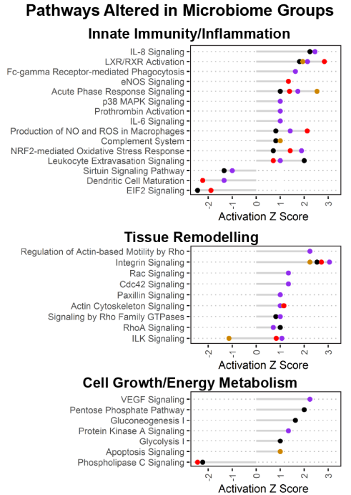
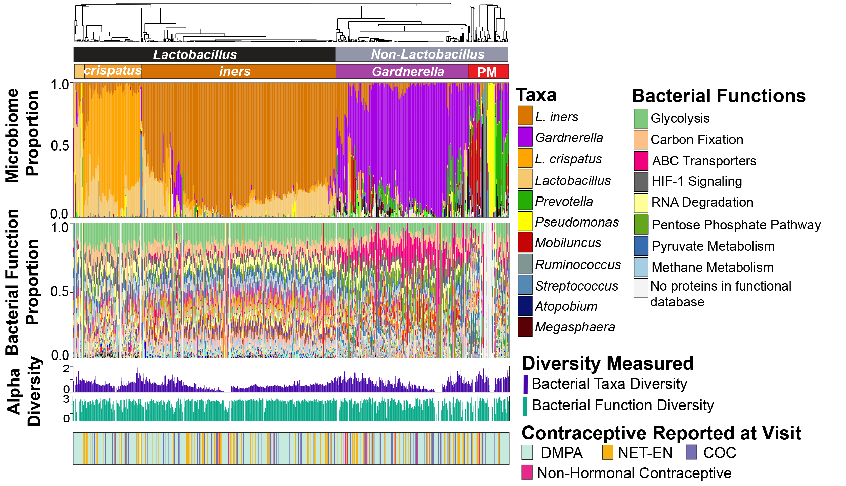

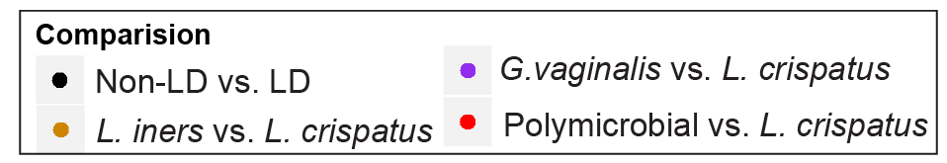

Microbiome-immune profiles in women using DMPA and other hormonal contraceptives in CAPRISA 004
Background:
  Genital inflammation affects HIV acquisition risk
  Both DMPA and the vaginal microbiome affect genital inflammation
  How do these two variables interact with inflammation, and does this interaction influence HIV risk?
Lactobacillus
+
Low Immune
Activation
Non-Lactobacillus
+
High Immune
Activation
  DMPA (n=447)
  NETEN (n=123)
  COC (n=97)
  Non-HC (n=16)DMPA
Kenzie Birse and Michelle Perner

Slide 3
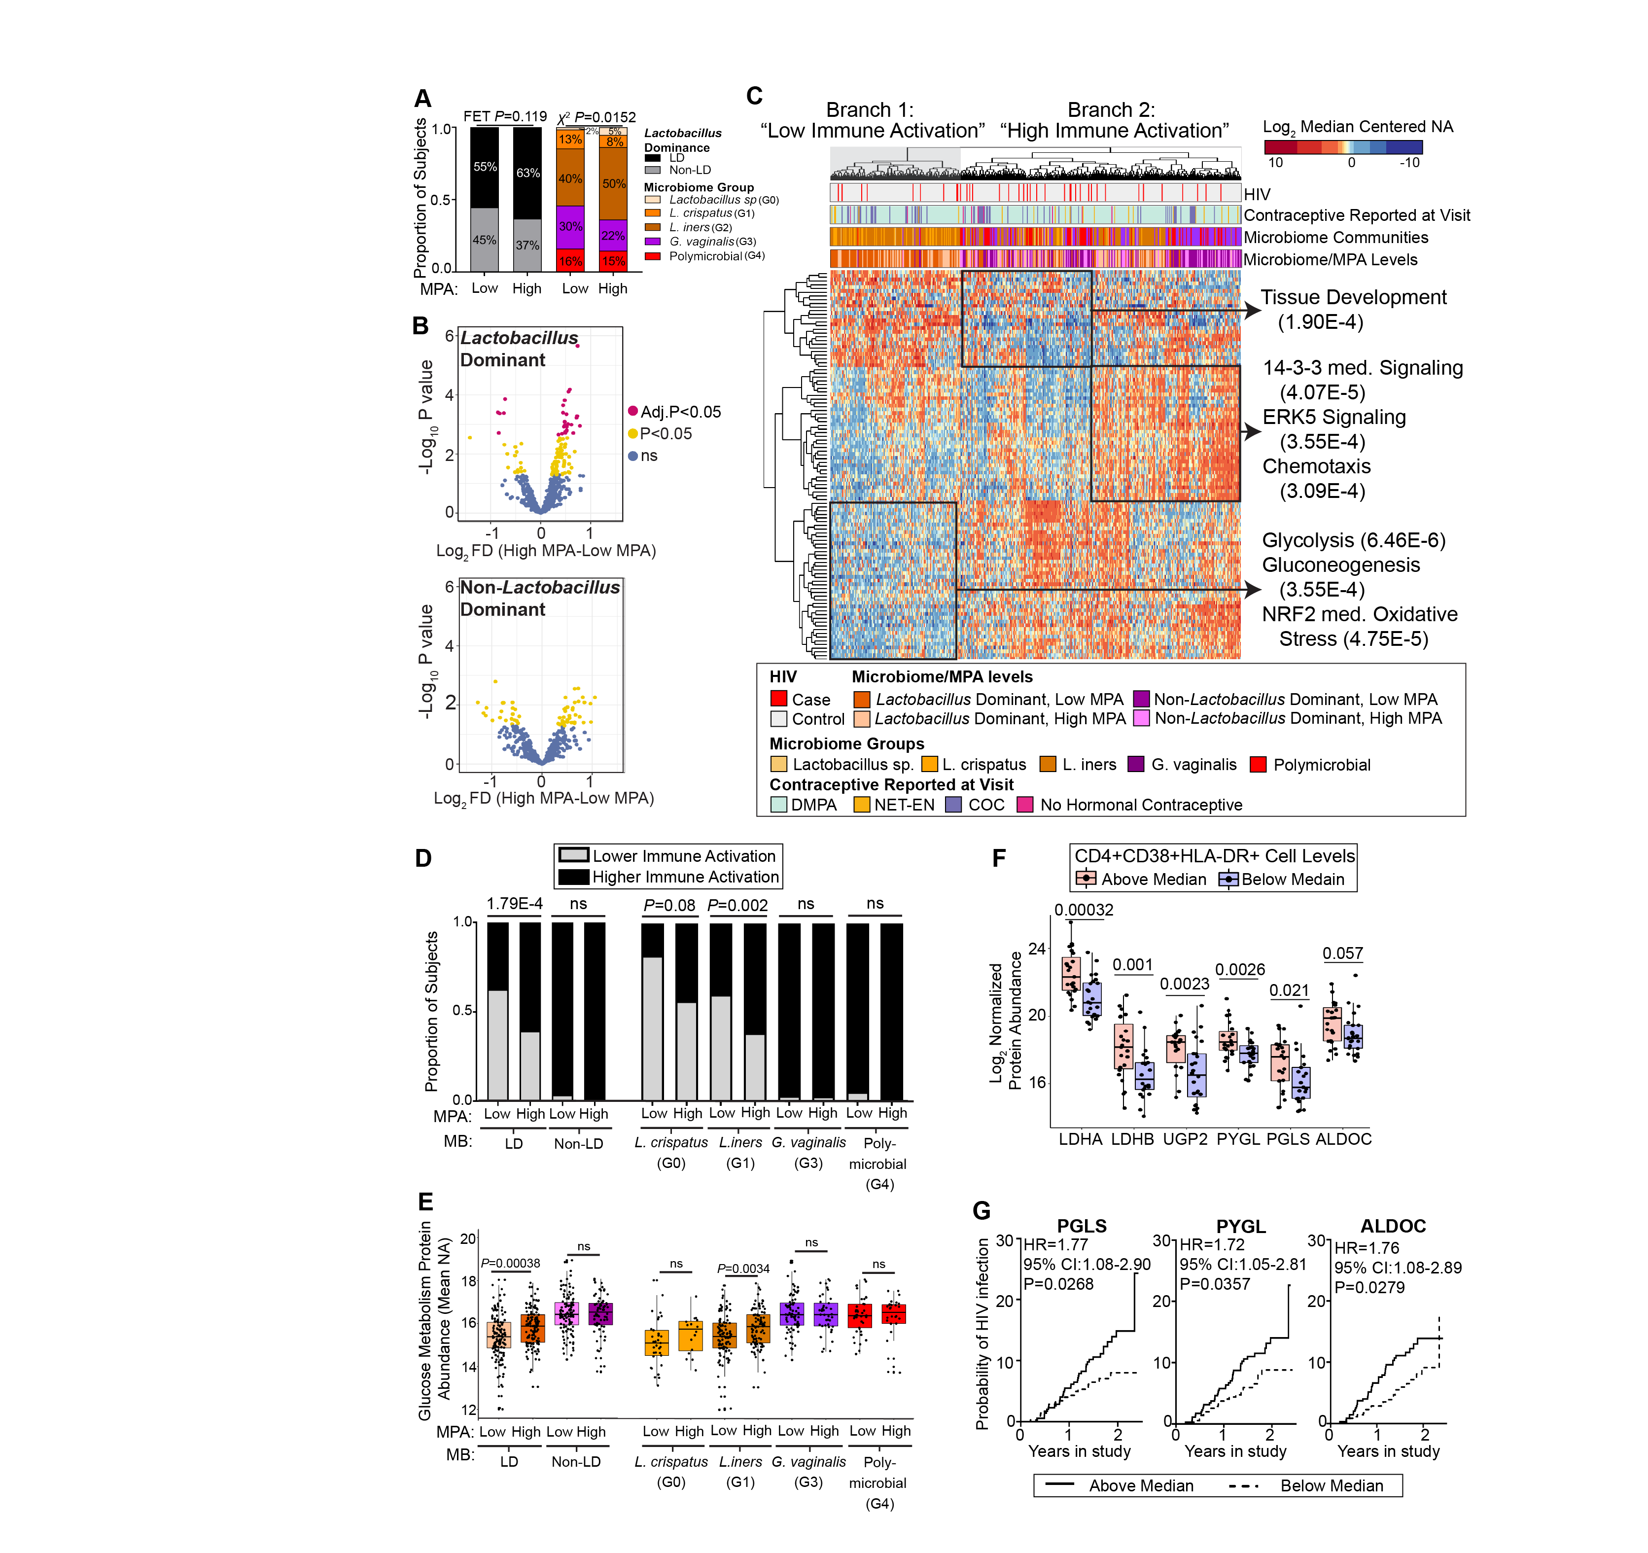
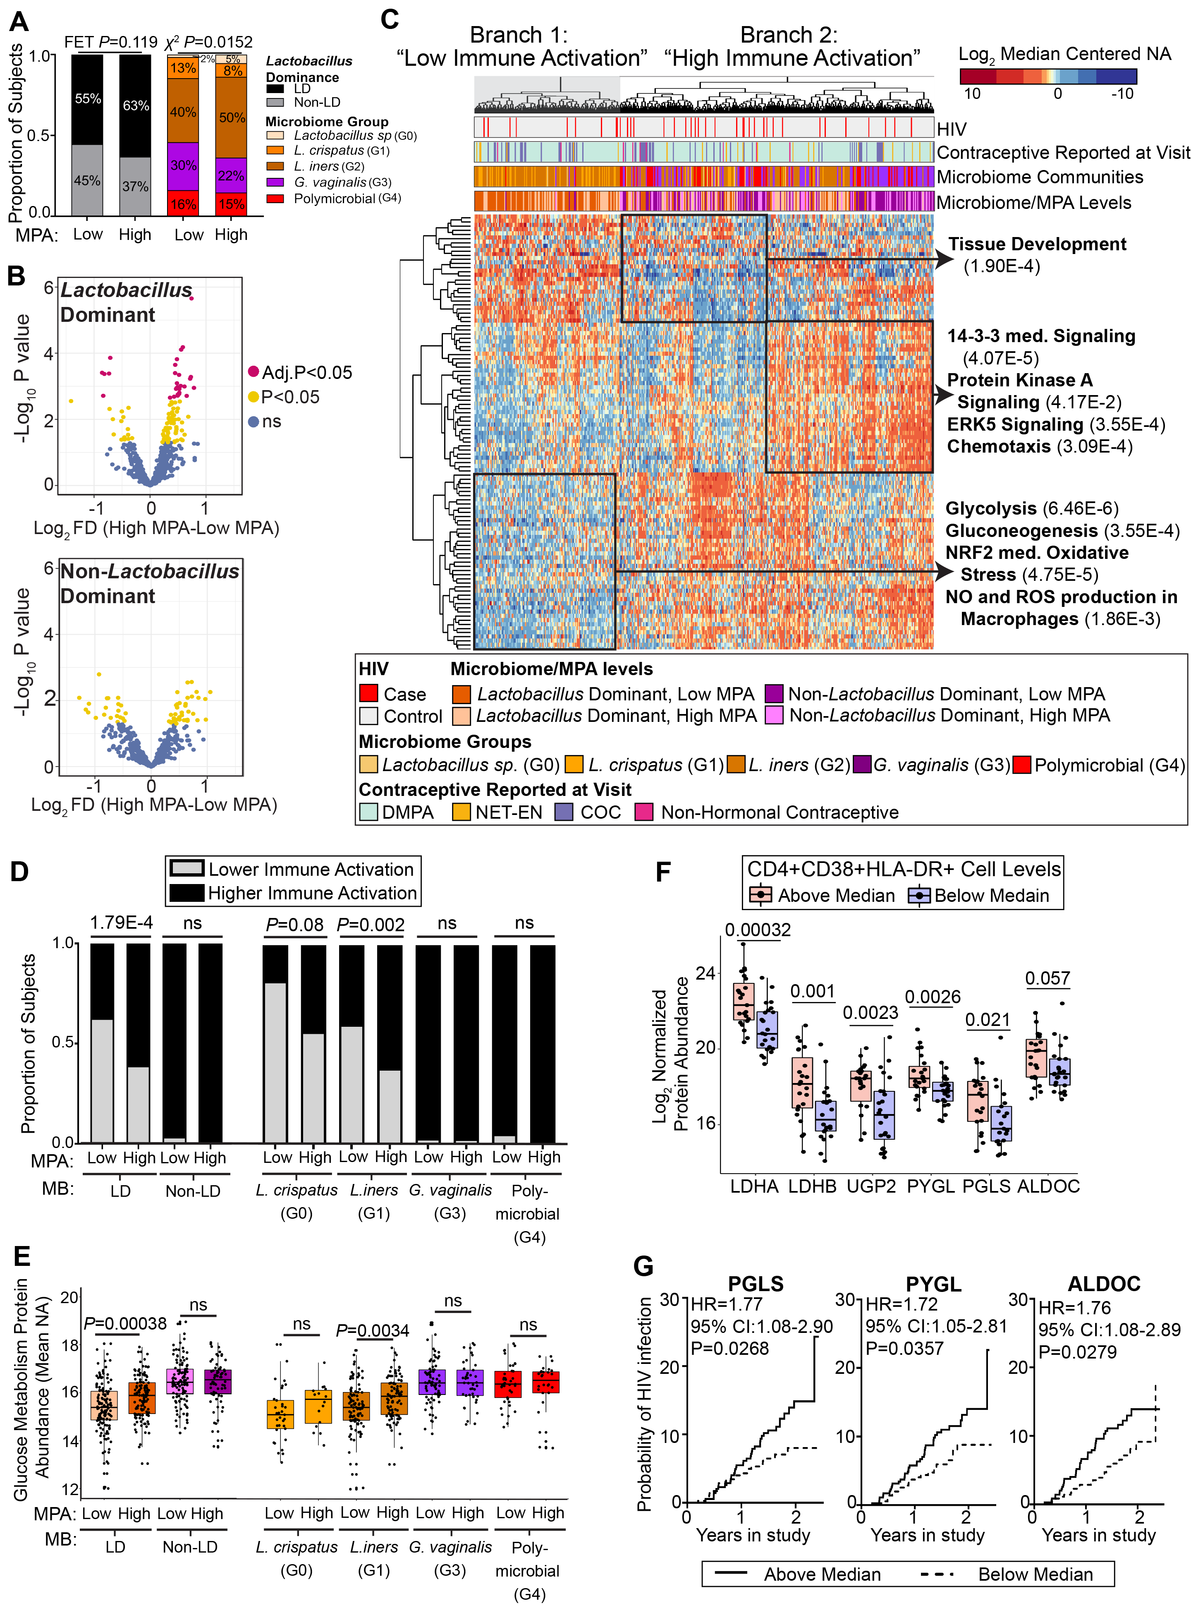
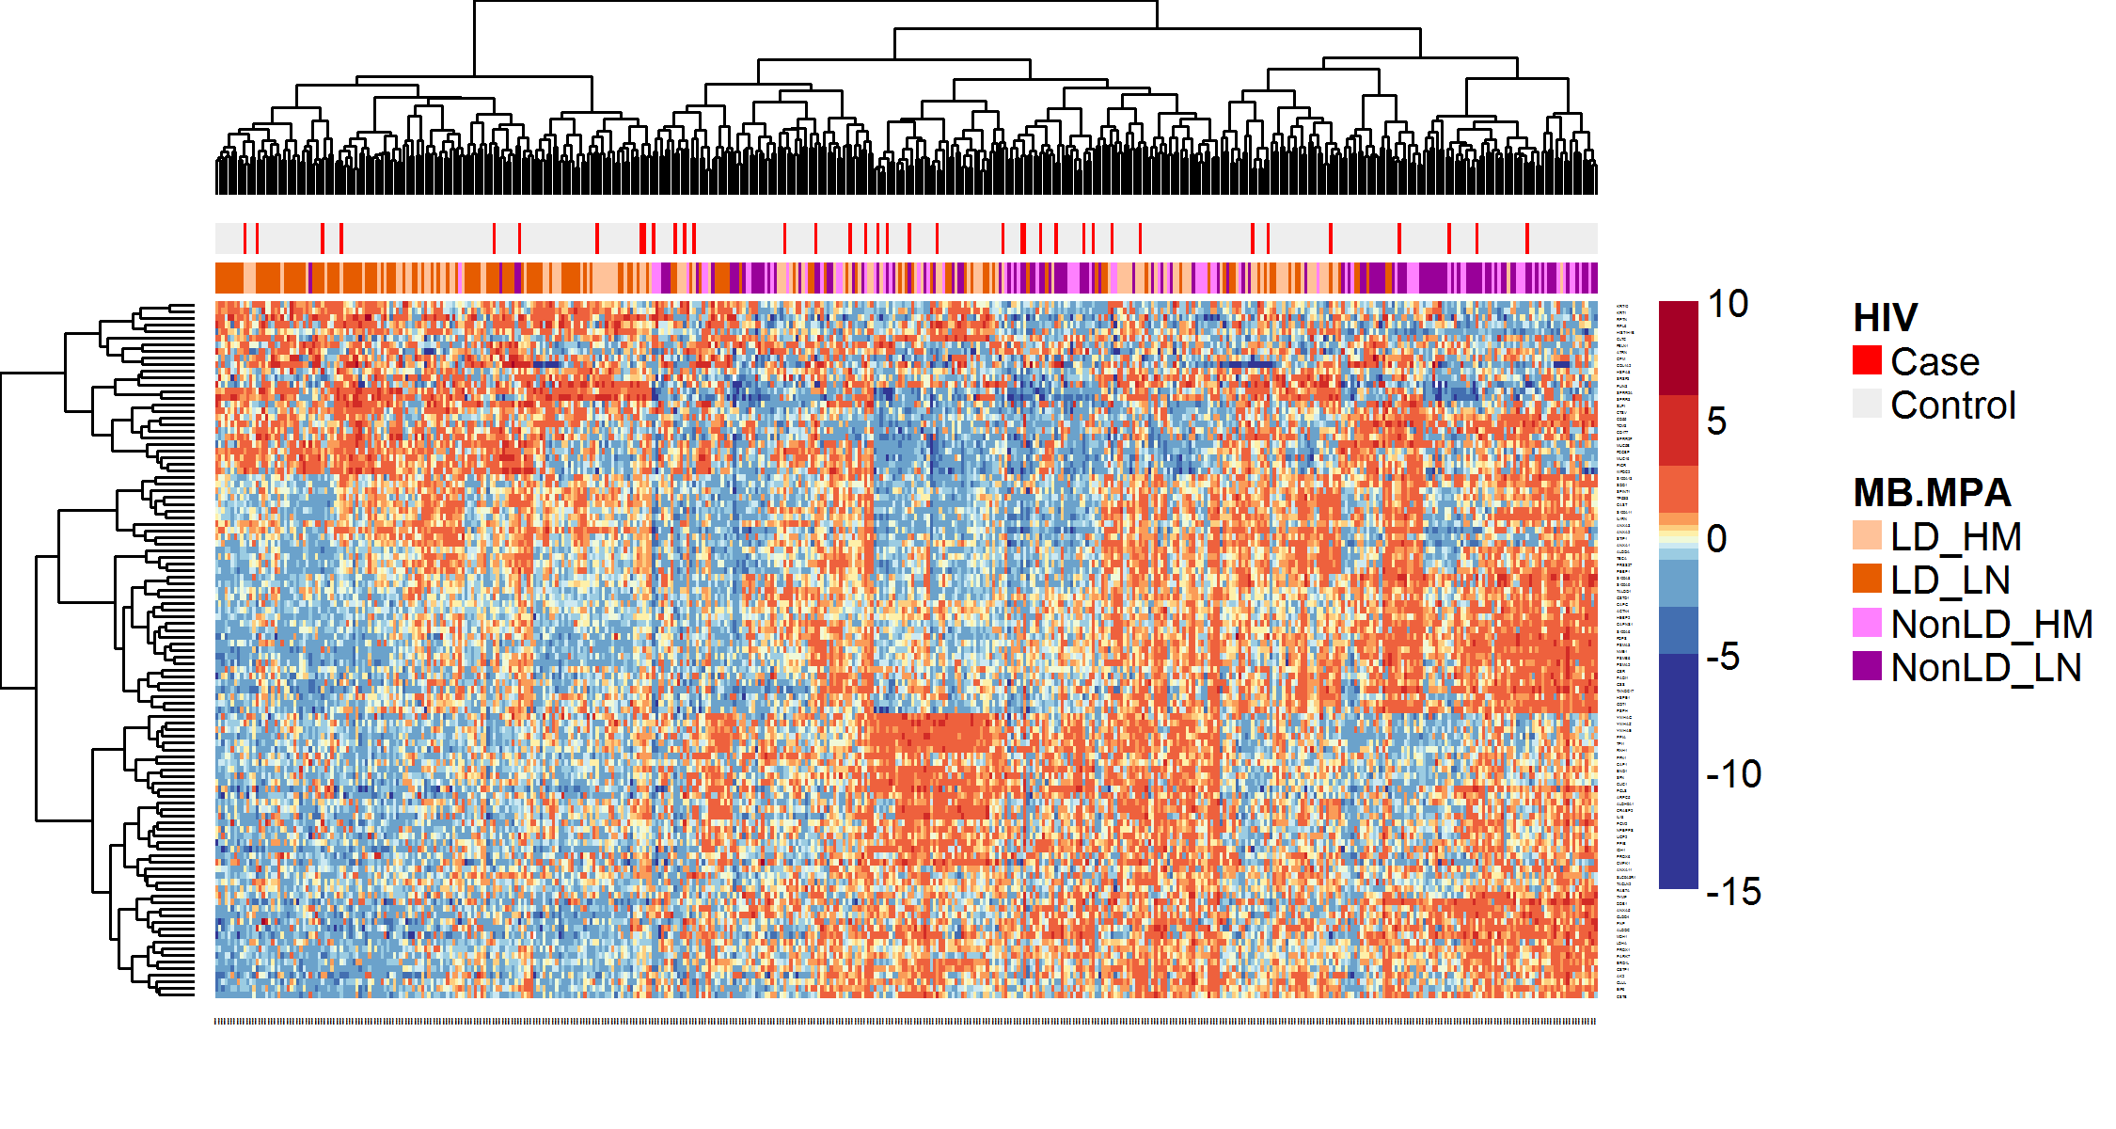
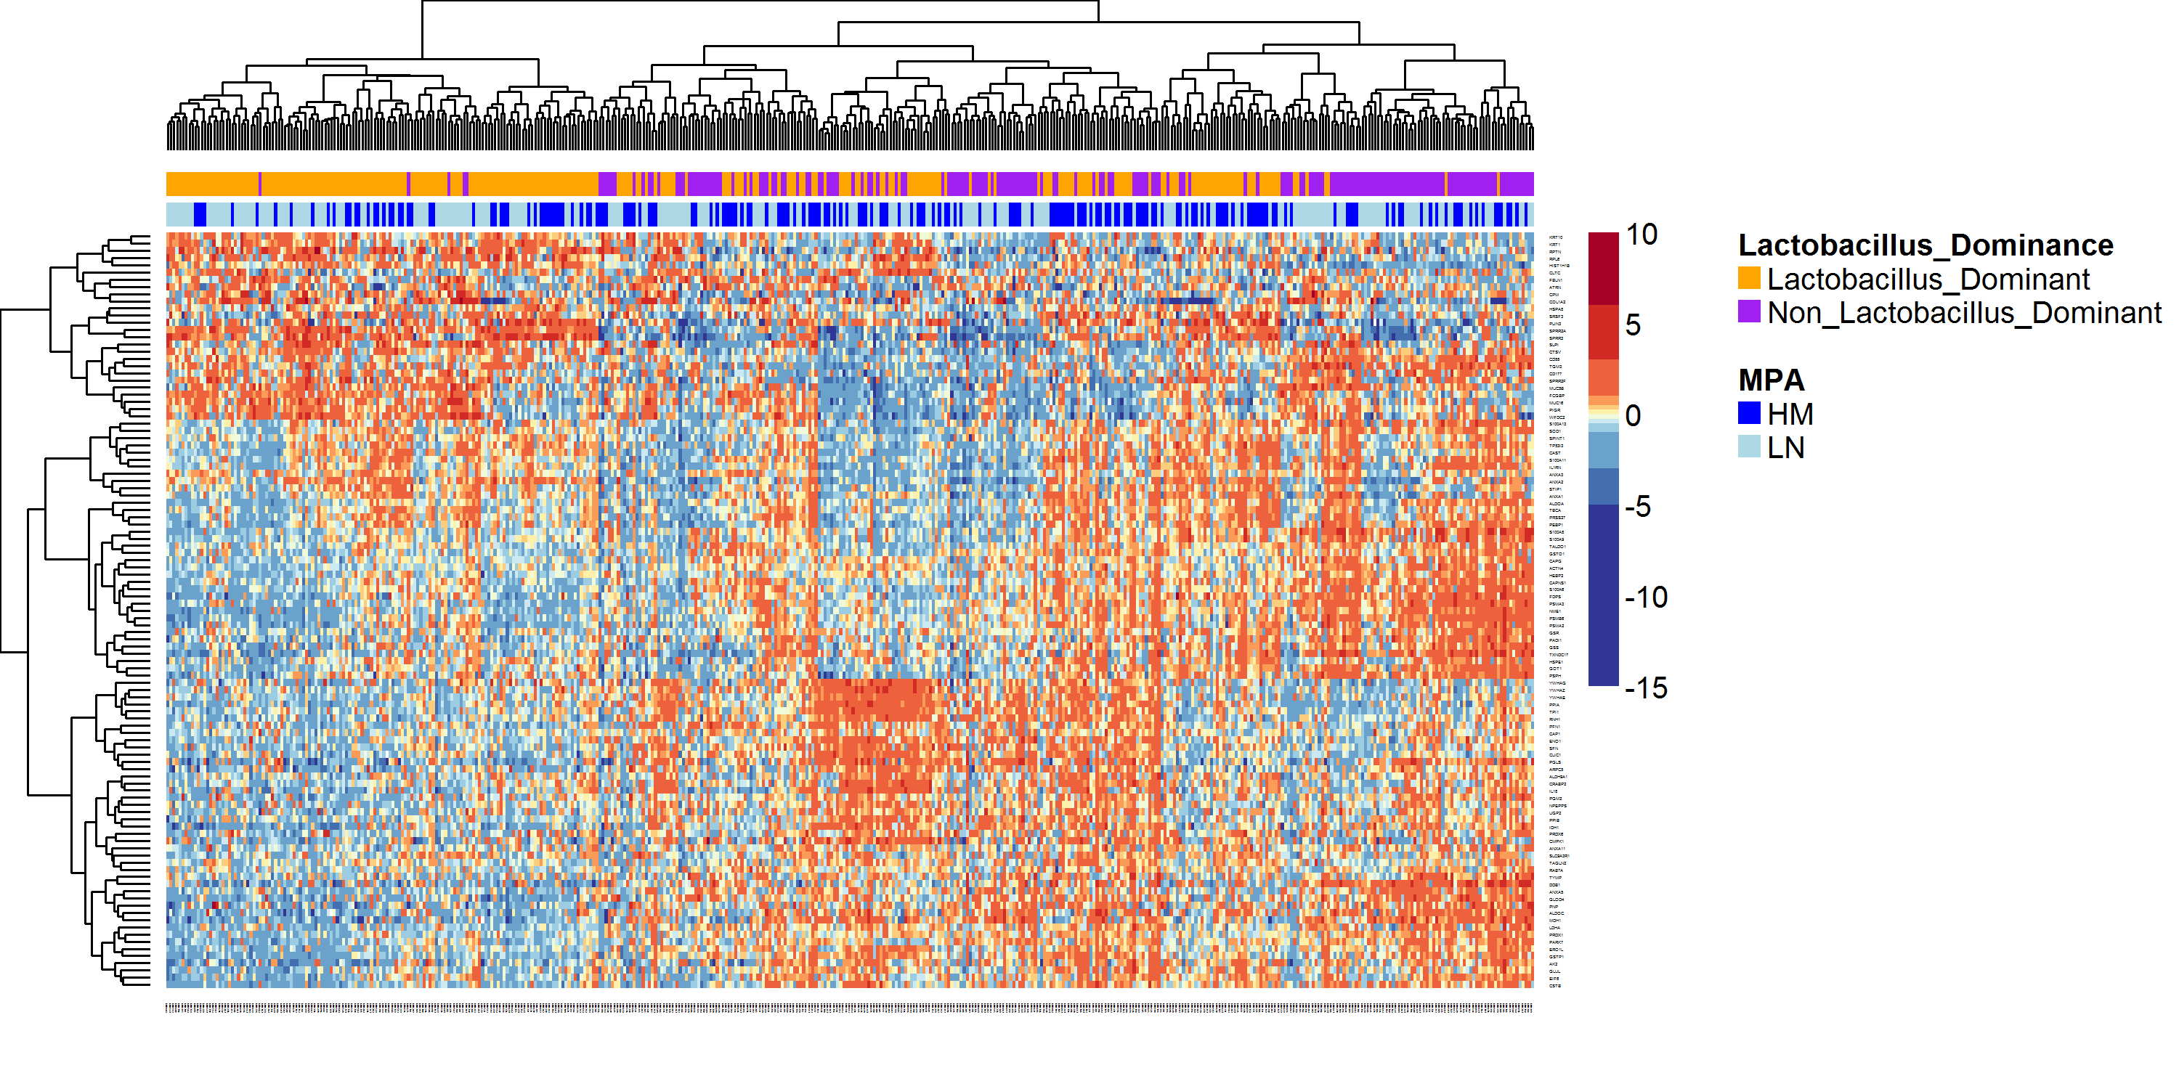
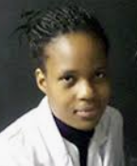

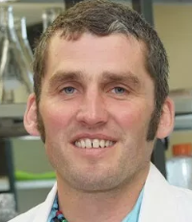
MPA-associated inflammation is more pronounced in Lactobacillus dominant women
High MPA: >300 pg/ml
Low MPA: ≤50-299 pg/ml
Low inflammation
Lactobacillus + low MPA
High inflammation
All Non-Lactobacillus
Lactobacillus + high MPA
Epithelial Integrity
Tissue development
Pro-inflammatory pathways
ERK signaling
Chemotaxis
Cellular
Metabolism
Glycolysis
NO/ROS signaling
Refilwe Molatlhegi, University of Kwazulu-Natal
Lyle McKinnon, University of Manitoba
Al Leslie, Africa Health Research Institute and University College London

Slide 4
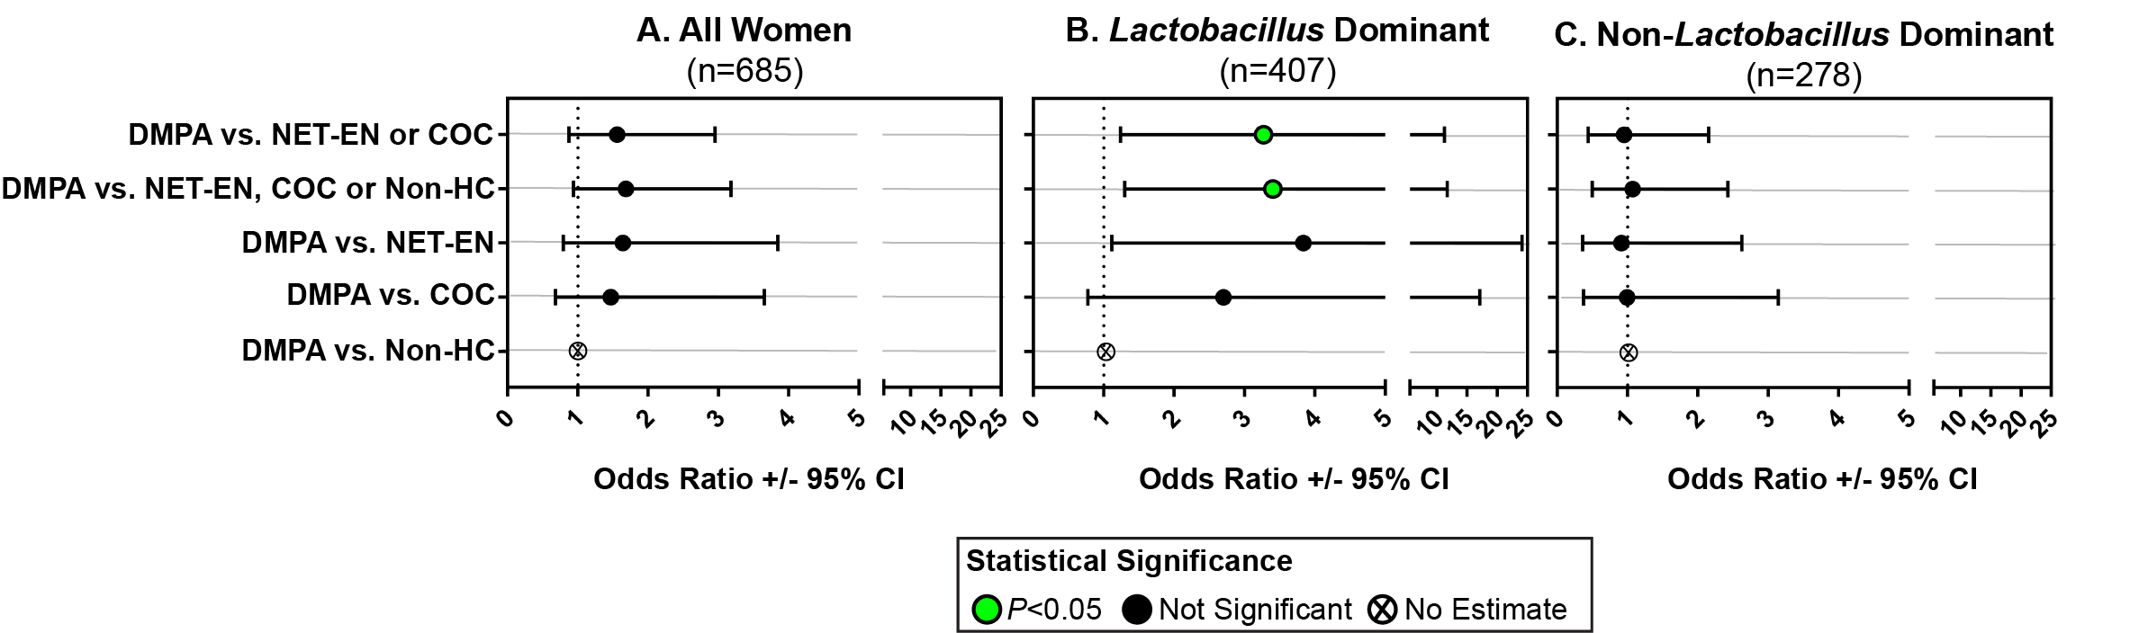
Case control analysis of DMPA use, stratified by microbiome groups
Adjustments for confounding variables (age, study arm, income, education and HSV2 status), as well as sexual behaviours (number, frequency and condom use) did not affect findings.
Repeated analysis in L. iners dominant women did not differ from above findings.
This study is hypothesis generating, and shows that the immune microbiome axis may modify DMPA-associated immune activation and HIV risk.
Considerations of the host-microbiome context will be important for the interpretation of clinical trial assessing the safety of hormonal contraceptives.

Slide 5
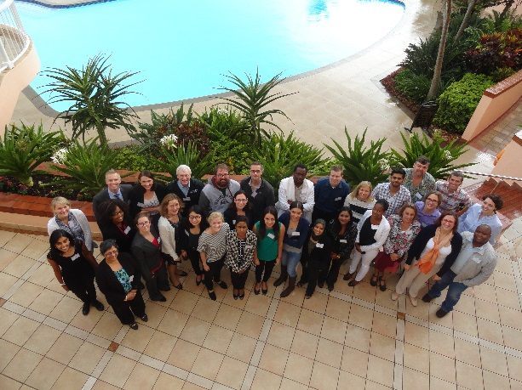
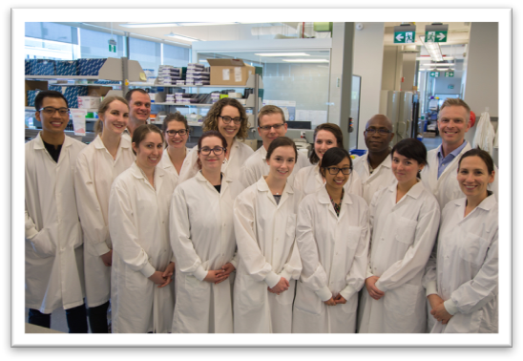
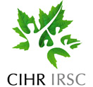
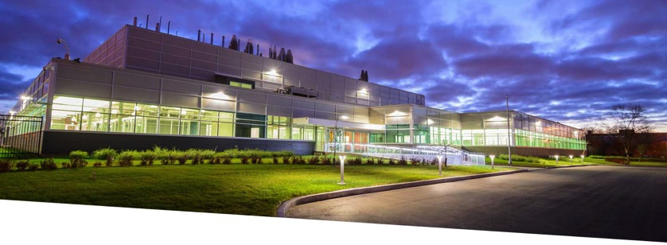
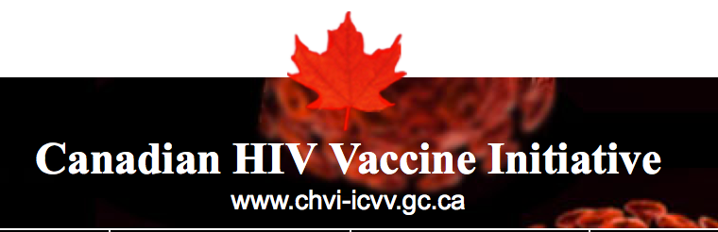
Acknowledgements
Public Health Agency of Canada (JC Wilt Infectious Disease Research Centre)
Dr. Adam Burgener
Michelle Perner
Alana Lamont
Sarah Mutch
Kenzie Birse
Max Abou
Christina Farr Zuend
Alicia Berard
Samantha Horne
Kat Kratzer
Marlon DeLeon
Hossaena Ayele
Peter McQueen
Lisa Zhan
Cobi Wichar
Paul Sandstrom
Garett Westmacott
Stuart McCorrister
Matt Gilmour
CAPRISA Team
Lyle McKinnon (U of Manitoba)
Refilwe Molatlhegi
Salim Abdool Karim
Quarraisha Abdool Karim
Anneke Grobler
Leila Mansoor
Natasha Samsunder
Kim Cousins
Jo-Ann Passmore
CIHR Team Grant Co-Investigators
Doug Lauffenburger
Kelly Arnold
Kristina Broliden
Annelie Tjerlund
Klara Hasselrot
University of Manitoba – Dept. Gynecology
Vanessa Poliquin
Fran Mulhall
Bonnie Sandberg
Adelicia Yu
Margaret Burnett
University of Washington
Renee Heffron
Study participants from the CAPRISA 004, without whom these studies wouldn’t be possible
Africa Health Research Institute
Al Leslie
Amanda Mabula

