Slide 1


Slide 2




Prospective, multicenter study to assess point prevalence, incidence and recurrence of sexually transmitted infections in men who have sex with men in Germany (BRAHMS study)
Hendrik Streeck
Institute for HIV Research, Essen, Germany
Institute for
HIV Research
@HendrikStreeck

Slide 3






Brahms Study Team -Acknowledgements
We thank all volunteers for their participation in this study!
Institut für HIV Forschung
MHRP/WRAIR
Universitätsklinikum Köln
Universitätsklinikum Bonn
Hendrik Streeck
Anna-Lena Brillen
Alexandra Knorr
Patrick Juszczak
Alexandra Braselmann
Robert Gramzinski
Merlin Robb
Nelson Michael
Sandyha Vasan
Erica Broach
Julie Dorsey Spitz
Trevor Crowell
Clara Lehmann
Jörg-Janne Vehreschild
Gerd Fäthkenheuer
Florian Klein
Christoph Boesecke
Jürgen Rockstroh
Community Advisory Board
Armin Schafberger
Dirk Sander
Harriet Langanke
Nicholas Feustel
Christopher Knoll
Marc Grenz
Martin Ocepek
Arne Kayser
Christoph Claes
Carsten Gehrig
HPSTD Clinic, Essen
USAMMDA
Stefan Esser
Robert Jablonka
Elisabeth Heger
Praxis Hohenstaufenring
Institut für Interdisziplinäre Medizin (IFI)
Stefan Scholten
Stephan Schneeweiß
Mascha Mues
Irene Beckmann
Johannes Kühn
Walk In Ruhr
Norbert H. Brockmeyer
Anja Potthoff
Janet Wach
Albrecht Stoehr
Andreas Plettenberg
Thore Lorenzen
Stefan Unger
ZIBP Berlin
Praxis Jessen²+Kollegen
Jukka Hartikainen
Axel Baumgarten
Infektiologikum
Heiko Jessen
Arne Jessen
Gabriele Knecht
Markus Bickel
Thomas Lutz
Praxis Dr. Cordes
This study was funded by:
Klinikum rechts der Isar
Christiane Cordes
Martin Viehweger
Elena Rodriguez Castellano
Christian Lieb
Christoph Spinner
Jochen Schneider
Christiane Schwerdtfeger Marcel Lee
Robert Koch Institut
Labor Krone
Viviane Bremer
Barbara Gunsenheimer-Bartmeyer
Klaus Jansen
Ulrich Marcus
Carsten Tiemann
Dieter Münstermann
Ann-Kathrin Ziesenis

Slide 4
Disclosure
Received project funds, grant awards or other kind of research related contributions in the last 5 years:
Janssen, Gilead, Hologic, DFG, DZIF, BMG, ERC, EKFS, Hector, USAMMDA, NIH, DoD.
Received honorarium, consultancy fees, advisory fees or other kind of personal contributions in the last 5 years:
BMS, Gilead, Janssen, ViiV, MSD, Hexal, EMA.

Slide 5


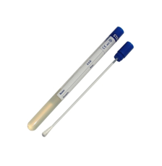
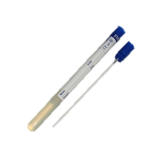

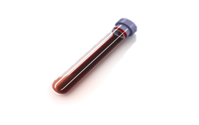
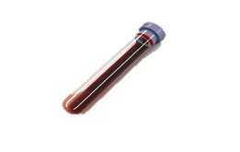
*
1000
(18-55)
1
2
3
HIV-
condomless anal intercourse with at least two unique male partners in the past 24 weeks
documented history of Syphilis, rectal Mycoplasma genitalium, Chlamydia, Gonorrhea or acute Hepatitis C infection in the last 24 weeks
0
months
3
Anal swab
months
Pharyngeal swab
6
months
urine
9
months
12
months
blood
* Assigned at birth, chosen or intersexual

Slide 6
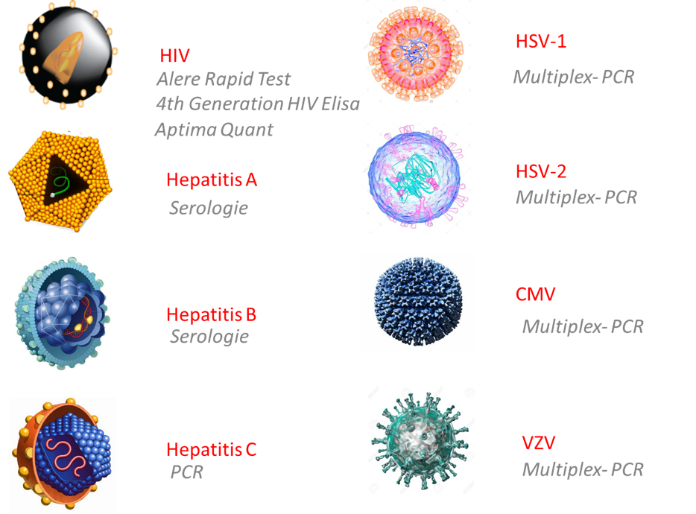
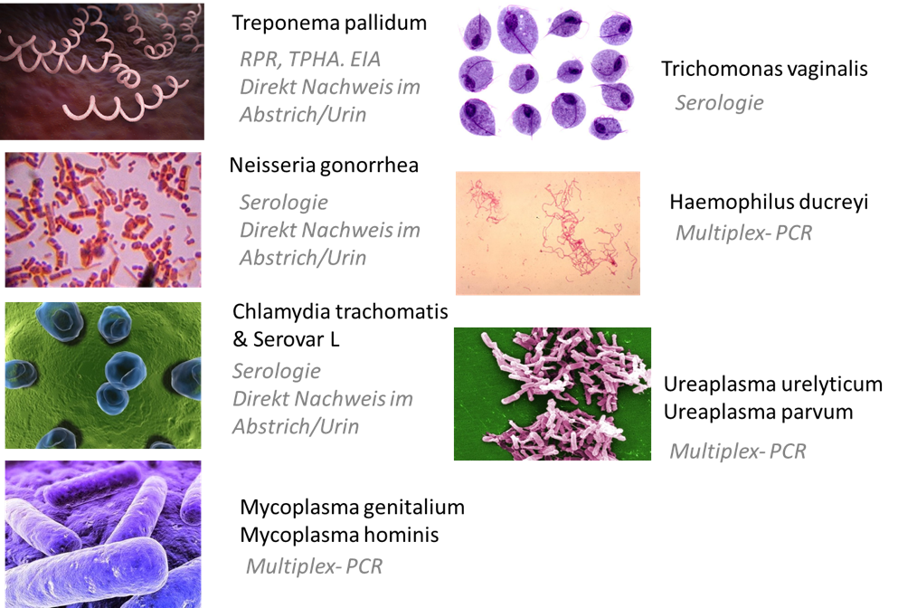

Slide 7
High point prevalence of STIs at screening
n=1040

Slide 8
Rectal and Asymptomatic

Slide 9
38%
44%
17%

Slide 10
STIs and PrEP use at baseline

Slide 11
Summary
High point prevalence of STIs (Gonorrhea (9.9%), Chlamydia trachomatis (12.7%) and Mycoplasm genitalium (18.8%)) low point prevalence of HIV (0.4%) in individuals at risk for HIV infection.
High frequency of asymptomatic (in particular rectal) STIs.
There was no difference in STIs among PrEP users and Non-PrEP user at baseline. However, only the results of the incidence data will show whether there is a difference between both groups.

