Slide 2
Factors associated with current ART use among trans women participating in Trans Amigas study, São Paulo, Brazil
Luca Fasciolo Maschião, Kátia Bassichetto, Gustavo Santa Roza Saggese, Hailey Gilmore, Maria Amélia Veras, Jae Sevelius and Sheri Lippman
www.nudhes.com
Share your thoughts on this presentation with #IAS2019

Slide 3
Disclosure
The authors claim no conflicts of interest.

Slide 4
Background
Trans women carry one of the heaviest burdens of HIV infection
Pooled worldwide prevalence of HIV: 19.1% (Baral S. et al, 2013)
In Rio de Janeiro, Brazil: 31.2% (Grinsztejn B. et al, 2017)
Context of social vulnerability, stigma, violence, risk behavior and poor mental health (Poteat, T. et al, 2016; Dhejne C. et al, 2016; Transrespect versus Transphobia, 2018 )
Brazil:t universal healthcare and availability of ART
Trans women face several barriers to access care - transphobia and discrimination in healthcare services (Rocon, P. C. et al, 2016; Costa A et al, 2016)
Importance of tailored strategies to tackle possible unique barriers to HIV care (Sevelius J.M. et al, 2019)

Slide 5
Trans Amigas study
Ongoing randomized pilot study among trans women living with HIV in Brazil to evaluate a peer navigation program.
Intervention based on gender affirmation and peer support.
Peer Navigators (PN)
Participants
18 or older trans women Living with HIV
Adherent to ART
Recruited from community
Selected during training phase
18 or older trans women Living with HIV
Randomized for Control or Intervention
Recruited from testing and HIV treatment clinic
If intervention, assigned to peer navigator at baseline

Slide 6
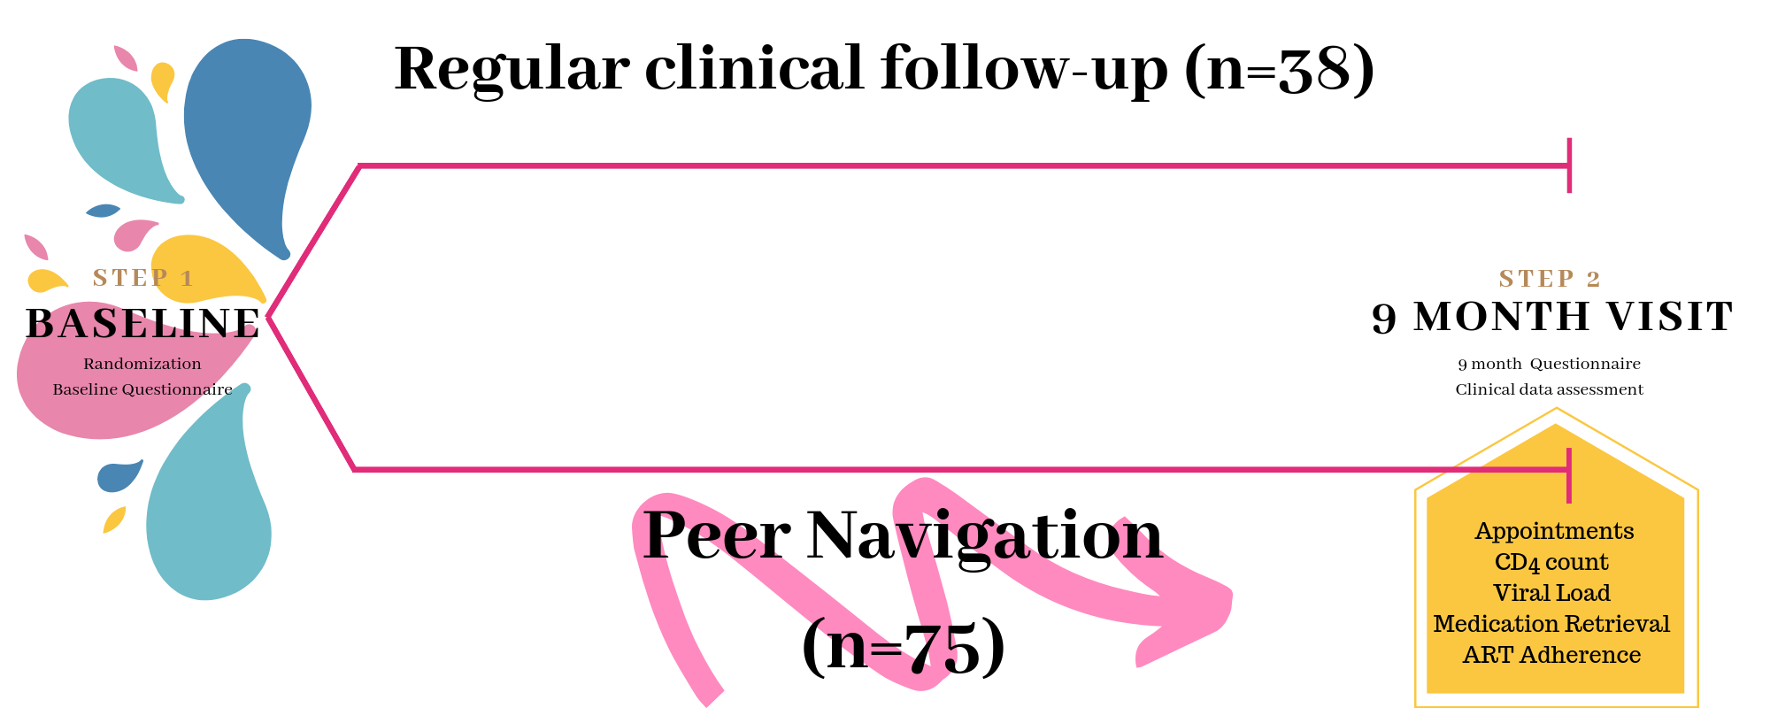

Slide 7
Objective
To describe and assess factors associated with current ART use among recruited trans women at baseline, including:
Sociodemographic data
Mental Health data
Substance Use
HIV-related appointments
Barriers to HIV Care

Slide 8
Methods
Those who reported current ART use were compared to the group of those:
Who never had an HIV-related appointment;
Who had an HIV-related appointment, but were not prescribed ART;
Who had an HIV-related appointment, reported previous ART use, but stopped taking ART.
Chi-square test was employed to assess factors associated with current ART use. Significant level was set to p<0.05.

Slide 9
Results

Slide 10
Results

Slide 11
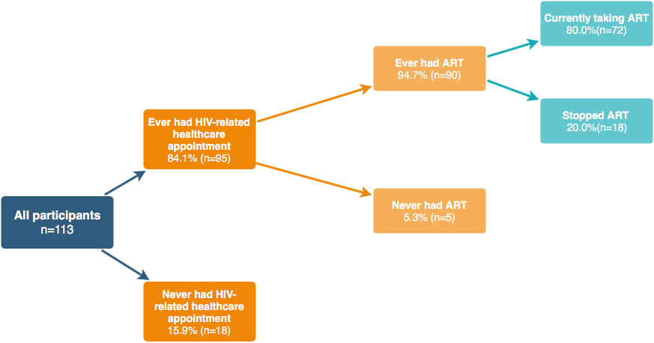
Results
Currently using ART: 63.7%
Not currently using ART: 36.3%

Slide 12
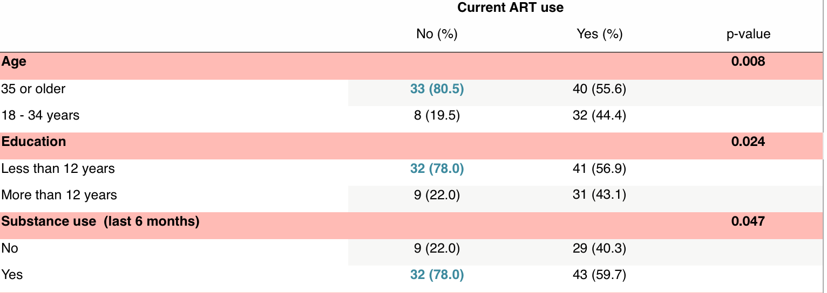
Results Factors associated with current ART use
Ethnicity, Income, housing stability, employment, mental distress (K10 scale), Alcohol use and experiences of violence were not significantly associated with current ART use, as well as randomized group assigned.

Slide 13
Discussion
Current ART use was low (64%) when compared to other key populations in Brazil (e.g. MSM who knew their status = 95% - Guimarães et al, 2019, unpublished data);
Lower education is a known risk factor for low adherence to ART;
In contrast to what is described in ART adherence literature, our findings indicate that younger trans women were more likely to be on ART - possibly an effect of less negative healthcare experiences due to recent health policies such as chosen name law;
Illegal substance use may play a role deepening barriers to care in a greater marginalization setting;
ART use at baseline will be taken into account in the final analyses of this study.

Slide 15
www.nudhes.com
Thank you!
Funding: NIH/NIMH- R34 MH112177: Lippman, Sevelius, Veras, Saggese with the collaboration of São Paulo State Health Department

Slide 16
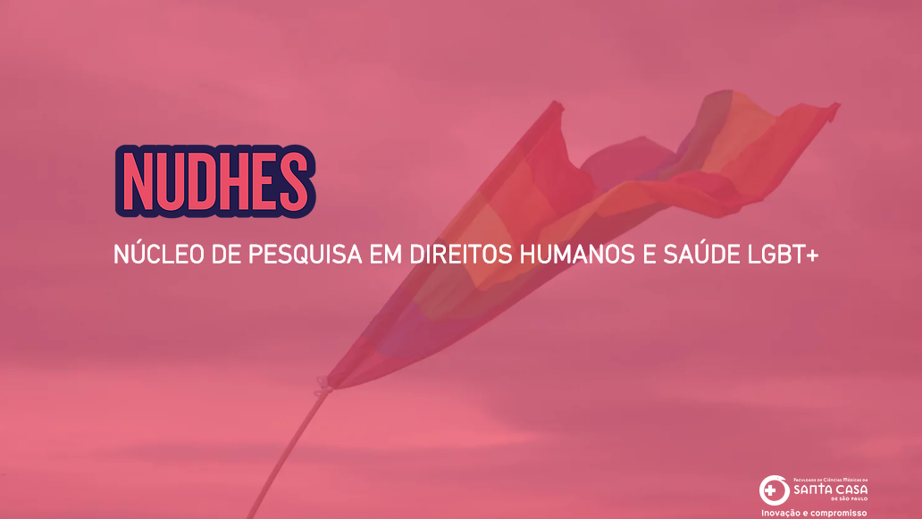
www.nudhes.com

