Slide 1
Social Network Characteristics Are Associated with Prevalent Tuberculosis Infection Among People Living with and without HIV in Nine Rural Ugandan Communities
Carina Marquez, Yiqun Chen, Mucunguzi Atukunda, Joel Kironde, Gabriel Chamie, Laura B. Balzer, Dalsone Kwarisiima, Tamara D. Clark, Moses R. Kamya, Edwin D. Charlebois, Maya L. Petersen, Diane V. Havlir
@carina_marquez
Share your thoughts on this presentation with #IAS2019

Slide 2
Disclosures
None

Slide 3
Background
An improved understanding of community based Tuberculosis (TB) transmission is needed to develop novel TB control interventions
Over a quarter of the world’s population is infected with TB¹
An estimated 80% of TB infections are acquired outside of the home;³ however, transmission in the community has not been well characterized.
Understanding TB transmission outside of the home is critical to developing novel prevention and and case-finding interventions
1. Houben & Dodd PLoS Med 2016; 2. WHO Global TB Report 2018; 3.Martinez Am J. Epi 2017

Slide 4
Background
Social network analysis has potential to elucidate hidden TB transmission dynamics in the community
Social network analysis (SNA) assesses the connections between individuals
  - Elucidate sources and patterns of persons-to-person spread of infectious diseases ^{1,2}
  - Identify networks of people at high risk for a given disease by nature of shared behaviors and shared spaces.
Few SNA studies have used latent TB infection as an outcome and community-wide social networks.
1. Shah NEJM 2017; Chamie PLOS One 2018

Slide 5
Primary Objective: To assess whether social network characteristics in 9 rural communities in Uganda are associated with prevalent TB infection, beyond individual-level TB risk factors.

Slide 6
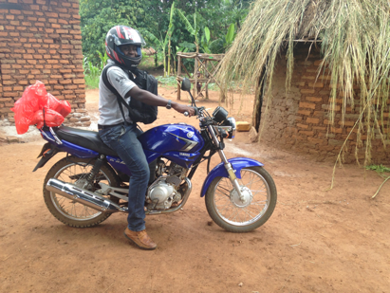
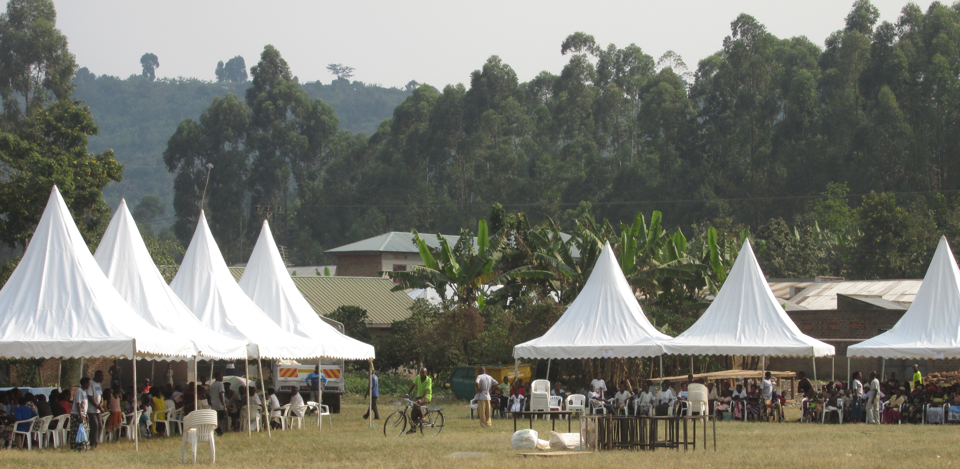
Study Population
SEARCH Baseline Survey (2013-2014):
Adult (>15 years) residents in 9 rural communities in Eastern Uganda enumerated in the baseline census of the SEARCH ‘test and treat trial’ ¹
Each community ~10,000 persons
TB Infection Baseline Survey (2015-2016):
Adults (>15 years) participating in a household survey nested within the 9 SEARCH communities in Eastern Uganda.
Random sample of 200 households per community enriched for households with people living with HIV (PLWH).
SEARCH community health campaign
Household visits for tuberculin skin tests in SEARCH communities
Household in Eastern Uganda
1.Havlir NEJM 2019

Slide 7
Study Measures and Definitions
SEARCH Baseline Survey
Demographics, HIV Status, and Social Networks: Community-wide health campaigns with home-based testing for non-attendees.
TB Infection Baseline Survey
Prevalent TB Infection:
TB infection defined as a positive tuberculin skin tests (TST): induration >10mm or >5mm if PLWH
All adults (>15 years) registered to households in the TB Infection Survey were eligible for TSTs.
3 visits to the household
Demographics and TB Questionnaire: TB history, BCG vaccination history (scar or record of vaccination), household TB contact (ever).

Slide 8
Methods-Social Networks
Social Networks
Adults named social contacts in 5 domains:
  Health: “With whom have you discussed any kind of health issue?”
  Emotional support: To whom have you gone to receive emotional support?
  Free time: With whom have you usually spent time for leisure, enjoyment, relaxation?
  Money: With whom have you discussed any kind of money matters?
  Food: With whom, outside of your household, have you shared, borrowed, or exchanged any food?
Matched named contacts to residents enumerated in the census
Social networks restricted to first-degree non-household contacts of the 3,335 persons in the TB infection baseline survey.
1st Degree Social Network

Slide 9
Statistical Analysis
1. Association between network features and prevalent TB infection
Primary outcome: Prevalent TB Infection
Exposure Variables: Network Features
  Structure: degree, density, and centrality
  Node Characteristics: number of men, women, PLWH, low household wealth
  Dichotomized exposures variables into top 10% (yes or no) and bottom 10% (yes or no)
Adjusted relative risk (aRR) by Targeted Maximum Likelihood Estimation (TMLE)
    Outcome and exposure propensity modeled by machine learning (Super Learner)
    Adjusted for individual level co-variates (age, gender, HIV, BCG, TB contact), sampling weights
2. Clustering by TB infection status
-Permutation test to assess whether persons are more likely than chance to be friends with someone of the same TST status.

Slide 10
TB Infection Baseline Survey
6118
Adults registered to households participating in household survey
97% Not at home
3% Declined TST
3,335 (55%)
Tuberculin Skin Test (TST) Placed
32% had a positive TST
2,395 (71%)
linked in a 1st- degree non-household social network

Slide 11
Demographics and Individual-level TB Risk Factors
TB Infection Survey
 | Overall (N=3,335) | RR (95%CI) | aRR (95% CI)*
Mean Age (SD) | 32.3 (18.3)
Age Strata
Younger than 20 | 21.7% | 0.7 (0.6-0.9) | 0.7 (0.6-0.93)
Older than 50 | 29.9% | 1.1 (1.0-1.3) | 1.1 (1.0-1.2)
Male | 43.1% | 1.2( 1.1-1.4) | 1.4 (1.2—1.5)
Lowest Wealth Tertile** | 20.2% | 1.1 (0.9-1.2) | 1.1 (1.0-1.4)
HIV infected*** | 20.2% | 0.6 (0.5-0.7) | 0.5 (0.5-0.6)
BCG Vaccinated (scar or record) | 80.0% | 1.3 (1.0-1.6) | 1.3 (1.0-1.5)
Household TB Contact (ever) | 30.0% | 1.9 (1.7-2.3) | 2.0 (1.7-2.3)
*adjusted for age, gender, wealth, HIV infection, BCG vaccination, and history of contact, clustering by household;* * wealth tertile- conducted from principal component analysis of household assets from households in SEARCH study;*** 3% with missing HIV status coded as missing.

Slide 12
Demographics and Individual-level TB Risk Factors
TB Infection Baseline Survey
 | Overall (N=3,335) | RR (95%CI) | aRR (95% CI)*
Mean Age (SD) | 32.3 (18.3)
Age Strata
Younger than 20 | 21.7% | 0.7 (0.6-0.9) | 0.7 (0.6-0.93)
Older than 50 | 29.9% | 1.1 (1.0-1.3) | 1.1 (1.0-1.2)
Male | 43.1% | 1.2( 1.1-1.4) | 1.4 (1.2—1.5)
Lowest Wealth Tertile** | 20.2% | 1.1 (0.9-1.2) | 1.1 (1.0-1.4)
HIV infected*** | 20.2% | 0.6 (0.5-0.7) | 0.5 (0.5-0.6)
BCG Vaccinated (scar or record) | 80.0% | 1.3 (1.0-1.6) | 1.3 (1.0-1.5)
Household TB Contact (ever) | 30.0% | 1.9 (1.7-2.3) | 2.0 (1.7-2.3)
*adjusted for age, gender, wealth, HIV infection, BCG vaccination, and history of contact, clustering by household;* * wealth tertile- conducted from principal component analysis of household assets from households in SEARCH study;*** 3% with missing HIV status coded as missing.

Slide 13
Does the structure of someone’s social network predict TB infection risk?
Degree
Number of connections to other nodes
Density
The proportion of potential connections that are actual connections
Centrality
How well connected a node within the network is, ie. a highly central node is one that has many connections and their connections have many connections
Degree= 4
Density: 3/3, 67%
Density: 2/3, 67%

Slide 14
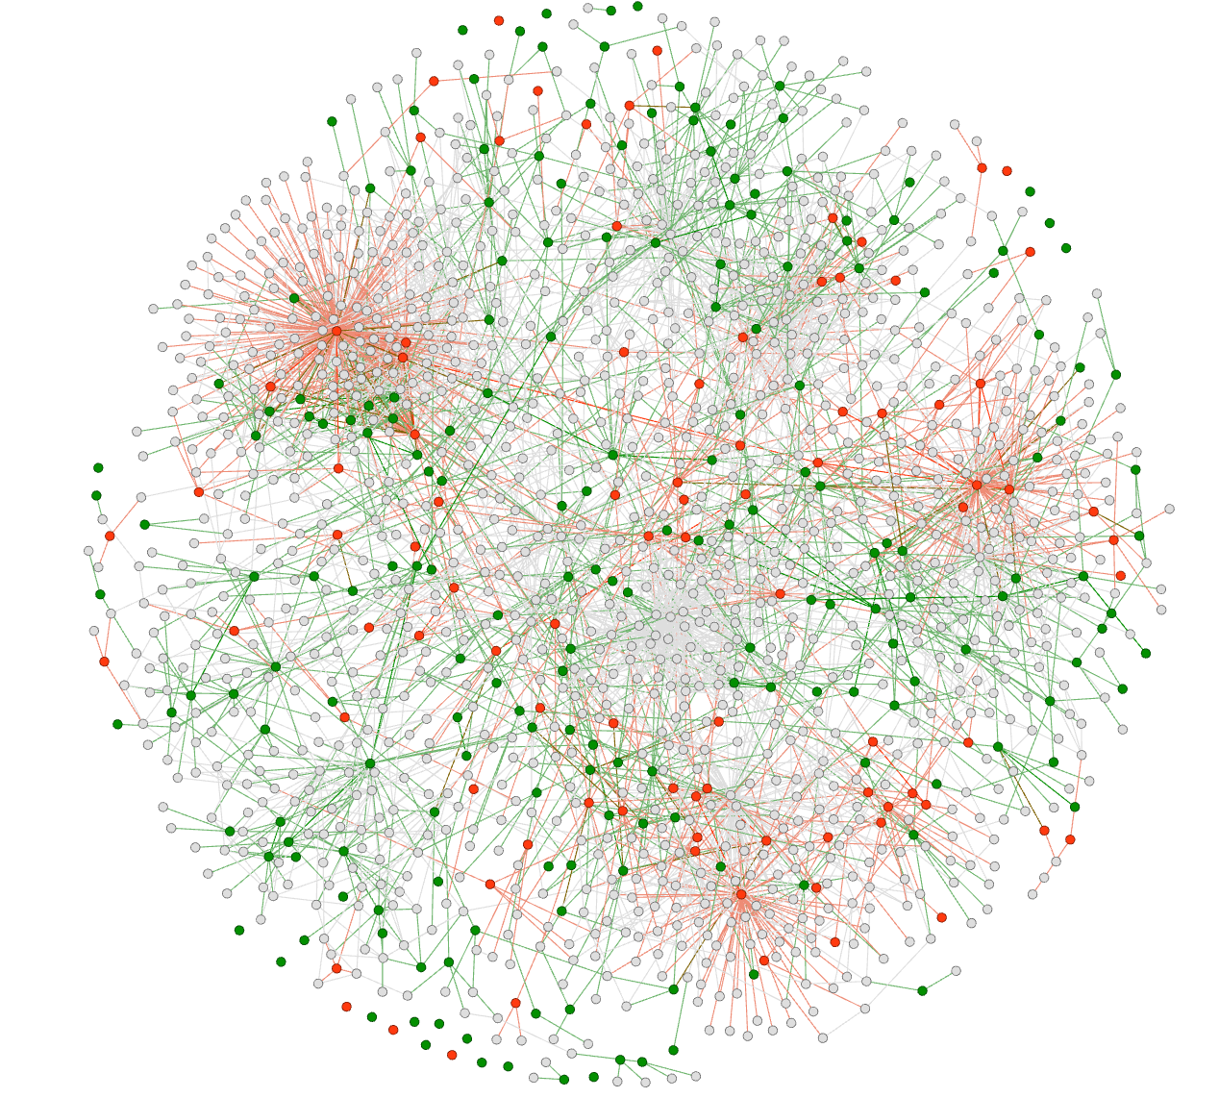
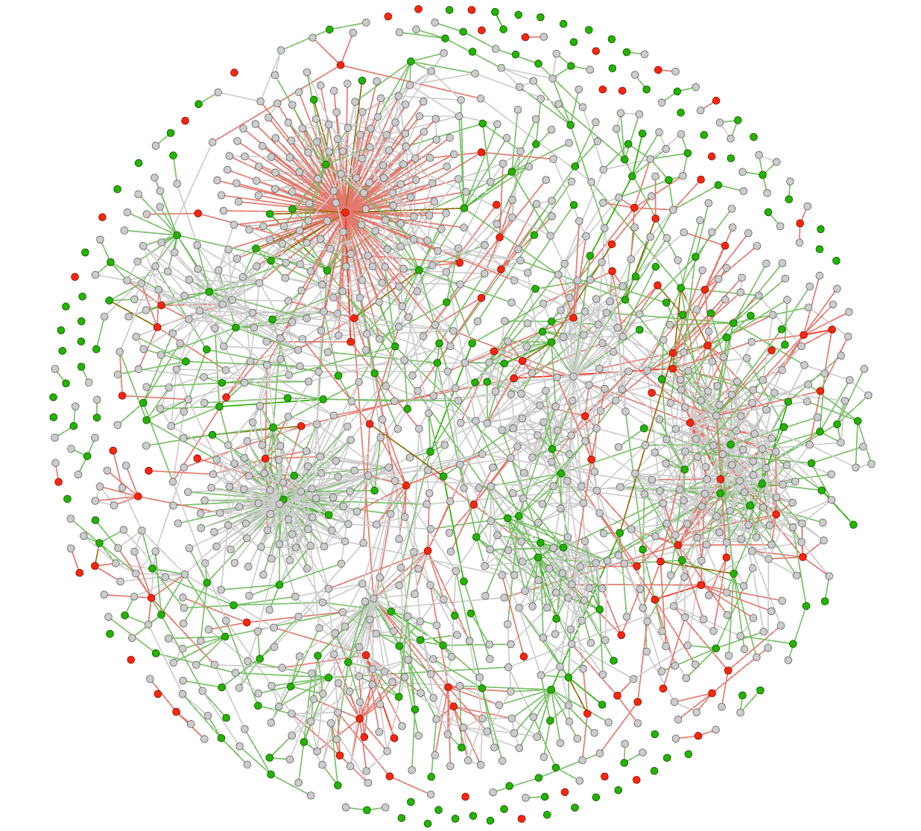
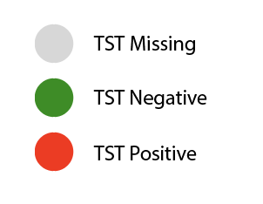
RESULTS- Network Visualization
Community 1: Kamuge
Community 2: Nankoma

Slide 15
RESULTS- Network Visualization
Community 1: Kiyunga
Community 2: Nankoma
TST positive persons with
high network degree

Slide 16
Persons with TB infection Are More Connected
 | Overall Mean (SD) | TST negative Mean (SD) | TST positive Mean (SD)
Degree (# of friends) | 6.7 (8.5) | 5.0 (5.7) | 6.5 (11.5)
*Restricted to 2,276 adults in social network
Notes:
When we look at unadjusted network features we can see that TST positive persons have more friendsare more connected. Aferage number of friends is 6.7, Negatives 5 and positives 6.46. Did not see differences in density.

Slide 17
Network degree associated with TB Infection, independent of individual level TB risk factors
Network Structure |  | aRR (95%CI) N=3,355
Degree | Top 10% | 1.3 (1.1-1.5)
 | Bottom 10% | 0.8 (0.7-1.0)
Density | Top 10% | 1.1 (0.9-1.2)
 | Bottom 10% | 0.8 (0.6-1.0)
Centrality (Eigencentrality) | Top 10% | 1.1 (0.9-1.3)
 | Bottom 10% | 1.0 (0.8-1.2)
Adjusted for age, gender, household wealth, BCG, TB contact
Reference groups for RR’s are remaining 90%

Slide 18
Are the characteristics of the people who you socialize with associated with TB infection, independent of individual risks?

Slide 19
Node Characteristics Associated with Prevalent TB Infection
Node Characteristics of 1st Degree Networks |  | aRR (95%CI)
Number of Men | Top 10% | 1.5(1.4-1.8)
 | Bottom 10% | 1.0 (0.9-1.1)
Number of Women | Top 10% | 1.2 (0.9-1.4)
 | Bottom 10% | 0.8 (0.7-0.9)
Number in Lowest Wealth Tertile | Top 10% | 1.1 (0.9-1.3)
 | Bottom 10% | 1.0 (0.9-1.2)
Number People Living With HIV | Top 10% | 1.2 (1.1-1.4)
 | Bottom 10% | 0.8 (0.7-0.9)

Slide 20
Are people with prevalent TB infection more likely to socialize with other persons with prevalent TB infection?

Slide 21
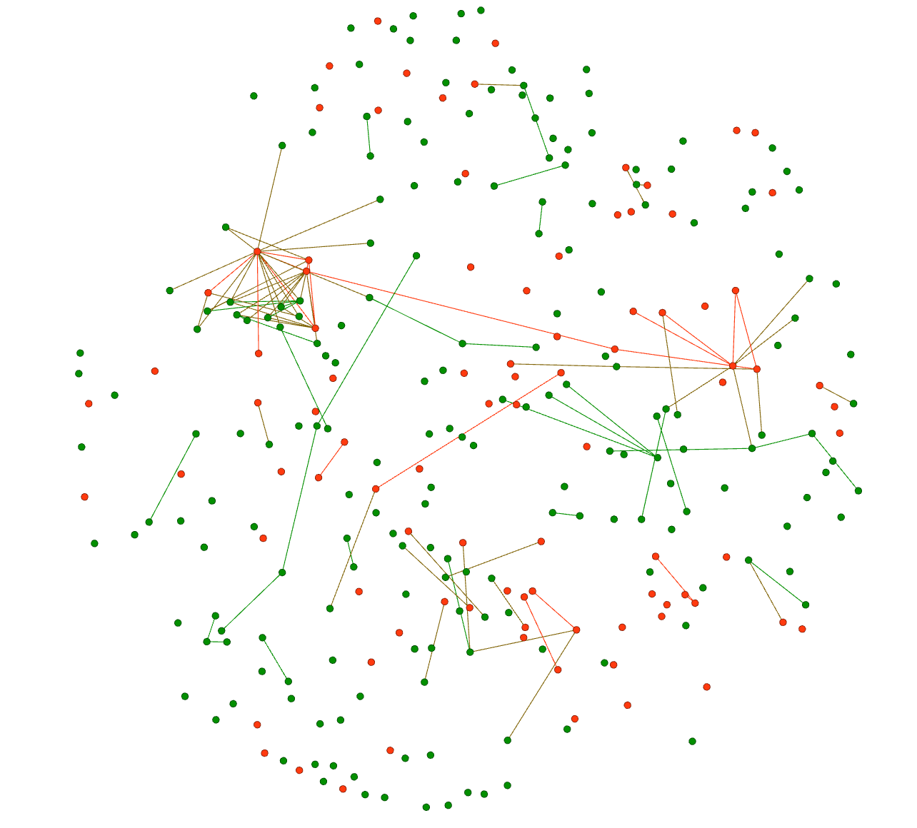
Prevalent TB infection in Friends Associated With TB Infection Status
Detected clustering by TST Status
  7/9 communities if p<0.1
  4/9 communities if p <0.05
Two or more TST + friends predict TST status
  One or more TST + contact: aRR 1.07 (95% CI: 0.92-1.25)
  Two or more TST + contact: aRR 1.29 (95% CI: 1.01-1.67)
Kiyunga 1st degree social network, restricted to network with TST status available, clustering detected, p-value for permutation test <0.001
Notes:
Mis

Slide 22
Conclusions
Characteristics of non-household social networks associated with prevalent TB infection.
  Higher network connectivity (degree)
  More men and PLWH (top 10%) in a network predict TB infection status.
Implications for community based TB transmission
  Associations mediated by shared risk behaviors and/or direct transmission
  Suggests potential for network- focused interventions for men and PLWH
We detected clustering by TB infection status in the majority of communities.
  Potential of social network based methods to enhance case finding in East Africa and other high-TB burden settings

Slide 23
TB Infection Survey Team
Pis: Diane Havlir, Moses Kamya, Maya Petersen
Statisticians: Laura Balzer, Mark van der Laan
Vice-Chair: Edwin Charlebois
Social Networks: Yiqun Chen, Wenjing Zheng
MU-UCSF : Dalsone Kwarisiima, Jane Kabami, Asiphas Owaraganise, Florence Mwangwa, Mucunguzi Atukunda, Tamara Clark, Gabriel Chamie, Starley Shade, Carol Camlin, Catherine Koss, Lillian Brown
TB Infection Survey Project Coordinators: Mucunguzi Atukunda, Joel Kironde
TB Infection Survey Research Assistants: Deogratius Ekol, Zadmina Wangbo, Peter Okira
TB Infection Survey Funding: NIH/NIAD K23 AI118592
KEMRI: Elizabeth Bukusi, Norton Sang, James Ayieko, Keven Kadeke ; KEMRI/UCSF: Craig Cohen

