Slide 1
Does the use of HIV self-testing kits lead to unintended effects? Evidence from female sex workers in Malawi
Dr Paul Mee – London School of Hygiene and Tropical Medicine
HIV SELF-TESTING AFRICA
STAR Initiative

Slide 2
Competing interests
The authors declare that they have no competing interests.

Slide 3
What I will cover today
Background to the study
Summary of research methods and analytical approach
Evidence for regret associated with HIVST use
Evidence for social harms following HIVST use
Conclusions and next steps

Slide 4
Background - HIV Self testing in Female Sex Workers
Worldwide Female Sex Workers (FSW) experience high levels of violence ¹
RCTs show HIVST associated with an increased uptake and frequency of testing ²
HIV Self testing (HIVST) - a safe and acceptable alternative to Facility based testing for FSWs in Zambia, Uganda, Kenya & Zimbabwe ^{3,4,5,6}
High readiness for HIVST in the General Population in Malawi – preferred to facility based testing ⁷
Concerns remain about social harms of HIVST amongst vulnerable groups
References
¹ Deering K.N. et al . AMJPH (2014 ) ⁵ Thirumurthy H. et al. Lancet HIV (2016)
² Johnson CC et al JIAS(2017) ⁶ Napierela et al Bull WHO (in press)
³ Chanda, M.M. et al. PLoS medicine (2017) ⁷ Choko A.T. et al PLoS medicine. (2015)
⁴ Ortblad, K. et al. PLoS medicine (2017)

Slide 5
This study - Peer distribution of HIVST to FSW in Malawi
Research led by the team from the Malawi-Liverpool-Wellcome Trust Clinical Research Programme in Blantyre, Malawi (March – December 2017)
Part of a programme of studies into HIVST distribution in Malawi (Kumwenda M.K. et al. JIAS 2019)
Study goals
Investigate appropriate HIVST delivery models among FSW
Monitor for potential social harms
FSWs recruited as peer distributors – 5281 kits distributed , 2001 in Blantyre district
Prizes for most successful distributors
Participants could receive multiple kits over 3 months
Oral Fluid Test HIVST– OraQuick ADVANCE (with WHO pre-qualification approval)
Study protocol (http://hivstar.lshtm.ac.uk/protocols/)

Slide 6
Data Collected
For each HIVST recipient
T= 0 – HIV Self test received
Baseline interview
Audio Computer Assisted Interviews (ACASI) interview
Collected data on socio-demographics,
sexual behaviour, testing history , social harms

Slide 7
Data Collected
For each HIVST recipient
T= 0 – HIV Self test received
Baseline interview
Audio Computer Assisted Interviews (ACASI) interview
Collected data on socio-demographics,
sexual behaviour, testing history , social harms
Three month longitudinal diary
Daily reports on sexual behavior & social harms
Weekly reports on HIV testing

Slide 8
Data Collected
For each HIVST recipient
T= 0 – HIV Self test received
Baseline interview
Audio Computer Assisted Interviews (ACASI) interview
Collected data on socio-demographics,
sexual behaviour, testing history , social harms
T= 3 months
Endline interview
Repeat ACASI interview
Changes in sexual behaviour, testing and
occurrences of social harms
Three month longitudinal diary
Daily reports on sexual behavior & social harms
Weekly reports on HIV testing

Slide 9
Analytical Questions from the endline data
What percentage of participants reported regret about HIVST use or relationship problems associated with HIVST use?
Did this differ by socio-demographic characteristics, test result or test initiator?

Slide 10
Characteristics of the study cohort
Variable | Category | N (%)
Age | 16-25 | 151(57.0)
 | 26-35 | 96(36.2)
 | >36 | 18(6.8)
Education level | Primary or less | 170(64.2)
 | Secondary or higher | 95(35.8)
Total |  | 265
High rates of Intimate Partner Violence reported at baseline (48.4%)
Data on regrets and relationship problems associated with HIVST use available for 131/265 (49.4 %)
This group slightly older than those not reporting this data

Slide 11
Regret and relationship problems amongst those reporting HIVST use at endline
Variable | Category | Total | Immediate regret about HIVST use |  | Regret now about HIVST use |  | Relationship problems caused by HIVST use
 |  |  | % | p-value | % | p-value | % | p-value
Test initiator | Self | 87 | 12.6 | 0.20 | 9.2 | 1.0 | 3.4 | 0.06
 | Other | 44 | 22.7 |  | 9.1 |  | 13.6
HIVST result | Reactive | 45 | 15.6 | 1.00 | 6.7 | 0.54 | 8.9 | 0.25
 | Unreactive | 86 | 16.3 |  | 10.5 |  | 5.8
Age in years | 16-25 | 66 | 18.2 | 0.40 | 16.7 | < 0.01 | 9.1 | 0.51
 | 26-35 | 53 | 11.3 |  | 0 |  | 3.8
 | >36 | 12 | 25 |  | 8.3 |  | 8.3
Total |  | 131 | 16.0 | - | 9.2 | - | 6.9 | -
Percentage reporting regret about HIVST use was low and decreased over time since test

Slide 12
ACASI results III – regret and relationship problems amongst those reporting HIVST use at endline
Variable | Category | Total | Immediate regret about HIVST |  | Regret now about HIVST |  | Relationship problems caused by HIVST
 |  |  | % | p-value | % | p-value | % | p-value
Test initiator | Self | 87 | 12.6 | 0.20 | 9.2 | 1.0 | 3.4 | 0.06
 | Other | 44 | 22.7 |  | 9.1 |  | 13.6
HIVST result | Reactive | 45 | 15.6 | 1.00 | 6.7 | 0.54 | 8.9 | 0.25
 | Unreactive | 86 | 16.3 |  | 10.5 |  | 5.8
Age in years | 16-25 | 66 | 18.2 | 0.40 | 16.7 | < 0.01 | 9.1 | 0.51
 | 26-35 | 53 | 11.3 |  | 0 |  | 3.8
 | >36 | 12 | 25 |  | 8.3 |  | 8.3
Total |  | 131 | 16.0 | - | 9.2 | - | 6.9 | -
Evidence that relationship problems were greater if someone else initiated the HIVST
(mainly peer distributors)

Slide 13
ACASI results III – regret and relationship problems amongst those reporting HIVST use at endline
Variable | Category | Total | Immediate regret about HIVST |  | Regret now about HIVST |  | Relationship problems caused by HIVST
 |  |  | % | p-value | % | p-value | % | p-value
Test initiator | Self | 87 | 12.6 | 0.20 | 9.2 | 1.0 | 3.4 | 0.06
 | Other | 44 | 22.7 |  | 9.1 |  | 13.6
HIVST result | Reactive | 45 | 15.6 | 1.00 | 6.7 | 0.54 | 8.9 | 0.25
 | Unreactive | 86 | 16.3 |  | 10.5 |  | 5.8
Age in years | 16-25 | 66 | 18.2 | 0.40 | 16.7 | < 0.01 | 9.1 | 0.51
 | 26-35 | 53 | 11.3 |  | 0 |  | 3.8
 | >36 | 12 | 25 |  | 8.3 |  | 8.3
Total |  | 131 | 16.0 | - | 9.2 | - | 6.9 | -
No evidence that regret or relationship problems were associated with HIVST result

Slide 14
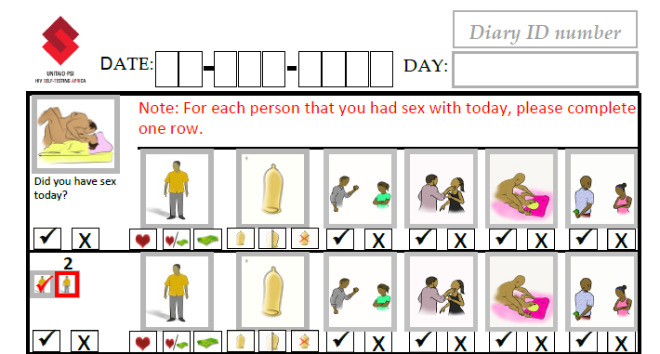
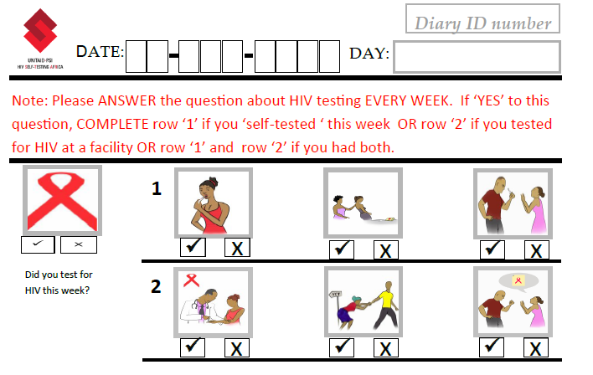
Longitudinal diary
Weekly reports of HIV self and facility based testing and coercion to test or disclose test result
Daily reports of type of sexual partners , condom use and social harms per partner

Slide 15
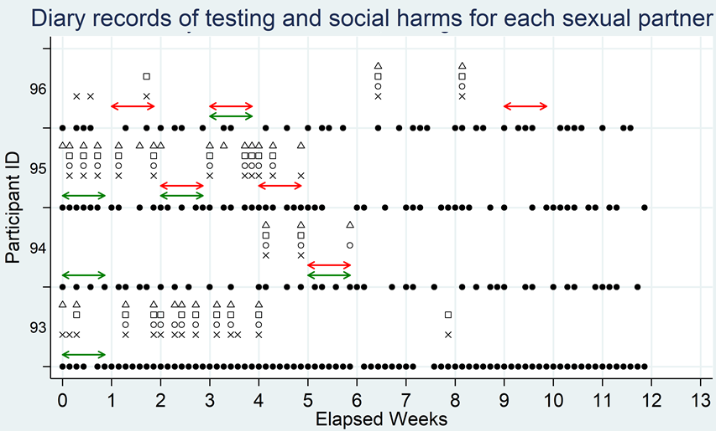
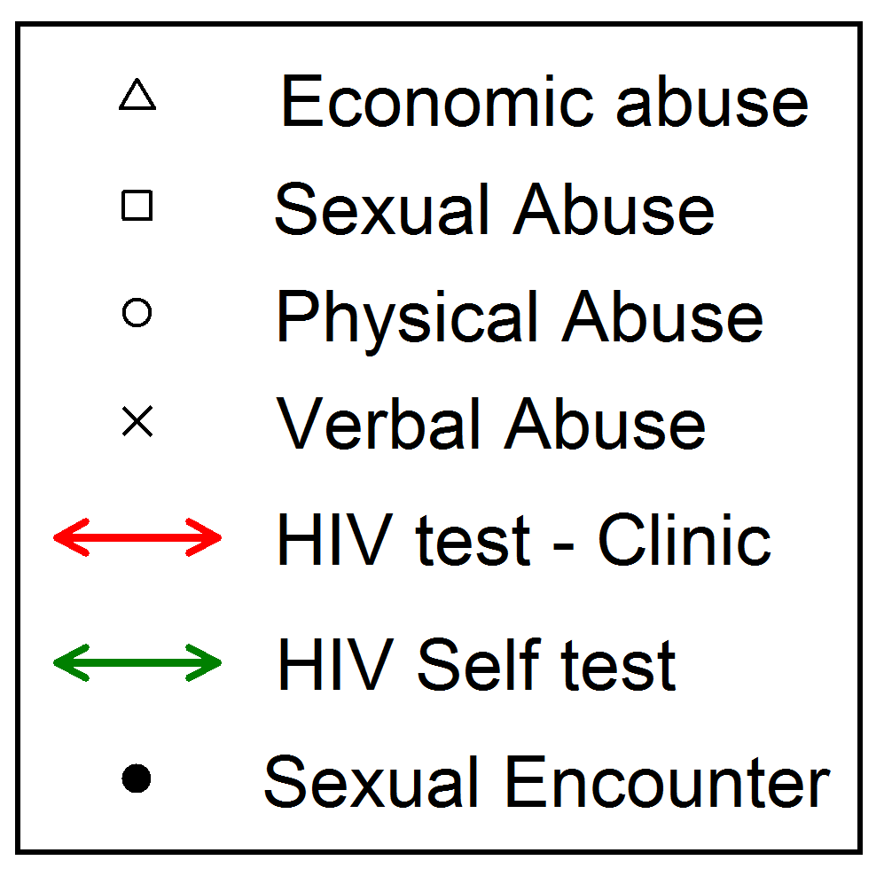
Longitudinal diary data

Slide 16
Longitudinal diary data
Analytical Questions
i) What evidence is there that social harms are more likely in the week of a test and the following week compared to weeks where no tests occur and following week?
ii) Is there evidence that this differs between self tests and facility based tests?

Slide 17
Results of GEE analysis
Including all individuals with baseline ACASI data (n=222)
Type of social harm | Adjusted ¹ odds ratio (95%CI) For occurrence of social harm in week of test and following week compared to weeks with no test and following week
 | Any test | Clinic Test only | Self Test only
Verbal | 1.22 (0.90 – 1.66) | 1.32 (0.76 – 2.29) | 1.42 (0.98 – 2.07)
Physical | 1.07 (0.76 – 1.49) | 0.84 (0.43 – 1.63) | 1.27 (0.84 – 1.91)
Sexual | 1.02 (0.72 – 1.43) | 0.94 (0.49 – 1.79) | 1.16 (0.76 – 1.77)
Economic | 0.95 (0.70 – 1.31) | 1.23 (0.71 – 2.15) | 0.91 (0.61 – 1.36)
Multivariate model using Generalised Estimating Equations (GEE) to account for correlated data within individuals and over time
Some evidence for increase in reports of verbal abuse in week of HIVST and following week
¹ Adjusted for total sex encounters per week, age and self identification as sex worker

Slide 18
Summary and Conclusions
Peer distribution strategy effective in reaching FSW with HIVST
Percentage of FSW reporting regret about taking HIVST was low and decreased over time
Regret not associated with test result
Further qualitative analysis probing meaning behind “regret”
Relationship problems more likely to be reported if test initiated by another person (mainly peer distributor)
Therefore important to consider alternative models to peer distributors for HIVST distribution among FSW
Some evidence in this small study population for increase in reports of verbal abuse following HIVST use for peer distribution model
Based on this and other studies – It is important to consider HIVST as an alternative where safe, acceptable and effective for reaching PLHIV in key at risk populations

Slide 19
Acknowledgements
Study participants
STAR project funders - Unitaid
Co-authors - Melissa Neuman¹, Moses Kumwenda², Mwiza Sambo², Wezzie Lora ² ,Pitchaya Indravudh^{1,2}, Karin Hatzold³, Cheryl Johnson⁴, Liz Corbett^{1,2}, Nicola Desmond²
¹ London School of Hygiene and Tropical Medicine, UK ² Malawi-Liverpool Wellcome Trust Clinical Research Programme, Blantyre, Malawi ³ Population Services International, Johannesburg, South Africa ⁴ Department of HIV/AIDS, WHO Geneva, Switzerland
paul.mee@lshtm.ac.uk

