Slide 2
Primary HIV Infection
–
An Opportunity Not To Be Missed
John Frater
University of Oxford
UK, Europe
Share your thoughts on this presentation with #IAS2019
@ukcherub

Slide 3
”Opportunity” – a definition:
Primary HIV Infection – An Opportunity Not To Be Missed
What we’ll cover:
What is Primary HIV Infection (PHI) ?
  Are we agreed on a definition?
  How do we diagnose PHI?
Why treat quickly at PHI?
PHI : an opportunity for new treatments?
Is PHI still important in the era of ‘ART for all’?
“A time or set of circumstances that makes it possible to do something”
What is the opportunity in PHI:
For the individual?
To tackle the epidemic?

Slide 4
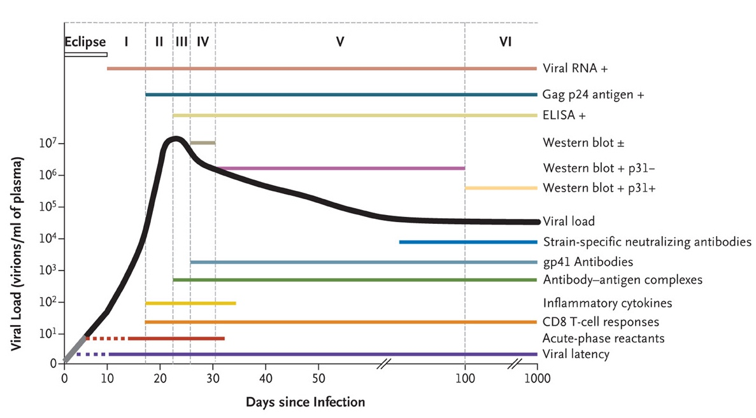
‘ACUTE’ vs ‘EARLY’ vs ‘PRIMARY’ HIV?
What is the difference?
  ‘Acute’
  Before Antibody +ve i.e. Feibig 1 and 2
  ‘Early’
  The time after acute: From Ab+ve to 6 months
  ‘Primary’
  A ‘catch all’
  The first six months
Cohen MS et al. N Engl J Med 2011;364:1943-1954.

Slide 5
‘ACUTE’ vs ‘EARLY’ vs ‘PRIMARY’ HIV?
What is the difference?
  ‘Acute’
  Before Antibody +ve i.e. Feibig 1 and 2
  ‘Early’
  The time after acute: From Ab+ve to 6 months
  ‘Primary’
  A ‘catch all’
  The first six months
Acute
Early
Fiebig Staging
  Stage 1: RNA / NAT only
  Stage 2: P24
  Stage 3: HIV IgM antibodies (ELISA)
  Stage 4: Western blot indeterminate
  Stages 5-6: Western clearly positive
Impact of 4th Gen Assays
  3rd gen test – 21 days
  4th gen combo – 14 days
    Fiebig et al; AIDS. 2003
    Ananworanich et al.; Retrovirology 2019
Cohen MS et al. N Engl J Med 2011;364:1943-1954.

Slide 6
How do we recognise PHI?
How PHI presents
Are we missing cases?
What is the impact of PrEP?
Indeterminate testing
Delays or even prevents seroconversion
RNA suppressed by ART
Could result in missed diagnoses?
Need to consider how to screen new HIV diagnoses in PreP era
Donnell; AIDS. 2017 Sep 10; 31(14)
Zucker; J Acquir Immune Defic Syndr. 2018 Jun 1; 78(2)
2-4 weeks after infection
Up to 50% - No symptoms
50-90% symptomatic
    Fever in 80-90%
    Sore throat, lymphadenopathy
    40% maculopapular rash
    50% headache
    Diarrhoea
Self-limiting
Very broad differential
Fidler, Fox; Clin Med April 1, 2016 vol. 16
25-50% of PHI cases missed*
Impact of 4th Gen tests
Not thought about
  Low prevalence settings
Non-specific symptoms
Poor history taking
Reluctance to test
*Das et al., BMJ 2010;341:c4583

Slide 7
At-risk women in South Africa: a prospective cohort study ‘FRESH’
Impact of Early ART on Seroconversion
Data Courtesy of Thumbi N’dungu
Dong et al; Lancet January 2018
De Souza et al; CID Aug 2016
Manak et al; JCM June 2019

Slide 8
If you diagnose PHI, you can treat quickly…..
  Quicker immunological recovery
  Reduced transmission rates
  Potential for new therapeutics

Slide 9
  Quicker immunological recovery

Slide 10
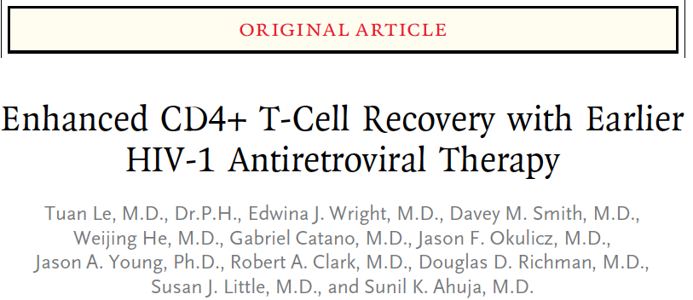
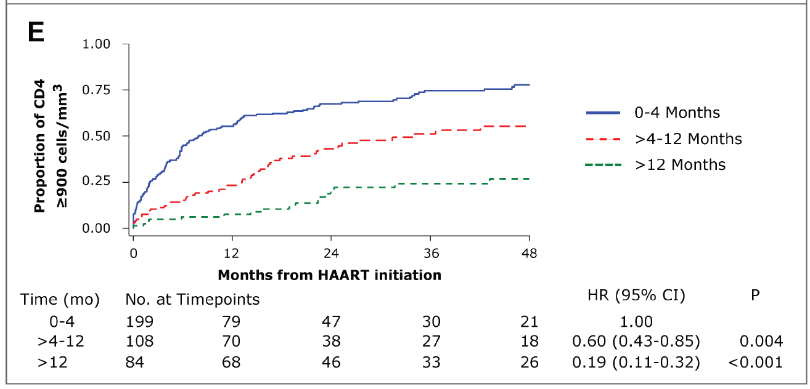
Treatment in PHI restores CD4 counts
  Quicker immunological recovery
Each additional month delay in ART reduced probability of achieving CD4 > 900 by approximately 10%
Le et al NEJM; Jan 2013
Notes:
Kaplan-Meier shows probability of attaining a CD4 >900 over 48 months was greatest for those who started ART within 4 months of EDI compared to other groups
No significant difference in VL response in the 3 groups

Slide 11
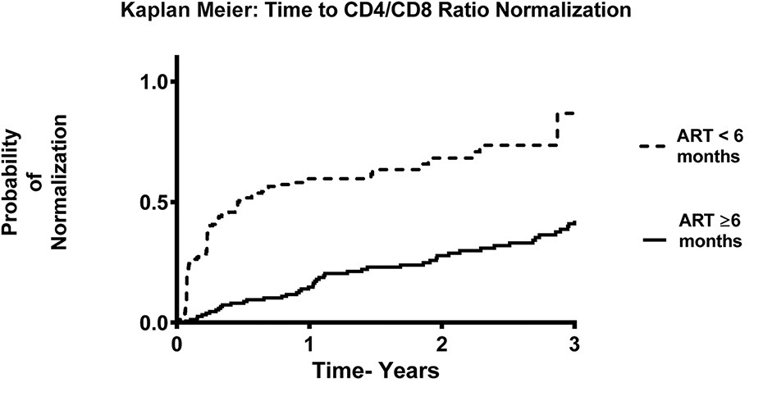
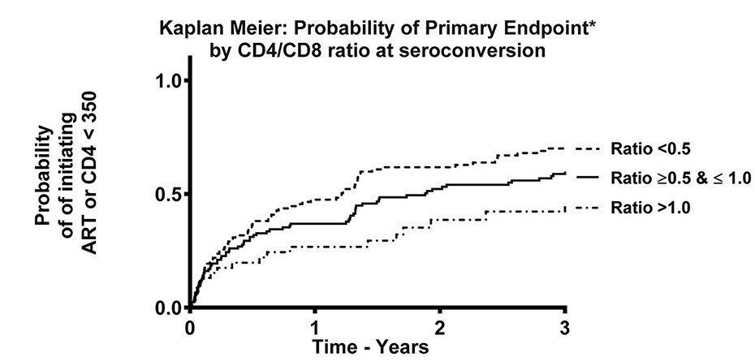
  Quicker immunological recovery
Treatment in PHI restores CD4 counts
Treatment in PHI restores CD4: CD8 ratio
CD4:CD8 ratio predicts CD4 decline
Early ART normalises CD4:CD8 ratio
CD4:CD8 ratio in PHI predicts progression
Thornhill et al
JAIDS 73(1):69-73,2016.

Slide 12
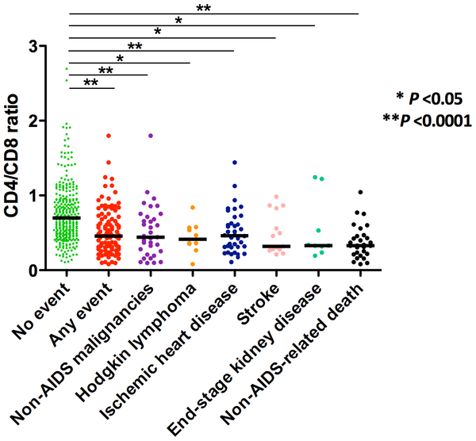
  Quicker immunological recovery
Treatment in PHI restores CD4 counts
Treatment in PHI restores CD4: CD8 ratio
CD4:CD8 ratio predicts CD4 decline
CD4:CD8 ratio predicts morbidity and mortality
CD4:CD8 ratio associates with:
T cell activation
Immunosenescence
Innate immune dysfunction
Non-AIDS morbidity
Serrano-Villar PLoS One 2014
Serrano-Villar PLoS Pathog 2014

Slide 13
Can we ‘reset to normal’ by treating early?

Slide 14

The HEATHERCohort
  UK study of treated PHI
  350+ enrolled participants
Sex | Male: 100%; n=66
Age (years; median [IQR]) | 34 (28 - 41)
Time between estimated date of seroconversion and ART (days; median [IQR]) | 52 (33 - 98)
Baseline CD4 T cell count (cells/μL; median [IQR])* | 530 (406 - 652)
Baseline HIV RNA (log₁₀ copies/mL; median [IQR]) | 5.4 (4.4 – 6.4)
Baseline CD4:CD8 ratio (median [IQR])* | 0.60 (0.36 – 0.79)
Genevieve Martin
Notes:
These are the clinical data for the individuals included in these analyses

Slide 15
Response to ART in PHI in HEATHER
A – Viral load
B - CD4 count
C - CD4:CD8
Rapid pVL drop
Quick CD4 recovery
CD4:CD8 normalizes
Notes:
This is n=66 for A and C
There are n=65 for B and D (no data from SM028)
This is the same as for previous data except I have also marked normal ranges in grey shading.
I have fitted a trend line using LOESS (local polynomial regression fitting) smoothing with an α value of 0.75 (R default, other values visually checked). Tis technique uses all of the points but unliked mixed-effects models, does not consider which individuals they come from.

Slide 16
What does 12 months of treated HIV do to you?
Put lots of markers into a model, and let the computer decide (PCA)…..
Markers chosen to understand status of immune system
  Age, sex
  CD4, CD8 counts
  pVL
  Time to ART start
  Total HIV DNA
  HLA Class I type
  T cell markers
    CD4 & CD8: CM, EM, TM, naïve
    CD38, PD1, Tim-3, TIGIT, CD39, T-bet, EOMES
CLINICAL
IMMUNOLOGICAL, VIROLOGICAL HOST

Slide 17
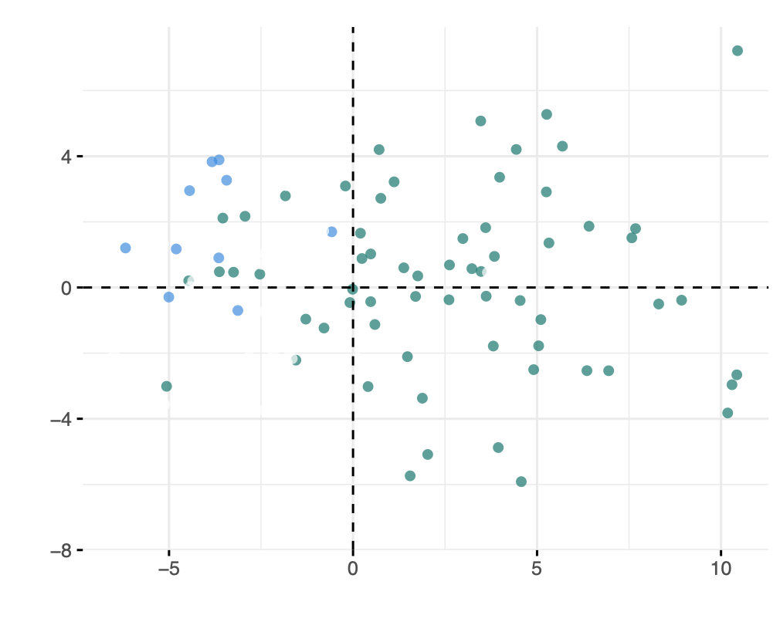
Principle component analysis: Untreated PHI vs Uninfected
Each dot is a participant
Blue Uninfected; Green PHI
PHI : Pre ART
POSTER MOPEA031

Slide 18
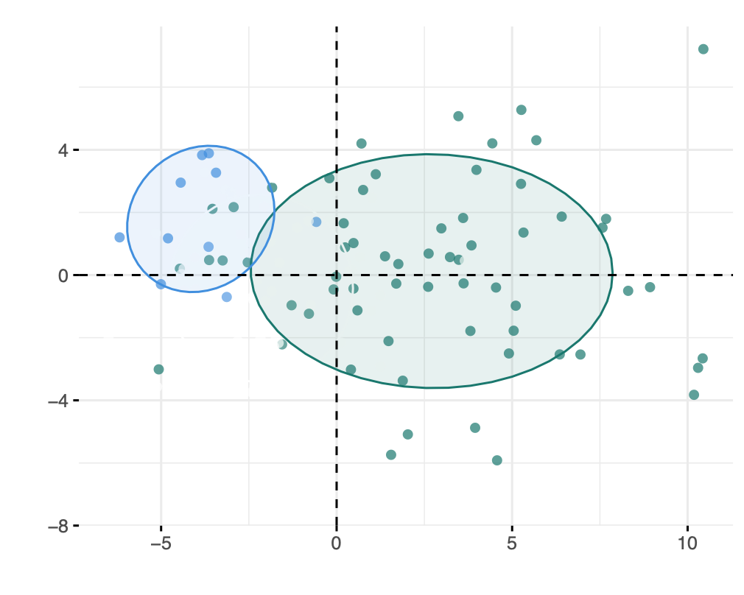
Principle component analysis: Untreated PHI vs Uninfected
Each dot is a participant
Blue Uninfected; Green PHI
Clear separation between uninfected controls and early HIV infection
PHI : Pre ART
What happens if you treat with ART for 12 months?
POSTER MOPEA031

Slide 19
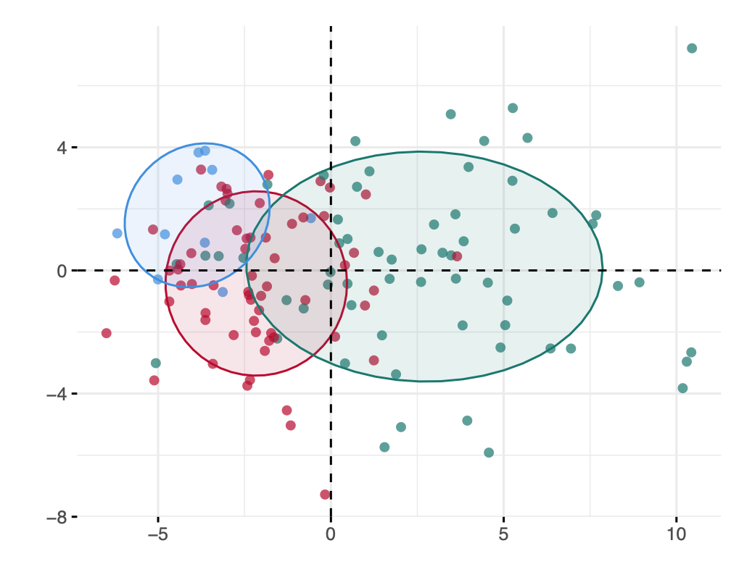
PCA: INCLUDING ART FOR 1 YEAR
Each dot is a participant
Blue Uninfected; Green PHI
Clear separation between uninfected controls and early HIV infection
PHI : Pre ART
PHI : 1 yr ART
12 months ART does not reset to normal
What hasn’t reversed?
Dominated by CD8 T cell markers
Markers of immune activation and exhaustion
CD38, Tim-3, PD-1
What happens if you treat with ART for 12 months?
Do we need ART for longer?

Slide 20
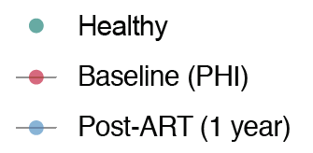

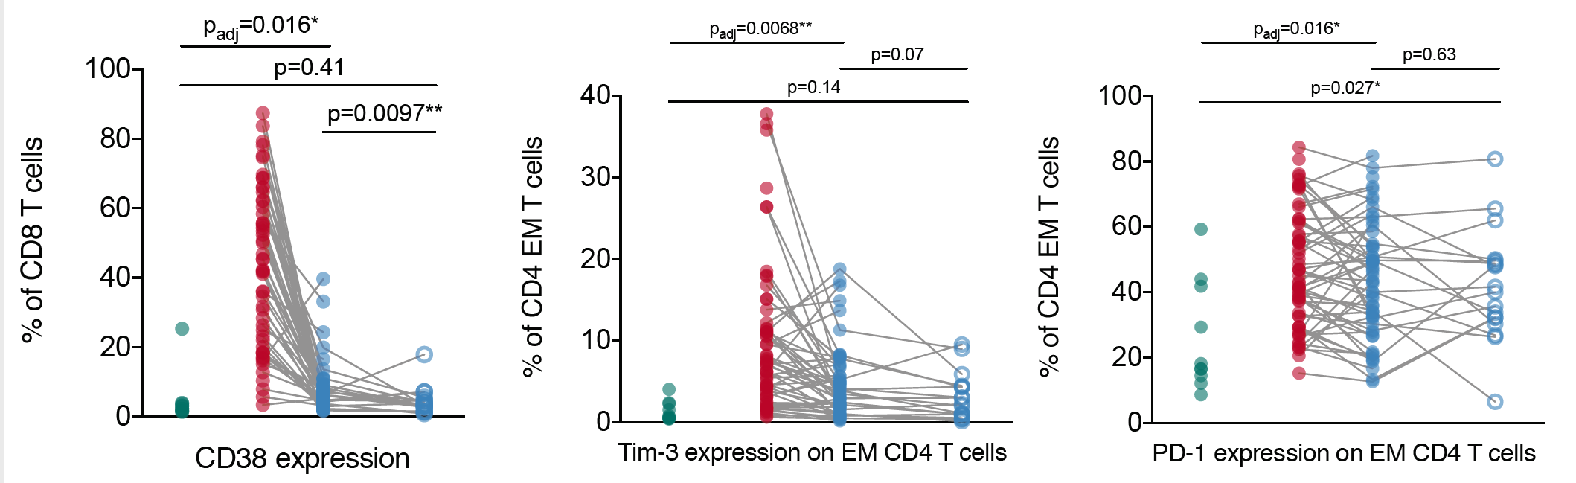
Is three years of ART better than one year?……
………for CD38, Tim-3 but not PD-1
Control
CD38
Tim-3
PD-1
Pre-ART
3yr sART
1yr ART
Pre-ART
Pre-ART
3yr sART
1yr ART
3yr sART
1yr ART

Slide 21
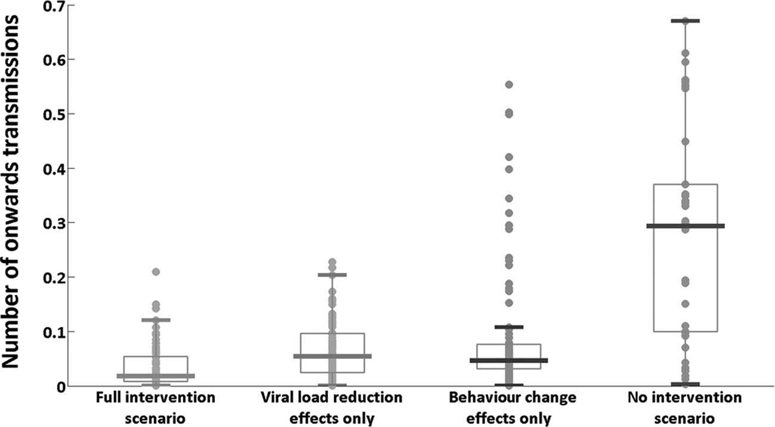
Why treating in PHI might be important
2. Reduced transmission rates
The Theory
The Data
High viral loads
PHI contributes 40% of transmissions
Increased risk behavior
Lack of knowledge of status
Other untreated STIs
Immediate ART in PHI modelled to reduce transmission by 89% among MSM*
The Need
Shift to WHO 95-95-95
Aim for <200,000 infections / year
Increased pressure on PHI as ‘test and treat’ roles out.
Rutstein JIAS 2017*, Kroon JIAS 2017, Fisher AIDS 2010

Slide 22
Why treating in PHI might be important
3. Potential for new therapeutics
Advantages
Decreased immune activation and exhaustion
Low HIV reservoir levels

Slide 23
Why treating in PHI might be important
3. Potential for new therapeutics
Advantages
Decreased immune activation and exhaustion
Low HIV reservoir levels
The most important determinant of the size of the reservoir after 1 year of ART is the reservoir at baseline
RESERVOIR HEATMAP AFTER 1 YEAR OF ART
PRE-ART RESERVOIR HEATMAP
Main determinant of size of reservoir at baseline is:
CD8 memory expansion (proportion of naïve and EM cells)
CD4 memory ICR expression (PD-1 and Tim-3)
CD38 expression on CD8 T cells.

Slide 24
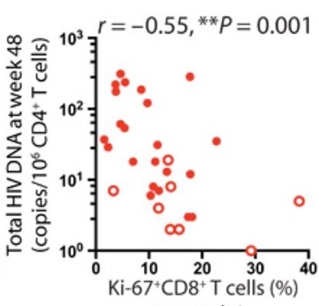
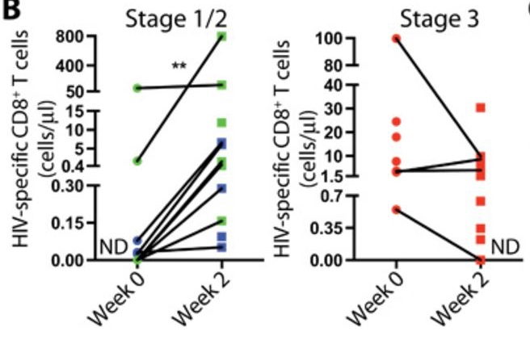
Why treating in PHI might be important
3. Potential for new therapeutics
Advantages
ART 14-16 days after infection maintains HIV specific immunity
These T cells recover ability to proliferate
Proliferative potential associates with lower reservoirs
Decreased immune activation and exhaustion
Low HIV reservoir levels
Preservation of HIV-specific immunity
Less opportunity for viral immune escape
Takata Sci Transl Med Feb 2017

Slide 25
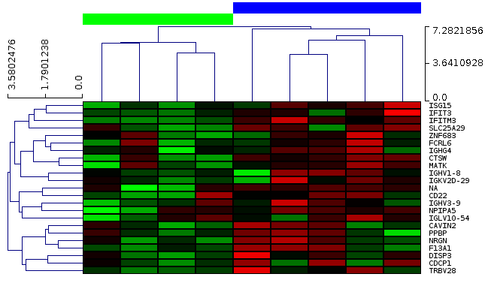
Why treating in PHI might be important
3. Potential for new therapeutics
Advantages
Decreased immune activation and exhaustion
Low HIV reservoir levels
Preservation of HIV-specific immunity
Potential for Post-Treatment Control
Less opportunity for viral immune escape
Less opportunity for viral immune escape
Gene Expression at Point of TI correlates with time to rebound
Rebound <100 days
Rebound >500days
Manu Marchi; Unpublished

Slide 26
Why treating in PHI might be important
3. Potential for new therapeutics
Advantages
Decreased immune activation and exhaustion
Low HIV reservoir levels
Preservation of HIV-specific immunity
Potential for Post-Treatment Control
Less opportunity for viral immune escape
Less opportunity for viral immune escape
Lee et al Nat Comms 2019*
Heiner et al Cell Reports 2017

Slide 27
Why treating in PHI might be important
3. Potential for new therapeutics
Advantages
Decreased immune activation and exhaustion
Low HIV reservoir levels
Preservation of HIV-specific immunity
Potential for Post-Treatment Control
Less opportunity for viral immune escapeLess opportunity for viral immune escape

Slide 28
Why treating in PHI might be important
3. Potential for new therapeutics
Advantages
Opportunities
Decreased immune activation and exhaustion
Low HIV reservoir levels
Preservation of HIV-specific immunity
Potential for Post-Treatment Control
Less opportunity for viral immune escapeLess opportunity for viral immune escape
Immune-based therapies
  Long acting
  Reservoir targeting – aiming for ART free remission

Slide 29
Why treating in PHI might be important
3. Potential for new therapeutics
Long-acting immune-based therapies
‘LS-bNAbs’
  Direct effect on virus
  ‘Vaccinal effect’ to enhance T cells
Unpublished
Courtesy of Marina Caskey, Rockefeller

Slide 30

Why treating in PHI might be important
3. Potential for new therapeutics
RIO clinical trial to commence in Q4 2019 in the UK
RCT to explore efficacy of LS bNAbs in PHI
  Long-acting agents
Randomised to bNAbs vs Placebo
  Followed by treatment interruption
  Explore sustained antiviral effect
  Induction of remission

Slide 31
Discussion Points around PHI
Issues around shifting needs and methods for diagnosis
    Need to consider strategies for diagnosing HIV in era of PrEP and early ART
Important – there are advantages in starting ART early
Public health importance for reducing transmission
An opportunity to test new interventions
    But any game-changing new therapy will need to work in chronic infection
    If new interventions are more effective in PHI, has policy implications

Slide 32




Acknowledgements
University of Oxford
  Genevieve Martin
  Matthew Pace
  Mathew Jones
  Lucia Parolini
  Helen Brown
  Nicola Robinson
  Peny Zacharopoulou
  Eva Zilber
  Chan Phetsouphanh
  Jodi Meyerowitz
  Natalia Olejniczak
  Manu Marchi
  Dirk Aarts
  Lucy Dorrell
  Tom Hanke
  Suki Kenth
UK CHERUB
  Imperial College, London
    Sarah Fidler
    John Thornhill
    Hanna Box
    Becky Hall
    Daphne Babalis
  King’s College; Guy’s Hospital
    Julie Fox
    Hiromi Uzu
    Kennedy Nkhoma
    Teresa Solano
    Julianne Lwanga
    Alice Sharp
  Cambridge University
    Ravi Gupta
    Andrew Lever
  Chelsea and Westminster Hospital
    Nneka Nwokolo
  University College London
    Clare Jolly
  i-Base
    Simon Collins
    Damien Kelly
Rockefeller University
  Michel Nussenzweig
  Marina Caskey
  Jill Horowitz
  Thiago Oliveira
TO ALL OUR AMAZING PARTICIPANTS IN ALL OUR STUDIES
THANK YOU!
www.cherub.uk.net
Twitter:@ukcherub

Slide 33
The Answers

