Slide 2
Sustainability of HIV programmes and financing the HIV response
Sherrie Kelly
Share your thoughts on this presentation with #IAS2019

Slide 3
Percent of Americans who spent 2 hours or more
On average, Americans spend less time planning for
retirement investment than buying a TV or picking a restaurant
Source: Teachers Insurance and Annuity Association of America-College Retirement Equities Fund survey 2014
Notes:
https://www.tiaa.org/public/about-tiaa/news-press/press-releases/pressrelease495.html

Slide 5
How does personal financial planning relate to sustainably financing the HIV response?
In both cases, planning for strategic investment must be a priority
We/country governments, may need to leverage extra resources
Not only saying YES to the most impactful approaches,
but understanding which good things we have to say NO to,
so we can prioritize for bigger impact
Notes:
You thought you were at the wrong talk?!

Slide 6
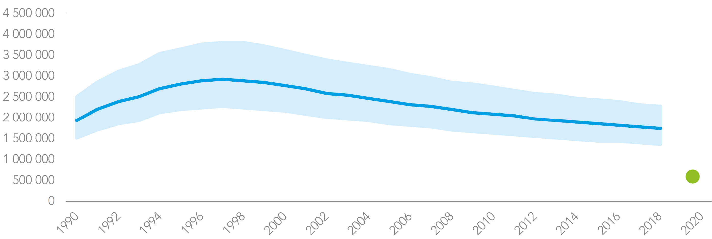
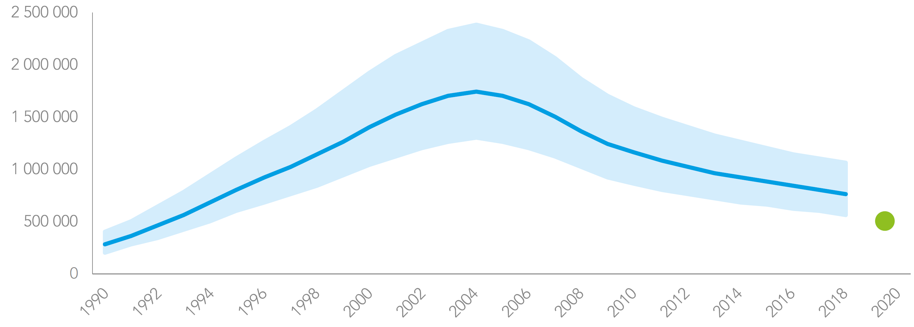
Tremendous progress made
, not tracking to targets
1.7m new HIV infections in 2018
16% reduction from 2010
2020 target <500,000
75% reduction from 2010
Must invest better
To prevent more infections
To save more lives
770,000 HIV-related deaths in 2018
33% reduction from 2010
2020 target <500,000
75% reduction from 2010
Source: UNAIDS Global AIDS Update 2019
Notes:
Infections: 2010: 2.1 million [1.6 million–2.7 million]; 2018: 1.7 million [1.6 million–2.3 million]
Deaths: 2010: 1.2 million [0.86 million–1.6 million]; 2018: 770 000 [570 000–1 100 000]

Slide 7
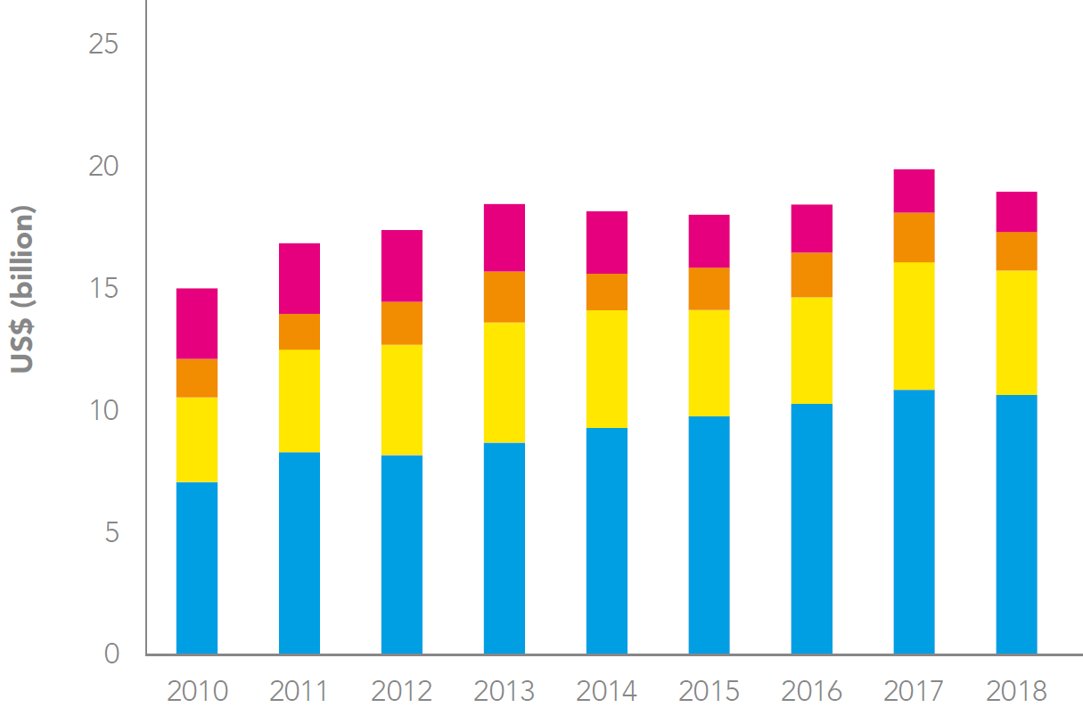
HIV resources and gap
$7.2b gap in 2018
Constant 2016 US$ billion
In low- and middle-income countries
Source: UNAIDS Global AIDS Update 2019

Slide 8
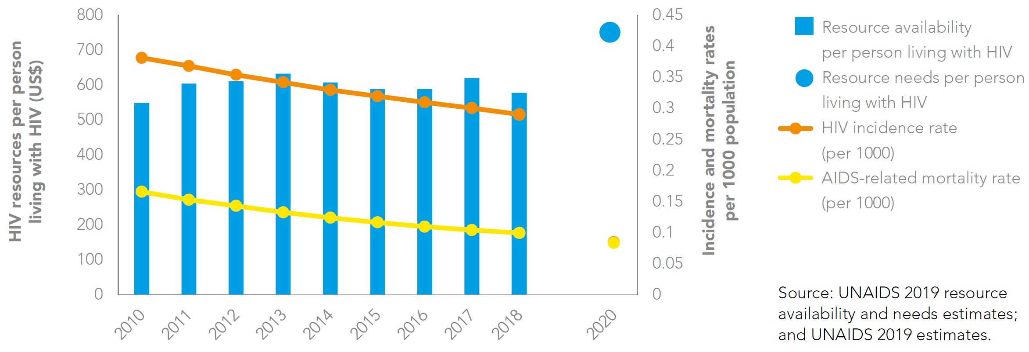
HIV resources and resources needs per person living with HIV HIV incidence and mortality rates
HIV resources per
person living with HIV
constant 2016 US$
$600 in 2018
Must invest better
To prevent more infections
To save more lives
In low- and middle-income countries
Source: UNAIDS Global AIDS Update 2019
Notes:
Available by region from 2019 UNAIDS AIDS Update report

Slide 9
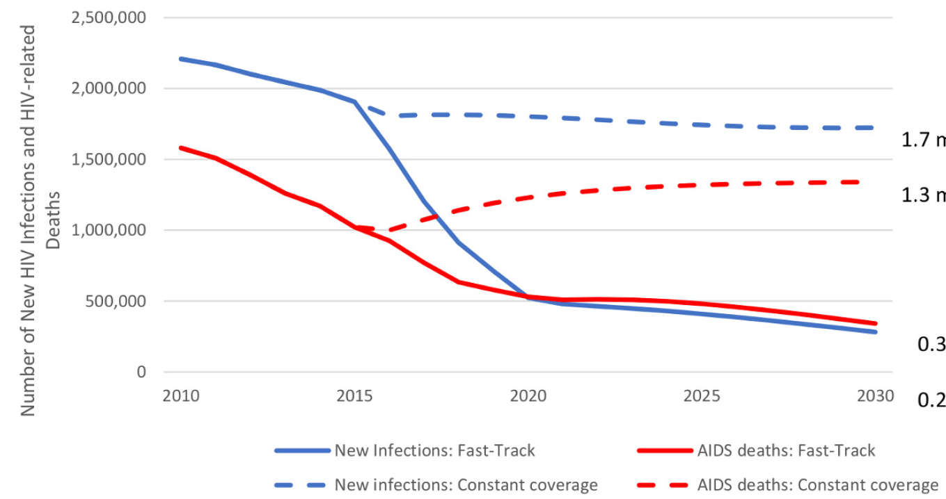
If funding gap is filled and HIV coverage targets met, then 90% reduction targets could be met by 2030
1.7 million
1.3 million
0.34 million
0.28 million
Constant coverage
Fast-Track
Source: Stover et al. PLOS ONE 2016

Slide 10
2019-2030
2,000,000 (9%)
more infections
500,000 (3%)
more deaths
700,000 (3%)
more infections
100,000 (0.5%) more deaths
Status quo
20% cut
expected from
major donor
in 2019¹
maintained to 2030
100% donor cut by 2030*
Status quo
20% cut
expected from
major donor
in 2019¹
maintained to 2030
100% donor cut by 2030*
44 countries, subnational representation
80% of global estimated PLHIV
*Continued increasing domestic funding to 2030
Source: ten Brink et al. AIDS 2019
¹KFF/UNAIDS 2018
Notes:
Anticipated 20% cut from USG, who fund 82.5% of total international donations = 17% international donor cut

Slide 11
Consequence of 5-year delay in achieving 90-90-90 targets
If we don’t invest better now:
more people will become infected
it will cost more lives
it will cost more in the long run
2.1 million more HIV infections
New HIV infections if Fast-Track
targets achieved in 2020
New HIV infections if Fast-Track
targets achieved in 2025
1.0 million more HIV-related deaths
HIV-related deaths if Fast-Track
targets achieved in 2020
HIV-related deaths if Fast-Track
targets achieved in 2025
Source: Avenir Health/UNAIDS based on Fast-Track modelling 2018

Slide 12
Are we OK with potentially 2 million more HIV infections and 1 million more deaths?

Slide 13
How can we avoid more infections and save more lives?

Slide 14
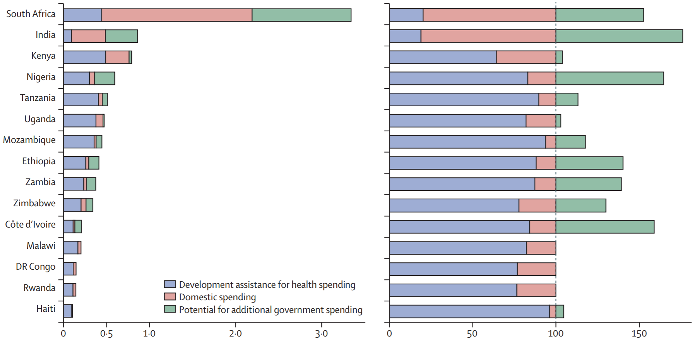
15 countries that received the most donor HIV funding in 2016
Potential for additional government spending?
To finance the
HIV response
more sustainably.
HIV spending by source (billions 2018 USD) % of total financing by source
Benchmarking only, limitations to sourcing more domestic funds
Should donor resource be reallocated between countries? If so, how?
Source: Haakenstad et al. Lancet HIV 2019
Notes:
Encouraging transition from donor to domestic funding
Who should get more? Who should get less?
How do you ensure countries don’t get rewarded if they aren’t domestically funding their HIV response as much as they are able?
Ambassador Birx, 2025 Target Setting satellite 21 July: same 90-90-90 levels, Kenya: $6b (total donor, domestic, private); Malawi: $2b. Q. Funding per PLHIV/GDP, etc.?
Some countries have been successful in funding the majority of their HIV response eg, South Africa, Vietnam

Slide 15
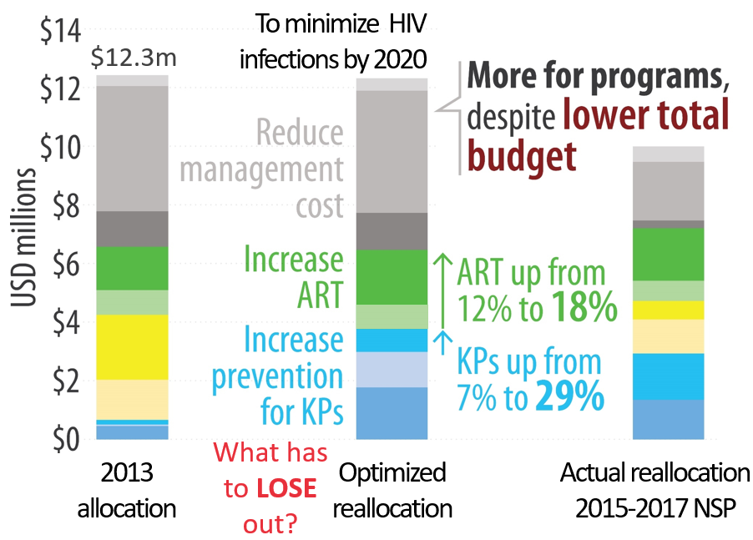
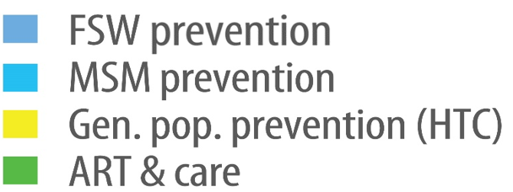
Sudan: better HIV spending
Sudan has a low-level concentrated HIV epidemic
Source: World Bank/UNSW Australia 2014
PLHIV: PLHIV involvement and support
IGP: Income Generation Projects

Slide 16
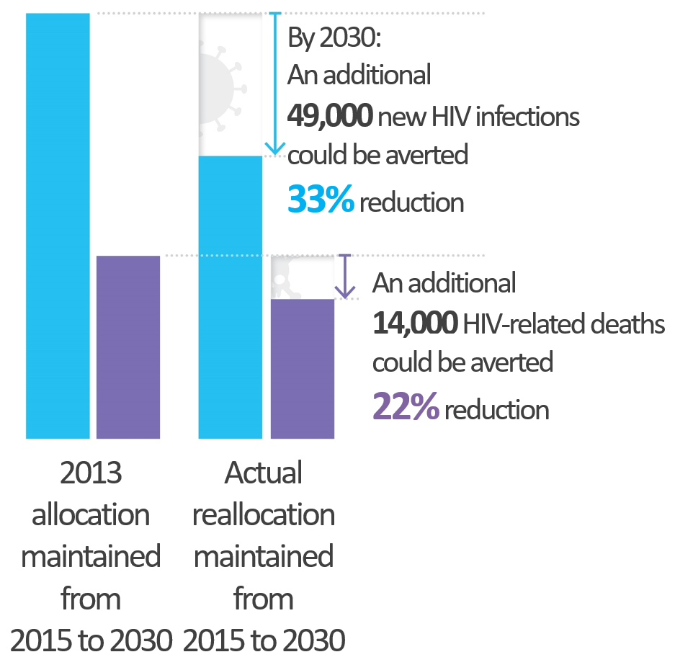
Sudan: better HIV spending, better outcomes
Find even more efficiencies, optimize:
subnationally
across service delivery modalities
Source: World Bank/UNSW Australia 2014

Slide 17
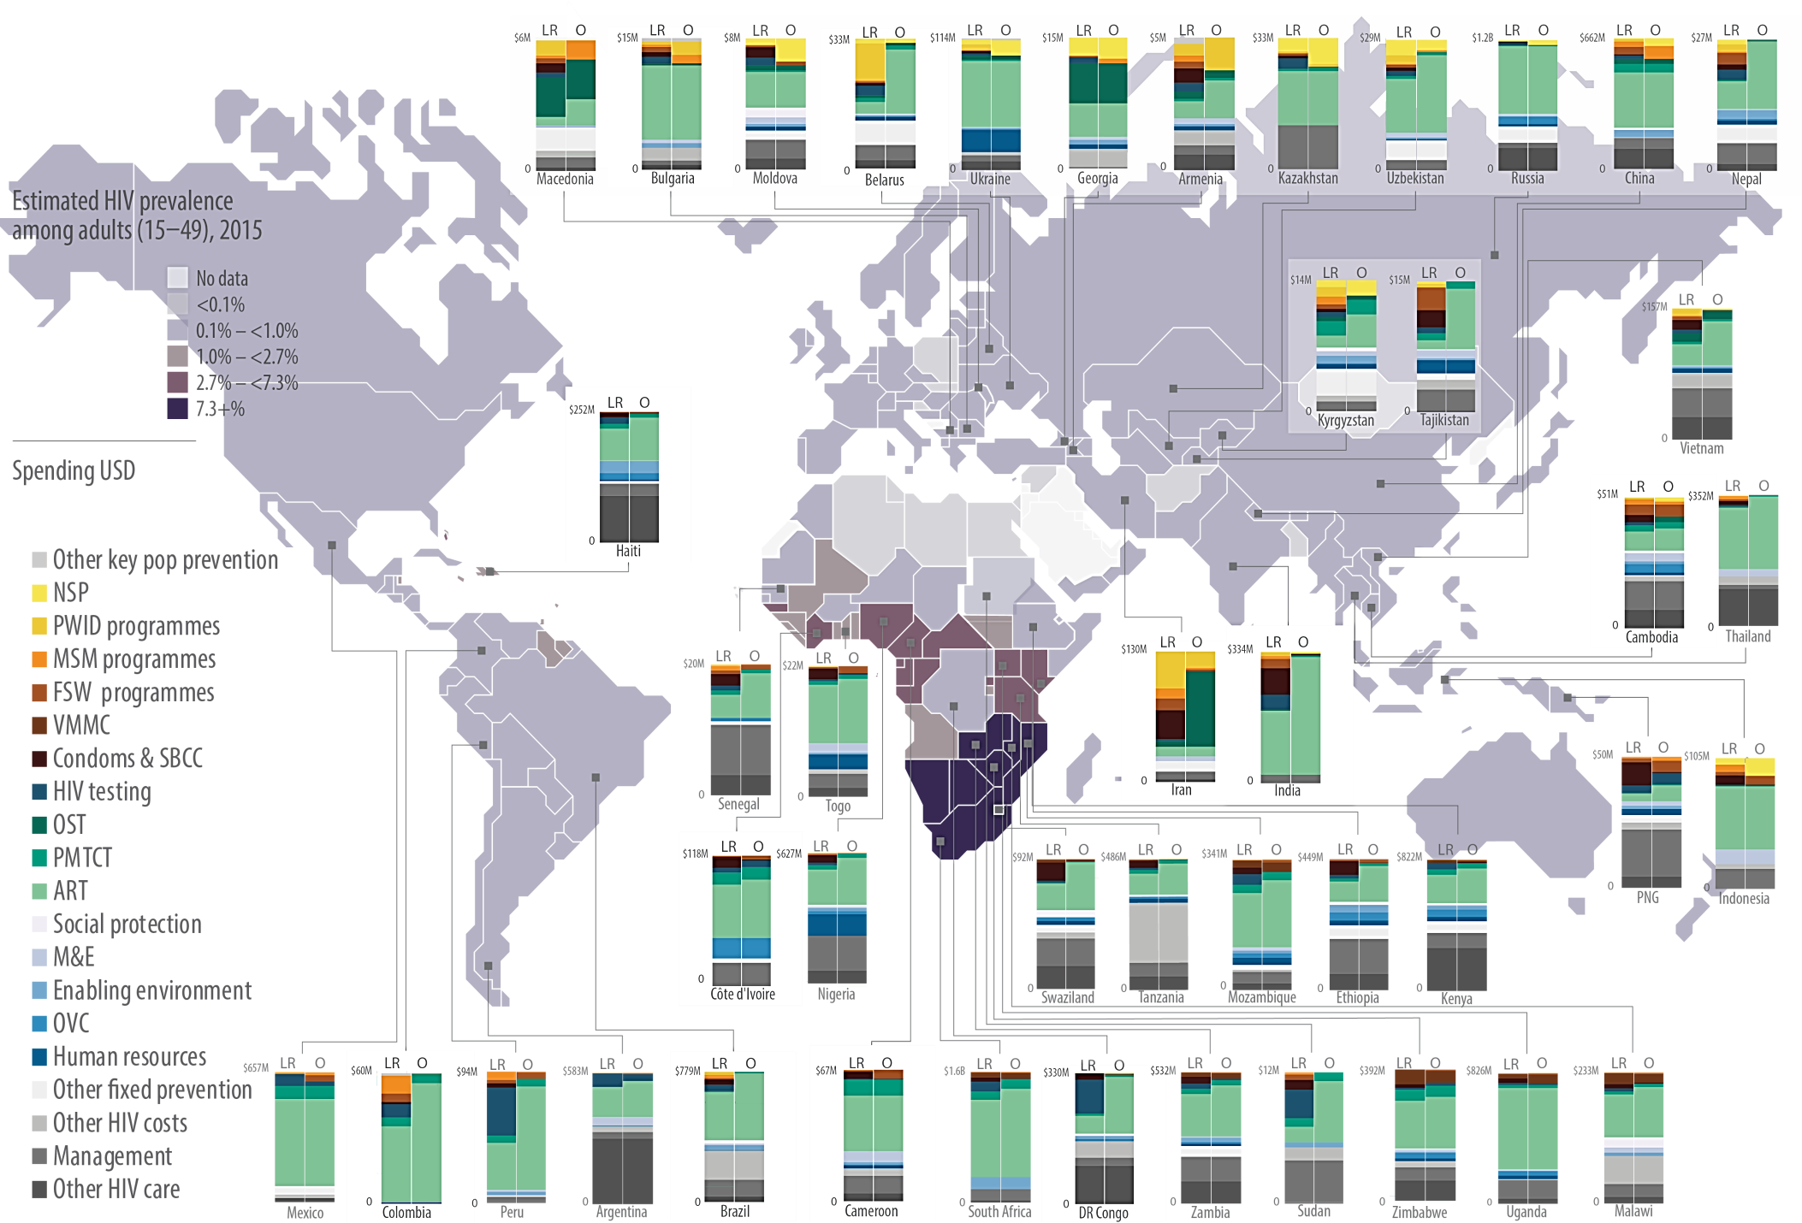
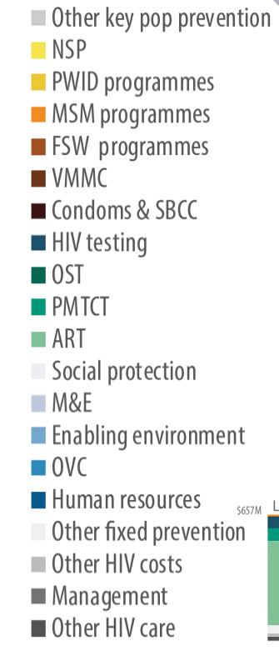
Optimized global HIV spending
44 countries, subnational representation
80% of global estimated PLHIV 2015
To minimize HIV infections globally by 2030
Scale-up:
Treatment 44% to 53%
Key pop prevention programs
NSP and OST
Deprioritize:
Gen pop prevention programs, particularly for concentrated epidemic settings
LR = Latest Reported
O = Optimized
Source: HIV prevalence (UNAIDS); Optimizations (Kelly et al. Lancet HIV 2018)

Slide 18
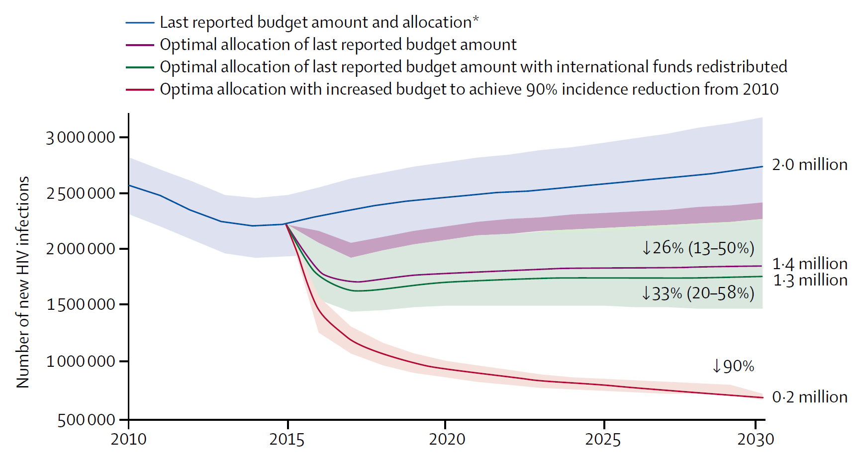
Optimized global HIV spending, better outcomes
From 2015 to 2030:
7.4M more HIV infections could be averted if the same budget amounts were better spent
2 500 000
New HIV infections
2 000 000
9.3M more infections
over 30% total could be averted if international funds were to be redistributed optimally between countries
1 500 000
1 000 000
500 000
0
Source: Kelly et al. Lancet HIV 2018

Slide 19
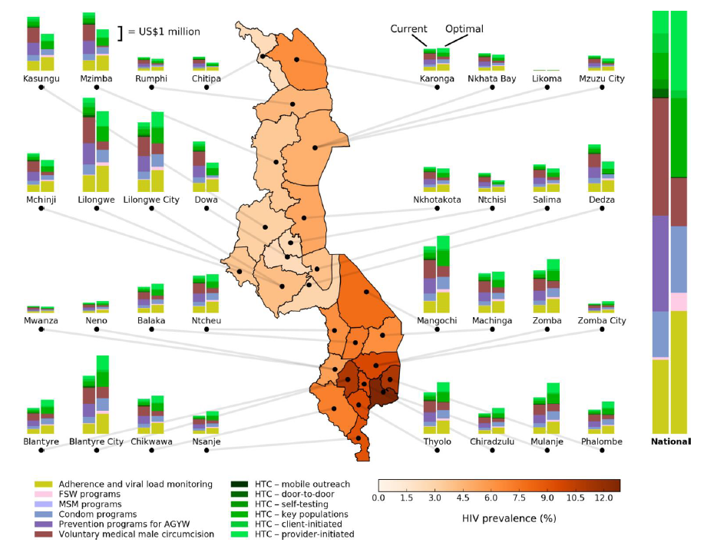
HIV resource optimization by district in Malawi
Latest reported
Optimized
Source: World Bank/Burnet/UNAIDS 2017

Slide 20
We’ve met the enemy, and he is us.*
We’re the ones asking for those resources and misdirecting them.
-- Paul Farmer, MD, PhD, Partners in Health Co-Founder, Devex 2014
More people are dying because of our bad spending choices.
By making better choices we can save more lives and avert more infections.
*Original source: Kelly W, Pogo daily strip 1971

Slide 21
How can we do better?
Right interventions: fund most cost-effective, highest impact interventions
treatment (alternate regimens where indicated, simplified protocols)
KP prevention (planning, capacity building, performance review)
VMMC (front loading for longer-term benefit)
pre-exposure prophylaxis (PrEP)
prioritized targeting of differentiated prevention and care services across the cascade
cut management and overhead costs
Right people: target those most affected or most vulnerable
Right places: prioritize to where there will be the most impact (geospatial analysis)
Right strategy: strategic buying, mitigate out-of-pocket fees for services,
joint service delivery, integration within universal health coverage (UHC)
YES
NO

Slide 22
What must get deprioritized?
CHOICE MEANS
SAYING NO TO ONE THING
SO YOU CAN SAY YES
TO ANOTHER
Saying YES to what is cost-effective, this is easy to agree on
Saying NO to what is not as cost-effective, this can be contentious
Everyone thinks their program is important and if it has to be defunded for the greater good with regards to cost-effectiveness, then there will be people not reached for services
The challenge is saying NO to what might be an excellent program and doing good work for people in need, but in the big picture of a country's epidemic or local epidemic it is seeing which programs will do BEST and making the tough call to say NO
However, there may be reasons for less than optimal spending
Funders may provide funds for causes that concern them most, such as HIV programs targeting adolescent young girls and young women (AGYW) or orphans and vulnerable children (OVC)
Those funds might not be disbursed if they were meant to be reallocated towards other programs
Use evidence to inform BEST spending choices within constraints

Slide 23
Social and economic benefits for every US$1 spent
Source: Copenhagen Consensus Center 2015
Over 1995-2015 period: “For every $1 spent on ART, $3.50 in benefits accrued globally.”
Source: Forsythe et al. Health Affairs 2019
Notes:
https://www.copenhagenconsensus.com/sites/default/files/post2015brochure_m.pdf

Slide 24
We urgently need increased political leadership to end AIDS.
This starts with investing adequately and smartly and by looking at what’s making some countries so successful.
-- Gunilla Carlsson, UNAIDS Executive Director a.i.
Press release for UNAIDS’ Global AIDS Update 2019

Slide 25
Learn from success stories
Sudan: shifted funds from general pop prevention to HIV treatment
could save an extra 14,000 lives by 2030¹
Moldova: coordinated institutions, cut HIV management costs by 26%
11% more people could receive life-saving treatment²
South Africa: negotiated 13% lower ARV* costs than 2017 Global Pricing Agreement, for 2019-2022 68% lower ($79 PPPY) than 2011-2012 ($247)
4-times more adults (4.5m) on treatment in 2019 than 2011 (1.3m)³
Back to the personal financial planning story: with limited resources, cut costs on rent and transport, pay tuition for good ROI, save and invest better to best reach goals
¹World Bank/UNSW Australia report 2014
³RT71-2019 Tender Award
*TLD = tenofovir/lamivudine/dolutegravir
PPPY = per person per year
²Communication with Moldova team 2019

Slide 26
Take home message
To save more lives and prevent more HIV infections, we must:
Make evidence-informed best spending choices, within constraints
Make hard decisions, say NO to less cost-effective HIV interventions

Slide 27
Thanks to everyone who contributed!
Aaron Osborne
Andrew Shattock
Clemens Benedikt
Cliff Kerr
Corina Maxim
David P Wilson
David Wilson
Debra ten Brink
Donald Sutherland
Gearóid Fitzmaurice
Jennifer Kates
John Stover
Jose Antonio Izazola Licea
Marelize Görgens
Mark Minnery
Michael Jordan
Nejma Cheikh
Nicole Fraser-Hurt
Nick Scott
Noah Haber
Peter Ghys
Robyn Stuart
Romesh Abeysuriya
Rowan Martin-Hughes
Shufang Zhang
Tom Palmer
Zara Shubber
Optima Consortium for Decision Science
IAS Planning Committee
The global HIV community
No conflicts of interest

