Slide 1
Understanding drug-drug interactions between exogenous hormones and PrEP
Peter L. Anderson, PharmD
@TwitterHandle
Share your thoughts on this presentation with #IAS2019

Slide 2
Disclosures
Research contracts, grants, and fees from Gilead Sciences.

Slide 3
Objectives
Review and interpret current evidence for PrEP-gender affirming hormone drug-drug interaction (DDI).

Slide 4
DDI background
No interaction between TDF and oral contraception.
Partners PrEP similar PrEP efficacy among 901 women using DMPA vs 1422 women using no hormonal contraception (65-76% efficacy).
iPrEx lower PrEP efficacy and lower drug concentrations driven by risk differences and adherence… DDI unlikely but untested
Deutsch M. Lancet HIV. Murnane P. AIDS. 2014 Heffron R. AIDS. 2014. Mehrotra M. JAIDS 2019. Kearny B. Pharmacotherapy 2009.

Slide 5
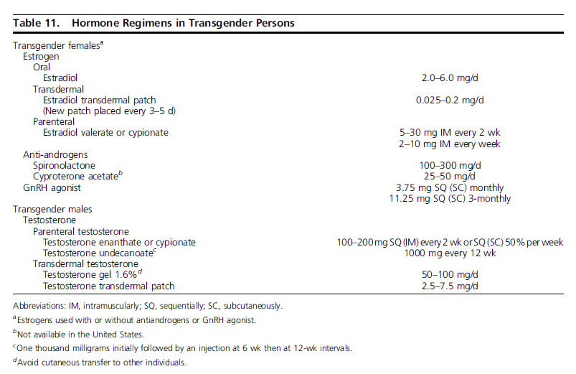
Gender-Affirming Hormones
Therapeutic drug monitoring. Goal normal range for affirming gender.
Estradiol (100 to 200 pg/mL and testosterone <50 ng/dL).
Testosterone (320 to 1000 ng/dL)
Hembree WC. J Clin Endocrinol Metab. 2017

Slide 6
Gender affirming hormone DDIs
Estradiol, cyproterone, spironolactone, testosterone, not major perpetrators of drug drug interactions (DDI) in vivo.
Some in vitro evidence for transporter interactions that need validation in vivo.
https://www.fda.gov/drugs/drug-interactions-labeling/drug-development-and-drug-interactions-table-substrates-inhibitors-and-inducers. Scarsi K. Drug Saf. 2016. Polasek T. B J Clin Pharm 2011. https://www.hiv-druginteractions.org/checker; Stanczyk F. Endocrine Reviews 2013. Anderson. JAIDS 2016.
Searle. Aldactone Product Information 2008. Carone L. J Pain Symptom Manage. 2017

Slide 7
Biological/clinical range of TFV and FTC pharmacokinetics
TFV AUC ~2000 to >3000 hr*ng/mL
FTC AUC ~9800-10700 hr*ng/mL
PBMC TFV-DP 35-160 fmol/10⁶ cells
PBMC FTC-TP 2200-6600 fmol/10⁶ cells
Truvada PI 2019. https://www.ema.europa.eu/en/documents/scientific-discussion/truvada-epar-scientific-discussion_en.pdf;
Seifert ARHR 2016. Hendrix ARHR 2016. Anderson JAC 2011. Adams. JAIDS 2014

Slide 8
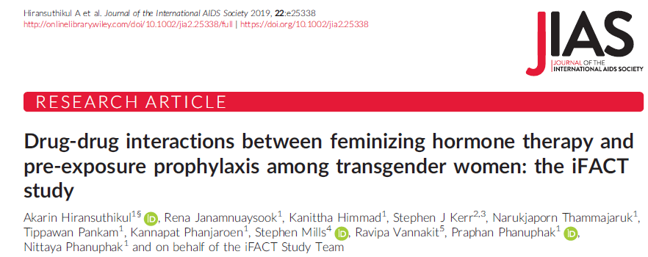
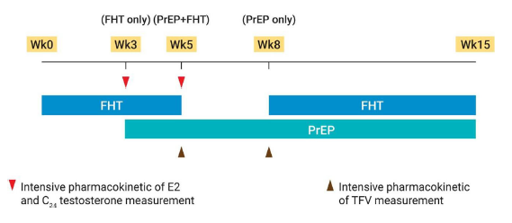
N=20

Slide 9
Results
“Biological/clinical TFV AUC ~2000 to >3000 hr*ng/mL”

Slide 10
JHU Pilot: 8 cismen and 8 transwomen
Day 0
Hormone PK
Day 1 – Day 6
Directly Observed
TFV/FTC dosing
Day 7
TFV/FTC PK
Hormone PK (TGW only)
Characteristic | 8 CGM Mean (Std Dev) | 8 TGW Mean (Std Dev)
Race | 75.0% A-A | 75.0% A-A
*Age (yrs) | 42.3 (12.9) | 32.8 (8.5)
*BMI | 23.7 (4.1) | 30.4 (7.1)
*Calculated Creatinine Clearance (mL/Min) | 104 (31) | 153 (43)
Screening Estradiol | ND | Median 756; IQR 150-1522
Hormones: |  | Estradiol PO (3); IM (5); premarin (3); spironolactone (6); Medpred (1)
Shieh, Marzinke, et al. Submitted

Slide 11
Results
TFV | TGW (IQR) | Cis Men (IQR) | Ratio | p
TFV Plasma AUC₀₋₂₄ (ng/mL-hr) | 2,500 (1,712; 3,002) | 3,438 (2,724; 3,649) | 73% | .07
FTC | TGW (IQR) | Cis Men (IQR) | Ratio | p
FTC Plasma AUC₀₋₂₄ (ng/mL-hr) | 9,682 (8,512; 10,926) | 12,698 (11,152; 13,673) | 76% | .03
“Biological/clinical TFV AUC ~2000 to >3000 hr*ng/mL & FTC ~10000”
TFV-DP | Ratio | p
Colon Tissue TFV-DP C_{tau} (fmol/10⁶ cells) | 53% | .80
FTC-TP | Ratio | p
Colon Tissue FTC-TP C_{tau} (fmol/10⁶ cells) | 60 % | .28
TFV-DP | Ratio | p
PBMC TFV-DP AUC₀₋₂₄ (fmol/10⁶ cells-hr) | 76% | .12
FTC-TP | Ratio | p
PBMC FTC-TP AUC₀₋₂₄ (fmol/10⁶ cells-hr) | 89% | .28
Shieh, Marzinke, et al. Submitted

Slide 12
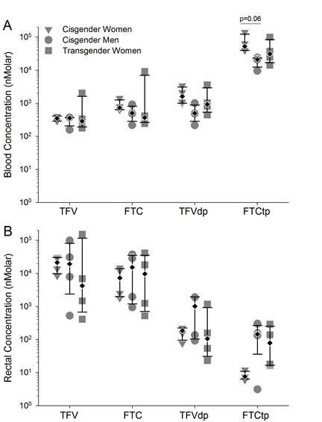
UNC Pilot 4 PM ciswomen; 4 cismen; 4 transwomen
Cottrell M. CID 2019

Slide 13
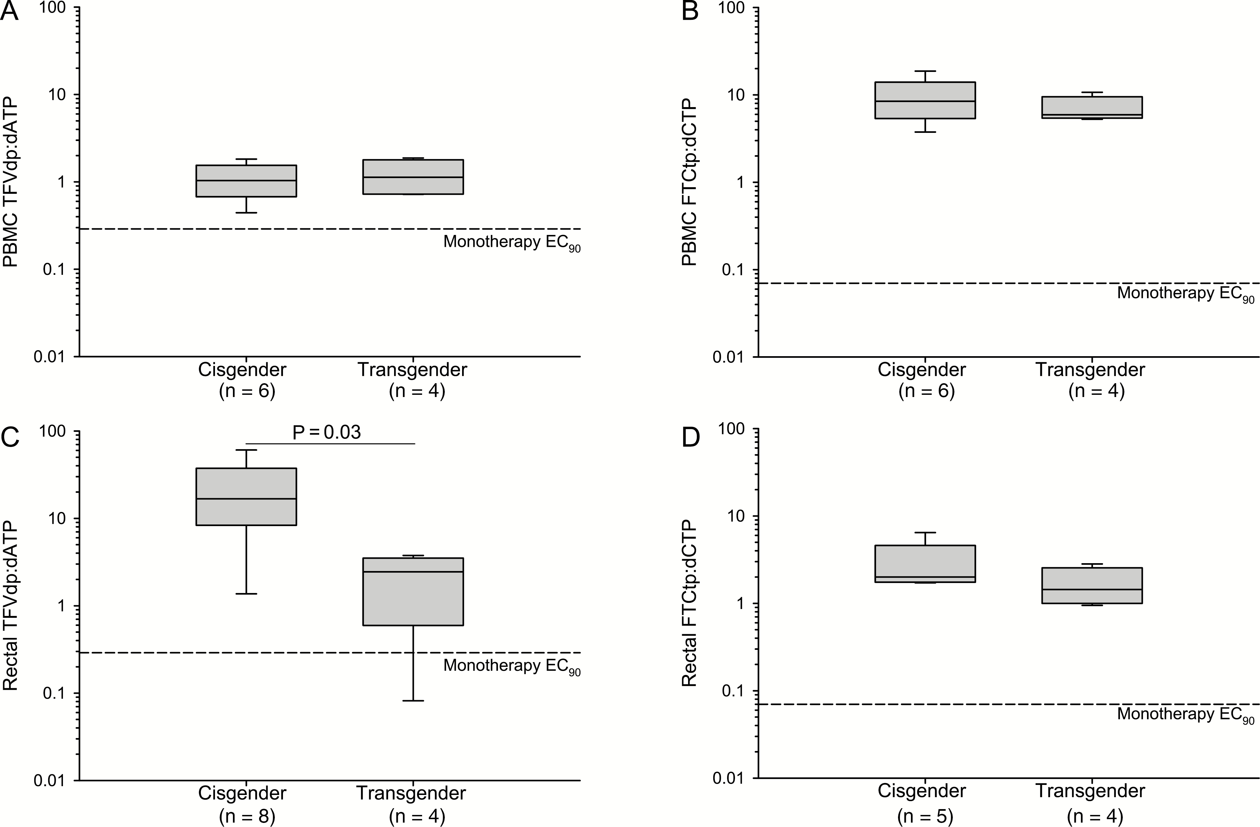
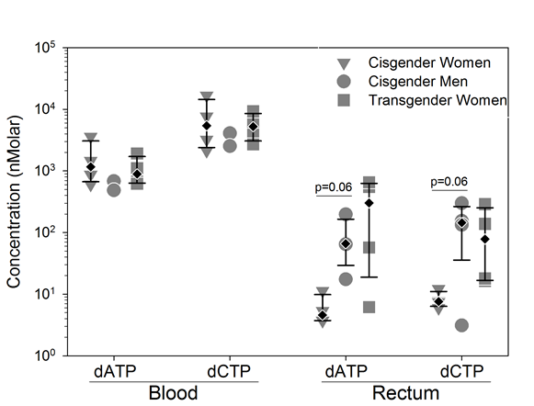
Ratio of intracellular TFV-DP:dATP
Cottrell M. CID 2019

Slide 14
Phosphorylation
Tissue TFV-DP ↑ with DMPA in vivo
TFV-DP ↓ or ↑ with estradiol/progesterone in vitro depending on cell type…
Translation to in vivo has to be validated
FTC
FTC-TP
TFV
TFV-DP
LYMPHOCYTE
Thurman JAIDS 2019. Shen PLOS One 2013. Nicol CID 2019. Shen Plos One 2014.
Figure from Yager J, et al. CROI 2019. Seattle, WA.

Slide 15
Summary
Small plasma interaction with TFV. Mechanism(s) unclear.
Pilot studies: lower TFV, FTC in plasma (similar trends in PBMC/rectal tissue). Lower TFV-DP:dATP in rectal tissue.
Plasma concentrations (e.g. AUC 2200, 2500) remain in normal biological/clinical range (~2000 to 3000).

Slide 16
Premature to conclude that transpersons need higher adherence or are not candidates for 2:1:1...
Study Name | Prevention Option | Countries | Sponsors
PreParadas | PrEP | Brazil | Oswaldo Cruz Foundation
Transgender-Focused PrEP Demo Project-Case Management Approach | PrEP | USA | California HIV/AIDS Research Program
Trans Research-Informed Communities United in Mobilization of the Prevention of HIV (TRIUMPH) | PrEP | USA | California HIV/AIDS Research Program
TransLife Center | Combination Prevention | USA | NIH (U01)
Chicas Creando Acceso a la Salud (ChiCAS) | Combination Prevention | USA | NIH (U01)
Transgender Youth and PrEP | PrEP | USA | NIH (R01)
Féminas | PrEP/viral suppression | Peru | amFAR
HPTN 091 | Combination Prevention | USA, Brazil | NIH (UM1)
Slide from M Marzinke

Slide 17
THANK YOU!

