Slide 2
Rapporteur Closing Session
Track A – Basic Science
Fabio Romerio, PhD
@TwitterHandle
Share your thoughts on this presentation with #IAS2019

Slide 3



Track A Rapporteur Team
Elizabeth Wonderlich, PhD
Southern Research
Angela Wahl, PhD
UNC Chapel Hill
Aurelio Orta-Reséndiz, MD
INCMNSZ

Slide 4

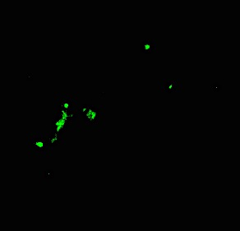
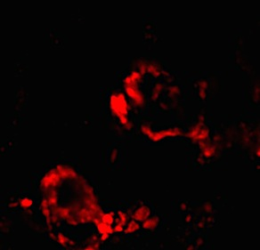
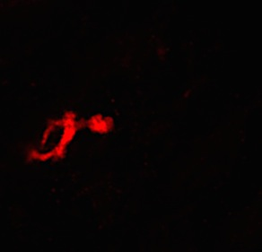
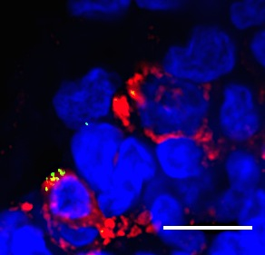
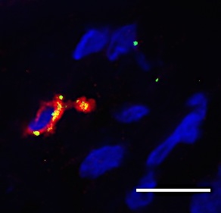
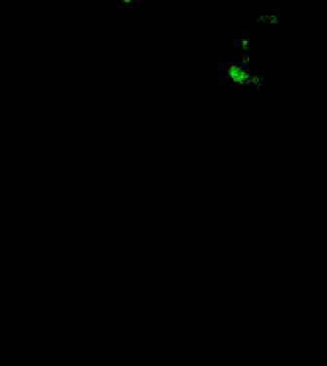
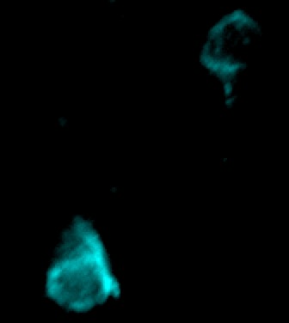
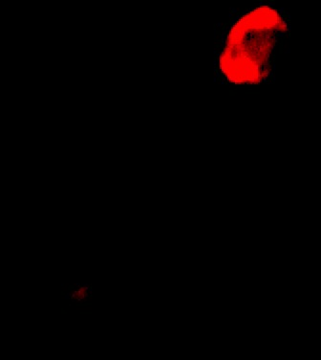
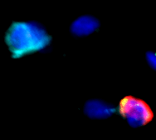


Macrophages as a reservoir of replication competent HIV
HIV-1 RNA FISH
Integrated HIV-1 DNA
(Alu-gag nested RT-PCR)
HIV-1 RNA
HIV-1 RNA
Whole penile tissue recovered from 20 HIV+ patients during elective gender reassignment surgery
Urethral MΦ but not CD4+ T cells contained integrated HIV
Viral outgrowth could be detected following LPS but not PHA stimulation
CD68+ MΦ were shown to contain HIV RNA and proteins
These cells display an M1/M2 intermediate phenotype
10⁵
Whole
tissue
10⁵
Sorted
cells
10⁴
10⁴
10³
10³
Integrated HIV-1 copies
per 10⁶ urethral cells
Integrated HIV-1 copies
per 10⁶ urethral cells
10²
10²
CD68
CD68
10¹
10¹
0
0
Uninfected
HIV-1/cART
Macrophages
T-cells
10²
Epithelium
*
10²
Stroma
10¹
10¹
**
Epithelium
Stroma
HIV-1 outgrowth
(‰ GHOST infection per 10⁶ urethral cells)
HIV-1 outgrowth
(‰ GHOST infection per 10⁶ urethral cells)
10⁰
10⁰
0
0
HIV-1 p24
CD4
CD68
PHA
LPS
PHA
LPS
TUSY0301 – Yonathan Ganor

Slide 5
Naïve CD4+ T cells as a reservoir of intact HIV
Naïve CD4+ T cells show low frequency of integrated HIV, but the percentage of intact proviruses in naïve cells is greater than in memory cells (TUAA0204 – Emmanuele Venanzi)
Clonal expansion is found more frequently in more differentiated T cell subsets (TUAA0205 – Jori Symons)
Naïve CD4+ T cells are an important reservoir because they are long lived, more transcriptionally silent, and can replenish the memory reservoirs through differentiation

Slide 6

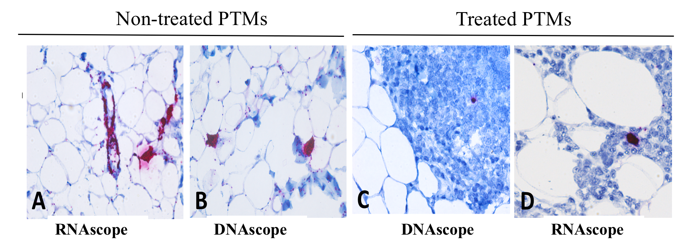
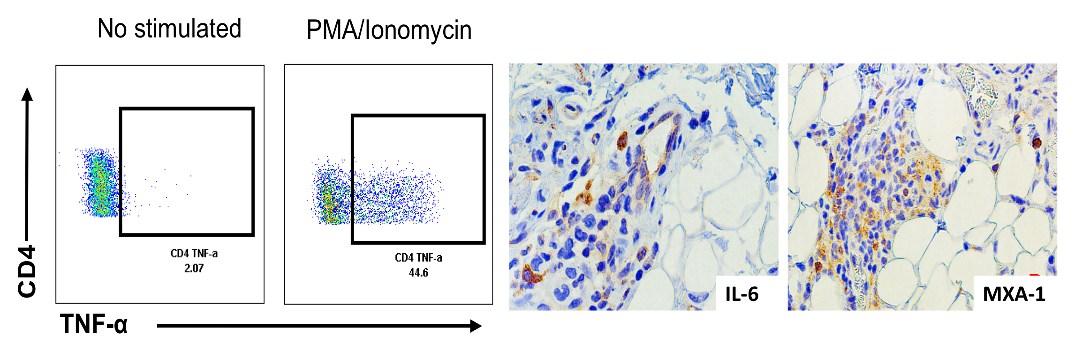
Adipose tissue is a viral reservoir in pigtailed macaques
SIVsab
(0 DPI)
ART
(48 DPI)
Six PTMs infected with SIVsab (300 TCID50)
ART (TFV, FTC, DTG)
Baseline
(-15 DPI)
Necropsy
(500 DPI)
The adipose tissue represents a significant virus reservoir in SIVsab+ PTMs on ART
Immune cells in the AdT secrete high levels of inflammatory cytokines
TUAA0203 – Paola Sette

Slide 7
AZD5582 a novel SMAC mimetic LRA
AZD5582 is a SMAC mimetic that activates NF𝛋B through the non-canonical pathway with a slower but longer lasting effect
AZD5582 activates a limited set of host genes compared to Ingenol
Reactivates HIV latency in cell line models and in CD4+ T cells from suppressed patients ex vivo
Tested in HIV-infected, ART-suppressed humanized mice and in SIV-infected, ART-suppressed rhesus macaques
AZD5582 treatment led to increased SIV RNA in lymph nodes of macaques, and HIV RNA in lymph nodes, thymus, bone marrow, liver and lung of humanized mice
SMAC mimetics may be the next class of LRAs
MOSY0705 – Victor Garcia
TUSY0303 – David Margolis

Slide 8
STING pathway agonists as LRAs
STING: ER-associated factor that senses cytosolic NAs
Activates IRF3, NFκB, STAT6
Induction of type-I IFNs, antigen presentation, antigen-specific T cell responses
Induced viremia in 2/6 ART-suppressed monkeys
One of them had increase of CA-SIV-RNA
2/6 monkeys also showed increased SIV-specific T cell responses
WEAA0301 – Maud Mavigner

Slide 9
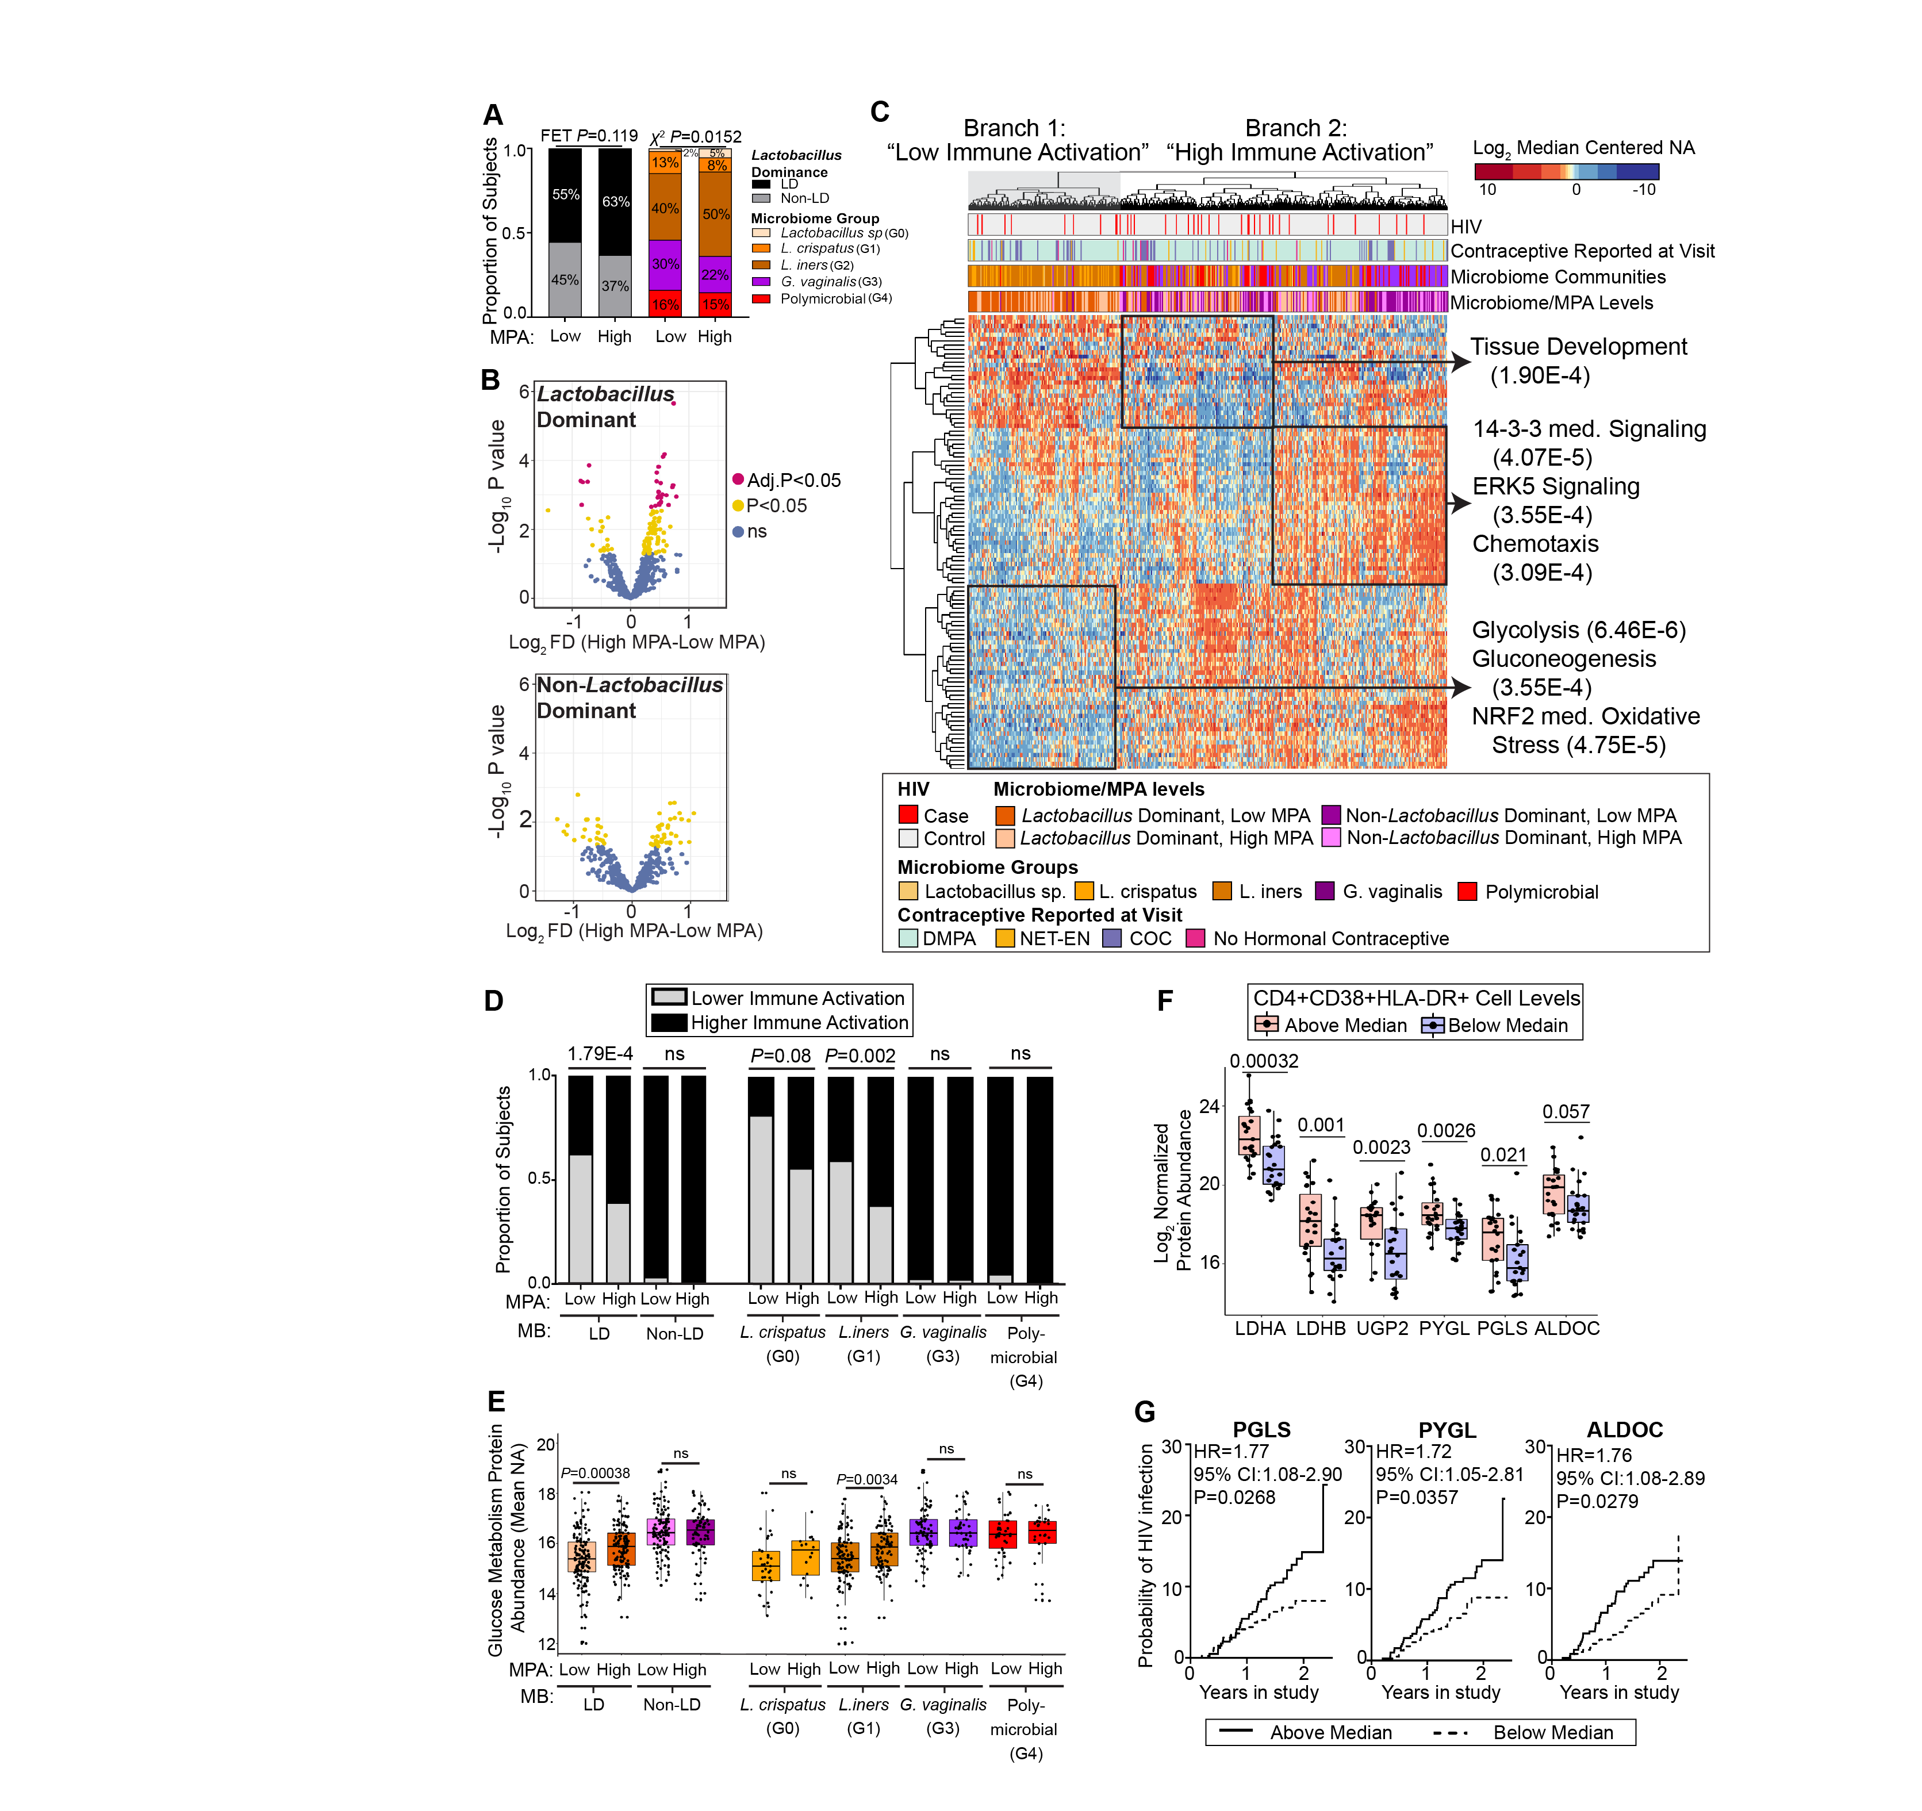
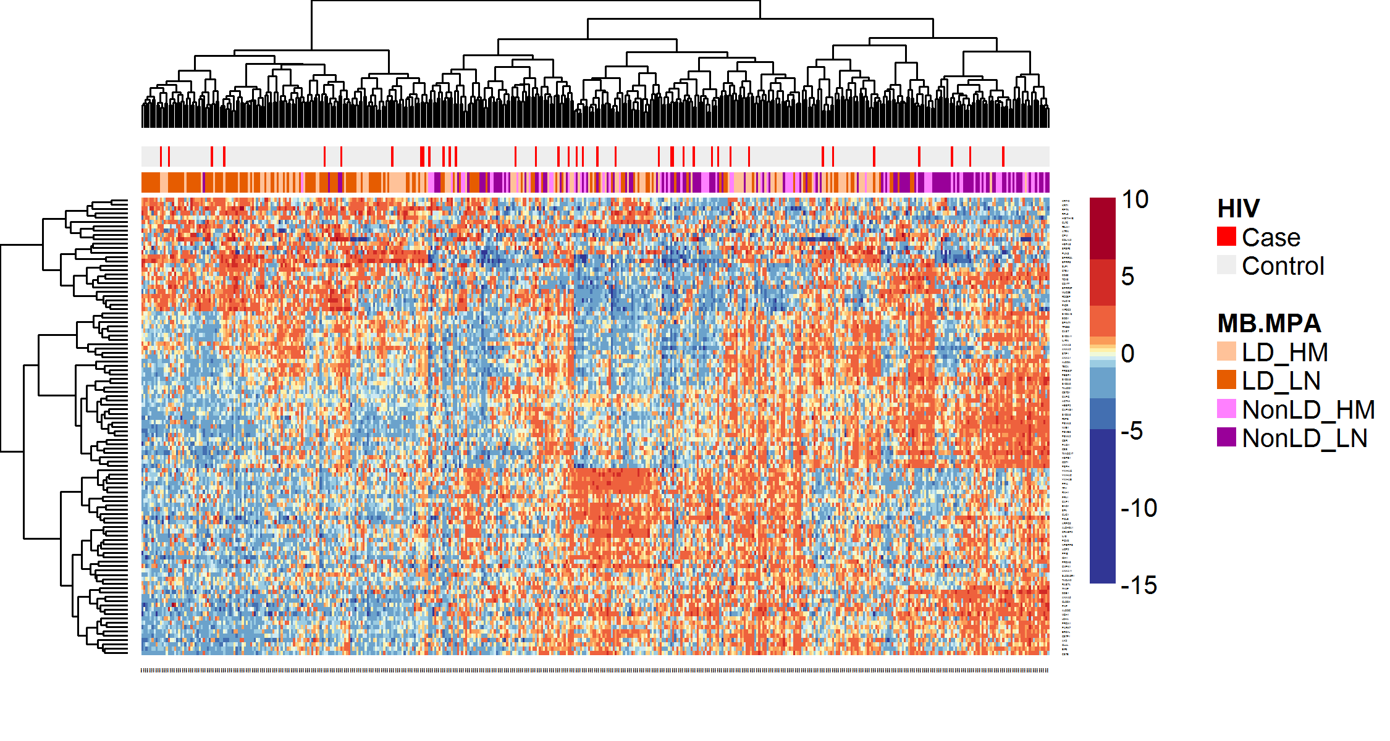
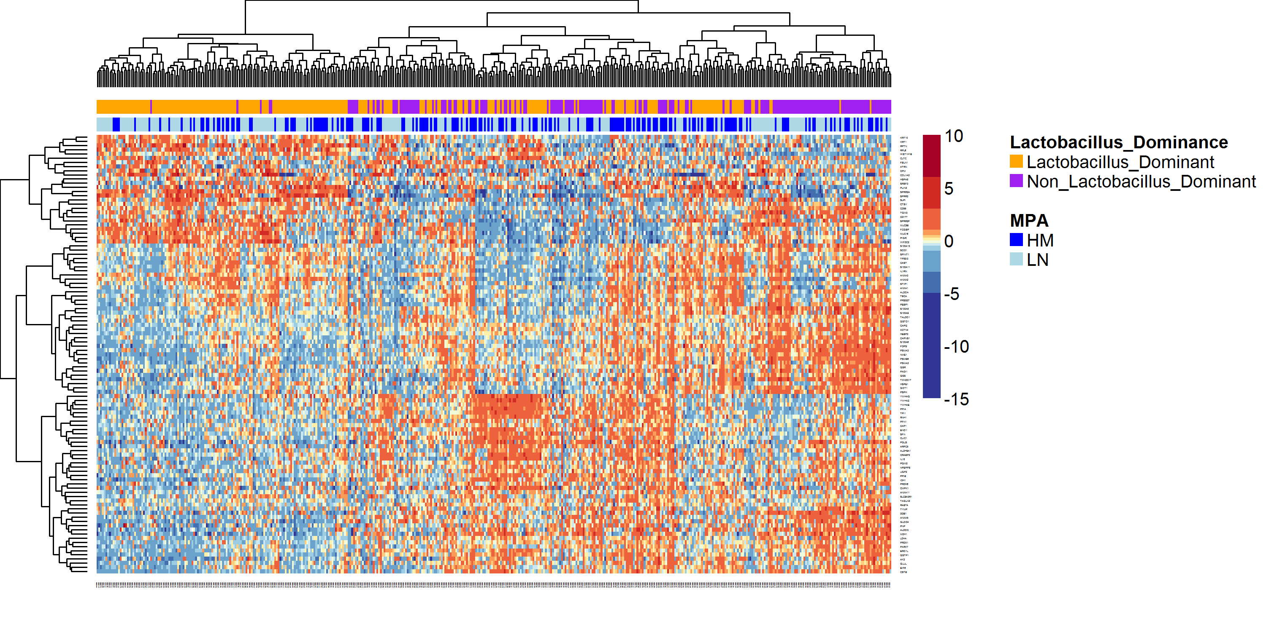
Vaginal microbiome, immune activation and contraceptives
Low inflammation
Lactobacillus + low MPA
High inflammation
All Non-Lactobacillus
Lactobacillus + high MPA
High levels of MPA (Depo-Provera) are associated with increased vaginal immune activation but only in women with Lactobacillus dominant microbiome
The microbiome environment influence MPA-associated immune activation and the risk of acquiring HIV
Epithelial Integrity
Tissue development
Pro-inflammatory pathways
ERK signaling
Chemotaxis
Cellular
Metabolism
Glycolysis
NO/ROS signaling
TUPDA0104 – Laura Noel-Romas

Slide 10
Control of HIV-1 latency by estrogen
Estrogen blocks HIV-RNA transcription, emergence from latency and spreading infection
The HIV reservoir size increases in women during reproductive aging
MOPDA0101 – Jon Karn

Slide 11
Combined analysis of integration sites and proviral sequence
3 HIV-1 patient on long-term ART
MIP-seq to analyze integration sites and proviral sequence
ATAC-seq to assess chromatin accessibility
Intact proviruses enriched for non-genic chromosomal positions and in opposite orientation relative to host genes
Preferentially integrated in increased distance from active transcription start sites and to accessible chromatin regions
Intact proviruses with features of deeper viral latency
P1
P2
P3
x20
Only intact sequences shown
Clonality indicated by circular symbols
Roughly equal number of defective proviruses analyzed
Einkauf KB et al, JCI 2019
MOSY0403 – Mathias Lichterfeld

Slide 12
HIV-1 insertion drives aberrant expression of host genes
SortSeq to analyze HIV-host RNA interactions at the integration site
HIV integration drives aberrant transcription of host genes (NFATC3, VAV1) downstream of the integration site
HIV-driven expression of cancer-related genes may lead to cell proliferation
This may represent a mechanism of clonal expansion
TUSY0304 – Ya-Chi Ho

Slide 13
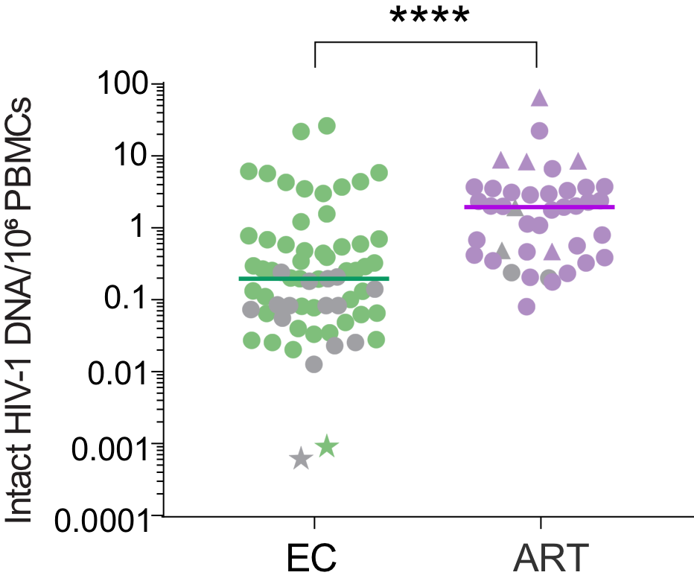
The San Francisco Patient
Clinical Information
HIV-1 infection diagnosed in 1992
Never been treated with ART
24 years of recorded undetectable viremia (1995-2019)
34 VL tests, all below detection limits
Laboratory testing
No genome-intact HIV-1 provirus identified in >1.5 billion PBMCs, using full-genome sequencing
No replication-competent HIV in 340 million resting CD4+ T cells tested in qVOA
No intact provirus in 14 million resting CD4+ T cells tested by IPDA (intact proviral DNA assay)
Limit of detection
N=65
N=41
The San Francisco patient might have approached a sterilizing cure of HIV-1 through natural immunity
MOSY1105 – Xu Yu

Slide 14
HIV-specific CTL responses in patients treated early
Absolute cell number in peripheral blood
Recalled HIV-specific CD8 T cells
Fiebig I
Fiebig I
Fiebig II
Fiebig II
Fiebig III
Fiebig III
Fiebig IV/V
Fiebig IV/V
Chronic
Chronic
HIV-specific CD8 T cells from people treated in acute infection have superior killing capacity but have lower cell number than that from treated in chronic infection
WESY0203 – Lydie Trautman
WEAA0205 – Hiroshi Takata

Slide 15
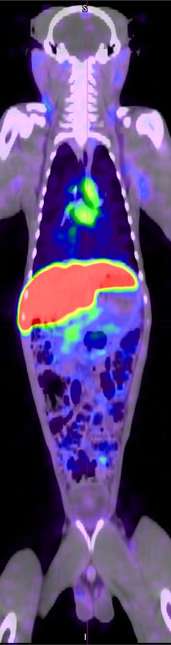
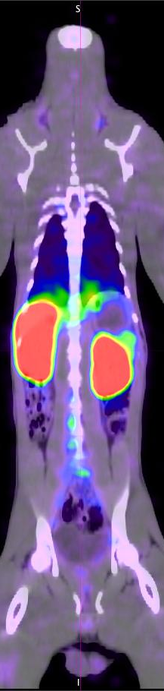
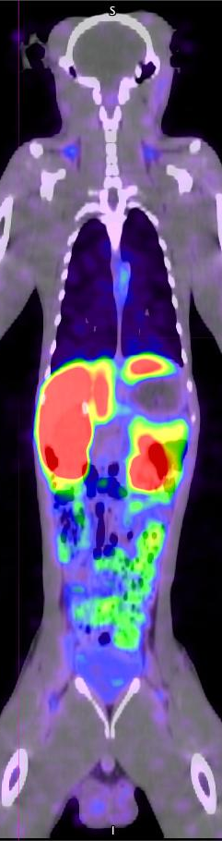
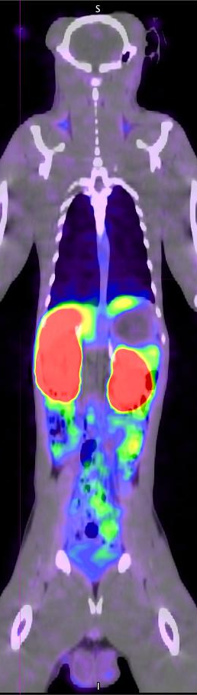
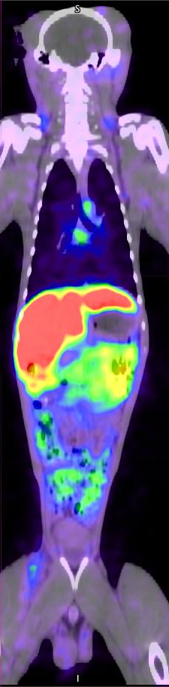
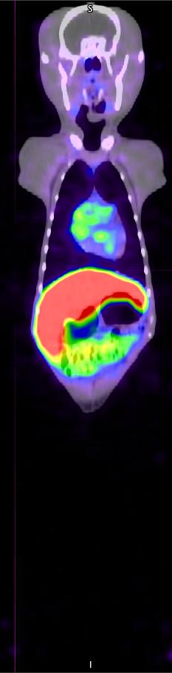
Detection of rebound viremia by immuno-PET/CT
Serial images from study animal: A12X023
  Immuno-PET/CT uses antibodies against SIV Env coupled to positron emitting radionuclides (Cu64 or Zr89) in combination with CT for vital anatomical information
It allows to monitor viral dynamics through all phases of the infection, identifying functional reservoirs from which viral rebound initiates.
This technology allows to detect tissue viral rebound is detected early post ATI 7-14 days prior to detectable viremia rebound.
6+ mos on ART
3 weeks post-ATI
TUBS0202 – Francois Villinger

