Slide 1
PROJECT SOAR OVERVIEW
Eileen Yam, Deputy Director, Project SOAR
Population Council, Washington DC
Making evidence accessible and usable: meaningful engagement of communities, programs, and policymakers in HIV implementation science
IAS 2019 │ Mexico City, Mexico
21 July 2019

Slide 2
Project SOAR (Supporting Operational AIDS Research)
Global HIV and AIDS operations research to inform programs and policy
PEPFAR-funded 6-year cooperative agreement (2014–20)
Led by Population Council with global consortium partners:
Avenir Health
Elizabeth Glaser Pediatric AIDS Foundation
Johns Hopkins University
Palladium
The University of North Carolina
Notes:
Three objectives: conduct the research, strengthen capacity, foster RU
Major project themes include:
how to best implement community-based programming
how to address social and structural barriers to reaching key and other vulnerable populations with HIV services

Slide 3
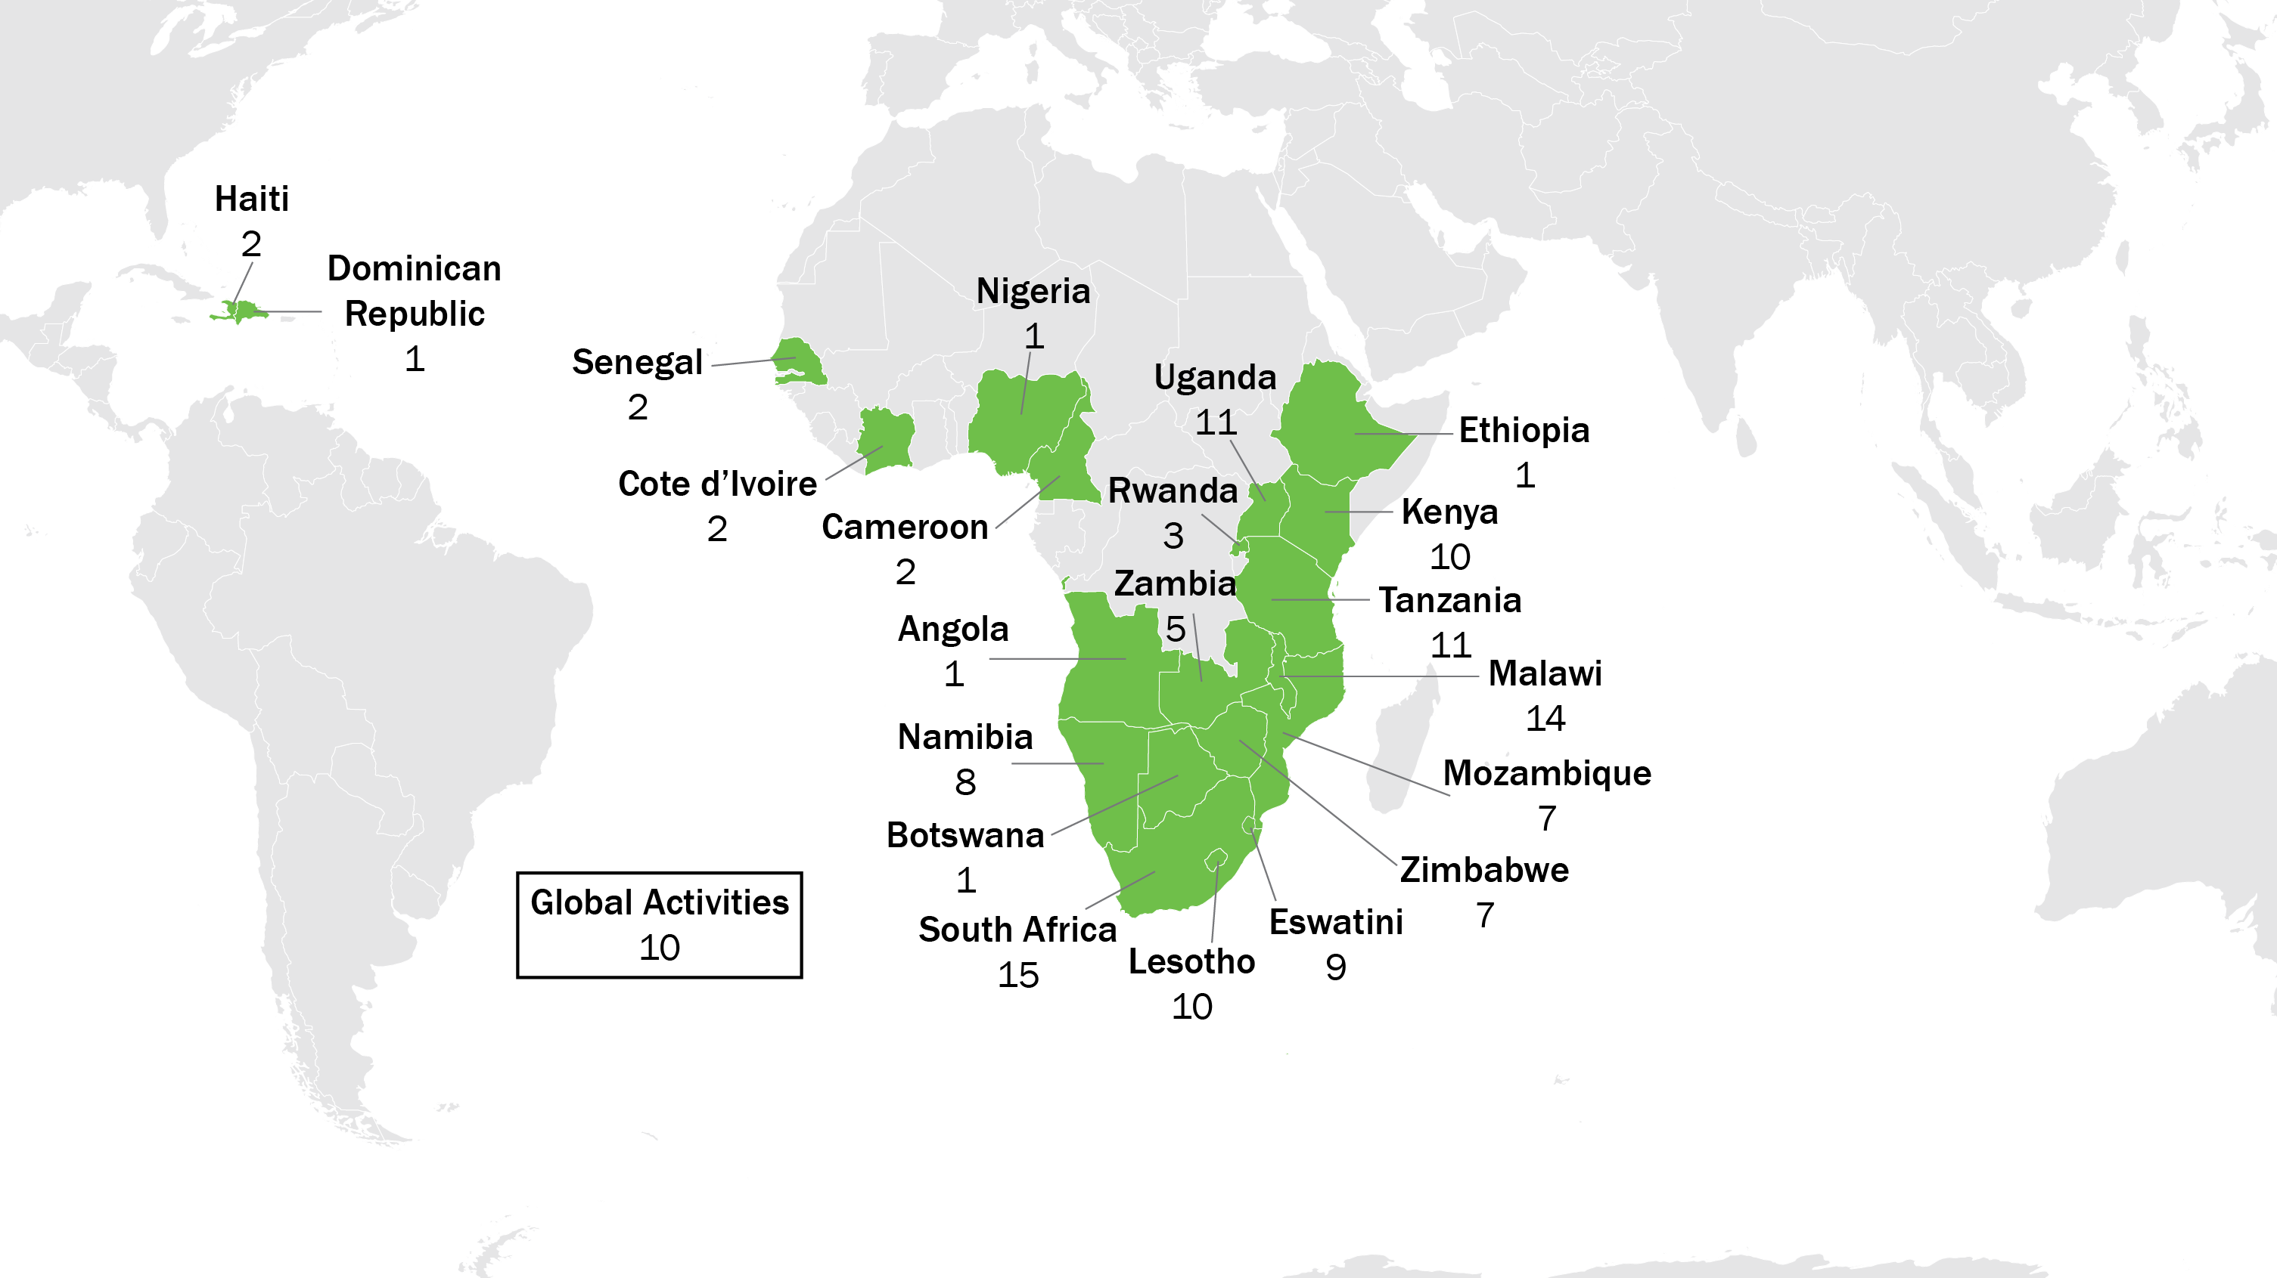
SOAR research portfolio
72 activities in 21 countries
Notes:
To update you on the overall SOAR activity portfolio, we are now implementing 70 activities in 21 countries.

Slide 4
SOAR thematic areas
Test and start
Community-based treatment and support
Key populations
Pediatric/child/adolescent treatment and PMTCT
Gender and stigma
Voluntary male medical circumcision (VMMC) (costing, modeling)
Notes:
Some of you will recall that early in SOAR, we looked critically at the HIV field, asked ourselves “what do we need to answer?”, and developed 4 overarching questions that would guide how the SOAR portfolio was developed. These questions were:
How do we optimize use of biomedical interventions?
How can we leverage community platforms for HIV prevention, treatment, and care?
How do we strengthen the continuum of care within health systems to improve treatment initiation, retention, and viral suppression?
How do we address social and structural barriers to meet the needs of key populations and other groups at heightened risk?
All 70 activities go towards answering these questions, and can further be categorized under one or more of the concise thematic areas that are listed here.
I will be presenting selected SOAR highlights under each of these areas today, and along the way I’ll pause at key moments to reflect on SOAR’s progress and contribution by theme and ask you if you have any thoughts about how SOAR can further highlight or disseminate our findings.

Slide 5
Project SOAR: three key results
Improve HIV and AIDS program outcomes through operational research
R1: Conduct high-quality OR studies
R2: Strengthen capacity to conduct (and consume) operational research
R3: Promote use of study results to guide planning, funding, and implementation
Notes:
Contribute to a worldwide reduction in new HIV infections and HIV-related morbidity by:
Conducting high-quality operations research studies to provide critical evidence
Strengthening capacity of local institutions to conduct and use operations research
Promoting use of operations research findings to ensure the adoption of evidence-based practices
Operational research…is defined as the discipline of applying advanced analytical methods…to help make better decisions. –(Zachariah et al., 2009: 711)

Slide 6
SOAR’S Research Utilization Process
Samuel Kalibala, Senior Research Utilization Advisor
Palladium/Project SOAR
Making evidence accessible and usable: meaningful engagement of communities, programs, and policymakers in HIV implementation science
IAS 2019 │ Mexico City, Mexico
21 July 2019

Slide 7
Result 3—Research utilization (RU)
Improve HIV and AIDS program outcomes through operational research
R1: Conduct high-quality OR studies
R2: Strengthen capacity to conduct (and consume) operational research
R3: Promote use of study results to guide planning, funding, and implementation
Effective dissemination of OR findings through multiple channels | Changes to practice and policy due to SOAR activities | Improved tracking of how SOAR research has been utilized for program and policy changes

Slide 8
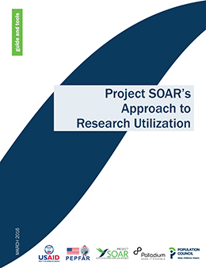
RU builds bridges between researchers and program managers and policy makers
PROGRAM
Practical
Urgent
Action-Oriented
RU
Highlights context
Engages stakeholders
Supports use of findings
Builds ownership
RESEARCH
Controlled
Empirical
Objective
POLICY
Bargaining
Lobbying
Compromising

Slide 9
Key RU practices
Identify and engage key stakeholders during the research process
Hold data interpretation meeting(s)
Disseminate findings
Develop RU plan to use findings and recommendations
Implement RU plan and document utilization

Slide 10
IDENTIFY AND ENGAGE KEY STAKEHOLDERS DURING THE RESEARCH PROCESS

Slide 11
Whom does SOAR engage?
Stakeholders at multiple levels:
beneficiaries
service providers
national and sub-national government
civil society
donors
academia
UN agencies

Slide 12
How does SOAR engage them?
Co-investigators:
Involvement in all aspects of the research process
Discussants of preliminary and final results:
Research advisory committees (RACs)
Existing technical working groups (TWGs)
Targeted meetings
Capacity-strengthening
Design, conduct, and utilize research

Slide 13
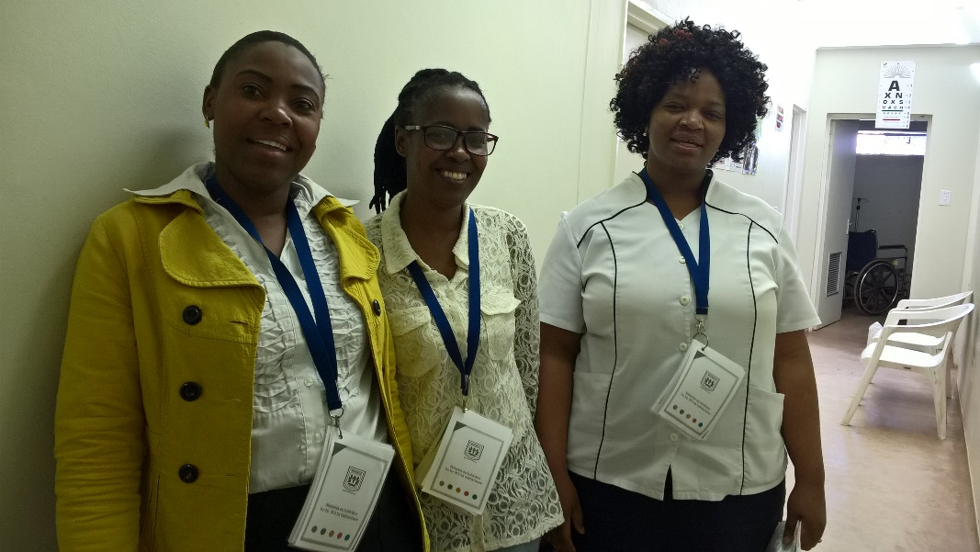
Lesotho: IMPROVE
What did we learn?
Insufficient number of qualified team members to track LTFU mothers
How were stakeholders engaged?
Study design and updates presented to Ped TWG
Presentation of baseline findings to District Health Management Team (DHMT)
What happened?
Recruited and trained 46 new village health workers

Slide 14
Uganda: Stigma Index
What did we learn?
High levels of stigma
How were stakeholders engaged?
Data collected by community members
Findings presented to DHMT
What happened?
DHMT included stigma reduction interventions in annual work plan

Slide 15
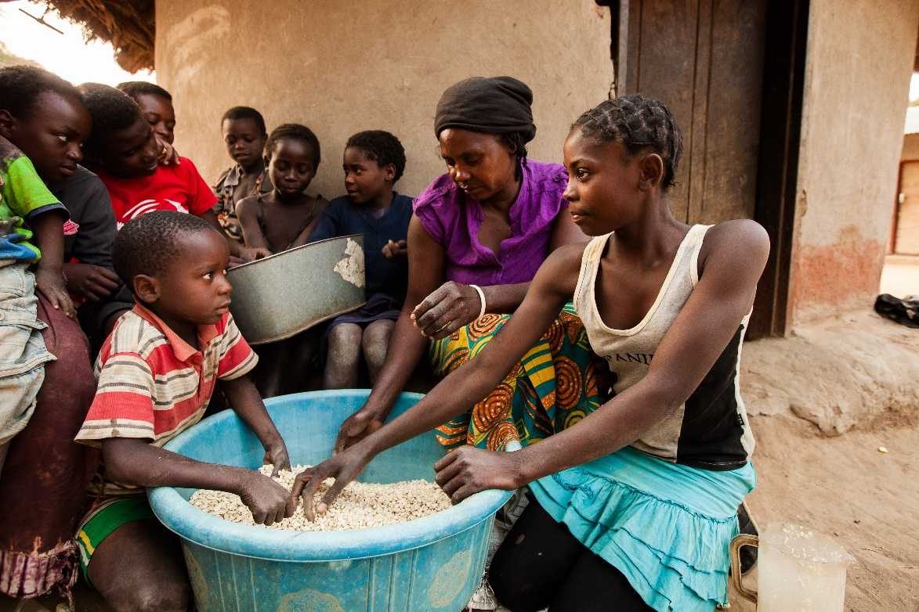
Zambia: Evaluation of ZAMFAM
What did we learn?
Less than 10% of OVC had a birth certificate
HIV status of only 53% of OVC was known to the caregiver
How were stakeholders engaged?
Ministry of Community Development chaired the RAC
Presentation of baseline findings at RAC meeting attended by IPs
What happened?
IPs modified work plans to assist OVC in getting birth certificates and encourage access to HTS

Slide 16
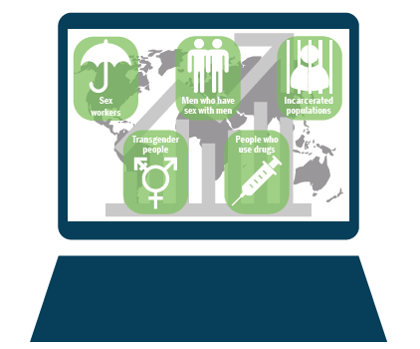
Strengthening capacity to use data to inform HIV responses for key populations
What did we learn?
HIV prevalence, incidence, population size estimation, etc. across countries. Data synthesized and deposited in central repository
How were stakeholders engaged?
Policymakers (UNAIDS, Global Fund, USAID missions, MOH) through meetings/conference calls
What happened?
Requests for data pulls from repository for decision-making (e.g., COP process)

Slide 17
Conclusions and recommendations
Decision-makers exist at all levels and can be involved through various mechanisms.
Decision-makers can make immediate use of research results.
Research projects should build in mechanisms to engage decision-makers with preliminary and final study results.

Slide 18
There’s hope for Cecilia

