Slide 1
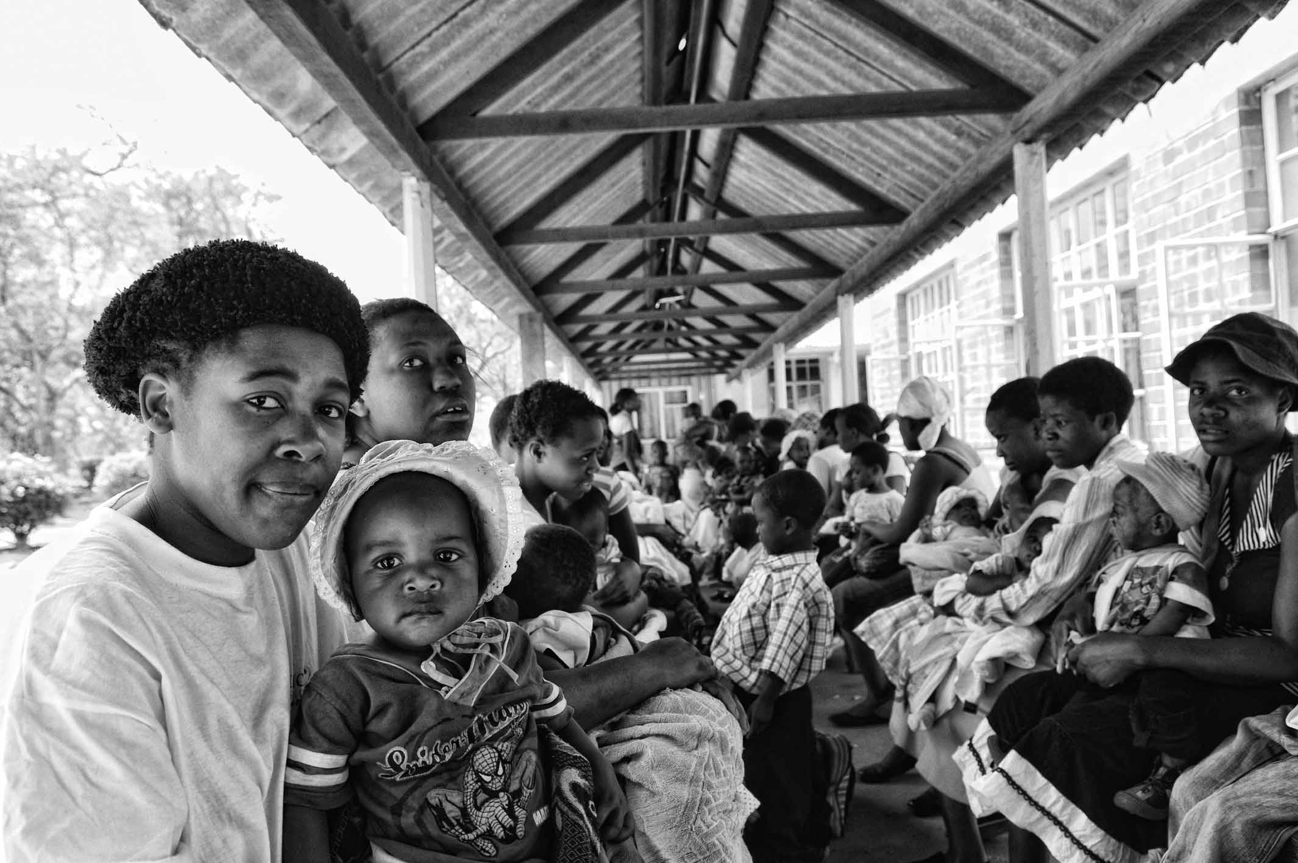
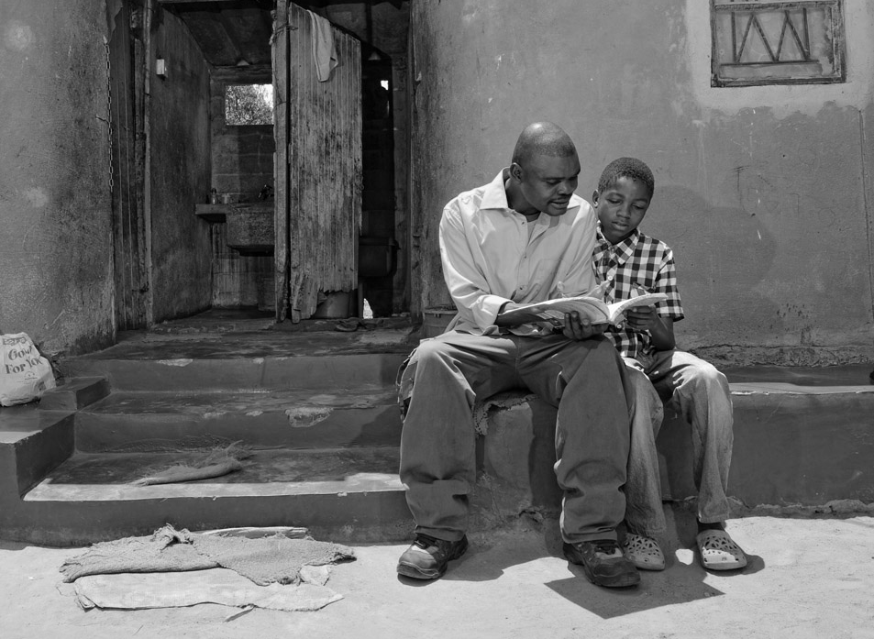
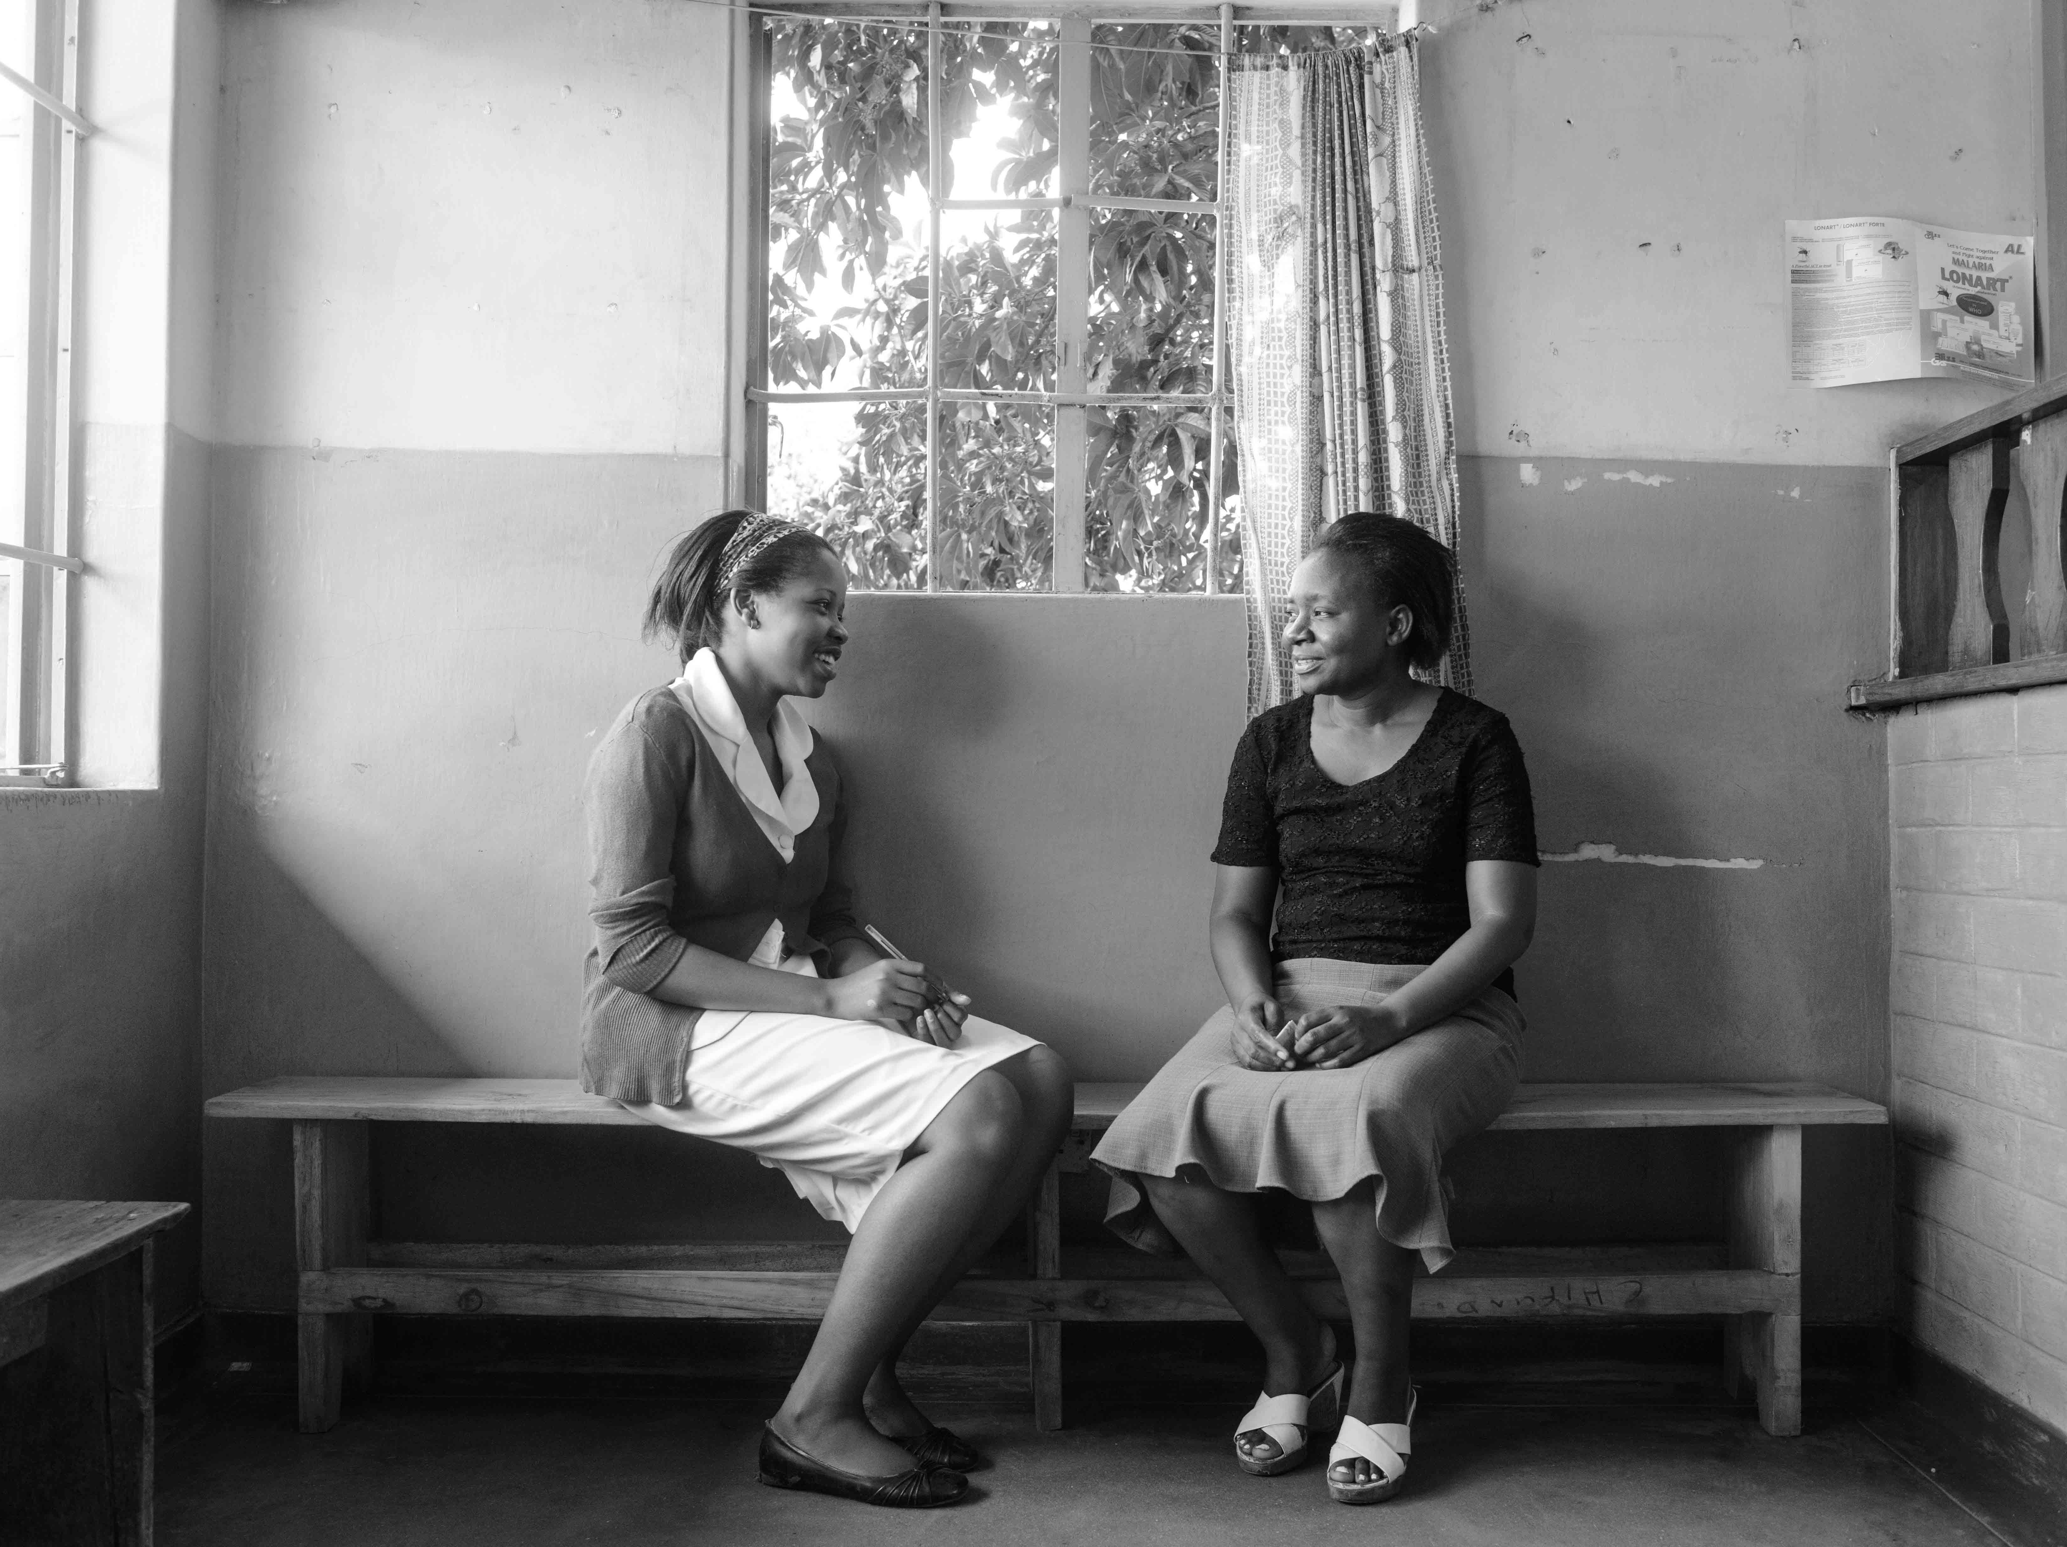
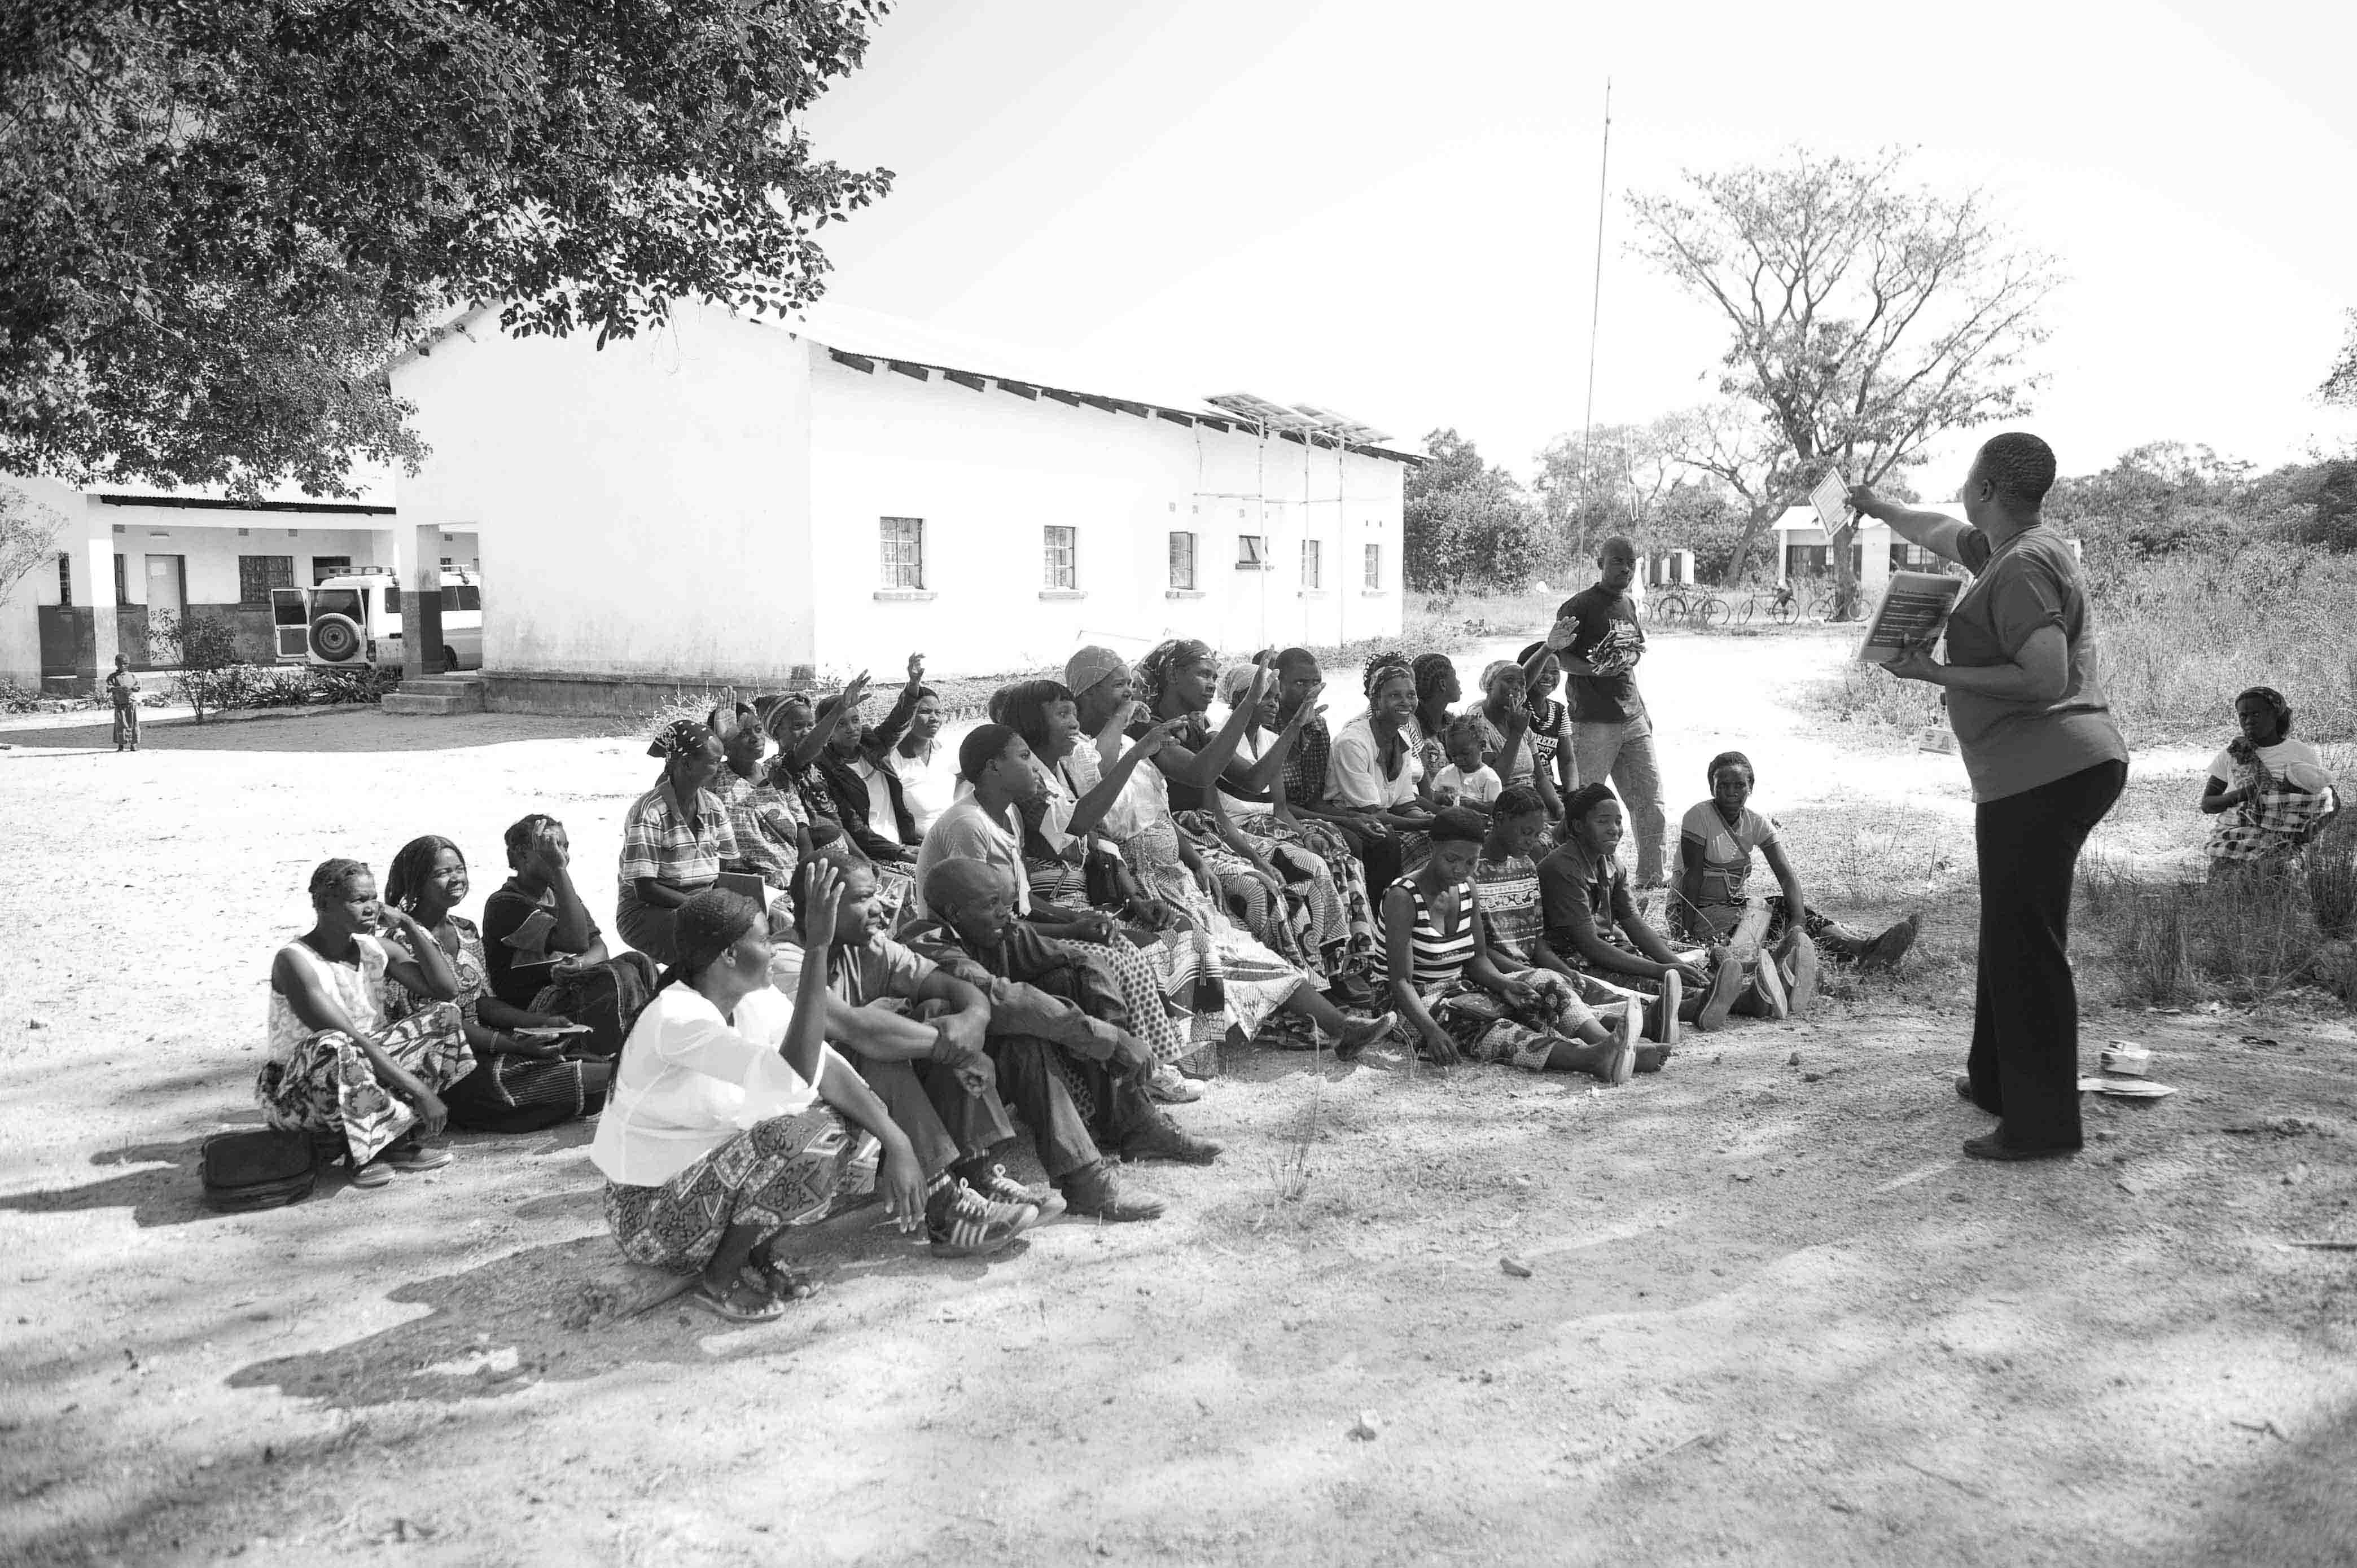


UNITAID PSI
HIV SELF-TESTING AFRICA
HIV Self-Testing
Secondary distribution through Antenatal and Index Testing
A pragmatic cluster-randomized trial
Moses Kumwenda (Augustine Choko)
Malawi Liverpool Wellcome Trust Clinical Research Programme

Slide 2
Key background points
Conventional testing failing to reach men & high risk groups
  HIVST a potential strategy to bridge the gap
Secondary distribution of HIVST a leading candidate among policy makers
  Considered for national scale but limited pragmatic evidence
  No evaluation of secondary accuracy
  Very limited data on yield among sexual contacts
Sharma et al., PLoS Med 2017; Choko et al., PLoS Med 2019

Slide 3
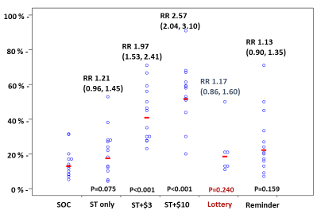
Primary outcome results for PASTAL trial (adjusted analysis)
PASTAL trial results [1]
Improving linkage to treatment and prevention after (self)-testing among male partners of antenatal care attendees: a multi-arm adaptive cluster randomised trial in Malawi
What are the most promising candidate interventions for increasing HIV testing, care and prevention in partners of pregnant women?
Proportion of male partners tested + linked to care or prevention within 28d
Intention-to-treat analysis
Stage 1 & 2 combined data:
  Linked: 676/2349 (28.8%)
  630 (93%) confirmed HIV-ve: 408 already circumcised; 222 uncircumcised men referred for VMMC
  46 (7%) confirmed HIV +ve; 42 (91.3%) started ART
  44.0% first time testing
  3 adverse events
  no serious adverse events
  Lottery arm dropped at interim
Choko et al., PLoS Med 2019

Slide 4
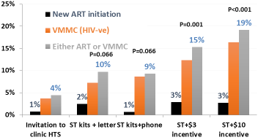
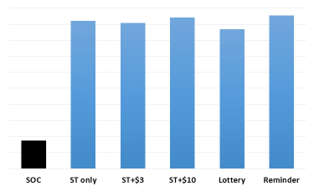
PASTAL trial results [2]
Proportion of male partners tested within 28d by arm & stage – as reported by the woman
% of all* male partners linking to HIV care or prevention
% of all* male partners testing for HIV
Day 28 follow-up (ACASI)
  91% ♀ interviewed
* Intention to treat analysis including all eligible women: assumes 1:1 ♂:♀
Choko et al., PLoS Med 2019

Slide 5
STAR ANC/Index trial research questions
Can secondary distribution of HIVST kits by MoH staff improve coverage of HIV testing by sexual partners of
  Pregnant women and
  Family Referral Slip recipients (new positive clients – index clients)
  while maintaining acceptable linkage, safety, and accuracy?
What is the diagnostic accuracy of oral fluid tests
  Following secondary distribution?
  In the intended-user intended-setting context (unobserved)?

Slide 6
Study design
Scale up of Choko PASTAL ANC model; Pilot for national scale up; CRT in Blantyre, Chikwawa, Mulanje and Zomba Districts Malawi
Randomize 27 MoH PHCs to one of 3 trial arms
N = 350 women / clinic and 35 new Index PLHIV / clinic
Enhanced Standard of care
Programmatic HIVST
HIVST Accuracy
Invitation leaflets
Dedicated partner clinic
ART, VMMC, Discordancy
SOC
OQ kits in ANC+HTC
Demonstration of HIVST
Programmatic HIVST
Accuracy evaluation
$10 incentive offered

Slide 7
Outcomes
Primary outcomes
% of (male) partners tested for HIV within 28 days
Number of new HIV positive contacts identified via index clients
Secondary Outcomes
Linkage
Adverse events
Cascade of service (testing)

Slide 8
Individual level eligibility screen (routine MoH staff)
ANC women:
1st ANC visit
Age 15 years or older
Has one main sexual partner (i.e. likely father)
Main sexual partner not already known to be HIV-positive and on ART
Sexual partner likely to remain in clinic catchment area for the next 28 days
Not already tested together in this pregnancy [e.g. partner has come with her on this visit and has tested today]
Not already recruited in the study
Newly diagnosed HIV +ve clients
Age 15 years or older
At least one sexual partner not already known to be HIV-positive and on ART
At least one sexual partner likely to remain in catchment area within the next 28 days
Not already recruited in the study

Slide 9
Data collection
Completed by study field workers
Completed by routine HTS providers
ANC
Distribution register for negative women
Linkage register for all partners: ANC and Index sexual contacts
Follow-up questionnaire for negative women at their next ANC visit
New HIV positive clients (Index)
Distribution register
Follow-up questionnaire with index clients at their next ART refill visit
Trial start dates: 12th September 2018 - HIVST arm; 25th September - Accuracy arm; 1st October – SOC arm

Slide 10
Recruitment & follow-up update
3934
2840
4031
9450
3359
3197
1165

Slide 11
HIVST Distribution and Linkage Cascades

Slide 13
Secondary accuracy evaluation – HIVST Accuracy arm only
 |  | HIV results from parallel finger prick testing*
 |  | Positive | Negative | Total
Participant self-test self-read result | Positive | 52 | 4 | 56
 | Negative | 6 | 801 | 807
 | Total | 58 | 805 | 863
* Determine and Unigold rapid tests
Estimates:
Agreement: 98.7%
Kappa: 0.91
Sensitivity: 89.7% (95% CI: 78.8; 96.1%)
Specificity: 99.5% (95% CI: 98.7; 99.9%)

Slide 14
Adverse events/Social Harm
Adverse events:
Four self-resolving temporary marriage separation in HIVST arms
Notes:
Linkage was 63.4% in the accuracy arm and 13.3% in the Standard of Care arm. For HIVST only arm, it can not be computed because because negatives were informed to remain at home

Slide 15
Conclusions
Secondary HIVST distribution:
  Preferred by male partners
  Preferred by sexual contacts of index clients
HIVST kit sensitivity was slightly lower than previously reported
  highlighting need to further optimise this approach
Results support scale up of secondary distribution through ANC and Index Testing

Slide 16
STAR Team
Researchers and implementers from Malawi, Zambia and Zimbabwe
Economics Network
Quantitative and Epi Research Network
Qualitative Research Network
Website: http://Hivstar.lshtm.ac.uk

