Slide 1
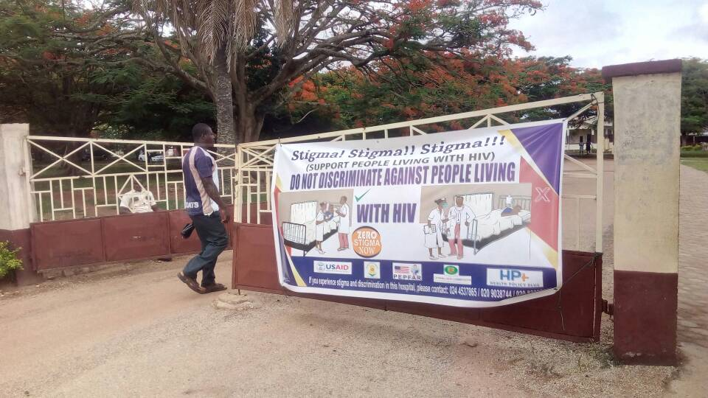
Breaking Down Barriers to Care
Reducing Stigma and Discrimination in Health Facilities
Laura Nyblade

Slide 2
Stigma: A Fundamental Determinant of Health and Health Equity
Stigma undermines three key determinants of health:
Access to resources
Access to social support
Psychological and behavioral responses
Through exclusion, segregation, discrimination, stress and downward socioeconomic placement
(Hatzenbuehler et al. 2013)

Slide 3
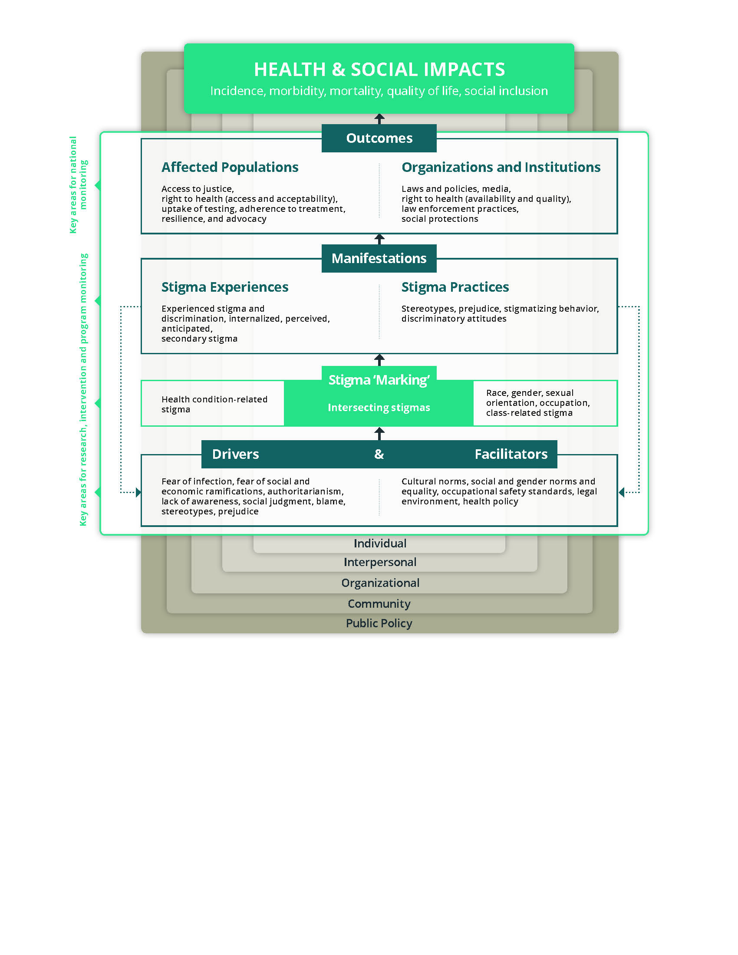
Leverage Synergies for Stigma Reduction Across Conditions and Groups
Combine stigma reduction across stigmatized conditions and groups
BMC Special Collection of Articles, Feb 2019: https://www.biomedcentral.com/collections/stigma
Stangl, A et al. The Health Stigma and Discrimination Framework: a global, crosscutting framework to inform research, intervention development, and policy on health-related stigmas.

Slide 4
Why and Where We Intervene to Reduce Stigma and Discrimination in Health Facilities
Immediately Actionable Drivers
Stigma Manifestations
HIV Treatment Cascade
experienced, anticipated,
perceived, internalized, etc.
Testing & Diagnosis
Fear of contracting HIV
Awareness of Stigma
Attitudes
Institutional Environment
Linkage to care
&
Retention in care
Viral Load Suppression
avoidance, harassment, refusal to treat, etc.
Adherence
Stigma Measurement and Intervention

Slide 5
Key Principles for HIV Stigma-Reduction Interventions
Create partnerships between affected groups and opinion leaders
Contact strategies
Build empathy Model desirable behaviors Recognize and reward role models
Address immediately actionable drivers
Raise awareness Discuss and challenge the shame and blame Address fears and misconceptions about contracting HIV
Place communities at the center of the response
Support networks Empower and strengthen capacity Address self-stigma

Slide 6
Global Stigma Measurement Tools: Available for Multiple Populations
People Living with HIV Stigma Index 2.0
Recent revision completed, more focus on health facility and key population stigma
Key Populations
Stigma questions added to the most recent IBBS
Health facility
Measuring HIV stigma and discrimination among health facility staff: Standardized brief questionnaire (www.healthpolicyproject.com)
Adaptations: Thailand, Lao PDR, Viet Nam, Jamaica, Ghana, Tanzania, Zambia, South Africa, Alabama
General population: Demographic and Health Surveys

Slide 7
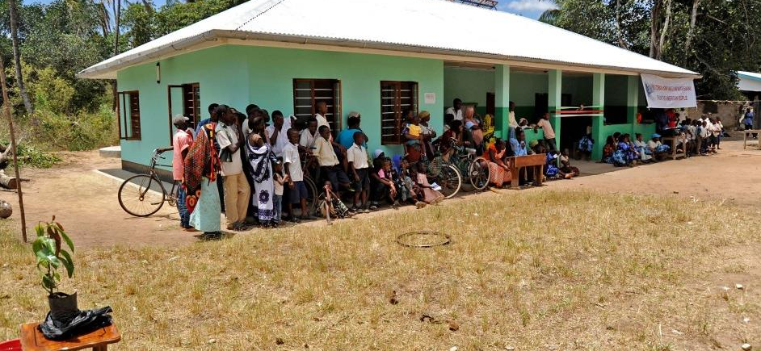
Combating HIV-Related Stigma and Discrimination in Health Facilities Unleashing the Power of Health Workers and Clients Working Together for Action

Slide 8
Acknowledgments
Respondents, facility staff, and management in Ghana and Tanzania
Governments of Tanzania and Ghana, including ministries of health and national AIDS programs
Local implementing partners
Educational Assessment Resource Centre (Ghana)
Kimara Peer Educators and Health Promotors Trust (Tanzania)
Muhimbili University for the Health and Allied Sciences
U.S. Agency for International Development (USAID), U.S. President’s Emergency Plan for AIDS Relief (PEPFAR) and the Global Fund (Ghana)

Slide 9
The HP+ Total Facility Approach to Stigma Reduction: Three Phases
Assessment
(Baseline)
Steps
1. Adapt global assessment tools
2. Quantitative surveys
Facility staff
Clients living with HIV
3. Participatory dissemination
Intervention
Steps
Adapt global training tools
Participatory skills building
Training of facilitators
Stigma-reduction trainings for all staff
Other tailored, facility-led interventions
Evaluation
(Endline)
Steps
Quantitative surveys
Data analysis
Dissemination at facilities

Slide 10
Participatory Training & Skills Building
Training of facilitators: Facility staff and clients living with HIV, including youth (Tanzania)
Competitive selection of facilitators (Tanzania)
Five-day offsite training and five days of mentoring/coaching (led by master trainers)
Two days onsite, participatory skills building for facility staff (clinical and non-clinical)
Mix of levels and departments minimizes disruption of service delivery
Timing is flexible, depending on facility schedule
Holding the sessions one week apart deepened learning (Tanzania)

Slide 11
Participatory, Facility-Based, Two-Day Staff Training
Topic | Corresponding Exercise
Create awareness of what HIV-related stigma is in concrete terms | Identify stigma and discrimination through pictures; analyze stigma in health facilities
Understand and address fear of contracting HIV in the workplace | Partner work and quality, quantity, route of transmission tool work on non-sexual transmission; role play to review standard precautions
Gender and sexual diversity, stigma and discrimination toward key populations (Ghana) | Sexual diversity education and terminology; learn about and connect stigma to human rights
Understand and address stigma faced by youth seeking HIV and other sexual and reproductive health services (Tanzania) | Use individual reflection, small group work, and plenary discussion to explore stigma experienced by youth, provider comfort/discomfort serving youth, ways to improve service delivery for youth clients
Building empathy and reducing distance (contact strategies) | Listen to first-hand experiences from members of key populations (Ghana), youth (Tanzania), and people living with HIV; discuss experiences in health facilities; self-reflection
Working to create change | Develop realistic strategies and a code of practice and action plan
Final curriculum: 14 participatory exercises (Ghana), 16 exercises (Tanzania)

Slide 12
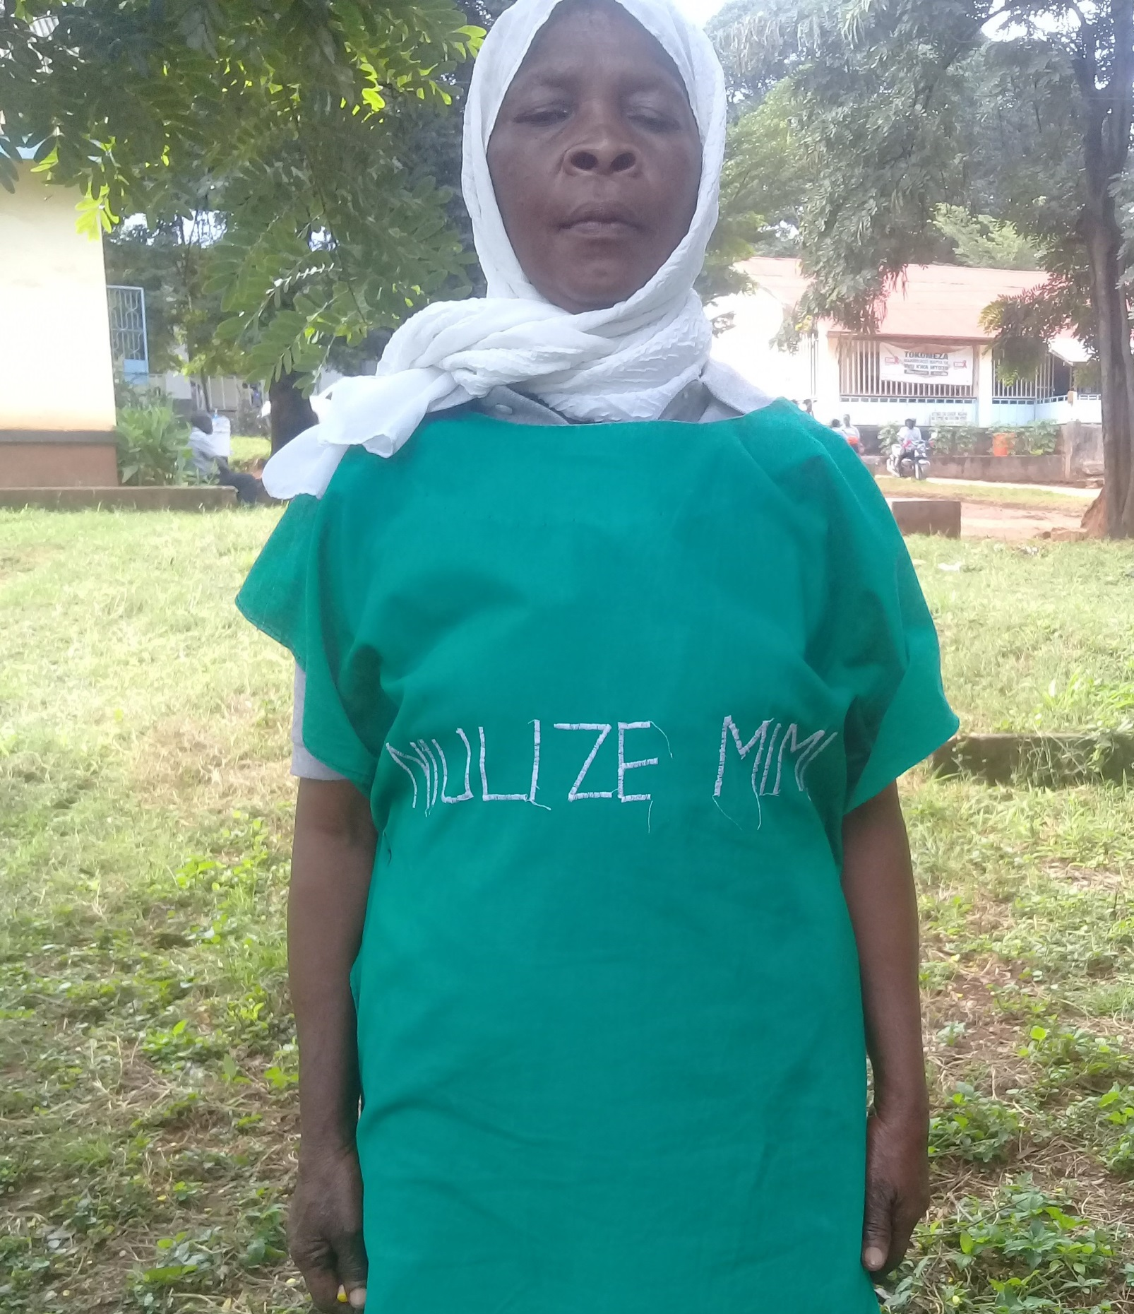
More Tailored Interventions Designed and Implemented by Facility Staff
Local Solutions
Champion teams
Public declarations to stigma-free care
Banners, posters, community TV and radio spots, loudspeaker announcements
Codes of conduct
Complaint and compliment system
Sustainable
Integrated in existing structures and processes
Small seed grants provided for stigma-reduction activities
NIULIZE MIMI (“ASK ME”)

Slide 13
Evaluation Methods
 | Ghana | Tanzania
Pre- and post-intervention comparison through baseline-endline surveys
District-level health facilities | 10 facilities (5 intervention, 5 comparison | 2 facilities
Regions | 5 of the highest HIV prevalence regions (Ashanti, Brong Ahafo, Eastern, Greater Accra, and Western) | 1 region (Morogoro)
Health facility staff of all levels (clinical and non-clinical)
Baseline | n=1,149 | n=233
Endline | n=1,149 | n=278
Estimated before-after trends | √ | √
Estimated difference-in-differences | √ | -

Slide 14
Evaluations Found Interventions Effective
Significant reductions in drivers and manifestations of stigma
Before-after improvements in most outcome domains in the intervention facilities
Difference-in-differences reductions between intervention and comparison facilities (Ghana)
Improved treatment of clients (reported by both clients and staff)
Benefits for facility staff of stigma reduction
This interaction is different from anything else we have experienced so far—we defined the response; we owned it.
— Dr. Akosua Osei Manu
Tema General Hospital

Slide 15
Key Elements of the Total Facility Approach
Evidence-based, building on two decades of work
Immediately actionable drivers
Adaptation of validated measurement and participatory training tools
Recognition that all facility staff have a role to play
Engagement of facility management
Data-driven
Baseline informs intervention and catalyzes action
Endline evaluation
Strengthens stigma-reduction capacity in facilities
Participatory approaches to learning and behavior change
Participatory stigma-reduction trainings led by staff and clients
Facility champion teams

Slide 16
Moving From What We Know To What We Do Next
Scale-up
Thailand leading the way—it is possible
Build on global best practices—there are readily adaptable tools and approaches available
Measure: Standardized & validated tools exist
Integrate S&D indicators into national HIV M&E frameworks
Expand and standardize measurement in health facilities and beyond
Set global targets
Hold ourselves, implementers, governments and donors accountable

Slide 17
Moving From What We Know To What We Do Next
Integrate: Make stigma an explicit component of delivering quality services by:
Empowering staff to identify and develop their own responses to stigma
Including S&D-reduction as part of quality-improvement processes
Incorporating stigma-reduction into formation of health workers
Licensing and accreditation for individuals & facilities
Performance assessment & supportive supervision
Reporting and redress mechanisms

Slide 18
Stigma Reduction is a Smart Investment: if You Invest in Stigma Reduction…
The ripple effects will impact across the cascade and contribute to reaching 95-95-95 targets…
Willingness to seek testing
Disclosure of HIV status
Ability to practice prevention
Pre-exposure prophylaxis (PrEP)
Willingness to seek care and treatment
Ability to access care and treatment
Retention in care
Quality of services
Improved treatment adherence and retention
Improved treatment effectiveness
Increased viral load suppression
Coverage across community served
Stigma-reduction interventions
Prevention and Testing
Linkage and Retention in Care
Adherence and Viral Load Suppression

Slide 19
Action to reduce facility stigma is possible!
http://www.healthpolicyplus.com/
lnyblade@rti.org
Notes:
Photo from an S&D workshop in Tanzania (Photo courtesy of Health Policy Plus).

