Slide 1
Why PEPFAR Is Going All In on Partner Notification Services
Heather Watts MD
Director of HIV Prevention, Program Quality Team
Office of the Global AIDS Coordinator

Slide 2
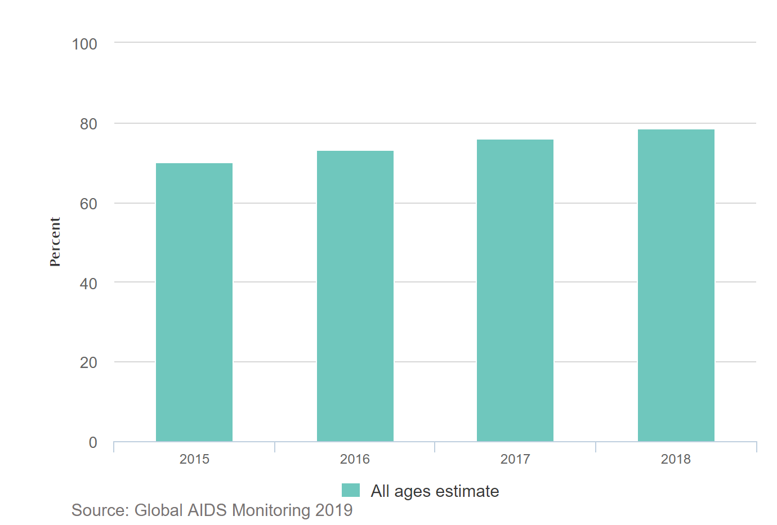
In 2018, 79% of people living with HIV knew their status, leaving
8.1 million people undiagnosed

Slide 3
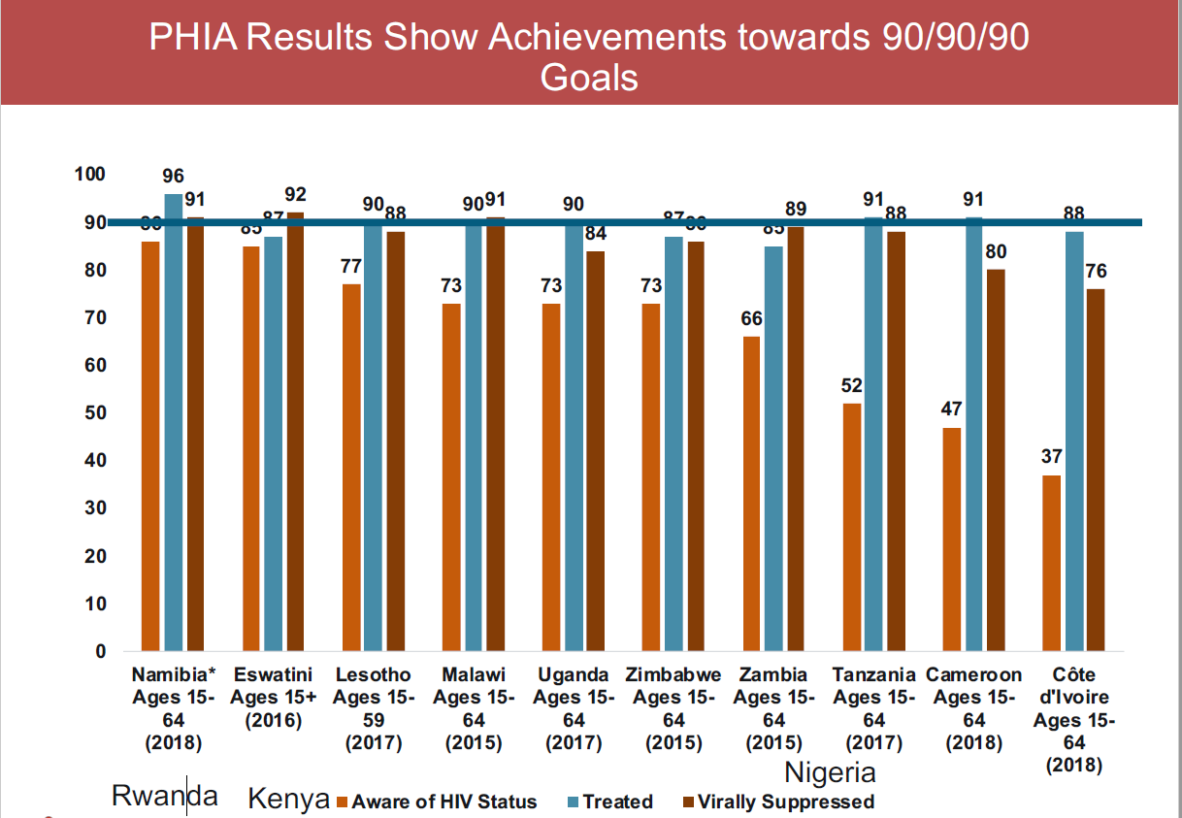
Different testing strategies are needed for countries approaching attainment of the first 90, shifting from widespread testing to a focused, public health approach based on epidemiology

Slide 4
Increasing testing volumes and decreasing yields are not sustainable and will not get us to epidemic control

Slide 5
Progress toward 2020 and 2030
Reaching HIV testing targets
# PLHIV
Diagnosed
(Millions)
Target 2020
90-90-90
Target 2030
95-95-95
Steep increase:
Ramping up the number of facilities, expansion of community based HTS, testing campaigns, geographic prioritization & KP focused strategies (e.g. Social Network Testing Strategy)
Getting here has required:
600+ million tests in low- to middle-income countries (2010-14)
380+ million HIV rapid diagnostic tests (RDTs) procured by donors. Between 2012-16 ~ US$ 473 million on HIV RDTs alone
To achieve 2020 and 2030 targets
More targeted testing and linkage to care
Scale-up index partner and family testing
Routine monitoring of emerging hot spots and changing geography for further prevention and case finding
Initial decelerated increase:
Individuals more difficult to reach via traditional strategies
Initial slow start to steep increase
In 2005 ~10% PLHIV diagnosed. Increases marked by ramping up PITC (Provider Initiated Testing and Counseling)
Adapted from V. Wong and A. Medley. PEPFAR Service Delivery Models Call: Finding the Undiagnosed, January 31, 2018, Presentation

Slide 6

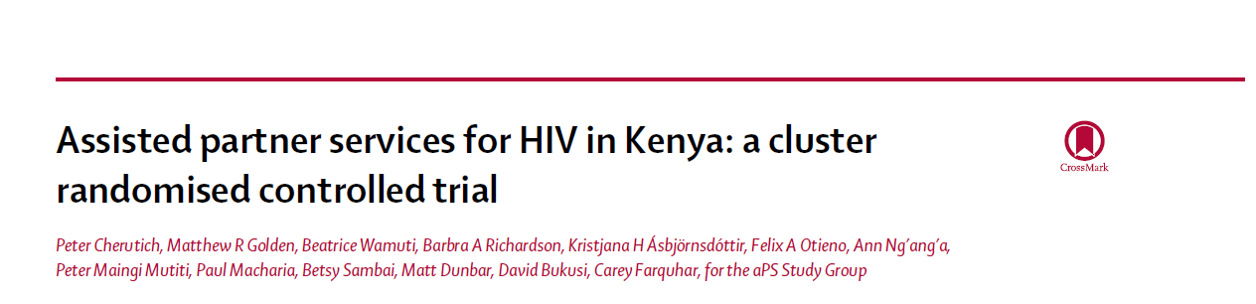
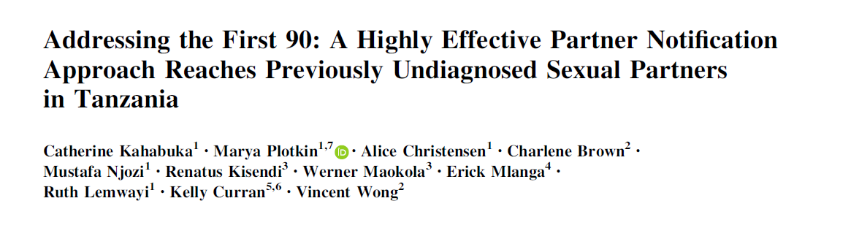
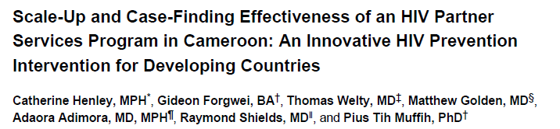

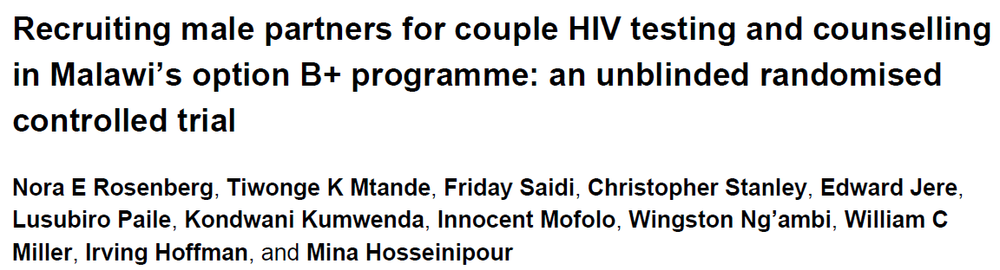
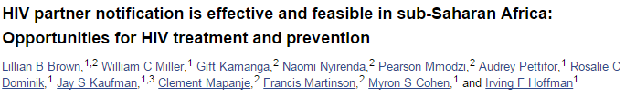
Partner Testing:
An Effective Case Finding Strategy
Several trials have demonstrated that index partner testing can: (1) increase uptake of HTS and (2) identify partners with undiagnosed infection (yield ranges from 35-62%), with no reports of serious intimate partner violence (IPV).
Notes:
Several studies, including three trials, have shown assisted partner notification services, using provider and/or “contract referral”, is a particularly effective strategy for increasing uptake of partner testing and identifying and treating new HIV-cases. But results from Tanzania suggest that giving options between passive, contract and provider referral can also increase uptake.

Slide 7
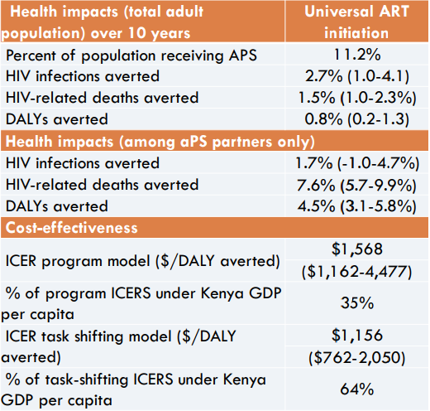
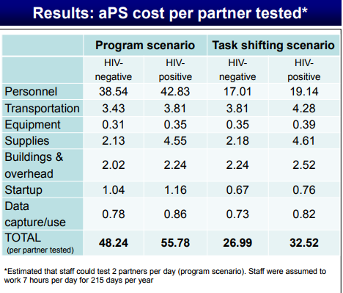
Cost-effectiveness of Assisted partner notification
Example from western Kenya
Assisted partner notification
Cost per partner tested
APS is cost-effective for reducing HIV burden in western Kenya and similar settings. Task-shifting to
lay providers will likely increase affordability. Although cost-effective, it should be combined with other HIV testing and prevention approaches Source: Sharma 2017
Notes:
Although aPS is cost-effective, it has a limited population-level impact. It is projected to reduce ~3% of HIV infections over 10 years. Therefore it should be combined with other cost-effective HIV prevention and other testing

Slide 8
Benefits of Partner Notification Services
Increased efficiency of testing allowing broader treatment coverage
Increased identification of asymptomatic children
Benefits to couples/partners
  Mutual support to access HIV prevention, treatment and care
  Improved adherence and retention on treatment
  Increased support for PMTCT
  Prioritization of HIV prevention for serodiscordant couples
    Condoms
    ART to reach viral suppression
    Pre-exposure prophylaxis for uninfected partner until VLS

Slide 9
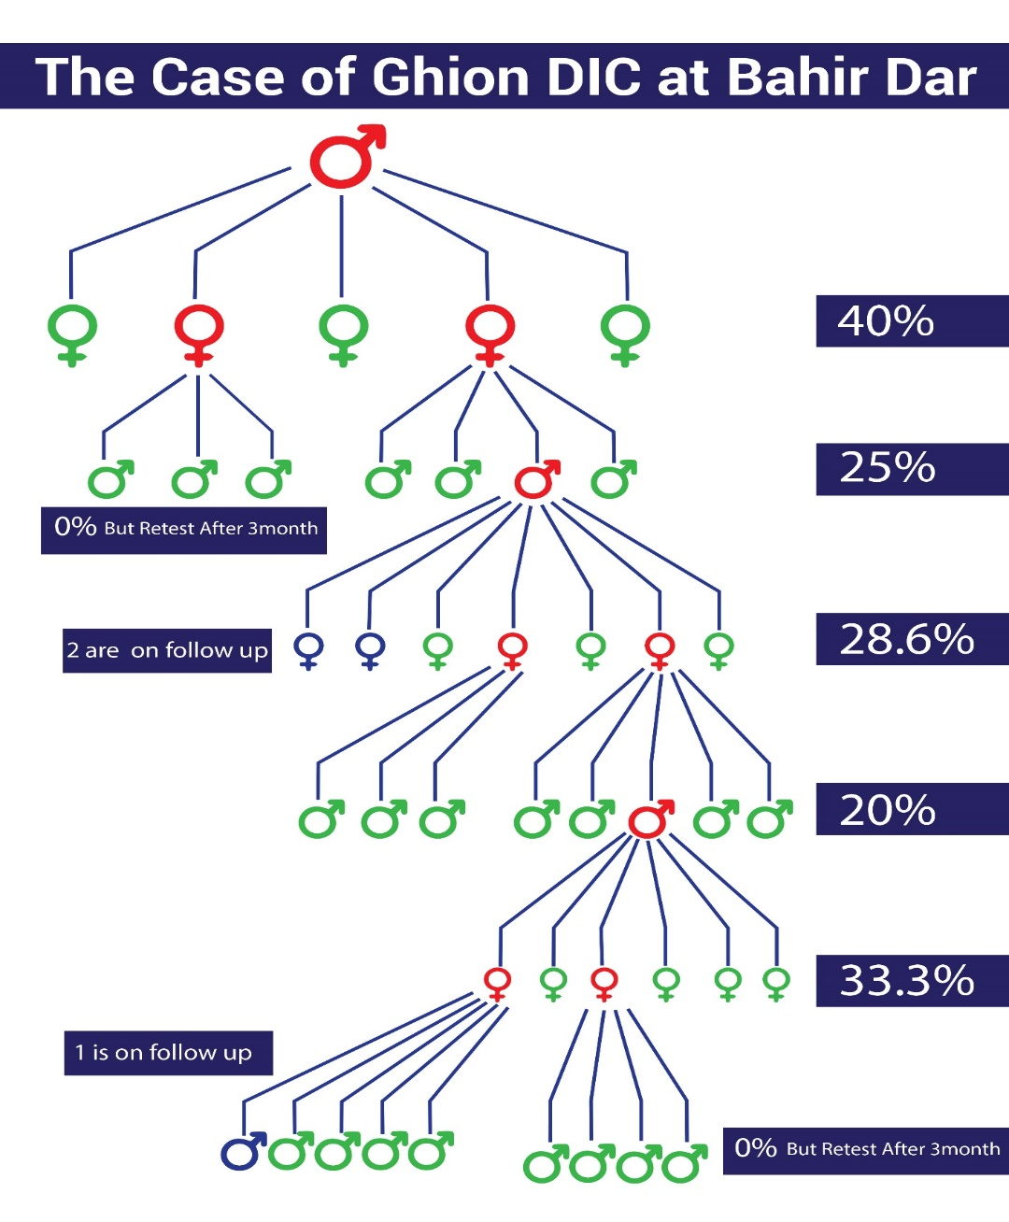
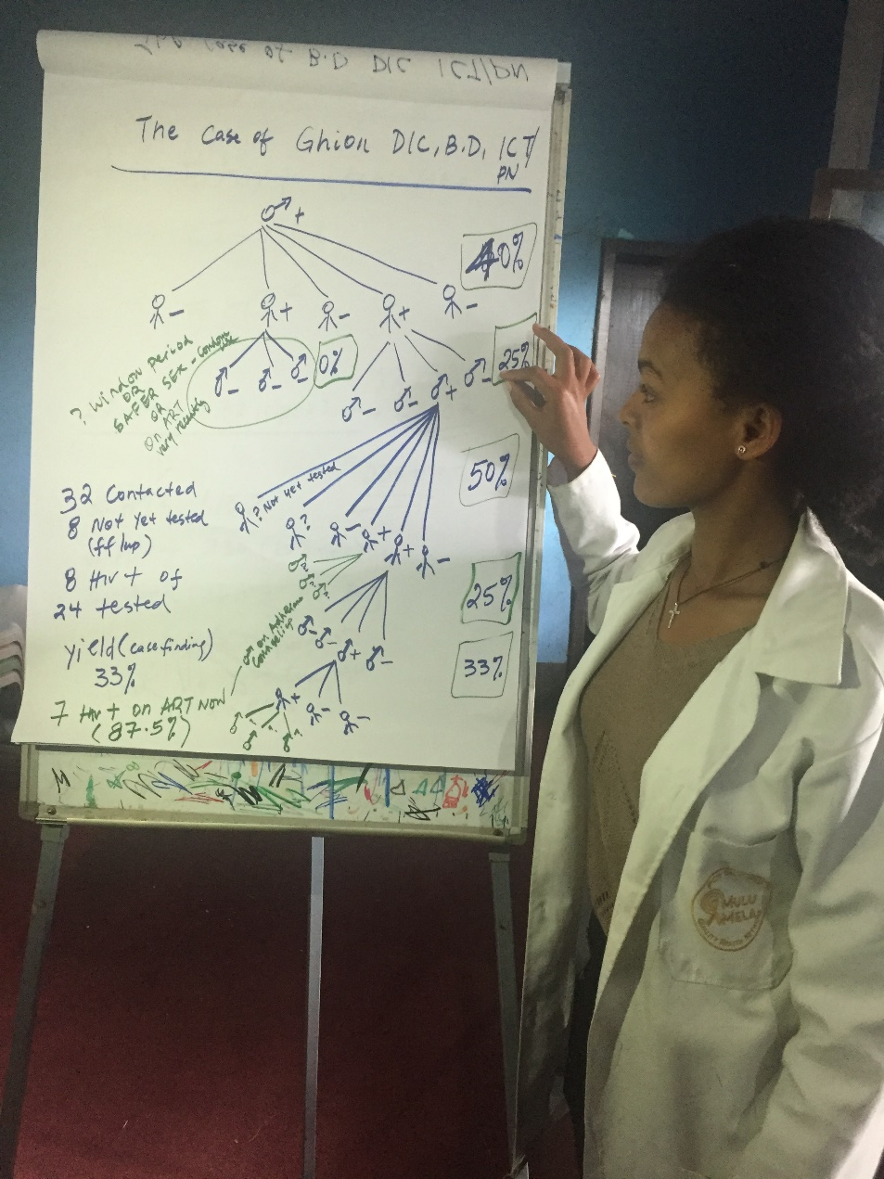
ICT: Promising Practice, Ghion DIC, Bahir Dar
MULU: Key Populations

Slide 10
Countries with an assisted partner notification or index HIV testing policy (top) and with policy and doing index testing (bottom) of all those reporting, by WHO region, 2017-2018
61% and 70% of countries reporting had an assisted partner notification or index HIV testing policy in 2017 and 2018, respectively
40%
59%
61%
68%
71%
72%
79%
94%
91%
83%
50%
50%
63%
38%
GAM – WHO, UNAIDS, UNICEF, 25 June 2019
2017 = 72/118 countries reporting; 2018=91/130 countries reporting

Slide 11
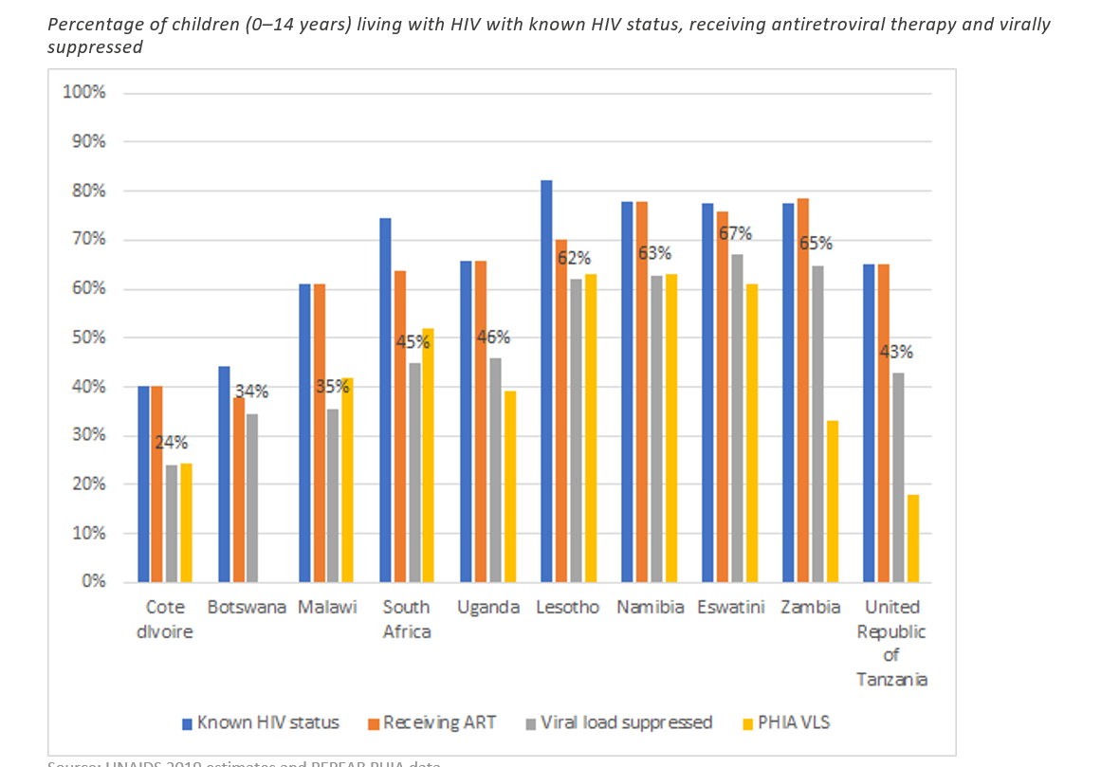
Identification of Children Living with HIV Lags Behind Adults Identification in Many Countries, Leading to Lower Treatment Coverage and VLS
Index testing is key to identify children living with HIV

Slide 12
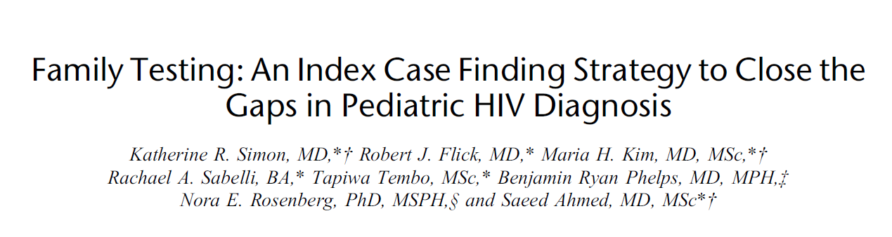
Family Index Testing:
A high yield strategy to identify healthy children with HIV
Several studies show family index testing can increase:
the number of children identified at a faster rate¥
the identification of healthy children living with HIV and
HIV testing yield [4% Ahmed, 7% Wagner, 12% Tonwe-Gold, 18% Kulzer]

Slide 13
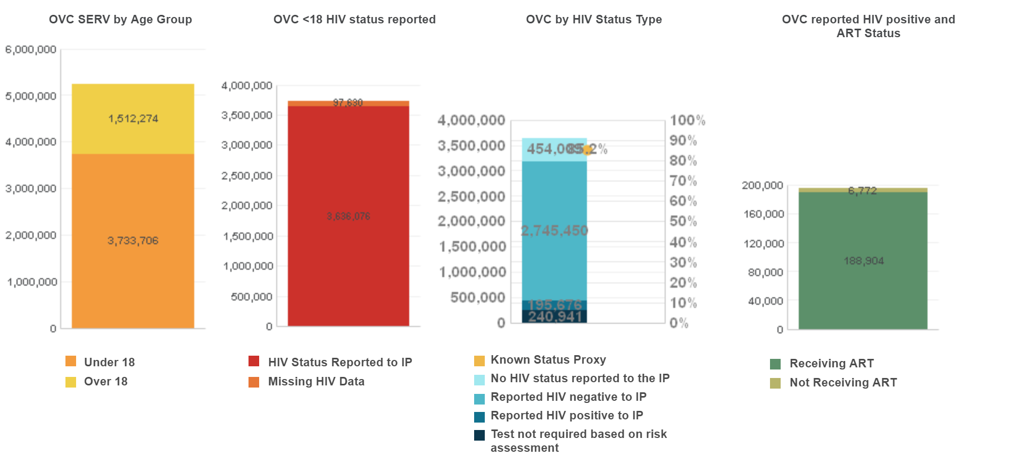
Orphan and Vulnerable Children Programs are an important component of index testing in children and their families

Slide 14
HIV case finding approaches supported by PEPFAR (COP19)
Figure 9.5.3. COP Guidance
Notes:
Megan Action: make sure Figure aligns with COP Guidance after release

Slide 15
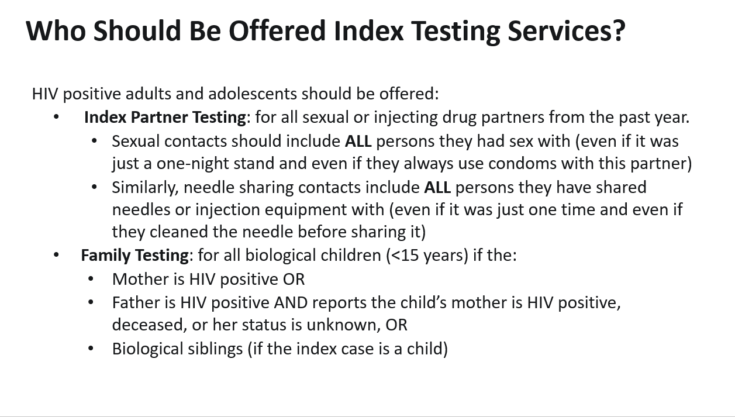
Who should be offered index testing services?

Slide 16
Key Considerations for Index Testing in COP19
Intimate Partner Violence (IPV) Risk Assessment is a required component for Index Testing
To protect the safety of the index client, partners who pose a risk of IPV should be excluded from PNS, and the index client provided with appropriate care and support services for IPV.
Primary goal of the IPV Risk Assessment is to ensure no harm comes to the index client as a result of index testing services
Link:
Link all positives to treatment and start index testing for their partners/children
Link negatives to prevention services: condoms, VMMC, PrEP
Use data to monitor implementation of PNS and yield

Slide 17
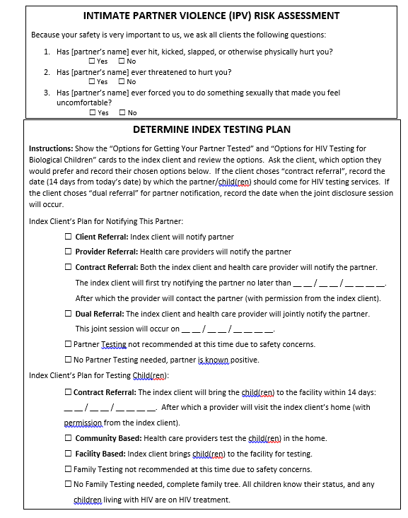

Slide 18
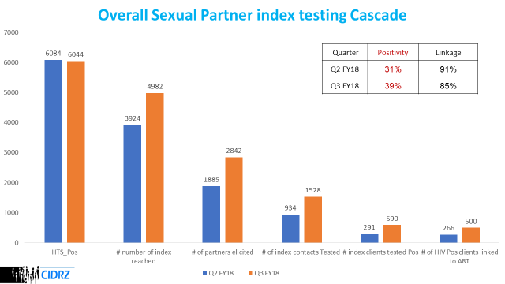
How to Interpret the Cascade for Quality Improvement
Other sources of index cases include those with unsuppressed viral load
Start: Number of Newly Diagnosed Individuals
Large Drop Here Could Suggest Inadequate Personnel
Ratio of No. Partners Elicited to No. of Index Clients Reached Should Be ≥1
Large Drop Off Here Could Indicate HR Issues/Overreliance on Client Referral
Yield Should Be 20-40% for Sex Partners
Aim for ≥90% LTC

Slide 19
Index testing yield is increasing in PEPFAR
Q1 and Q2

Slide 20
The proportion of PLHIV found through index testing is increasing in PEPFAR and we expect continuing increases.
Q1 and Q2

Slide 21
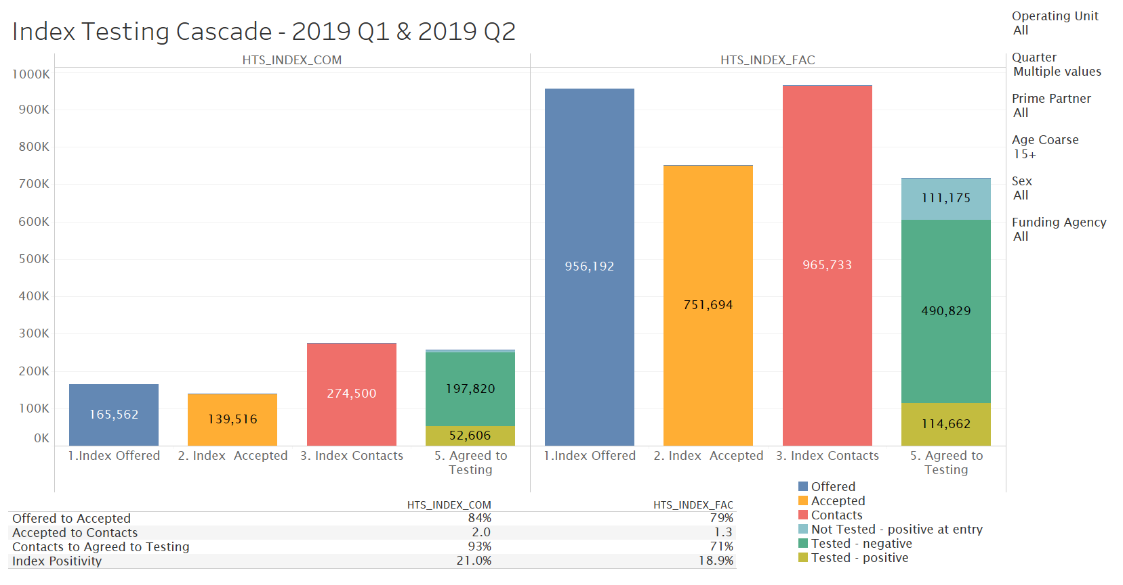
INDEX COVERAGE CASCADES FOR ALL Ous > 15 Q1 and Q2 2019

Slide 22
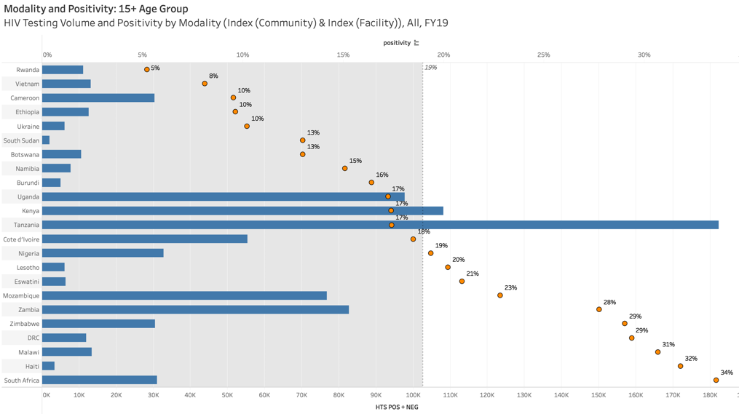
ADULT INDEX POSITIVITY: large range, but most >10%

Slide 23
Summary and Conclusions
New approaches to testing, including index testing, enhanced peer outreach, and hotspot mapping, are needed to find the remaining PLHIV, especially in countries nearing epidemic control.
Partner notification services provide:
  More efficient testing;
  Better support for treatment adherence in couples;
  Opportunities for prevention in uninfected partners;
  The primary mode of identification of asymptomatic children.
PNS must be provided according to standard guidelines, including an assessment for IPV and other risks, and those found to be living with HIV must be linked to treatment and negatives to prevetion.
Results should be monitored to assure implementation with fidelity.
PEPFAR IS ALL IN ON PNS!

Slide 24
Thank You!

