Slide 1
Charles van der Horst, MD
Professor
International Clinical Researcher
Guideline writer
Teacher
Mentor

Slide 2
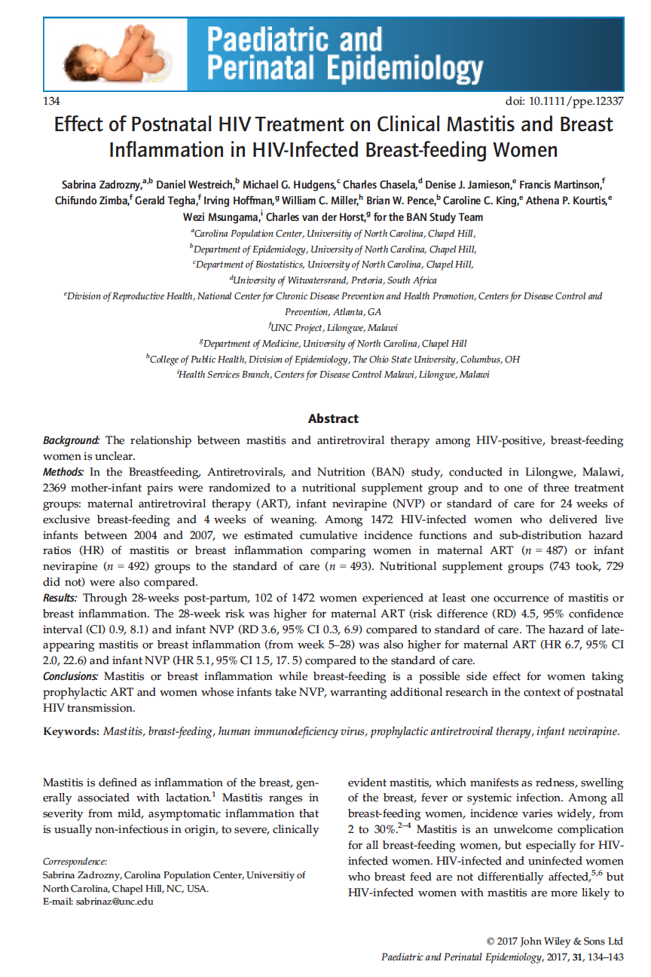
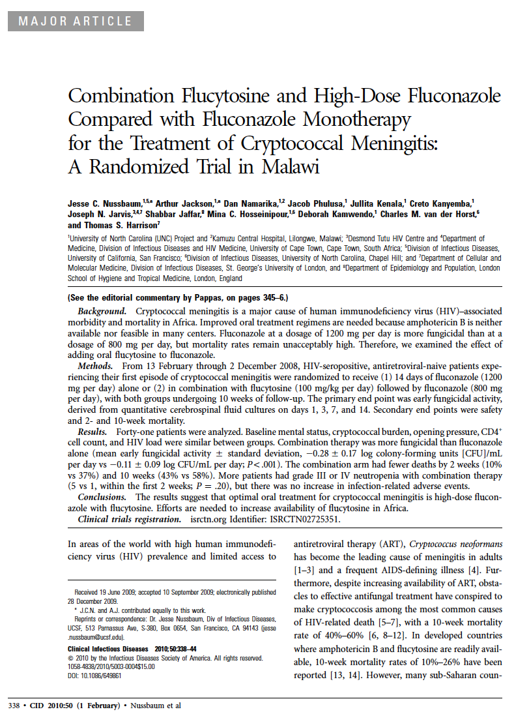
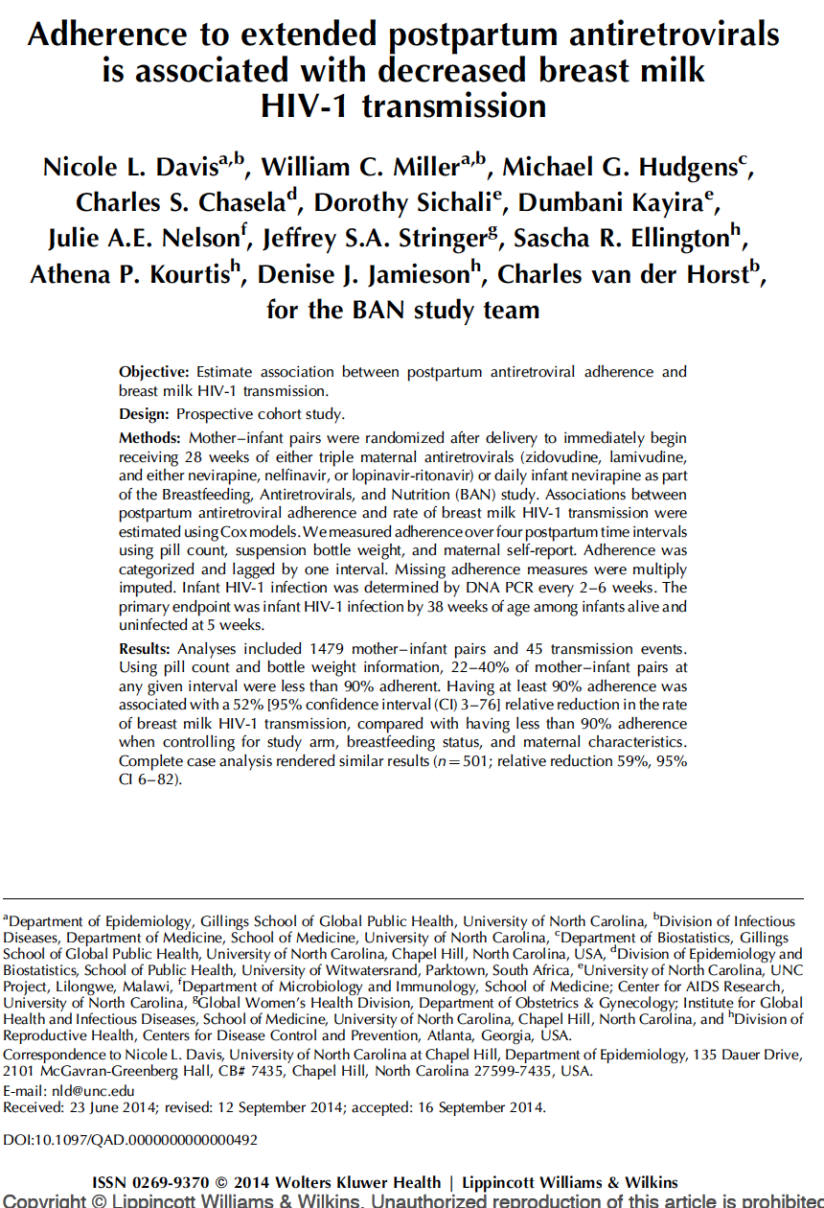
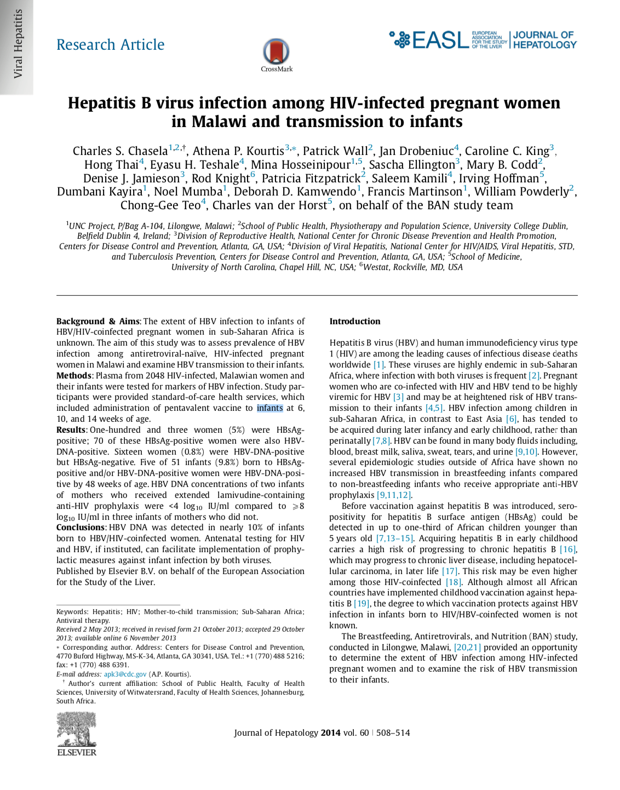
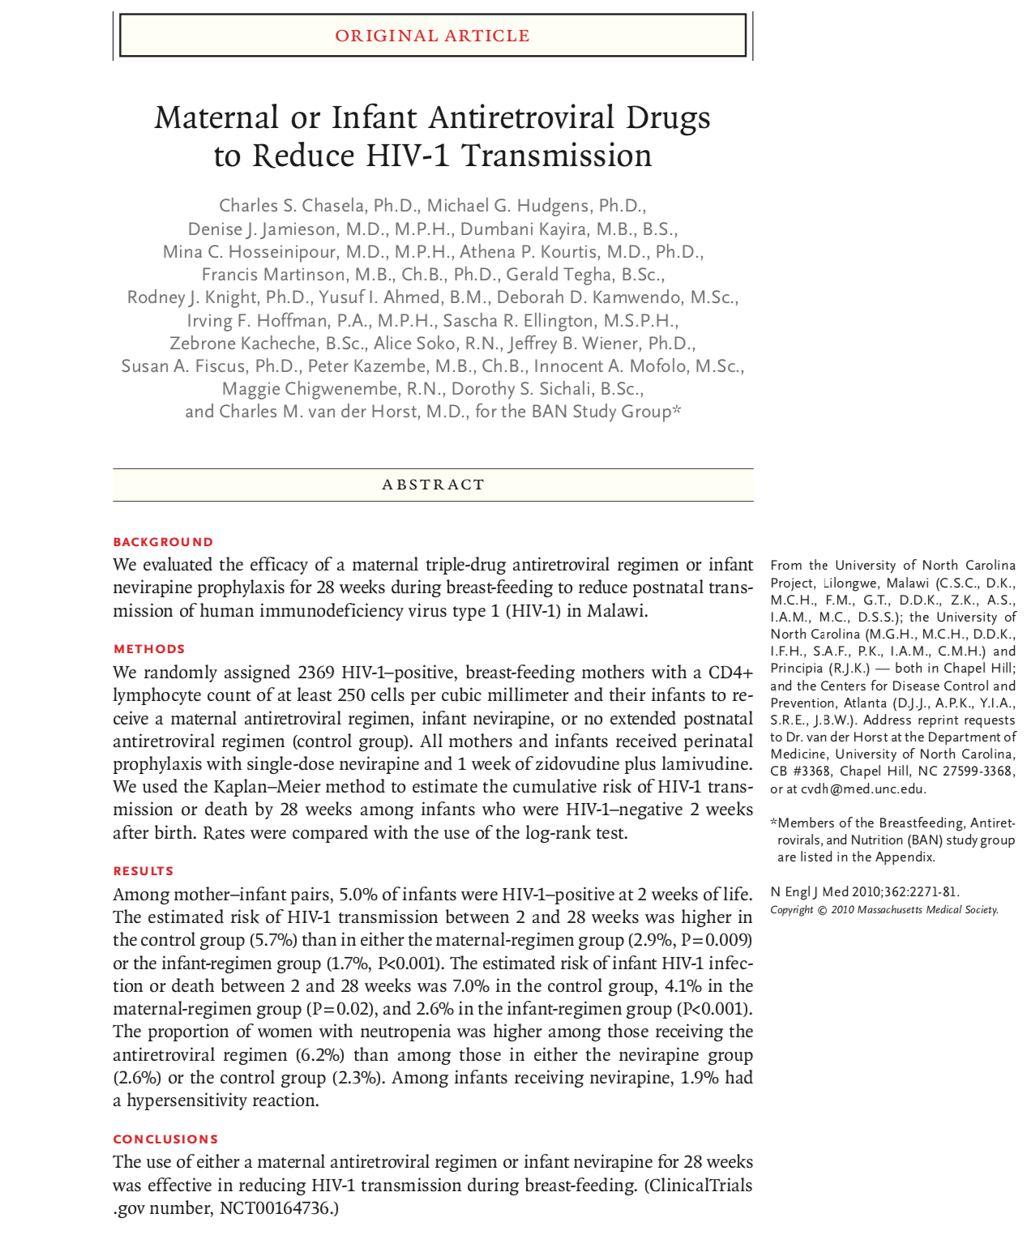
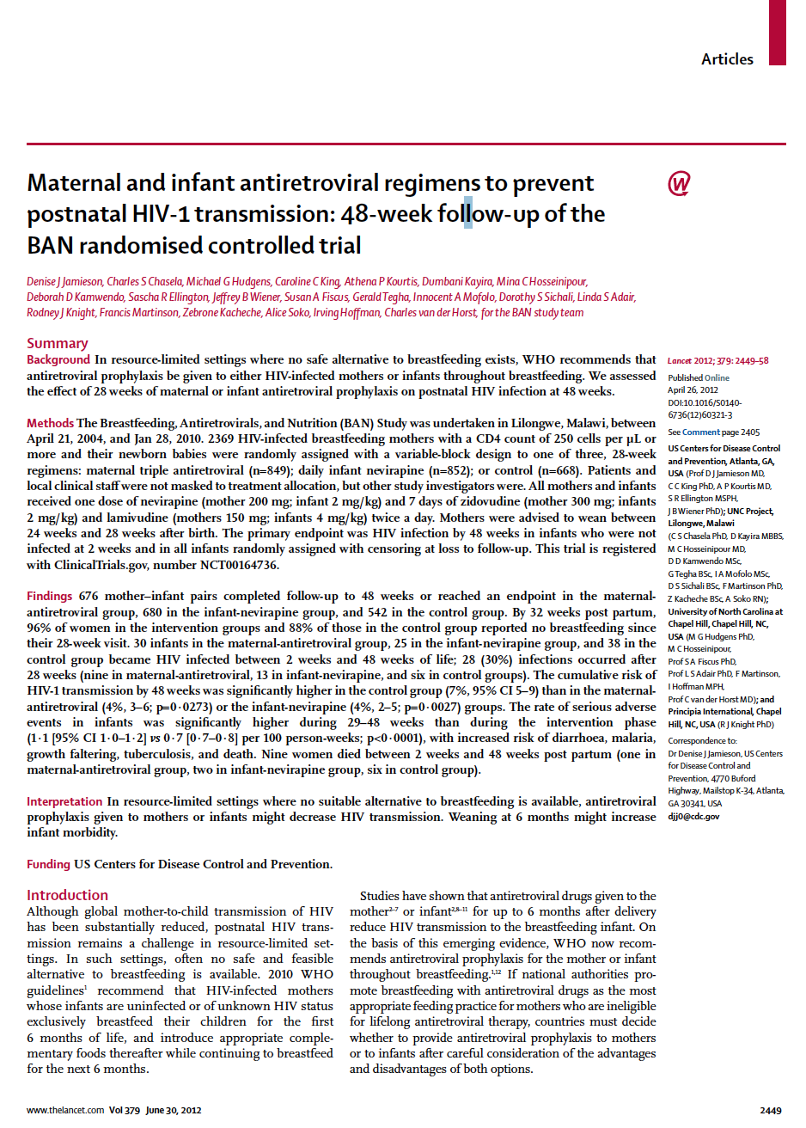
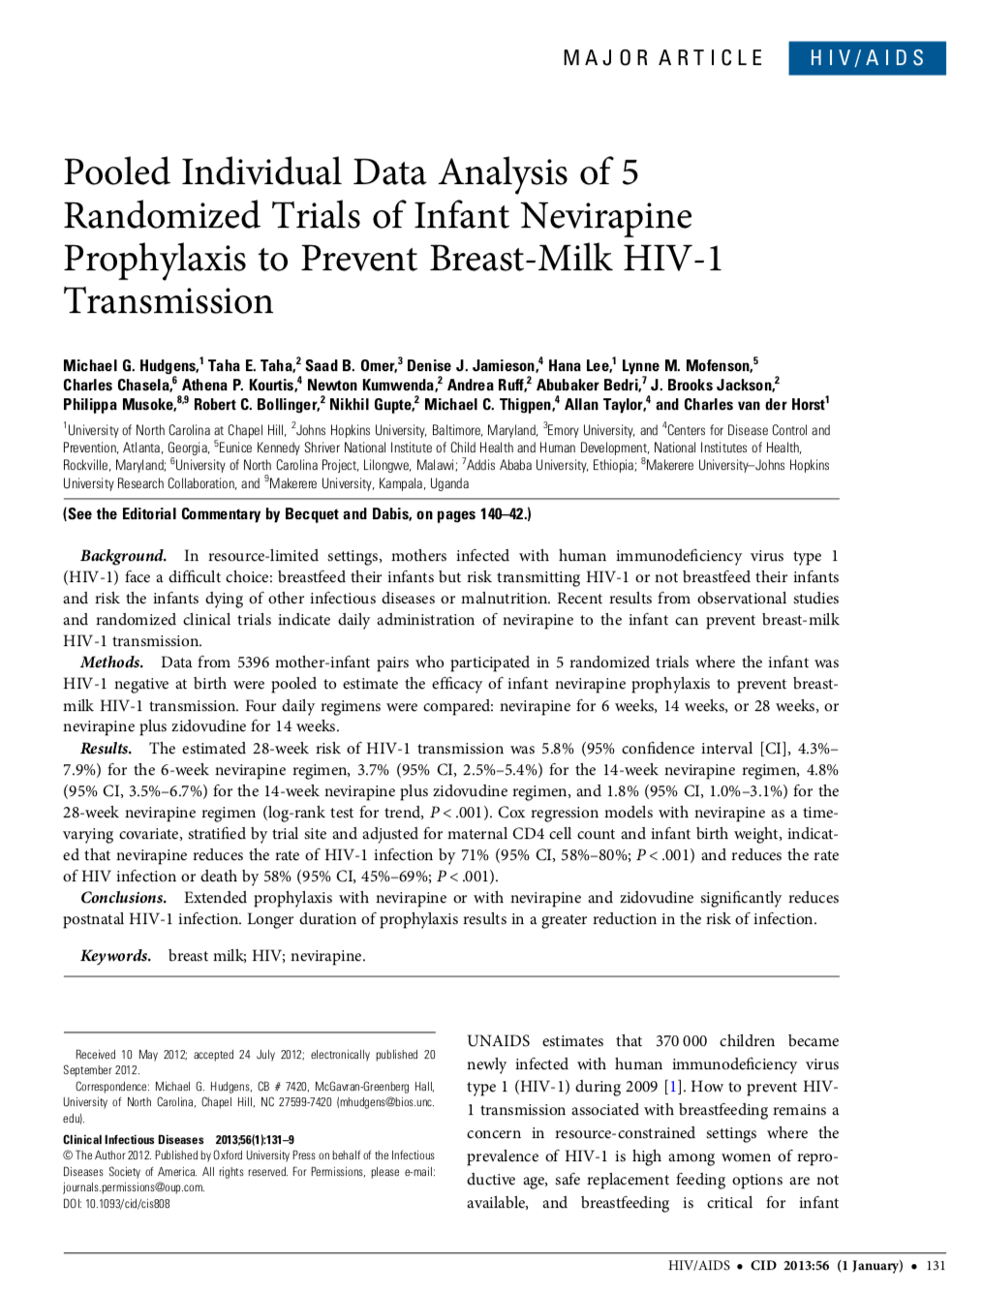
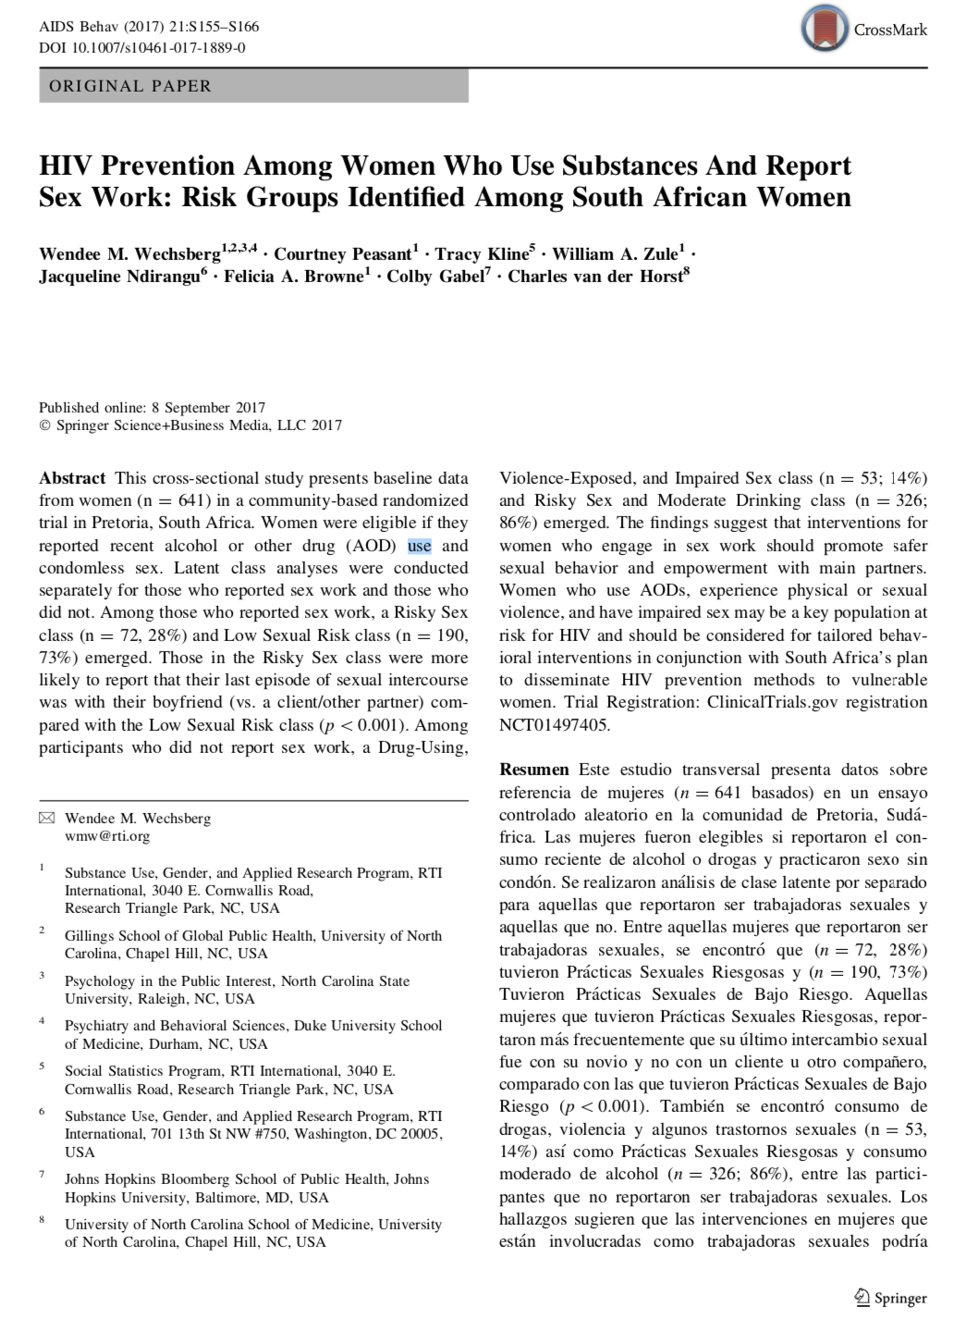
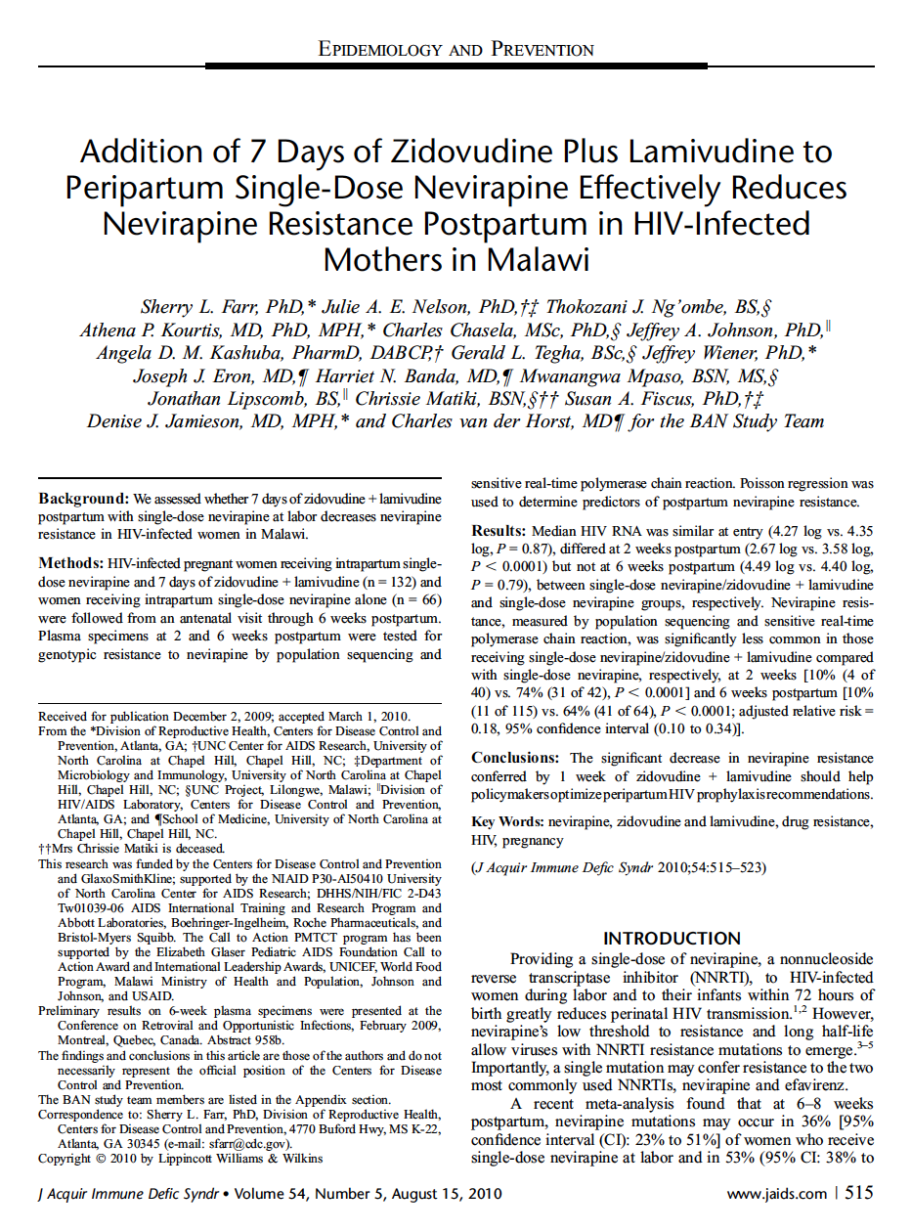
Charles van der Horst, MD
Professor
International Clinical Researcher
Guideline writer
Teacher
Mentor

Slide 3
Charles van der Horst, MD
Professor
International Clinical Researcher
Guideline writer
Teacher
Mentor

Slide 4
Charles van der Horst, MD
Ramble-rouser
Provocateur
Activist
Philanthropist
Life of the party
Disorganized mess
Confidante
Conscience
Friend

Slide 5
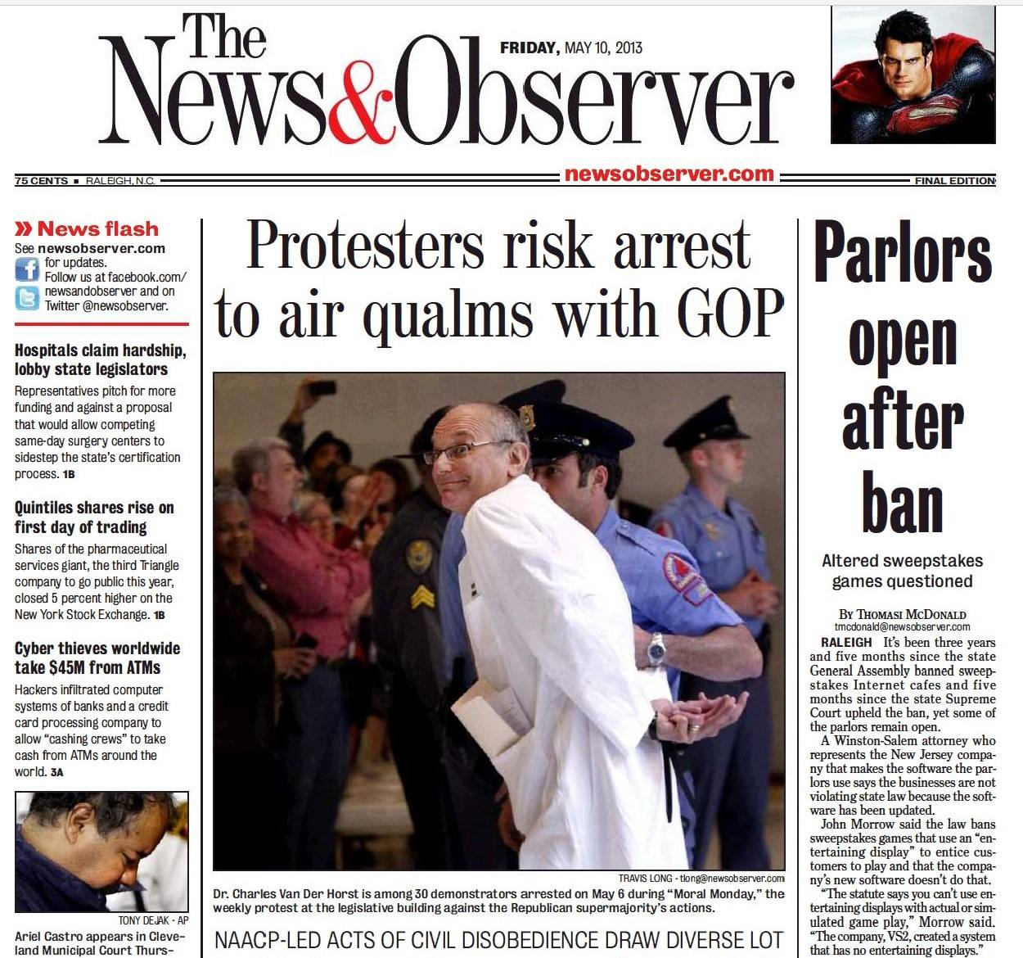
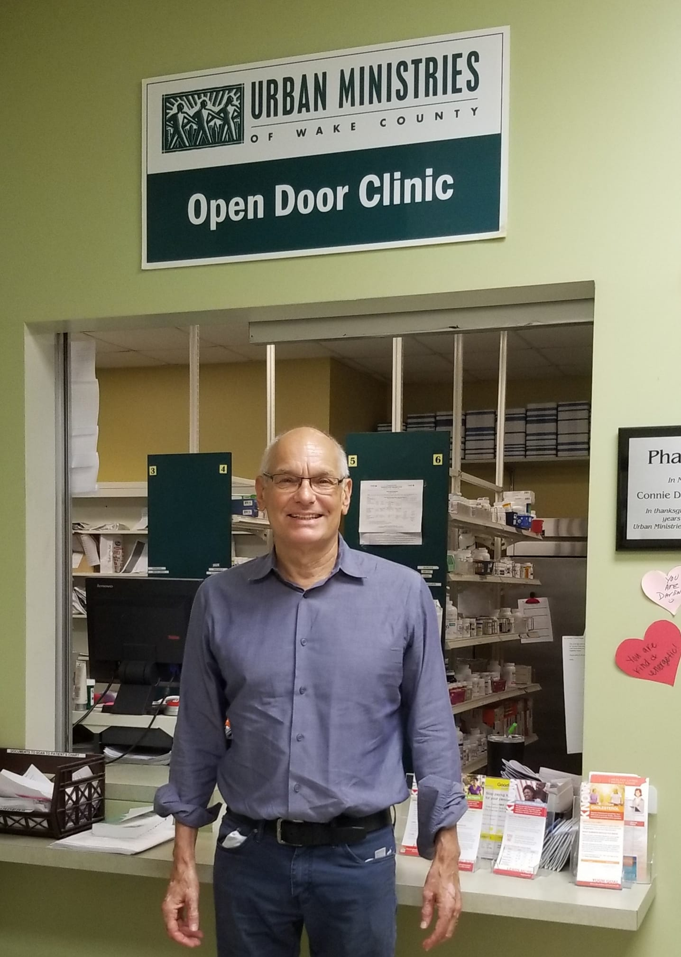
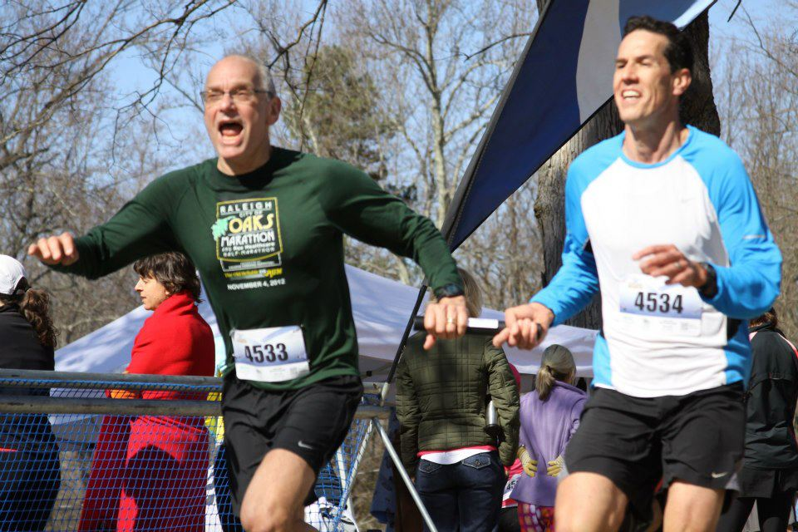
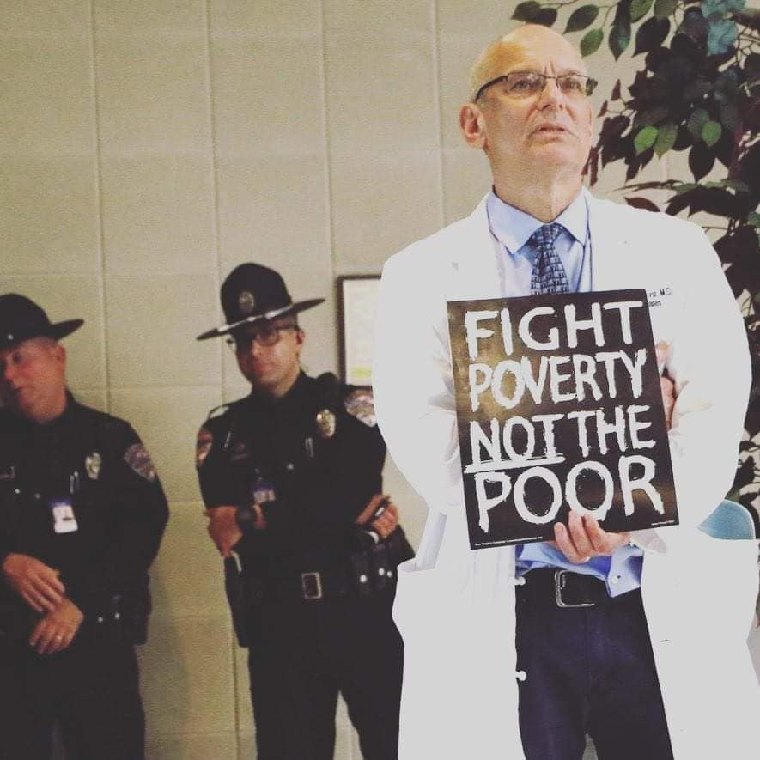
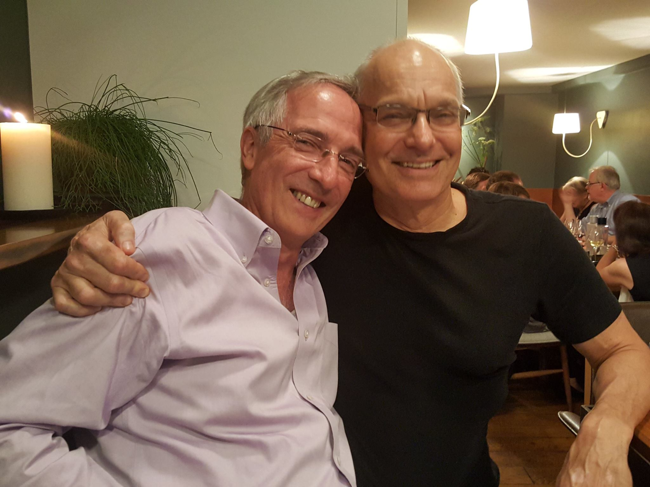
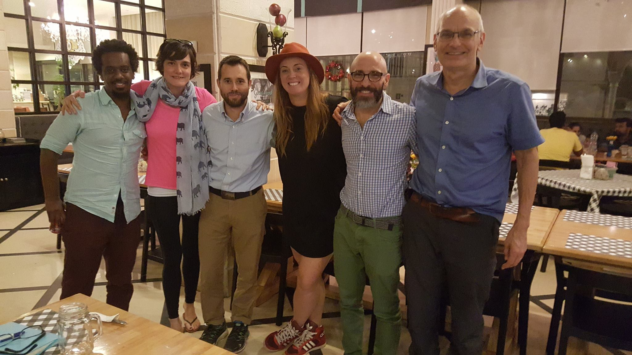
Charles van der Horst, MD
Ramble-rouser
Provocateur
Activist
Philanthropist
Life of the party
Disorganized mess
Confidante
Conscience
Friend

Slide 6
Charles van der Horst, MD
Ramble-rouser
Provocateur
Activist
Philanthropist
Life of the party
Disorganized mess
Confidante
Conscience
Friend

Slide 7
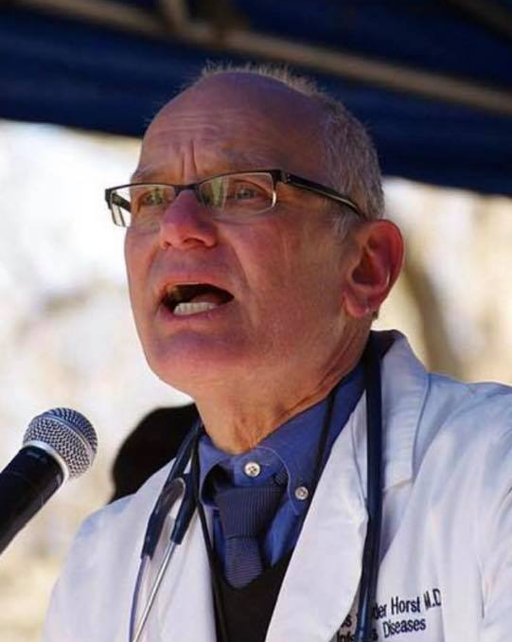
Charles van der Horst, MD
Be courageous to stand-up for what is just
Be willing to challenge the status quo
Be the one who makes a difference in another’s life
Be generous
Be a leader
Be an inspiration

Slide 8
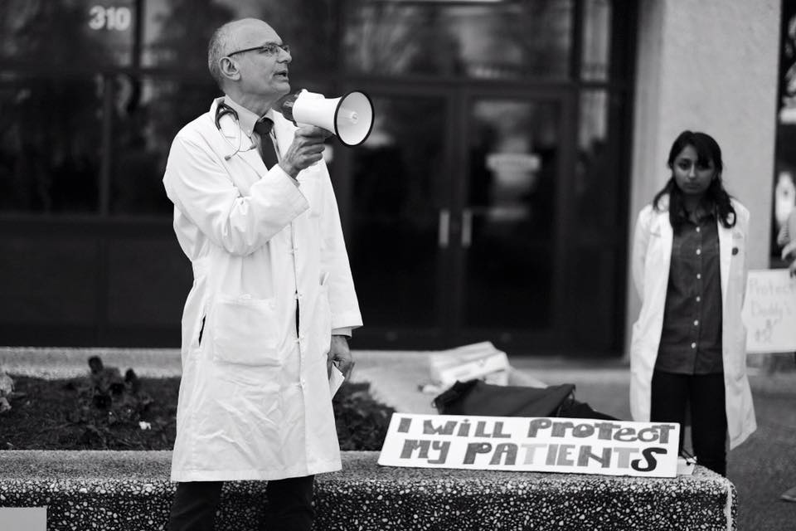
Be a Charlie

