Slide 2
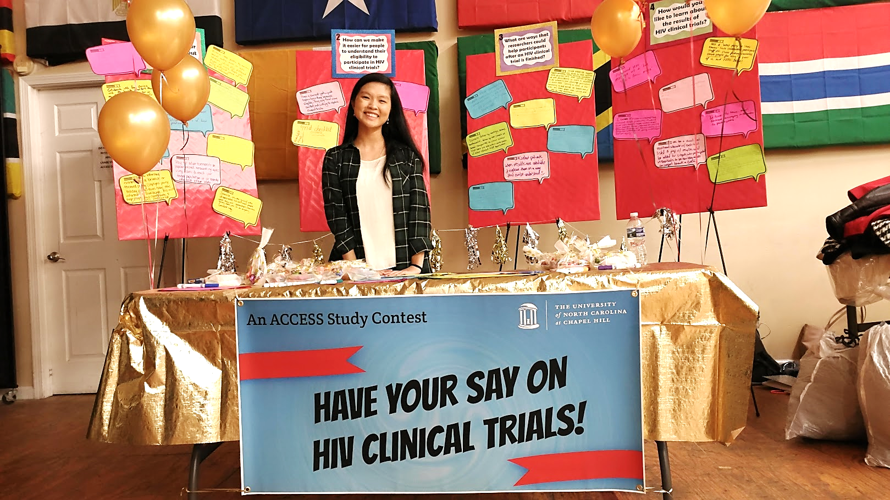
Expanding Community Engagement in HIV Clinical Trials: A Pilot Study Using Crowdsourcing
Suzanne Day
July 22, 2019

Slide 3
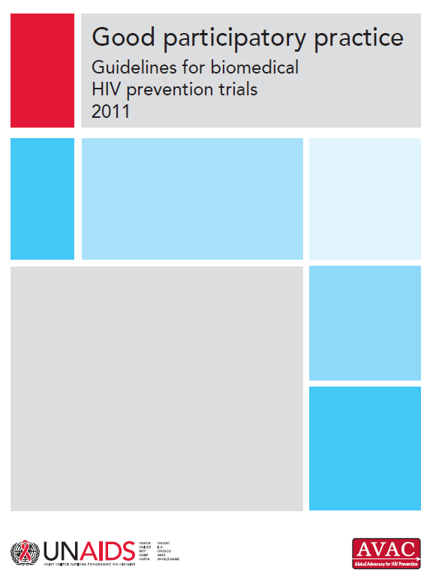
Engagement Recommendations
UNAIDS/AVAC Good Participatory
Practice Guidelines, 2011:
Community advisory boards (CABs) are a key engagement strategy for HIV clinical trials
CAB feedback should be complimented by “other advisory mechanisms”

Slide 4
ACCESS: The Acceptability of Combined Community Engagement Strategies Study
Goal: to conduct both CAB and crowdsourcing community engagement for a phase 1 HIV clinical trial, and compare the resulting feedback.
1. Community Advisory
Board (CAB)
A group of community representatives providing feedback to research teams.
Inviting community members to come together to solve a problem, then sharing the exceptional solution(s) with the public.
2. Crowdsourcing

Slide 5
The Clinical Trial Context
VOR-07 study: a phase 1 trial examining the safety and effectiveness of taking an antibody followed by vorinostat
PI: Dr. Cindy Gay at UNC Chapel Hill
Starting to enroll participants
NOTE:
ACCESS did not replace VOR-07’s engagement practices (CAB review/discussion)

Slide 6
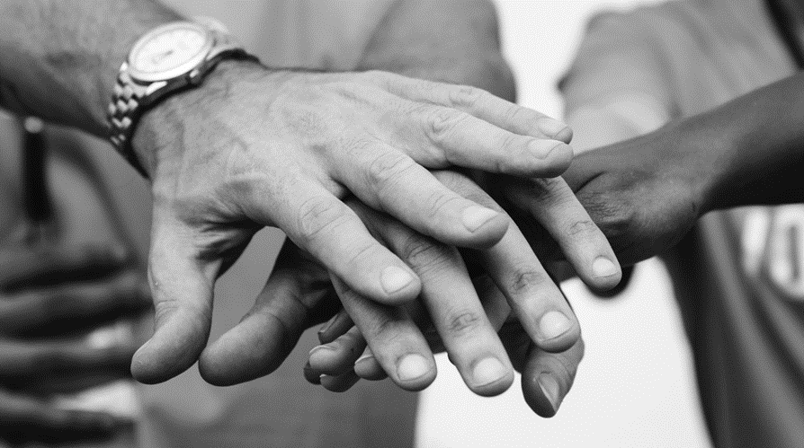
Feedback on Three Trial Aspects
Informed consent
Participation processes
Issues of fairness and reciprocity in HIV clinical trials
CAB & Crowdsourcing Engagement Activities

Slide 7
CAB Engagement Activities
1. Informed consent
Group discussion on clarity, completeness & format of trial informed consent form
2. Trial participation process
Group discussion of three fictional vignettes depicting trial experiences (e.g. barriers/facilitators to participation)
3. Fairness & reciprocity
Group discussion on ways that clinical trial researchers can ‘give back’ to community

Slide 8
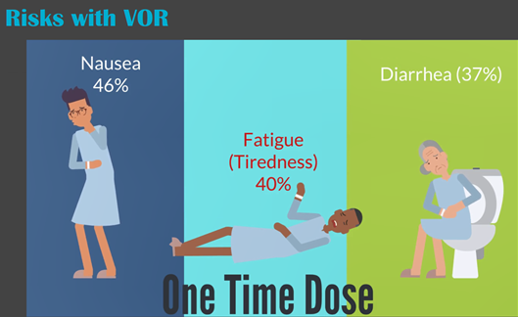
Crowdsourcing Activity 1: Informed Consent
Trial consent form adapted into narrated, interactive video modules
Modules screened at open public event, followed by guided discussion
Module screenshots courtesy of Community Expert Solutions

Slide 9
Crowdsourcing Activity 2: Trial Participation
Vignettes adapted into three short animated videos
Videos screened at open public event, followed by guided discussion
Animation screenshots courtesy of Community Expert Solutions

Slide 10
Crowdsourcing Activity 3: Fairness & Reciprocity
Idea contest, open to the public with online and in-person submission opportunities.
Entries judged by panel; winning ideas awarded prizes & celebrated.

Slide 11
Differences in CAB & Crowdsourcing Demographics
CAB Participants (N = 9)
Higher education levels; 67% held Masters degrees.
Higher employment; 44% employed.
Higher income; 56% reported annual income of $50,000 to $74,999.
Crowdsourcing Participants (N = 38)
Lower education levels; 34% reported high school/equivalent as highest education level, 10.5% did not complete high school.
Lower employment; 7% employed.
Lower income; 47% reported annual income of $10,000 or less.

Slide 12
Overlap in CAB & Crowdsourced Feedback
Similar ideas to improve trial communication
E.g. alternative ways to deliver informed consent (iPad, video).
Similar ideas to improve supports for trial participants
E.g. supporting participants’ partners/family; offering links to psychosocial resources.

Slide 13
Divergences in CAB & Crowdsourced Feedback
CAB feedback emphasized:
the impact of institutional regulations
the value of tailoring trial processes
Crowdsourced feedback emphasized:
alternative strategies for recruitment
potential risks of trial participation
incommensurate compensation

Slide 14
Conclusions
Crowdsourcing is a promising strategy for meeting GPP recommendations.
Combining CAB engagement with crowdsourcing can reach a broader range of stakeholders to inform HIV clinical trials.
Crowdsourced feedback can both complement and extend CAB feedback on HIV clinical trials.

Slide 15
Acknowledgements
Thank you to all CAB and crowdsourcing participants for sharing your ideas and making ACCESS possible.
ACCESS Team
Joseph D. Tucker (Co-PI)
Stuart Rennie (Co-PI)
Allison Mathews (Community Expert Solutions)
Thi Vu (Research Assistant)
Meredith Blumberg (Research Assistant)
Hailey Mason (Research Assistant)
VOR-07 Partners
Cindy Gay (PI)
JoAnn Kuruc (Co-I)
David Margolis (Co-I)
UNC Center for AIDS Research (CFAR)
Funding:
National Institutes of Health Research (NIAID project numbers 5R01A108366 and 1K24AI143471)
Contact Info:
Suzanne Day
suzanne.day@med.unc.edu
searchiv.web.unc.edu

