Slide 2
No occurrences of neural tube defects among 382 women on Dolutegravir at pregnancy conception in Brazil
IAS 2019 Co-chairs’ choice, 22 July 2019
MOAX0104LB
G. Pereira, A. Kim, E. Jalil, F. Fernandes Fonseca, B. Shepherd, V. Veloso, R. Rick, R. Ribeiro, A. Beber,
K. Jayathilake, R. Girade, R. Lima, F. Maruri, A. Caruso, C. McGowan, A. Benzaken, J. Castilho, B. Grinsztejn for
The National Cohort Study of Dolutegravir and Pregnancy Outcomes in Brazil

Slide 3
Conflict of Interest Disclosure
I have no conflict of interest.

Slide 4
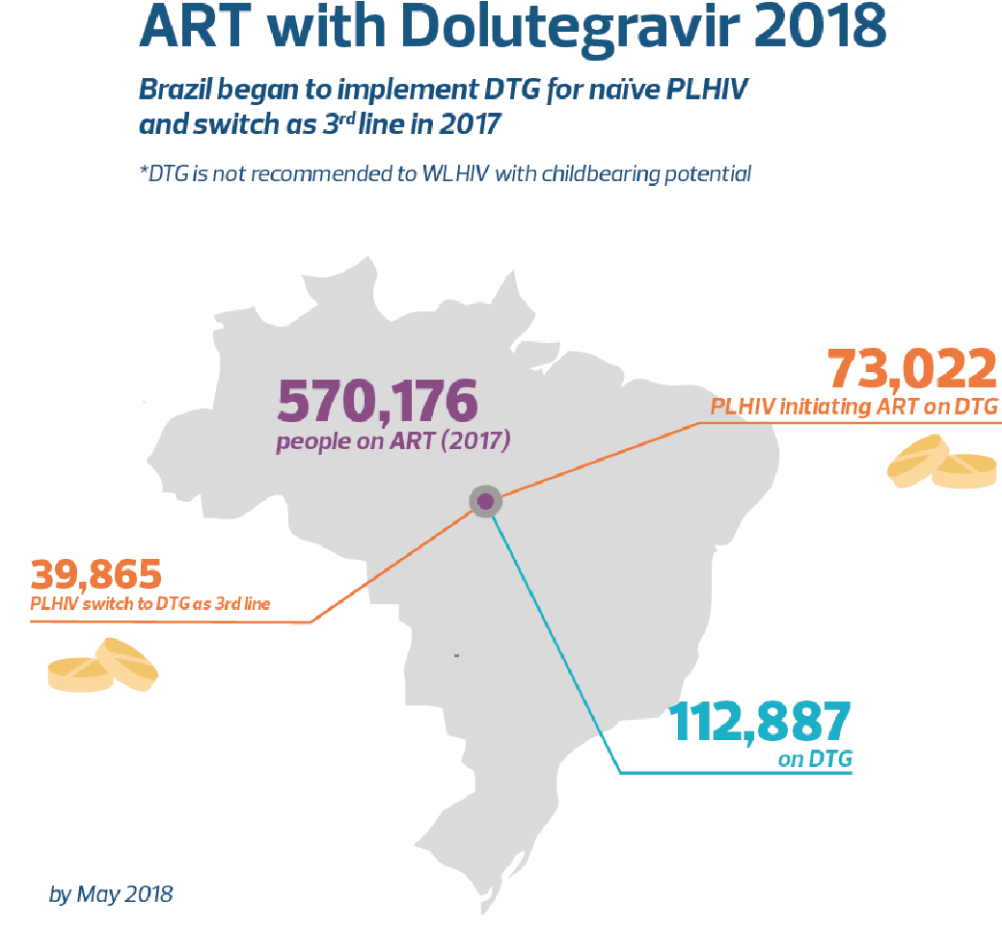
How was it possible?
Universal HIV care & ART free of charge (1996)
Computerized ART distribution system (SICLOM)
Every person on ART
Rules based on national guidelines
DTG for 1st line (2017)
Use in pregnancy systematically restricted
As of May 2018> 22,624 women between
15-49 years were on DTG in Brazil
NTD signal led to a national investigation
Dolutegravir use in Brazil

Slide 5
Aim
To estimate the risk of NTD in infants born to women
receiving DTG and non-DTG ART regimens at time of
conception in Brazil
Primary outcomes of interest:
All NTD
Stillbirths
Abortions*
Composite outcome
for multivariable analyses
* Elective abortions are illegal in Brazil. All abortions presumed to be spontaneous.

Slide 6
Methodology
Retrospective cohort of every women identified in SICLOM as possible exposure to DTG or RAL during pregnancy (2017-2018)
Unexposed group: pool of women with exposure to EFV during pregnancy (2015-2018)
EFV 3: DTG 1
Systematic data collection by trained public health professionals:
Chart review of all health services
Maternal demographic, behavioral, HIV history, comorbidities, obstetrical history, prenatal care, and birth outcomes
HIV clinic
Antenatal clinic
Maternity
REDCap

Slide 7
Methodology
Exposure: periconception window (16-week period)
+/- 8 weeks of estimated date of conception (EDC)
(1) 1st or 2nd trimester ultrasound (preferred method),
(2) last recorded menstrual period (LMP), and
(3) gestational age at delivery or 3rd trimester ultrasound
Statistical approach:
Calculation of NTD incidence with Wilson 95% CI among women with and without DTG exposure
Matched propensity score weighted logistic regression for composite pregnancy outcome for
Any DTG vs. EFV only
Sensitivity analyses: Only DTG vs. Only EFV / Only DTG or RAL vs. Only EFV
Used multiple imputation for missing data

Slide 8
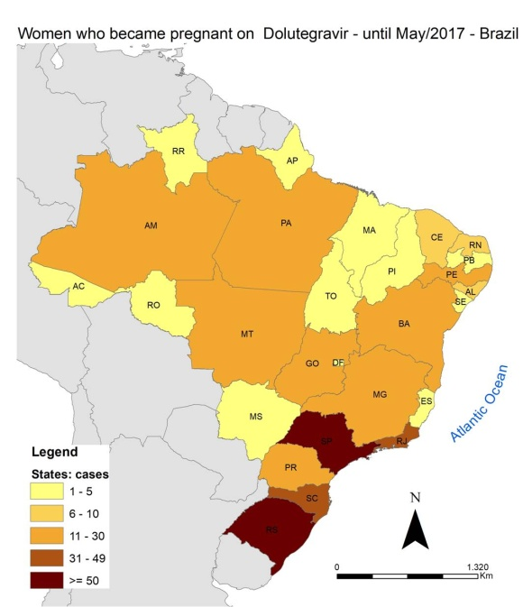
Results
Women with possible prenatal exposure to DTG
Inclusion Criteria
Source: SICLOM/ MoH Brazil
All women with possible DTG or RAL exposure during pregnancy:
Indication of pregnancy in SICLOM,
Women of childbearing age on DTG whom were switched to an approved ART regimen for pregnancy,
Women who received IV AZT one time.
Exclusion Criteria
No confirmed pregnancy
No periconception ART exposure
ART exposure including medications other than DTG, RAL, EFV
Missing/unknown periconception ART or birth outcomes

Slide 9
Cohort Creation
Total pool of presumed pregnancies (SICLOM: 1/2015-5/2018)
N=3390 women
Pregnancies with complete investigation
N=2507
Started RAL at week 9 of pregnancy: myelomeningocele and spina bifida
Started EFV at week 10 of pregnancy: myelomeningocele
NEITHER WOMEN HAD ANY EXPOSURE TO DTG BEFORE OR DURING PREGNANCY!
Women with exclusion criteria
N=1039
2 NTD cases:

Slide 10
Periconception final cohort
N=1468
(women with EFV, DTG, or RAL within 8 weeks of EDC)
Any DTG
N= 382
51
247
1045
6
78
13
Any EFV
N= 1115
Any RAL
N= 125
28

Slide 11
Table 1. Maternal characteristics at EDC
 | No DTG (N=1086) | Any DTG (N=382) | P value
Age in years, median (IQR) | 28.4 (23.2-33.3) | 26.6 (21.9-31.9) | <0.01
Year of HIV diagnosis | 2014 (2011-2016) | 2017 (2014-2017) | <0.01
Years since HIV diagnosis | 2.9 (1.4-6.1) | 0.7 (0.3-2.7) | <0.01
CD4 cell count (cells/μL) | 605 (420-838) | 530 (375-751) | <0.01
HIV RNA below limit of detection | 483 (74) | 139 (58) | <0.01
Prior adverse pregnancy outcome | 376 (35) | 128 (34) | 0.69
Tobacco use | 209 (19) | 78 (20) | 0.62
Alcohol use | 177 (16) | 77 (20) | 0.09
Substance use | 117 (11) | 54 (14) | 0.08

Slide 12
Table 2. Prenatal characteristics
 | No DTG (N=1086) | Any DTG (N=382) | P value
Number of ART regimens, median (IQR) | 1.0 (1.0-2.0) | 2.0 (2.0-2.0) | <0.01
Folic acid supplementation, n (%) Only before pregnancy Only during pregnancy Before and during pregnancy Unknown | 18 (2) 488 (45) 26 (2) 554 (51) | 11 (3) 183 (48) 10 (3) 178 (47) | 0.28
Fewer than 6 total prenatal visits | 410 (38) | 175 (46) | 0.01
Syphilis | 63 (6) | 40 (11) | <0.01
Zika | 3 (0) | 0 (0) | 0.30
Gestational hypertension | 35 (3) | 25 (7) | <0.01

Slide 13
Birth Outcomes
Of the total 1452 birth outcomes, there were no NTD observed
DTG-exposed women incidence = 0 [95% CI: 0, 0.0099]
DTG-unexposed women incidence = 0 [95% CI: 0, 0.003]
 | No DTG (N=1068) | Any DTG (N=384) | P value
NTD | 0 (0) | 0 (0) | -
Live birth Stillbirth Abortion | 1025 (96.0) 15 (1.4) 28 (2.6) | 359 (93.5) 2 (0.5) 23 (6.0) | <0.01

Slide 14
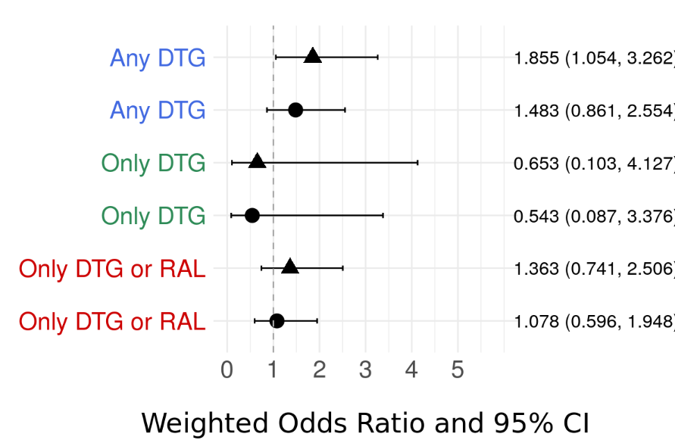
Composite Outcome Regression Models
Weighted PS Models
Exposure Group vs. Only EFV
EDC Covariates
1.86 [95% CI: 1.05-3.26]
EDC + Prenatal
Covariates
1.48 [95% CI: 0.86-2.56]
0.65 [95% CI: 0.10-4.13]
EDC Covariates: age, education, race, region, years since ART initiation, years since HIV diagnosis, CD4 cell count, HIV RNA below limit of detection, epilepsy or antiepileptic medication use, tobacco, alcohol, crack/cocaine, number of previous pregnancies, prior adverse pregnancy outcome, any folic acid use, BMI
Prenatal Covariates: number of prenatal visits, syphilis, diabetes, gestational hypertension, average weight gain per week
0.54 [95% CI: 0.09-3.38]
1.36 [95% CI: 0.74-2.51]
1.08 [95% CI: 0.60-1.95]

Slide 15
Limitations
Retrospective study
Missing data
Periconception ART exposure
While we observed no NTD events in our analysis cohort, it is possible that our study remained underpowered to detect a difference in exposure groups

Slide 16
Conclusions
No occurrences of NTD in this national cohort study.
Folic acid supplementation in Brazil: Enriched flour and high prevalence of prenatal supplementation in this study
Pharmacovigilance is a priority for the Ministry of Health in Brazil
Results of this study do not conclusively indicate increased or decreased risk of stillbirth and/or abortion associated with periconception DTG exposure.

Slide 17
Acknowledgements
South Region
Andrea Maciel de Oliveira Rossoni
Deisy Rodrigues Felicio de Souza
Glaucia Harumi Maruo Kanabushi
Maysa Mabel Fauth
Hellen Corrêa Teixera Cordeiro
Jacqueline A. Pruner Polidoro
Juliana Rita Pinheiro
Andreza Madeira Macário
Carla Félix dos Santos
Daniela Dal Forno Kinalski
Emanuele Lopes Ambrós
Lisiane Bernhard Hinterhol
Silvia Marielli da Costa Madeira
Solange de F. Mohd Suleiman Shama
Virginia de Menezes Portes
Simone Gonçalves Senna
Northeast Region
Dayana Tenório da Silva Mendonça
Luciana Maria Rodrigues de Oliveira
Fabrina Lopes Ferreira
Heloise Maria Morais de Andrade
Joselina Soeiro de Jesus
Maria Vilani de Matos Sena
Telma Alves Matins
Joseneide Teixeira Câmara
Joanna Angelica Araujo Ramalho
Andreza da Silva Sontos
Lavínia Sobral Barreto Nunes
Márcia Maria Cavalcanti Marcondes
Mônica da Silva Pinto Cronemberger
Simone Alli Fernandes Farias
Stella Rosa de Sousa Leal
Bruna Emanuelle Feitosa Vasconcelos
Midwest Region
Luciana Melo de Moura
Adriana Queiroz de Campos
Miriam Estela de Souza Freire
Aneth da Silva Benites Lino
Thiago Theodoro Martins Prata
Izôlda Maria Passos Lucena
Maria Joelma Pereira da Silva
Southest Region
Benisia Maria Barbosa Cordeiro Adell
Carla Joelma Villares Guimarães Marcel
Danielle Portela Ferreira
Janete Duarte Teixeira Duarte
José Alfredo de Sousa Moreira
Joseane Pessanha Ferreira
Luciana Castaneda Ribeiro
Lucrecia Helena Loureiro
Wilsa Mary Sousa dos Santos
Akemi Fuonke
Ana Cristina Barbosa
Carolina Simone Souza Adania
Cláudia Camargo Lorite
Cristina Magnabosco
Dirce Maria de Moura Prado
Luiz Roberto Lourena
Maria Cristina Longo
Maria Emilia Braite
Michelle Abou Dehn
Norma Noguchi
Tatiane Comerio
Cristiane Campos Monteiro
Maria Ângela dos Santos Pereira
Renata Siqueira Julio
Rita Sibele de Souza Esteves
Abstractors:
Supervisors: Gerson Winkler, Luciana Garritano, Sandra Gomes, Silvia Fruet
The National Cohort Study of Dolutegravir and Pregnancy Outcomes in Brazil: Gerson Pereira, Ahra Kim, Emilia Jalil, Fernanda Fernandes Fonseca, Bryan Shepherd, Valdilea Veloso, Fernanda Rick, Rachel Ribeiro, Andrea Beber, Karu Jayathilake, Renato Girarde, Renato Lima, Fernanda Maruri, Catherine McGowan, Adele Benzaken, Jessica Castilho, Beatriz Grinsztejn
North Region
Adriana Raquel Nunes de Souza
Ana Celia da Silva Moura
Chriscie Klen de Melo Rodrigues
Jeanne Silva da Costa
Valdirene Oliveira Cruz
Andréa Carolina Chagas de Miranda
Carla Gisele Ribeiro Garcia
José Arimateia Rodrigues Reis
Rutineide Queiroz Pantoja
Caroline Biserra Costa da Luz

Slide 18
Thank you!
Gracias!
Obrigada!

Slide 19
Inclusion Criteria
The identification of potential DTG exposures during pregnancy included:
Indication of pregnancy in SICLOM,
Women of childbearing age on DTG that underwent ART change to an ART regimen recommended during pregnancy,
Women who received a single dose of IV AZT.
Selection of unexposed group included women with possible exposure to EFZ during pregnancy from 2015 to 2018, on a 3:1 ratio.
Unexposed women were balanced by geographic location with women possible exposed to DTG/ RAL

Slide 20
Exclusion Criteria
245 women who were not pregnant on chart review
52 women with unknown or missing birth outcomes
Included 5 women with DTG exposure
713 were not on ART of interest during EDC window (either started after the window, were on other ART, or stopped before window)
29 had missing ART data from window EDC

Slide 21
Estimated Date of Conception
For each woman confirmed to have a pregnancy, we calculated the estimated date of conception by: 1st or 2nd trimester USG (preferred method), LMP, or EGA at delivery
USG: subtracting the estimated gestational age reported from the first prenatal ultrasound occurring in the first or second trimester (preferred method), or
LMP: as the first day of the woman’s last recorded menstrual period (if no ultrasound was obtained in the first or second trimester), or
EGA at delivery: by subtracting an estimated gestational age obtained from a third trimester ultrasound or at the time of delivery if no other data were available.
N=1468
1108 (76%)
255 (17%)
105 (7%)

Slide 22
Next Steps
Evaluation of other adverse pregnancy outcomes using this cohort
Evaluation of birth outcomes and DTG exposure later in pregnancy
Case-control study based on national surveillance data to complete the investigation regarding neural tube defects, abortions and stillbirths among children perinatally exposed to HIV

