Slide 2

Dolutegravir plus two different formulations of tenofovir, and emtricitabine, for the treatment of HIV-1 infection: ADVANCE trial
For the ADVANCE team: Francois Venter₁, Michelle Moorhouse₁, Simiso Sokhela₁, Godspower Akpomiemie₁, Ambar Qavi₂, Kaitlyn McCann₂, Bryony Simmons₂, Celicia Serenata₁, Andrew Hill₃
¹Ezintsha, Wits Reproductive Health and HIV Institute, Johannesburg, South Africa; ²Imperial College, Faculty of Medicine, London, United Kingdom; ³Liverpool University, Pharmacology, Liverpool, United Kingdom

Slide 3
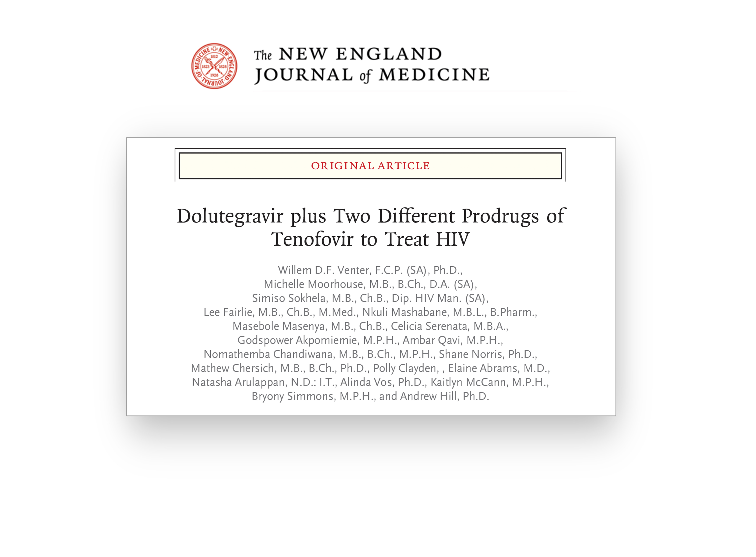
Full set of disclosures at nejm.org

Slide 4
Background
Integrase inhibitors, including dolutegravir (DTG), have replaced non-nucleoside reverse transcriptase inhibitors (NNRTI), and tenofovir alafenamide (TAF) has replaced tenofovir disoproxil (TDF) in high-income countries’ guidelines
DTG and TAF offer toxicity and cost benefits; DTG offers resistance benefits in an era of rising NNRTI resistance
South Africa background NNRTI resistance estimated 5-15% (Hunt, Antiviral Therapy, 2019)
ADVANCE is a three arm, investigator-led, open-label, randomised 96-week study of first-line treatment for HIV infection, conducted in South Africa. Final week 96 visit scheduled for March 2020.
This analysis includes the 48-week primary efficacy analysis. Additional incomplete data are presented here, as well as earlier (oral late breaker MOAX0102LB; poster WEPEB280).

Slide 5
ADVANCE: Study design
Inclusion criteria: Treatment-naïve, HIV-1 RNA level > 500 copies/mL, no TB or pregnancy, no baseline genotyping
TAF/FTC+DTG
n = 351
1053 Participants
TDF/FTC+DTG
n = 351
TDF/FTC/EFV
n = 351
96 Weeks
Study visits: baseline, Weeks 4, 12, 24, 36, 48, 60, 72, 84 and 96

Slide 6
Primary efficacy endpoint: HIV RNA Analysis
Main efficacy endpoint: Intent to Treat, Missing equals failure analysis
This analysis used the last HIV RNA level for each patient in the Week 48 time window. Patients with missing data at Week 48 were classified as failures.
Patients with HIV RNA > 50 copies/mL were counselled on adherence and re-tested within the Week 48 time window and during long-term follow-up.
The trial was powered assuming a response rate of 80% at Week 48
FDA non-inferiority margin for ARV-naive studies = -10%
Treatment arms first compared for non-inferiority, then superiority
P value = 0.017 for superiority tests, to adjust for three pairwise comparisons

Slide 7
Baseline characteristics (ITT)
 | TAF/FTC+DTG (n=351) | TDF/FTC+DTG (n=351) | TDF/FTC/EFV (n=351)
Median age (years) | 32 | 32 | 32
Female | 61% | 59% | 57%
Black * | 99% | 100% | 100%
Weight (median, kg) | 66.1 | 66.4 | 66
BMI (kg/m²) | 24.1 | 24.1 | 24.1
Mean CD4+ cell count (cells/uL) | 349 | 322 | 337
Baseline HIV RNA (copies/mL)
HIV RNA <100,000 | 272 (76%) | 279 (80%) | 270 (77%)
HIV RNA 100-500,000 | 66 (19%) | 62 (18%) | 72 (21%)
HIV RNA >500,000 | 13 (4%) | 10 (3%) | 9 (3%)
* 62% South African, 32% Zimbabwean

Slide 8
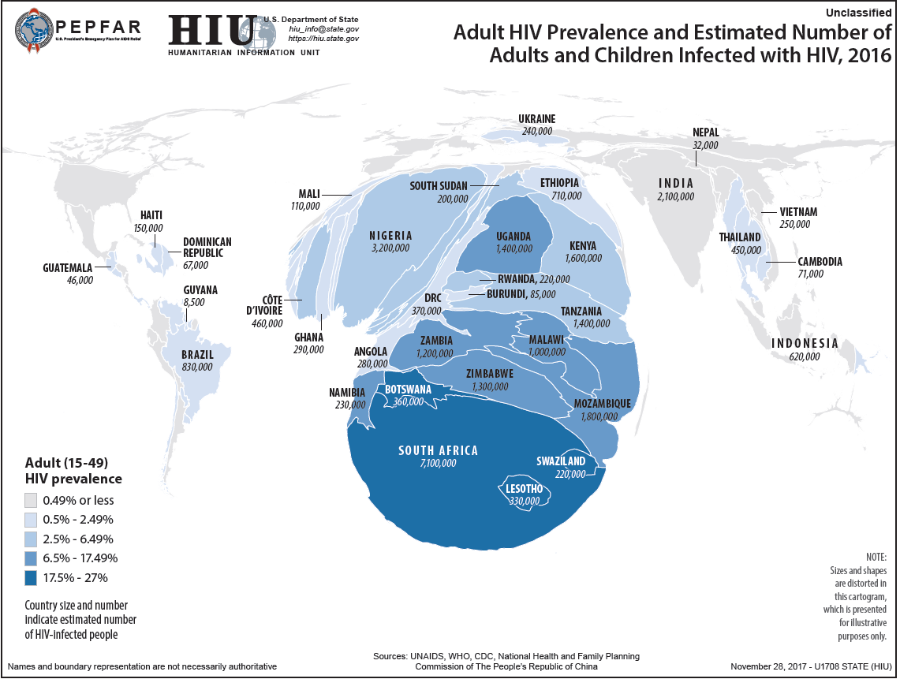

Slide 9
HIV RNA by study visit (observed data)
TAF/FTC+DTG
N=351
* 48-96 week dataset incomplete

Slide 10
HIV RNA by study visit (observed data)
TDF/FTC+DTG
N=351
* 48-96 week dataset incomplete

Slide 11
HIV RNA by study visit (observed data)
TGF/FTC/EFV
N=351
* 48-96 week dataset incomplete

Slide 12
Proportion of participants with HIV-1 RNA level <50 copies/mL by time point (ITT)
Strongest correlation in ITT: age/employment

Slide 13
Proportion of participants with HIV-1 RNA level <50 copies/mL by time point (per-protocol)

Slide 14
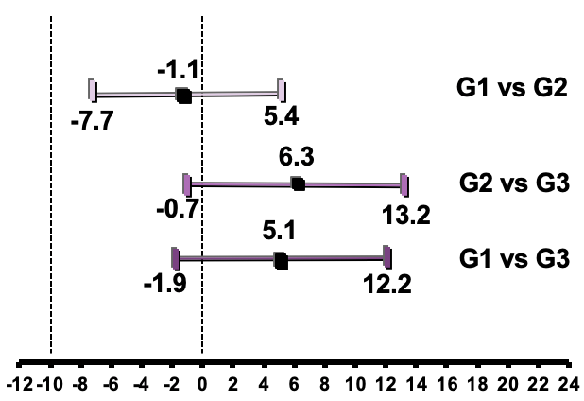
Primary efficacy analysis at Week 48: Statistical comparison
  Treatment differences (98.3% CI)
Comparison | Difference in response (98.3% CI) | p value for difference
TAF/FTC+DTG vs TDF/FTC+DTG | -1.1% (-7.7%, +5.4%) | 0.68
TDF/FTC+DTG vs TDF/FTC/EFV | +6.3% (-0.7%, +13.2%) | 0.03
TAF/FTC+DTG vs TDF/FTC/EFV | +5.1% (-1.9%, +12.2%) | 0.08
Non-inferiority margin used for the single interim analysis is -10%

Slide 15
HIV RNA suppression <50 copies/mL at Week 48:
TAF/FTC+DTG and TDF/FTC+DTG in ADVANCE vs other trials
Other Phase 3 trials of first-line 2NRTI+DTG
TAF/FTC+DTG TDF/FTC+DTG

Slide 16
HIV RNA suppression <50 copies/mL at Week 48:
TDF/FTC/EF in ADVANCE vs other trials
Other Phase 3 trials of TDF/FTC/EFV
TDF/FTC/EFV

Slide 17
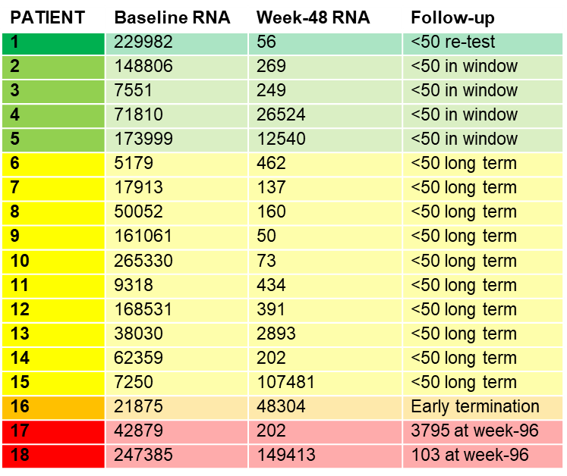
Outcome after HIV RNA >50 at Week 48
TAF/FTC+DTG arm

Slide 18
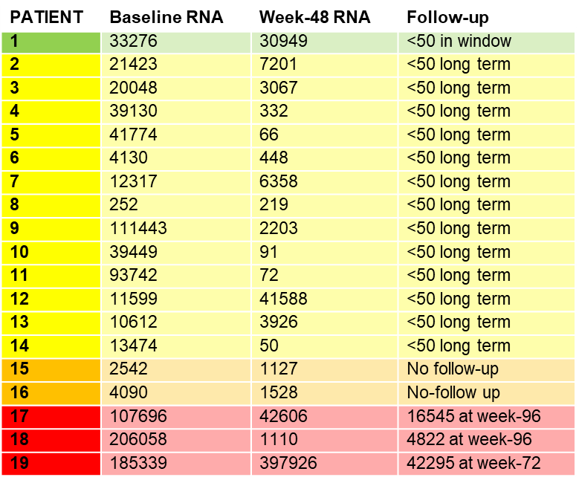
Outcome after HIV RNA >50 at Week 48
TDF/FTC+DTG arm

Slide 19
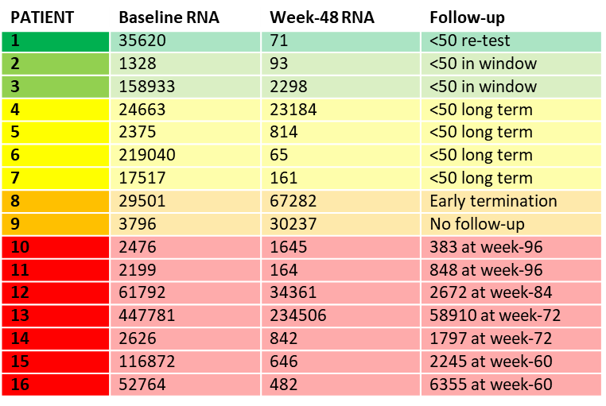
Outcome after HIV RNA >50 at Week 48
TDF/FTC/EFV arm

Slide 20
Drug Resistance
 | TAF/FTC+DTG (n=351) | TDF/FTC+DTG (n=351) | TDF/FTC/EFV (n=351)
Number w/VF, tested for resistance with paired baseline genotype | 1 (0.3%) | 1 (0.3%) | 6 (2%)
Emergent NRTI mutation | 0 (0%) | 1 (0.3%) | 4 (1%)
Emergent NNRTI mutation | 0 (0%) | 0 (0%) | 3 (1%)
Emergent InSTI mutation | 0 (0%) | 0 (0%) | 0 (0%)

Slide 21
Summary of Clinical Adverse Events
 | TAF/FTC+DTG (n=351) | TDF/FTC+DTG (n=351) | TDF/FTC/EFV (n=351)
Number of patients with:
Serious Adverse Events | 16 (5%) | 20 (6%) | 24 (7%)
Grade 3 and 4 AEs | 42 (12%) | 51 (15%) | 85 (24%)
Drug-related Grade 1-4 AEs | 185 (63%) | 227 (65%) | 251 (72%)
Death | 1 (0%) | 1 (0%) | 2 (1%)

Slide 22
Across arms:
No effect on sleep/anxiety/depression
Slight improvement on Quality of Life
Minimal immune reconstitution inflammatory syndrome, very little TB (high isoniazid use)

Slide 23
Worst treatment emergent grade 3 or 4 laboratory abnormalities
 | TAF/FTC+DTG (n=351) | TDF/FTC+DTG (n=351) | TDF/FTC/EFV (n=351)
Haematology
Haemoglobin | 3 (1%) | 7 (2%) | 10 (3%)
Platelets | 2 (1%) | 0 (0%) | 2 (1%)
Neutrophil count | 0 (0%) | 0 (0%) | 0 (0%)
Chemistry
ALT | 9 (3%) | 7 (2%) | 18 (5%)
AST | 6 (2%) | 6 (2%) | 14 (4%)
GGT | 4 (1%) | 6 (2%) | 33 (9%)
LDL | 8 (2%) | 1 (0%) | 7 (2%)
Albumin | 0 (0%) | 0 (0%) | 0 (0%)
Grading of all abnormalities was conducted using the DAIDs grading system. LLN and ULNs, used in conjunction, were taken from the BARC reference ranges and were done in accordance to participant’s age and gender.

Slide 24
Bone DXA: WHO category at Week 48
 | TAF/FTC+DTG (n=351) | TDF/FTC+DTG (n=351) | TDF/FTC/EFV (n=351)
Hip
Normal | 212/227 (93%) | 196/234 (84%) | 185/225 (82%)
Osteopenia | 15/227 (7%) | 38/234 (16%) | 40/225 (18%)
Lumbar Spine
Normal | 166/203 (82%) | 170/220 (77%) | 157/202 (78%)
Osteopenia | 37/203 (18%) | 50/220 (23%) | 45/202 (22%)

Slide 25
Grade 3 or 4 renal adverse events, renal markers and creatinine clearance
 | TAF/FTC+DTG (n=351) | TDF/FTC+DTG (n=351) | TDF/FTC/EFV (n=351)
Renal | 1 (0%) | 1 (0%) | 3 (1%)
Acute kidney injury | 0 (0%) | 0 (0%) | 1 (0%)
Haematuria | 0 (0%) | 0 (0%) | 1 (0%)
Hydronephrosis | 0 (0%) | 0 (0%) | 1 (0%)
Lupus nephritis | 0 (0%) | 1 (0%) | 0 (0%)
Renal impairment | 1 (0%) | 0 (0%) | 0 (0%)
Renal markers above normal range- worst treatment emergent
β2 microglobulin | 22 (6%) | 74 (21%) | 82 (23%)
Retinol binding protein | 10 (3%) | 26 (7%) | 38 (11%)
Urine albumin to creatinine | 57 (16%) | 81 (23%) | 83 (24%)
Creatinine clearance
Grade 3 or 4 | 3 (1%) | 13 (4%) | 6 (2%)

Slide 26
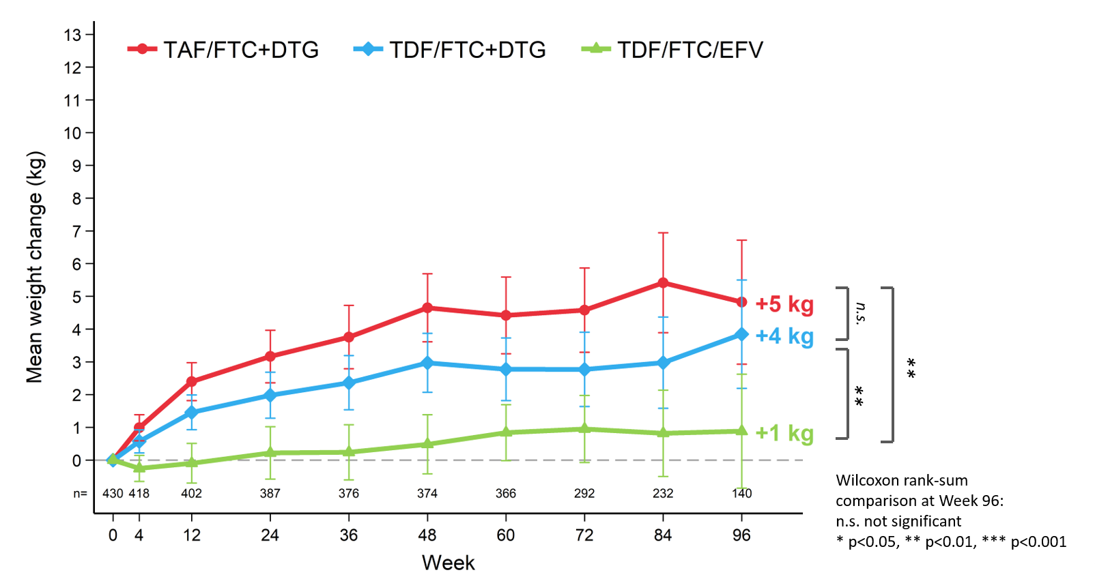
Mean change in weight (kg) to Week 96: men
For full data presentation: see oral late breaker MOAX0102LB
* 48-96 week dataset incomplete

Slide 27
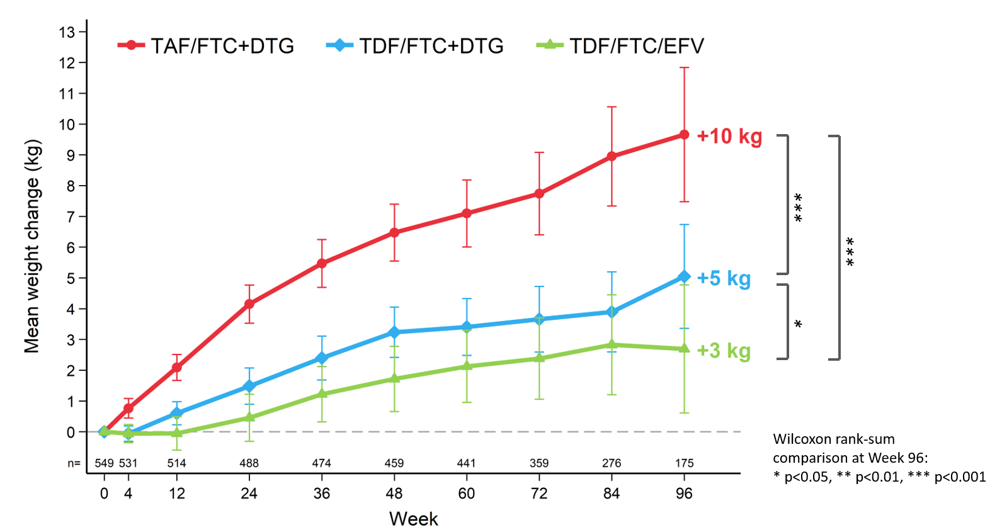
Mean change in weight (kg) to Week 96: women
For full data presentation: see oral late breaker MOAX0102LB
* 48-96 week dataset incomplete

Slide 28
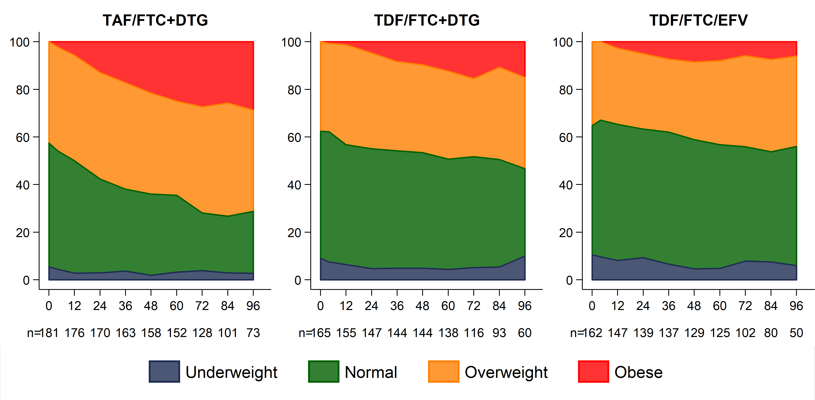
ADVANCE: BMI category over time: women
(obese at baseline excluded)
% Participants
Notes:
Here we show changes in BMI category over 96 weeks for women in ADVANCE, with those who were obese at BL excluded from the analysis. More women receiving TAF/FTC+DTG became overweight or obese than the other 2 study arms: by week 96, almost 70% of women in the TAF/FTC+DTG were overweight or obese. More than 20% of women in the TAF/FTC+DTG arm became obese by week 96, compared to less than 20% in the TDF/FTC+DTG arm and less than 10% in the EFV-containing arm. There were more underweight women in the two TDF-containing arms, and this was relatively stable across the study.
At the time of the analysis, not all participants had reached week 96 of the study; accordingly the number of participants at each time point is represented.

Slide 29
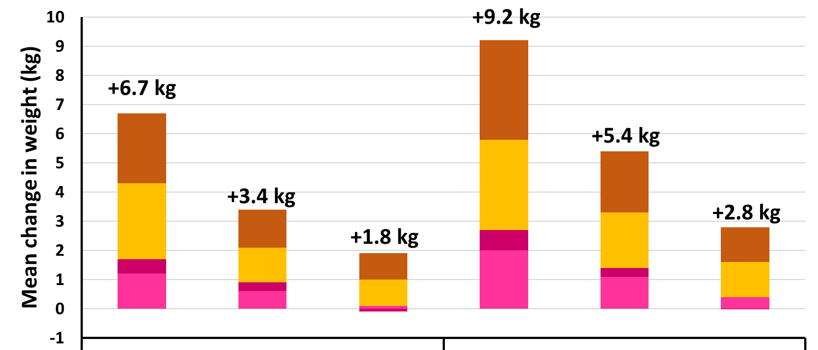
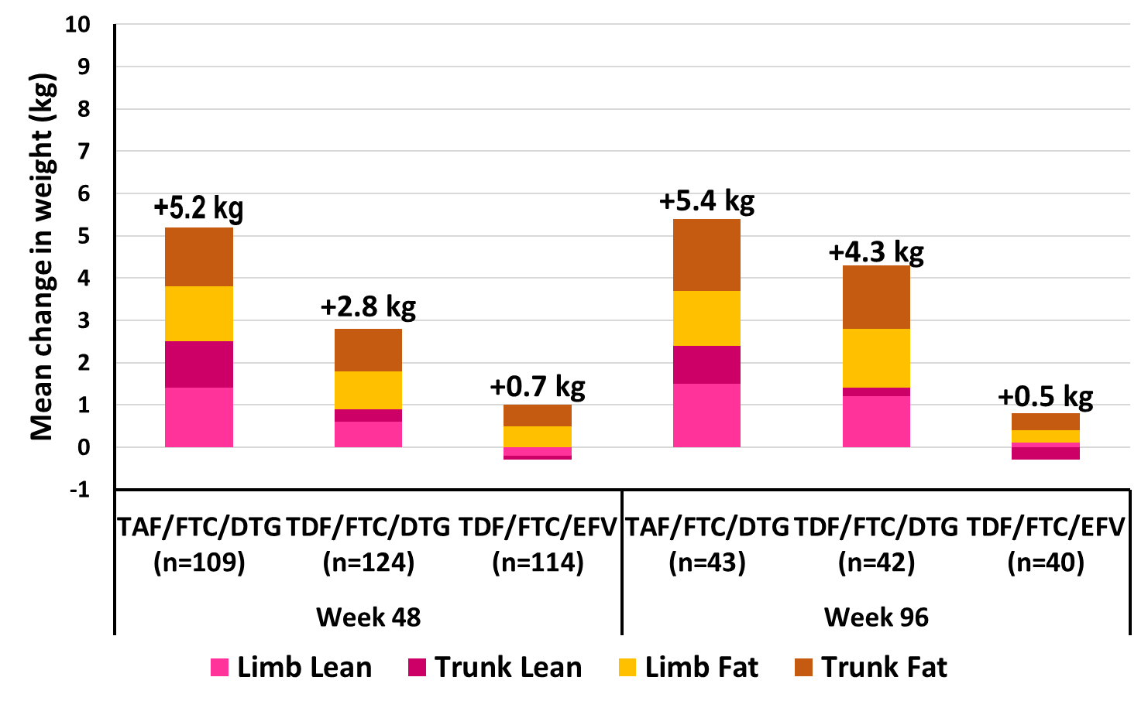
ADVANCE: Changes in body composition: women
Week 48
Week 96
TAF/FTC+DTG
(n=158)
TDF/FTC+DTG
(n=156)
TAF/FTC/EFV
(n=137)
TAF/FTC+DTG
(n=60)
TDF/FTC+DTG
(n=53)
TAF/FTC/EFV
(n=48)
Notes:
Looking at the DEXA data in women: Increases in trunk and limb fat were higher in both DTG arms and increased further from week 48 to week 96 in women. Increases in both limb and trunk fat which were considerably higher in women on the TAF/FTC+DTG arm and which continued to increase substantially from week 48 to week 96. Increases in lean mass, both limb and trunk, were also higher in the DTG arms than with EFV.
In the EFV arm, we can see different changes, with smaller increases in limb and trunk fat, and minimal increase in lean mass by week 96.
At the time of the analysis, not all participants had reached week 96 of the study; accordingly the number of participants at each time point is represented.

Slide 30
In addition
No notable changes in blood pressure, lipids or glucose across arms or timelines
No difference in week 48 HbA1C (not pre-specified, so no baseline)
Weight gain NOT correlated with:
  Hormonal contraception
  Sleep
  Nausea
  Mental illness
  Adherence
Not return to health of DTG > EFV (VL has very similar decay and the weight gain persists throughout)

Slide 31
Pregnancy-related outcomes
(See WEPEB280, presented immediately after this)
 | TAF/FTC+DTG | TDF/FTC+DTG | TDF/FTC/EFV
Total pregnancies since trial began | 29 | 25 | 29
Ongoing pregnancies | 3 | 5 | 1
Lost to follow-up | - | - | 1
Live births | 11 | 13 | 13
Spontaneous abortion | 7 | - | 9
Elective abortion | 7 | 7 | 4
Stillbirth | - | - | 1
Neonatal death | 1 | - | -
All data reported to APR, data collection ongoing

Slide 32
Perceptions on weight gain – Administered before weight gain information leaflet and consent
Questionnaires by 15 Jul 2019: 250 (157 Females, 93 Males)
35 participants unhappy with the change in weight, 22 indifferent, and 193 happy.
Of the 35, 11 were unhappy due to LOSS of weight
20 of the participants surveyed gained more than 20% of their baseline weight, but only 2 were unhappy
No participant has opted to switch DTG or TAF to-date (re-consenting and counselling done).
Thanks Dr Simiso Sokhela and team
Notes:
Recently, several observational studies and RCTs have demonstrated weight gain associated with the use of InSTIs, which is appears to be more pronounced in black PLWH and women.
Compared to those receiving TAF, ABC or NRTI-sparing ART, TDF is associated with lower body weight.
NAMSAL and ADVANCE are 2 RCTs among African populations which assessed body weight and BMI at each visit; ADVANCE also performed DXA scans at 3 time points – BL, week 48 and week 96

Slide 33
Conclusions
Virological efficacy is high: good across all regimens, similar to other studies; age/employment > impact than regimen
Resistance was not a major problem:
  No DTG emerging resistance mutations
  EFV arm did very well, despite reported background high level resistance
  Most patients re-suppress with adherence intervention and no regimen change
Toxicity was low except for weight gain:
  Renal, bone, lipid measures showed similar differences as per other studies
  No neuropsychiatric impact
  Weight gain significant - > women, > DTG, > TAF, similar to registration studies
Complexity for developing world programmes invested in DTG-based regimens - ?EFV-based alternatives required for foreseeable future
Notes:
We performed multivariate analyses to adjust for various factors, including
Sociodemographic factors: age, gender, nationality, relationship status, education level, employment status
BL factors: weight/BMI, treatment arm, CD4 count and VL
Disease history and adverse events: history of HPT, DM or dyslipidaemia
Concomitant medications: contraceptives, amlodipine, psychotropic medications and prednisone

Slide 34
Thanks to:
Ezintsha/Wits RHI
Study participants
Andrew Hill and his team
Treatment Action Campaign and HIV i-Base
Yogan Pillay, Glaudina Loots and the South African government
WHO – especially Meg Doherty
Carole Wallis and BARC
Clinton Health Access Initiative
Committees who oversaw the study
Donors (including much technical support):
  USAID
  Unitaid
  SA MRC
Drug donations and support
  Gilead Sciences
  ViiV Healthcare
  Mylan

Slide 35



Acknowledgments
This study was supported by U.S. Agency for International Development (USAID), a key implementing agency of the U.S. President’s Emergency Plan for AIDS Relief (PEPFAR), Unitaid and SAMRC, with study drugs donated by Gilead Sciences and ViiV Healthcare. The views expressed in this poster are those of the authors and do not necessarily reflect USAID, PEPFAR or the U.S. Government.

Slide 36


Thank you!

