Slide 2


Use of data to monitor and improve key-population-focused programming
Navindra Persaud
Deputy Director, Strategic Information, LINKAGES
@LINKAGESproject
Share your thoughts on this presentation with #IAS2019

Slide 3
Disclosure
No conflict of interest to disclose

Slide 4
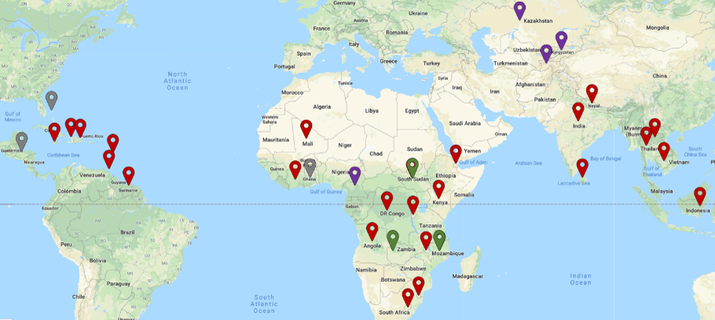
Geographic scope of LINKAGES
RESULT 1: Increased Availability of Comprehensive Prevention, Care, and Treatment Services, Including Reliable Coverage across the Continuum of Care for Key Populations
RESULT 2: Demand for Comprehensive Prevention, Care, and Treatment Services among Key Populations Enhanced and Sustained
RESULT 3: Strengthened Systems for Planning, Monitoring, Evaluating, and Assuring the Quality of Programs for Key Populations
June 11, 2014 to December 30, 2021
LINKAGES has worked in 35 countries
Currently active in 29

Slide 5
Improving key population programs — context
Key populations (KPs) are:
Groups at increased risk of HIV, irrespective of the epidemic context, due to:
  Specific high-risk behaviors
  Legal, social, and structural issues
Not a homogenous group
Harder to reach with comprehensive programs
KPs access different services from different providers
Lack of disclosure of KP status due to local policies and laws
Using data for monitoring and improving KP programs is about:
  Defining the data needs from the start
  Collecting the right data
  Using simple interlinked systems
  Doing the right analyses
  Involving the right people
  Reviewing and using the data with the right frequency

Slide 6
LINKAGES’ strategic information operational framework
Understand the population and situation
Programmatic mapping, PLACE, IBBS
Performance improvement
Measure outcomes and impact
Use simple approaches
Small area measurements
Microplanning: prevention, test, enroll, retain,
re-engage
Monitor and evaluate
Plan and implement the response
Routine system to measure performance:
data quality, tracking along the cascade,
capacity-building, electronic system

Slide 7
Burundi: Population dynamics change over time

Slide 8
Data needed to develop comprehensive cascades
HIV Negative
PrEP_NEW
PrEP_CURR

Slide 9
Standard indicators alone do not tell the entire story of services accessed by KPs
Understanding FSWs reached in
Cote D’Ivoire: FY19
Using custom indicators to follow up all
HIV-positive KPs
Providing PrEP to HIV-negative KP members in Lesotho: Q2 FY19
Community support for retention
Needed more time (8%)
Returned to treatment
Declined PrEP (37%)
Linked to other treatment site
43% started PrEP
Accepted referral for PrEP (55%)

Slide 10
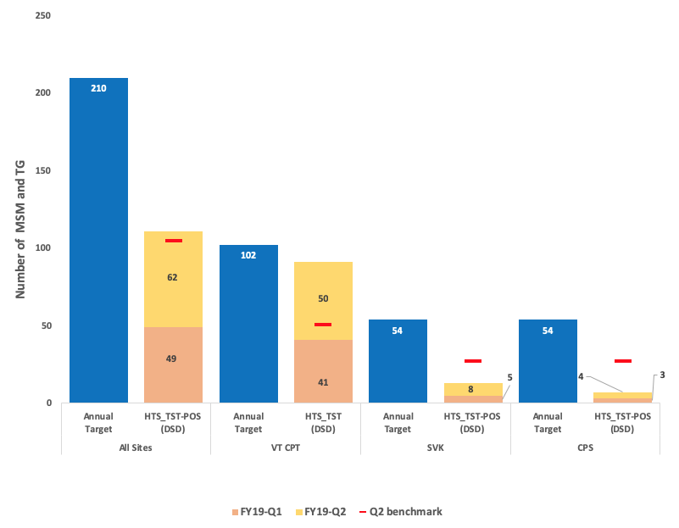
Analyzing data by partner helps to focus technical support
Laos: cumulative case detection rates among partners
Q2 FY19
Cote D’Ivoire: variation in performance across partners-Q2_FY19
Name of Implementing partner | Indicators
 | KP_PREV |  |  | HTST_TST |  |  | HTS_TST_POS |  |  | TX_LINK_NEW
 | Target | # Achieved Cumulative | % | Target | # Achieved Cumulative | % | Target | # Achieved Cumulative | % | Target | # Achieved Cumulative | %
BLETY | 10,907 | 5,633 | 51,6 | 9,362 | 4,439 | 47,4 | 721 | 378 | 52,4 | 603 | 248 | 41,1
ESPACE CONFIANCE | 520 | 147 | 28,3 | 460 | 113 | 24,6 | 32 | 17 | 53,1 | 27 | 17 | 63,0
GBH-CI | 1,028 | 419 | 40,8 | 791 | 329 | 41,6 | 55 | 78 | 142 | 46 | 73 | 158,7
NOTRE GRENIER | 769 | 804 | 105 | 641 | 551 | 86,0 | 45 | 48 | 107 | 38 | 48 | 126,3
RSB | 2,780 | 1,473 | 53,0 | 714 | 505 | 70,7 | 57 | 62 | 109 | 48 | 60 | 125,0
ASAPSU Yamoussoukro | 1,120 | 381 | 34,0 | 271 | 66 | 24,4 | 19 | 16 | 84,2 | 16 | 16 | 100,0
SAPHARM | 1,936 | 1,270 | 65,6 | 427 | 234 | 54,8 | 35 | 29 | 82,9 | 29 | 24 | 82,8

Slide 11
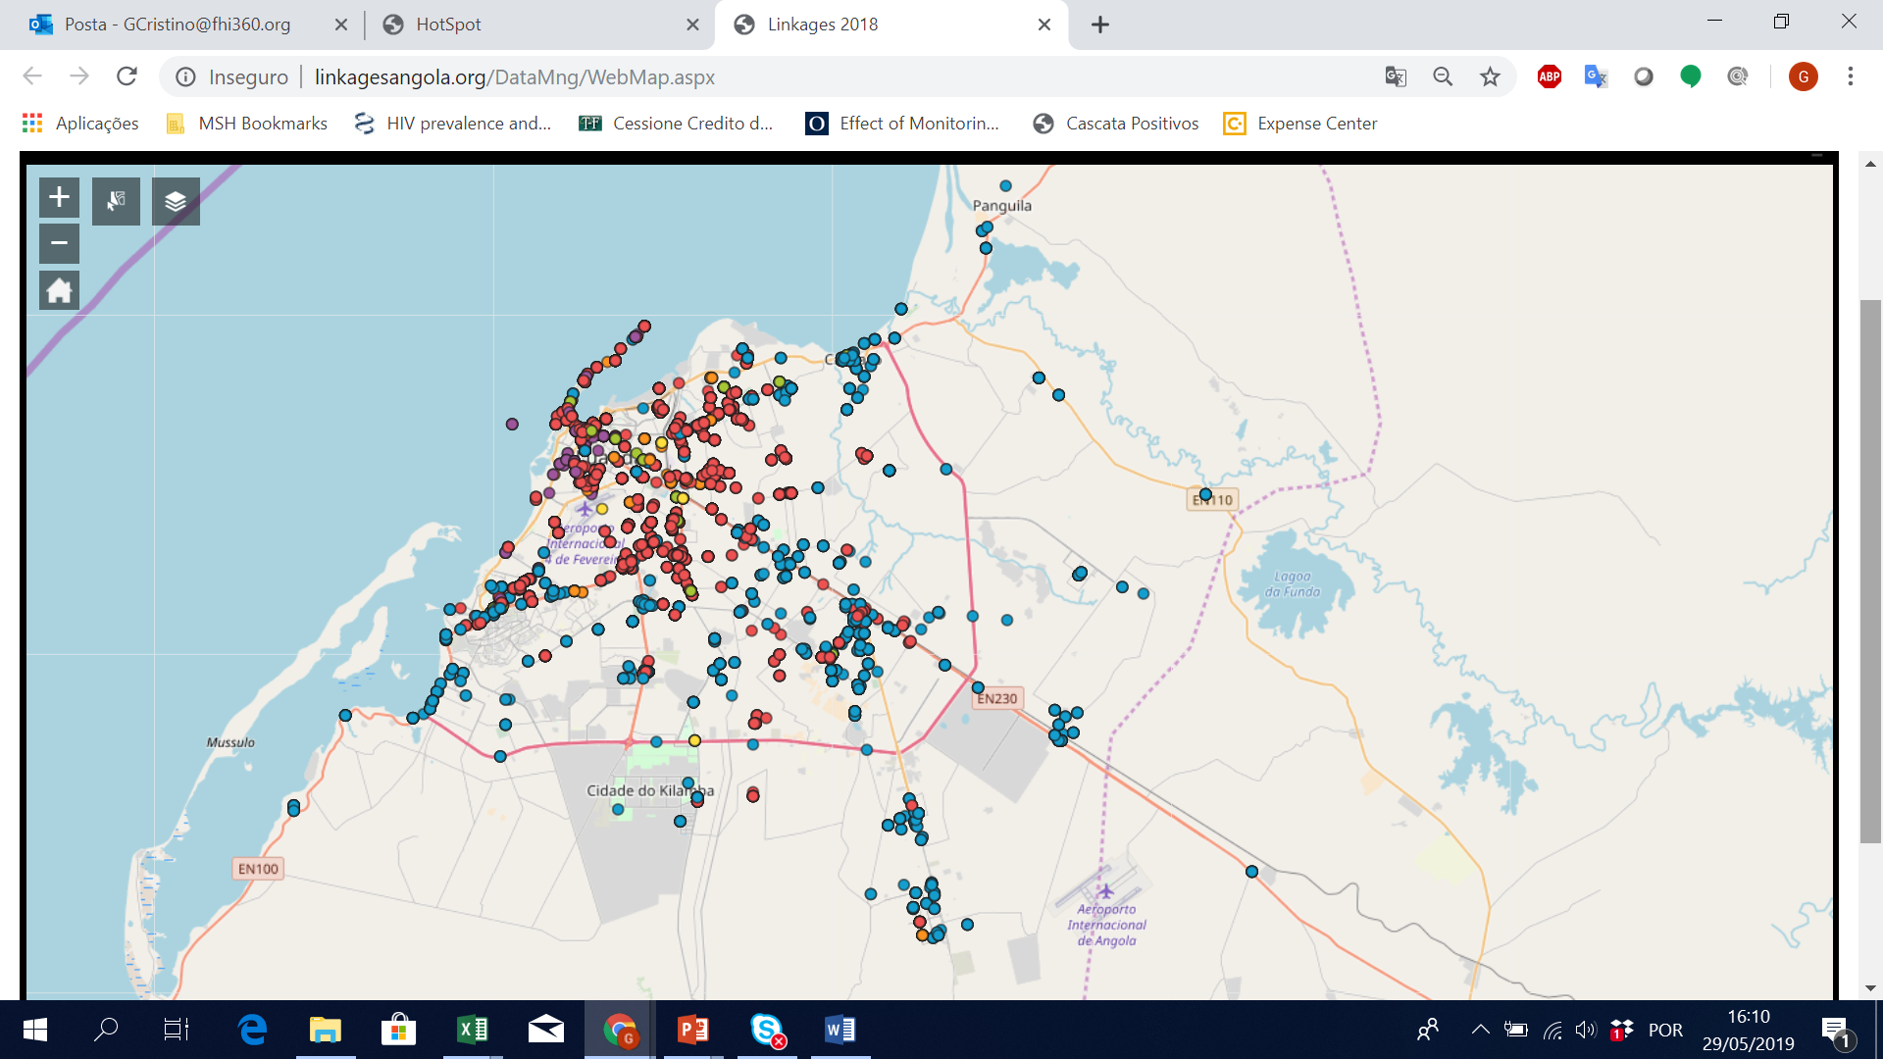
Site-level analysis of data helps to identify gaps in services
Angola: using maps to track site-level coverage
Cote D’Ivoire: variation in case-finding among FSWs

Slide 12
Summary
Improving KP programs requires a robust understanding of the local population — number, context, service availability, dynamics, and needs
Repeated measurements are needed because size, dynamics, and needs may
change over time
Current approaches to enumerating KPs are inadequate for all populations in all settings
Data systems must be aligned with program design — sharing information between facility and community-based information systems
Systems should be able to track access to prevention services among HIV-negative
KP members
Use standard indicators and custom indicators to capture the broad array of interventions for KP programs
Conduct granular analyses of data on a regular basis

