Slide 2

TRANSFORMING EVIDENCE INTO HIV POLICIES AND PRACTICE: LESSONS FROM IMPLEMENTATION SCIENCE
Julie Pulerwitz, ScM, ScD
Director, HIV and AIDS Program, Population Council
@Pop_Council
Share your thoughts on this presentation with #IAS2019

Slide 3

The Population Council
conducts biomedical, social science, and public health research. We deliver solutions that lead to more effective policies, programs, and technologies that improve lives around the world.
Notes:
This text supplements the information on the slide:
The Population Council is a nongovernmental, international nonprofit organization.
The Council confronts critical health and development issues—from stopping the spread of HIV and expanding contraceptive choices to improving reproductive health and ensuring young people lead full and productive lives.
We change the way the world thinks through research used to generate more effective policies, programs, and technologies.

Slide 4
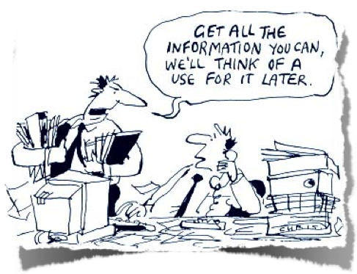

Slide 5
HALLMARKS OF IMPLEMENTATION SCIENCE
Practical/applied evidence generation focused on ‘how to’ questions
Bridges perspectives of multiple stakeholders
  Program, policy makers, researchers
Promotes integration of research findings into policy and practice
  Often called Research Utilization or Data-for-decision-making

Slide 6
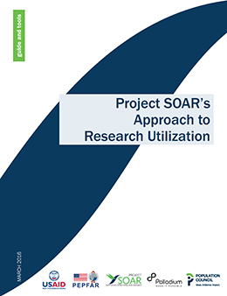
OUR SYSTEMATIC APPROACH FOR DATA USE
Identify key stakeholders early in the research process
Engage stakeholders along the study phases
Hold data interpretation workshop(s)
Disseminate findings to multiple audiences
Develop/implement data use plan to apply findings

Slide 7
STUDY DESIGN PHASE
Research Process
Define research questions
Develop protocol
Finalize protocol & tools
IMPLEMENTATION
USE
Identify key stakeholders
Engage key stakeholders
Research Utilization Process

Slide 8
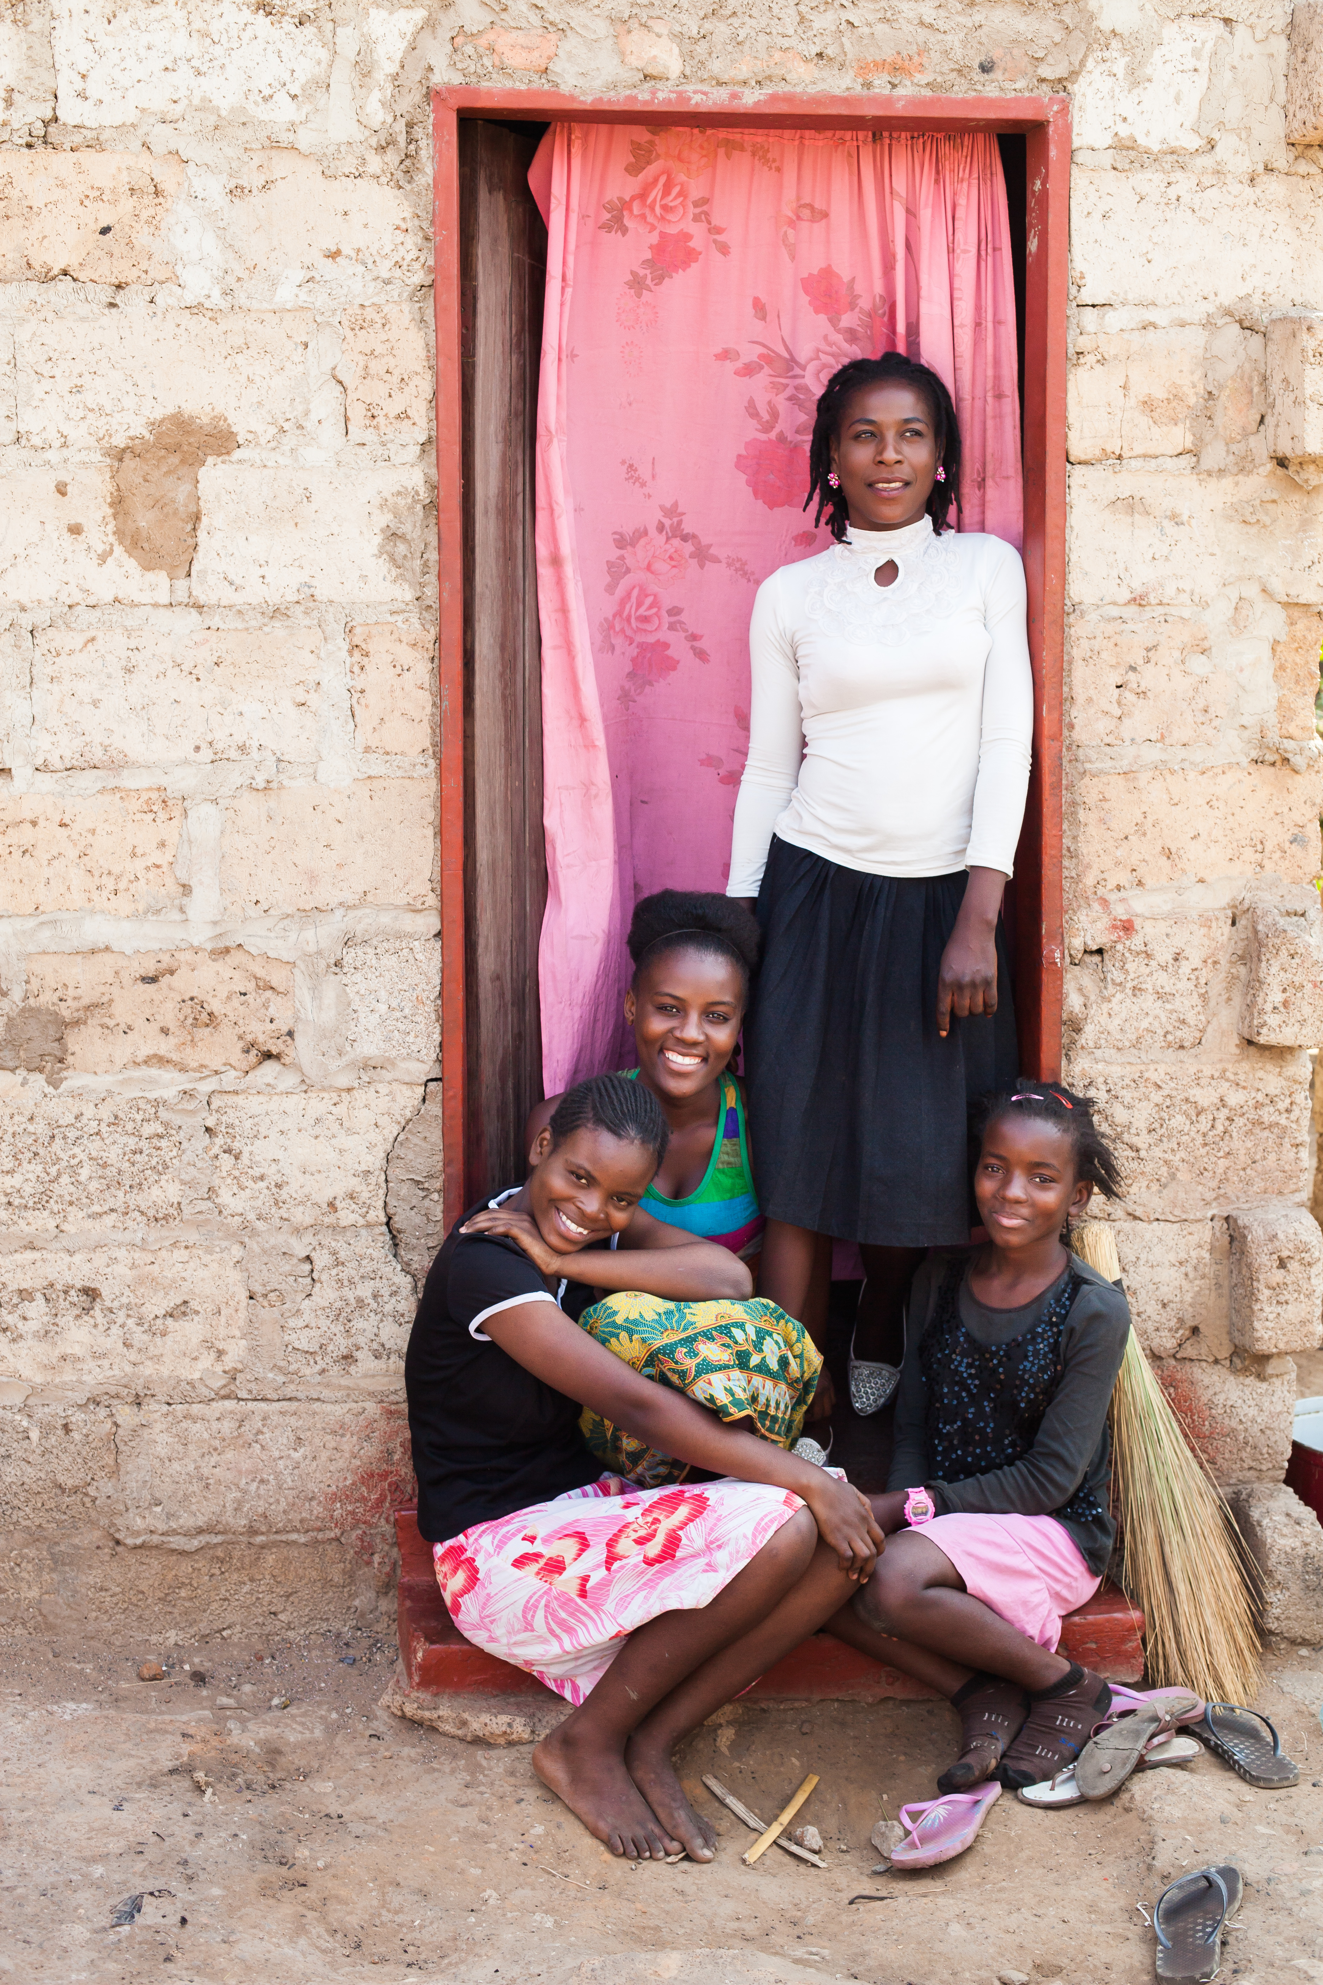
PREP INTRODUCTION IN TANZANIA
Countries need contextually-relevant information to help inform introduction & rollout of PrEP for at-risk populations
  Very high HIV incidence for AGYW in several regions of Tanzania
Study to assess the feasibility of and opportunities for providing PrEP to AGYW
  Conducted in the context of PEPFAR’s DREAMS Partnership

Slide 9
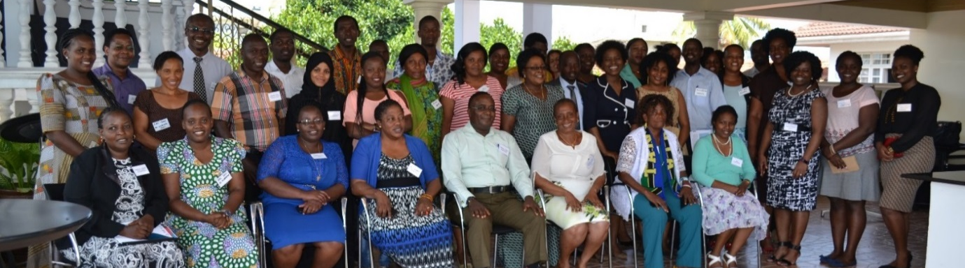
EARLY ENGAGEMENT OF STAKEHOLDERS
Gathered input into key questions before data collection
  Planned to include AGYW, partners, service provider, policy-makers, community leaders
  Suggested inclusion of parents as key stakeholders
  NACP as a co-PI on study and co-convener of the meeting
Notes:
exploring potential client, provider, policymaker, & community perspectives
Neema Makyao

Slide 10
FINDING: AGYW WANT SUPPORT FOR USE;
PREP TO NOT BE STIGMATIZED
Creating support
  Mass-media campaigns
  (Street announcements, radio/TV)
  Education of partners & parents
Fostering adherence
  Accurate biomedical information
  about PrEP & its side effects
  Peer support groups (in-person or virtual)
When the peers of my age see a person taking PrEP, they will think that the person has AIDS or they are very unfaithful hanging out with many partners. They will speak many things and I will be considered as a bad person in the community, a misbehaving person.
—AGYW, age 22
Notes:
Lot of support from parents as well, they know AGYW are at risk, but worried this support will showing condoning sexual activity, and don’t know hwo to talk about / need support for dialogue with children

Slide 11
RESEARCH IMPACT/USE: TANZANIA PREP
PrEP tools/conceptual framework
used for programming
PEPFAR highlights study in annual report; Peer-reviewed publication
(Pilgrim et al., PLOS-One 2018)
PrEP approved for use in Tanzania in 2018
Tz NACP/MOH support for demo trials;
Organize PrEP Working Group
Prep Acceptability Study
(9 months)
…this formative assessment study and the way it was conducted is one of the main reasons the demonstration trials are now fully receiving the Ministry’s backing.
—Neema Makyao, NACP, Study co-PI, Tz
Notes:
Also study replicated in Ghana so expanding to other settings…

Slide 12
IMPLEMENTATION PHASE
Research Process
Collect data
Analyze data
STUDY DESIGN
USE
Engage local stakeholders in
data collection
Engage local stakeholders in interpreting findings and developing recommendations
Research Utilization Process

Slide 13

MEASURING AND ADDRESSING STIGMA
Survey tool to quantify stigma and effects
  For advocacy, policy reform, service delivery
  Developed, implemented by and among
  people living with HIV
Update to incorporate current treatment options, mental health / resiliency, intersecting stigmas
  Collaboration between SOAR/Population Council, tool developers (GNP+, ICW, IPPF), other experts

Slide 14
MULTIPLE STEPS IN UPDATE PROCESS
Desk review of Stigma Index country reports
Key informant conversations
In-person stakeholder consultation
Research team synthesizes recommendations into draft updated tool
Updated tool pre-tested @AIDS 2016
Feedback incorporated
Updated Stigma Index tested/fielded in 3 countries
Final recommendations/results shared
Notes:
BARBARA

Slide 15
FINDING: HIGH LEVELS OF ABUSE EXPERIENCED BY
MEN WHO HAVE SEX WITH MEN
Notes:
This slide shows high levels of violence and abuse experienced by men who have sex with men who are living with HIV in all 3 countries
ALSO RESILIENCE.

Slide 16

RESEARCH IMPACT/USE
PLHIV Stigma Index “2.0” rolled out in 12 countries; 17 more planned—led by community organizations
Named as one of top 10 USAID research activities for 2017
Peer-reviewed publications
  Friedland BA et al. (2018) Measuring intersecting stigma among key populations living with HIV: implementing the people living with HIV Stigma Index 2.0. JIAS
  doi: 10.1002/jia2.25131
  Gottert A et al. (forthcoming) The People Living with HIV (PLHIV) Resilience Scale: Development and validation in three countries. AIDS & Behavior
USAID
TOP 10
2017
Notes:
“Stigma Index 2.0” has been implemented in 12 countries
Argentina, Canada, Dominican Republic, Eswatini, Germany, Indonesia, Latvia, Lithuania, New Zealand, Philippines, Spain, Uganda.
17 additional countries planning an implementation
Botswana, Cambodia, Ethiopia, Finland, Ghana, Jamaica, Kyrgyzstan, Lesotho, Malaysia, Morocco, Mozambique, Nepal, Sierra, Leone, Somalia, Rwanda, and Vietnam.

Slide 17
KNOWLEDGE TRANSLATION PHASE
Research Process
Work with champions to influence key decision makers
Develop materials for different audiences
Provide TA/capacity strengthening to inform program change
In-county dissemination meeting
IMPLEMENTATION
STUDY DESIGN
Dissemination strategy and data use plan
Research Utilization Process
Notes:
For example,

Slide 18
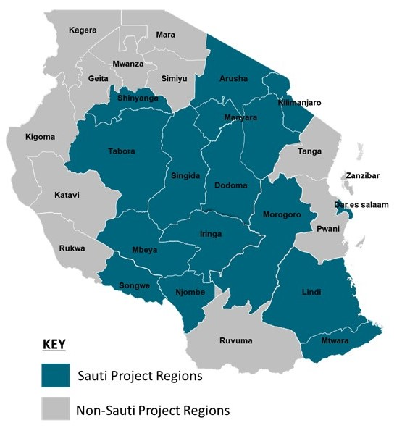
IMPROVING ACCESS TO TREATMENT AMONG FSWS
Reaching key and vulnerable populations (KVPs) with ongoing care/treatment challenging
Community-based ART is promising strategy, but not approved in Tanzania
Study to test feasibility / acceptability, and effectiveness of bringing HIV treatment to FSW in community settings (e.g., mobile clinics, brothel-based)
  SOAR/Population Council, with intervention partner Sauti/Jhpiego
Notes:
Intervention site: Njombe
Comparison site: Mbeya
Tanzania—4.7% adult prev

Slide 19
FINDING: COMMUNITY-ART IMPROVED ART RETENTION
Notes:
At 6 months
At 12 months
Sig in both bi-variate and multivariate analysis

Slide 20
RESEARCH IMPACT/USE
Study findings and implementation experiences
Disseminated progress with MOH, local govt, and other stakeholders
Refined Sauti’s Comm ART SOPs, training package/ curricula, checklists, and M&E tools
Used findings to further improve programming & influence policy change
Notes:
Project Director Albert Komba – champion who worked tirelessly reaching out to various stakeholders (GoT, LGAs, USAID, other IPs, the parliamentary committee for HIV and Drugs, etc.) to advocate for the fast tracking of ART delivery

Slide 21
2019 POLICY CHANGE ALLOWS FACILITY-LED COMMUNITY INITIATION OF ART FOR KVPS
Notes:
As result of the lessons learnt and the success of the community ART service, two years later (very recently), MOH issued a circular authorizing community-based ART initiation to KVP

Slide 22
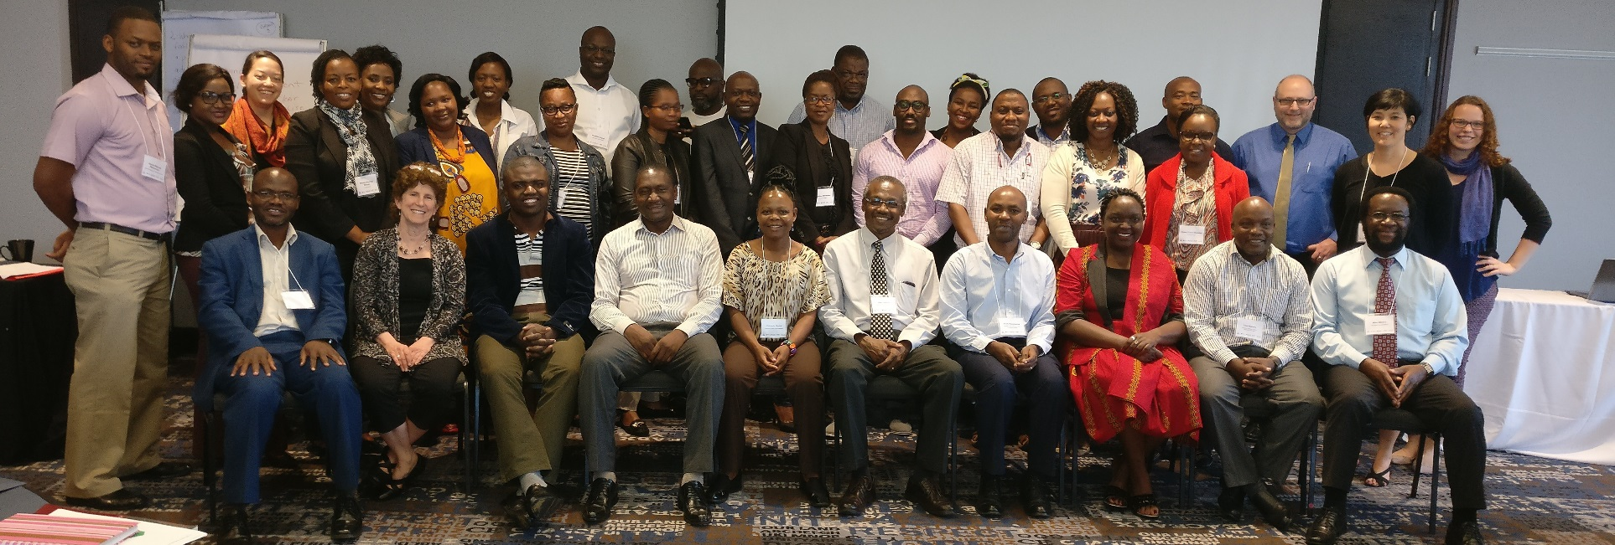
STRENGTHENING CAPACITY FOR DATA USE
Capacity strengthening workshops
  In-country researchers paired with government stakeholders and others
  Aim to increase data use awareness, skills, and research-stakeholder collaboration

Slide 23

















ACKNOWLEDGMENTS
DREAMS IS Tanzania
Population Council: Sanyukta Mathur, DREAMS Proj Dir; Lou Apicella, Craig Heck; Nrupa Jani, Jerry Okal; Nanlesta Pilgrim, Julie Pulerwitz, Vaibhav Saria
CSK, Tanzania: Catherine Kahabuka;
Salum Mshamu
NACP, Tanzania: Neema Makyao,
Lija Jackson
In collaboration with: PEPFAR/Tanzania;
Sauti/Tanzania
Study participants
With funding support from Bill & Melinda Gates Foundation
Stigma Index
Population Council: Julie Pulerwitz;
  Scott Geibel, SOAR Proj Dir; Barbara Friedland; Ann Gottert; Sherry Hutchinson; Samuel Kalibala (Palladium); Tracy McClair; Deborah Weiss; Eileen Yam
Enda Santé: Daouda Diouf, Fatou Mbacké Sy
Global Fund: Noah Metheny (formerly USAID)
GNP+: Julian Hows, Laurel Sprague
ICW: Florence Anam, Sophie Brion, Margaret Happy
JHU: Stefan Baral, Deanna Kerrigan, Iliassou Mfochive Njindam, Oluwasolape Olawore, Gnilane Turpin, Fan Yang
Metabiota: Guy Fako, Ubald Tamoufe
NAFOPHANU: Richard Batamwita, Stella Kentutsi, Richard Mugumya, Prossy Nanyanzi, Enos Sande, Stephen Sentongo
RTI: Laura Nyblade, James Wrenn
UNAIDS: Victoria Bendaud, Chris Mallouris, Jason Sigurdson
USAID: Ugo Amanyeiwe, Alison Cheng, Aasha Jackson, Cameron Wolf
Study participants
With funding support from PEPFAR and USAID
Tanzania FZW
Population Council: Lung Vu, Waimar Tun, Lou Apicella, Scott Geibel, SOAR Proj Dir; Sherry Hutchinson; Samuel Kalibala (Palladium); Deborah Weiss; Eileen Yam
NACP, Tanzania: Neema Makyao
National Institute of Medical Research, Tanzania: Kidola Jeremiah
USAID/Tanzania: Todd Koppenhaver, Erick Mlanga
Sauti/Tanzania, Jhpiego: Caterina Casalini, Gasper Mbita, Albert Komba
Study participants
With funding support from PEPFAR and USAID

Slide 24
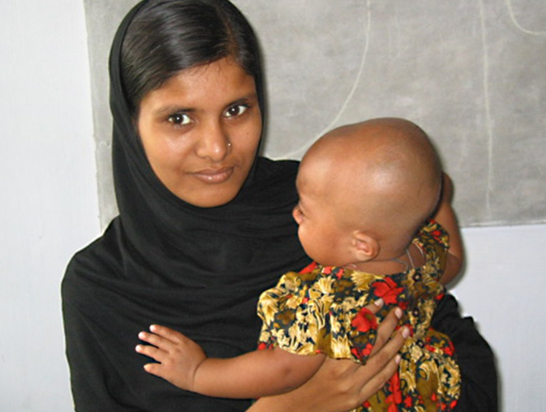

Ideas. Evidence. Impact.
The Population Council conducts research and delivers solutions that improve lives around the world. Big ideas supported by evidence: It’s our model for global change.

