Slide 1
HIV and STI: Why Addressing These Syndemics Matters
Kenneth H. Mayer, MD
IAS 2019, Mexico City
July 24, 2019

Slide 2
Epidemiological Synergy
Interrelationships between Human Immunodeficiency Virus Infection
And Other Sexually Transmitted Diseases
JUDITH N. WASSERHEIT, MD, MPH
From the Sexually Transmitted Diseases Branch,
National Institute of Allergy and Infectious Diseases,
National Institutes of Health, Bethesda, Maryland
Sex Transm Dis. 1992 Mar-Apr;19(2):61-77

Slide 3
The Old Paradigm: Pre-HAART
Biology (inflammation/ulceration)
Behavior (condomless sex, ↑ partners)
STI
HIV
Epidemiology (risky partners, core group)
Immune
suppression

Slide 4
The New Paradigm: After U=U and PrEP
Biology (inflammation/ulceration)
X
PrEP
Behavior (condomless sex, ↑partners)
STI
HIV
x
U=U & PrEP
Epidemiology (risky partners, core group)
U=U
X
Immune
suppression

Slide 5
WHO estimates 357 million new cases of four curable STIs in 15-49 year-olds in 2012
> 1 million new cases of STI / day
Curable STIs: chlamydia, gonorrhea, syphilis, trichomoniasis
Source: WHO. Global incidence and prevalence of selected curable sexually transmitted infections - 2012.

Slide 6
Prevalence of STIs in sub-Saharan Africa: Individual patient data meta-analysis of 18 HIV prevalence studies
15 – 24 years old
25 – 49 years old
BV was high among 25–49 year-olds range: 33–44%
Torrone EA, Morrison CS, Chen PL, Kwok C, Francis SC, et al. PLoS Med. February 2018.

Slide 7
HIV is highly co-prevalent among patients presenting with STI syndromes in South Africa, 2014-2016
STI syndrome | N = | HIV co-infected | Per cent HIV positive
Genital Ulcer Disease | 363 | 208 | 57.3%
Vaginal Discharge | 742 | 350 | 47.2%
Male urethral discharge | 784 | 211 | 26.6%
There was a significant association between HIV seropositivity and all STI syndromes (p<0.001).
Source: Ranmini Kularatne, Centre for HIV & STIs, NICD. Aetiological Surveillance of Sexually Transmitted Infection Syndromes at Sentinel Sites: Germs-SA 2014-2016. The Communicable Diseases Surveillance Bulletin, Volume 15. Issue 3 – November 2017. http://www.nicd.ac.za/index.php/publications/communicable-diseases-surveillance-bulletin/

Slide 8
Rectal gonorrhea and syphilis are predictive of future HIV infection
Katz et al. Sex Trans Dis. 43(4):249-254, 2016.
Also Bernstein et al from SF and Pathela et al from NYC
Notes:
Let’s switch gears to look at STI infection among HIV-negative men and what that means for future HIV infection.
In an STD clinic population in Seattle & King County, more than 20% of individuals with a rectal GC infection acquired HIV over 5 years of follow-up. Those with early syphilis were also highly likely to acquire HIV infection over the follow-up period. These data again emphasize the overlap of sexual networks that facilitate rectal GC and syphilis transmission and those networks that facilitate HIV transmission.

Slide 9
STIs among MSM in South Africa and Nigeria
STI among MSM in Nigeria
Lagos
Gonorrhea 28.1%
Chlamydia 18.3%
Syphilis 19.6%
All Asymptomatic
STI among MSM in South Africa
Source : Babajide Keshinro, MHRP, Nigeria, Kevin Rebe, Anova Health Institute, South Africa

Slide 10
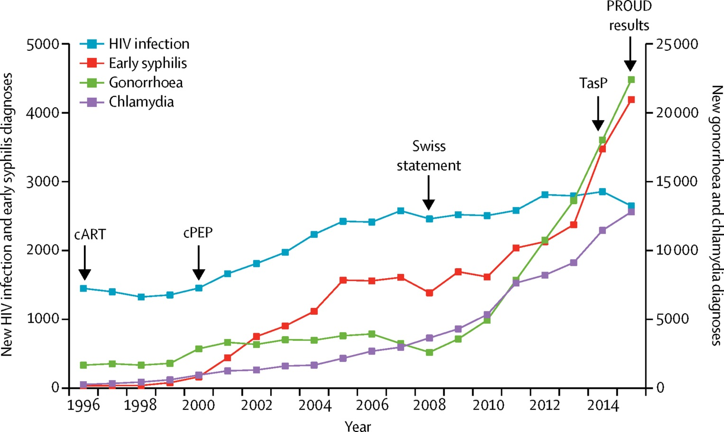
New diagnoses of HIV and STIs from 1996 to 2015 in MSM in England
Figure 10
Unemo M et al. Lancet Infect Dis 2017

Slide 11
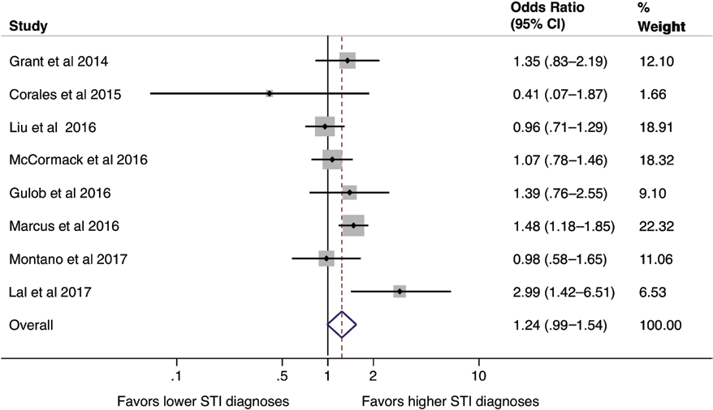
Meta-Analyis of Effect of PrEP on STIs Diagnosis among MSM
Significant increase in any rectal STI diagnosis (OR: 1.39, 95% CI: 1.03-1.87)
Significant increase in rectal chlamydia (OR: 1.59, 95% CI: 1.19-2.13)
Increase in STIs rates in more recent studies (OR: 1.47, 95% CI: 1.05-2.05)
Traeger MW et al. CID 2018

Slide 12
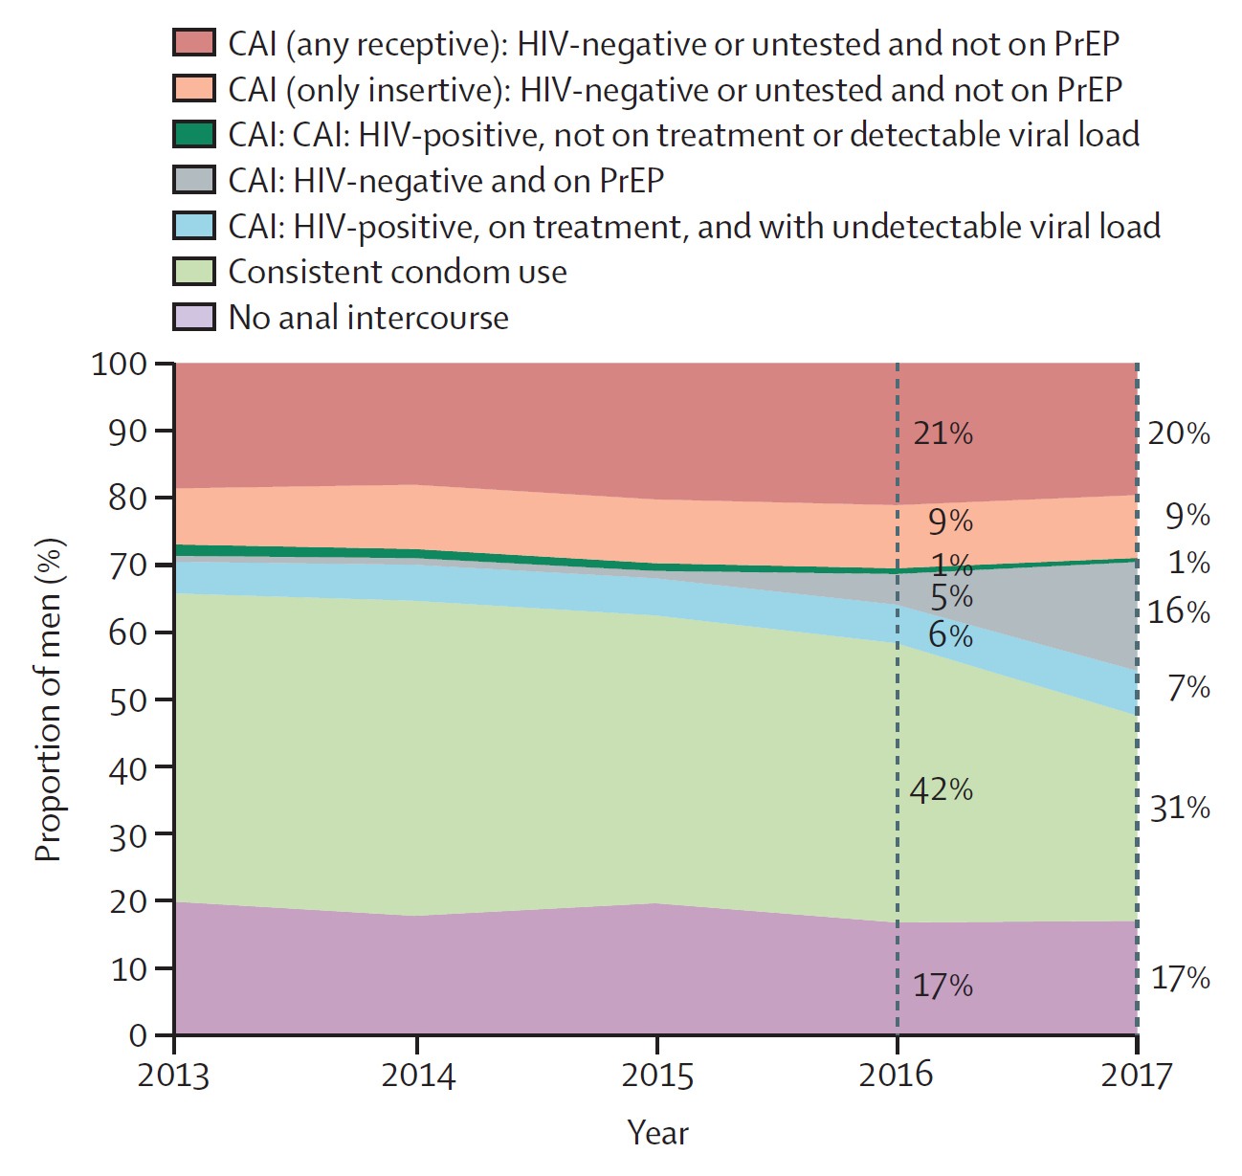
Community-Level Changes in Condom use with Casual Partners Among MSM
Figure 11
30%
1%
46%
The Lancet Infectious Diseases 2017 17, e235-e279DOI: (10.1016/S1473-3099(17)30310-9)
Copyright
Holt M. et al . Lancet HIV 2018

Slide 13
Increasing bacterial STI rates include HIV+ and HIV- GC, CT, Syphilis, by HIV status and PrEP Use (Fenway Health, 2005-2015)
Mayer, OFID, 2017

Slide 14
Testing for STIs in Last 12 months among MSM – an eCDC/Hornet Survey
n=8613
n=690
Of those currently not on PrEP
Of those currently on PrEP
Men taking PrEP test more often for STIs
Noori T. et al EACS 2017

Slide 15
Reducing STI by increasing screening
Menza et al. IDWeek, 2018.
Notes:
And folks found self-screening acceptable and would even think about testing more often, collecting specimens at home, and recommending self-screening to a friend.

Slide 16
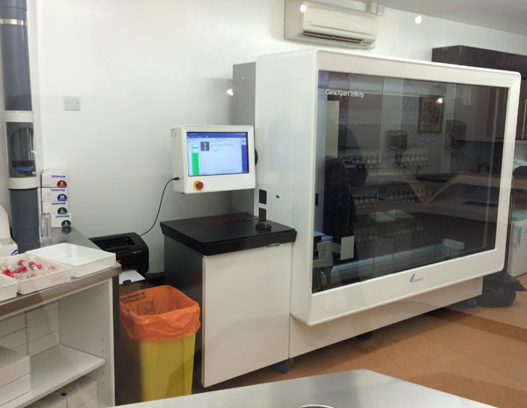
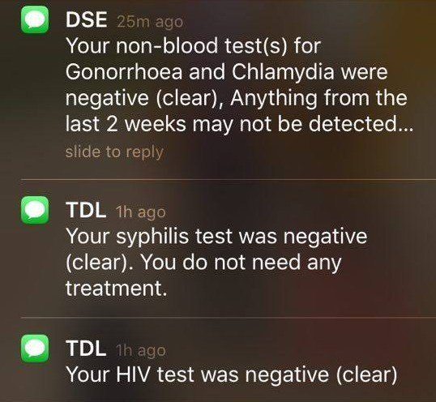
Reducing STI through improved services
Notes:
There is a clinic in SoHo in London called Dean Street. They have an express sexual health clinic using iPad technology for data collection and GeneXpert rapid NAAT testing for GC/CT. They also perform HIV and syphilis serologic testing. All results return within 6 hours and are communicated via text message. This rapid screening means more timely treatment and, thus, decreased duration of infection.

Slide 17
Beyond Syndromic Management: Multiple etiologies of vaginal discharge in South Africa: 2014-2016

Slide 18
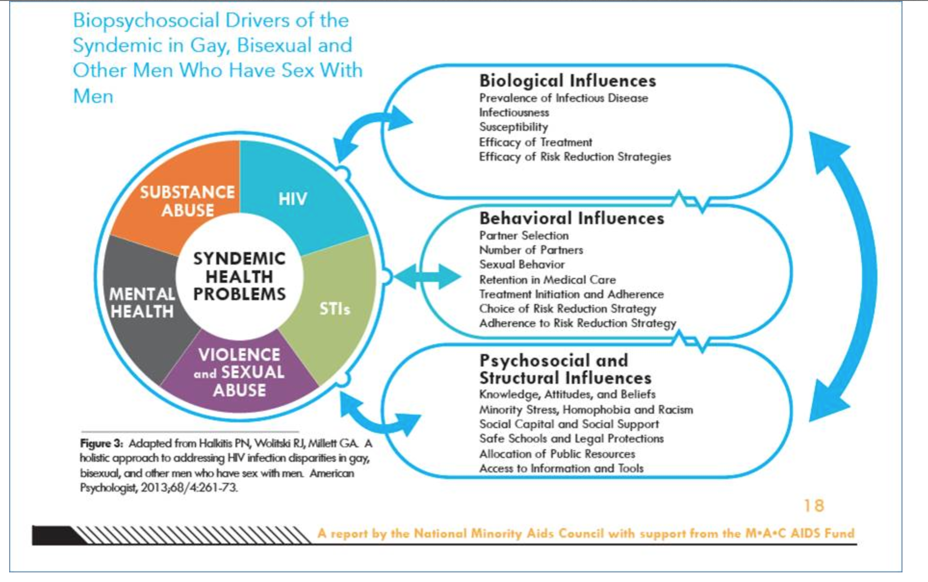

Slide 19
Need to Address Behavioral Health Syndemics: Depression and HIV/STIs among MSM in Lesotho
527 MSM completed structured survey instrument, biologic testing for HIV and Syphilis
Defined positive depression screen as a PHQ-9 score of 10 or more
Outcome variable | Adjusted Odds Ratio | 95% Confidence Interval
Laboratory test result
Positive for syphilis | 2.75* | 1.07, 7.08
Positive for HIV | 1.58 | 0.85, 2.94
Self-report
Diagnosed with any STI, past 12 months | 2.04* | 1.02, 4.06
Diagnosed with HIV, ever | 1.27 | 0.61, 2.63
Sources: Stahlman, Baral, et al. Depression and Social Stigma among MSM in Lesotho: Implications for HIV and Sexually Transmitted Infection Prevention. Forthcoming

Slide 20
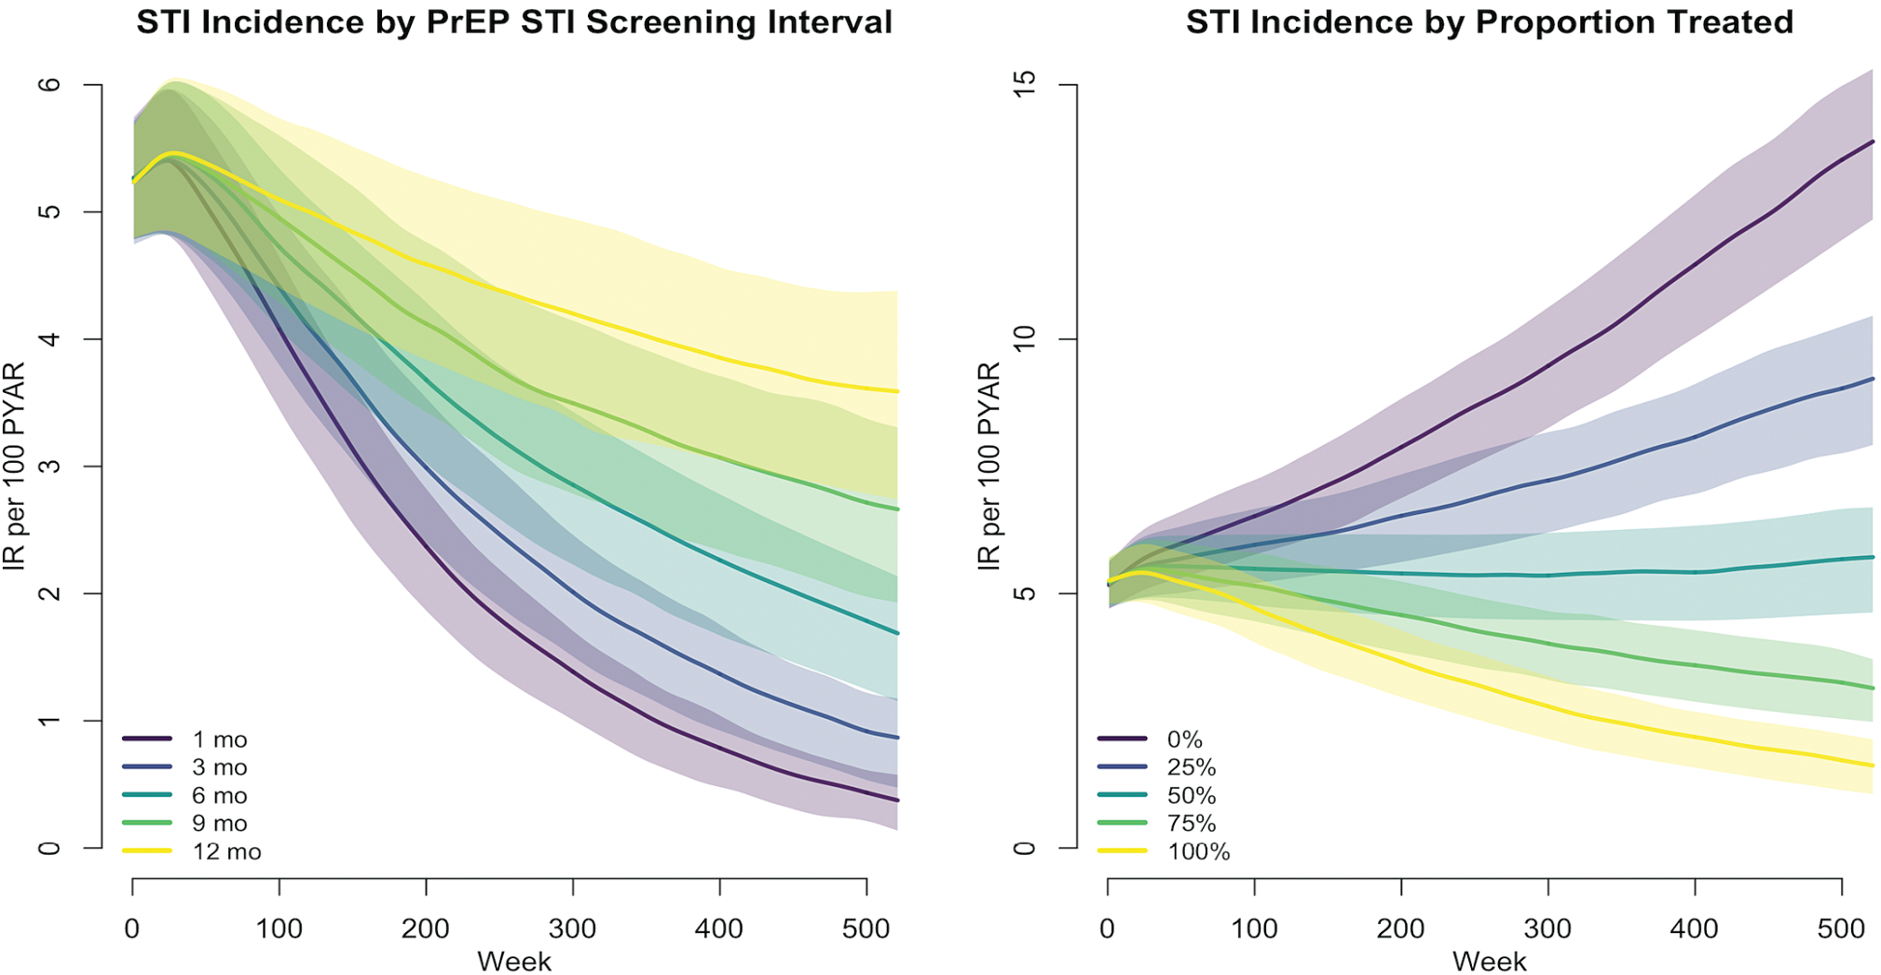
Incidence of Gonorrhea and Chlamydia among MSM using PrEP
Over the next decade, 40% of NG and CT infections would be averted (40% PrEP coverage)
Jenness et al CID 2017

Slide 21
Conclusions
High rates of condomless sex and STI do not undermine high efficacy of ART to prevent HIV transmission or acquisition
BUT, STI will continue to potentiate HIV spread until all PLHIV have access to rx. and all at risk persons can access PrEP
STI continue to be major sources of morbidity in their own right
Frequent testing, early diagnosis and treatment and better partner notification should help reduce HIV and STI incidence
STI and HIV services provide gateways to testing, diagnoses, and treatment, leading to improved sexual health.
Community engagement is key to counter the increase in STI associated with biomedical interventions, and should address concomitant syndemic issues (e.g. behavioral health)

Slide 22
Thank you
Stef Baral
Chris Beyrer
Myron Cohen
Jeanne Marrazzo
Tim Menza
Jean-Michel Molina
Francis Ndowa
Kevin Rebe
Steven A. Safren
Patrick Sullivan
Teodora Wi
NIAID, NIMH, NIDA, NICHD, CDC, HRSA,
Mass DPH, Gilead
www.fenwayhealth.org

