Slide 1
Impact of Mental Health and Substance Use Disorders on Reaching Global HIV Care and Prevention Targets
Steven Shoptaw PhD
Department of Family Medicine
University of California, Los Angeles
24 July 2019

Slide 2
Introduction
Rationale
Definitions
Epidemiology on Links: Drug Use, Mental Health Disorders and Relevant HIV Outcomes
  HIV Positive
  HIV Negative
Proposal for Relevant HIV Prevention Strategy

Slide 3
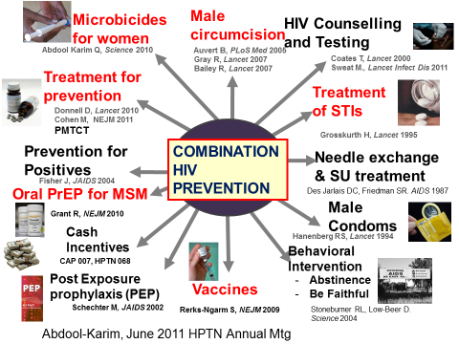
HIV Prevention Tools

Slide 4



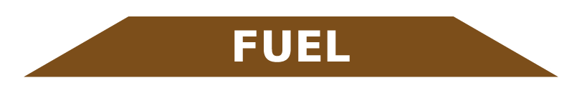
For 80% of the population, standard biomedical, behavioral and risk reduction approaches to HIV prevention and care are effective
Rationale for Disaggregated Strategy
It’s the remaining 20% we need to think about
Poverty
Substance use and mental health disorders
HIV
OUTBREAK
Erosion or unavailability of health resources

Slide 5




Mental Health Disorders: A Spectrum?
Adam, D. Nature. 2013. 496:416-418
Past year prevalence of common symptoms: ~20%
Steel et al., 2014. Int. J. Epi. 476-493
←Severity→

Slide 6

Definitions of a Spectrum:
Drug Use to Drug Use Disorder,
Mild to Moderate to Severe
Mild to Moderate SUD
No use
or use that does not cause problems
Occasional use causes problems occasionally to frequently
Severe SUD
(Addiction)
Problems
Fun
Fun with Problems

Slide 7
Global Burden of Common
Mental Health Disorders
Whiteford et al., Lancet, 2013. 382:1575-1586

Slide 8
Global Burden of Amphetamines, Cannabis, Cocaine, Opioids – DALYs
Degenhardt et al., LANCET, 2014

Slide 9
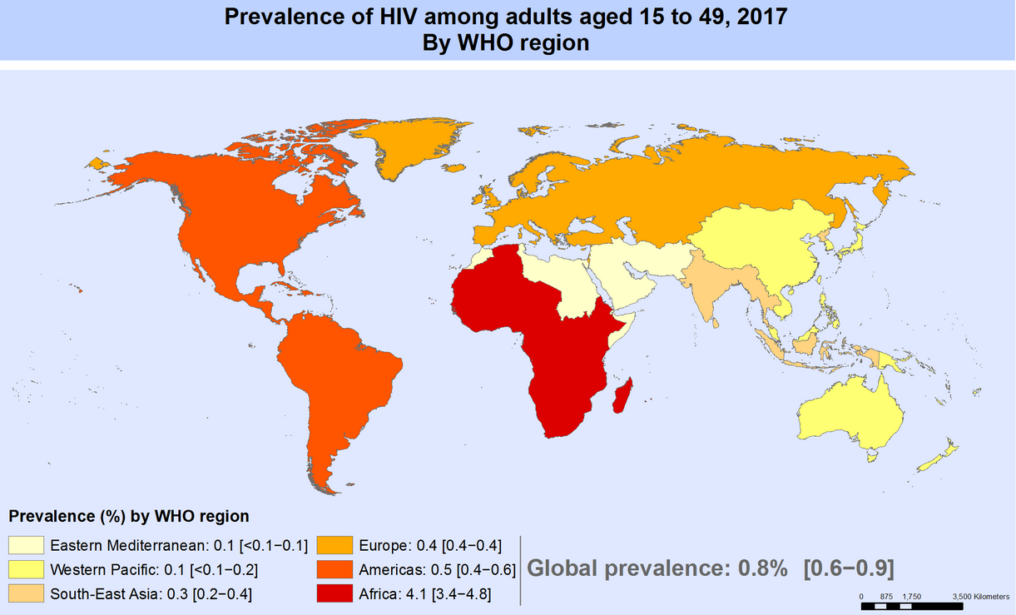
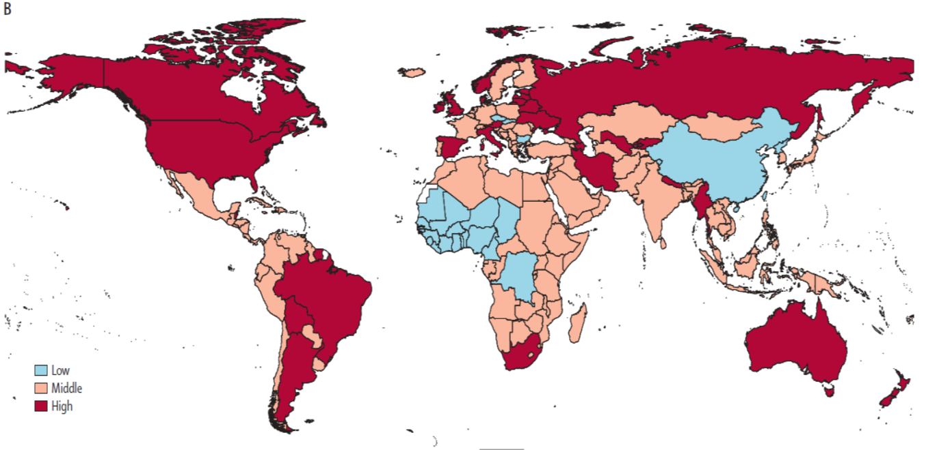
Co-Location: HIV, SUD, MHD

Slide 10
Many PLWHA drink alcohol
Meta-analysis of 21 intervention studies of >8400 PLWHA, ~69% problem drinkers, ~47% had alcohol use disorders, 51% use drugs with alcohol (Scott-Sheldon et al. AIDS Behav. 2017, 21(S2):126-143)
  Interventions reduced VL compared to controls
Meta analysis of Latin American studies, >22K PLWHA, 53 studies show 70% adherent to ART
  Comorbidities of alcohol use, substance use, depressive symptoms, high pill burden, unemployment and unstable housing (de Mattos Costa et al. JIAS, 2018, 21:e25066)

Slide 11
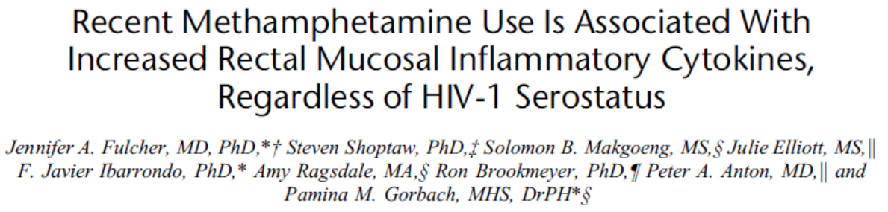
Drugs Have Direct Effects on HIV Transmission…
A biological mechanism to explain a behavioral assumption
Fulcher et al. JAIDS. 2018, 78: 119-123
Ellis et al., 2003, JID: 188:1820-26

Slide 12
Depression and Viral Load
Depression is most common comorbidity for PLWHA, with 20-33% affected
  For Latin America (de Mattos Costa et al. JIAS, 2018, 21:e25066)
  For Sub Saharan Africa (Heestermans T et al. BMC Glob Health, 2016 Dec 30,1(4):e000125)
Depression is very common comorbidity to non-injection substance misuse
Depressive symptoms interfere with HIV disease progression beyond ART, ↓ CD4+ counts, ↑ VL (Carrico AW et al. JAIDS, 2011, 56:146).

Slide 13
Meta analysis: ART Adherence, Substance Use, Depression
Langebeek N et al. BMC Medicine. 2014 Aug 21, 12:142.

Slide 14


Substance Use, Depression Adherence, Viral Load Levels
Tsuyuki K. et al. AIDS & Beh. 2019 23(3):649-660
 | Thailand | Brazil
3 month substance use ↓ UDL?
Did Adherence mediate this link?
 | Thailand | Brazil
Substance use, Dep Sxs → Detectable VL?
Did Dep Sxs mediate this link?
Brazil MSM: Etoh misuse→viremia;
# substances → viremia in het men
Thailand MSM:
Etoh misuse ↑ Dep Sxs, but not VL

Slide 15


Youth: Meta Analysis of Substance Use,
Comorbidities, HIV
 | Tobacco | Alcohol | Cannabis | Other Illicit Drugs
Addiction
Depression
Anxiety
HIV, HCV, STIs
?
Hall WD et al. Lancet Psychiatry. 2016, 3:265-279

Slide 16
80/20 Global and Domestic
HIV Prevention Priorities
For the 80:
Among those who can maintain HIV care and prevention, provide medicines and support to sustain suppression and prophylaxis
For the 20: (esp in areas co-located with mental health, substance use disorders and HIV)
Sustain access to health systems, especially for those living with poverty
Use epi/surveillance to monitor HIV hot spots and comorbidities linked to them
Field integrated, culturally competent services for key populations living with mental health, substance use disorders and HIV disease or at risk
Recognize systemic and cultural sources for stigma when working with key populations--Women (and their male sex and drug partners), Transgender, MSM, Sex Workers (♀ & ♂), Youth

Slide 17
HIV Prevention Targets for Key Populations
Women/Girls – Generalized epidemic
Alcohol – risks for HIV, STIs, unintended pregnancy, IPV, Fetal Alcohol Syndrome
Stimulants – sex – both interest and risks; weight loss (+!)
Depression – exacerbated by poverty
Transgender men and women
Substance use that facilitates transmission risks in settings of high HIV prevalence
Poverty
MSM
Chemsex - stimulants – 16%-33% attributable risk to HIV incidence in U.S.
Poly Substance Use – ED drugs, “poppers,” fentanyl?
Homophobia
Female (and Male) Sex Workers
Stimulants – many sex-functional purposes; Poly Substance Use (including opioids)
PWID
Limited access to medications for opioid use disorder; syringe and needle exchange
Lots of access to criminal justice
STIGMA

Slide 18



Thank You
Dr. Shoptaw is grateful to support from NIH:
P30MH058107 (CHIPTS) U01DA036267 (mSTUDY)
UM1AI068619, UM1AI068613, UM1AI1068617 (HPTN)
mSTUDY

