Slide 1
Attitudes, Confidence and Knowledge towards Antiretroviral Pre-Exposure Prophylaxis (PrEP) Prescription among Healthcare Providers in Thailand
Poster: WEPDC0206
Rujipas Sirijatuphat, M.D.
Department of Medicine, Faculty of Medicine Siriraj Hospital
Mahidol University, Bangkok, Thailand

Slide 2
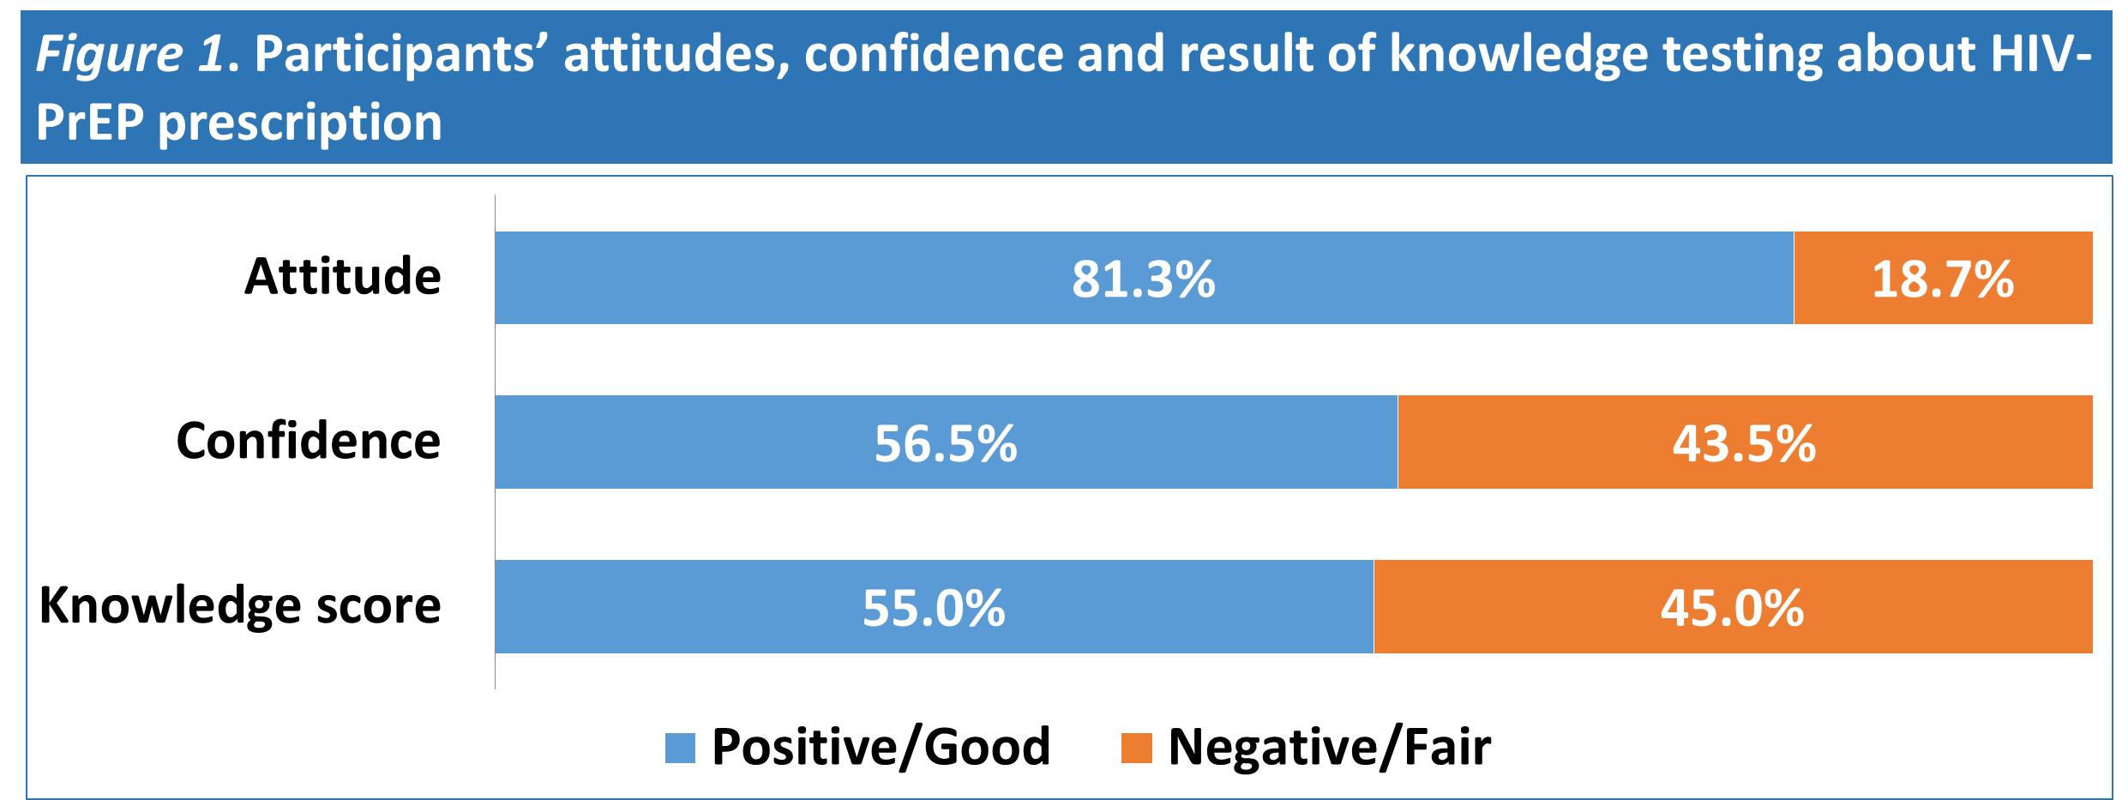
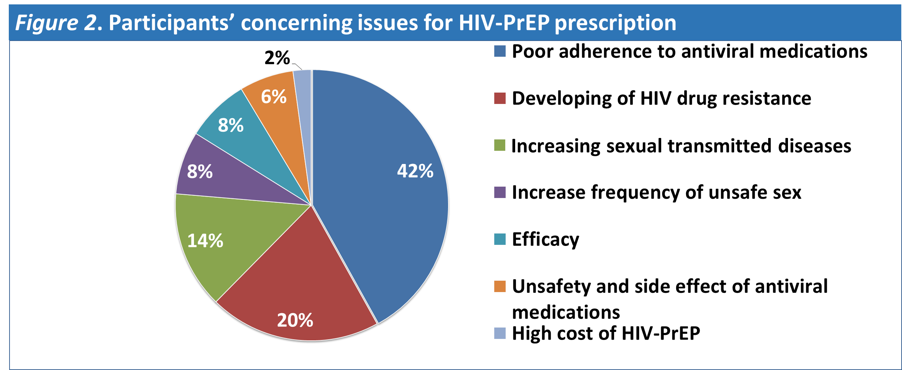
Attitudes, Confidence and Knowledge towards Antiretroviral Pre-Exposure Prophylaxis (PrEP) Prescription among Healthcare Providers in Thailand
Background:
HIV-PrEP is a novel issue for Thailand healthcare system.
The aim of the study was to determine healthcare providers’ attitudes, confidence and knowledge towards HIV-PrEP prescription in Thailand.
Methods:
A questionnaire-based descriptive study was administered to Thai healthcare providers (May 2017-September 2018).
Results
460 participants (reply rate 92% (460/500)).
336 physicians (48 ID physicians and 288 non-ID physicians; 146 IM, GP 69, 73 others).
124 non-physicians (70 nurses, 35 pharmacists and 19 others).

Slide 3
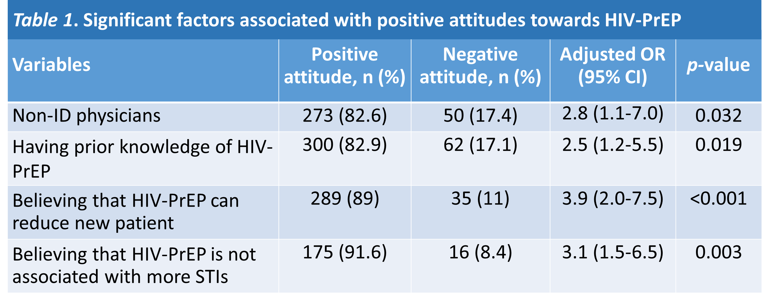
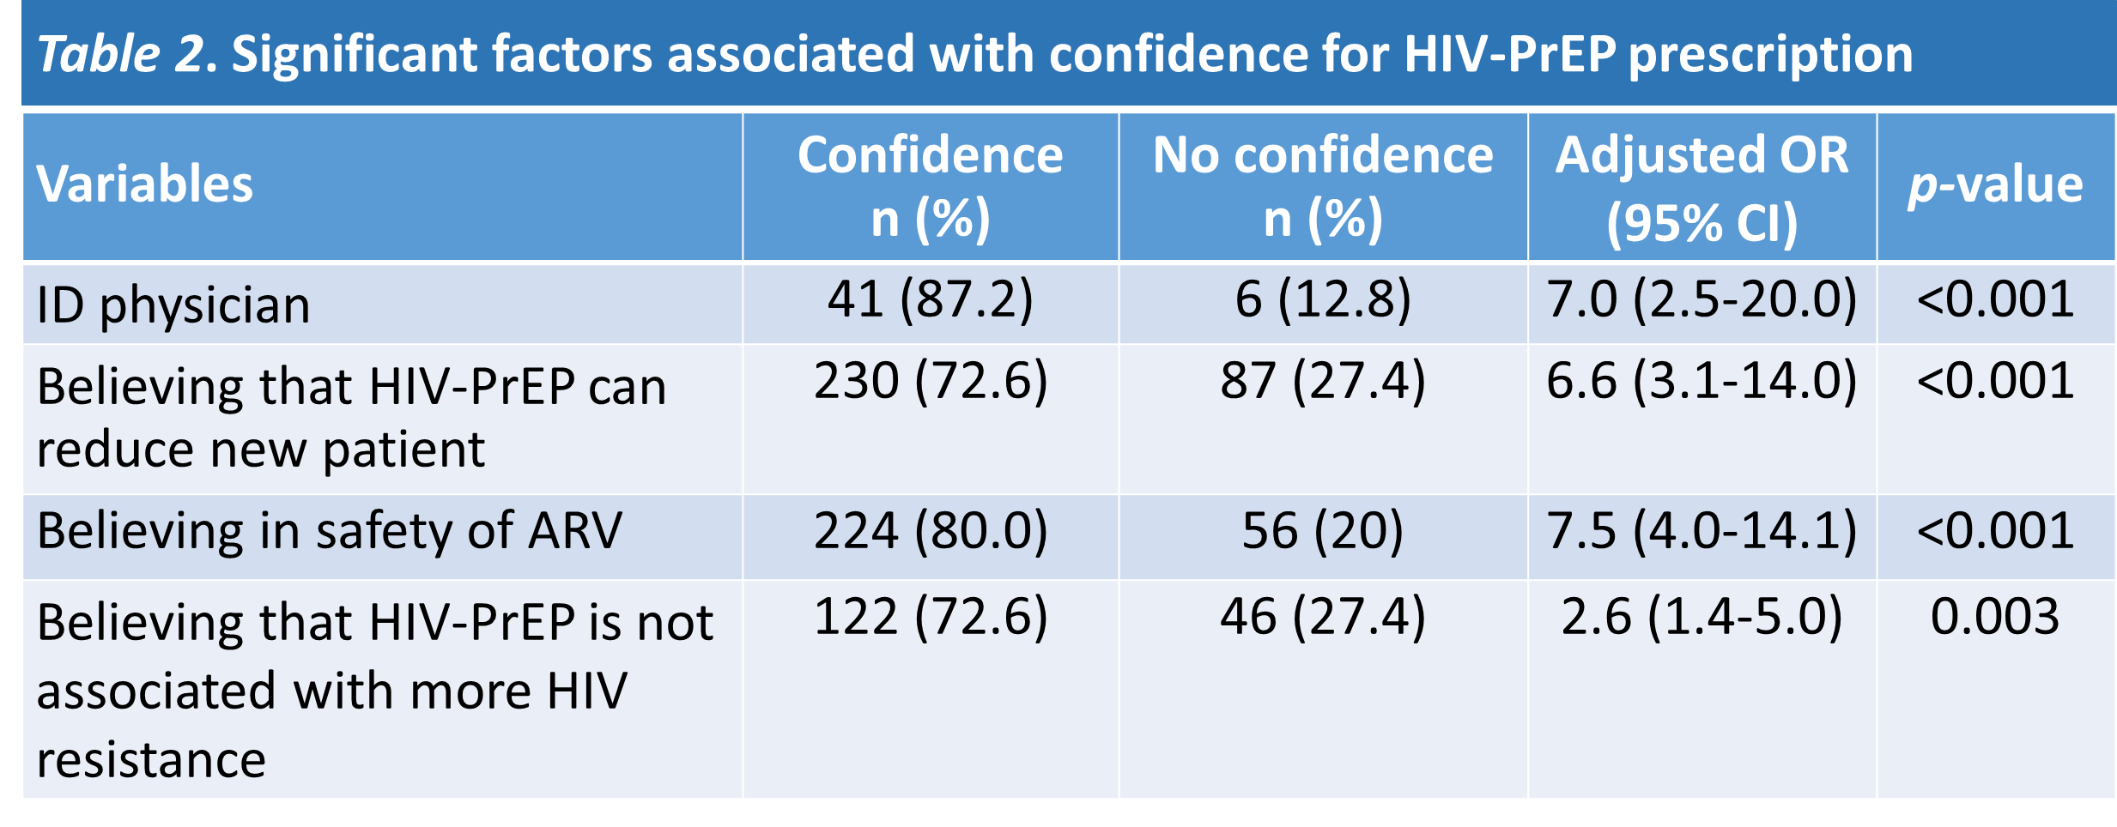
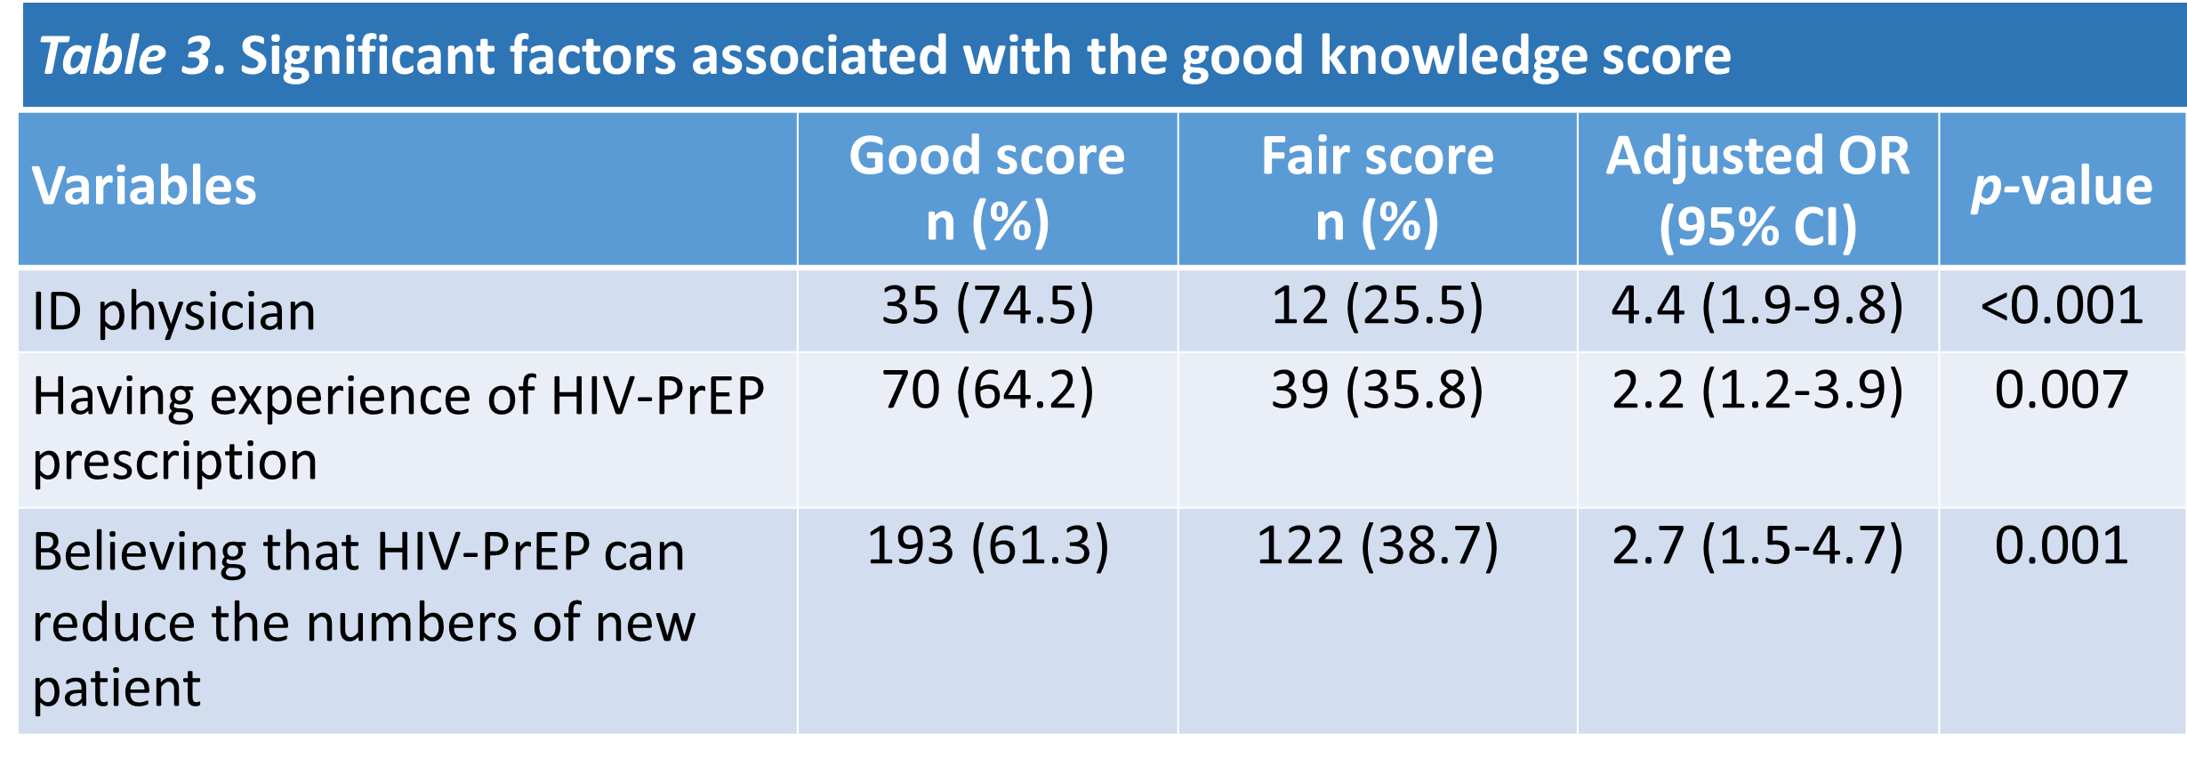
Attitudes, Confidence and Knowledge towards Antiretroviral Pre-Exposure Prophylaxis (PrEP) Prescription among Healthcare Providers in Thailand
Conclusions:
Most of Thai healthcare providers had positive attitudes towards HIV-PrEP.
Only about half of participants had confidence for HIV-PrEP prescription and good score result in HIV-PrEP knowledge testing.
The major concerning barriers were the patient’s adherence to ARV, more STIs, more HIV resistance.
Successful HIV-PrEP implementation will require continuing education and improving experience of healthcare providers to strengthen confidence and knowledge together with mitigate barrier about HIV-PrEP.

