Slide 1
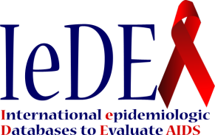



Assessment of risk factors for hepatocellular carcinoma in HIV care and treatment programs across 31 countries: a cross-sectional survey within IeDEA
C. Mugglin, P. Coffie, F. Dabis, M. Kuniholm, P. Easterbrook, J. Ross, A. Avihingsanon, C. McGowan, M. Yotebieng, K. Anastos, M. Urassa, S.Duda, M.A. Davies, M. Egger, G. Wandeler for the IeDEA collaboration

Slide 2
Disclosure
I have no actual or potential conflict of interest in relation to this presentation.

Slide 3
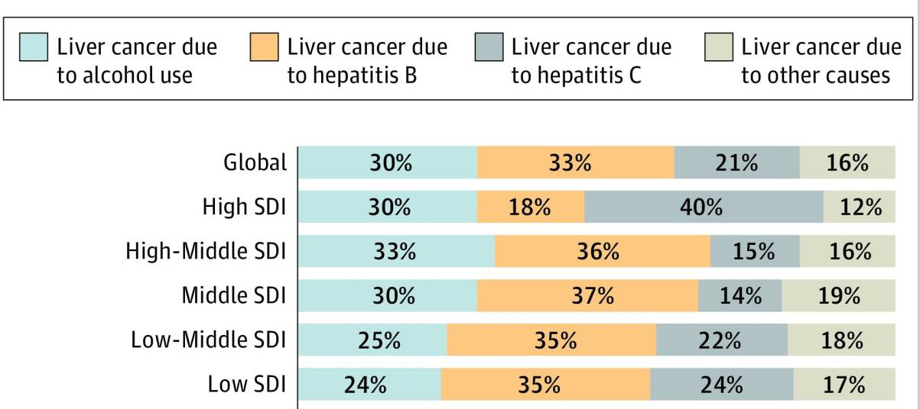
Background
Liver cancer is the fourth leading cause of cancer death worldwide ¹
¹ Global Burden of Disease Liver Cancer Collaboration et al., JAMA Oncol, 2017

Slide 4
Background
Serological testing:
Single rapid diagnostic test (RDT) or laboratory-base immunoassay
Confirmation: viral load
Assessment of the stage of liver disease
Anti – HCV Antibody
Single rapid diagnostic test (RDT) or laboratory-based immunoassay
Transaminases
Ultrasond
Elastography
Liver biopsy
HCV RNA Nucleic Acid Test
Hepatitis B surface Antigen (HBsAg)
Single rapid diagnostic test (RDT) or laboratory-based immunoassay
HBV DNA Nucleic acid test
WHO guidelines on hepatitis B and C testing. Geneva: World Health Organization; 2017

Slide 5
Methods
Cross-sectional web-based survey
  HIV care and treatment sites, participating in the International epidemiology Database to Evaluate AIDS (IeDEA)
  Data on testing and management of liver-related disease and risk factors
  Collected through RedCap surveys from December 2014 to September 2015

Slide 6
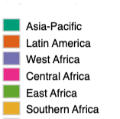
55 clinical sites across 31 countries participated

Slide 7
55 clinical sites across 31 countries participated
5 countries
10 sites
- 80 % tertiary level
- 100 % urban
3 countries
9 sites
- 67 % tertiary level
- 67 % urban
7 countries
10 sites
- 90 % tertiary level
- 100 % urban
7 countries
9 sites
- 89 % tertiary level
- 100 % urban
3 countries
4 sites
- 50 % tertiary level
- 100 % urban
6 countries
13 sites
- 67 % tertiary level
- 50 % urban

Slide 8
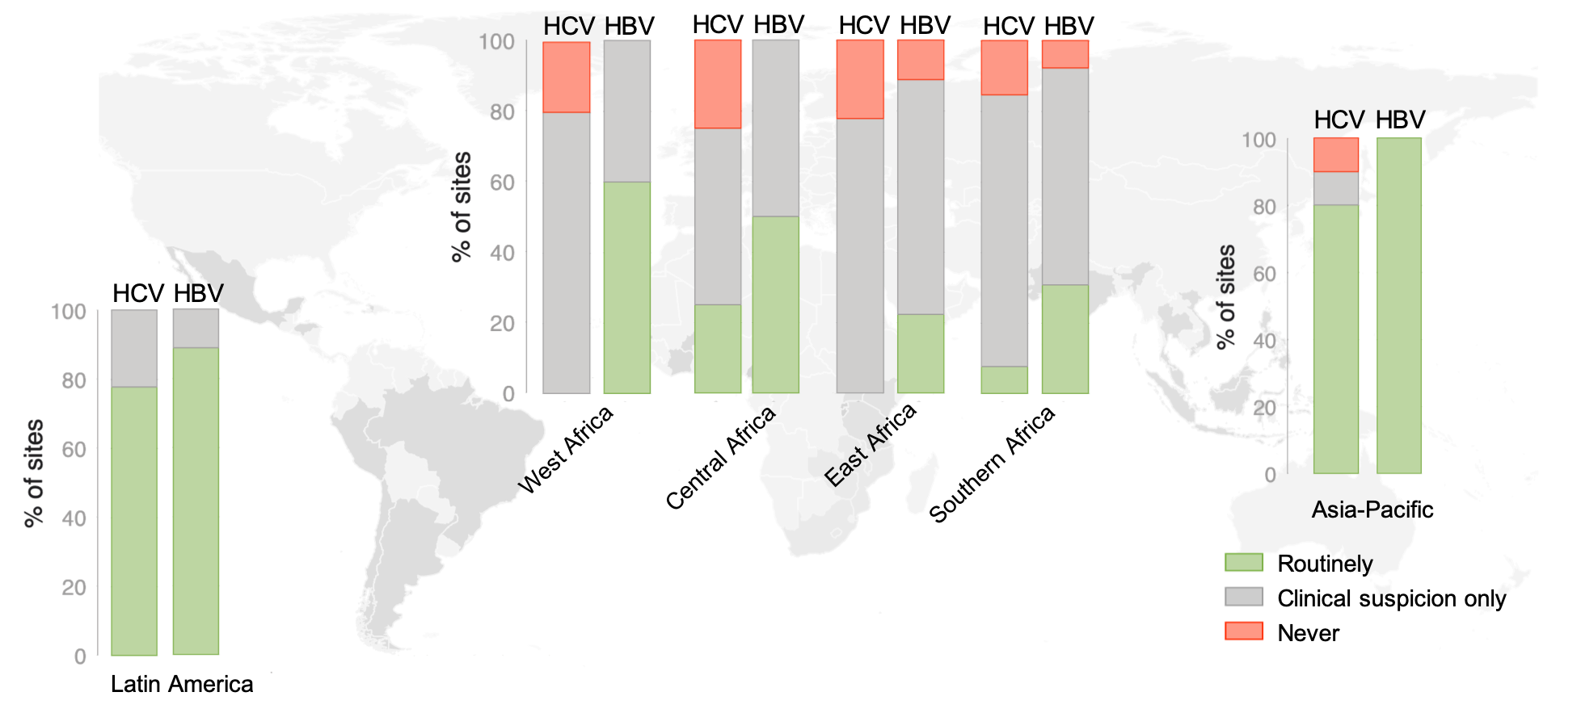
How is viral hepatitis testing integrated into HIV care?

Slide 9
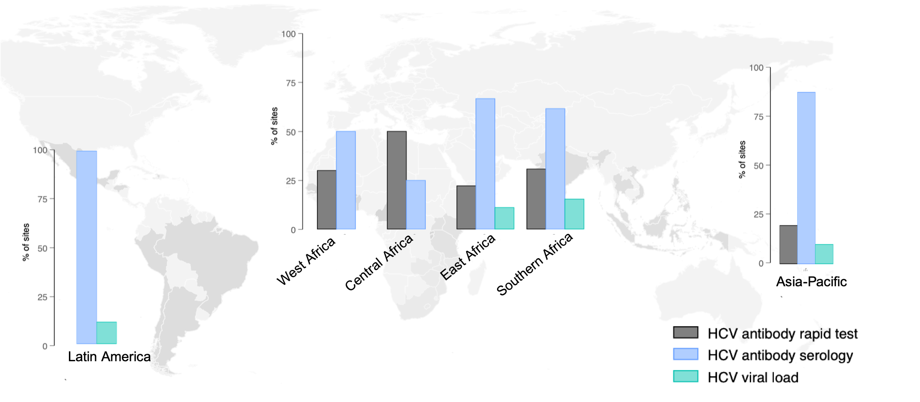
How is HCV infection tested for?

Slide 10
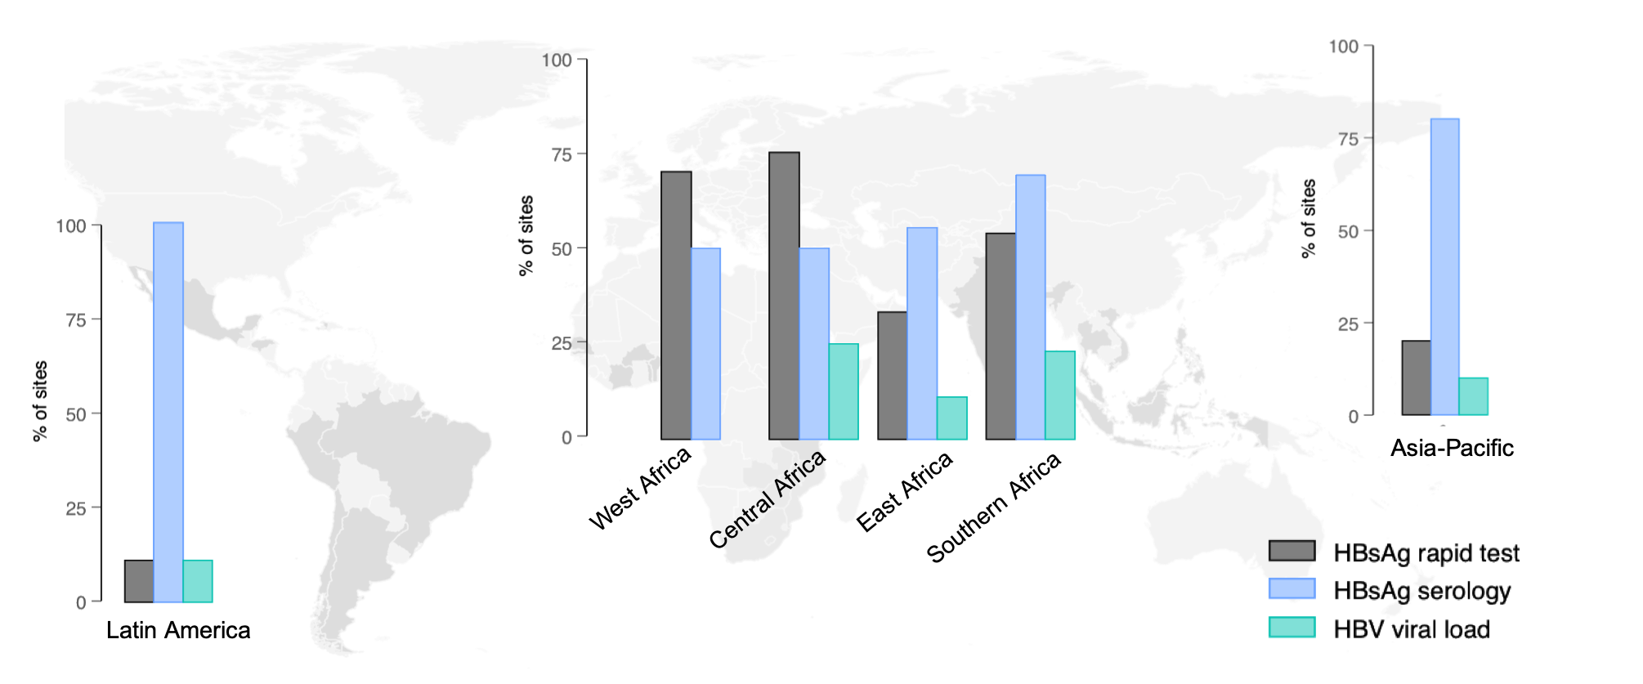
How is HBV infection tested for?

Slide 11
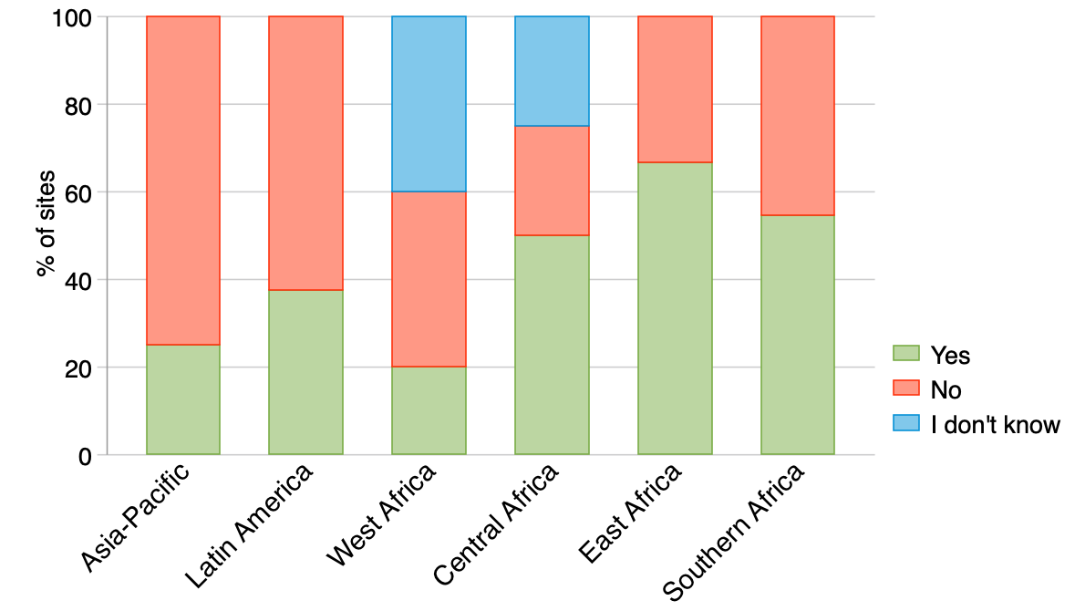
Do you see alcohol consumption as a major problem in your clinic?

Slide 12
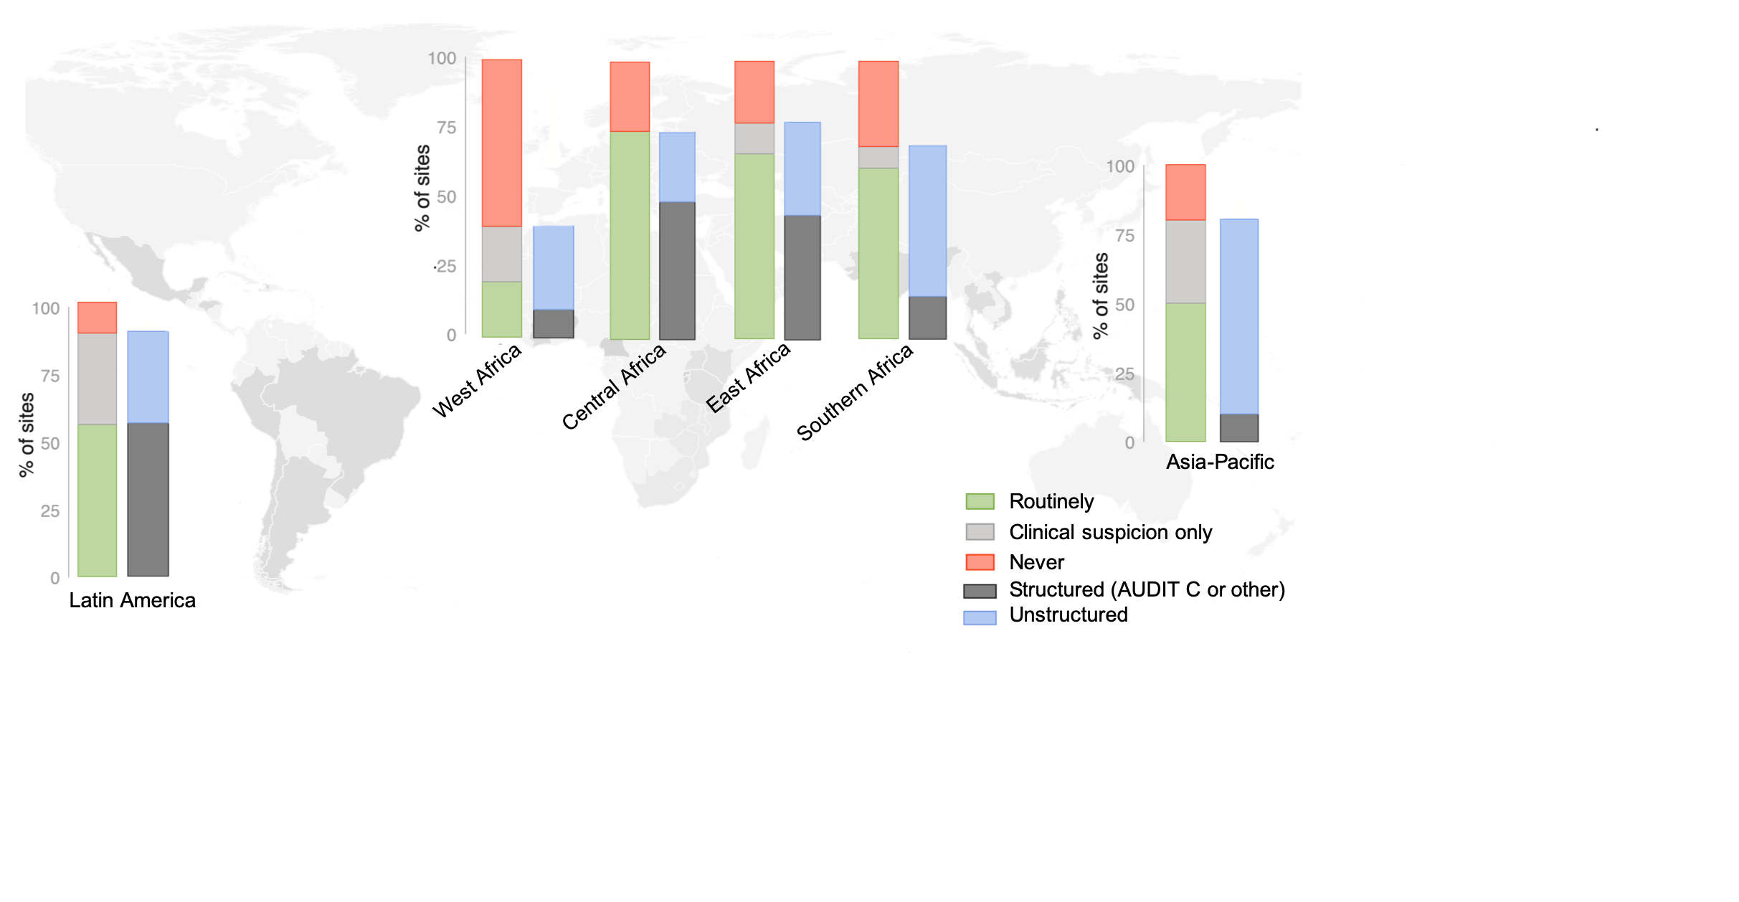
Few sites assess alcohol consumption in a structured way

Slide 13
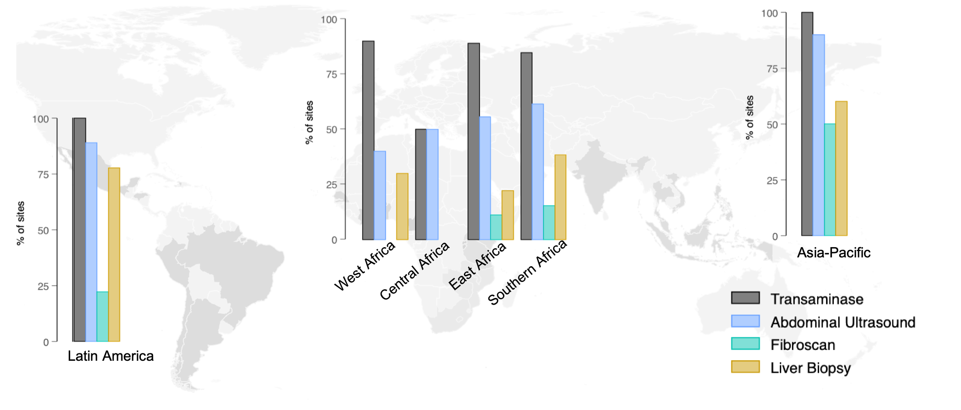
How is liver disease assessed at the facility?

Slide 14
Summary & conclusion
Limitations: mostly tertiary sites, non representative
Serological testing for HBV and HCV infections is generally available, but rarely performed routinely in Africa
Routine testing for HBV and HCV showed large variation across regions, including across high burden countries
Confirmation of HBV and HCV replication and assessment of hazardous alcohol consumption were less frequently implemented globally
Diagnostic tools for assessing the stage of liver disease are poorly available in low-income countries

Slide 15
Acknowledgements
Collaborators, participating sites and site investigators, staff and patients
The International Epidemiology Databases to Evaluate AIDS (IeDEA) is supported by the U.S. National Institutes of Health’s National Institute of Allergy and Infectious Diseases, the Eunice Kennedy Shriver National Institute of Child Health and Human Development, the National Cancer Institute, the National Institute of Mental Health, and the National Institute on Drug Abuse: Asia-Pacific, U01AI069907; CCASAnet, U01AI069923; Central Africa, U01AI096299; East Africa, U01AI069911; NA- ACCORD, U01AI069918; Southern Africa, U01AI069924; West Africa, U01AI069919. This work is solely the responsibility of the authors and does not necessarily represent the official views of any of the institutions mentioned above.

