Slide 1
The Hepatitis C treatment cascade in the era of direct-acting antivirals (DAAs), and barriers to DAA treatment initiation, among US men and women with and without HIV (Abstract #A-1077-0093-00722)
Danielle F. Haley,^{1,2} Andrew Edmonds,² Catalina Ramirez,² Audrey French,³ Phyllis Tien,⁴ Chloe Thio,⁵ Eric Seaberg,⁵ Michael Plankey,⁶ Mallory Witt,⁷ Mardge Cohen,³ Christine Oramasionwu,² Adaora A. Adimora²
¹Northeastern University, Boston, USA, ²University of North Carolina at Chapel Hill, Chapel Hill, USA, ³Stroger (Cook County) Hospital, Chicago, USA, ⁴University of California San Francisco, San Francisco, USA, ⁵Johns Hopkins University, Baltimore, USA, ⁶Georgetown University Medical Center, Washington, DC, USA, ⁷David Geffen School of Medicine at UCLA, Los Angeles, USA

Slide 2
Background and Study Aims
People with HIV are disproportionately co-infected with the Hepatitis C virus (HCV) and experience accelerated liver-related morbidity and mortality.
Direct-acting antivirals (DAAs) are well-tolerated and yield high sustained virologic response (SVR) rates, but DAA uptake is low.
This study characterizes the DAA-era HCV treatment cascade among US men and women with and without HIV and identifies HCV treatment barriers.

Slide 3
Methods
We constructed DAA-era HCV treatment cascades using data from two observational cohorts:
  Women’s Interagency HIV Study (women, six semiannual visits, 2015-2018, n=2,447)
  Multicenter AIDS Cohort Study (men, one visit, 2016-2017, n=2221).
Cascades included HCV treatment-eligible individuals, defined as HCV RNA+ or reported DAAs.
Surveys captured clinical (e.g., CD4/viral load, poor health), patient (e.g., missed visits), system (e.g., appointment access), and financial (e.g., insurance) barriers.
All participants consented to participate in the MACS or WIHS, with approval granted by relevant institutional review boards.

Slide 4
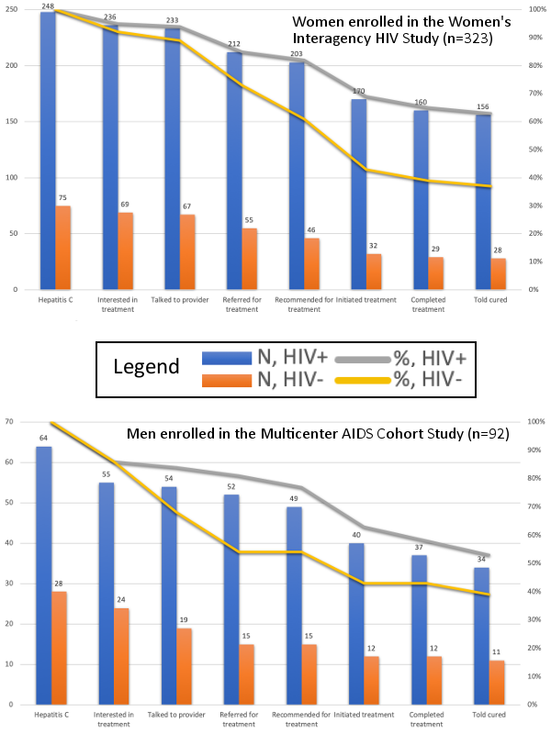
Direct-acting antiviral Hepatitis C treatment cascade among women enrolled in WIHS, by HIV status (n=323)
Notes:
Despite similar treatment interest, women with HIV were more likely to attain cascade outcomes than women without HIV (63% of women with HIV vs. 37% of women without HIV achieving SVR). Women who were not treated reported more patient-level barriers (e.g., missing appointment).
Women reporting substance use were less often treated.

Slide 5
Direct-acting antiviral Hepatitis C treatment cascade among men enrolled in MACS, by HIV status (n=92)
Notes:
Men were less likely to progress through the cascade than women (53% vs. 39%). Men who were not treated reported more clinical barriers (e.g., lab values, health).
Men reporting substance use and Black men were less often treated.

Slide 6
Conclusion
Barriers to HCV treatment initiation are common and may differ by gender and patient characteristics (e.g., HIV status).
HIV-related care may facilitate linkage to HCV care and navigation of barriers.
People without HIV, Black men, and people who use substances may need additional support.
Please visit online program (TUPDB0105) for details or email d.haley@northeastern.edu

Slide 7
Funding
Data were collected by the MACS/WIHS Combined Cohort Study (MWCCS). The contents of this publication are solely the responsibility of the authors and do not represent the official views of the National Institutes of Health (NIH). MWCCS (Principal Investigators): Atlanta CRS (Ighovwerha Ofotokun, Anandi Sheth, and Gina Wingood), U01-HL146241-01; Baltimore CRS (Todd Brown and Joseph Margolick), U01-HL146201-01; Bronx CRS (Kathryn Anastos and Anjali Sharma), U01-HL146204-01; Brooklyn CRS (Deborah Gustafson and Tracey Wilson), U01-HL146202-01; Data Analysis and Coordination Center (Gypsyamber D’Souza, Stephen Gange and Elizabeth Golub), U01- HL146193-01; Chicago-Cook County CRS (Mardge Cohen and Audrey French), U01-HL146245-01; Chicago-Northwestern CRS (Steven Wolinsky), U01-HL146240-01; Connie Wofsy Women’s HIV Study, Northern California CRS (Bradley Aouizerat and Phyllis Tien), U01-HL146242-01; Los Angeles CRS (Roger Detels and Otoniel Martinez-Maza), U01-HL146333-01; Metropolitan Washington CRS (Seble Kassaye and Daniel Merenstein), U01-HL146205-01; Miami CRS (Maria Alcaide, Margaret Fischl, and Deborah Jones), U01-HL146203-01; Pittsburgh CRS (Jeremy Martinson and Charles Rinaldo), U01- HL146208-01; UAB-MS CRS (Mirjam-Colette Kempf and Deborah Konkle-Parker), U01-HL146192-01; UNC CRS (Adaora Adimora), U01-HL146194-01. The MWCCS is funded primarily by the National Heart, Lung, and Blood Institute (NHLBI), with additional co-funding from the Eunice Kennedy Shriver National Institute Of Child Health & Human Development (NICHD), National Human Genome Research Institute (NHGRI), National Institute On Aging (NIA), National Institute Of Dental & Craniofacial Research (NIDCR), National Institute Of Allergy And Infectious Diseases (NIAID), National Institute Of Neurological Disorders And Stroke (NINDS), National Institute Of Mental Health (NIMH), National Institute On Drug Abuse (NIDA), National Institute Of Nursing Research (NINR), National Cancer Institute (NCI), National Institute on Alcohol Abuse and Alcoholism (NIAAA), National Institute on Deafness and Other Communication Disorders (NIDCD), National Institute of Diabetes and Digestive and Kidney Diseases (NIDDK). MWCCS data collection is also supported by UL1- TR000004 (UCSF CTSA), P30-AI-050409 (Atlanta CFAR), P30-AI-050410 (UNC CFAR), and P30-AI- 027767 (UAB CFAR).

