Slide 1
Polydrug use and HIV Sexual Risks in a sample of men who inject drugs on the U.S.-Mexico border.
Oscar Beltran, Ph.D.
Deputy Director, Programa Compañeros, A.C.
Share your thoughts on this presentation with #IAS2019

Slide 2
I have no conflict of interest

Slide 3
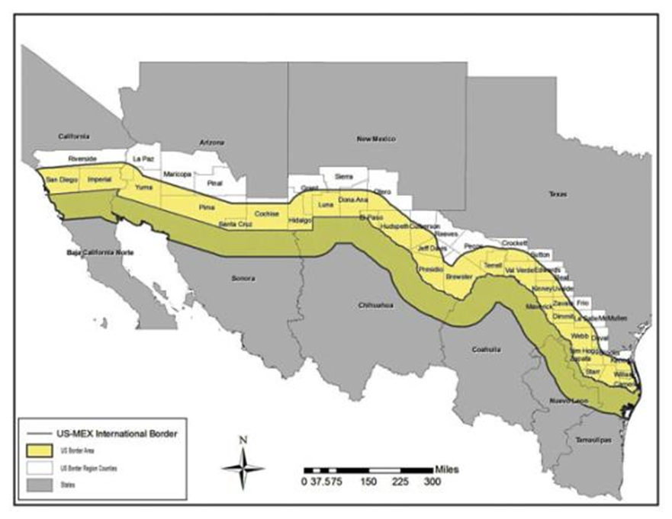
The U.S.–Mexico Border
*The length of the continental border is 3,145 kilometers. This border has been ranked as the most frequently crossed border in the world with more than one million people crossing back and forth every day.
*Four states in the U.S. (California, Arizona, New Mexico, and Texas) share borders with six states in Mexico (Baja California Norte, Sonora, Chihuahua, Coahuila, Nuevo Leon, and Tamaulipas)
*The Latino population in the U.S. border region comes primarily from Mexico or is of Mexican descent.

Slide 4
The U.S.–Mexico Border
*The health of their communities for example, relies on the preventive approaches implemented by both sides of the border.
*The use and abuse of heroin has been part of the El Paso and Ciudad Juarez region’s history for several decades.

Slide 5
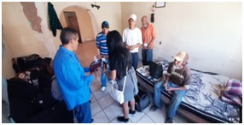
Harm reduction strategies in the El Paso/Juarez region
*Programa Compañeros, a non-profit organization in Juarez focused on the prevention of HIV since 1986. It is one of the pioneers of harm reduction strategies in Mexico.
*Alliance of Border Collaboratives in El Paso implements harm reduction strategies.

Slide 6
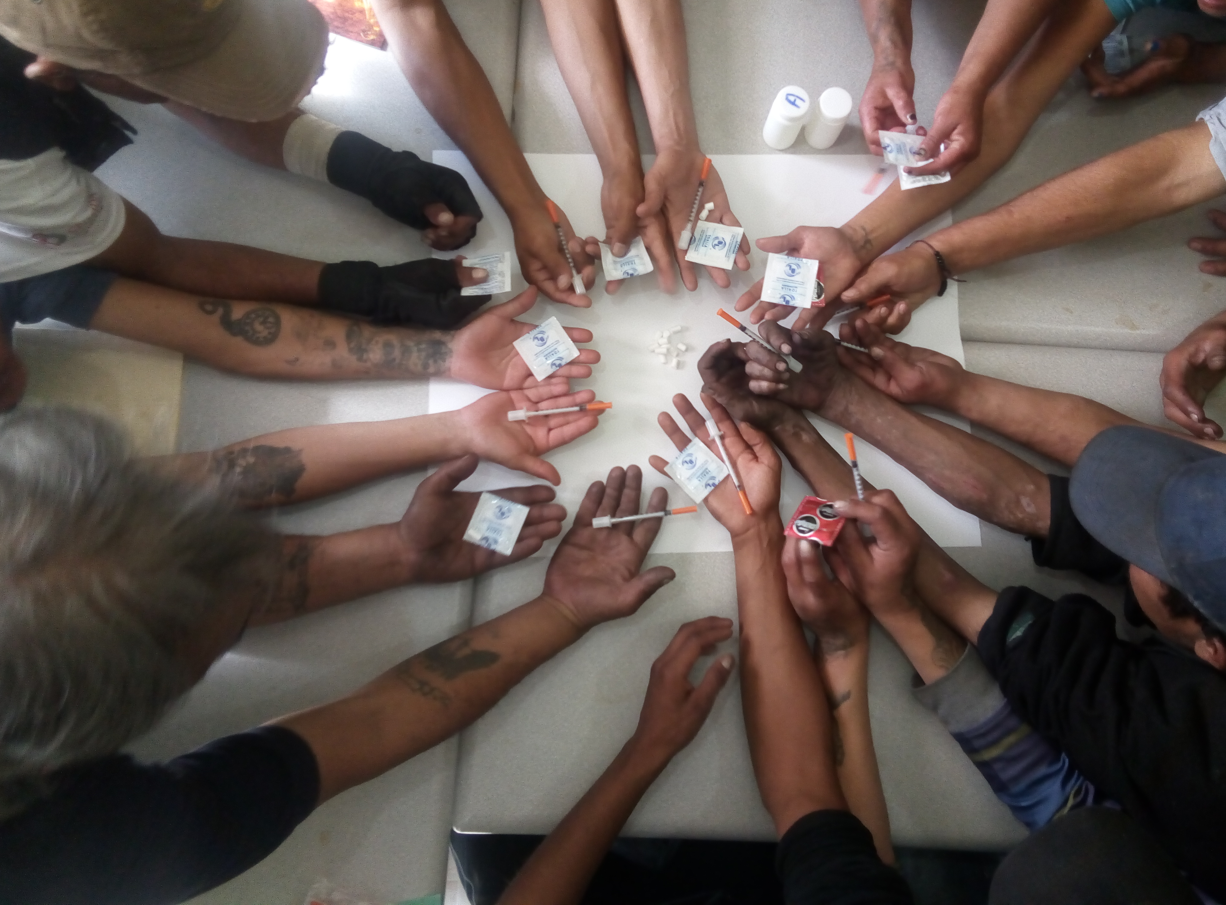
Harm reduction strategies in the El Paso/Juarez region
*Polydrug use among Latino men who inject drugs on the U.S.-Mexico border has been increasing over the last years yielding to negative health outcomes.
*We explored HIV risk behaviors and the patterns of drug use in a sample of Latino men who inject drugs that reported MSM practices vs Latino men who inject drugs that did not report MSM practices.

Slide 7
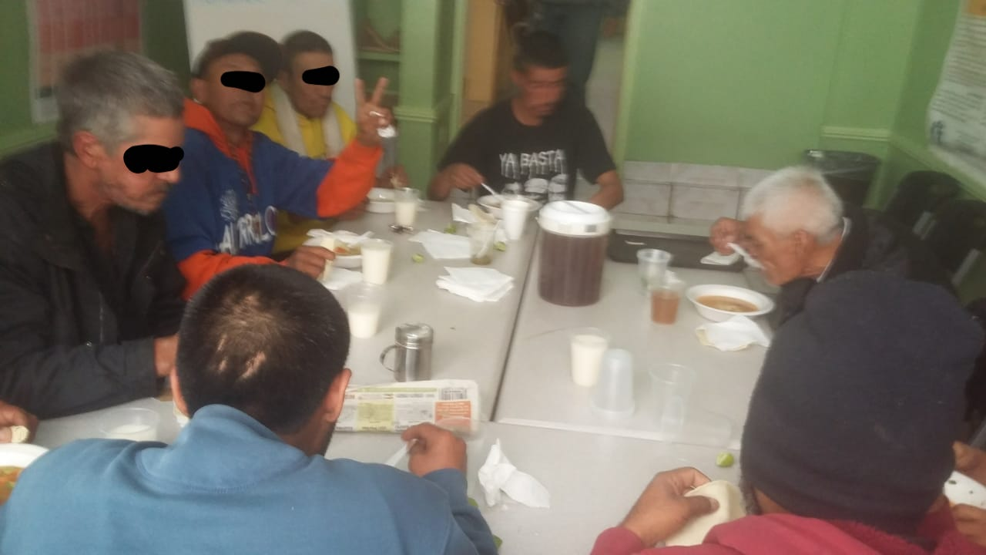
Methods
The sample for this study included 160 men who inject drugs recruited through respondent driven sampling methodology. Data analysis was conducted using SPSS v.25. Independent sample t-test was used to identify mean differences and chi-squared to explore proportional differences on binomial substance use, STIs, and sexual risk behaviors.

Slide 8
Results
SELF-REPORTED HIV STATUS

Slide 9
Results
No differences were found on HIV diagnosis from self-reported measures to rapid test.
For hepatitis C, there were significant differences from self-reported diagnosis vs. rapid test: 9 out of every 10 participants were living with HCV.
No difference were found among MSM vs. non-MSM for diagnosis of HIV or HCV.
9 out of 10 people who inject drugs live with HCV

Slide 10
Results
Variables | Mean (SD) | MSM vs. Non-MSM [OR, (95%CI)]
Age | 39.19 (0.82)
**Employment |  | 1.96 (1.23, 3.12)
*Inhalants |  | 1.96 (1.06, 2.71)
**Methamphetamines |  | 2.42, (1.38, 4.23)
**History of an STI |  | 1.76, (1.15, 2.68)
***New Sex partners on the last 30 days | MSM: 1.88 Non-MSM: 0.54
*Sex under the influence of a drug last 30 days | MSM: 14.38 Non-MSM: 6.83

Slide 11
Results
Variables | Mean (SD) | MSM vs. Non-MSM [OR, (95%CI)]
***Engage in anal sex las 30 days | MSM: 4.47 Non-MSM: 1.21
***Exchange of sex for money in the past 30 days | MSM: 3.32 Non-MSM: 0.92
**Condomless sex in the last 30 days | MSM: 4.53 Non-MSM: 8.99
**Experienced sexual abuse before age of 18 |  | 1.81 (1.15, 3.18)
**Experienced rape by multiple persons |  | 7.04, (1.35, 37.03)

Slide 12
Conclusions:
Latino MSM in the El Paso/Juarez region have higher consumption of inhalants and methamphetamines.
Both groups have high rates of HCV.
Possible increase of condom use among MSM could be a result of engaging in more transactional sex and having experience more STIs in the past.
More testing must be conducted among this group.
Limitation: Small N.
Treatment as prevention.
Although MSM who inject drugs reported lower cases of condomless sex compared to their non-MSM counterpart, their sexual risk behaviors are higher, including sex under the influence of drugs which can decrease their willingness of use condom and be more susceptible to sexual violence. Risk reduction strategies including Pre-Exposure Prophylaxis (PrEP) could be a method to effectively reduce their HIV risks.

Slide 13
ACKNOWLEDGEMENT Project Encuentro is funded by the National Institutes of Health, through the National Institute on Minority Health and Health Disparities (NIMHD). Grant # MDO10657
Co-authors:
Rebeca Ramos², Gilberto Perez², Julia Lechuga³, & Sara Beachy⁴
2 Alliance of Border Collaboratives (El Paso, TX, USA)
3 College of Health Sciences, University of Texas at El Paso (El Paso, TX, USA)
4 LeHigh University (Bethlehem, PA, USA)

