Slide 2
ENGAGING YOUNG FEMALE SEX WORKERS IN HIV TESTING WITH MOBILE OUTREACH CLINICS
Tanaka Chirombo
@TanakaChirombo1
Share your thoughts on this presentation with #IAS2019

Slide 3
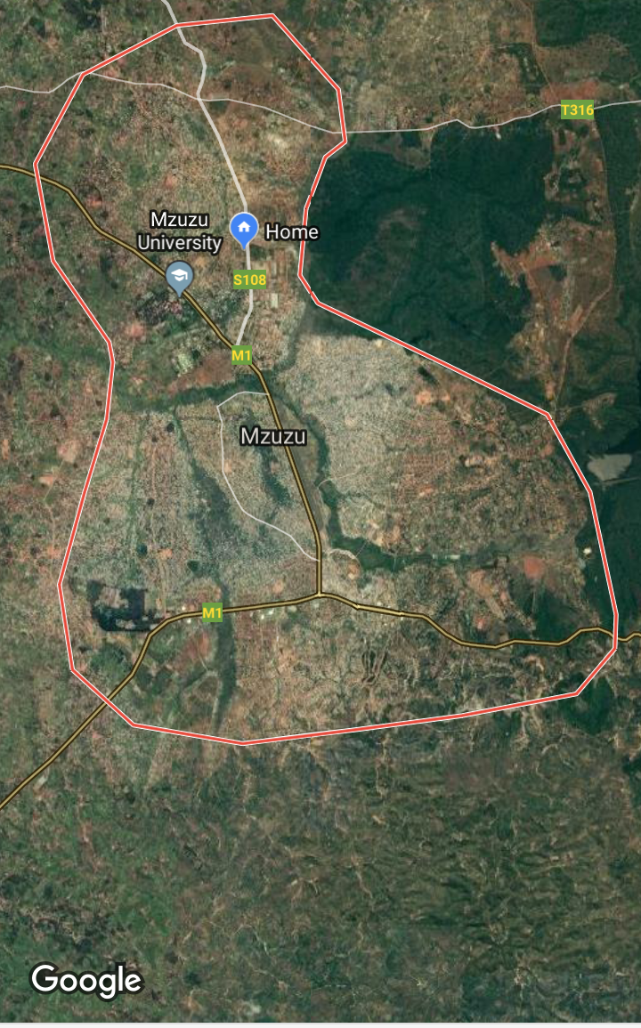
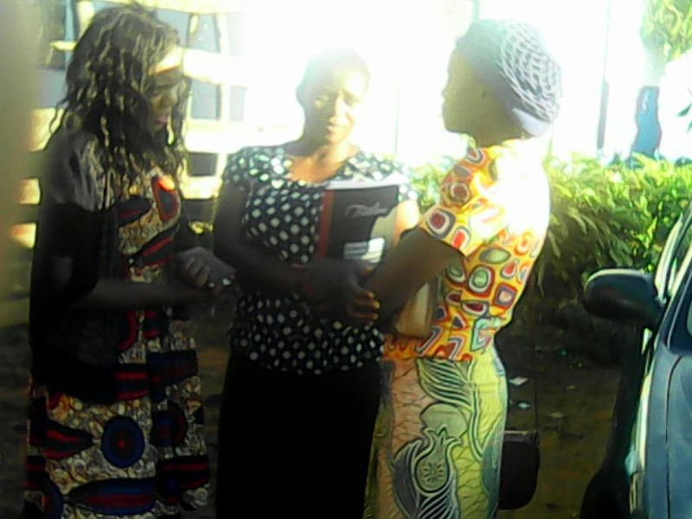
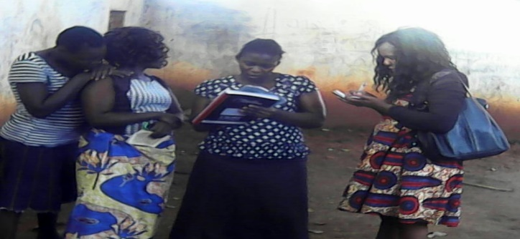
BACKGROUND
HIV
1400 sex workers are living with HIV
20% on ART
Population
3000 sex workers
1700 are aged (16-25)
Problems
Stigma and discrimination
Threat of violence
Marginalization
Criminalization of sex work
Results
HIV infections
Low uptake of HIV testing
Poor adherence

Slide 4
TIMELINE
International AIDS Society
$10,000
9 months
Family Planning Association of Malawi
Youth and Society
Notes:
Youth and Society came up with the initiative based on the status of FSW’s in Mzuzu and then partner with Family planning Association of Malawi as one of the major stakeholder(an implementer) on an initiative to tackle HIV testing problem with funding from the International AIDS Society worth $10,000

Slide 5
PROJECT AIMS
Increasing access to HIV services including Treatment among Young Female Sex workers.
Find out on how young people wanted to receive their treatment.

Slide 6
ACTIVITIES IMPLEMENTED MOBILE CLINICS
MOONLIGHT TESTING AND DAY TIME TESTING
This involved taking HIV services to the doorstep of FSW at hot spots.
FPAM provided on site key HIV services including HIV screening, ART initiation, STI screening and Condom distribution.
8 mobile clinics were ran.
82 sex workers were screened for HIV
11 were diagnosed, initiated on ART and entered follow up system.

Slide 7
ACTIVITIES IMPLEMENTED MOBILE CLINICS
MOONLIGHT TESTING AND DAY TIME TESTING
152 YFSWs were screened for STIs among which 69 were diagnosed with different STIs and treated
3,871 condoms were distributed to YFSWs
17 ART treatment defaulters were retained into care.

Slide 8
OTHER MILESTONES ACHIEVED
CAPACITY BUILDING FOR YFSWs PEER EDUCATOR
30 YFSWs peer educators were trained in a 3 comprehensive workshop with focus on health rights, HIV testing and treatment, adherence and retention in care and prevention
Notes:
This 3-day workshop targeted 30 sex worker Peer Educators aimed at providing them with key skills in health rights and redress mechanisms, advocacy and HIV information such as HIV testing, Treatment, Adherence and Retention in Care and Prevention. Participants were drawn from various ‘Hot-spots’. During project implementation, Peer Educators became instrumental in mobilizing fellow sex workers for HIV services.

Slide 9
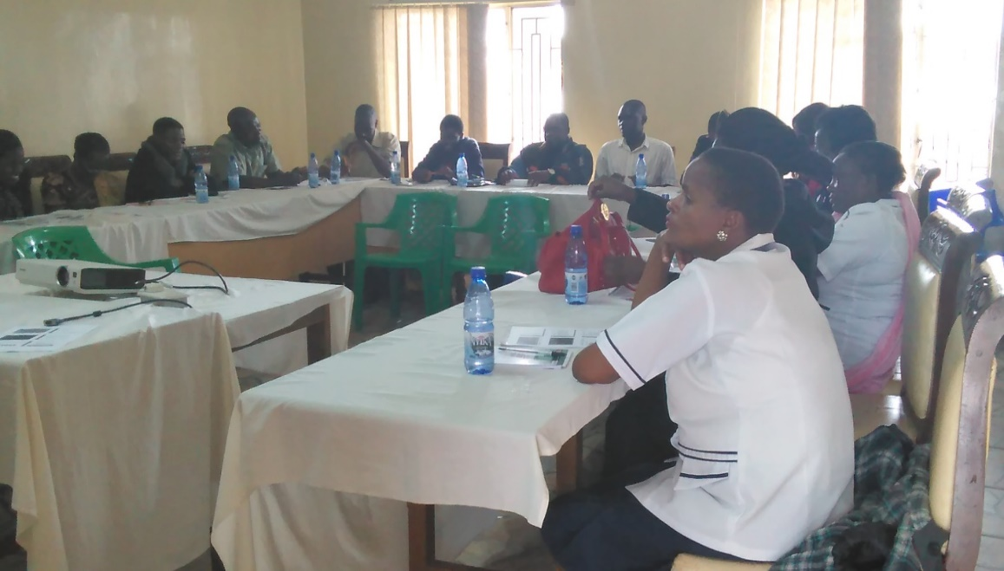
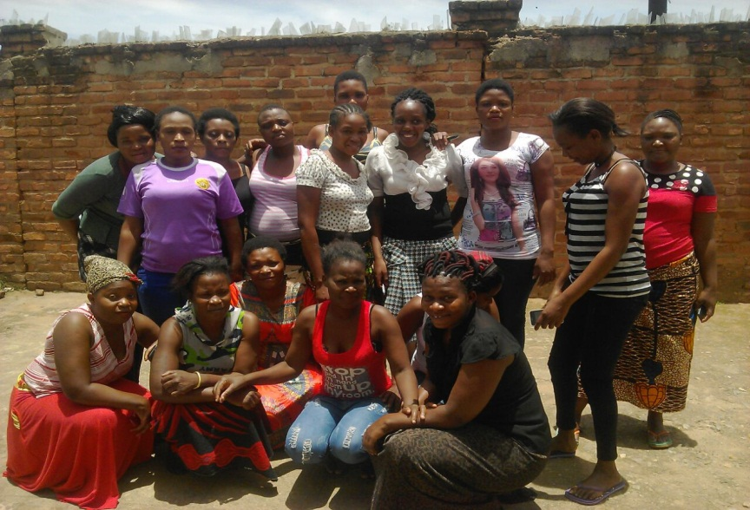
OTHER MILESTONES ACHIEVED
TRAINING FOR HEALTH SERVICE PROVIDERS
FOCUSED GROUP DISCUSSION
FOLLOW UP SESSION

Slide 10
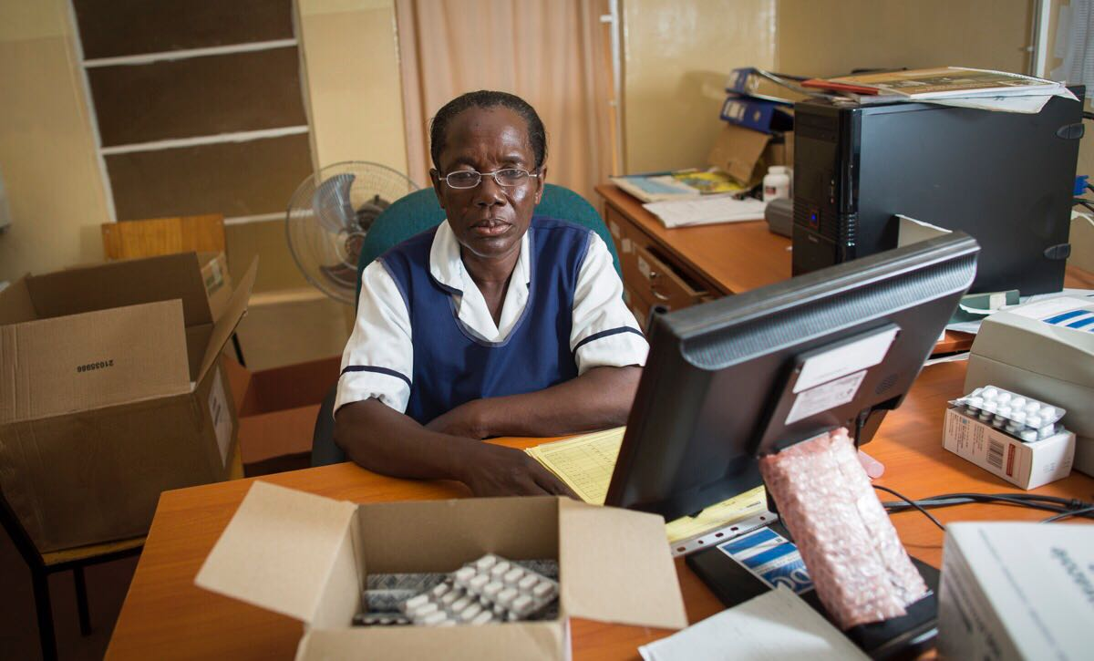
CHALLENGES
Issue of drugs and alcohol abuse at times compromised the quality of data collected.
Inconsistency of patronage due to the mobility of YFSWs

Slide 11
REFERENCES
Young Lives, New Solutions – IAS Policy Brief Series, International AIDS Society
Family Planning Association of Malawi(FPAM) – Annual Report 2014
Malawi Demographic Health survey 2010

Slide 12
THANK YOU!!!!!!

