Slide 2
PrEP uptake and early adherence among at HIV risk transgender women from Rio de Janeiro, Brazil: Results from the PrEParadas study
EM Jalil, T Torres, R Moreira, C Castro, L Monteiro, L Monteiro, ACG Ferreira, D Santos, I Leite, M Pedrosa, V Cattani, L Kamel, CM Jalil, E Carvalheira, PM Luz, M Gomes, B Hoagland, R Estrela, PL Anderson, AY Liu, S Wagner, VG Veloso, B Grinsztejn, PrEParadas Study Team
Share your thoughts on this presentation with #IAS2019

Slide 3
DISCLAIMER
No conflicts of interest

Slide 4
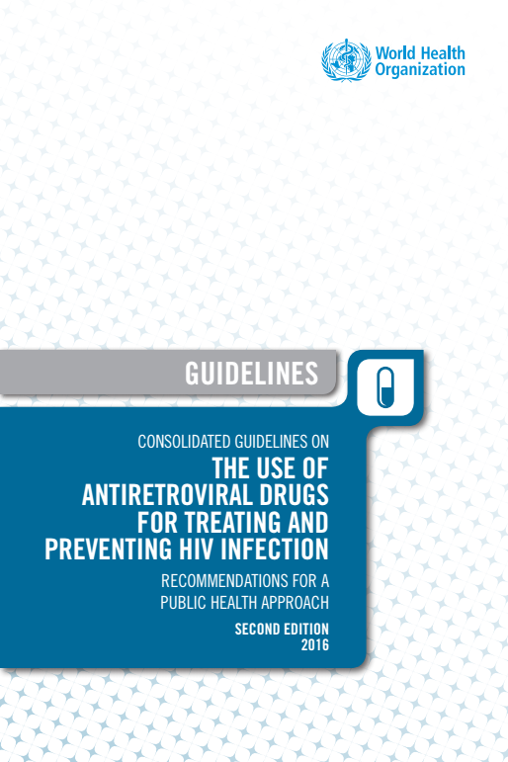
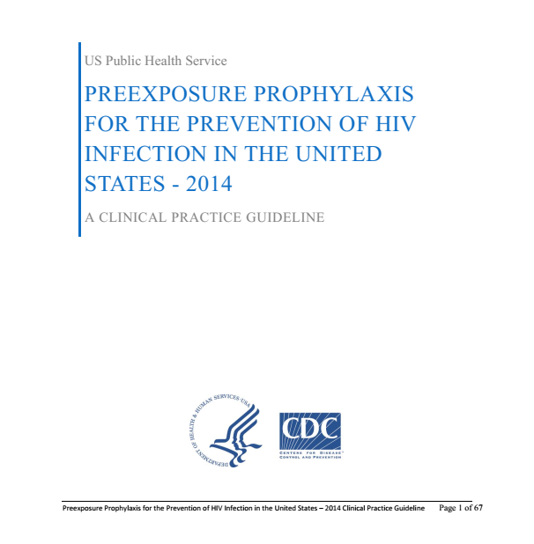
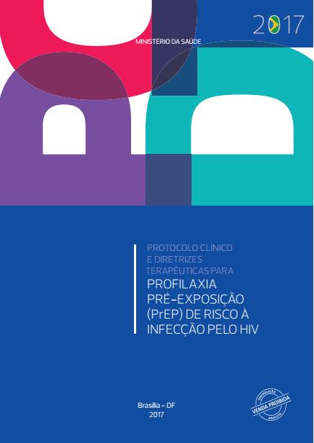
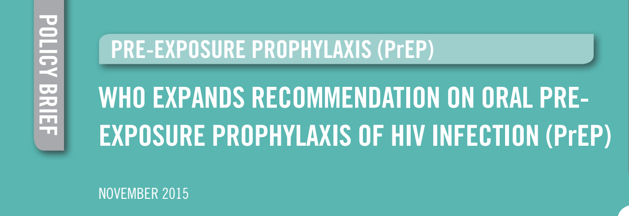
Pre-exposure prophylaxis

Slide 5
Transgender women and HIV
%

Slide 6
Transgender women and PrEP
Adherence as a major issue for PrEP
iPrex:
PrEP: safe and efficacious strategy if taken as prescribed.¹
Transwomen were less likely to use PrEP effectively as indicated.²
PrEP uptake and adherence:
Gender-affirming setting
Concerns with DDI between hormones and PrEP
Lack of information about transwomen needs and challenges of PrEP implementation

Slide 7
Aim
To evaluate PrEP use among transgender women.
We aimed to describe PrEP uptake and early adherence in PrEParadas study.

Slide 8
Methods
Brazilian trans-specific PrEP demonstration study
STD & AIDS Clinical Research Laboratory, INI - FIOCRUZ
Enrollment: August 2017 – December 2018
Inclusion criteria:
Male sex assigned at birth and self-identification as transwomen
Aged 18+ years
HIV-negative status at enrollment
High-risk sexual behavior
Exclusion criteria: HIV positive result, HIV acute infection, urine protein, creatinine clearence <60, using ARV, using interferon, severe medical comorbidity, unable to return within 45 days
Unprotected anal and/or neovaginal sex in the last 6 months
Report of STI in the last 12 months
Transactional sex
HIV-positive sexual partner

Slide 9
Methods
Assessment
Self-referral, by peers, or community educators team
During HIV testing or PEP use
HIV testing; AVI assessment if indicated
Potentially eligible
Met the inclusion criteria
HIV-negative
Screening
Complete behavior & clinical assessment
STI & HIV testing; HIV RNA pool
Enrollment
Within 45 days after screening
Behavior + clinical assessment
STI & HIV testing; HIV RNA pool
Follow-up visits
Week 4, and quarterly (12, 24, 36, and 48 weeks)
Behavior + clinical assessment
STI & HIV testing; HIV RNA pool; DBS measurements

Slide 10
Methods
PrEP uptake: proportion of enrolled participants/potentially eligible
PrEP engagement: Ordinal five-level variable combining attendance at the study visit and drug concentrations¹
1) Missing visit
2) Visit attendance but medication BLQ
3) <2 doses per week
4) 2-3 doses per weeks
5) 4-7 doses per week
Poor engagement in PrEP: <2 doses per week or worst
Associated factors - logistic regression models
Variables statistically significant at p<0.1 kept in the adjusted model

Slide 11
Results
Assessed
N=318
Ineligible (N=43)
15 without risk behavior criteria
1 less than 18 years
1 severe medical comorbidity
26 HIV-infected
Potentially eligible
N=275 (86.5%)
Declined screening (N=52)
15 no self-perception of HIV risk
12 not interested
12 preferred injectable PrEP
7 no time
4 moving to other city
2 concerns about side effects
Did not return (N=58)
Screen visit
N=165 (51.9%)
Ineligible (N=4)
4 without risk behavior criteria
Did not return (N=29)
Enrollment visit
N=132 (41.5%)
Declined enrollment (N=2)
1 no self-perception of HIV risk
1 no reason
Enrolled
N=130 (40.9%)

Slide 12
Results
Assessed
N=318
PrEP uptake
Potentially eligible
N=275 (86.5%)
# Enrolled*100
Screen visit
N=165 (51.9%)
Potentially eligible
Enrollment visit
N=132 (41.5%)
48.0%
Eligibility:
Condomless anal sex in the last 6 months (63.1%)
STI diagnosis in the last 12 months (24.6%)
HIV-positive partner in the last 30 days (3.9%)
Transactional sex in the last 6 months (40.0%)
Enrolled
N=130 (40.9%)

Slide 13
Baseline characteristics of transwomen enrolled in PrEParadas study, Rio de Janeiro, Brazil, 2017-2018
Characteristics | Transwomen enrolled N=130 (%)** | Transwomen with poor PrEP engagement
Age, years
18-24 | 35 ( 26.9) | 42.9
25-34 | 50 (48.5) | 30.0
≥ 35 | 45 (34.6) | 22.2
Schooling, years
0-7 years | 27 (20.8) | 44.4
≥8 years | 103 (79.2) | 27.2
Self-declared color/race
White | 36 (28.8) | 25.0
Black | 35 (28.0) | 42.9
Mixed | 54 (43.2) | 25.9
Housing situation
Stable | 92 (77.8) | 23.9
Unstable | 38 (29.2) | 47.4
Current use of hormones
Yes | 55 (44.0) | 29.1
No | 70 (56.0) | 34.3
Received supportive SMS
Yes | 48 (36.9) | 22.9
No | 82 (63.1) | 35.4

Slide 14
Baseline characteristics of transwomen enrolled in PrEParadas study, Rio de Janeiro, Brazil, 2017-2018
Characteristics | Transwomen enrolled N=130 (%)** | Transwomen with poor PrEP engagement
Main partner
Yes | 74 (58.5) | 32.4
No | 52 (41.3) | 28.8
Transactional sex
Yes | 50 (60.3) | 36.0
No | 76 (39.7) | 27.6
Had condomless anal sex
Yes | 83 (66.4) | 30.1
No | 42 (33.6) | 31.0
Had a HIV-infected sexual partner | 5 (4.0) | 0.0
Binge drinking
Yes | 82 (65.1) | 30.5
No | 44 (34.9) | 31.8
Use of stimulants
Yes | 21 (16.7) | 57.1
No | 105 (83.3) | 25.7

Slide 15
Baseline characteristics of transwomen enrolled in PrEParadas study, Rio de Janeiro, Brazil, 2017-2018
Characteristics | Transwomen enrolled N=130 (%)** | Transwomen with poor PrEP engagement
Positive depression screening (PH9)
Yes | 98 (77.8) | 29.6
No | 28 (22.2) | 35.7
Violence (last 3 months)
Yes | 37 (29.4) | 21.6
No | 89 (70.6) | 34.8
Syphilis: 22.1 (14.6-29.2)
Chlamydia: 8.3 (3-4-13.2)
Gonorrheae: 6.6 (2.2-11)
STI diagnosis at enrollment
Yes | 38 (29.2) | 31.6
No | 92 (70.8) | 30.4
PrEP stigma
Yes | 31 (24.6) | 45.2
No | 95 (75.4) | 27.4
HIV risk self-perception
>=50% | 10 (7.9) | 20.0
<50% | 116 (92.1) | 32.8

Slide 16
Results
Assessed
N=318
Potentially eligible
N=275 (86.5%)
Screen visit
N=165 (51.9%)
Enrollment visit
N=132 (41.5%)
Enrolled
N=130 (40.9%)
Did not return (N=12)
Weeks 4 and 12 visit
N= 118 (37.1%)

Slide 17
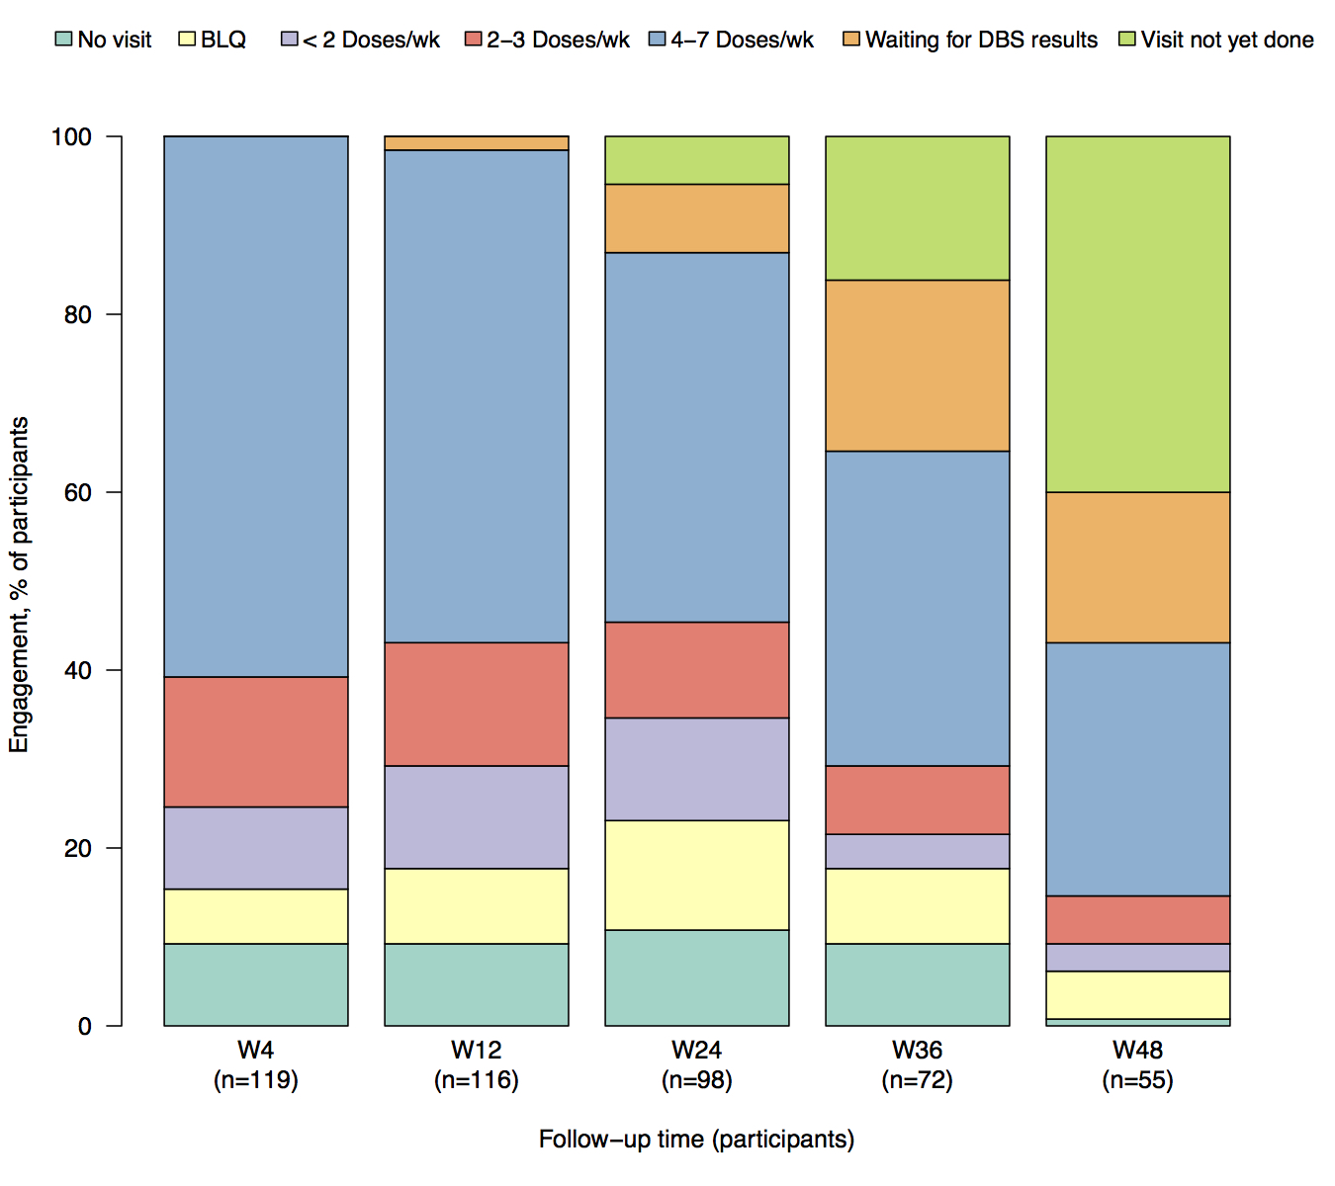
PrEP engagement according to study visit
2 (1.5%)
7 (5.4%)
10 (7.7%)
21 (16.2%)
52 (40.0%)
72 (55.4%)
25 (19.2%)
54 (41.5%)
79 (60.8%)
22 (16.9%)
46 (35.4%)
14 (10.7%)
18 (13.9%)
19 (14.6%)
15 (11.5%)
37 (28.5%)
15 (11.5%)
10 (7.7%)
Missing visit
12 (9.2%)
5 (3.9%)
BLQ
16 (12.3%)
8 (6.2%)
11 (8.5%)
11 (8.5%)
7 (5.4%)
<2 doses/week
4 (3.1%)
2-3 doses/week
12 (9.2%)
12 (9.2%)
14 (10.8%)
12 (9.2%)
7 (5.4%)
4-7 doses/week
1 (0.8%)
Waiting for DBS results
W4
N=130
W12
N=130
W24
N=130
W36
N=130
W48
N=130
Visits will be performed

Slide 18
PrEP engagement according to study visit
2 (1.5%)
Poor PrEP engagement (W4)
24.6%
72 (55.4%)
79 (60.8%)
Poor PrEP engagement (W12)
29.2%
18 (13.9%)
19 (14.6%)
15 (11.5%)
12 (9.2%)
Missing visit
8 (6.2%)
11 (8.5%)
BLQ
<2 doses/week
12 (9.2%)
12 (9.2%)
2-3 doses/week
4-7 doses/week
W4
N=130
W12
N=130
Waiting for DBS results
Visits will be performed

Slide 19
Factors associated with poor PrEP engagement amont transwomen enrolled in PrEParadas study in week 12 visit, Rio de Janeiro, Brazil, 2017-2018
Characteristics | OR (95%CI) | p-value | aOR (95%CI) | p-value
Age, years (ref. ≥ 35)
18-24 | 2.62 (0.99-6.93)
25-34 | 1.50 (0.59-3.79) | 0.14
Low schooling (ref. ≥8 years) | 2.14 (0.89-5.14) | 0.09 | 2.23 (0.84-5.92) | 0.11
Color/Race (ref. white)
Black | 2.25 (0.82-6.17)
Mixed | 1.05 (0.40-2.77) | 0.12
Unstable housing situation (ref. stable housing) | 2.86 (1.29-6.35) | 0.01 | 2.35 (1.00-5.55) | 0.05
Had a main partner | 1.18 (0.55-2.56) | 0.67
Had transactional sex | 1.47 (0.68-3.17) | 0.32
Had condomless anal sex | 0.96 (0.43-2.15) | 0.92
Had HIV-infected partners | 0 (0.00-0.00) | 1
Binge drinking | 0.94 (0.43-2.07) | 0.88
Use of stimulants | 3.85 (1.46-10.15) | 0.01 | 2.74 (0.98-7.72) | 0.06
STI at baseline | 1.05 (0.47-2.38) | 0.90
Current use of hormones | 0.79(0.37-1.69) | 0.54
Prep stigma | 2.18 (0.94-5.06) | 0.07 | 1.80 (0.72-4.52) | 0.21
HIV risk self-perception (ref. <50%) | 0.51 (0.1-2.53) | 0.39
Positive depression screening | 1.32 (0.54-3.21) | 0.54
Violence (last 3mo) | 0.52 (0.21-1.26) | 0.14
Received supportive SMS | 0.54 (0.24-1.22) | 0.13

Slide 20
Conclusions
Transwomen had good uptake and adequate early adherence levels.
Significant proportion of transwomen with poor PrEP engagement.
Factors related to social vulnerability and risky behavior were associated with poor PrEP engagement.
Longer follow-up results will help to address the challenges of retaining transwomen.

Slide 21
Acknowledgments
All participants
Study team
Sponsors
Gilead – Truvada donation and covered the drug measurements at Dr. Peter Anderson’s laboratory
FIOCRUZ
Brazilian National Department of Surveillance, Prevention and Control of sexually transmitted diseases (STIs), HIV/AIDS and Viral Hepatitis, Brazilian Ministry of Health
Dep. Jean Wyllys

Slide 22
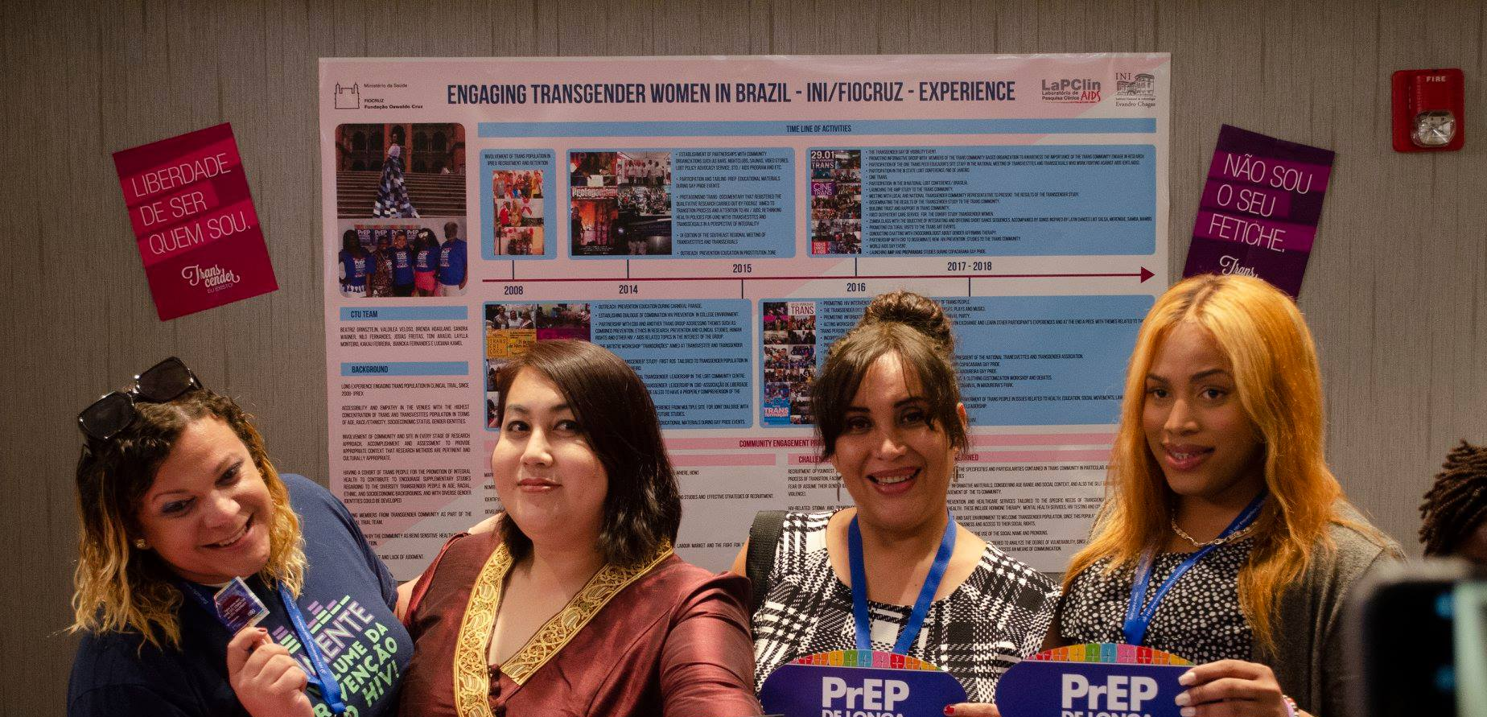
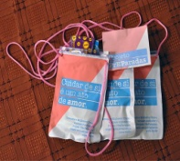
Thank you!
Thank you!

