Slide 2
High levels of depression among Peruvian men who have sex with men and transgender women: implications for HIV prevention and treatment care
Jerome T. Galea, PhD, MSW

Slide 3
Conflict of Interest Statement
None declared

Slide 4
Collaborators
Hugo Sánchez Segundo León
Zhiwei Zhang
Brandon Brown

Slide 5
~ 970 million people worldwide had a mental or substance use disorder in 2017
Includes: depression, anxiety, bipolar d/o, eating d/o, alcohol & drug use d/o & schizophrenia
Source: IHME, Global Burden of Disease

Slide 6
…and that number is growing
Number of people with mental and substance use disorders, World
800
Females
600
Millions
400
200
Males
0
1990
1995
2000
2005
2010
2015
2017
Source: IHME, Global Burden of Disease

Slide 7
Anxiety & depression are the most prevalent
Prevalence by mental and substance use disorder, World, 2017
Anxiety disorders
3.76%
Depression
3.44%
Alcohol use disorders
1.4%
Drug use disorders
0.94%
Bipolar disorder
0.6%
Schizophrenia
0.25%
Eating disorders
0.21%
0%
0.5%
1%
1.5%
2%
2.5%
3%
3.5%
Source: IHME, Global Burden of Disease

Slide 8
Few mental health human resources globally

Slide 9
LMIC like Peru are disproportionally affected by both mental disorders and HIV

Slide 10
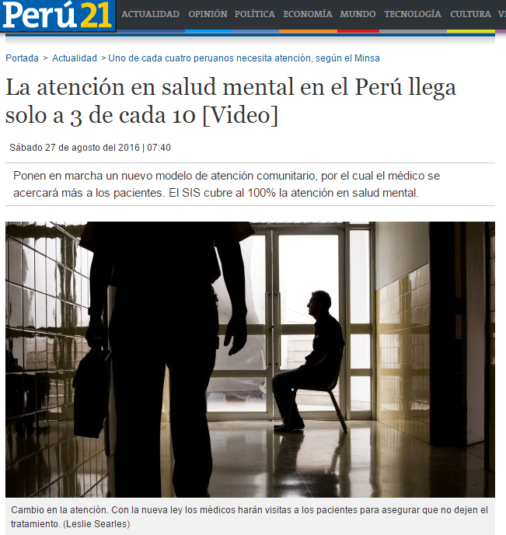
Peru: High rates of unmet mental health need
“20% of the [Peruvian] adult and senior populations suffer from a mental disorder, especially depression, anxiety, and alcoholism, not including those who suffer from violence.”
Source: Peruvian Ministry of Health, Mental Health Division
Boletin de gestión, año 2016

Slide 11
Depression rates in Peru
No studies specifically reporting depression prevalence & severity Peruvian MSM and TW

Slide 12
HIV rates in Peru
Group | HIV % [95% CI]
General population 15-49 years | 0.30 [0.30-0.50]
MSM | 15.2 [*]
TW | 13.8 [*]
Source: UNAIDS, Peru fact sheet 2016
* Not reported

Slide 13
Depression and MSM, TW & HIV
Depression + HIV:
↓ accessing or adhering to medical care
↓ ART adherence
↑ ETOH use, drugs
↑ Sexual risks
↑ Viral load (even with high ART adherence)
↑ Mortality (2x)
Annual depression rate for SGM 3 to 9 times higher than non-SGM
1 in 5 attempt suicide over lifetime

Slide 14
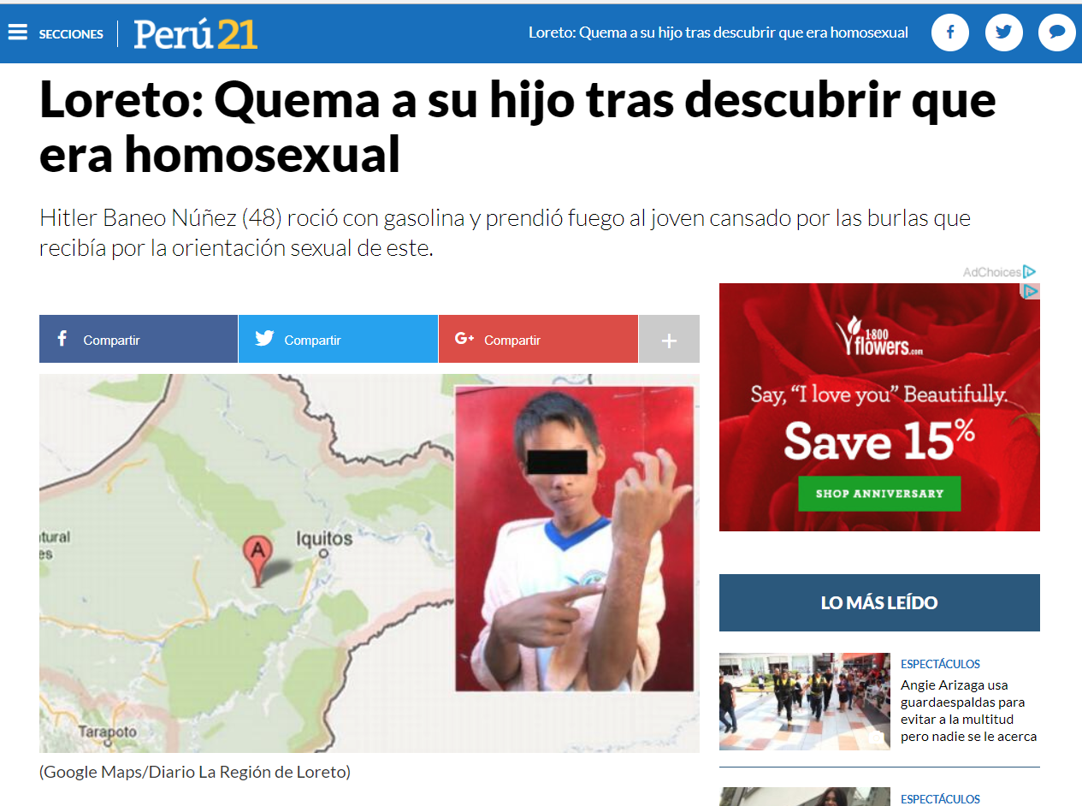
+ Conspiring social determinants
Stigma, discrimination, homoprejudice.
Cultural aspects: machismo, homosexuality
Weak post conflict state = weak public health system
Free ART available since 2004 and PrEP not yet widely used yet
Low community organizing
Socialization places for gay men = commercial, focused on sex.
Notes:
One study participant said…
But there was also resilience: people wanted to something new and wanted to be a part of it

Slide 15
Research Questions
Among Peruvian MSM and TW in an HIV services setting:
What is the prevalence & severity depression?
2. What factors are associated with depression?

Slide 16
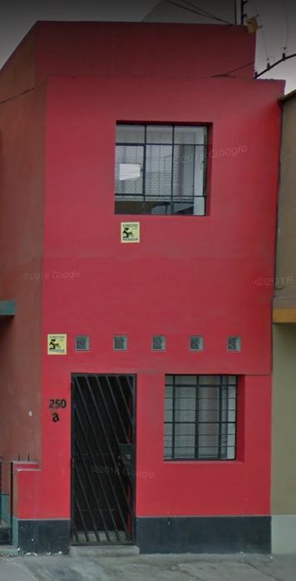
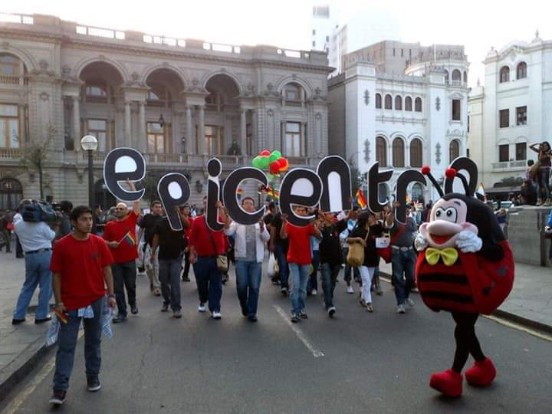
Methods
Retrospective analysis of existing, anonymized clinic data
18 demographic and health questions
9-question depression screener
August 2017-December 2018
Community-based sample at NGO Epicentro, Lima: Mostly MSM and some TW

Slide 17
Measure – Sexual Health
Brief, in-house form used to guide health encounter
Motive for visit (routine or due to recent sexual risk)
Sexual and gender self-identification (gay, bi, hetero, trans)
STI symptoms (subjective / reported)
Last sex partner (days since; type; condom use; drug/ETOH use)

Slide 18
Measure – Depression
Patient Health Questionnaire (PHQ-9)
Screening tool; used globally, validated in Peru
9 questions scored from 0 (never) to 3 (nearly every day)
Score ranges from 0-27 points
Self or interviewer administered (we administered)

Slide 19
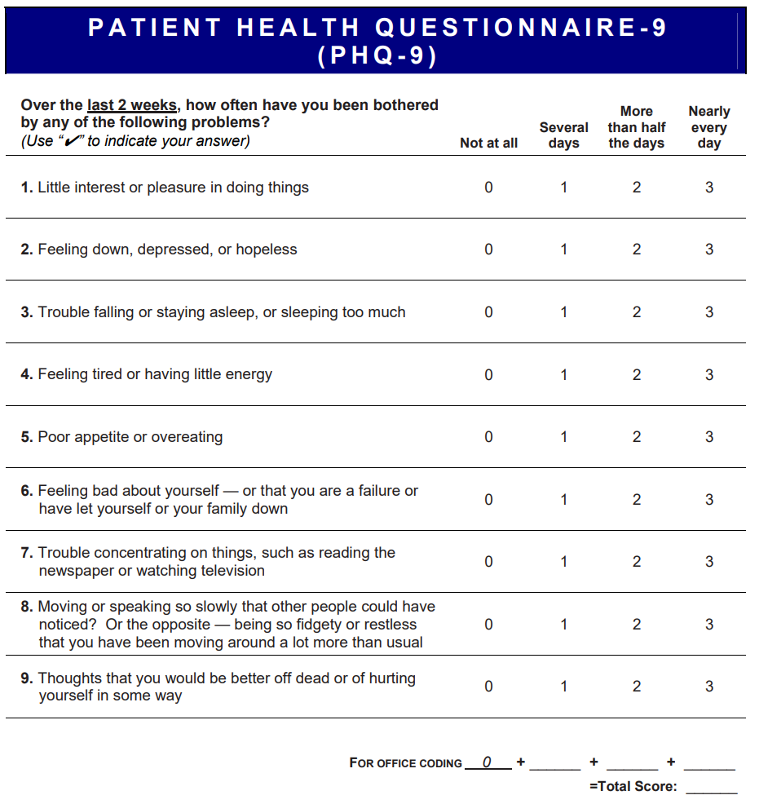
PHQ-9 Scoring and Interpretation
Score | Depression Severity
0-4 | Minimal / None
5-9 | Mild
10-14 | Moderate
15-19 | Moderately severe
20-27 | Severe

Slide 20
Results: Participant Characteristics (N=185)
Characteristic | Total n
Age, years | 27* (IQR: 23-33)
Clinic visit motive
routine | 107 (58%)
recent sexual risk | 78 (42%)
Self-identification
homosexual or gay | 158 (85%)
bisexual | 17 (9%)
heterosexual | 5 (3%)
transgender woman | 5 (3%)
HIV test result
positive | 24 (13%)
negative | 157 (87%)
Characteristic | Total n
STI symptoms present
yes | 47 (26%)
no | 135 (74%)
Most recent sex
days ago | 14* (IQR: 6-30)
Partner type
stable / regular partner | 68 (37%)
casual or “one-nighter” | 117 (63%)
Condom used (by either partner)
yes | 106 (58%)
no | 77 (42%)
Alcohol and/or drug use
yes | 34 (18%)
no | 150 (82%)
*Median
Drugs: marijuana, cocaine, poppers and other

Slide 21
Distribution of depression (N=185)
107
43
15% (12/78)
23
3
9

Slide 22
Bi-variate analysis (N=185)
Characteristic | PHQ-9 <5 n | PHQ-9 ≥ 5 n | P value
Age, years | 27* (IQR: 23-32) | 27* (IQR: 23-34) | 0.70
Clinic visit motive |  |  | 0.85
routine | 63 (59%) | 44 (41%)
recent sexual risk | 44 (56%) | 34 (44%)
Self-Identification |  |  | 0.83
homosexual or gay | 93 (59%) | 65 (41%)
bisexual | 9 (53%) | 8 (47%)
heterosexual | 3 (60%) | 2 (40%)
transgender woman | 2 (40%) | 3 (60%)
HIV test result |  |  | 0.48
positive | 16 (67%) | 8 (33%)
negative | 89 (57%) | 68 (43%)
*Median

Slide 23
Bi-variate analysis (N=185)
Characteristic | PHQ-9 <5 n | PHQ-9 ≥ 5 n | P value
STI symptoms present |  |  | 0.70
yes | 26 (55%) | 21 (45%)
no | 81 (60%) | 54 (40%)
Most recent sex
days ago | 7* (IQR: 6-30) | 18* (IQR: 7-56) | 0.07
Partner type |  |  | 0.01
stable / regular partner | 48 (71%) | 20 (29%)
casual or “one-nighter” | 59 (50%) | 58 (50%)
Condom used |  |  | 0.64
yes | 64 (60%) | 42 (40%)
no | 43 (56%) | 34 (44%)
Alcohol and/or drug use
yes | 17 (50%) | 17 (50%) | 0.38
no | 90 (60%) | 60 (40%)
*Median
Drugs: marijuana, cocaine, poppers and other

Slide 24
In other words, depression was:
Common among this sample of SGM
Twofold greater than the general Peruvian population
Mostly mild-moderate
PHQ-9 = > 4 and < 15
Significantly associated with last sex partner being “casual” (stable partner associated with lower chance of depression)

Slide 25
Implications
Troubling: lots of depression in SGM
Bright side: treatable
Non pharmacological interventions ideal for mild to moderate depression
“Low intensity” interventions: low cost, don’t require mental health background. HIV counselors/staff could be trained.
Continued, urgent need for advances in human rights and anti-stigma work
Mental Health Gap Action Programme
https://www.who.int/mental_health/mhgap/en/

Slide 26
Limitations
Small sample size: non-generalizable, limited analyses
PHQ-9 is not a diagnostic tool (biased towards positive)
Many other factors not accounted for:
Violence and trauma
Stigma
Disclosure, sexual orientation, gender identity, HIV
Income
Drug and alcohol use (beyond last sex partner)
ART adherence

Slide 27
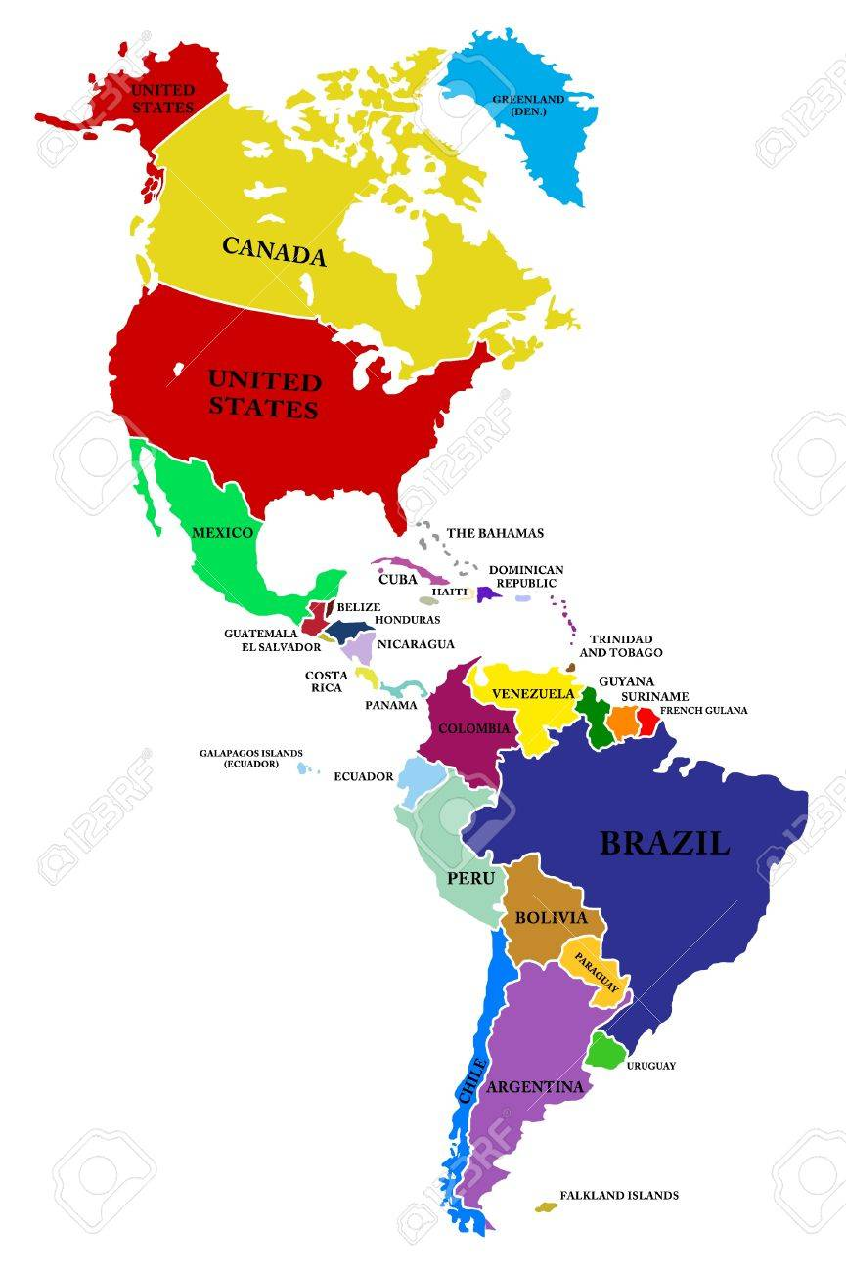
Now and Future
Integrated depression screening at USF Bridge Clinic Tampa, FL, USA, 2019
Pilot depression treatment program (October 2019)
Trained community health workers at Compañeros en Salud to deliver low intensity depression treatment in rural Chiapas, Mexico, May 2019
Depression screening integrated at SOMOSGAY in Asuncion, Paraguay March 2019
Pilot low-intensity depression treatment in HIV care setting (2020)
2 Low-intensity depression interventions already implemented (general populations), 2017-present
Depression screening at Epicentro in Lima, Peru, August 2017-present
Integrate depression screening in HIV care at MoH Level (August 2019)
Pilot low-intensity depression treatment in HIV care setting (2020)

Slide 28
Thanks
Interested in integrated Mental Health and HIV care?
Contact me!
Jerome T. Galea
jeromegalea@usf.edu

