Slide 1
Maternal HIV infection alters the community composition and dynamics of the enteric microbiome of associated infants
Bryan P. Brown, Denis Chopera, Enock Havyarimana, Shameem Jaumdally, Clive Gray, Darren Martin, Arvind Varsani, and Heather B. Jaspan for the INFANT Study Team
IAS 2019

Slide 2
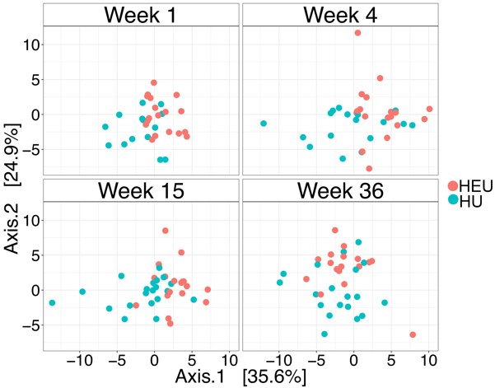
Maternal HIV infection alters enteric bacterial communities in HEU infants
Parent study: Innate Factors Associated with Nursing Transmission (InFANT)
Aims: 500 mother-infant pairs, of which 300 are HIV-exposed uninfected (HEU) breastfed, 200 HIV-unexposed (HU) breastfed
As of March 2019, 481 mother-infant pairs have been enrolled from Khayelitsha, Cape Town
~200 infants have longitudinal 16S data, 10 dyads have viral metagenome data
  Bacterial 16S: Bacterial genomic DNA was isolated from stool and the V6 region of the 16S rRNA gene was amplified and sequenced using a 125bp paired-end (PE) approach on an Illumina HiSeq 4000.
  Viral metagenome:Virus-like particles were extracted from stool and amplified using rolling circle amplification. Amplified genomes were sequenced on an Illumina HiSeq 2500 using a 150 PE approach.
Notes:
Sequenced ~200 babies, multiple time points

Slide 3
Maternal HIV infection also alters enteric viral communities in HEU infants!
The community composition of the fecal virome is altered and diversity is elevated in HEU infants

Slide 4
HIV exposure alters phage-bacterial dynamics in the infant gut
Conclusions:
Maternal HIV infection alters the fecal bacterial communities of the infant
This is potentially driven by an elevated diversity of bacteriophages (though eukaryotic viral diversity is increased as well!)
Viral communities may be inherited vertically from the mother.
But, are they shared or acquired via decreased immune functionality?

Slide 5



The all-stars
Jaspan Group, Seattle Children’s
Donald Nyangahu
Aubrey Brown
Melanie Gasper
Heather Jaspan
Smritee Dabee
Jaspan Group, University of Cape Town
Enock Havyarimana
Shameem Jaumdally
D William Cameron - Ottawa Hospital Research Institute
Alash'le Abimiku - Institute for Human Virology, Nigeria, UMD
Sophia Osawe - Institute for Human Virology, Nigeria
Ken Rosenthal – McMaster University
Denis Chopera - Africa Health Research Institute
University of Cape Town :
Clive Gray
Darren Martin
Arizona State University:
Arvind Varsani

