Slide 1
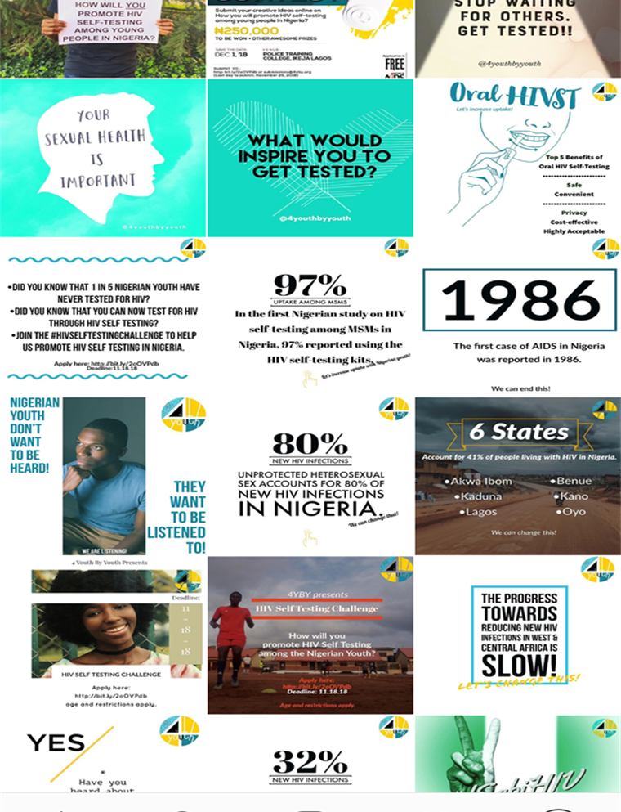
#HIVSelfTest: A social media campaign to promote HIV Self-Testing among Young People in Nigeria
Juliet Iwelunmor PhD¹, Oliver Ezechi MD², Chisom Obiezu-Umeh MPH¹, Ucheoma Nwaozuru MSc¹, Titilola Gbajabiamila MBBS², David Oladele MBBS², Joseph Tucker MD³ ¹Saint Louis University, ²Nigerian Institute of Medical Research,³University of North Carolina at Chapel Hill
INTRODUCTION
High HIV prevalence among Nigerian youth aged 15-24 years in (HIV prevalence of 1.5% or greater in some states).
HIVST is an important early entry point to accessing preventive education, care and treatment.
HIVST allows individuals to collect their own specimen and interpret their own results, often in privacy or under supervision.
Novel and youth-centered strategies are needed to increased uptake of HIV testing among this population
A HIVST social media campaign through 4 Youth by Youth (4YBY) was created to create awareness of HIV self-testing among young people in Nigeria as part of the 2018 World AIDS Day activities in Nigeria.
Figure 1. 4YBY Social Media posts
RESULT
Over 89.5% of output being original HIV self-testing content, the social media campaign reached over 3.5 million people with an estimated 17.2 million impressions.
Majority of the engagement content across our various social media platforms were grouped into the following themes:
WHY SOCIAL MEDIA?
Social media is a popular means of interaction for young people, in which they create, share, and exchange information in virtual communities and networks.
It allows young people to become consumers of content that is then discussed, modified and shared.
Despite proliferation of social media in health, only a few social media campaigns have been developed to promote HIV testing among young people.
Study Objective: To evaluate youth-focused social media campaign focused on promoting HIVST among young people in Nigeria.
Informational (55%)
Collaborative (31%)
Empowerment (14%)
Provided the audiences with facts, slogans, figures and statistics on HIV, sexual health seeking behaviors and risks, HIVST and other STI testing modalities. Creatively representing data to make it more palatable to lay audiences.
Engaging audiences to share their inputs or ideas on sexual health-related topics and also to provide an open dialogue on sexual health-related issues. Usually done by posing a question, challenge or concept.
Key messages to champion young people to take charge of their sexual health and encourage safer sexual behaviors and decision-making.
Figure 2. Themes that emerged from social media engagement contents
METHOD
From October to December 2018, we disseminated messages emphasizing HIV self-testing through social media platforms such as Facebook, Instagram, WhatsApp, digital channels and social media influencers in Lagos, Nigeria.
We used social media metrics to examine the reach and impressions of a social media campaign focused on HIVST among Nigerian youth.
We tracked both using Facebook insights, Instagram insights, total number of likes and followers.
DISCUSSION
Findings show the dynamics and potential utility of using social media platforms for meaningful youth engagement, effective messaging and real-time monitoring of campaigns to promote HIV self-testing among young people in Nigeria.
1. Nigerian Ministry of Health. National HIV and AIDS Strategic Framework. 2017-2021. 2. National Agency for the Control of AIDS. Federal Republic of Nigeria, Global AIDS Report: Country Progress Report. 2015. 3. Nigerian Demographic and Health Survey. National Population Commission. Nigerian Demographic and Health Survey Reports. June 2014. 4. Asaolu IO, Gunn JK, Center KE, Koss MP, Iwelunmor JI, Ehiri JE. Predictors of HIV Testing among Youth in Sub-Saharan Africa: A Cross-Sectional Study. PloS One. 2016 5. Sekoni A, Somefun E, Fatoba O, Onajole A. Use of HIV Screening Services and Sexual Behavior of In-School Adolescents in Surulere LGA, Lagos State. Nigerian Quarterly Journal of Hospital Medicine.2015 6. Sam-Agudu NA, Folayan MO, Ezeanolue EE. Seeking wider access to HIV testing for adolescents in sub-Saharan Africa. Pediatric Research. 2016 7. Tucker JD, Wei C, Pendse R, Lo Y-R. HIV self-testing among key populations: an implementation science approach to evaluating self-testing. Journal of Virus Eradication. 8. Indravudh PP, Sibanda EL, d’Elbée M, et al. ‘I will choose when to test, where I want to test’: investigating young people's preferences for HIV self-testing in Malawi and Zimbabwe. AIDS. 2017 9. Gleeson, H. S., Oliveras Rodriguez, C. A., Hatane, L., & Hart, D. T. (2018). Ending AIDS by 2030: the importance of an interlinked approach and meaningful youth leadership. Journal of the International AIDS Society. 10. Dowshen N, Lee S, Matty Lehman B, Castillo M, Mollen C. IknowUshould2: Feasibility of a Youth-Driven Social Media Campaign to Promote STI and HIV Testing Among Adolescents in Philadelphia. AIDS and Behavior. 2015. 11. Tso LS, Tang W, Li H, Yan HY, Tucker JD. Social media interventions to prevent HIV: a review of interventions and methodological considerations. Current Opinion in Psychology. 2016.
PRESENTED AT THE 10TH IAS CONFERENCE ON HIV SCIENCE (IAS 2019) | MEXICO CITY, MEXICO | 21-24 JULY 2019

