Slide 1



for a healthy Zambia

Slide 2
The "Failure Cascade" for Patients with Unsuppressed Viral Load in Zambia: Results from a Large HIV Treatment Cohort
TUPDB0104
Ranjit Warrier,
Jake Pry, Paul Elish, Paul Kaumba, Helene Smith, Izukanji Sikazwe, Carolyn Bolton, and Michael Herce
Centre for Infectious Disease Research in Zambia (CIDRZ)
Share your thoughts on this presentation with #IAS2019
for a healthy Zambia

Slide 3
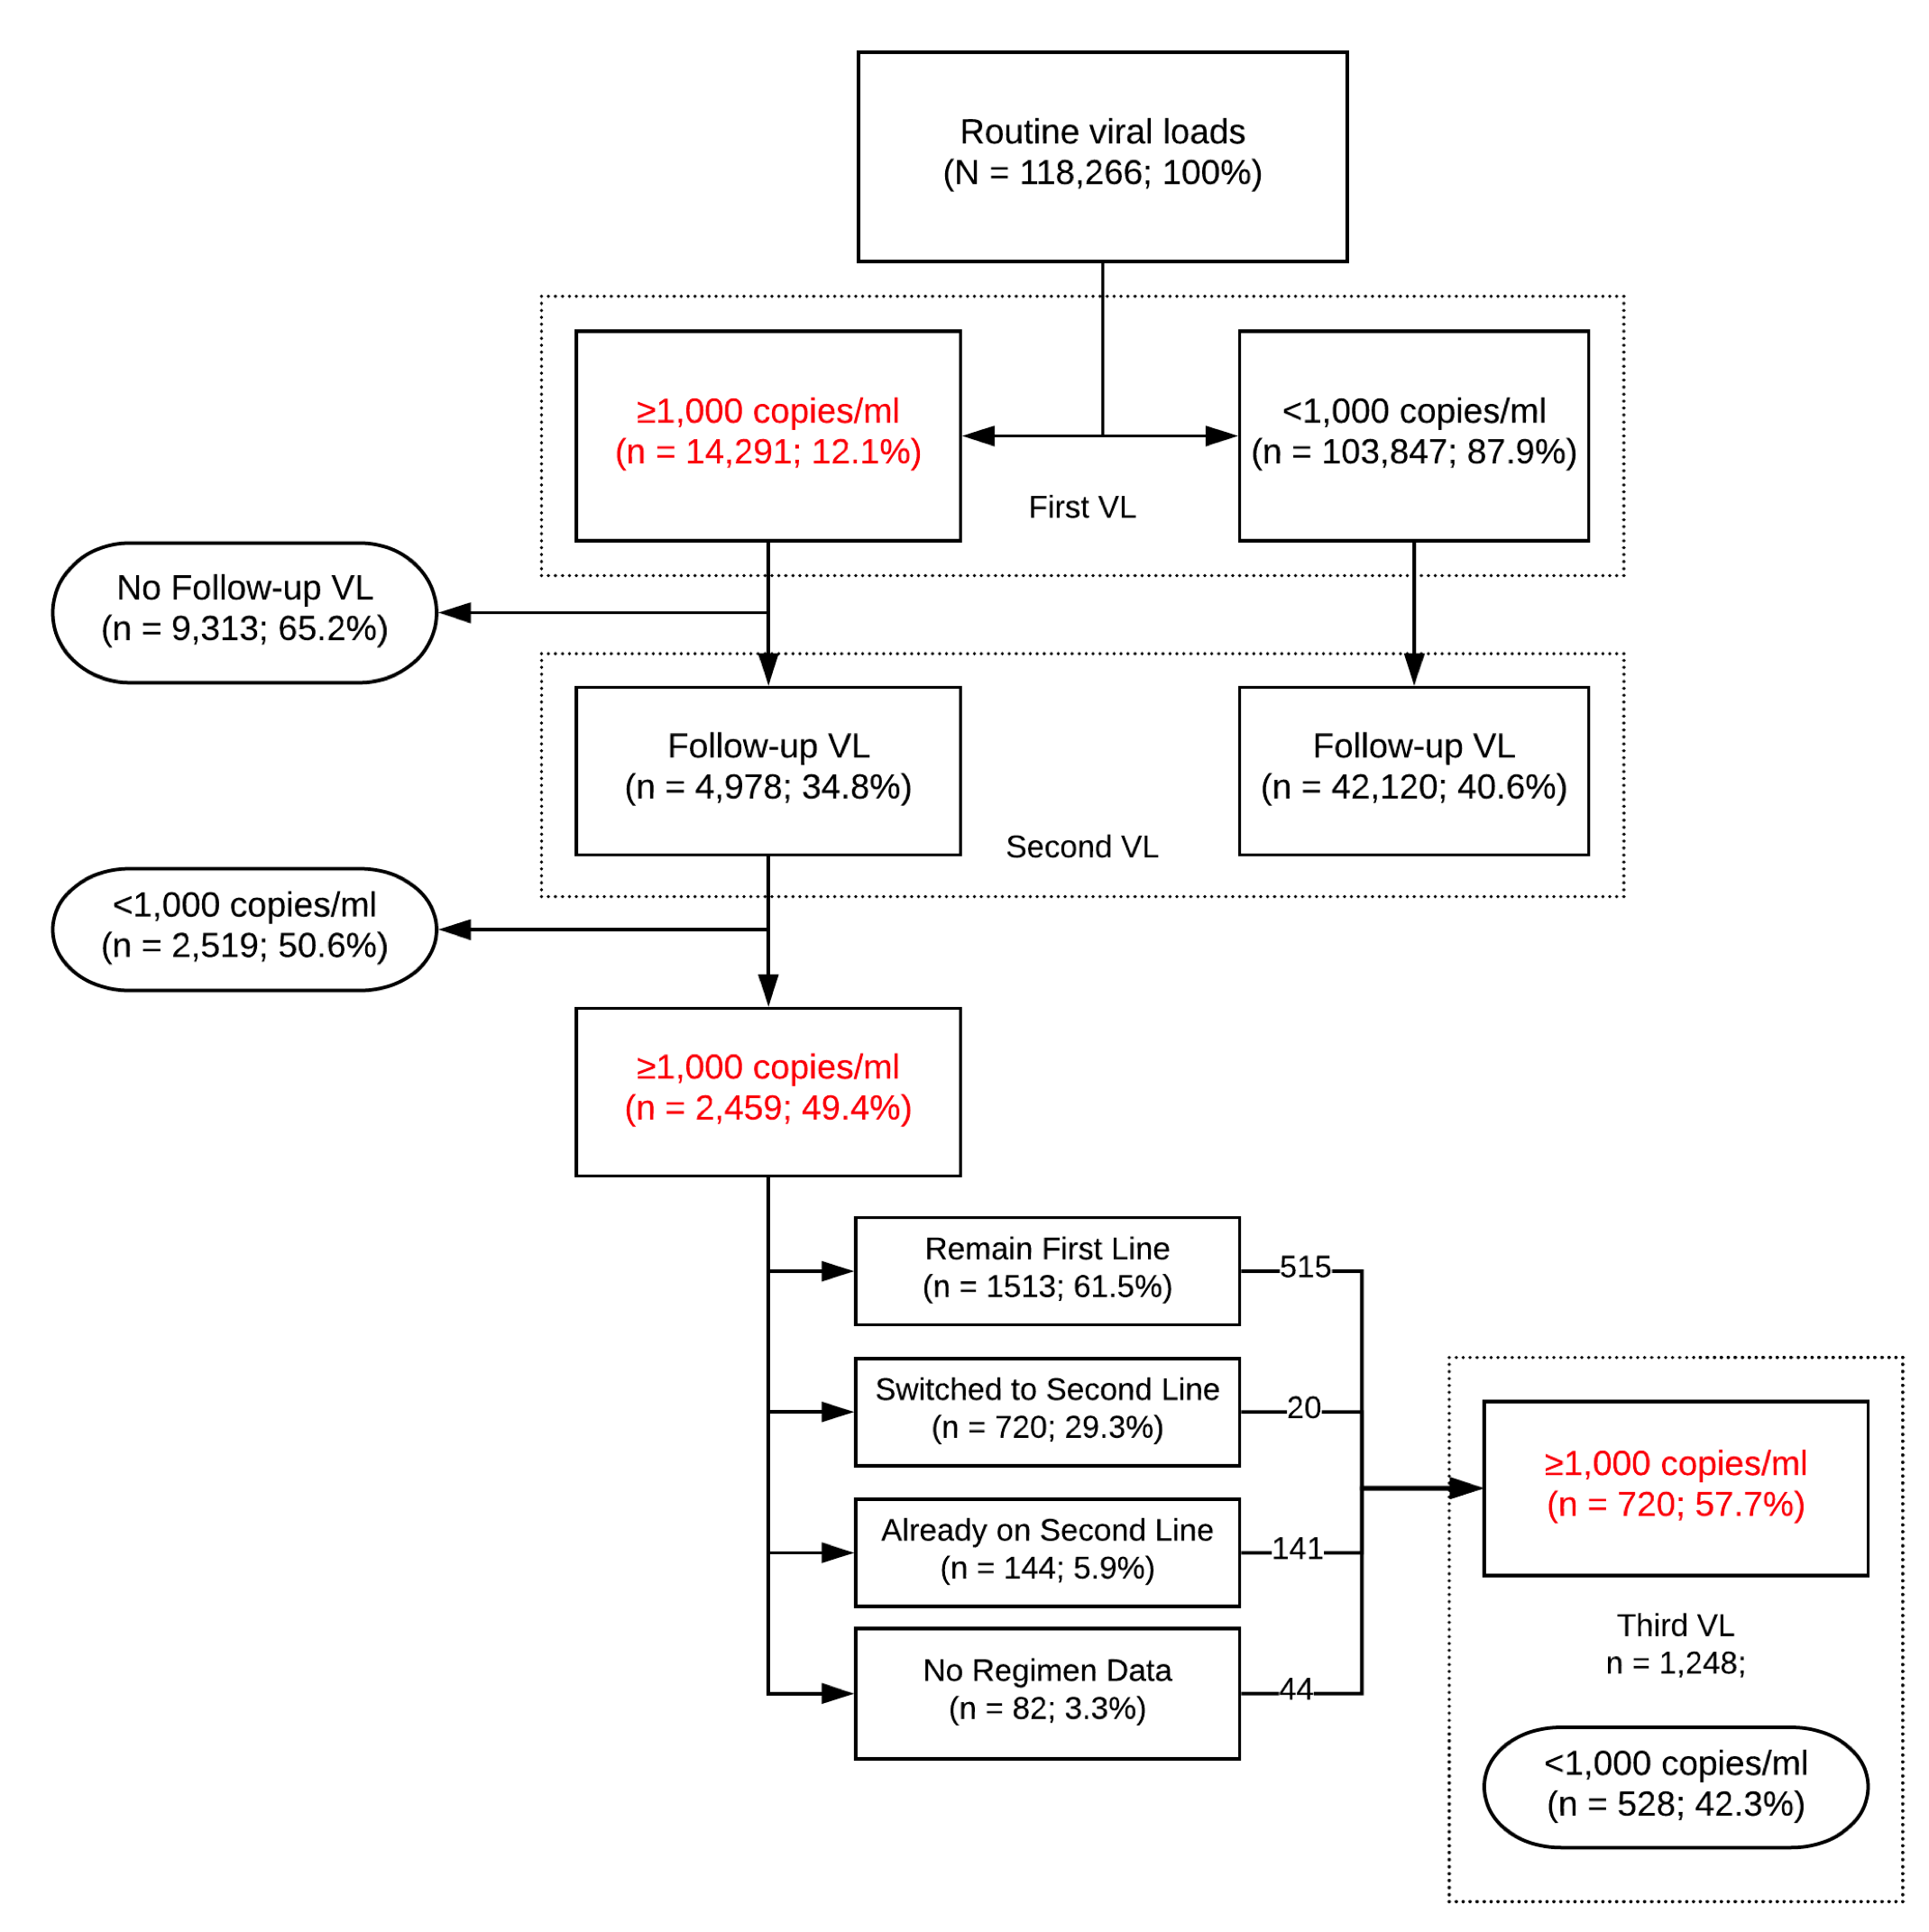
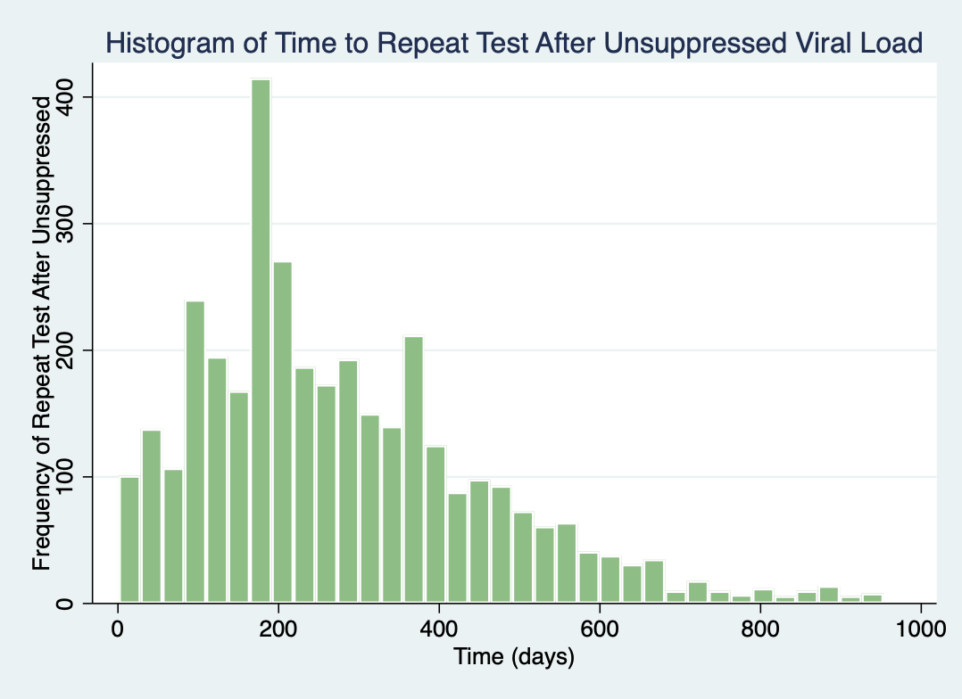
For ART-treated PLHIV with an unsuppressed routine viral load (VL) in Zambia, we observed gaps with provision of follow-up VL testing and switch to second-line ART.
Our objective was to characterize the “failure cascade” for ART-treated patients with a first unsuppressed VL for program improvement.
Zambian national guidelines for using VL for clinical care came into effect on 1 Jan 2016. We used clinical and laboratory data sources to identify how well the “failure cascade” was followed during a period of scale-up from Jan 2016 – Sept 2018.
for a healthy Zambia
Notes:
The national guidelines that included viral load for clinical decision making were adopted in Jan 2016. At this time, the clinics and the labs were not ready. We looked at how well these guidelines were followed for VL unsuppressed during this time of scale-up until September 2018. On your right is a cascade diagram that follows the VL unsuppression guidelines. We can see that of the 118,000 clients that were on ART during this period, 12% had a first unsuppressed viral load. Of those that had a follow-up viral load, half continued to be unsuppressed. Of these, we could only find evidence of switch to second line for 30% of clients, while about 60% still remained on first-line treatment. Therefore, we observed gaps in the failure cascade. To illustrate the follow-up VL issue further, here is a histogram of when the follow-up VL was ordered after an unsuppressed value. The guidelines say this is supposed to be done at 3 months, however, you can see a bump at 6 months here, and even beyond a year. If you think about this, then thousands of people are found to be VL unsuppressed, and they are continuing to be unsuppressed for months.

Slide 4
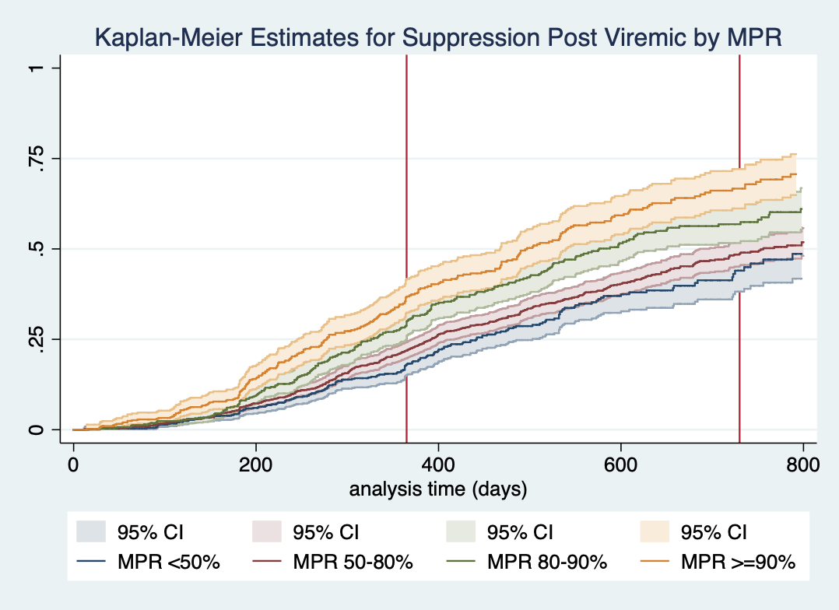
Despite high MPR (>90%), we noted sub-optimal HIV viral suppression after first unsuppressed VL, increasing the risk of HIV drug resistance and associated morbidity and mortality
Kaplan-Meier Estimates for Post-Viremic Suppression by Medication Possession Ratio Categories
The Medication Possession Ratio (MPR) is the amount of time with record of ART dispensed divided by the total time in HIV care as recorded in the electronic medical record.
At one year of follow-up, 36.9% of individuals in the >90% MPR category were able to achieve VL suppression, compared to 18.1% in the lowest (<50%) MPR category.
for a healthy Zambia
Notes:
Then we looked at the pharmacy data to try to understand how the medication possession ratio for VL unsuppressed clients affected suppression. On the x-axis here is time, with one year and two years marked with a red line. The top line is 90% MPR, meaning that drugs were dispensed 90% of the time. On the y-axis is VL suppression. Even at one year, only about 37% of individuals in the >90% MPR band achieved VL suppression. This rises to 70% after two years, which we think is due to only adherent clients making it this far into treatment.

Slide 5
Conclusions
We observed gaps in the failure cascade for PLHIV with an unsuppressed first routine VL during a time of rapid scale-up of VL testing in Zambia.
Currently, these gaps in the failure cascade are being addressed by:
  Increasing laboratory and clinical capacity to manage patients with unsuppressed VL
  Moving to digital results reporting
  Clinic staff training and daily monitoring of repeat VL testing uptake, time to repeat VL, and proportion undergoing appropriate regimen switch
  Peer educators/ community health workers assigned to contact and locate patients with unsuppressed VL
  Monthly all-partners meeting to understand gaps in the failure cascade
for a healthy Zambia
Notes:
I did have to rush through quickly, but please come by the poster for a longer discussion. Here are our conclusions.

Slide 6
Acknowledgements
Study Team
Carolyn Bolton
Paul Elish
Michael Herce
Paul Kaumba
Jake Pry
Izukanji Sikazwe
Helene Smith
Ranjit Warrier
Data
CIDRZ Central Laboratory
CIDRZ ACHIEVE project staff
Ministry of Health Clinic Staff
Funding
Ministry of Health of the Republic of Zambia
Centers for Disease Control
for a healthy Zambia

