Slide 2
Evolution on HIV drug resistance surveillance in Brazil: a declining trend to celebrate
Rosana Elisa Gonçalves Gonçalves Pinho, Nazle Mendonça Collaço Véras, Ana Roberta Pascom, José Boullosa, Fernanda Rick, Gerson Fernando Mendes Pereira
Department of Diseases of Chronic Condition and Sexually Transmitted Infections, Secretariat for Health Surveillance, Ministry of Health of Brazil
Share your thoughts on this presentation with #IAS2019

Slide 3
I have no conflicts of interest to disclosure.

Slide 4
Brazil’s Genotyping test offering
Pretreatment HIV genotyping test: pregnant woman, children, serodifferent couples, HIV/TB co-infected, seroconversion on PrEP and individuals initiating antiretroviral therapy with EFV.
All individuals under ART experiencing virological failure
Information System for Genotyping Network (Sisgeno)

Slide 5
Methods/Results
52,658 PR-RT sequences from 44,806 individuals
from 2008-2018
18+ ARV-experienced individuals
Stanford HIVdb Program (High‐Level DRMs - Score = 60+)
HIV subtype (Rega HIV Subtyping)
Demographic and clinical characteristcs

Slide 6
HIV drug resistance amongst people taking ART decreased over the last decade

Slide 7
DR Mutations
K103 – 27% (NNRTI)
M184 – 27% (NRTI)
M46 – 11% (PI)
I54 – 9% (PI)
K65 – 8% (NRTI)

Slide 8
HIV resistance according to the number of drugs exposed before genotyping test

Slide 9
HIV resistance according to the number of drugs exposed before genotyping test

Slide 10
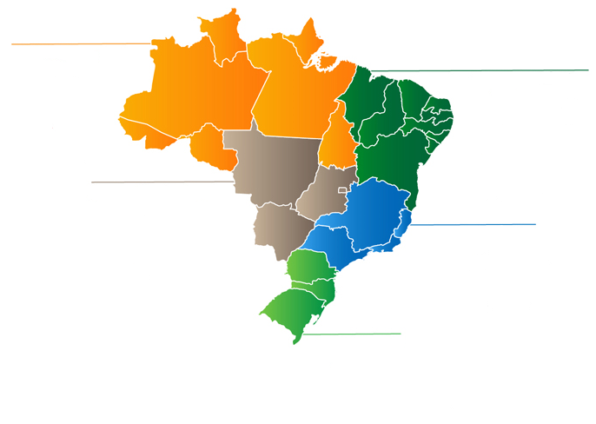
Distribution of HIV-1 Subtypes in Brazil
North
Northeast
Center-West
Southeast
South

Slide 11
Resistance to ARV class according to the most frequent subtypes in Brazil

Slide 13
Conclusions
Acquired HIV drug resistance decreased over the decade in Brazil.
Continuous improvement of the monitoring of HIV drug resistance routine is particularly important to minimize the spread of resistance in country, specially related to new drugs, and thus to contribute to the control of the HIV epidemic.

Slide 14
Thank you!

