Slide 1
Training, Communication, and Prescribing Patterns of PrEP among a Sample of Nurse Practitioners in the US:
Gaps and Opportunities
Matthew S. Ellis, MPE
College for Public Health and Social Justice
Saint Louis University
Share your thoughts on this presentation with #IAS2019

Slide 2
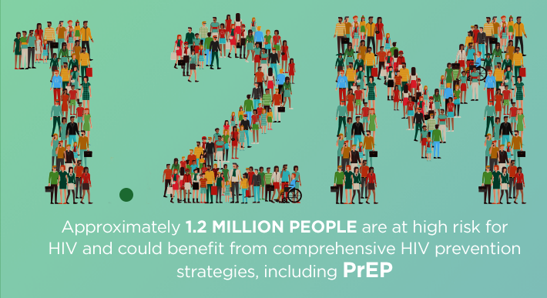
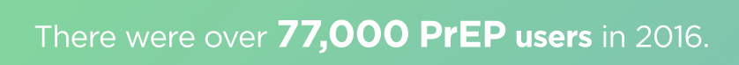
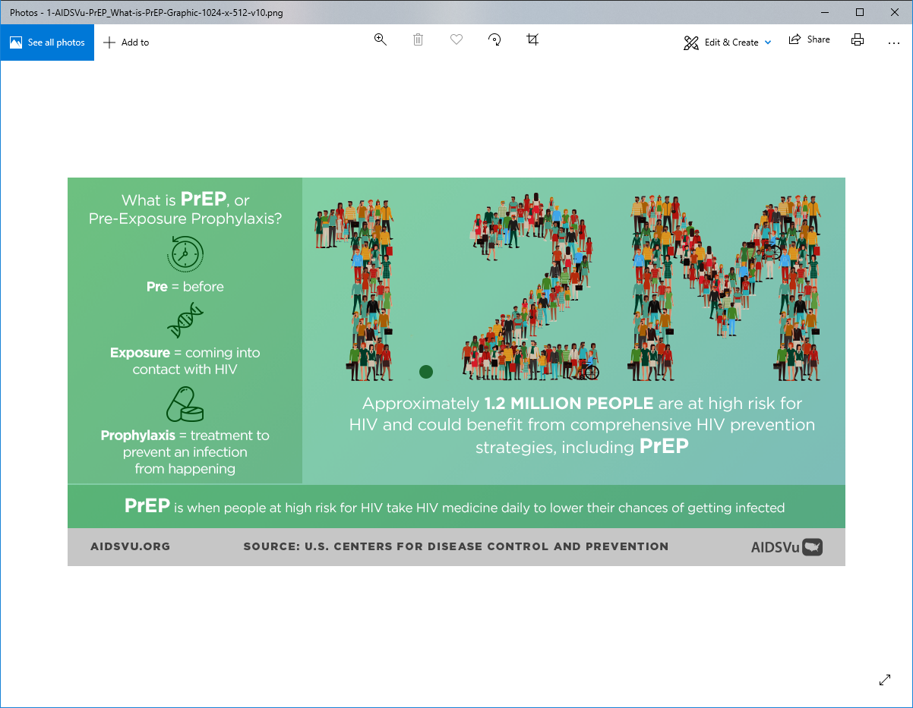
PrEP
Despite increases, PrEP uptake remains low in the United States
Barriers
  Lack of provider communication/promotion
  Interpersonal trust and stigma
  Perception of responsibility among healthcare providers

Slide 3
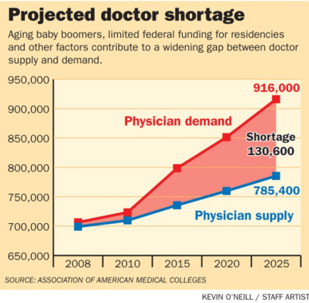
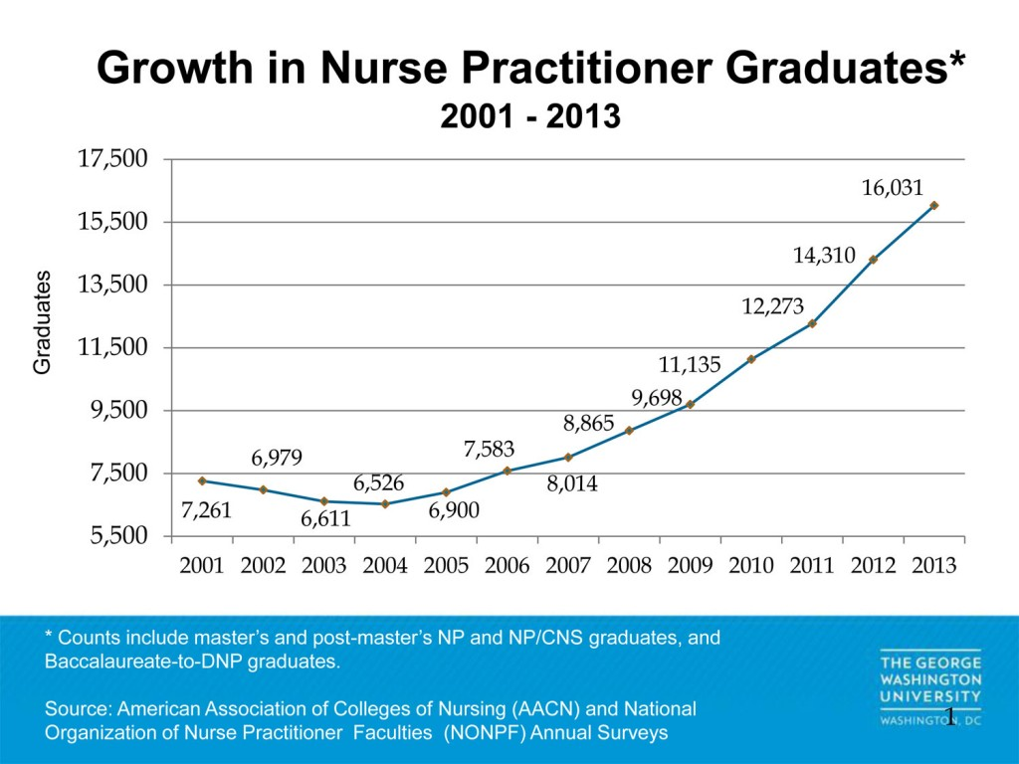
Nurse Practitioners
Expected to shoulder a greater portion of healthcare burden
Provide bulk of primary care to low resources areas and vulnerable populations
Research shows equal or better care
Have prescribing privileges, although to varying degrees

Slide 4
Methods
Cross-sectional survey of Nurse Practitioners at the 2018 conference of the American Association of Nurse Practitioners (n=271)

Slide 5
Results: Knowledge
50.2%
57.9%
could correctly identify the PrEP regimen
could correctly identify PrEP’s effectiveness rate

Slide 6
Results: Prescribing & Communication
68.6%
are not currently prescribing PrEP to ANY patients
(20% Rx to 1-10 patients)
Have NEVER initiated a conversation about PrEP with a patient
62.4%

Slide 7
Results: Training
60.1%
61.3%
have NEVER received any training or education on PrEP
WOULD prescribe PrEP if they did have training or education

Slide 8
Implications
Education and training are crucial for a healthcare profession expected to take on more of the healthcare burden
Institutions and policies should advance HIV prevention as part of Primary Care and develop PCPs and PCNPs as a source of PrEP promotion and management
Nurse Practitioners should leverage their existing interactions with low resource and vulnerable populations to promote PrEP and HIV prevention strategies

