Slide 1

The Sawa Sawa Intervention: A quazi-experimental trial to reduce community level stigma and improve HIV testing service uptake among men in Sofala Province, Mozambique
Andrea L. Wirtz, Elizabeth C. Mallalieu, Jose Chidassicua,
Dirce Pinho, Patrick Devos, Lynn Van Lith
10th IAS Conference on International HIV Science, 22 July 2019
MOAD0404

Slide 2
Disclosures:
Andrea Wirtz receives other funding support from Gilead Sciences and ViiV Healthcare

Slide 3
Background
Focus on the HIV care continuum has led to scrutiny of gender disparities in uptake of HIV services and outcomes
Observational studies consistently highlight low uptake of HIV testing, ART use, and higher mortality among men living with HIV
HIV “blind spot” a priority to global and country targets
Search for effective combination interventions to engage men in HIV services and ultimately change epidemic trajectories
Notes:
With 90-90-90 and other international and national epidemic targets, there is a heavy focus on improving engagement at all points along the HIV care continuum.
This has led to increased concern and efforts to address gender disparities along the continuum. While disparities exist at different points for all genders, men notably have lower uptake of HIV testing and thus delayed engagement in care and higher AIDS-related and all-cause mortality. Observational studies, as well as meta-analyses, have presented a wealth of data highlighting these disparities, particularly in generalize epidemics.
UNAIDS has called for urgently addressing this so called ‘HIV blind spot’ and substantial work has been underway to developing combination interventions to address gaps in the HIV care continuum among men.

Slide 4
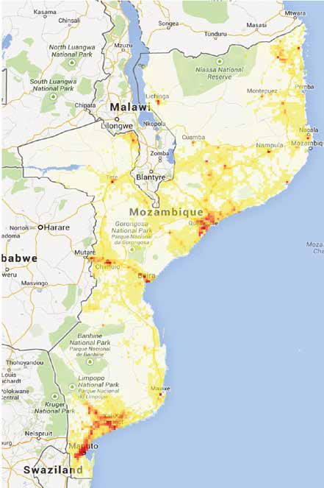
Intervention Goal & Objectives
Goal: Reduce community level stigma to
improve engagement in HIV care continuum
among men in Sofala Province, Mozambique
Primary outcome objectives:
  Reduce community stigma
  Increase number of men tested for HIV
Other outcomes of interest:
  Increase number of men initiating ART
Sofala Province
Map 1 HIV Prevalence In Mozambique
Notes:
Specifically, Sawa Sawa aimed to reduce community-level HIV stigma and increase the number of men tested for HIV, as a means to impact the first component of the HIV care continuum. Though the evaluation was not designed to identify impacts on ART initiation, we did hope to see qualitative improvements in ART initiation that was associated with the intervention for men living with HIV.
Theory?
The intervention was implemented in Sofala Province, one of the most heavily burdened areas. Contextually, HVI testing and engagement in HIV care has been notably low in Mozambique with gender-disparities similar to those reported in other generalized epidemics in SSA.

Slide 5

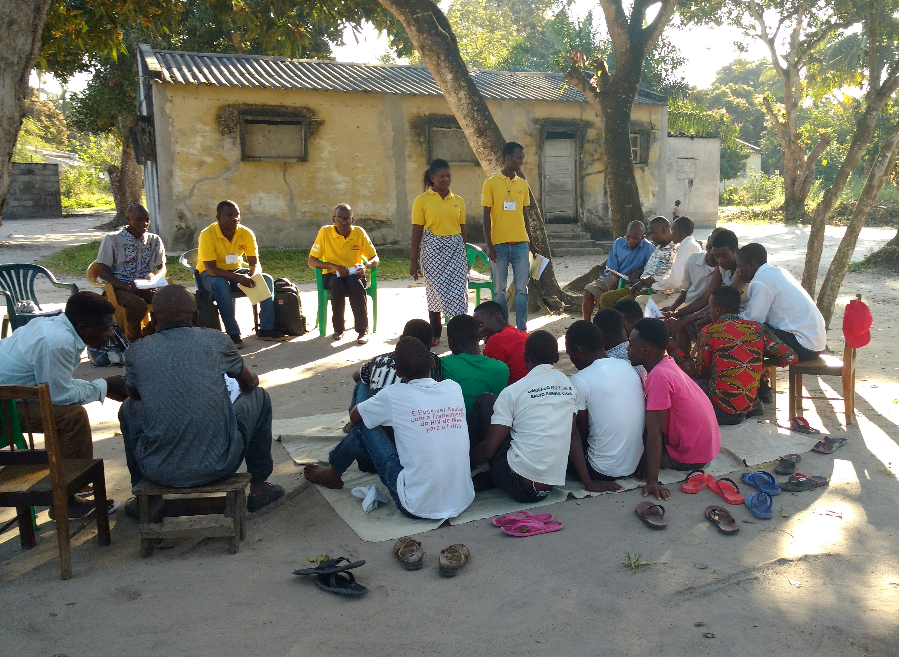
Intervention Activities
Community Dialogues
Positive Prevention
7 sessions for PLHIV
5-10 per group
SM-Yes Referrals
SMS-based linkage
Men only and mixed groups
6 sessions for those 18yrs+
HIV Community Testing Drive
Community Radio
Five radio programs and two advertising spots were produced
Monthly Debate show
Facility Focal Points
Provide testing outside of facilities
Coordinated with SM-Yes and focal points
Notes:
Sawa Sawa was a multi-pronged intervention that ran for 10 months from March – December 2017. It was developed by JHU CCP with support from USAID
It was developed using a revised package of community dialogue tools with explicit stigma messages.
The word Sawa means equality in Sena language and all messaging had this emphasis.
Local CBO staff were trained to become facilitators and mobilizers in their community, specifically for men, and supported a variety of activities.
Sawa Sawa also aimed to reach the broad community in the Intervention district via Community Radio. Radio shows, spots and debates were aired for the 10 months of the intervention and covered topics of the impacts of HIV stigma, the importance of treatment and disclosure, and how to put Sawa Sawa (demonstrate equality for all) in practice in ones community.
At more individual levels, Sawa Sawa also included community dialogues, which included adult men only and mixed groups. Groups, consisting of 15-25 participants, joined for 6 sessions that were 2 hours in duration. Sessions provided information on HIV transmission and prevention, importance of treatment, HIV disclosure, and Continuing the work of Sawa Sawa In Your Community.
Positive Prevention groups were comprised of 5-10 PLHIV, regardless of ART use, who participated in a total of seven sessions. The curriculum shared similar themes to the Community Dialogues, though with additional emphasis on Antiretroviral Treatment, Living Positively, Feeling Good, Dealing with Stigma, and Strengths-based Counselling.
Participants of the Community Dialogues and Positive Prevention who needed HIV-related services (e.g. HIV testing, ART initiation or reinitiation, or other ancillary service) were linked to care through SMYes referrals, which was a text-based referral system that indicated the type of referral needed for each individual. The SMYes system was operated by group facilitators who provided referrals and health facility focal points who received referrals. These individuals wore the bright yellow shirts you see in this photo and were immediately recognizable within the health facility. They helped participants to efficiently navigate their referrals and also supported identification of defaulters.
An HIV testing drive was also implemented for one month to support and boost HIV testing. This campaign brought service providers from the facility out into the community to provide community-based HIV testing and link those with a positive test to the health facility via SMYes. This was implemented for one month, though the rest of the activities were implemented for the full 10 months.

Slide 6
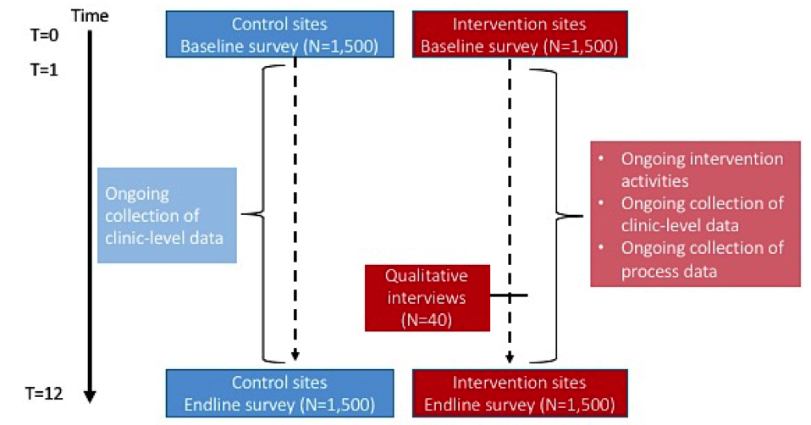
Methods
Quazi experimental design
Longitudinal population-based pre- and post-intervention surveys in intervention (Dondo) and control (Nhamatanda) districts
Validated stigma scale (Genberg 2008;α=0.79) and self-reported HIV testing (last 12mo)
Supported by qualitatlive research and process indicators
Notes:
There are two challenges inherent in measuring the effects of the intervention. First, our outcomes focus on estimating changes in stigma in the wider community and changes in HIV testing among men. Second, where a typical design for such a study would use a community or cluster-randomized approach, the community radio stations that played the Sawa Sawa programs span the entire districts and would result in contamination in control sites.
Thus, we developed a quasi-experimental design to estimate the effect of the intervention on 1) community-level stigma and 2) changes in HTS among adult men.
Intervention activities were implemented in Dondo district; Nhamatanda served as the control district. Five matched catchment areas were selected within each district.
A longitudinal population-based survey (N=3,000) was implemented pre- and post-intervention in intervention and control districts (N=1,500/district) by design, we oversampled men by a ratio of 2:1.
To measure stigma, we used a validated stigma scale (Genberg 2008;α=0.79) composed of shame, discrimination and inequity subscales. A residualized change regression model estimated the effect of the intervention on the stigma scale score in intervention compared to control sites.
To test the effect of the intervention on HTS among men, we implemented a multi-level random effects model of self-reported measures of recent HIV testing (last 12mo) among HIV uninfected men.
Qualitative research was conducted among 40 men who participated in Positive Prevention to explore the mechanisms by which the invention may address community stigma and access to care and treatment.
Process indicator and clinic-level data were also collected over time to assess uptake of the intervention and changes in ART access over the course of the evaluation.

Slide 7
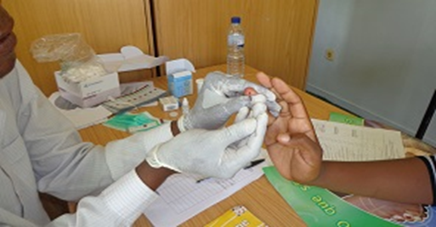
Results: Intervention Reach
Implemented from March – December 2017
Community Dialogues
  8,873 people reached; 51% men
Positive Prevention
  821 people reached; 71% men LHIV
HIV testing campaign
  3,107 people reached within one month; 78% men
  4.5% of men tested were newly diagnosed, referred for care and treatment

Slide 8
Endline findings: Coverage of
*Significantly different by gender, p<0.05;
Denominator for Positive Prevention groups are PLHIV
Notes:
The endline survey was conducted February to March 2018, surveying 2,447 participants from the baseline and was a retention rate of 81%. A total of 241 reported living with HIV, which comprised 9% of men and 19% of women.
As the community-based survey is a probability-based sample of the population, the survey gives a sense of the coverage of the various Sawa Sawa activities across the intervention communities, as demonstrated in this figure.
[click]
If we focus on the top section of the slide, this tells us about primary exposure- that is direct involvement in any one of these Sawa Sawa activities. Radio programs had the greatest coverage, as over 47% of the sample reported hearing the Sawa Sawa radio programs and spots. Community Dialogue groups reached over one-third of the population while Positive Prevention groups reached almost 30% of PLHIV in the community. A total of 16% of the population were tested via the Sawa Sawa HIV testing campaign; of these, 40% of men reported that they were tested for the first time. In total, 60% of the population was exposed to at least one Sawa Sawa activity, with no difference by gender. Importantly, with HIV interventions, we often observe that women tend to have more exposures to HIV interventions, but here we generally see no difference across gender when we look at any primary exposure to Sawa Sawa. [click]
Turning our attention to the bottom half of the slide, we can also assess secondary exposure to the intervention – this was measured by asking participants who did not participate in Sawa Sawa activity if they had a discussion about the activity and its content with anyone who had participated. In this case, we see that Sawa Sawa messages continue to be shared even with those had not directly participated.

Slide 9
Intervention impact:
Stigma among all participants
Estimated using residualized change models*
Total stigma score decreased with the overall intervention (β: -2.38; 95%CI: -3.07,-1.69; p <0.001)
  Reductions more pronounced among men (p<0.001)
HIV testing among men
Estimated using multi-level model with random effects
Increased odds of HIV testing among men associated with the intervention (aOR: 1.32; 95%CI: 1.01-1.74; p=0.049)
  Increased odds of HIV testing in the community (aOR: 1.23; 95%CI: 0.98, 1.53, p=0.073)
* Residualized models account for different starting points on stigma scales among participants
Notes:
Our primary objectives were to assess changes in community stigma over time and changes in recent HIV testing among men that were associated with the intervention.
We used a statistical method that allows us to calculate individual changes in stigma scores among individuals and pooled across sites within districts.
These methods account for different starting points on stigma scales among participants and controls for unobservable and time variant characteristics and provided approximately the same impact estimates. Using the total stigma scale score (composite of shame, discrimination and inequity subscales), we observed a significant reduction in stigma that was associated with the Sawa Sawa intervention (Beta: -2.38; 95%CI: -3.07, -1.69; p <0.001), which were more pronounced among men.
Using similar statistical methods that allow us to account for within person change and clustering by site, we found that the odds of HIV testing among men, a primary outcome of interest, significantly increased with the intervention.
We did observe a modest increase in perceived community stigma, which is to be expect with stigma messaging.

Slide 10
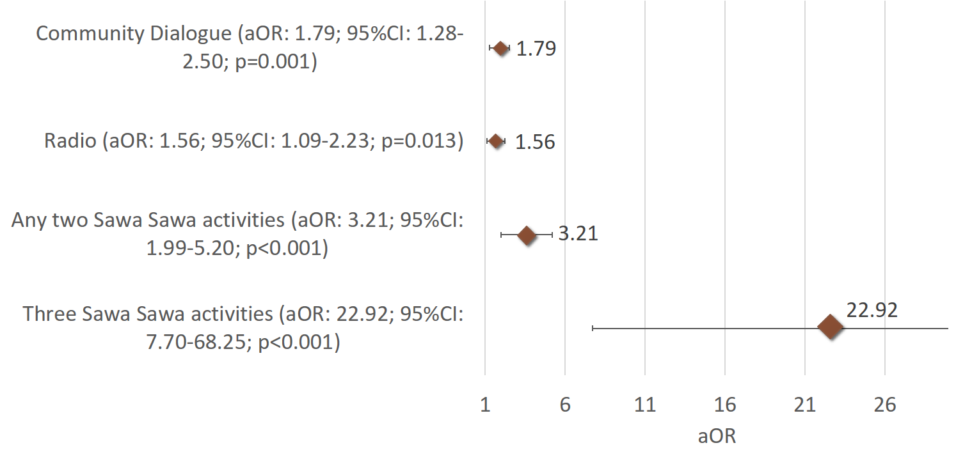
Intervention impact: HIV testing among men associated with Sawa Sawa
Notes:
As a multi-pronged intervention, we investigated whether any single activity had a significant effect above the others.
While the radio and community dialogue components of the intervention were independently associated with improvements in HIV testing, the combined approach seemed to provide the greatest benefit in which the odds increase for men who were exposed to two or three activities.
In this case, participation in any two activities, compared to none, was associated with a 3-fold increased odds of HIV testing among men and participation in 3 was associated with a 22 fold-increased odds. In summary, we see that individual activities are important, but the combined approach provides greatest benefit.
Qualitative interviews highlighted past experiences of stigma, observed changes in stigma associated with the intervention, and the mechanisms by which Sawa Sawa supported HIV care.

Slide 11
Conclusions:
Sawa Sawa successfully reduced community-level stigma and improved HIV testing among men
May support achievement of local and regional HIV care continuum targets
Combination intervention approach critical
Maximizes coverage and engagement
Increased engagement in activities provides greatest benefits in HIV testing among men
Limitation: structural barriers
Ongoing need to reduce barriers related to time for testing and service access
Notes:
In summary, we know that stigma inhibits engagement across the HIV care continuum; however, the implementation of Sawa Sawa, a community-based stigma reduction and HIV care continuum intervention, demonstrated significant impacts on community-level stigma and improving HIV testing among men.
The combination approach to Sawa Sawa was critical to the success of the intervention, not only increasing coverage within the community to reach over 60% of the men and women in these communities, but also exponentially increasing the effect of the intervention on HIV testing among men as they became more engaged in Sawa Sawa activities.
While the evaluation was not designed or powered to assess ART initiation among men as a primary outcome, there is evidence to suggest that this intervention also improves treatment outcomes for men.
There remain challenges in terms of uptake of HIV testing associated with time needed to attend facility based testing, thus an approach that combines self-testing or mobile testing with this intervention may have an even greater effect.

Slide 12
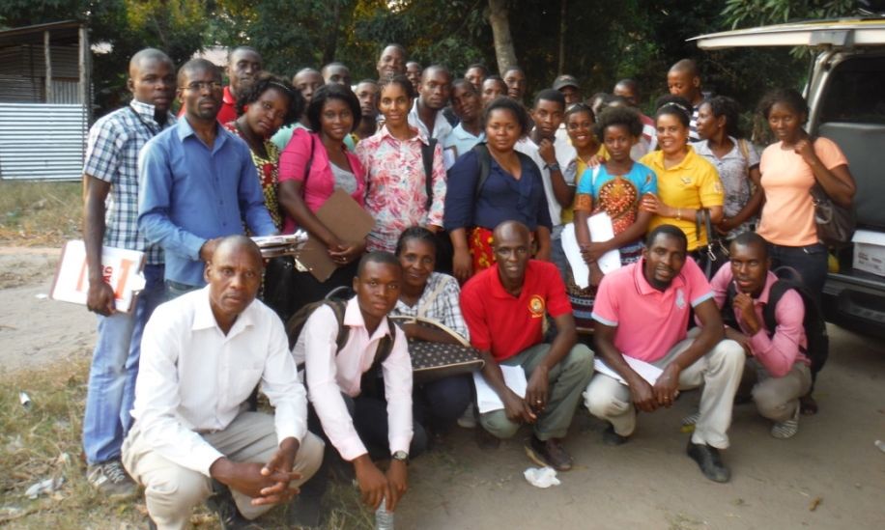
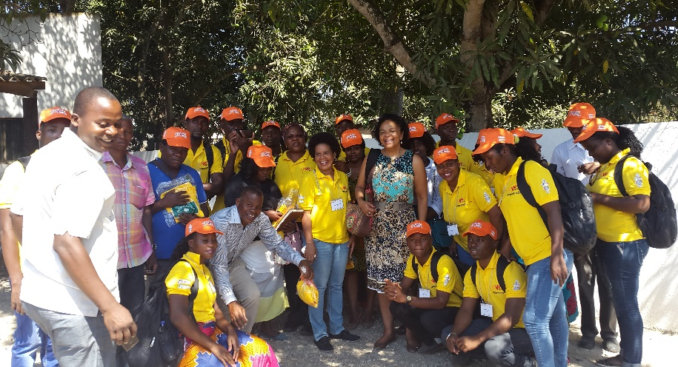
Acknowledgements
Thank you to the village of participants, facilitators, focal points, data
collectors, data entry staff, community leaders in Dondo and Nhamatanda
who contributed substantial effort to this project.
CCP-HC3: Lynn Van Lith, Beth Mallalieu,
Patrick Devos, Dida Pinho, Jose “Braz” Chidassicua, Matilde Cunhaque
JHU: Andrea Wirtz, Jackie Tran, Shirley Yan, Bee-Ah Khan
USAID: Kim Ahanda
USAID Maputo: Lopa Basu, Shadit Murargy, Julio Machava, Ferreira Ferreira
Our hearts and prayers go to all of the wonderful people of Beira, Sofala Province
Notes:
I’d like to close by thanking everyone for your attention, to thank the participants whose involvement and experiences made this work possible, and the enormous team who implemented this work. Most importantly I extend gratitude and love to the people of Sofala Province who are recovering from the recent Cyclone.

