Slide 1
Notes:
Good afternoon everybody and Welcome to Mexico City.
My name is Pablo Belaunzaran and I work at the Instituto Nacional de Ciencias Médicas y Nutrición Salvador Zubirán, here in Mexico City, as a researcher and clinician.
It is an honour for me to share this symposium about the importance of non-communicable diseases in people ageing with HIV with my colleagues in the panel; all four accomplished and recognized

Slide 2
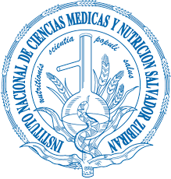
Ageing successfully with controlled HIV: The importance of non-communicable diseases
Pablo F Belaunzarán-Zamudio
Department of Infectious Diseases, Instituto Nacional de Ciencias Médicas y Nutrición Salvador Zubirán.
Mexico City
@BelaunzaranF
Share your thoughts on this presentation with #IAS2019

Slide 3
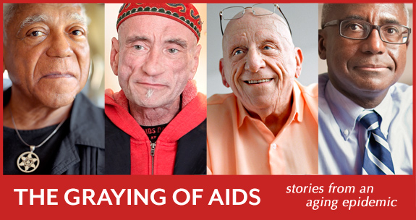
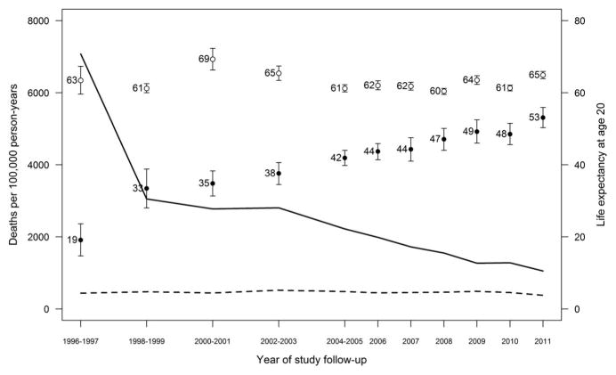
Introduction
Percentage of HIV + patients older than 50 years actively receiving care each year by age-group at enrollment in 7 CCASAnet centers in Latin America (2000-2015)
Kaiser Permanente California (1996–2011)
(n=24,768 HIV+ / n=257,600 HIV-)
Dealing with the complications of success.
Combined ART associated to:
Decreasing mortality rates
Increasing life-expectancy
Reduction in AIDS-defining events
Epidemiological transition
Shift in distribution of causes of death
Increasing age in adult population
Is this a good thing?
Of course it is!, but…
N=5,505
Caro-Vega Y, et al. Epidemiology & Infection 2018
Marcus JL, et al. JAIDS 2016
Notes:
- This symposium is all about how we are learning to deal with the enormous success of antiretroviral therapy for HIV-infection.
The use of combined antiretroviral therapies after its conception in 1996, was followed in high-income countries by an abrupt decrease in mortality rates among people living with HIV, paired to progressive increases in life-expectancy at ART initiation.
These changes, have lead an epidemiological transition in the population living with HIV.
Other consequences of the use of ART has been the reductions in the incidence of infectious and non-infectious AIDS defining events; and changes in the frequency of causes of death which have shifted from AIDS-related deaths to an increasing relative importance of complications of non-communicable diseases not traditionally associated to HIV-infection.
And of course, as people receiving ART lives longer, the proportion of the population living with HIV in older age groups have been also increasing, as we can see in this figure illustrating the how the proportions of people receiving care for HIV in 7 Latin American centers, has increased over time from 8% in 2000 to 25% by 2015. This growth is mainly determined by the increasing survival of people enrolling in care before 50 years of age and ageing receiving care as you can see in the gray portions of the bar, but also by the increasing population of people diagnosed and enrolled in care after 50 years of age, that survives to continue on care in subsequent years, shown here in the orange portion of the bars.
But this is also the example of what is occurring all around the world, and what lies behind the “graying of AIDS”,
Dr. Judith Aberg from the Mount Sinai Hospital will talk us about the epidemiology and the science of Ageing and HIV.
Dr Aberg will talk about age distribution of PWH and provide us with a general overview of the most frequent health conditions
affecting older patients with HIV.
She will also show us the recent data on the epidemiology of multimorbidity in cohorts of ageing people with HIV in North America and how can the epidemiology of multimorbidity can be framed in the polypathology by age, and talk about the underlying immunopathological and inflammatory mechanisms of ageing in people with HIV and some of its clinical applications.

Slide 4
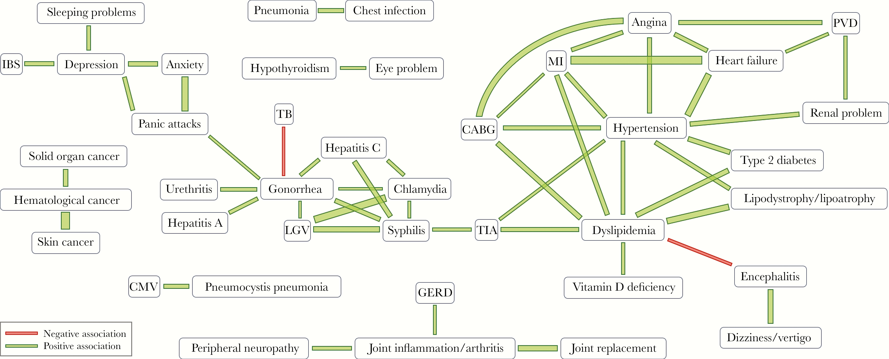
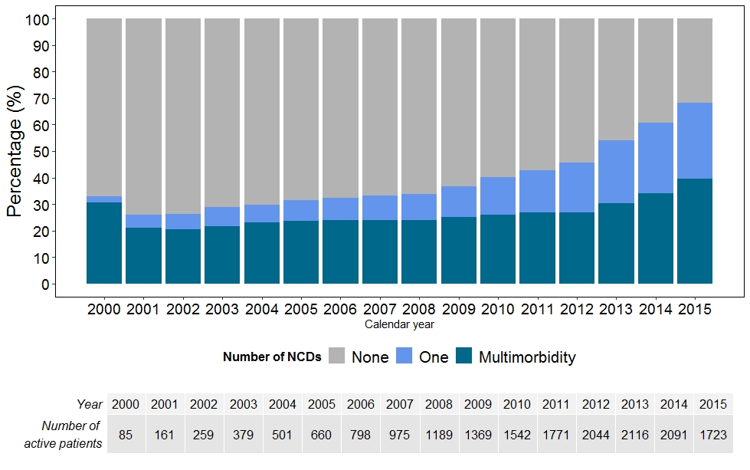
The importance of non-communicable diseases
Annual prevalence of NCDs and MM in people 50 years of age or older receiving care for HIV in 6 centers in Latin America (2000-2015).
It´s complicated…
Ageing people have different health care needs
HIV healthcare is NO longer exclusively about HIV:
People with HIV require integral healthcare services traditionally provided through primary care..
2. Frequency of non-communicable diseases (NCDs) and multiple NCDs (MM) is higher than in adults without HIV.
In Latin America: 68% >1 NCDs % 40% >2 NCDs
Dyslipidemia | 32%
Hypertension | 17%
Diabetes | 11%
Cardiovascular | 8%
Psychiatric | 13%
CCASAnet. Unpublished

Slide 5
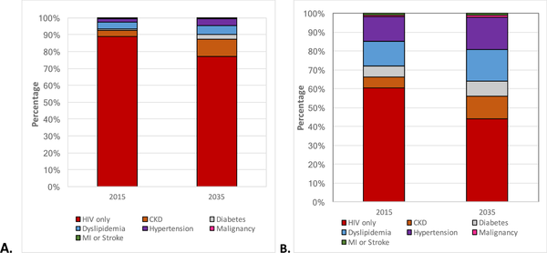
Percentage contribution of HIV and NCD treatment costs to overall costs of care of HIV-positive patients on ART
Italy
USA
HIV
HIV
HIV
HIV
2015
2035
2015
2035
Smit M, et al. PLOS ONE 2017

Slide 6
Impact of polypharmacy (PP) on ART prescription in people living with HIV.
PP negatively associated with STR
RRR= 0.48 (95%CI = 0.28-0.81)
Frailty
RRR = 0.68, 95% CI = 0.59-0.78) (FI)
Adjustment: age, gender, HIV infection duration, current and nadir CD4 and calendar year
Guaraldi J. J Antimicrob Chemother 2017

Slide 7
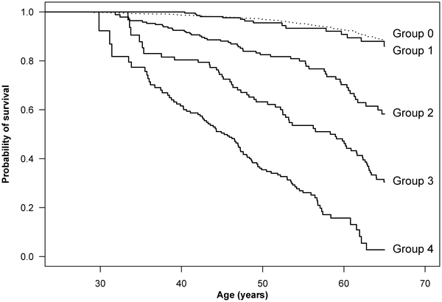
Impact of Non-HIV and HIV Risk Factors on Survival
Cumulative survival for HIV-infected patients starting ART
Danish HIV Cohort Study (1998-2009)
Mortality in patients without risk factors on a successful cART is similar to that of non–HIV.
Increased risk of death mainly attributable to risk factors identifiable at ART initiation.
Risk of death due to NCD and/or substance abuse greater than poor viral or immune response to ART.
Population cohort
HIV+ controlled
0 NCD / 0 abuse
HIV+ uncontrolled
0 NCD / 0 abuse
NCD
0 abuse / HIV+
Abuse
HIV+ / + NCD
Obel N, et al. PLOS ONE 6(7): e22698.
Notes:
Time was calculated from 1 year after start of HAART. The study population was categorized as: Group 0: Population comparison cohort (dotted line, N = 9,068). Group 1: HIV-infected patients without HIV risk factors, comorbidity or alcohol/drug abuse (N = 871). Group 2: HIV-infected patients with HIV risk factors, but no comorbidity or alcohol/drug abuse (N = 704). Group 3: HIV-infected patients with comorbidity, but no alcohol/drug abuse (N = 379). Group 4: HIV-infected patients with alcohol/drug abuse (N = 313). HIV risk factors: detectable viral load (>49 copies/ml) and/or CD4 below 200 cells/ul at the last measurement prior to the index date and/or AIDS- defining disease as of the index date. Comorbidity: diagnosed with comorbidity as defined in the Charlson Comorbidity Index before index date. Abuse: diagnosed with drug or alcohol abuse before index date or reporting drug abuse as route of HIV transmission.
We included HIV-infected patients aged 25–65 who started HAART between 1 January 1998 and 1 July 2009, were registered in the CRS, and lived in Denmark at start of HAART. HAART was defined as a treatment regimen of at least three antiretroviral drugs or a treatment regimen including a combination of a non-nucleoside reverse transcriptase inhibitor and a boosted protease inhibitor. For HIV-infected patients, the index date was defined as 1 year after start of HAART.
We also used the CRS to identify a comparison cohort drawn from the general population, consisting of 4 individuals for each HIV-infected patient, matched on age and date of birth. To be eligible, matched individuals had to be alive on the index date of the corresponding HIV-infected patient, had to be living in Denmark on the date the corresponding patient started HAART, and could not be registered as having a comorbidity included in the Charlson Comorbidity Index (CCI), alcoholism, or drug abuse, as of the index date. The index date of individuals in the comparison cohort was defined as the index date of the corresponding HIV-infected patient.
Risk factors
Risk factors were defined as follows:
HIV risk factors.
Detectable viral load (>49 copies/ml) and/or CD4 below 200 cells/ul at the last measurement prior to the index date and/or AIDS- defining disease as of the index date.
Comorbidity.
Diagnosed with comorbidity (excluding AIDS-defining diseases) as defined in the Charlson comorbidity index (CCI) [12]–[14] before the index date. Hepatitis C, if registered in the Danish HIV Cohort Study, also was included as comorbidity.
Alcohol and drug abuse.
Drug abuse reported as the route of HIV transmission or hospital contacts before the index date with the following diagnoses: ICD-8: 29100–29199, 57109, 57110, 30300–30389, 30391–30399, 30409–30499; and ICD-10: K700–K709, F102–109, G312, F110–199, or T400.

Slide 8
16:40 WESY0702 | Ageing and HIV – what is the epidemiology and the science?
 | Judith Aberg, The Mount Sinai Hospital
17:00 WESY0703 | Noncommunicable diseases among persons living with HIV
 | Andrew Carr, St Vincent’s Hospital
17:25 WESY0704 | Risk and prevention of diabetes in PLWH
 | Jonathan Colasanti, Emory University School of Medicine
17:45 WESY0706 | Q&A

