Slide 2
“Test and treat” approaches to HIV care may affect the Xpert MTB/RIF testing impact in high burden TB/HIV settings: results from a cohort from a rural hospital in Southern Mozambique
Emilio Valverde, The Aurum Institute
@Auruminstitute
Share your thoughts on this presentation with #IAS2019

Slide 3
Conflict of interest
Authors of this abstract have no conflict of interest to disclose
Edy Nacarapa, Hospital Carmelo
Maria Elisa Verdú-Jordá, Hospital Carmelo
Troy D. Moon, Vanderbilt Institute for Global Health
Gavin Churchyard, The Aurum Institute
Emilio Valverde, The Aurum Institute
Study cleared by the Mozambican Bioethics Committee (25/CNBS/2019)

Slide 4
Background
Xpert MTB/RIF rolled out globally as the initial diagnostic test for TB.
Available in Mozambique since 2011, defined as the initial test since 2016.
Reported to significantly increase bacteriologically confirmed TB cases and multi-drug resistant TB cases.¹
Two-fold increase in the number of HIV-associated TB cases reported^{2,3} following Xpert MTB/RIF introduction.
¹Boehme CC, et al. Rapid Molecular Detection of Tuberculosis and Rifampin Resistance. N Engl J Med. 2010, 363(11):1005-1015
²Lawn SD, et al. Screening for HIV-associated tuberculosis and rifampicin resistance before antiretroviral therapy using the Xpert MTB/RIF assay: a prospective study. PLoS Med. 2011, 8(7):e1001067
³World Health Organization. Xpert MTB/RIF for people living with HIV. WHO: Geneva, Switzerland. 2014
Notes:
Since its appearance in 2010, Xpert MTB/RIF has become one of the first choices to diagnose tuberculosis.
In developing countries, international cooperation programs like The Global Fund fors AIDS, Malaria and Tuberculosis and PEPFAR have promoted roll out of GeneXpert testing trying to increase TB detection rates and consequently numbers of patients treated. In Mozambique Xpert was introduced in 2011, and subsequently was defined as the initial diagnostic TB test in 2016.
Different reports have shown that Xpert MTB/RIF use increases significantly the number of bacteriologically confirmed TB cases and multi-drug resistant TB cases.
For HIV-associated tuberculosis, Xpert MTB/RIF has been also reported by WHO and independent researchers to increase two-fold the number of cases detected.

Slide 5
Background
Universal test and treat approach to HIV care⁴ since 2015.
Approach is meant to improve survival and outcomes for persons diagnosed with HIV.
Possible focus shift from pre-ART interventions to immediate ART start.
This study explores the link between Xpert MTB/RIF introduction, universal test and treat and TB treatment outcomes in a rural hospital in southern Mozambique.
⁴World Health Organization. Guideline on when to start antiretroviral therapy and on preexposure prophylaxis for HIV Guidelines. WHO: Geneva, Switzerland; 2015
Notes:
For HIV patients, WHO and other health agencies recommend since 2015 a universal test and treat approach starting ART in all HIV diagnosed persons independent of CD4 count as the basic pillar of the UNAIDS 90-90-90 strategy. In developing countries this recommendation has generated a strong pressure from the donor community to quickly increase the numbers of individuals on ART.
Universal test and treat is meant to improve survival and outcomes for persons diagnosed with HIV. However, in high-burden HIV/TB contexts, pressure to quickly start ART in individuals with a positive HIV result may reduce focus on pre-ART interventions, among them the necessary screening for TB in all individuals newly diagnosed with HIV.
Through the analysis of a large cohort of TB patients from a rural hospital in southern Mozambique, we want to explore the relationships between Xpert introduction, universal test and treat and TB treatment outcomes.

Slide 6
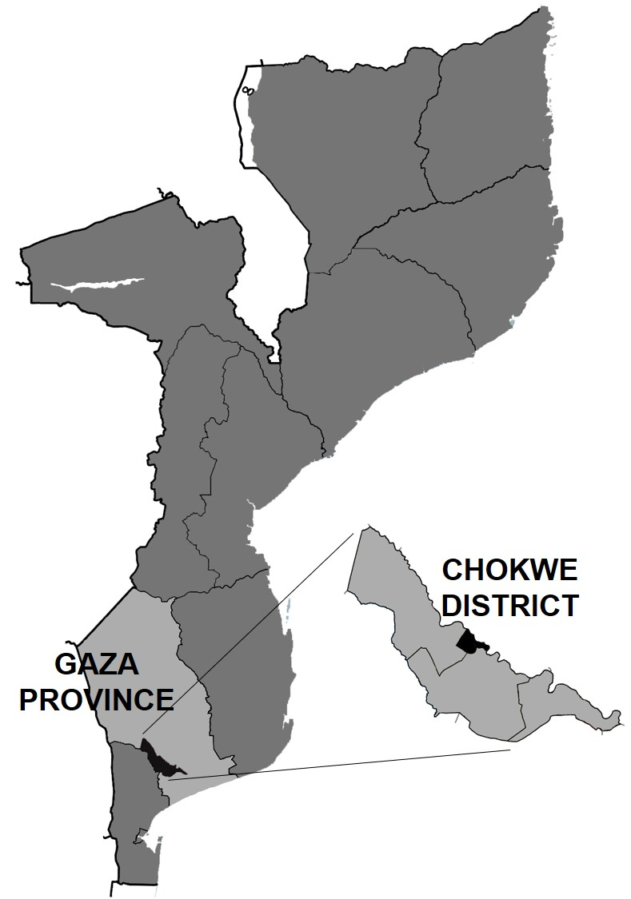
Methods
Carmelo Hospital of Chókwè (CHC) is a TB/HIV reference center in Gaza Province in Southern Mozambique.
Retrospective cohort study of TB infected patients ≥15 years of age, diagnosed and treated at CHC between January 1st, 2006 and December 31st, 2017.
Notes:
Carmelo Hospital of Chókwè is a large rural TB/HIV reference center in Gaza Province, Southern Mozambique, (with a catchment population of 200,000, but receiving also many patients referred from other districts. Male population of Chókwè district has traditionally migrated to South Africa to work in the mines, coming back home for holidays but also very often when feeling sick.)
Carmelo Hospital was one of the centres pioneering introduction of ART in Mozambique back in 2002, and has currently more than 12,000 patients on treatment. Approximately 1,000 tuberculosis patients per year are diagnosed and treated at Carmelo.
Carmelo Hospital has Xpert MTB/RIF testing available since the beginning of 2013, with number of tests performed increasing gradually every year.
As per the national HIV program policies, Carmelo introduced universal test and treat in August 2016.
We conducted a retrospective 12-years cohort study of the tuberculosis patients of 15 years of age and older, consecutively diagnosed and treated at Carmelo Hospital between January 1st 2006 and December 31st 2017.

Slide 7
Methods
Data collected:
Patient demographics
Sputum smear results
Xpert MTB/RIF results
TB treatment starting and end dates
HIV treatment starting dates
Treatment outcomes
Notes:
Patient characteristics recorded in the hospital registry documents were collected, including demographics, results of sputum smear and Xpert MTB/RIF, TB starting and end dates, treatment outcomes, and ART starting and end dates. HIV-negative patients were followed only for the length of the anti-TB treatment.
The evolution and trends in TB treatment outcomes were plotted and analyzed, focusing on the two main events happening in the period: introduction of Xpert MTB/RIF testing and HIV test and treat approach.

Slide 8
Methods
Data collected:
Patient demographics
Sputum smear results
Xpert MTB/RIF results
TB treatment starting and end dates
HIV treatment starting dates
Treatment outcomes
Evolution and trends of treatment outcomes were plotted and analyzed, focusing on introduction of Xpert MTB/RIF testing and universal test and treat approach.
Notes:
Patient characteristics recorded in the hospital registry documents were collected, including demographics, results of sputum smear and Xpert MTB/RIF, TB starting and end dates, treatment outcomes, and ART starting and end dates. HIV-negative patients were followed only for the length of the anti-TB treatment.
The evolution and trends in TB treatment outcomes were plotted and analyzed, focusing on the two main events happening in the period: introduction of Xpert MTB/RIF testing and HIV test and treat approach.

Slide 9
Results
Notes:
(Some patients were excluded because they were transferred before completion of treatment, duplication and missing data. Patients transferred to Carmelo after starting anti-TB treatment were also not included.)
Close to 45% were female patients.
Practically the totality of patients in the cohort was tested for HIV, above the national averages.
The rate of TB/HIV co-infection was 83.5% well above other co-infection rates reported for other sites in Mozambique and also above the co-infection rates reported in the annual NTP reports. This is probably an effect of the status of Carmelo Hospital as reference center, often receiving complicated and difficult-to-treat cases from other health facilities.

Slide 10
Results
Notes:
(Some patients were excluded because they were transferred before completion of treatment, duplication and missing data. Patients transferred to Carmelo after starting anti-TB treatment were also not included.)
Close to 45% were female patients.
Practically the totality of patients in the cohort was tested for HIV, above the national averages.
The rate of TB/HIV co-infection was 83.5% well above other co-infection rates reported for other sites in Mozambique and also above the co-infection rates reported in the annual NTP reports. This is probably an effect of the status of Carmelo Hospital as reference center, often receiving complicated and difficult-to-treat cases from other health facilities.

Slide 11
Results
Xpert MTB/RIF introduction
test and treat approach
No increase in the number of TB/HIV co-infected patients after introduction of Xpert MTB/RIF
Notes:
Number of patients with TB/HIV co-infection varied between 600 and 800 cases per year, while yearly TB/HIV co-infection rates slightly fluctuated around 80%. However, no statistically significant difference or increase was noticed after introduction of Xpert MTB/RIF testing.

Slide 12
Results
Bacteriologically confirmed cases dropped from 42.4% in 2006 to 22.0% in 2017.
Xpert MTB/RIF introduction
test and treat approach
Notes:
Number of patients with TB/HIV co-infection varied between 600 and 800 cases per year, while yearly TB/HIV co-infection rates slightly fluctuated around 80%. However, no statistically significant difference or increase was noticed after introduction of Xpert MTB/RIF testing.

Slide 13
Results
Mortality decreased up until 2013, but increased again until 2017.
Increase more evident in 2016/2017, coinciding with the start of the “universal test and treat” approach for HIV.
Treatment mortality rates disaggregated by sex, 2006-2017
Xpert MTB/RIF introduction
test and treat approach
Notes:
Mortality during TB treatment showed a trend to go down, from 22.0% in 2006 to 12.1% in 2013, immediately after Xpert MTB/RIF introduction. However, this trend was immediately reversed and mortality increased again up to 25.7% in 2017, as shown in the graph. This increase is more evident in 2016 and 2017, coinciding with the start of the “universal test and treat” approach for HIV.

Slide 14
Results
Proportion of PLHIV starting TB treatment prior to ART initiation declined after introduction of universal test and treat.
Notes:
The proportion of people with HIV starting anti-TB treatment before ART initiation was steady around 60% until 2015, but afterwards came down to 31.7% in 2017. This decrease was statistically significant, and most probably suggests a reduction in TB screening at the time of people enrolment on the HIV program.
People with actual TB disease missed before ART start will later develop TB as IRIS in the first months of ART.
Actually, an increase in the proportion of TB cases diagnosed within 90 days after ART initiation is evidenced in 2016 and 2017.

Slide 15
Results
Proportion of PLHIV starting TB treatment prior to ART initiation declined after introduction of universal test and treat.
Possible reduction in TB screening before ART initiation.
Notes:
The proportion of people with HIV starting anti-TB treatment before ART initiation was steady around 60% until 2015, but afterwards came down to 31.7% in 2017. This decrease was statistically significant, and most probably suggests a reduction in TB screening at the time of people enrolment on the HIV program.
People with actual TB disease missed before ART start will later develop TB as IRIS in the first months of ART.
Actually, an increase in the proportion of TB cases diagnosed within 90 days after ART initiation is evidenced in 2016 and 2017.

Slide 16
Proportion of TB cases diagnosed ≤90 days after ART correlates with mortality observed in co-infected patients
Xpert MTB/RIF introduction
HIV “test and treat” approach
Treatment death rate vs. % TB cases diagnosed ≤90 days after ART start, TB/HIV co-infected patients, 2006-2017
Pearson coefficient 0.8
Notes:
Furthermore, variations in the proportion of TB cases diagnosed within 90 days after ART initiation is closely correlated with the variation in treatment death rates.
Graph shows the existing correlation between the proportion of TB cases diagnosed within 90 days after ART initiation and treatment death rates.

Slide 17
Limitations
Being a retrospective study, data availability was limited and often incomplete.
This may have implications in the calculations of treatment outcome rates.
Data come from only one site.

Slide 18
Conclusions
Challenges remain as to how best to integrate Xpert MTB/RIF into diagnostic algorithms to maximize its impact on TB morbidity and mortality.
Observed increase in mortality rates could be potentially linked to the loss of pre-ART interventions, particularly missing TB screening in patients newly diagnosed with HIV.
HIV care “test and treat” approach implementation should be reviewed to highlight the need of reasonably excluding TB disease before ART start.
Notes:
Roll out of Xpert MTB/RIF testing faces many challenges hampering the impact of this technology on TB morbidity and mortality. We need to explore the data more to understand the reasons behind this decrease, although we believe some of them may be lack of training, low compliance of diagnostic algorithms, no clear criteria to prioritize samples for testing, low throughput of Xpert machines, lack of availability of consumables, and quality of sputum samples.
The observed increase in mortality rates could be potentially linked to the loss of pre-ART interventions, particularly missing TB screening in patients newly diagnosed with HIV, causing some patients with active TB disease to start ART with undiagnosed TB which will later appear as IRIS-TB, more difficult to manage in resource-limited rural contexts. The implementation of “test and treat” approaches needs review and clarification as it is necessary to reinforce a reasonable exclusion of active TB disease before starting ART.

