Slide 2
Transgender People’s Experiences in HIV Testing, Sexual Partner Based Violence and Mental Health in Malawi
Eric Umar, PhD

Slide 3
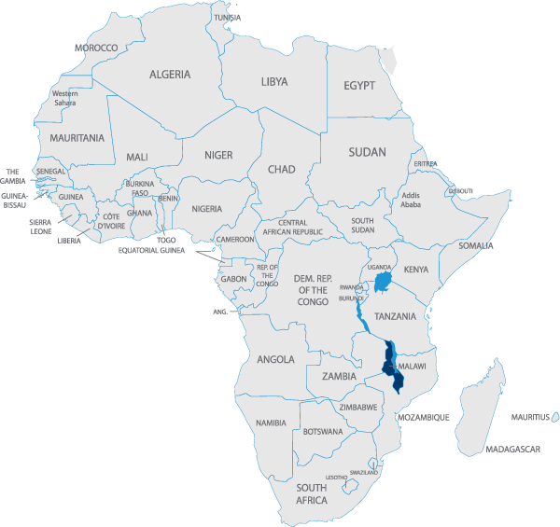
Malawi
Landlocked country.
south-eastern Africa
Estimated pop – 17.5 Million
70% of population – below the international poverty line

Slide 4
Study Objectives
Broad Objective
Identify the needs of Malawi’s transgender community regarding health seeking and their experiences
Specific Objective
To explore transgender people’s practices in regard to HIV testing
To establish incidents of sexual gender based violence
To examine mental health issues experienced

Slide 5
Methodology
Study Design : Cross sectional – Mixed Methods
Data Collection Methods
Desk Review
Survey - 117
Focus Group Discussions
Data Management and Analysis – SPSS and NVIVO

Slide 6
Results
Demographic Details
Age | Mean | 23.3 | SD 4.0
Schooling | Out of school | 34 | 29.3 %
 | In school | 82 | 70.7 %
Education Level | Primary | 14 | 12.0 %
 | High School | 85 | 72.6 %
 | College | 18 | 15.4 %
Employment | Self-employed | 29 | 26.1 %
 | Employed | 21 | 18.9 %
 | Unemployed | 61 | 55.0 %
Religion | Catholic | 29 | 24.8 %
 | Protestant | 34 | 29.0 %
 | Pentecostal | 13 | 11.1 %
 | Islam | 19 | 16.2 %
 | Other | 22 | 18.8 %

Slide 7
Self-Identified Transgender Identity

Slide 8
Gender Identity Experiences
 |  | Transwoman |  | Transman | Genderqueer |  |  | All
What Gender do people say you are?
 | Male | 24 (37.5 %) | 36 (75. 0 %) |  |  |  | 60 (51.7 %)
 | Female | 39 (60. 9 %) | 8 (16.7 %) |  |  |  | 47 (40.5 %)
 | Intersex | 1 (1.6 %) | 4 (8.3 %) |  |  | 4 (100%) | 9 (7.8 %)
Do people notice/tell you are transgender?
 | Yes | 38 (60.3 %) |  | 24 (50 %) |  | 2 (50 %) | 69 (60.5 %)
 | No | 25 (39.7 %) |  | 24 (50 %) |  | 2 (50 %) | 45 (39.5 %)
Do you disclose your gender identity?
 | Yes | 34 (52.3 %) |  | 24 (50 %) |  | 2 (50 %) | 60 (51.3 %)
 | No | 31 (47.7 %) |  | 24 (50 %) |  | 2 (50 %) | 57 (48.7 %)

Slide 9
HIV Testing
 |  | Transwoman | Transman | Genderqueer | All
Ever Tested for HIV
 | Yes | 59 (90.8 %) | 44 (91.7 %) | 4 (100 %) | 107 (91.4 %)
 | No | 6 (9.2 %) | 6 (8.3 %) |  | 10 (8.6 %)
Ever sought STI Treatment
 | Yes | 36 (55.4%) | 12 (25.0%) | 4 (100%) | 52 (44.4 %)
 | No | 29 (44.6%) | 36 (75.0%) |  | 65 (55.6%)

Slide 10
Sexual Partner Based Violence
 |  |  | Transwoman | Transman | Genderqueer | All
In a romantic / sexual relationship
 |  | yes | 60 (92.3%) | 46 (95.8%) | 4 (100%) | 110 (94.0%)
 |  | No | 5 (7.7%) | 2 (4.1%) |  | 7 (6.0%)
Sexual partner physically / verbally abusive
 |  | Yes | 20 (32.5%) | 15 (31.3%) |  | 35 (30.7%)
 |  | No | 42 (67.7%) | 33 (68.7% | 4 (100%) | 79 (69.3%)
Experienced unwanted sexual contact
 |  | Yes | 20 (31.8% | 7 (14.6%) |  | 27 (23.5%)
 |  | No | 43 (68.2%) | 41 (85.4%) |  | 88 (76.5%)

Slide 11
Mental Health

Slide 12
Mental Health (cont.)

Slide 13
Health seeking experiences

Slide 14
Acknowledgements

