Slide 1
Apples and Oranges: Assessment of the Care Cascade in sub-Saharan Africa - Systematic Review of Criteria and Definitions used in Academic Papers
Catrina Mugglin, Delia Kläger, Aysel Gueler, Fiona Vanobberghen, Brian Rice, Matthias Egger

Slide 2
Background
Monitoring and evaluation are needed to track linkage and retention throughout the continuum of care
Study Selection and Data Extraction
Reporting on at least two steps of the HIV care cascade
Reporting defined as providing number or percentage for the step
Extracted definitions for numerator and denominator at each reported step
Methods
Systematic review to identify the different methodological approaches used to define the steps in the HIV care cascade in sub-Saharan Africa (SSA), and to assess the proportion of participants retained at each step
Articles reporting on steps of the HIV cascade in SSA
Cross-sectional and cohort studies included
Linked to pre-ART care
ART initiation
Suppressed VL
Diagnosed
Retention pre-ART
Retention on ART
PLHIV
On ART

Slide 3
Results
Study Characteristic (N=58)
Year of publication | 2014 (2012-2015)
No. of people included | 1,494 (466-6,766)
Study design
Longitudinal study | 44 (75.9%)
Cross-sectional study | 10 (17.2%)
Mixed design | 4 (6.9%)
No. of steps covered | 3 (2-4)
Duration of follow-up (years) | 3 (2-5)
No. of countries included | 16
Region
Central Africa | 3 (5.2%)
East Africa | 15 (25.9%)
Southern Africa | 30 (51.6%)
West Africa | 7 (12.1%)
Multi-regional study | 3 (5.2%)
No. of sites | 2 (1 – 10)
No. of studies at national level | 2 (2.4%)
Data collection methods
Routine clinical records | 44 (75.9%)
Questionnaires | 26 (44.8%)
Samples collected specifically | 25 (43%)

Slide 4
 | HIV care cascade step | Type of data | No. of studies reporting | No. of definitions numerator | No. of definitions denominator
1 | People living with HIV | Cross-sectional and longitudinal | 8 | 6 | 5
2 | Diagnosed with HIV | Cross-sectional and longitudinal | 14 | 4 | 2
3 | Linked to pre-ART care | Cross-sectional and longitudinal | 22 | 10 | 8
4 | Retention in pre-ART care | Cross-sectional and longitudinal | 16 | 9 | 9
5 | ART initiation | Cross-sectional and longitudinal | 26 | 15 | 6
6 | On ART | Cross-sectional | 9 | 4 | 6
7 | Retention on ART | Cross-sectional and longitudinal | 28 | 12 | 2
8 | Viral suppression | Cross-sectional and longitudinal | 34 | 21 | 12

Slide 5
 | HIV care cascade step | Type of data | No. of studies reporting | No. of definitions numerator | No. of definitions denominator
1 | People living with HIV | Cross-sectional and longitudinal | 8 | 6 | 5
2 | Diagnosed with HIV | Cross-sectional and longitudinal | 14 | 4 | 2
3 | Linked to pre-ART care | Cross-sectional and longitudinal | 22 | 10 | 8
4 | Retention in pre-ART care | Cross-sectional and longitudinal | 16 | 9 | 9
5 | ART initiation | Cross-sectional and longitudinal | 26 | 15 | 6
6 | On ART | Cross-sectional | 9 | 4 | 6
7 | Retention on ART | Cross-sectional and longitudinal | 28 | 12 | 2
8 | Viral suppression | Cross-sectional and longitudinal | 34 | 21 | 12
Numerator:
Self-reported ART use
Pill counts as assessed by counsellor
ART use assessed through clinical records
Positive blood test for ART drug level
Denominator:
HIV+ participants
Participants currently in HIV care
Self-reported
Assessed through clinical records
5

Slide 6
 | HIV care cascade step | Type of data | No. of studies reporting | No. of definitions numerator | No. of definitions denominator
1 | People living with HIV | Cross-sectional and longitudinal | 8 | 6 | 5
2 | Diagnosed with HIV | Cross-sectional and longitudinal | 14 | 4 | 2
3 | Linked to pre-ART care | Cross-sectional and longitudinal | 22 | 10 | 8
4 | Retention in pre-ART care | Cross-sectional and longitudinal | 16 | 9 | 9
5 | ART initiation | Cross-sectional and longitudinal | 26 | 15 | 6
6 | On ART | Cross-sectional | 9 | 4 | 6
7 | Retention on ART | Cross-sectional and longitudinal | 28 | 12 | 2
8 | Viral suppression | Cross-sectional and longitudinal | 34 | 21 | 12
Numerator:
Viral load threshold ranged from < 25 copies / ml to < 5,000 copies / ml
Time points at which viral suppression was assessed ranged from 1 month on ART to 10 years on ART
6

Slide 7
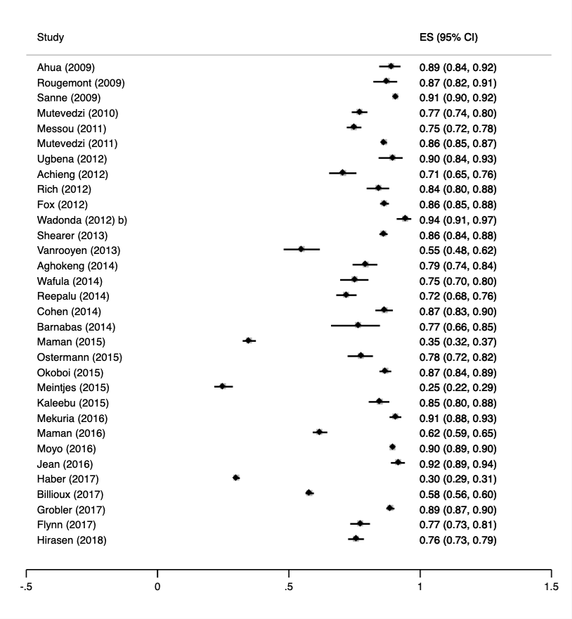
 | HIV care cascade step | Type of data | No. of studies reporting | No. of definitions: numerator | No. of definitions: denominator
1 | People living with HIV | Cross-sectional and longitudinal | 8 | 6 | 5
2 | Diagnosed with HIV | Cross-sectional and longitudinal | 14 | 4 | 2
3 | Linked to pre-ART care | Cross-sectional and longitudinal | 22 | 10 | 8
4 | Retention in pre-ART care | Cross-sectional and longitudinal | 16 | 9 | 9
5 | ART initiation | Cross-sectional and longitudinal | 26 | 15 | 6
6 | On ART | Cross-sectional | 9 | 4 | 6
7 | Retention on ART | Cross-sectional and longitudinal | 28 | 12 | 2
8 | Viral suppression | Cross-sectional and longitudinal | 34 | 21 | 12

Slide 8
Conclusion
Most studies reported clear definitions of numerator and denominators used
Cascade step definitions were heterogeneous, making comparisons across studies difficult
Only few SSA countries, with the majority of the studies coming from southern Africa
To allow tracking of progress along the care pathway and towards the 90-90-90 targets, comparable measures and definitions of numerator and denominator at each step are needed
 | HIV care cascade step | Type of data | No. of studies reporting | No. of definitions numerator | No. of definitions denominator
1 | People living with HIV | Cross-sectional and longitudinal | 8 | 6 | 5
2 | Diagnosed with HIV | Cross-sectional and longitudinal | 14 | 4 | 2
3 | Linked to pre-ART care | Cross-sectional and longitudinal | 22 | 10 | 8
4 | Retention in pre-ART care | Cross-sectional and longitudinal | 16 | 9 | 9
5 | ART initiation | Cross-sectional and longitudinal | 26 | 15 | 6
6 | On ART | Cross-sectional | 9 | 4 | 6
7 | Retention on ART | Cross-sectional and longitudinal | 28 | 12 | 2
8 | Viral suppression | Cross-sectional and longitudinal | 34 | 21 | 12
8

Slide 9
Acknowledgements
IeDEA-Southern Africa Steering Committee: Matthias Egger (co-PI), University of Bern, Switzerland; Mary-Ann Davies (co-PI), University of Cape Town, South Africa; Frank Tanser, Africa Centre for Health and Population Studies, University of Kwazulu-NatalSouth Africa; Michael Vinikoor, Centre for Infectious Disease Research in Zambia; Eusebio Macete, Centro de Investigação em Saúde de Manhiça, Mozambique; Robin Wood, Desmond Tutu HIV Centre (Gugulethu and Masiphumelele clinics), South Africa; Kathryn Stinson, Khayelitsha ART Programme and Médecins Sans Frontières, South Africa; Geoffrey Fatti, Kheth’Impilo Programme, South Africa; Sam Phiri, Lighthouse Trust Clinic, Malawi; Cleophas Chimbetete, Newlands Clinic, Zimbabwe; Kennedy Malisita, Queen Elizabeth Hospital, Malawi; Brian Eley, Red Cross War Memorial Children’s Hospital and Department of Paediatrics and Child Health, University of Cape Town, South Africa; Jochen Ehmer, Solidarmed, Switzerland; Christiane Fritz, SolidarMed SMART Programme, Lesotho; Michael Hobbins, SolidarMed SMART Programme, Mozambique; Kamelia Kamenova, SolidarMed SMART Programme, Zimbabwe; Matthew Fox, Themba Lethu Clinic, South Africa; Hans Prozesky, Tygerberg Academic Hospital, South Africa; Karl Technau, Empilweni Clinic, Rahima Moosa Mother and Child Hospital, South Africa; Shobna Sawry, Harriet Shezi Children’s Clinic, Chris Hani Baragwanath Academic Hospital, South Africa.
Funding: Research reported in this publication was supported by the National Institute Of Allergy And Infectious Diseases of the National Institutes of Health under Award Number U01AI069924. The content is solely the responsibility of the authors and does not necessarily represent the official views of the National Institutes of Health.
Contact: Catrina Mugglin, catrina.mugglin@ispm.unibe.ch; www.iedea-sa.org

