Slide 2
Status Neutral Approach to
Ending the HIV Epidemic in New York City
Demetre Daskalakis, MD, MPH
Deputy Commissioner, Disease Control
Department of Health and Mental Hygiene
@DrDemetre
Share your thoughts on this presentation with #IAS2019

Slide 3
New York Ending the HIV Epidemic: Science + COMMUNITY + Political Will

Slide 4
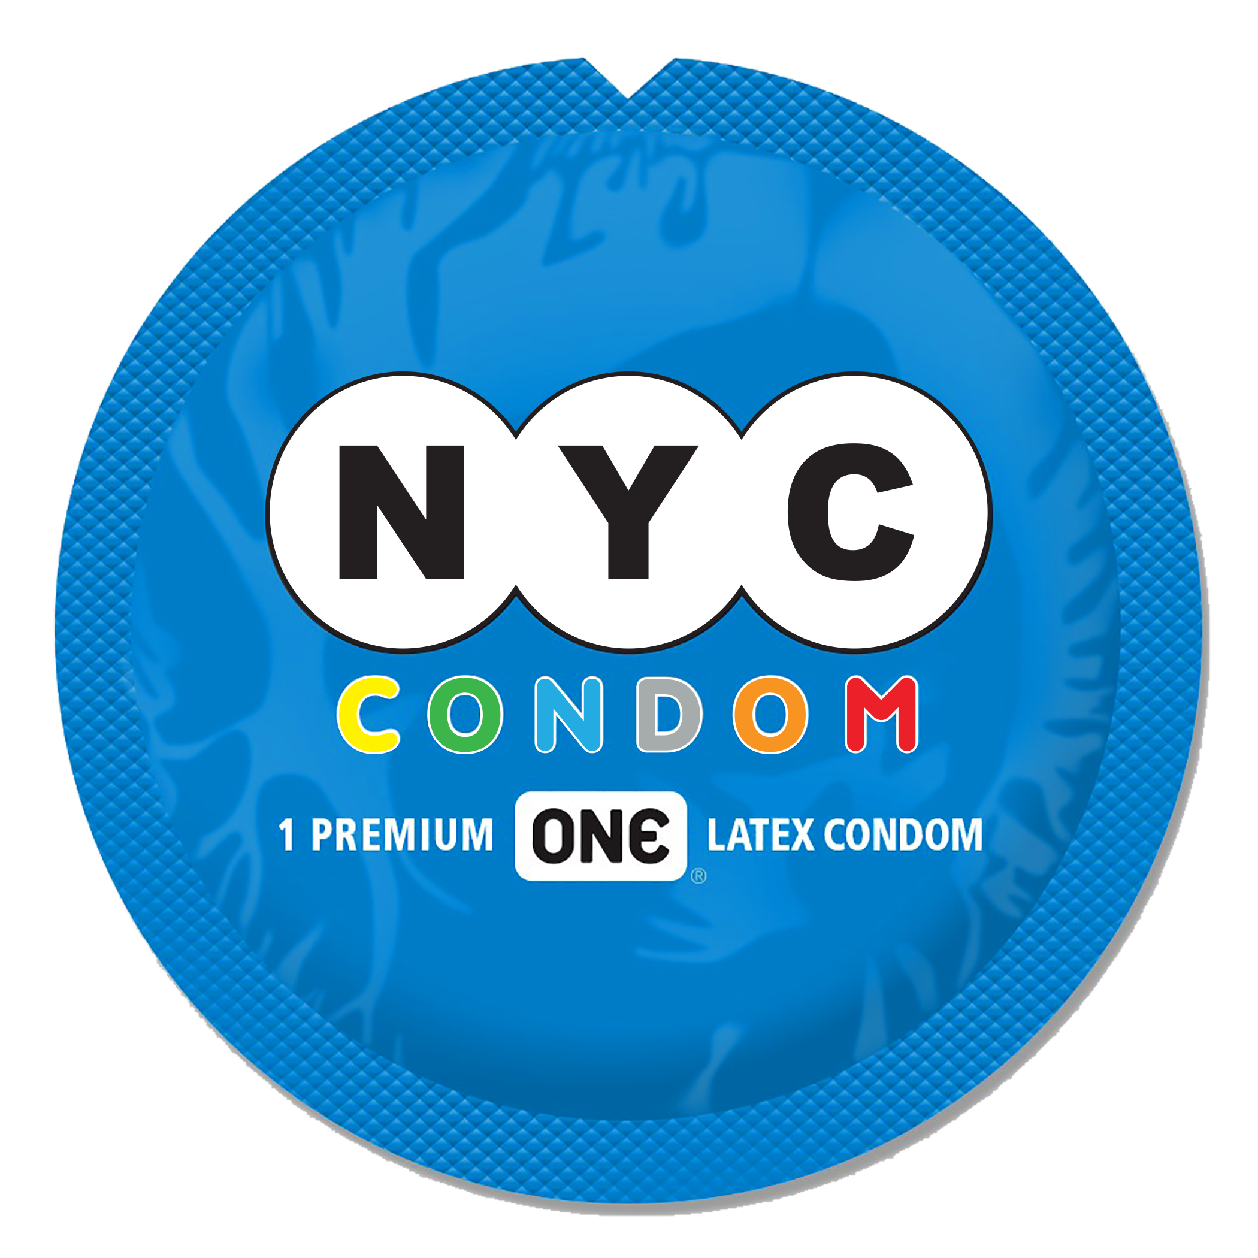

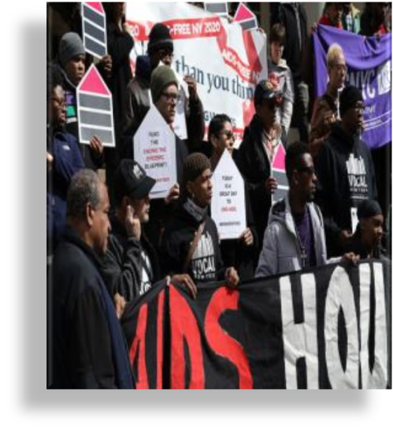
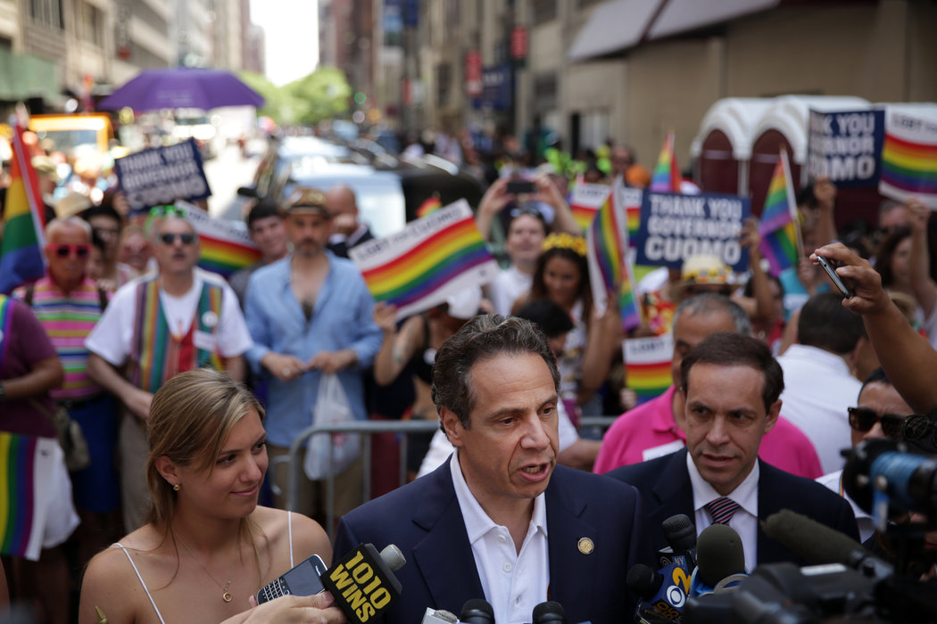
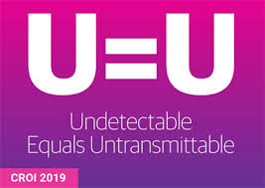
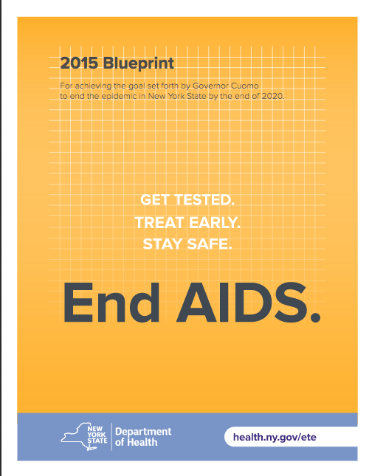
Ending the Epidemic (EtE): A Recipe
Science
Community
Political Will
Notes:
Motivated by the epidemiology, an effort began to mobilize forces and resources to actually end the epidemic in NYS.
The recipe for ending the epidemic in NYS has leveraged
Community activism
Emerging science AND
Political will
Which have all combined to support the development and ultimate acceptance of a Blueprint to end AIDS in NYS by 2010.

Slide 5
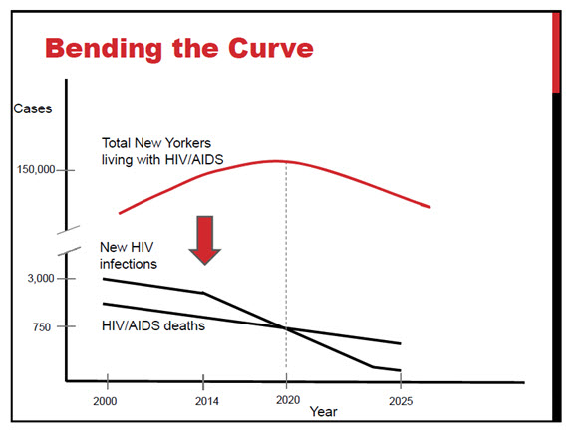
What Does Ending the Epidemic Mean?
Identify persons with HIV who remain undiagnosed and link them to health care.
Link and retain persons diagnosed with HIV in health care to maximize viral suppression so they remain healthy and prevent further transmission.
Facilitate access to Pre-Exposure Prophylaxis (PrEP) for HIV negative persons at risk of exposure.
D. Holtgrave

Slide 6
Creating The Blueprint
Recommendations solicited from the Community
October 2014: Task Force Convened
December 2014: Task force meetings to generate recommendations completed
Unanimous Agreement of All Members
January 2015: Blueprint released

Slide 7
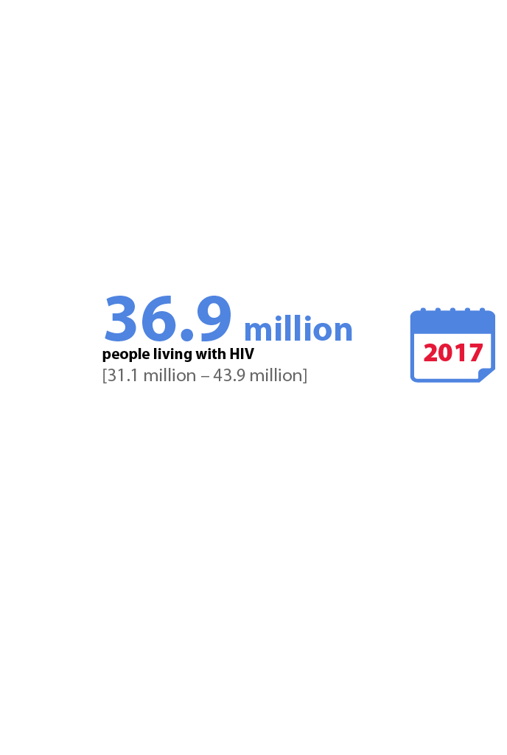
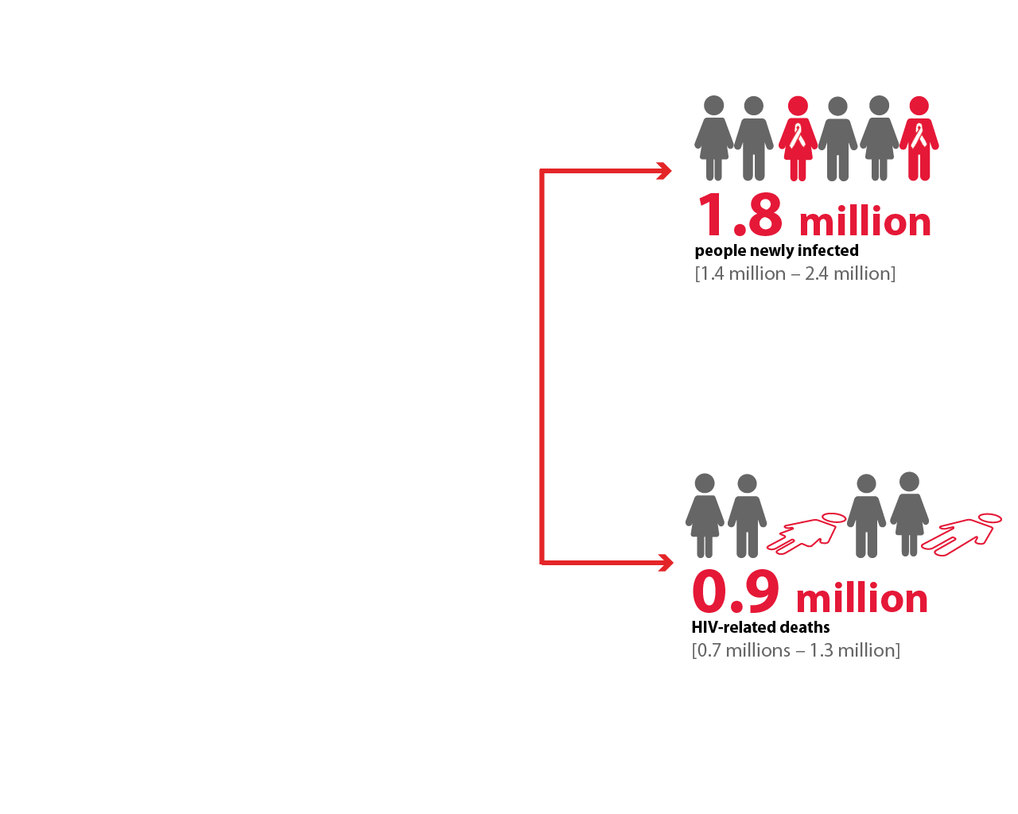
Summary of the global HIV epidemic (2017)
HIV is an Emergency: Treat it That Way!
Source: UNAIDS/WHO estimates

Slide 8
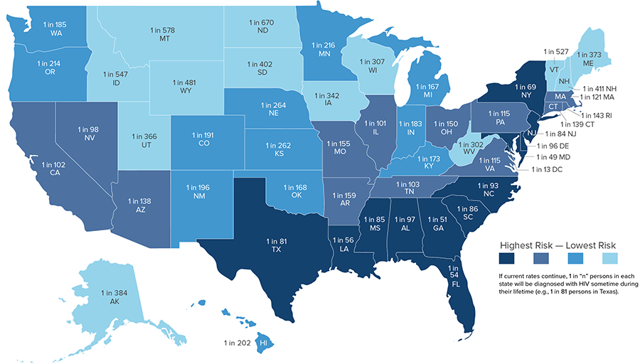
HIV is an Emergency: Treat it That Way!
CDC
Estimated Lifetime Risk of HIV

Slide 9
Ending the epidemic:
Our strategy to end HIV in new York city

Slide 10
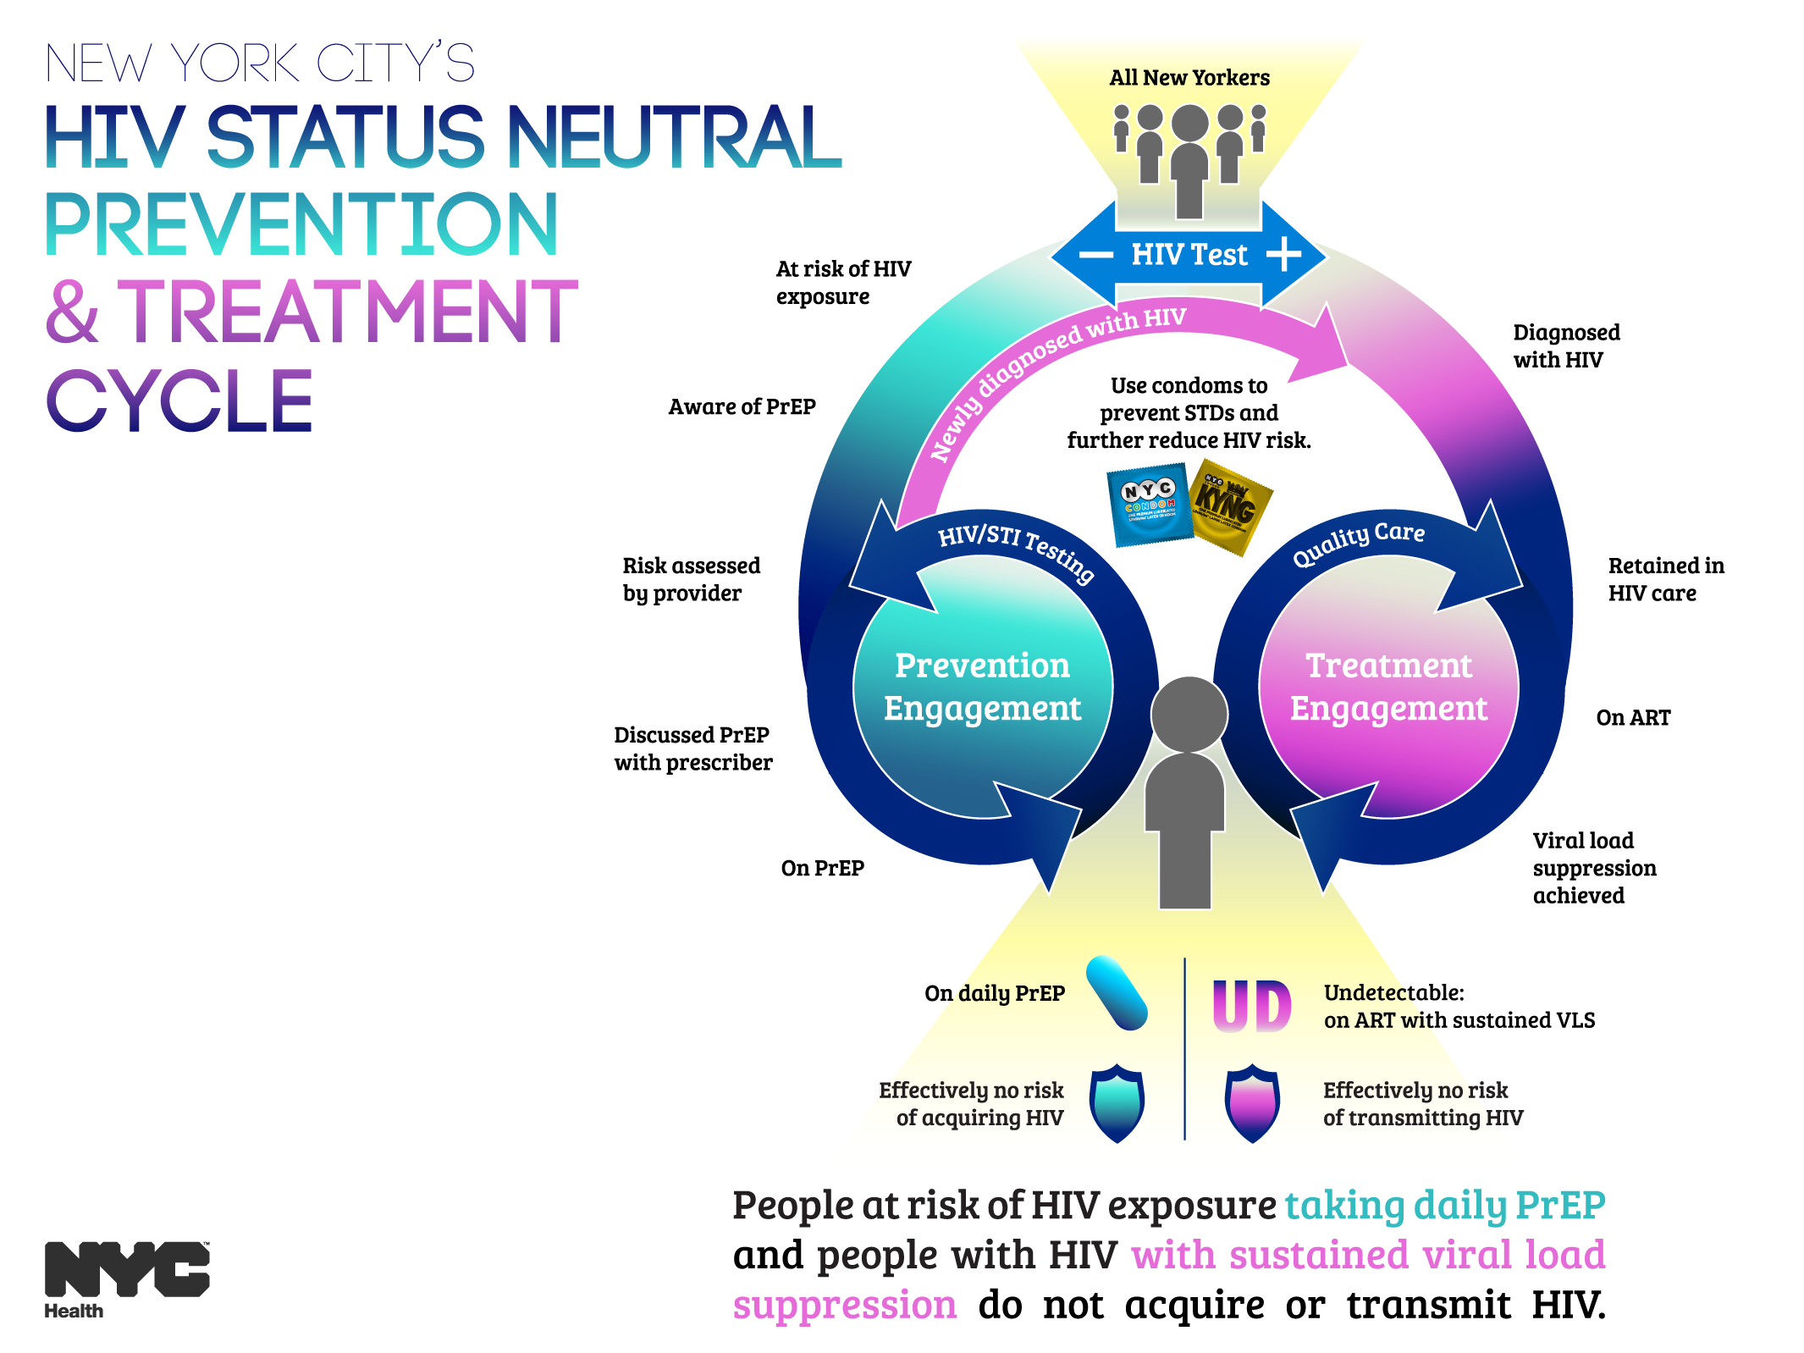

Slide 11
Increase Access to HIV Prevention Services
Increase awareness and uptake of HIV prevention services, including PrEP and post-exposure prophylaxis (PEP). Initiatives include:

Slide 12
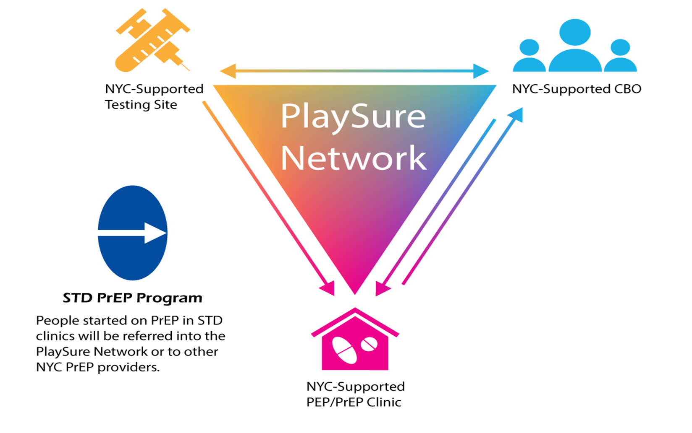
Increase Access to HIV Prevention Services
Increase awareness and uptake of HIV prevention services, including PrEP and post-exposure prophylaxis (PEP). Initiatives include:
PlaySure Network, a citywide network of HIV testing sites, community-based organizations, and clinics that promote patient-specific approaches to sexual health and HIV prevention, increase access to PrEP and PEP, and link people who test positive for HIV to care

Slide 13
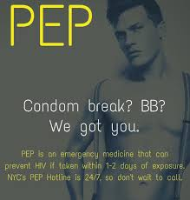
Increase Access to HIV Prevention Services
Increase awareness and uptake of HIV prevention services, including PrEP and post-exposure prophylaxis (PEP). Initiatives include:
PEP Centers of Excellence and a 24-hour PEP hotline

Slide 14

Increase Access to HIV Prevention Services
Increase awareness and uptake of HIV prevention services, including PrEP and post-exposure prophylaxis (PEP). Initiatives include:
Clinical sites engaging adolescents at risk for HIV in biomedical prevention and support services

Slide 15

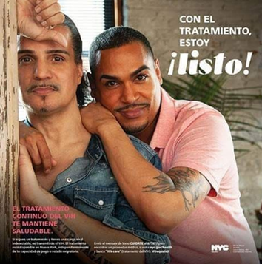
Increase Access to HIV Prevention Services
Increase awareness and uptake of HIV prevention services, including PrEP and post-exposure prophylaxis (PEP). Initiatives include:
Sexual health marketing campaigns, including “Living Sure,” which promotes PrEP among cisgender and transgender women, and “¡Listos!”, which promotes PrEP, PEP, and treatment adherence among Latinos and is the Health Department’s first campaign conceived of and principally released in Spanish

Slide 16
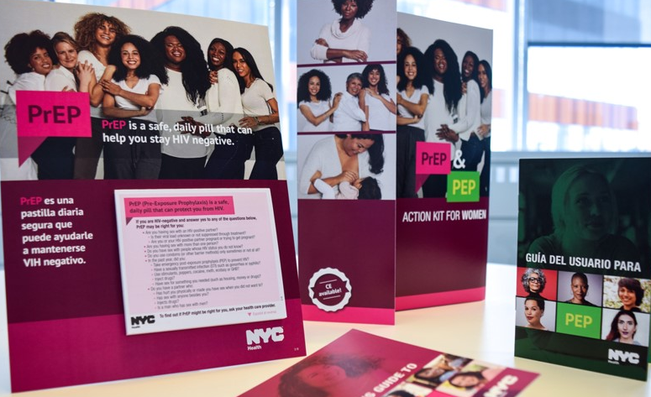
Increase Access to HIV Prevention Services
Increase awareness and uptake of HIV prevention services, including PrEP and post-exposure prophylaxis (PEP). Initiatives include:
PrEP and PEP detailing campaigns involving highly trained, full-time teams conducting one-on-one educational visits with providers, with the latest cycle focusing on women’s health care providers

Slide 17
Increase Access to HIV Prevention Services
Increase awareness and uptake of HIV prevention services, including PrEP and post-exposure prophylaxis (PEP). Initiatives include:

Slide 18
Promote Optimal Treatment for All New Yorkers Living with HIV
Link people newly diagnosed with HIV and those who have fallen out of care to antiretroviral treatment, partner services, and support services to improve health outcomes and viral suppression. Initiatives include:

Slide 19


Promote Optimal Treatment for All New Yorkers Living with HIV
Link people newly diagnosed with HIV and those who have fallen out of care to antiretroviral treatment, partner services, and support services to improve health outcomes and viral suppression. Initiatives include:
The Undetectables program, which combines social marketing with a toolkit of evidence-based adherence supports, including patient-centered care planning and financial incentives for achieving viral suppression

Slide 20

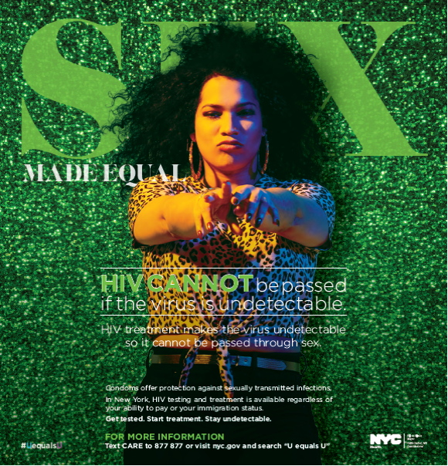
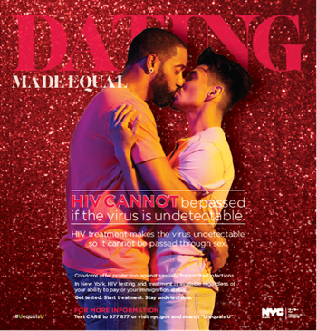
Promote Optimal Treatment for All New Yorkers Living with HIV
Link people newly diagnosed with HIV and those who have fallen out of care to antiretroviral treatment, partner services, and support services to improve health outcomes and viral suppression. Initiatives include:
Promotion of the evidence-based finding that people with HIV who maintain an undetectable viral load for at least six months do not transmit HIV through sex – also known as “Undetectable equals Untransmittable” or “U = U”

Slide 21
Promote Optimal Treatment for All New Yorkers Living with HIV
Link people newly diagnosed with HIV and those who have fallen out of care to antiretroviral treatment, partner services, and support services to improve health outcomes and viral suppression. Initiatives include:

Slide 22
Achieve Sexual Health Equity for All New Yorkers
Promote comprehensive, affirming sexual health care for all New Yorkers and support community-driven programs focused on those disproportionately affected by HIV. Initiatives include:

Slide 23
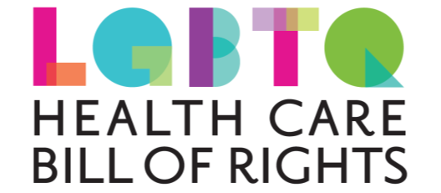
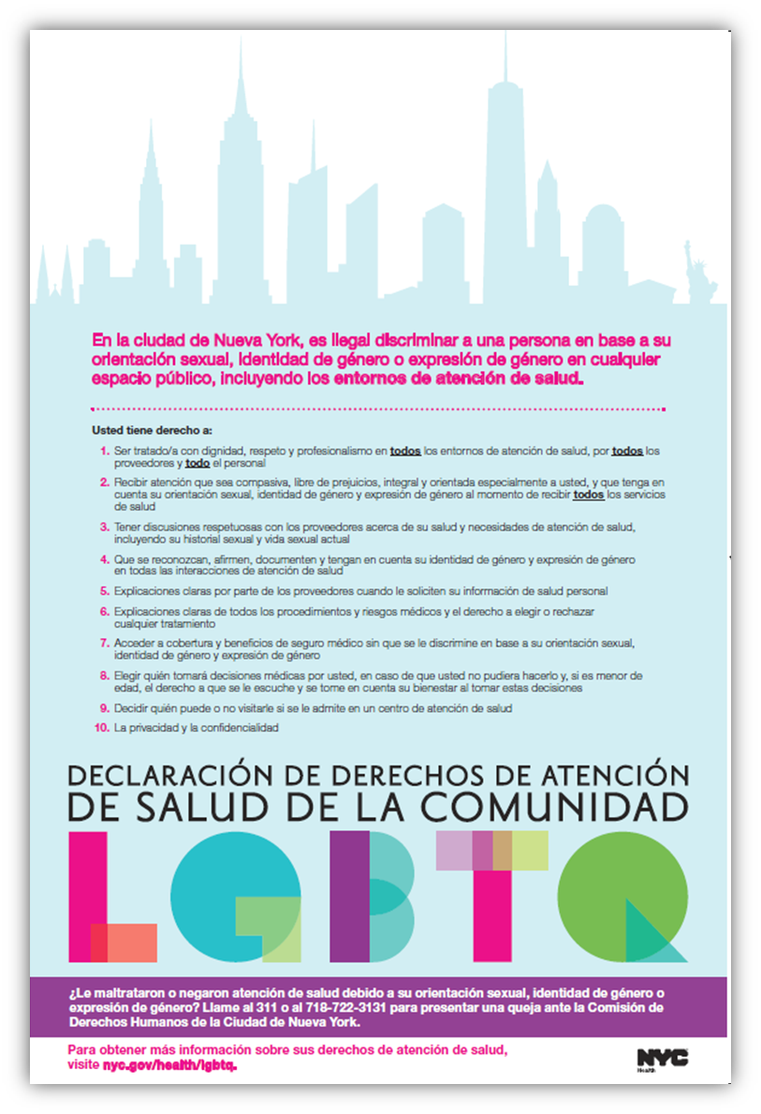
Achieve Sexual Health Equity for All New Yorkers
Promote comprehensive, affirming sexual health care for all New Yorkers and support community-driven programs focused on those disproportionately affected by HIV. Initiatives include:
Creation and promotion of the LGBTQ Health Care Bill of Rights to empower LGBTQ patients to seek optimal care

Slide 24


Achieve Sexual Health Equity for All New Yorkers
Promote comprehensive, affirming sexual health care for all New Yorkers and support community-driven programs focused on those disproportionately affected by HIV. Initiatives include:
LGBTQ Health Equity Coalition, a group of nonprofit and governmental organizations, community members, and allies committed to advancing the health of LGBTQ New Yorkers through the collective impact of novel partnerships

Slide 25
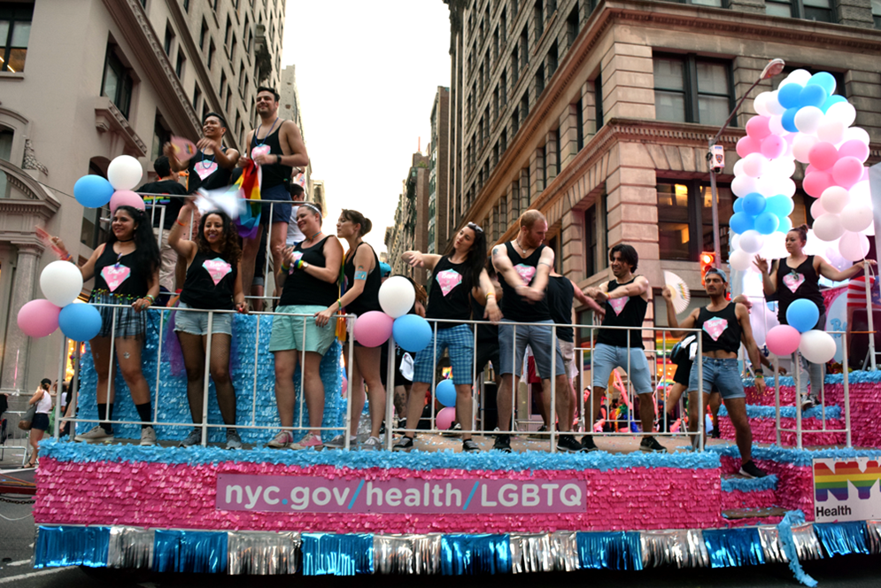

Achieve Sexual Health Equity for All New Yorkers
Promote comprehensive, affirming sexual health care for all New Yorkers and support community-driven programs focused on those disproportionately affected by HIV. Initiatives include:
Technical assistance and support to transgender and gender nonconforming-led community-based, grassroots organizations to build their capacity to serve their communities

Slide 26
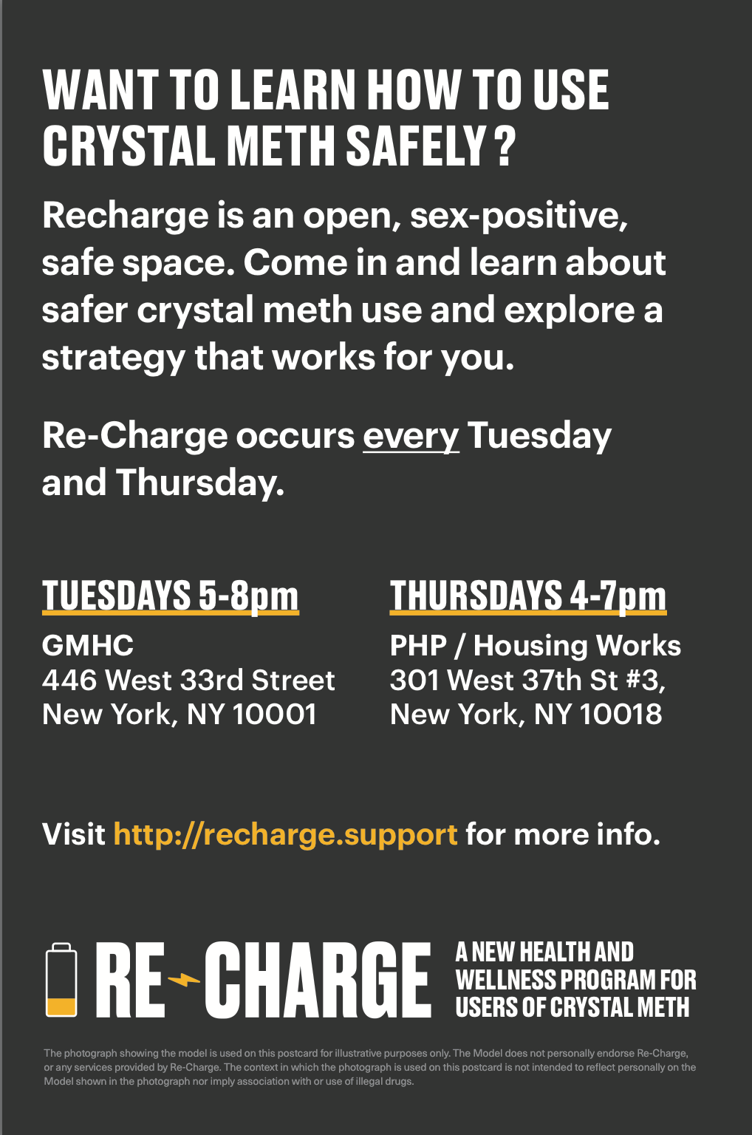
Achieve Sexual Health Equity for All New Yorkers
Promote comprehensive, affirming sexual health care for all New Yorkers and support community-driven programs focused on those disproportionately affected by HIV. Initiatives include:
Re-Charge, an HIV status neutral, sex-positive, and nonjudgmental harm reduction program for men who have sex with men and individuals of trans experience who have sex with men and who use crystal methamphetamine

Slide 27
Achieve Sexual Health Equity for All New Yorkers
Promote comprehensive, affirming sexual health care for all New Yorkers and support community-driven programs focused on those disproportionately affected by HIV. Initiatives include:

Slide 28
The NYC ETE Plan at the Health Department’s
Sexual Health Clinics
The Health Department’s eight Sexual Health Clinics provide low-to-no cost walk-in services to anyone 12 years of age or older, regardless of ability to pay, insurance coverage, or immigration status. No parental consent is necessary.

Slide 29

The NYC ETE Plan at the Health Department’s
Sexual Health Clinics
The Health Department’s eight Sexual Health Clinics provide low-to-no cost walk-in services to anyone 12 years of age or older, regardless of ability to pay, insurance coverage, or immigration status. No parental consent is necessary.
Sexually transmitted infection services: Testing and onsite treatment for syphilis, gonorrhea, chlamydia, and other sexually transmitted infections; “express visit” testing for asymptomatic patients, partner services, and expedited partner therapy for chlamydia

Slide 30
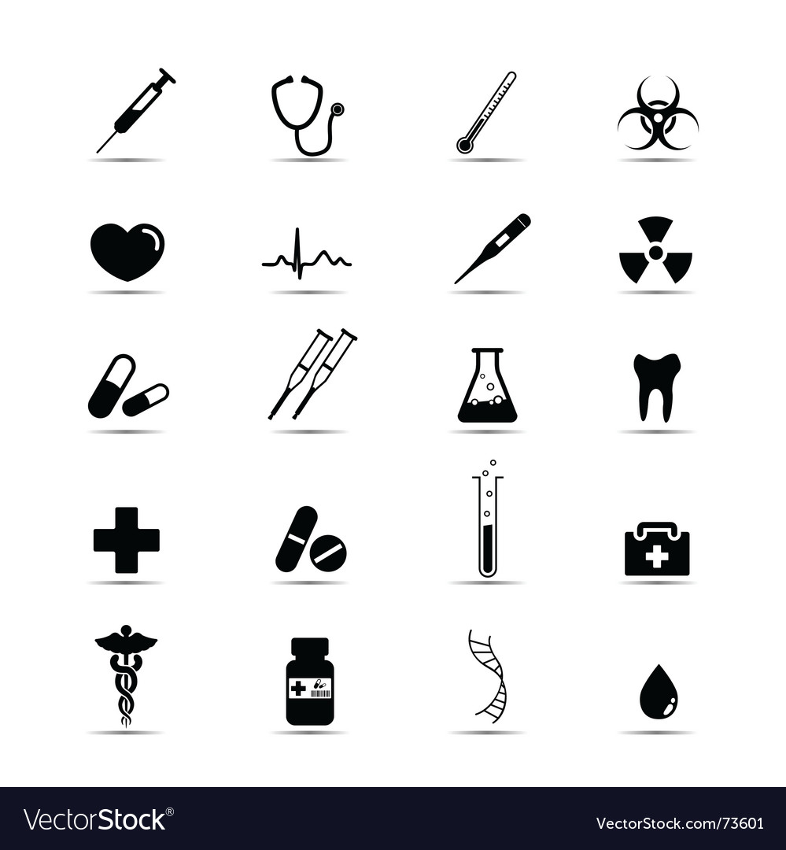
The NYC ETE Plan at the Health Department’s
Sexual Health Clinics
The Health Department’s eight Sexual Health Clinics provide low-to-no cost walk-in services to anyone 12 years of age or older, regardless of ability to pay, insurance coverage, or immigration status. No parental consent is necessary.
HIV Services: Testing and same-day JumpstART treatment initiation for persons testing positive for HIV, PEP and PrEP initiation and referral, linkage to care, and partner services

Slide 31

The NYC ETE Plan at the Health Department’s
Sexual Health Clinics
The Health Department’s eight Sexual Health Clinics provide low-to-no cost walk-in services to anyone 12 years of age or older, regardless of ability to pay, insurance coverage, or immigration status. No parental consent is necessary.
Immunizations: Human papilloma virus, hepatitis A, hepatitis B, and meningococcal vaccines

Slide 32

The NYC ETE Plan at the Health Department’s
Sexual Health Clinics
The Health Department’s eight Sexual Health Clinics provide low-to-no cost walk-in services to anyone 12 years of age or older, regardless of ability to pay, insurance coverage, or immigration status. No parental consent is necessary.
Behavioral health services: Screening and interventions for substance use and short-term counseling and support for other behavioral health needs

Slide 33
The NYC ETE Plan at the Health Department’s
Sexual Health Clinics
The Health Department’s eight Sexual Health Clinics provide low-to-no cost walk-in services to anyone 12 years of age or older, regardless of ability to pay, insurance coverage, or immigration status. No parental consent is necessary.
Contraceptive services: Emergency contraception and birth control, including pills, patches, rings, and Depo-Provera injection

Slide 34

The NYC ETE Plan at the Health Department’s
Sexual Health Clinics
The Health Department’s eight Sexual Health Clinics provide low-to-no cost walk-in services to anyone 12 years of age or older, regardless of ability to pay, insurance coverage, or immigration status. No parental consent is necessary.
Harm reduction services: Narcan kits and syringe dispensing

Slide 35
The NYC ETE Plan at the Health Department’s
Sexual Health Clinics
The Health Department’s eight Sexual Health Clinics provide low-to-no cost walk-in services to anyone 12 years of age or older, regardless of ability to pay, insurance coverage, or immigration status. No parental consent is necessary.

Slide 36
New York City
Epidemiology & Background

Slide 37
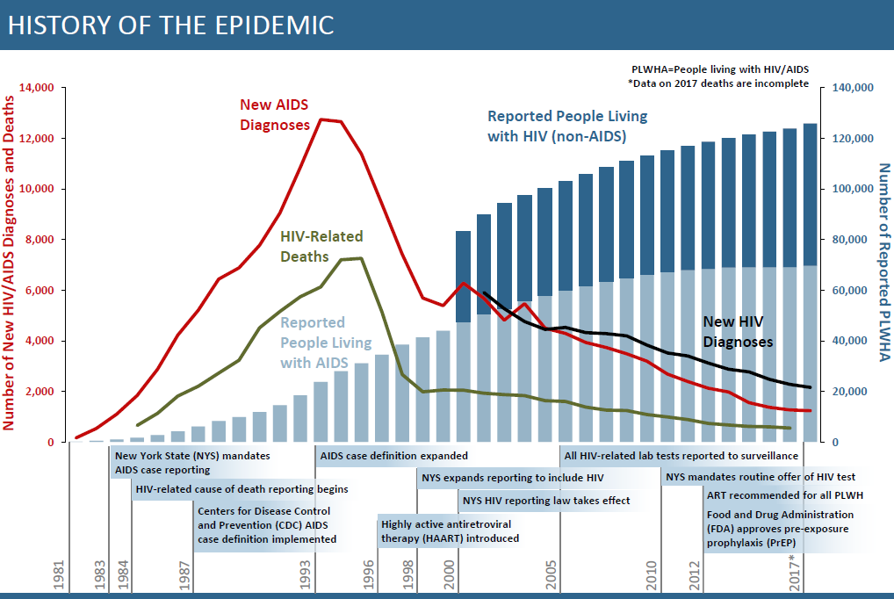
HIV Epidemiology and Field Services Program. HIV Surveillance Annual Report, 2017. New York City Department of Health and Mental Hygiene: New York, NY. December 2018

Slide 38
New HIV Diagnoses – NYC 2017
Gender
Age
Borough
Transmission
Risk*
Poverty
(area-based, % below FPL)
Source: NYC DOHMH, Bureau of HIV Surveillance Data
*MSM=Men who have sex with men, TG-SC=Transgender people with sexual contact, IDU=People with injection drug use history

Slide 39
New HIV diagnoses and estimated incident HIV infections¹, NYC 2013-2017²
Trends in estimated incident HIV infections¹ by sex at birth and transmission risk, NYC 2013-2017²
2
Estimated HIV incidence overall and by transmission risk group declined in NYC between 2013 and 2017.
HIV Epidemiology and Field Services Program. HIV Surveillance Annual Report, 2017. New York City Department of Health and Mental Hygiene: New York, NY. December 2018
MSM=Men who have sex with men; IDU=Injection drug use history.
¹Using the method in: Song R, et al. Using CD4 data to estimate HIV incidence, prevalence, and percent of undiagnosed infections in the United States. J Acquir Immune Defic Syndr 2017;74(1):3-9. ²2017 incidence estimates are preliminary.

Slide 40
Achieving ETE GOALS:
New HIV Diagnoses and Estimated Incident HIV Infections in NYC, 2010-2020
Number of HIV cases
Year
Actual Data
Projection
Numbers of new HIV diagnoses from 2010 to 2017 were reported to NYC DOHMH as of March 31, 2018. Estimated incident HIV infections from 2010 to 2017 were calculated using CDC’s “CD4-depletion model,” which uses distribution of CD4 count at HIV diagnosis to estimate timing of HIV infection. All data from 2018 to 2020 are projections based on an estimated acceleration of historical declines.

Slide 41
What does this all mean?
We are diagnosing prevalent HIV infections at a stable rate earlier and more efficiently
  Proportion of acute infections detected increasing
  Diagnosis at earlier stage of infection, before people get ill. 17.5 % concurrent AIDS
Decreasing incidence means that people are not getting HIV
  U=U continues to work
  PrEP in MSM is likely driving down transmission
Areas we are working to improve
  PrEP in cis Women and TGNC People
  Latino MSM- ¡Listos! and more!
NYC IS ON TRACK FOR 2020!

Slide 42
Thank you!

Slide 43
Enhance Methods for Tracing HIV Transmission
Employ state-of-the-art scientific methods to “fingerprint” HIV strains, allowing staff to map possible transmission networks, identify people with HIV or at risk of acquiring HIV within those networks, and link them to partner services, HIV testing, HIV care or PrEP, and support services. Initiatives include:
HIV phylogenetic testing by the New York City Public Health Laboratory and integrating laboratory processes and findings into protocols for field work and outreach
Piloting the model, including resistance testing, at the Health Department’s Sexual Health Clinics and expanding the model to identify HIV networks citywide

