Slide 1
Barriers and facilitators to the successful transition of adolescents living with HIV from pediatric to adult care in low and middle-income countries: A policy review
Tiarney (TEER-nee) Ritchwood, PhD
Assistant Professor, Family Medicine and Community Health
Duke University School of Medicine
Co-authors: Cameron Jones, MD and Tamara Taggart, PhD

Slide 2
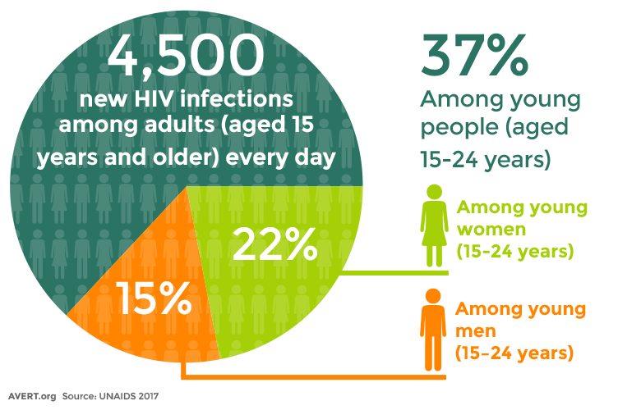
HIV/AIDS and Adolescents
The total number of adolescents living with HIV (ALWH) increased by 30% between 2005 & 2016.
Approximately 70% of ALWH were infected via maternal-to-child transmission.
AIDS-related illnesses are the second leading cause of death among female adolescents despite an overall 48% decline in deaths from AIDS-related causes between 2005 and 2016.
AIDS-related deaths among youth are closely linked to poor retention in HIV care and inadequate ART adherence, leading to low rates of viral suppression among ALWH and increased risk for HIV-related morbidity and mortality.

Slide 3
Healthcare transition (HCT)
The transition from pediatric to adult care, referred to as healthcare transition (HCT), is a critical process during with many ALWH are at high risk for poor HIV-related outcomes.
HCT occurs when adolescents age out of pediatric care and engage in a planned transfer to adult care.
This process often coincides with a developmental period during which many ALWH struggle with disease management and experience the onset of HIV-related complications and interruptions in care.
It is therefore critical that we identify and address barriers to HCT among ALWH to facilitate patient-centered support strategies that could help youth remain in care and adhere to ART during this key transition period.
Pediatric
Adolescent
Adult

Slide 4
Methods
The purpose of this study was to systematically review the available literature on barriers and facilitators to HCT in LMICs. Additionally, we conducted a policy review to determine whether country-specific HCT guidelines address previously reported barriers to successful HCT.
We searched several electronic databases for article published up to April 2018.
Articles were included in this review if they:
Focused on ALWH 10 and 21 years who had undergone HCT;
presented original data on HCT;
focused on world bank-defined LMICs;
were published in a peer-reviewed journal; and
were written in English.
Barriers | Facilitators
Reduce the likelihood that ALWH would engage in HIV care and/or adhere to ART immediately before, during, or after | Make it easier for ALWH to remain in care and/or adhere to ART immediately before, during, or after HCT

Slide 5
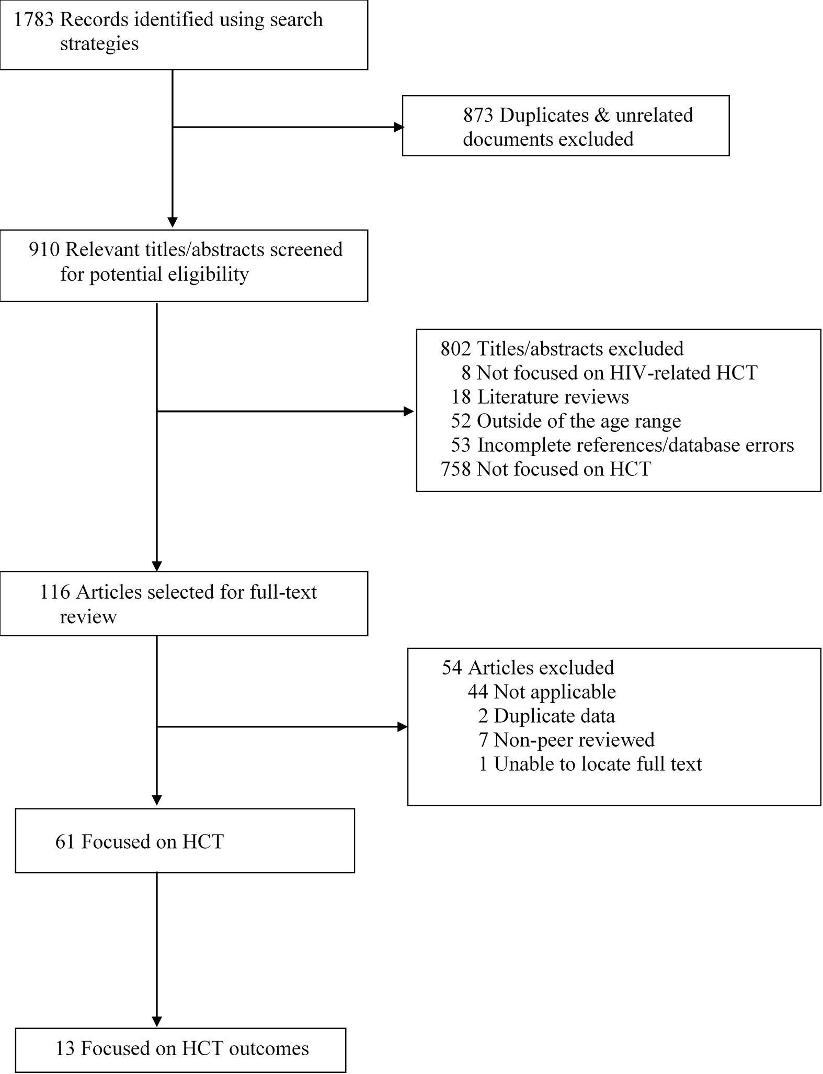
Results

Slide 6
Barriers to successful HCT
Barriers | Examples
Emotional and interpersonal burden | In a study of 30 Ugandan ALWH, participants described the pediatric clinic as feeling like ‘home,’ and compared transition to a new treatment team to death or losing a family member
Effects of HIV disease | A South African study suggested that cognitive delays among ALWH could impact adolescents’ ability to adopt key behaviors and learn self-management skills to help them be successful post-HCT
Logistical and systemic impediments | One study found that ALWH struggled to navigate adult treatment settings, as the clinics tended to be larger, busier, and had longer wait times
HIV stigma | In a retrospective, qualitative study in the Dominican Republic, ALWH reported concerns about involuntary or accidental HIV status disclosure in adult care settings due to their larger size, and lack of familiarity with and trust in clinic staff and providers

Slide 7
Facilitators of successful HCT
Barriers | Examples
Social support | Peer support groups, the most commonly used approach to facilitate social support, were associated with improved treatment adherence and greater social capital, which were linked to greater resilience
Skills development for ALWH and adult treatment team | One study, for example, found that educating youth on sexual risk reduction, ART self-management, healthcare system navigation, stress reduction, and other life skills was linked to high scores on program satisfaction
Transition readiness | Several studies suggested that delaying transition until ALWH are prepared facilitates successful HCT
Multidisciplinary treatment teams | Healthcare models that integrated key services such as mental health treatment, sexual/reproductive health, family planning, dental care and pharmaceutical services were linked to greater retention in HIV care post-HCT
Transition coordination | Several articles suggested that greater coordination and communication between the pediatric and adult treatment teams pre-HCT could help ALWH feel more comfortable and thus engage in adult care post-HCT

Slide 8
Policy review summary
Do the countries from which we identified HCT-related barriers and facilitators have specific guidelines for transitioning ALWH from pediatric to adult care?
And if so, do their guidelines address the HCT facilitators and barriers identified identified by studies from those countries?
Of the 12 countries identified, only five (Uganda, Thailand, Brazil, Kenya, and Cambodia) had HCT-specific guidelines.
There was substantial variation across guidelines regarding the existence of protocols for monitoring and enforcement, and allocated funding to support their implementation.

Slide 9
Country | Guidelines | Facilitators from systematic review | Approach | Barriers from systemic review | Approach
Uganda | Consolidated Guidelines for Prevention and Treatment of HIV in Uganda | Social support Transition coordination | Peer support groups Referral from pediatric team to adult provider Pre-HCT meetings Individualized transition plan Caregiver engagement Transition readiness assessments Multidisciplinary team, including social worker or case managers | Emotional or interpersonal burden Logistical or systemic impediments Effects of HIV disease | Acknowledged challenges associated with adjusting to adult care providers & atmosphere, Acknowledged importance of patient-provider communication Acknowledged the influence of cognitive development
Notes:
The government of Uganda is currently responsible for approximately 11% of the funding required for its national HIV response, according to the most recent estimates. The largest single contributor of external funding is the U.S. President’s Emergency Plan for AIDS Relief (PEPFAR) (34). The Ugandan Country Operational Plan (COP) for PEPFAR funding for FY 2018—a document required of all countries receiving PEPFAR funding to describe domestic strategies for meeting stated PEPFAR goals—includes specific funding for increasing ALWH retention in HIV care. This document specifically addresses barriers within the sub-theme of logistical and systemic impediments through such interventions as linking ALWH to community services and sponsoring adolescent-friendly clinic spaces. Moreover, the COP provides suggestions that incorporate identified facilitators of successful HCT, including social support—such as peer support groups—and multidisciplinary treatment teams—including peer counselors and a specific adolescent-focused individual at each facility—are also included (48).

Slide 10
Gaps in Policies
Despite the growth of evidence on the facilitators and barriers to successful transition, our review of country-specific guidelines revealed that few countries have guidelines specific to HCT for ALWH.
Few guidelines addressed the role of caregivers in HCT.
Few guidelines addressed the training needs of adult providers who may have limited training and experience in treating adolescents.
Finally, none of the guidelines addressed specific funding for HCT programs, nor did any of the guidelines include targets or monitoring mechanisms to assess existing or future HCT programs.

Slide 11
Thank you
A manuscript providing additional detail on the work reported in this presentation has recently been accepted to AIDS & Behavior.
Please email tiarney.Ritchwood@duke.edu if you would like to obtain a pre-print copy.

