Slide 1
Community mobilization is associated with HIV testing, particularly among men and rural dwellers, in Zambia
Joseph G. Rosen, Maria A. Carrasco, Bolanle Olapeju, E. ‘Kuor Kumoji
@JohnsHopkinsCCP
Share your thoughts on this presentation with #IAS2019

Slide 2
Disclosure Statement
2
The authors have no conflicts of interests to declare.

Slide 3
Background
3
Engaging men in HIV testing is a priority to reach UNAIDS 90-90-90 targets in sub-Saharan African countries
Men continue to access testing less frequently than women¹
~30% gap in reaching the ‘first 90’ among Zambian men²
HIV prevalence (%) and serostatus knowledge (%), by sex – Zambia population-based impact assessment (ZAMPHIA), 2016²

Slide 4
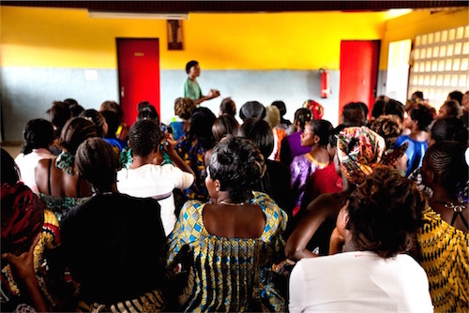
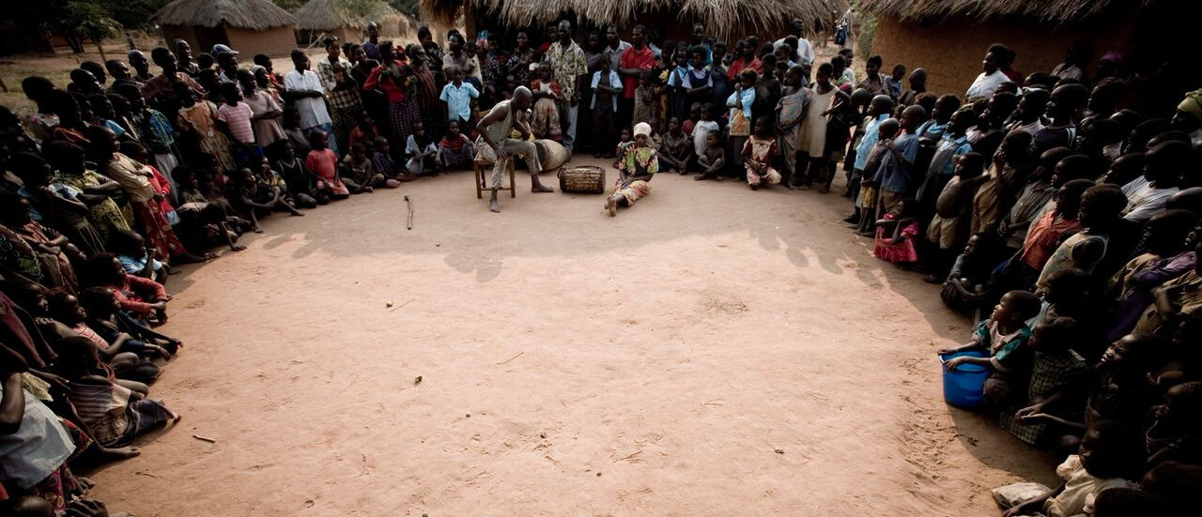
Background
4
Community mobilization may be a viable strategy for increasing HIV service uptake, including HTS^{3,4}
Facilitating community dialogue around services and initiatives
Integrating beneficiaries in HIV service design and implementation
Can increase acceptance/uptake⁵
Helps demystify and destigmatize services, notably for first-time users⁵
Photo courtesy of Elizabeth Glaser Pediatric AIDS Foundation
Photo courtesy of Project Concern International

Slide 5
Methods
5
Objective
Measure the association between community mobilization (CM) and HIV testing in Zambia
Study Design
Population-based household survey
Data Collection
10 provinces, 24 communities
Sampling Strategy
Two-stage stratified (urban/rural) sampling proportional to population size
Study Population
Individuals aged 15-59 years
Districts
Urban
Rural
Wards
Wards
Enumeration Areas
Enumeration Areas

Slide 6
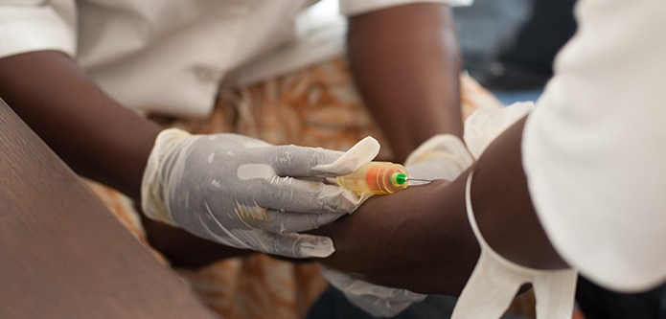
Methods
6
Outcome Measure
Independent Variables
HIV testing
Lifetime, self-reported
Dichotomous (ever tested vs. never tested/other responses)
HIV-related factors (indices)
HIV knowledge (range: 0 – 17)
Sexual risk behaviors (range: 0 – 15)
Stigmatizing attitudes towards PLHIV (range: 0 – 7)⁶
Socio-demographics
Age groups (10-years)
Sex
Marital status
Residence
Wealth quartile (25%)
Education
Photo courtesy of Alere

Slide 7
Methods
7
Operationalizing community mobilization^{7,8}
Leadership
Individual efficacy
Presence of leaders
Fair treatment
Community input
Leading by example
Conflict resolution
Participation
Problem-solving
Capacity to assist
Social cohesion
Collective efficacy
Assistance in adversity
Trust
Tangible relationships
Comfort discussing community challenges
Accountability
Agreement on issues
Commitment to community projects
Community conflict management
Collective goals
Collaboration

Slide 8
Methods
8
CM scale (range: 18 – 90) constructed from 18 items assessing four CM dimensions
Adapted from Underwood and Figueroa et al’s communication for social change frameworks^{7,8}
5-point items (‘strongly disagree’ = 1 to ‘strongly agree’ = 5)
High internal consistency (Cronbach’s alpha: 0.87)
 | CM Dimension | No. of Items
 | Individual efficacy | 3
 | Social cohesion | 6
 | Collective efficacy | 4
 | Leadership | 5
 | Total | 18

Slide 9
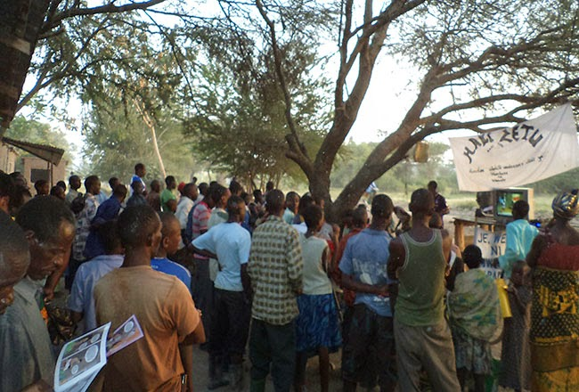
Methods
9
Analysis
Binomial logistic regression
Tested significance (p < 0.05) of relationship between HIV testing and community mobilization
Final multivariable model stratified by sex and residence
Variance Inflation Factor (VIF) scores assessed multicollinearity
Analytic weights adjusted for clustering and stratification
Derived from 2010 census estimates and 2016 population projections
Photo courtesy of ICAP
Photo courtesy of Johns Hopkins Center for Communication Programs

Slide 10
Results
10
Weighted Descriptive Sample Statistics (N = 3,535)
Largest share of participants fell into the poorest quartile (34%)
Sex evenly distributed in sample
Adolescents (15-24 years) were the most represented age group (49%)
Over half had no formal or primary-level education only (52%)
Participants resided predominantly in urban areas (71%)
Most participants were married or in a union (54%)

Slide 11
Results
11
Weighted Behavioral Sample Statistics (N = 3,535)
High perceived levels of community mobilization were reported
(mean: 63, range: 18 – 90)
High degrees of HIV knowledge were observed (mean: 14)
Most reported multiple sexual risk behaviors (mean: 3)
Participants exhibited stigmatizing attitudes towards PLHIV (mean: 3)
A majority reported testing for HIV in their lifetime (83%)

Slide 12
Results
12
Mean (SD)
Range
Individual efficacy
Social cohesion
Collective efficacy
Leadership
11.3 (2.4)
3 – 15
19.6 (4.1)
6 – 30
15.1 (2.5)
4 – 20
16.4 (4.6)
5 – 25

Slide 13
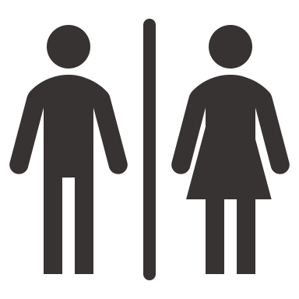
Results
13
Among the 83% of participants who had ever tested for HIV
Never Married
Married or in Union
Male
* p < 0.001

Slide 14
Results
14
Adjusted odds of HIV testing, by socio-demographic and HIV factors (N = 3,531)
 | Adj. OR (95% CI)* | p-value
Age group (years) 15-24 25-34 35-44 45-59 | 1.00 2.36 (1.68, 3.32) 2.56 (1.53, 4.28) 0.69 (0.44, 1.09) | Ref. <0.001 <0.001 0.112
Sex Male Female | 1.00 1.69 (1.37, 2.09) | Ref. <0.001
Marital status Never married Married or in union Sep./wid./div. | 1.00 5.53 (3.98, 7.67) 5.35 (2.29, 12.50) | Ref. <0.001 <0.001
Residence Rural Urban | 1.00 1.38 (1.03, 1.85) | Ref. 0.031
 | Adj. OR (95% CI)* | p-value
Wealth quartile Poorest (lowest 25%) Lower-mid Upper-mid Wealthiest (highest 25%) | 1.00 1.13 (0.67, 1.91) 0.82 (0.61, 1.11) 1.05 (0.77, 1.44) | Ref. 0.655 0.200 0.747
Education No formal/primary only Secondary or higher | 1.00 1.69 (1.37, 2.09) | Ref. <0.001
HIV knowledge | 1.23 (0.99, 1.52) | 0.060
Sexual risk behaviors | 1.27 (1.20, 1.34) | <0.001
Stigmatizing attitudes towards PLHIV | 0.98 (0.92, 1.05) | 0.573
Community mobilization | 1.02 (1.00, 1.03) | 0.008
* Adjusted for all covariates in table.

Slide 15
Results
15
Model-specific adjusted odds of HIV testing, by CM scale score
 | N | CM Scale Mean (SD) | Adj. OR (95% CI) | p-value
Sex
Male* | 1,763 | 62.5 (10.0) | 1.02 (1.01, 1.04) | 0.007
Female* | 1,768 | 62.4 (9.6) | 1.00 (0.98, 1.02) | 0.833
Residence
Rural** | 1,797 | 67.3 (8.9) | 1.03 (1.01, 1.06) | 0.002
Urban** | 1,734 | 60.5 (9.4) | 1.01 (0.99, 1.02) | 0.214
* Adjusted for age, residence, marital status, wealth quartile, education, HIV knowledge, sexual risk behaviors, and stigmatizing attitudes.
** Adjusted for age, sex, marital status, wealth quartile, education, HIV knowledge, sexual risk behaviors, and stigmatizing attitudes.

Slide 16
Conclusions
16
CM correlated with HIV testing, notably among men and rural dwellers
Significance detected in spite of high proportion of HTS in sample
Gender norms and residential settings may mediate associations
Strengthening community mobilization may increase HTS uptake
Programmatic Implications
Individual Efficacy
Capacitate community member involvement in program design and implementation
Skills-building negotiation (particularly for women) and mutual decision-making
Social cohesion
Bolster trust, solidarity, and reciprocity
Community spaces that facilitate dialogue and amplify voices of all groups
Collective efficacy
Testing campaigns led by community leaders
Leadership
Create space for communities, especially women, to lead HIV response activities

Slide 17
References
17
Shand T, Thomson-de Boor H, van den Berg W, et al. The HIV blind spot: men and HIV testing, treatment and care in sub-Saharan Africa. IDS Bull 2014; 1:53–60.
ICAP. Zambia population-based HIV impact assessment (ZAMPHIA 2015-2016) – summary sheet: preliminary findings. ICAP. New York, NY;Dec 2013. Available from: https://phia.icap.columbia.edu/wp-content/uploads/2016/09/ZAMBIA-Factsheet.FIN_.pdf
Lippman SA, Neilands TB, MacPhail C, et al. Community Mobilization for HIV Testing Uptake: Results From a Community Randomized Trial of a Theory-Based Intervention in Rural South Africa. J Acquir Immune Defic Syndr. 2017;74(Suppl 1):S44–S51.
Lippman SA, Maman S, MacPhail C, et al. Conceptualizing community mobilization for HIV prevention: implications for HIV prevention programming in the African context. PLoS One. 2013;8(10):e78208.
WHO. HIV/AIDS: community mobilization. World Health Organization. Geneva, Switzerland;2019. Available from: https://www.who.int/hiv/topics/vct/toolkit/components/community/en/
NZP+, GNP+ (2011). People Living with HIV Stigma Index Zambia Country Assessment 2009. Lusaka: NZP+
Underwood, C., Boulay, M., Snetro-Plewman, G., MacWan'Gi, M., Vijayaraghavan, J., Namfukwe, M., & Marsh, D. (2013). Community capacity as means to improved health practices and an end in itself: evidence from a multi-stage study. International quarterly of community health education, 33(2), 105-127.
Figueroa, ME., Kincaid, DL., Rani, M. and Lewis G. (2002). Communication for Social Change: An Integrated Model for Measuring the Process and its Outcomes. Rockefeller Foundation and The Communication for Social Change Working Paper Series: No.1 Johns Hopkins University Center for Communication Programs. Thre Rockefellar Foundation: New York

Slide 18
Thank You!
18
Acknowledgements
Contact
Study participants
Survey enumerators
SSAM Research Consortium, Zambia
USAID/PEPFAR
Heidi O’bra, Arlene Phiri, Sara Miner, Ashley Frost
Joseph G. Rosen, MSPH
Department of International Health
Johns Hopkins Bloomberg School of Public Health
Email: jrosen72@jhu.edu
Skype: greg_rosen16

