Slide 1
A Helical Structure in the V2 Domain of gp120 that Localizes to the Site of Immune Pressure in the RV144 Vaccine Trial is Conserved in HIV and SIV Envelopes
James Arthos
NIAID

Slide 2
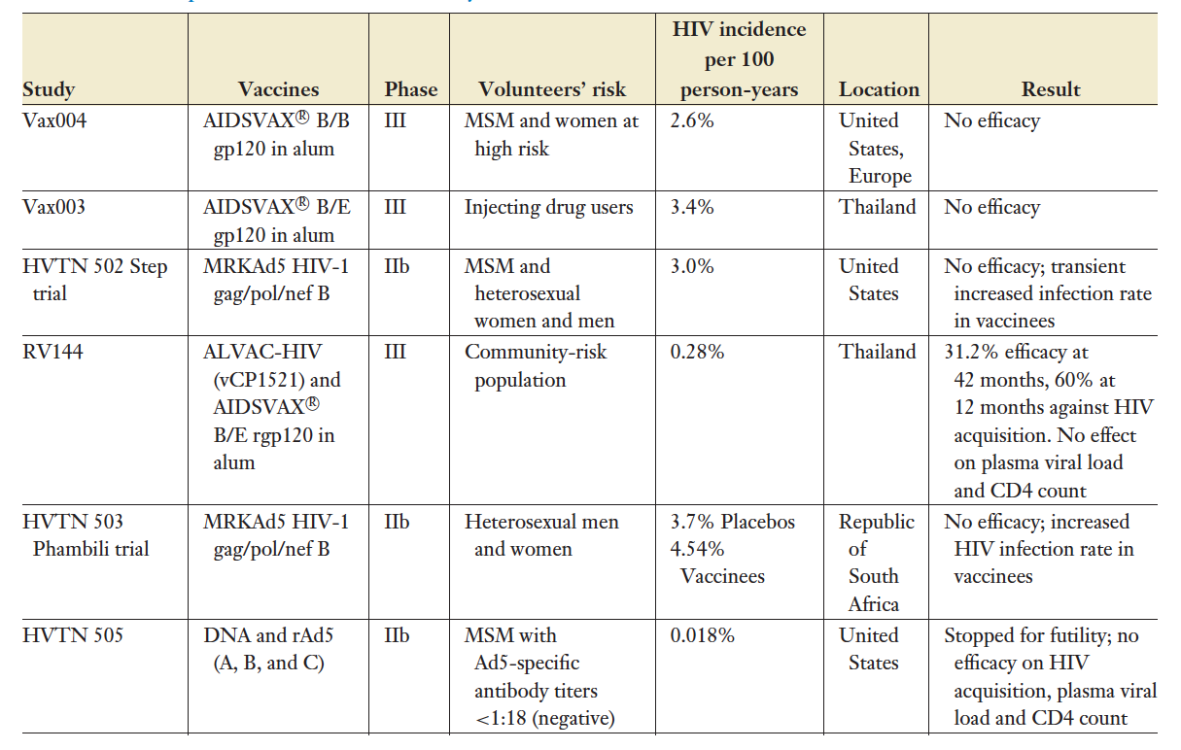
HIV-1 vaccine efficacy trials
Kim JH, Excler JL, Michael NL., Annu Rev Med., 2015
Notes:
there are 6 HIV vaccine efficacy trials which include RV144 trial in Thailand
The RV144 trial provided the first success in the development of effective HIV vaccine demonstrating a 31% efficacy at protection against HIV-1 infection.

Slide 3
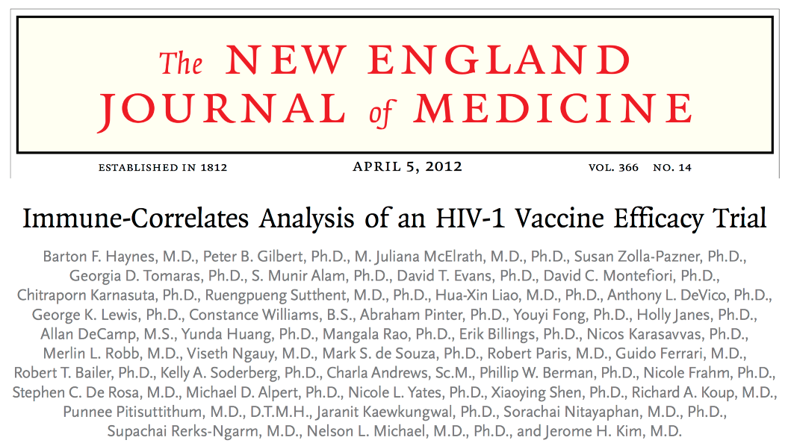
RV144 reduced risk correlated with non neutralizing antibodies specific to the V1/V2 domain of gp120
gp120 trimer
Zhou, Fera ARHR, 2018
Notes:
V1/V2 non essential for viral replication

Slide 4


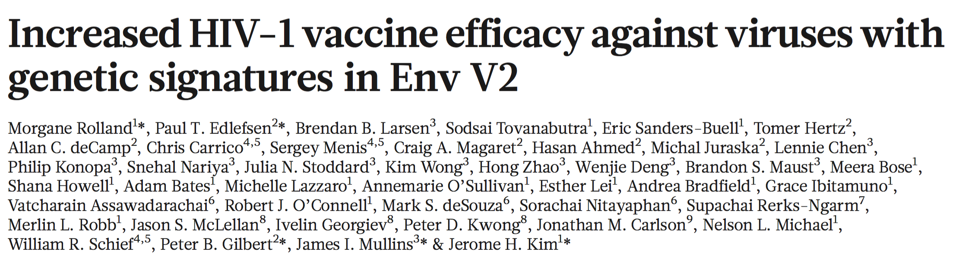

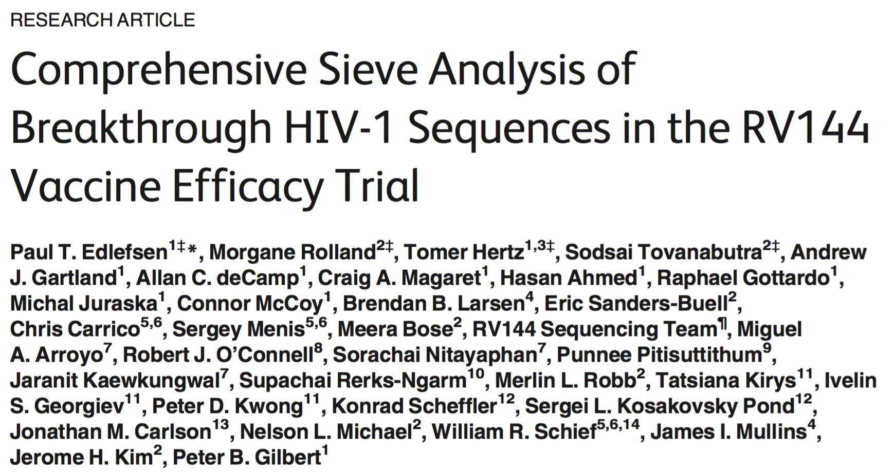
Immune pressure in RV144 localizes in the V2 domain
gp120 trimer
Cardozo et. al., 2014

Slide 5
V2 domain of gp120
Question: How conserved is the structure of the epitope associated
with reduced risk in the RV144 vaccine trial?
V2 domain
sequence conservation across 5 subtypes of HIV

Slide 6
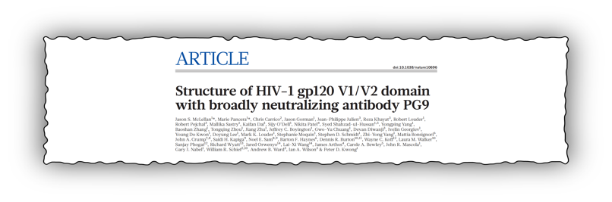
A V1/V2 scaffold in complex with the neutralizing antibody PG9 adopts a Greek key motif
V1/V2 scaffold
mAb PG9
constrained V1/V2 scaffold co crystalized with the
neutralizing mAb PG9 as a β sheet: Greek key

Slide 7

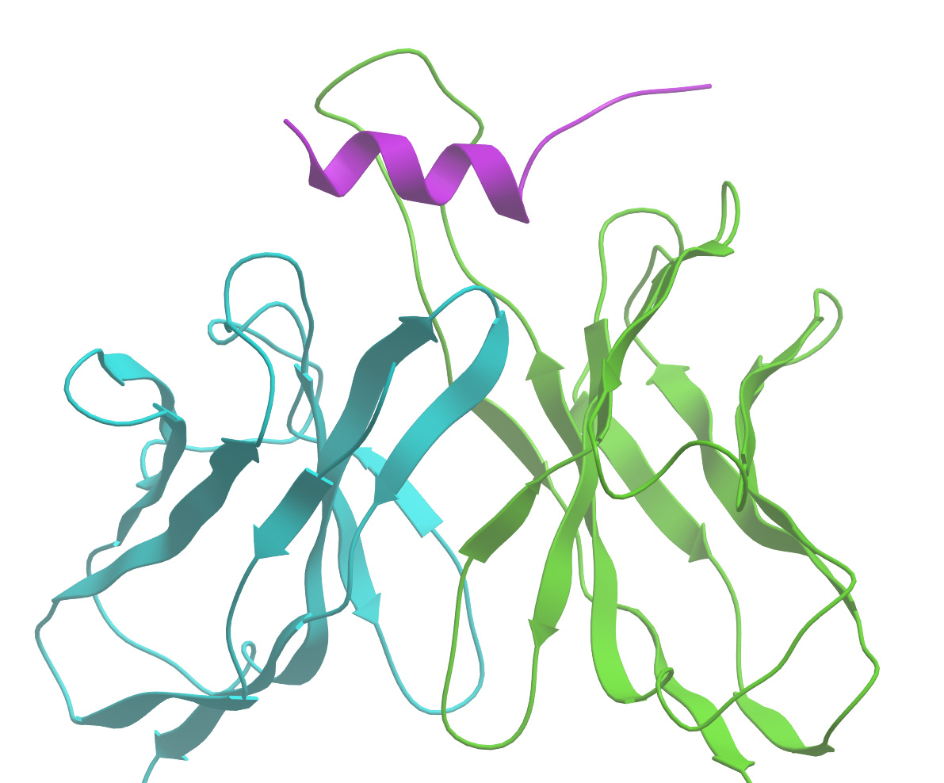
An unconstrained V2 peptide in complex with a non neutralizing antibody adopts a helical/loop structure
V2 peptide
mAb CH58
Notes:
To begin to learn more about the structural characterization of the v2q epitope, we solved the crystal structures of two antigen binding fragments for V2q antibodies (also called QNE antibodies – Quaternary Neutralizing Epitopes)

Slide 8
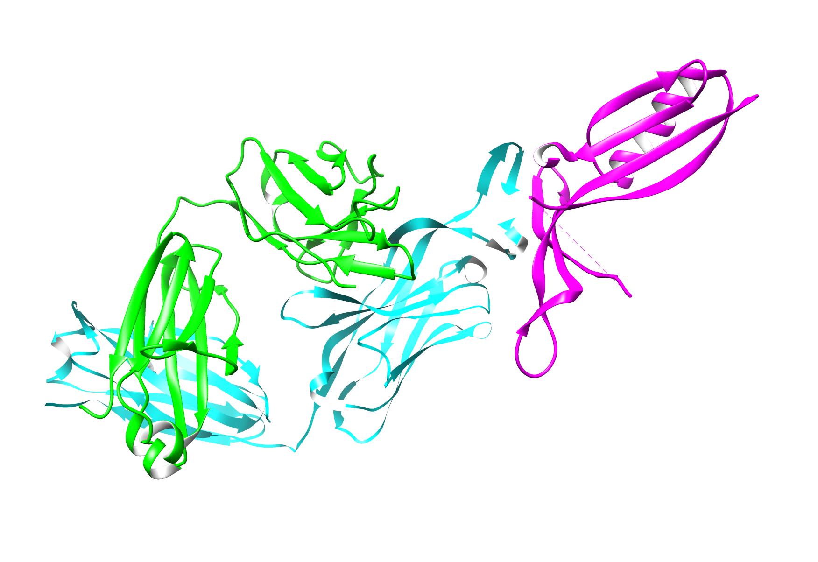
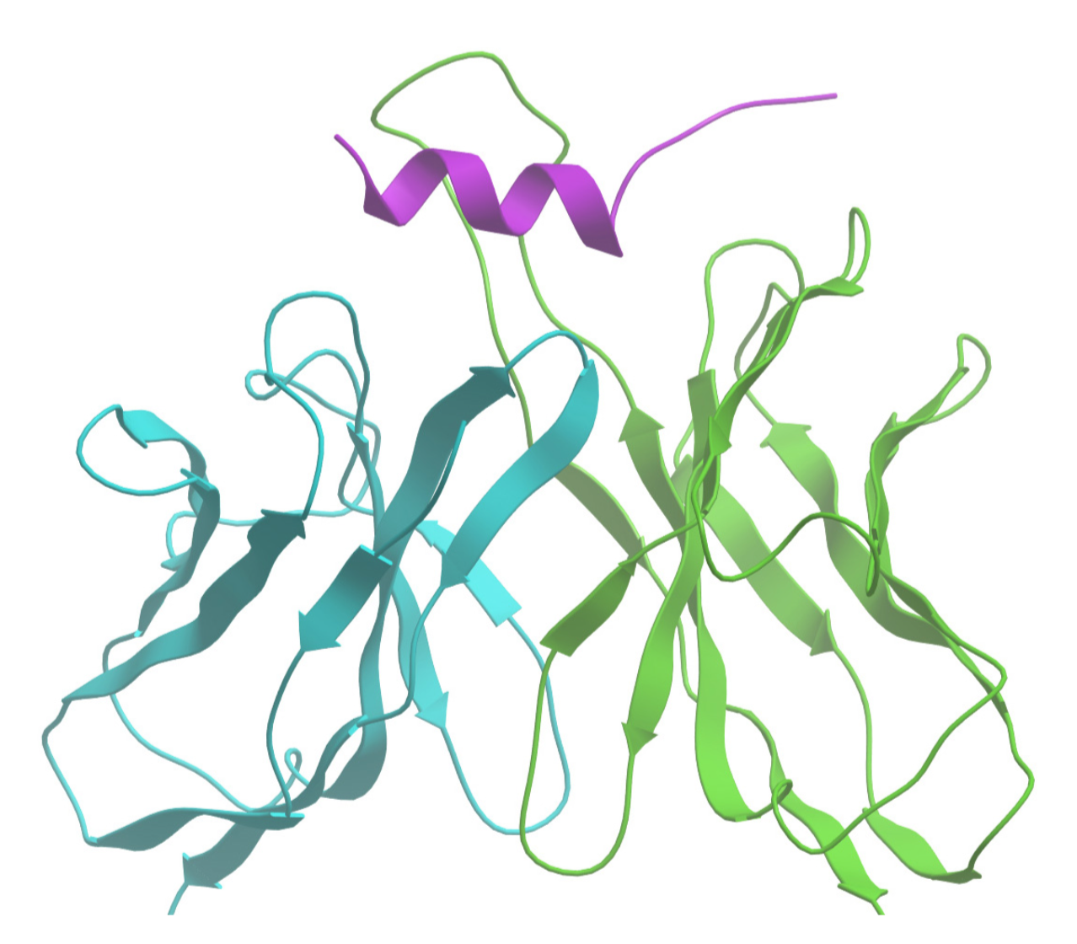
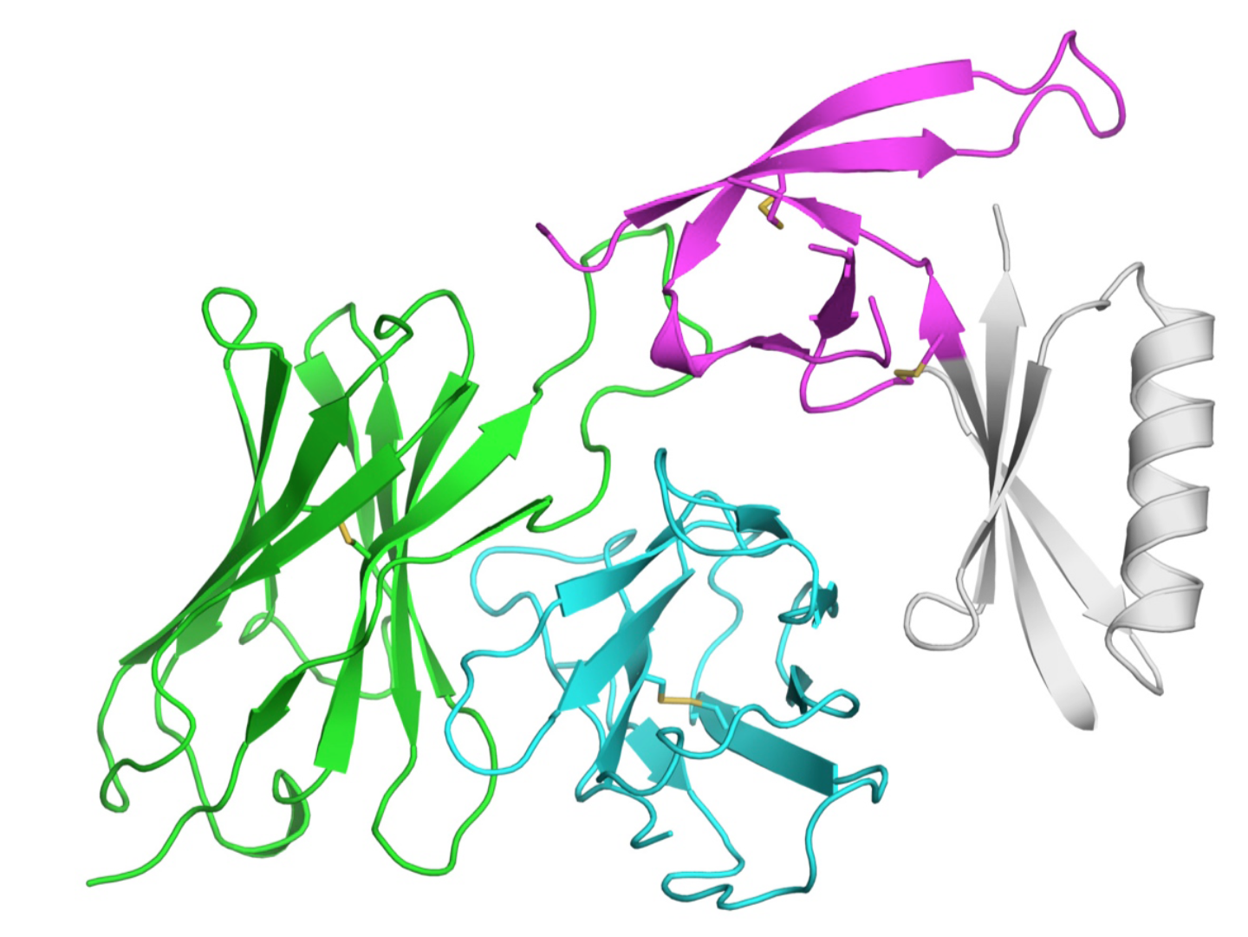
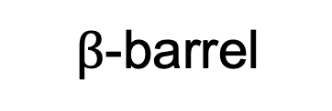
The V1/V2 domain of gp120 is structurally polymorphic
V2 mAb categories
V2p:peptide
CH58, CH59,
CAP228-16H
V2i: integrin
$β$-barrel
Greek key
helix
830A, 697-D, 2158
V2q: quaternary
PG9, PG16, CH01
Pan, Kong JVI
McLellan, Kwong Nature
Liao, Haynes Immunity
Notes:
The V1/V2 Loops can form many different conformations due to the structurally polymorphic nature of this region. These conformations can be structurally constrained like those shown here with beta sheets … the V2 can also adopt alternate conformations that are structurally unconstrained like and in that conformation CH58 epitope is an alpha-helix. V2 epitopes are recognized by three types of V2 antibodies.

Slide 9
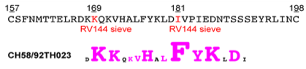
mAb CH58: a non-neutralizing V2 mAb captures
a V2 peptide in a helical conformation
• mAb CH58 derived from an RV144 vaccinee
• epitope overlaps RV144 sieve sites
mAb CH58
helix
CH58 contacts
conservation
Notes:
CH58 has been studied in great detail

Slide 10
The CH58 epitope is hidden in a BG505 SOSIP (subtype A) but present in BG505 gp120
BG505 SOSIP
25nM
12.5nM
6.25nM
3.125nM
1.56nM
Julien, Wilson et. al., Science 2013

Slide 11
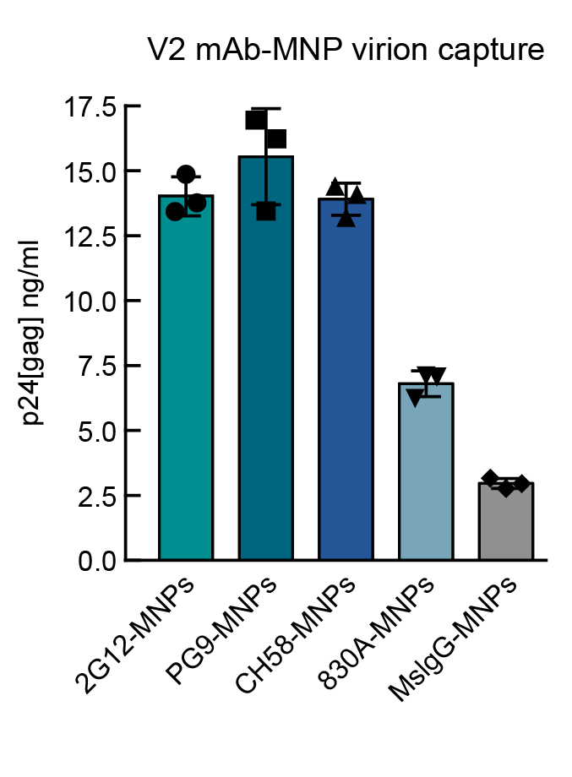

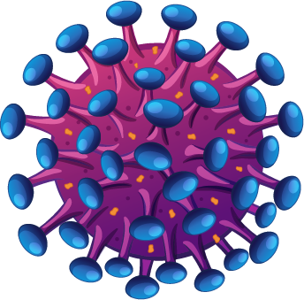
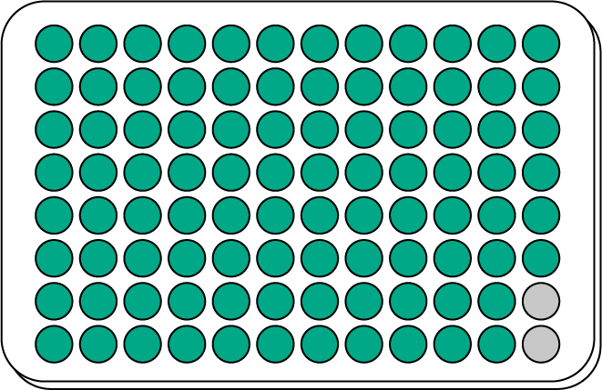
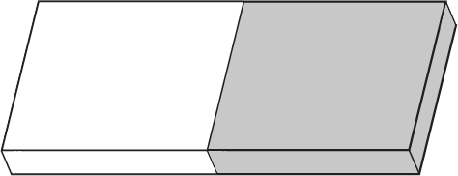
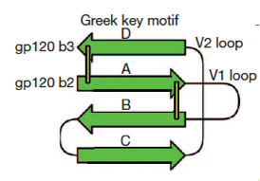
HIV virions derived from primary CD4⁺ T cells are
captured by mAb CH58 coated nanoparticles
magnetic nanoparticles
coated with V2 mAbs
virions from primary
CD4⁺ T cells
Anush Arakelyan
magnet
PLOS Pathogens | August 28, 2018

Slide 12
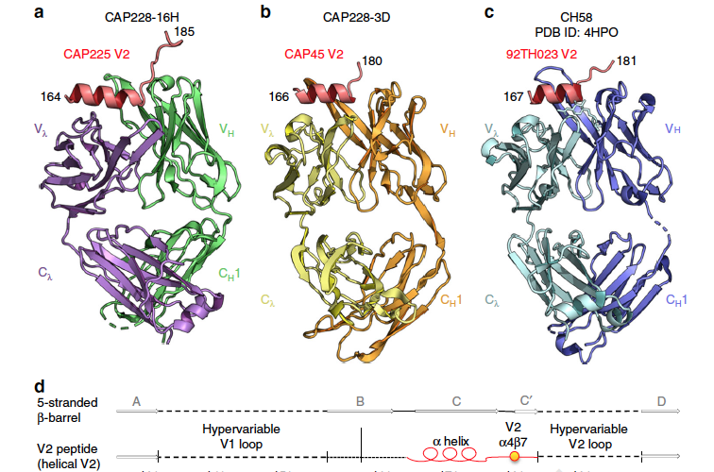

CH58 –like antibodies derives from infected subjects
Common Helical V1V2 Conformations of HIV-1 Envelope Exposes the α₄β₇ Binding Site on Intact Virions
Wibmer, Morris et al. 2018

Slide 13
CH58 –like antibodies are broadly cross-reactive
mAb CAP228-16H (subtype C) binding to
92TH023 (subtype A/E) V2
Notes:
the high affinity interaction of a mAb derived from an infected individual is consistent with conservation of the helix/loop structure

Slide 14
An RV144 –like vaccine in Rhesus macaques; non neutralizing V2 Abs correlate with protection
• macaques vaccinated w/ ALVAC-SIV (prime),
gp120 protein (boost). mucosal challenge w/
SIVMac251
• non neutralizing antibodies mapping to V2
correlated with protection
2016 NATURE MEDICINE
• SIV V2 domain structural data is limited
-helix/loop?
Adjuvant-dependent innate and adaptive immune
signatures of risk of SIVmac251 acquisition
Monica Vaccari^{1,23}, Shari N Gordon^{1,23}, Slim Fourati^{2,23}, Luca Schifanella^{1,3,23}, Namal P M Livanage^{1,23} & Genoveffa Franchini^{1,23}
Jay Gorman
Notes:
there is very little structural data for SIV . We need to use other types of information

Slide 15
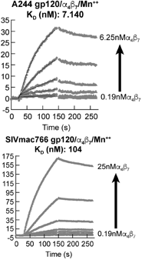
The V2 domain of SIV gp120, like HIV V2 mediates
binding to integrin α₄β₇
gp120 binding to α₄β₇
α₄β₇ binding site
157
*
*
196
CSFNISTSIRGKVQKEYAFFYKLDIIPID----NDTTSYKLTSC
HXB2 V2
SIVmac239 V2
CKFNMTGLKRDKKKEYNETWYSADLVCEQGNNTGNESRCYMNHC
168
211
* RV144 sieve
• minimal sequence conservation
• retention of α₄β₇ –reactivity
• suggests a common structure

Slide 16
mAb ITS03: a non neutralizing SIV V2 mAb
analogous to CH58
• ITS03 is a non neutralizing SIV V2 mAb analogous to CH58
α₄β₇ binding site
Mason, Roederer et. al., 2016
subtype A/E V2:
SIV Mac239 V2:
CKFNMTGLKRDKKKEYNETWYSADLVCEQGNNTGNESRCYMNHC
mAb CH58 (HIV)
mAb ITS03 (SIV)

Slide 17
mAbs CH58 (HIV) and ITS03 (SIV) both inhibit V2
binding to integrin α₄β₇
• Both mAb CH58 and mAb ITS03 inhibit α₄β₇ binding to V2
?
CH58 inhibits HIV V2- α₄β₇
ITS03 inhibits SIV V2- α₄β₇

Slide 18
An SIV V2 domain mAb cross reacts with a helical/loop
region of HIV V2
mAb ITS03: HIV 92TH023 (A/E)
25nM
12.5nM
schematic
6.25nM
3.125nM
1.56nM
• ITS03 cross reacts with HIV V2
• mAb cross reactivity between HIV and SIV is unusual
• indicates a shared structure

Slide 19
Conclusions
Two conformations of V2 appear on virions. A helix/loop is the conformation linked with protection in RV144
V2 helix/loop specific mAbs show high-affinity inter-subtype cross-reactivity
A non neutralizing V2 mAb linked to protection recognizes the V2 loop of BG505, but not a BG505 SOSIP
Conservation of the V2 helix/loop structure is likely very broad:
-both HIV V2 and SIV V2 react with α₄β₇
-an SIV V2 antibody similar the HIV mAb CH58 cross-reacts with HIV V2
The role of the conserved V2 helix/loop structure in HIV pathogenesis is unknown
Lyle McKinnon Tuesday 16:30 TUAA0201 &
Claudia Cicala Wednesday 14:45 WEAA0203

Slide 20
Acknowledgements
NIAID, Bethesda MD
Claudia Cicala
Donald Van Ryk
Danlan Wei
Livia Goes
Jason Yolitz
Fatima Nawaz
ANTHONY S. FAUCI
NIH, VRC, BETHESDA
MARIO ROEDERER
ROSEMARIE MASON
NAMI IWAMOTO
NIH, NCI, BETHESDA
GENOVEFFA FRANCHINI
GIACOMO GORINI
MONICA VACARRI
Federal University Rio de Janeiro
ELIZABETH MACHADO
MARCELO SOARES
UNIV OF MANITOBA
LYLE R. MCKINNON
AIDA SIVRO
POPULATION COUNCIL'S CENTER FOR
BIOMEDICAL RESEARCH, NEW YORK, NY
ELENA MARTINELLI
NYU, NEW YORK
XIANG-PENG KONG
RUIMIN PAN
UNIVERSITY OF THE WITWATERSRAND,
CAPRISA, NICD, SOUTH AFRICA
LYNN MORRIS
KURT WIBMER

