Slide 1
Impact of Rosuvastatin on Atherosclerotic Progression in People with HIV at Moderate Cardiovascular risk; a multinational, randomized, double blind, placebo-controlled trial
Janine Trevillyan, Matthias Cavassini, Jan Fehr, Cornelia Staehelin , Anthony Dart, Liz Dewar, Alexandra Calmy*, Jennifer Hoy*
*Joint last authors

Slide 2
Conflicts of Interest
I have received honoraria from Gilead Health Sciences for speaker responsibilities unrelated to this project
Prof Hoy’s institution received reimbursement for her participation in Advisory Boards for Gilead Sciences, ViiV Healthcare and MSD.
Prof Calmy’s institution received unrestricted educational grants from Gilead Health Sciences, ViiV, AbbVie and MSD.

Slide 3
Background
People with HIV are at increased risk for cardiovascular disease
Risk scores designed to predict myocardial infarctions lack sensitivity and specificity in people with HIV
Current guidelines based on these scores may underestimate the need for statins for primary preventative therapy
It’s not yet known if people with HIV should start primary preventative therapy at different thresholds, or for different indications, to those recommended in the general population
Notes:
atherosclerotic cardiovascular disease (ASCVD) Pooled Cohort Equations

Slide 4
Aims
This study aimed to determine the effect of 96 weeks of rosuvastatin on atherosclerotic progression (as estimated by change in carotid intima media thickness, cIMT) in people with HIV at moderate cardiovascular risk who did not fulfil criteria for the recommendation of statin therapy.
Secondary Aim: To determine the safety profile of rosuvastatin in people with HIV on antiretroviral therapy

Slide 5
Methods
A randomized, double blinded, placebo controlled, multinational trial
Participants were randomized 1:1 (stratified by site) to rosuvastatin 20mg daily or matched placebo for 96 weeks
Participants on a boosted-protease inhibitor or cobicistat received reduced dose (10mg) rosuvastatin

Slide 6
Inclusion Criteria
HIV positive
Age >30 years
Moderate coronary heart disease risk, defined as Framingham Risk Score 10-15%¹
Stable ARV regimen > 3 months
Plasma HIV viral load <200 copies/ml for ≥ 6 months
¹www.old.mdcalc.com/framingham-coronary-heart-disease-risk-score-si-units/.

Slide 7
Exclusion Criteria
Recommended use of lipid lowering drug therapy according to Australian Guidelines¹
History of cardiovascular disease
Type 2 Diabetes
Familial hypercholesterolemia
Blood pressure ≥ 180/110
Total Cholesterol > 7.5 mmol/L
Triglyceride level >4.0 mmol/L
HDL-c <1 and total cholesterol > 6.5 mmol/L
¹Guidelines for the management of absolute cardiovascular disease risk. Accessed at www.heartfoundation.com.au

Slide 8
Exclusion Criteria cont.
Carotid artery stenosis or >50% occlusion of the carotid artery
Current or prior (last 6 months) statin, ezetimibe, fibrate or niacin therapy
Contraindication to statin use
Creatinine clearance <50ml/min
Moderate Hepatic Dysfunction

Slide 9
Study sites
●
BERN
ZURICH
●
SWITZERLAND
LAUSANNE
●
●
GENEVA
AUSTRALIA
●
MELBOURNE

Slide 10
Timeline of Assessments
 | Screening | Baseline | Week 12 | Week 24 | Week 48 | Week 72 | Week 96
Fasting Bloods | X | X |  | X | X |  | X
cIMT* | X |  |  |  | X |  | X
Physical Examination | X | X |  |  | X |  | X
Compliance Assessment |  |  |  |  | X |  | X
*cIMT images were all read by a central ultrasound team, blinded to treatment allocation

Slide 11
Statistical Methods
All primary analyses were based on the intention-to-treat population
Analyses were then repeated on the per-protocol population (participants who remained on randomized treatment and completed the full 96 week assessments)
Analysis of the primary endpoint was performed using restricted maximum likelihood methods to account for the measurement of the primary endpoint at sequential time points (Baseline, 48 and 96 weeks) and to account for any potential variance by site.

Slide 12
Statistical Methods continued..
The primary endpoint: change from baseline to week 96 in mean common carotid artery IMT
Lipid, immunological and inflammatory markers were analysed using linear mixed models
Values are described as means (standard deviations) for longitudinal variables and number (%) for categorical ones
No adjustment for multiple comparisons has been made

Slide 13
Sample Size
Assumptions for sample size calculation:
cIMT progression of 0.080mm with a SD of 0.09mm over 2 years in placebo arm¹
Near stabilisation in the rosuvastatin arm (conservatively estimated 75% relative reduction).
15% dropout over 96 weeks
A sample size of 102 was initially targeted (p<0.01 and power 95%) but this was reduced to n=84 with support of the DSMB in August 2016 due to slow recruitment.
With 84 participants (15% LTFU) the study has 90% power to detect a difference of 0.06mm between treatment arms at week 96 (p<0.05)
¹Bots ML, et al. J Intern Med (2009) 265:698-707.

Slide 14
Flow chart of participant recruitment
115 individuals screened
28 Ineligible:
9x FRS >15%
7x FRS <10%
4x stenosis on cIMT
4x pre-existing CAD
2x new dx of diabetes
1x abnormal LFT
1x abnormal CrCL
87 Eligible
3 withdrew prior to randomisation and did not start study drug
84 Randomised
7 withdrawn prior to week 48:
4x patient request
2x GIT side effects
1x myalgia
76 Completed week 48
3 withdrawn prior to week 96:
2x patient request
1x stroke
73 Completed week 96

Slide 15
Baseline Demographics
mean (SD) or n (%) | Rosuvastatin (n=44) | Placebo (n=40)
Age (years) | 53.8 (5.8) | 54.3 (6.3)
Male | 42 (95%) | 40 (100%)
Race
Caucasian/White | 40 (90%) | 34 (85%)
Asian | 2 (6%) | 1 (2%)
Black | 1 (2%) | 5 (12%)
Framingham risk score (%) | 11 (1) | 11 (1)
Current smoker | 16 (36%) | 12 (30%)
Family History of myocardial infarction | 14 (31%) | 12 (30%)
Body Mass Index (kg/m²) | 26.3 (3.6) | 26.4 (3.3)
Systolic Blood Pressure (mmHg) | 128 (13) | 128 (14)

Slide 16
Baseline HIV Demographics
mean (SD) or n (%) | Rosuvastatin (n=44) | Placebo (n=40)
Duration HIV infection (years) | 17.2 (8.1) | 13.6 (7.6)
Current CD4 cell count (cells/ul) | 699 (257) | 550 (254)
Nadir CD4 cell count (cells/ul) | 218 (173) | 159 (137)
Undetectable viral load | 44 (100%) | 40 (100%)
Previous AIDS defining illness | 11 (25%) | 13 (32%)
Current Antiretroviral therapy
Protease inhibitor | 18 (43%) | 18 (45%)
NNRTI | 17 (41%) | 21 (52%)
Integrase inhibitor | 12 (29%) | 13 (32%)
Abacavir | 10 (24%) | 10 (25%)
Tenofovir | 26 (63%) | 25 (62%)

Slide 17
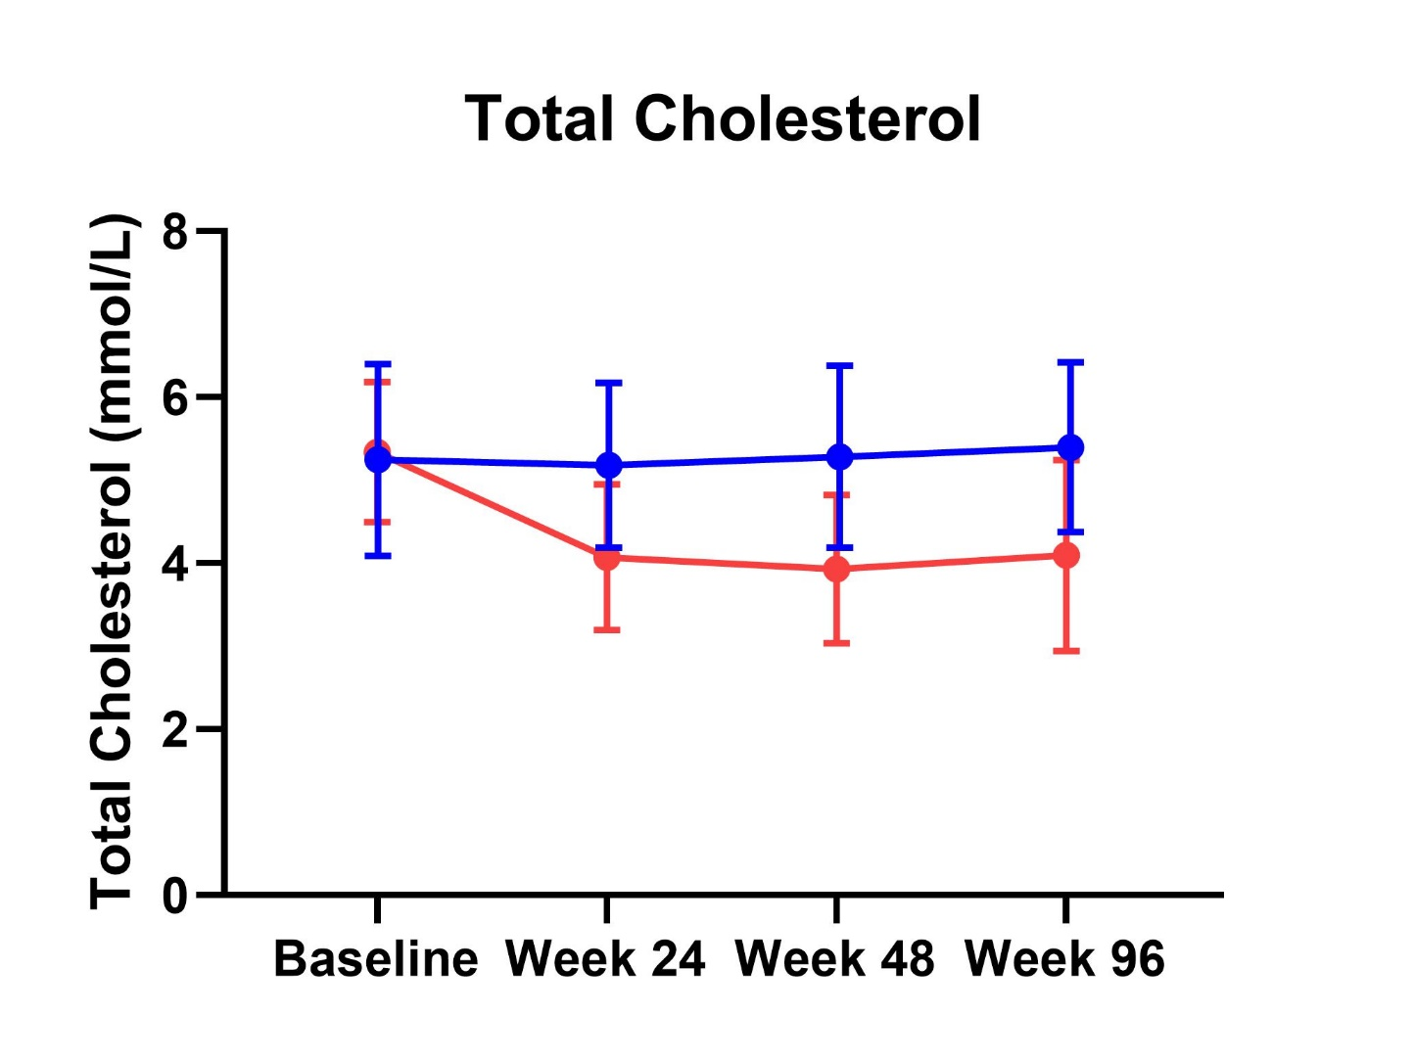
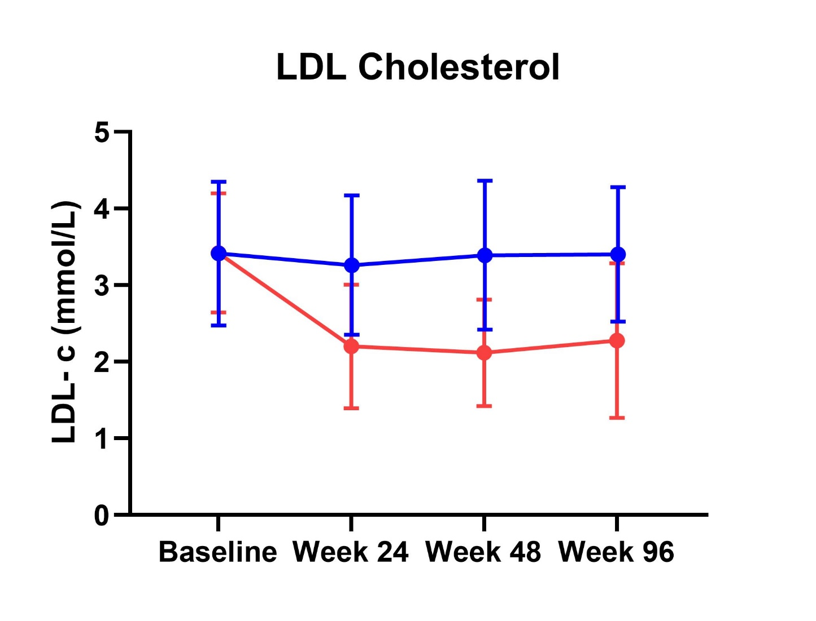
Rosuvastatin lead to predictable changes in total and LDL-cholesterol
*
*
*
*
*
*
* p-value for the difference between arms <0.001
● Placebo
● Rosuvastatin
Circular symbols = means; error bars = standard deviation

Slide 18
No difference in common carotid artery IMT progression between rosuvastatin and placebo arms
Change in cIMT between each time point
Mean common carotid IMT by arm at each time point
 | Baseline | 48 weeks | 96 weeks | P-valueª
Rosuvastatin | 0.722 (0.032) | 0.726 (0.032) | 0.726 (0.032) | 0.319
Placebo | 0.772 (0.033) | 0.771 (0.033) | 0.779 (0.033) | 0.115
P-value^{b} | 0.115 | 0.158 | 0.097
*mean (standard deviation)
ªp-value for within arm change from baseline to 96 weeks
^{b}p-value for difference between arms at each time point
Intention to treat population
● Placebo
● Rosuvastatin

Slide 19
Results were also similar when restricted to the per-protocol participant population
 | Baseline | 48 weeks | 96 weeks | P-valueª
Rosuvastatin | 0.720 (0.033) | 0.725 (0.033) | 0.723 (0.033) | 0.428
Placebo | 0.747 (0.034) | 0.746 (0.034) | 0.754 (0.034) | 0.113
P-value^{b} | 0.394 | 0.493 | 0.337
*mean (standard deviation)
ªp-value for within arm change from baseline to 96 weeks
^{b}p-value for difference between arms at each time point
Per Protocol Population
● Placebo
● Rosuvastatin
Notes:
Those participants who remained on randomised regimen and completed all three main study visits

Slide 20
This result was not altered following adjustment for age, gender and baseline Framingham risk score
Common Carotid Artery IMT by time point, adjusted for age, gender, FRS
 | Baseline | 48 weeks | 96 weeks | P-valueª
Rosuvastatin | 0.72 (0.033) | 0.724 (0.033) | 0.724 (0.033) | 0.319
Placebo | 0.773 (0.033) | 0.772 (0.033) | 0.779 (0.033) | 0.119
P-value^{b} | 0.092 | 0.129 | 0.078
*mean (standard deviation)
ªp-value for within arm change from baseline to 96 weeks
^{b}p-value for difference between arms at each time point
Intention to treat population
● Placebo
● Rosuvastatin

Slide 21
Change in cIMT from baseline at different sites
 | Change from baseline to week 48 |  |  | Change from baseline to week 96
 | Rosuvastatin | Placebo | P-value | Rosuvastatin | Placebo | P-value
Right CCA | 0 (0.008) | 0.004 (0.008) | 0.600 | -0.001 (0.008) | -0.003(0.008) | 0.406
Left CCA | 0 (0.008) | -0.002 (0.008) | 0.811 | -0.011 (0.008) | -0.006(0.009) | 0.664
Right ICA | -0.004 (0.009) | -0.007 (0.011) | 0.514 | 0 (0.009) | -0.01 (0.011) | 0.783
Left ICA | -0.018 (0.009) | -0.002 (0.012) | 0.865 | -0.016 (0.009) | -0.008 (0.011) | 0.621
Right Bulb | -0.008 (0.01) | 0.018 (0.01) | 0.076 | 0.004 (0.01) | 0.005 (0.01) | 0.189
Left Bulb | 0.01 (0.01) | -0.004 (0.01) | 0.703 | 0.006 (0.01) | -0.02 (0.01) | 0.111
*mean (standard deviation)

Slide 22
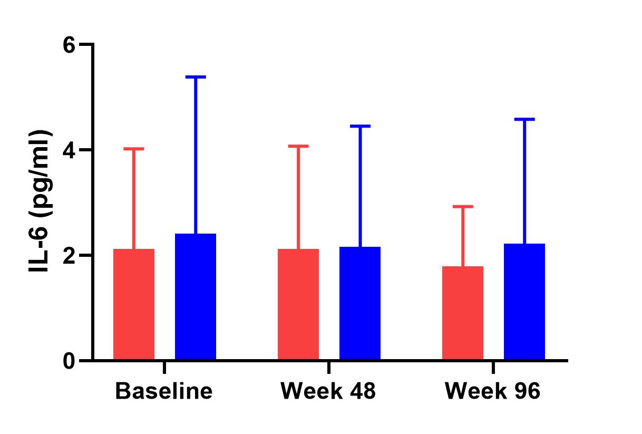
Trend towards slightly higher hsCRP with placebo, but no change in interleukin-6
hsCRP
IL-6
(p = 0.751)
(p = 0.347)
(p = 0.053)
(p = 0.427)
(p = 0.531)
(p = 0.901)
● Placebo
● Rosuvastatin

Slide 23
Adverse Events
 |  | Rosuvastatin (n=44) | Rosuvastatin (n=44) | Placebo (n=40)
Overall* – n (%) |  | 33 (75%) | 33 (75%) | 11 (27%)
Grade 4 |  | 2 (4%) | 2 (4%) | 0 (0%)
 | - Stroke
 | - Asympt. CK 9,100U/L
Grade 3 |  |  | 5 (11%) | 0 (0%)
 | - 2x AMI
 | - 2 x new T2DM
 | - Heart Failure
Grade 2 |  |  | 12 (27%) | 0 (0%)
Grade 1 |  |  | 49 (111%) | 14 (35%)
Summary of Grade 1 & 2 events
 | Total (n=84) | Rosuvastatin (n=44) | Placebo (n=40)
Myalgia | 12 (14%) | 2 (4%) | 10 (25%)
Musculoskeletal | 10 (11%) | 10 (22%) | --
Abdominal Bloating | 8 (9%) | 8 (18%) | --
Respiratory (cough/SOB) | 7 (8%) | 7 (16%) | --
Rash/Itch | 7 (8%) | 7 (16%) | --
Infections | 7 (8%) | 7 (16%) | --
CK elevations >4x ULN | 5 (6%) | 2 (4%) | 3 (7%)
ALT elevations >4x ULN | 3 (3%) | 2 (4%) | 1 (2%)
*n (%)
* Individuals with at least one adverse event

Slide 24
Participants reported high compliance with study medication
Tablets missed last 28 days | Week 48 | Week 96
0 | 51 (76%) | 39 (60%)
1 | 7 (10%) | 12 (19%)
2 | 6 (8%0 | 7 (10%)
3 | 1 (1%) | 0 (0%)
4 | 1 (1%) | 4 (6%)
5 | 0 (0%) | 1 (1%)
10 | 1 (1%) | 0 (0%)
Tablets missed last 7 days | Week 48 | Week 96
0 | 64 (95%) | 59 (92%)
1 | 1 (1%) | 4 (6%)
2 | 2 (3%) | 1 (1%)
*n (%)

Slide 25
Limitations
Small sample size
Homogeneous participant population with a significant lack of women
Surrogate endpoint may not represent true effect of rosuvastatin on clinical endpoints
cIMT progression in the placebo arm was well below anticipated

Slide 26
Conclusions
Despite predictable effects on total and LDL-cholesterol 96 weeks of rosuvastatin in PWHIV at moderate cardiovascular risk did not alter progression of atherosclerosis (as estimated by cIMT) compared with placebo
Rosuvastatin was however associated with increased incidence of side effects
Thus the benefits of statin therapy in PWHIV at low-moderate risk may not justify the potential harms
Need to await the currently running REPREIVE trial before different thresholds for the institution of primary preventative therapy in people with HIV can be recommended

Slide 27
Acknowledgments
The participants without whom this project could not have been completed
Cath Downes, Janine Roney, Kerrie Watson, Anne Mak, Donatienne Cordier, Sabine Bavamian, Rachel Spycher-Elbes, Yoana Dimitrova, Thanh Lecompte, Baris Gencer, Fabrizio Montecucco, Laura Ciaffi, Patricia Vasquez, Victoria Rollason, and The Swiss HIV Cohort Study Network.
Funders (Swiss Sites): Swiss Foundation of Cardiology, Swiss National Foundation FNRS#32003B_135745, Reuter Foundation No 519, Boninchi Foundation, Foundation Gerbex-Bourget, Clinical Research Center, University Hospital and Faculty of Medicine, Geneva
Funders (Australian Sites): National Health and Medical Research Council (APP1111626); Faculty of Medicine Monash University, Alfred Health Department of Cardiology
Janine.Trevillyan@monash.edu
@J_Trevillyan

Slide 28
Baseline Lipid levels
mean (SD) or n (%) | Rosuvastatin (n=44) | Placebo (n=40) | Normal Range
Total Cholesterol (mmol/L) | 5.5 (0.8) | 5.3 (1.1) | < 5.5
LDL-cholesterol (mmol/L) | 3.5 (0.7) | 3.5 (0.9) | < 3.5
HDL-cholesterol (mmol/L) | 1.1 (0.3) | 1.2 (0.3) | > 1.0
Triglycerides (mmol/L) | 1.9 (0.9) | 1.5 (0.7) | < 2.0
Glucose (mmol/L) | 5.2 (0.5) | 5 (0.5) | 3.8 – 7.7

Slide 29
Minimal Difference in HDL cholesterol
 | Baseline | 24 weeks | 48 weeks | 96 weeks | P-value
Rosuvastatin | 1.1 (0.043) | 1.18 (0.04) | 1.18 (0.04) | 1.19 (0.04) | 0.022
Placebo | 1.20 (0.04) | 1.16 (0.04) | 1.19 (0.04) | 1.23 (0.04) | 0.292
● Placebo
● Rosuvastatin
*mean (standard deviation)
Circular symbols = means; error bars = standard deviation

