Slide 2
Effectiveness of HIV Telehealth Training Program in Increasing the Level of Knowledge of HIV Care Personnel in the Philippines: A Pilot Study
MOPDD0204
Rod Olete, RN
Sustained Health Initiatives of the Philippines (SHIP)
@SHIP_PH
Share your thoughts on this presentation with #IAS2019

Slide 3
Disclosure
No conflict of interest

Slide 4
Introduction
PH has the fastest-growing HIV epidemic in the world
Only has 100+ HIV care facilities nationwide
Not all HIV care providers have access to trainings
203%
Increase in HIV infection since 2010
(UNAIDS 2019 Report)
4 MD, 9 RN, 4 RM, 1 MT
In 10,000 population
(Asia-Pacific Observatory on Health Systems and Policies in 2018)
55.9%
PLHIV on ART
April 2019 HARP Report
Notes:
The Philippines has the fastest-growing HIV epidemic in the world as of the latest UNAIDS report which calls for an equally aggressive response from our healthcare system yet one of the many challenges that we face is the lack HIV care providers. There are not enough health care providers in the Philippines according to the 2018 Health Systems and Policies Report for Asia-Pacific. On top of that, with only about a hundred HIV care facilities established nationwide, not all 66,000 PLHIV are linked to care immediately.
With most Infectious Diseases Specialists concentrated in major cities in the country, rural health centers are manage by non-IDS and not all of them are able to attend national HIV conferences and trainings.

Slide 5
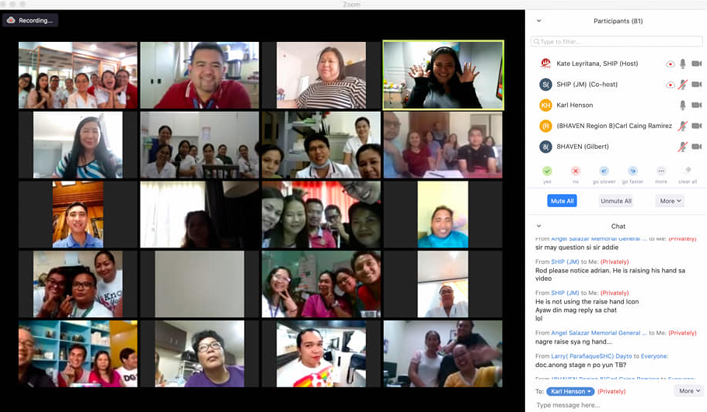
HIV Telehealth Training Program (HTTP)
Connecting HIV Experts to health personnel & non-specialists
Innovative and cost-effective approach
Piloted to 12 HIV care facilities (62 health providers)
Notes:
As a response, Sustained Health Initiatives of the Philippines (SHIP) developed HIV telehealth training program (HTTP) with the aspiration of augmenting the national efforts of DOH in curbing the HIV epidemic in the country. With the training model adapted from Viet Nam, which was patterned from the Project ECHO Model for Hepatitis in New Mexico, we contextualized this innovative method of learning and brought the Infectious Diseases Specialists at the doorsteps of rural health practitioners in the remote areas of the country—WITHOUT THE NEED TO SPEND TOO MUCH ON TRAVELING.
We piloted the program to 12 HIV care facilities with 62 health providers, 76% of them have 0-3 years of experience in HIV care.

Slide 6
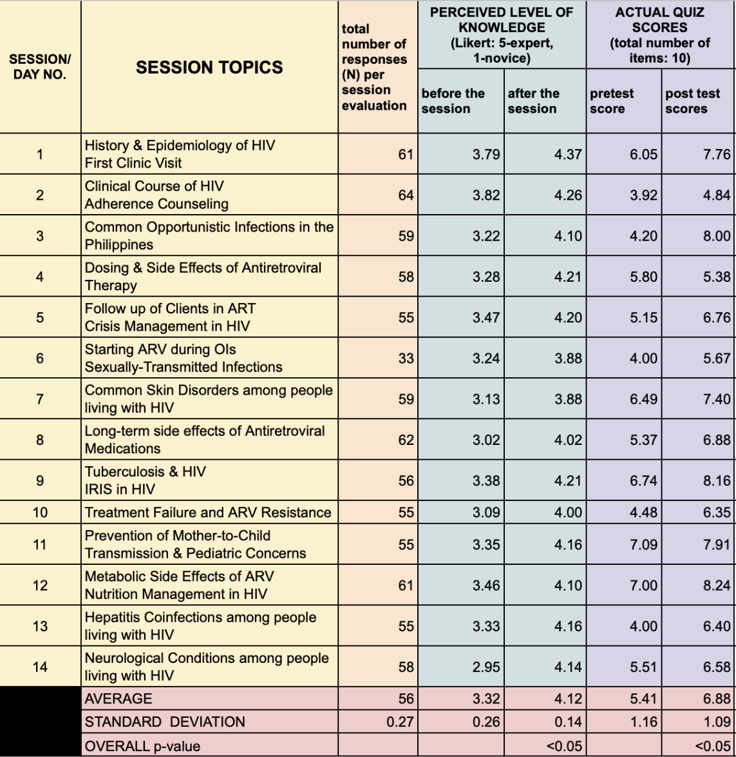
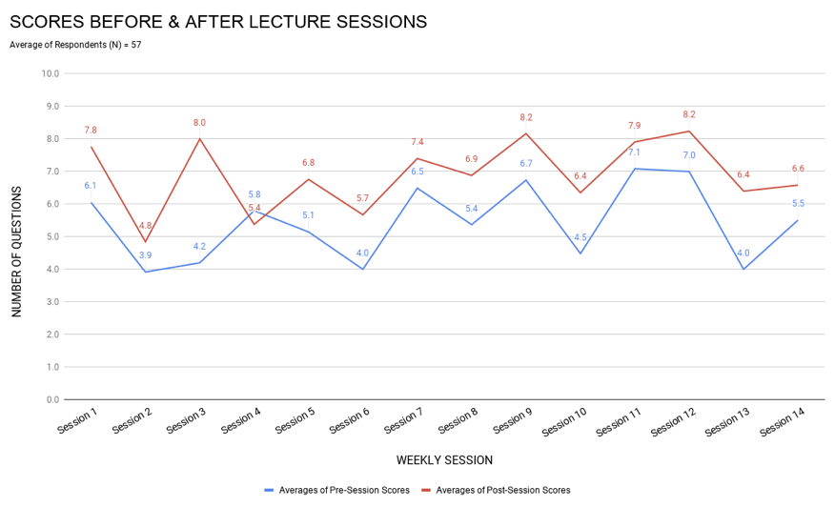
Results
Noticeable increase in pre-/post-test scores in almost all lecture sessions
Significant change in perceived level of knowledge
Notes:
The curriculum was divided into basic and advanced HIV management.
With one-hour lecture per week held every Thursday between August to November 2018, quizzes provided by each expert for every session were administered to measure the level of knowledge among the trainees. The results of the quizzes were compared to the self-perceived improvement of the participants and revealed that:
There is a noticeable increase in averages of scores in almost all of the sessions,
Evaluative survey (Likert: 5-excellent, 1-poor) shows that there is a perceived improvement in the level of knowledge among trainees, with average of response from 3.32 to 4.14 (p=<0.05);
The internet quality was rated as neither poor nor excellent (3.88/5)

Slide 7
Summary
HTTP is very practical, useful, and almost excellent in terms of overall quality based of the pilot batch’s evaluation
There is a statistically significant difference in the level of knowledge before and after the HTTP sessions (p<0.05)
HTTP also opened a long-term referral network among HIV care providers
Limitations
Internet quality may become a barrier in achieving HTTP’s maximum potential
Evaluation of knowledge application in actual practice is needed
Notes:
The self-reported evaluation results revealed that HTTP is very practical, useful, and almost excellent in terms of the overall quality. The data also shows statistically significant difference of (p=<0.05) in the level of knowledge. This pilot evaluation of HTTP reveals a promising positive impact in accessing quality learning for HIV care providers in a geographically challenging and resource-limited country such as the Philippines.
The limitations of this pilot study is primarily affected by the internet quality. In addition, there should be a monitoring mechanism to evaluate how the trainees apply the knowledge learned into actual practice.

Slide 8
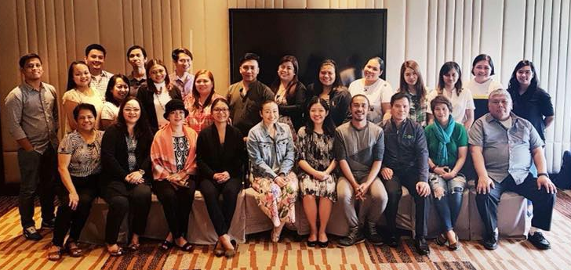
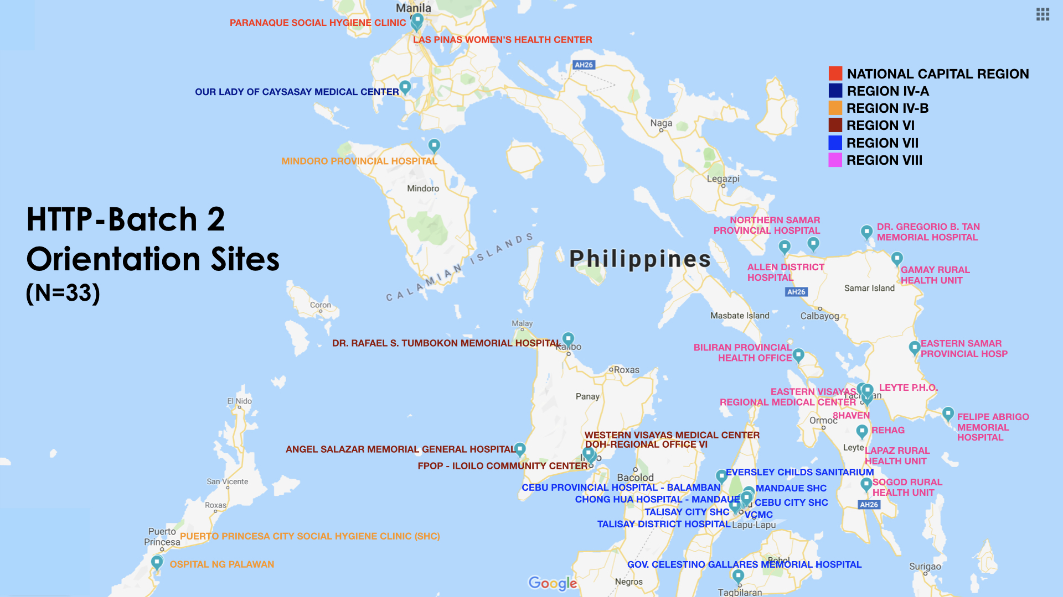
ACKNOWLEGMENT
“HTTP bridges the gap in HIV response through ICT while strengthening collaboration among HIV care providers from private institutions and local government-led facilities.”
A capacity-building program supported by:
Notes:
Nevertheless, HTTP provides potential opportunity in providing cost-effective and updated knowledge on HIV care through a collaborative linkage between HIV care experts and non-specializing health providers located in rural and remote areas in the country with the aid of innovation & technology.
Because of the promising outcome of this program, we are now in the middle of replicating the program to the second batch of healthcare providers in the central regions.
Before I end, I wish to thank the 12 health facilities who participated in the pilot program and of course, Gilead, who supported our project.

