Slide 1
Digitizing interventions: An internet based approach to reach out to the ‘hidden network of Men who have sex with Men’ in Mumbai, India
Dr Shrikala Acharya
Mumbai Districts AIDS Control Society, India

Slide 2
Background
National HIV prevention services among Key Population through Targeted Interventions through NGO/CBO
With the advent of smartphones, internet and social platforms, the dynamics of sexual activity has changed.
MSM are becoming more anonymous, hidden and inaccessible for face-to-face outreach and delivery of prevention services.
A need for alternative models of intervention to reach hidden MSM.
The internet based Enhanced Peer Outreach Approach (EPOA) was undertaken to reach out to high-risk MSM who solicit through dating apps

Slide 3
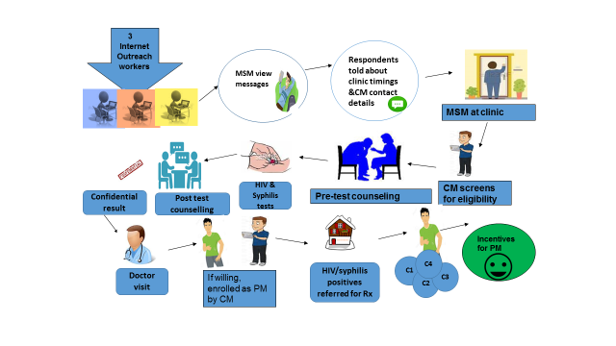
Methods
The criteria for selecting seeds & participants were highly specific.
‘Seeds’ were to have participated in MSM activity in the last month.
They should have also used the internet/social media for solicitation of the male partner in the last 3 months
240 MSM (25 seeds and 215 wave participants) were recruited using an internet-based respondent driven sampling
Information on demographics, sexual preferences and behaviours, and awareness about targeted prevention programmes was collected.
CM: Coupon Manager, PM: Peer Mobilizer, Rx: Treatment, C: Coupons given to PM

Slide 4
Results
Of the total 240 MSM included, 25 (10%) were seeds, 52 (22%) in wave one, 64 (27%) in wave 2, 33 (18%) in wave 4, 17 (7%) in wave 5, & 15 (6%) were recruited in wave 6.
Nine seeds did not recruit any additional MSM; the values ranged from 2 to 80 in the other seeds.
The mean age of MSM recruits (SD) was 23.9 (5.5) years; there was no difference in mean ages across different waves (p=0.32).
Though most MSM in seeds and initial waves were students, a higher proportion of working MSM were recruited in subsequent waves (after 3) compared with seeds (p=0.02).
None of the individuals after wave four knew about TIs; this was significantly lower compared with earlier waves (10%) (p=0.04).

Slide 5
Results
Grindr (44%) was most common source to find partners, followed by Facebook (25%) and Whatsapp (21%).
About 3% were HIV infected and 9% were reactive for syphilis.
Most of the MSM infected by syphilis were recruited by one seed (30% vs. 4%, p<0.001); there were no significant differences in HIV positivity in these two networks (2% vs. 3%, p=0.72)
VDRL reactivity in the network
HIV reactivity in the network

Slide 6
Conclusion
Digital platforms are an important choice for finding sexual partners among young men.
Internet-based EPOA is very useful to reach working MSM and those who are not enrolled for any targeted prevention programs.
Thus, these EPOAs should be a part of MSM interventions in India to reach the hidden population, where the social framework is not conducive for MSM to ‘come-out’ socially and become a part of HIV prevention programs.

Slide 7
ACKNOWLEGEMENT
FHI360-LINKAGES
Humsafar Trust
Dr Maninder Setia
Ms Priyamvada T.
Mr Amol Palkar

